Slide 1
November 2003
58th IETF Meeting
Minneapolis, Minnesota
RFC Editor Report

Slide 2

Current News
Accepting xml2nroff source files
Errata page – being modified to include anchors for each RFC entry; will allow external pages to link directly to relevant errata entry
ABNF check – ensuring correct
compilation

Slide 3
Monthly Stats
Totals Since Last IETF: July - October 2003
  Document Submissions Docs
  IESG Reviewed Submissions: 68
  Individual Submissions (accepted by RFC Editor): 25
  Total Submissions: 93
  Queue Departures Docs Pages
  DNPs/Withdrawals: 7 151
  Total Published: 86 2432
RFC Editor Queue as of October 31 , 2003
Status of Documents Docs Pages
  Pending RFC Editor Action:
  Independent Submission Review (ISR) 13 562
  Editing/Nroffing/Proofing (EDIT) 19 494
  Final Review (RFC-EDITOR) 21 779
  Pending External Action:
  Author Revisions (AUTH & AUTH48) 08 368
  IANA action needed (IANA) 23 572
  IESG action needed (IESG & TO) 25 504
  Documents with Normative Ref. Issues (REF) 39 1869
  Total Drafts in Queue 149 5148

Slide 4
Throughput
MONTH # Submitted # Published # Not Pub’d # in Queue
at month end
July 2003 27 29 2 129
August 2003 29 11 2 145
September 2003 18 31 3 129
October 2003 21 15 0 135
Total in Queue 95 86 7

Slide 5
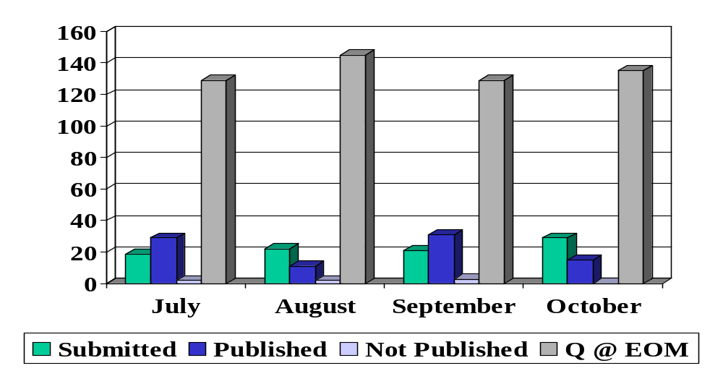
Throughput

Slide 6
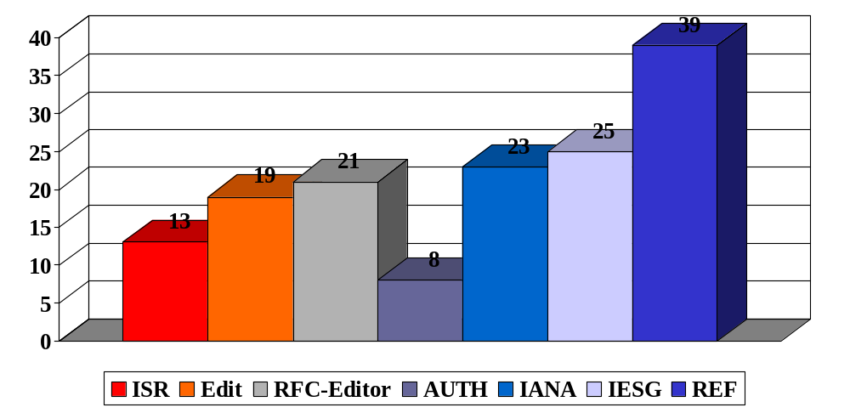
Current Queue Breakdown

