Slide 1
4 Aug 2004
60th IETF Meeting
San Diego, California
RFC Editor Report

Slide 2

Justifiable Pride
April 7, 2004: 35th anniversary of RFC 1.
RFCs were earliest online publication series.
Series currently contains over 80,000 pages.

Slide 3
Procedure Changes
New copyright/IPR rules put into practice.
  In: draft-rfc-editor-rfc2223bis-08.txt
  See: http://www.rfc-editor.org/copyright.html
  We think we have it right, now…
New IESG rules for approving independent submissions
  In: draft-iesg-rfced-documents-03.txt
  New disclaimer boilerplate.

Slide 4
Procedure Changes
Require that citations & references match.
Using automated checkers when feasible -
  MIBs, abnf, XML, XML schema.
WG chairs included in msgs to author, ADs
Public discussion list:
rfc-interest@rfc-editor.org
“Office hours” at this IETF.

Slide 5
Procedure Changes
Advisory group for RFC Editor
  “Editorial Board”
  Chosen by RFC Editor, to provide a set of wise heads with deep Internet and/or publication experience.
  To help us to serve the community better.
  Provide broader competence for review of independent submissions.

Slide 6
Current Ed Board membership (expected to grow):
Scott Bradner, Vint Cerf, Bruce Davie, Sue Hares,
Bob Hinden, John Klensin, Craig Partridge, Jim Schaad.

Slide 7
New Services
Errata pages linked from RFC search engine.
Internet Draft names in master index file
rfc-index.xml.
File of RFC bibliographic entries.
Queue page now contains hyperlinks.

Slide 8
Monthly Stats (1)
Since Last IETF: March 2004 – July 2004
  Processed Docs ~Pages
  DNPs/Withdrawals: 2 64
  Total Published: 132 3899
  Submissions Docs
  IETF Submissions: 123
  Independent Submissions 18
  Total Submissions: 141

Slide 9
Monthly Stats (2)
RFC Editor Queue as of June 30 , 2004
Status Docs Pages
  Pending RFC Editor Action:
  (EDIT) Editing/Nroffing/Proofing 50 1340
  (EDIT) + IANA 27 767
  (EDIT) + REF 30 1170
  (EDIT) + REF + IANA 5 298
  Final Review (RFC-EDITOR) 10 596
  Independent Submis. Review (ISR) 25 782
  Pending External Action:
  Author Revisions (AUTH & AUTH48 20 529
  &ISR-AUTH)
  IESG action needed (IESG & TO) 18 524
  IANA action needed (IANA) 0 0
  Docs with Norm Ref. Issues (REF) 28 1000
  Total Drafts in Queue 213 7006

Slide 10
Reminders
If your RFC was created with xml2rfc: please send us the xml file with the .txt file.
URLs
  ftp://ftp.rfc-editor.org/in-notes/IETFreports
  ftp://ftp.rfc-editor.org/in-notes/rfc-index.txt, .xml
  ftp://ftp.rfc-editor.org/in-notes/rfc-ref.txt
  http://www.rfc-editor.org/news.html

Slide 11
Work in Progress
Adding working group names into the RFC index.
    Obstacle: getting valid historic data.
Improving spam-robustness of email retrieval service (rfc-info)

Slide 12
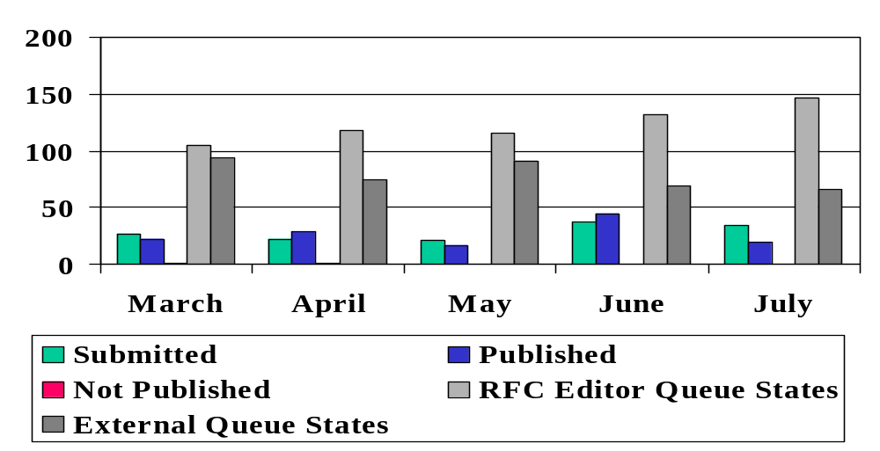
Stats by Month

Slide 13
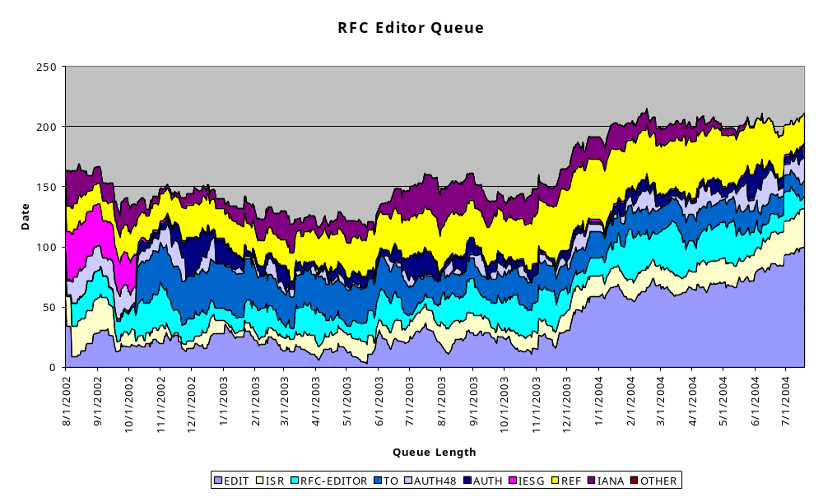
Queue – all states

Slide 14
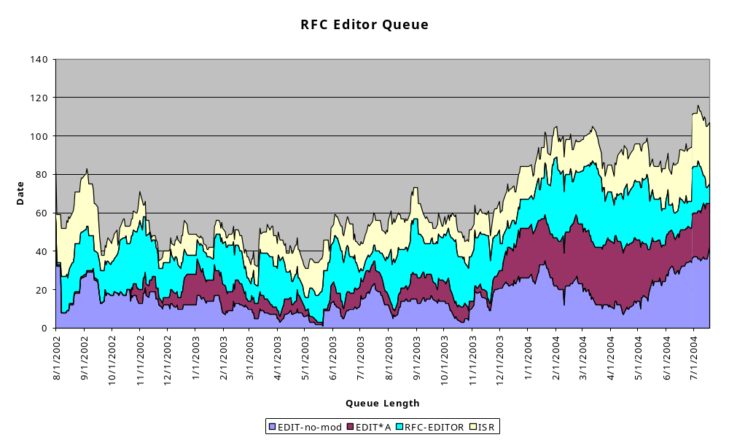
Queue – only RFCEd states

