Slide 1
March 2004
59th IETF Meeting
Seoul, Korea
RFC Editor Report

Slide 2

Current News
Errata page –modified to include anchors for each RFC entry, allowing external pages to link directly to relevant errata entry
RFC interest mailing list: used to discuss issues directly related to RFC Editor functions and procedures
  rfc-interest@rfc-editor.org

Slide 3
Policy Issues
New Copyright and IPR statements are being inserted into all RFCs; Please see our site for more information:
  http://www.rfc-editor.org/copyright.html
All references should have corresponding textual citations; also applies for the IMPORTS section in MIBs

Slide 4
IETF Reports
RFC Editor Reports are available
online at:
  ftp://ftp.rfc-editor.org/in-notes/IETFreports/

Slide 5
Monthly Stats
Totals Since Last IETF: November 2003 – February 2004
  Document Submissions Docs
  Working Group Submissions: 98
  Non Working Group Submissions 34
  Total Submissions: 132
  Queue Departures Docs ~Pages
  DNPs/Withdrawals: 4 74
  Total Published: 81 2146
RFC Editor Queue as of February 29 , 2004
Status of Documents Docs ~Pages
  Pending RFC Editor Action:
  Independent Submission Review (ISR) 15 467
  Editing/Nroffing/Proofing (EDIT) 27 594
  (EDIT) + IANA 31 1062
  (EDIT) + REF 10 397
  (EDIT) + REF + IANA 5 181
  Final Review (RFC-EDITOR) 23 1032
  Pending External Action:
  Author Revisions (AUTH & AUTH48) 12 425
  IESG action needed (IESG & TO) 20 442
  IANA action needed (IANA) 13 404
  Documents with Normative Ref. Issues (REF) 38 1167
  REF + IANA 3 241
  Total Drafts in Queue 197 6412

Slide 6
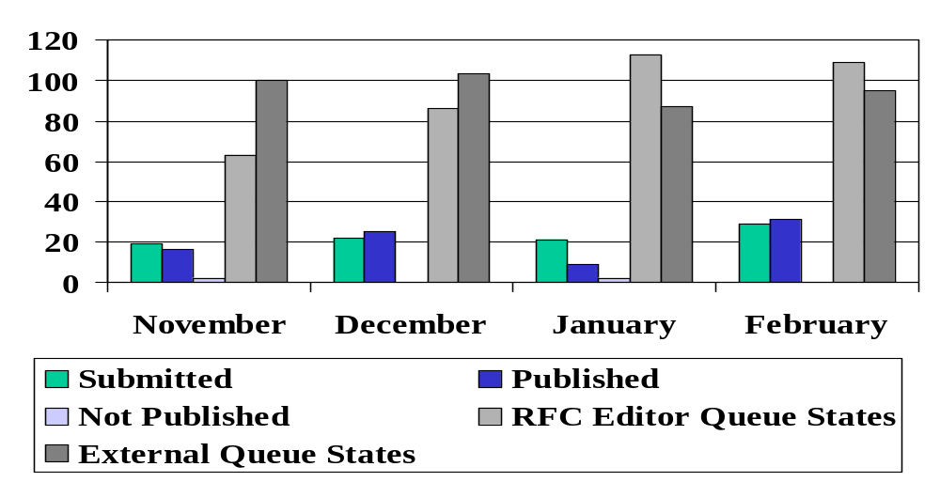
Throughput

Slide 7
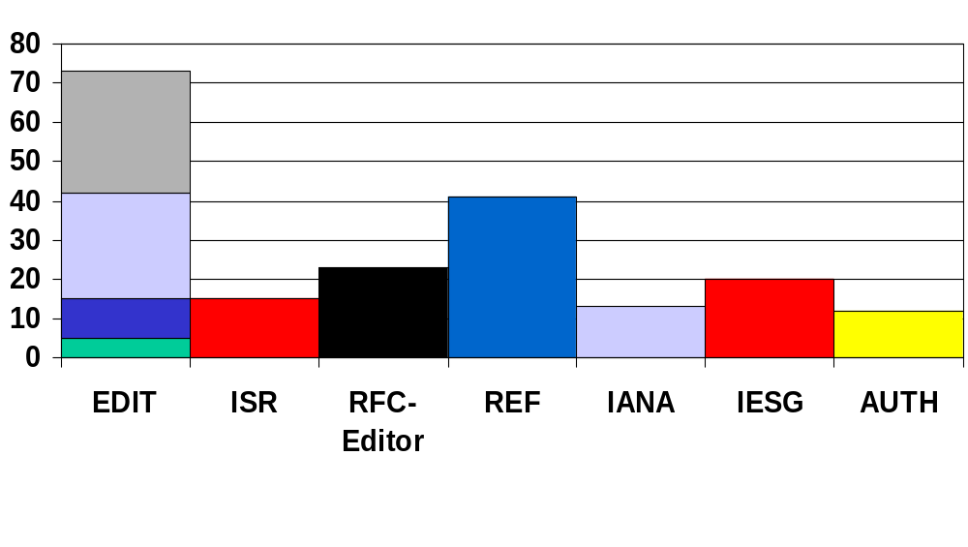
Current Queue Breakdown
Edit + IANA
Edit
Edit + Ref
Edit + Ref + IANA

