Slide 1
August 2005
63rd IETF Meeting
Paris, France
RFC Editor Report

Slide 2
Summary
Since Last IETF: March 2005 – June 2005
  Processed Docs ~Pages
  DNPs/Withdrawals: 1 8
  Total Published: 119* 2749
  Submissions Docs
  IETF Submissions: 129
  Independent Submissions: 9
  Total Submissions: 138
  *9 Expedited docs

Slide 3

Trends
Publication throughput: The trend is UP.
        Submitted/ Published/ Reported @
        Month Month
  Mar – Jul 04 28.2 26.8 IETF 60
  Aug – Oct 04 28.7 31.0 IETF 61
  Nov04–Feb05 31.2 13.8* IETF 62
  Mar – Jun 05 34.2 29.8 IETF 63
  *Holidays and staff turnover

Slide 4
Current Queue Breakdown
Count Median Max
Wks in Q Wks in Q
Editable: 169 11 25
Await Norm. Ref 60 78 135
Await author (AUTH48) 31 31 38
Await IESG 9 14 68
Await review (ISR) 22 27 57

Slide 5
General Status
Good news: We are cranking again.
Bad news: Still have a large backlog
In process: hiring additional editing staff
    (Training takes awhile)

Slide 6


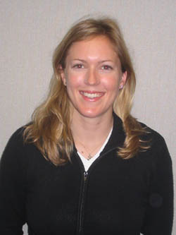

Editing Staff
Joyce Reynolds
Sandy Ginoza
Alice Hagens
Eric Nord

Slide 7
Other News
Starting to catch up on processing errata – at least 6 months behind.
New procedure to ensure that independent submission I-Ds do not expire.
No office hours this IETF, but Joyce, Aaron, and Bob are available.

Slide 8
Other News
Constantly working to:
    Improve edit and conformance tools
    Improve staff efficiency
    Clean up database
    Generate more useful and accurate reports.

Slide 9
Thank you.
  Web site: http://www.rfc-editor.org/
  Interest list: rfc-interest@rfc-editor.org

