Slide 1
November 2005
64th IETF Meeting
Vancouver, Canada
RFC Editor Report

Slide 2
Monthly Stats
Since Last IETF: July 2005 – October 2005
  Processed Docs ~Pages
  DNPs/Withdrawals: 3
  Total Published: 105* 2987
  Submissions Docs
  IETF Submissions: 97
  Independent Submissions: 2
  Total Submissions: 99
  *2 Expedited docs + 6 in AUTH48

Slide 3
Current Queue Breakdown
Count Median Wks Max Wks in State in State
Editable: 150 10 *
Await final RFC review 24 1.4 11
Await Norm. Ref 40 * *
Await author (AUTH48) 46 1.4 15
Await review (ISR) 20 20 72
Await author (ISR) 5 18 27
*: Not meaningful because of Norm Ref holds

Slide 4

Trends
Publication throughput: The trend is UP.
        Submitted/ Published/ Reported @
        Month Month
  Mar – Jul 04 28.2 26.8 IETF 60
  Aug – Oct 04 28.7 31.0 IETF 61
  Nov04–Feb05 31.2 13.8* IETF 62
  Mar – Jun 05 34.2 29.8 IETF 63
  Jul – Oct 05 24.75 26.25 IETF 64
  *Holidays and staff turnover

Slide 5
News
Collaborated on an experiment to introduce editing earlier in the IETF Process.
  Coordinated by Bert Wijnen
  Results presented at TechSpec BoF.

Slide 6
News
Rationalized treatment of Normative Reference holds.
  Norm Refs have become a major problem.
  New state: MISSREF: queue docs at submittal to RFC Editor until all their Norm Refs are also submitted.
  Queue again after editing, before final review, until all ref’d RFCs are also edited.

Slide 7
Other News
Automatic generation of publication queue http://www.rfc-editor.org/queue.html
    More info in queue about Norm Refs
Pending Errata file – lists errata we have yet to confirm and post.

Slide 8
Other News
Office Hours were held at this IETF
    Monday – Wednesday 10 – 3 pm
The RFC Editor presented its tutorial on “RFC Editor Training”.

Slide 9
Contact Info
Thank you.
  Web site: http://www.rfc-editor.org/
  Interest list: rfc-interest@rfc-editor.org

Slide 10
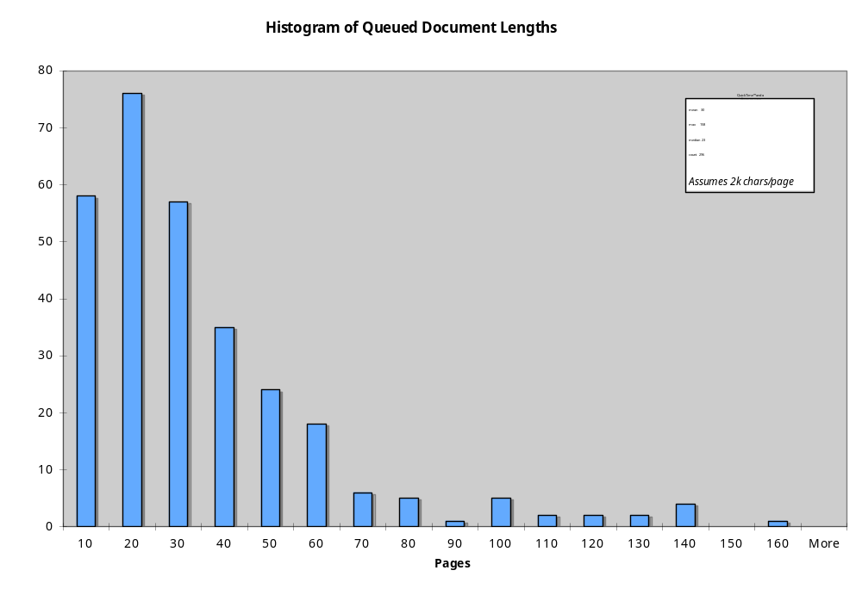

Slide 11
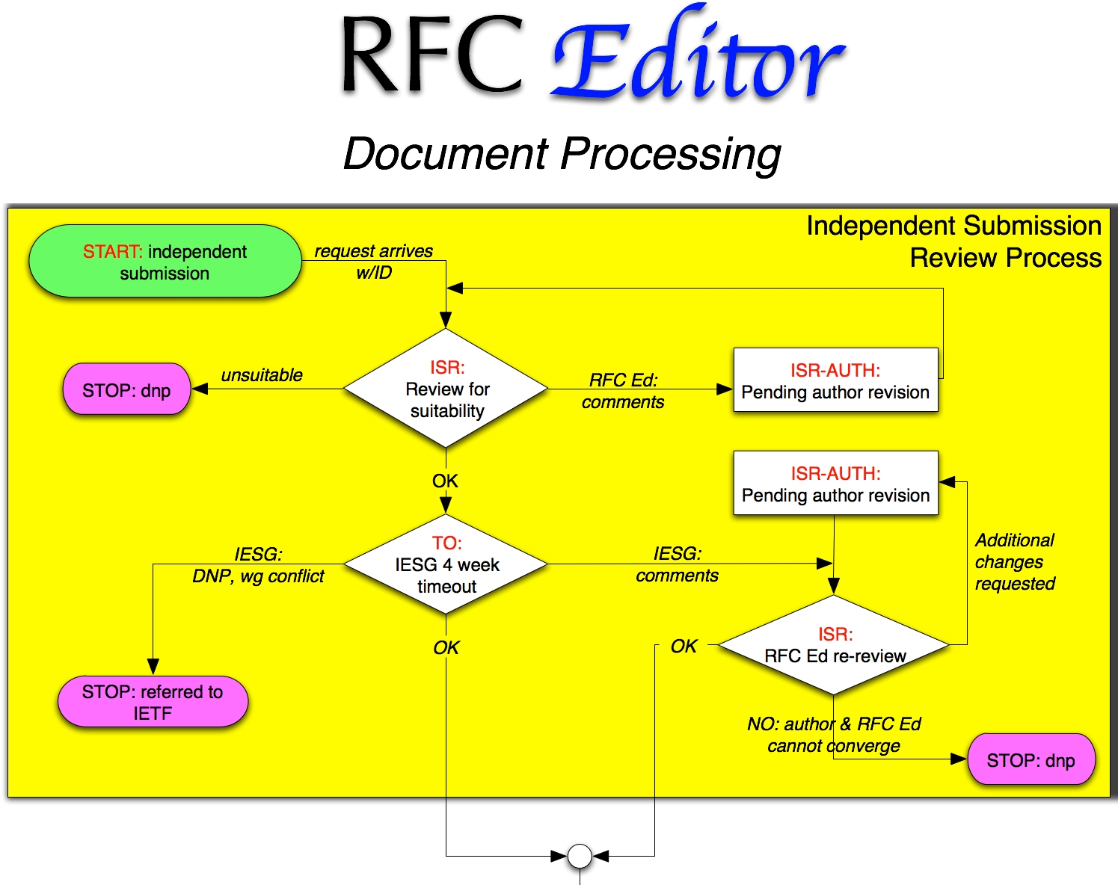
Process Flow Chart

Slide 12
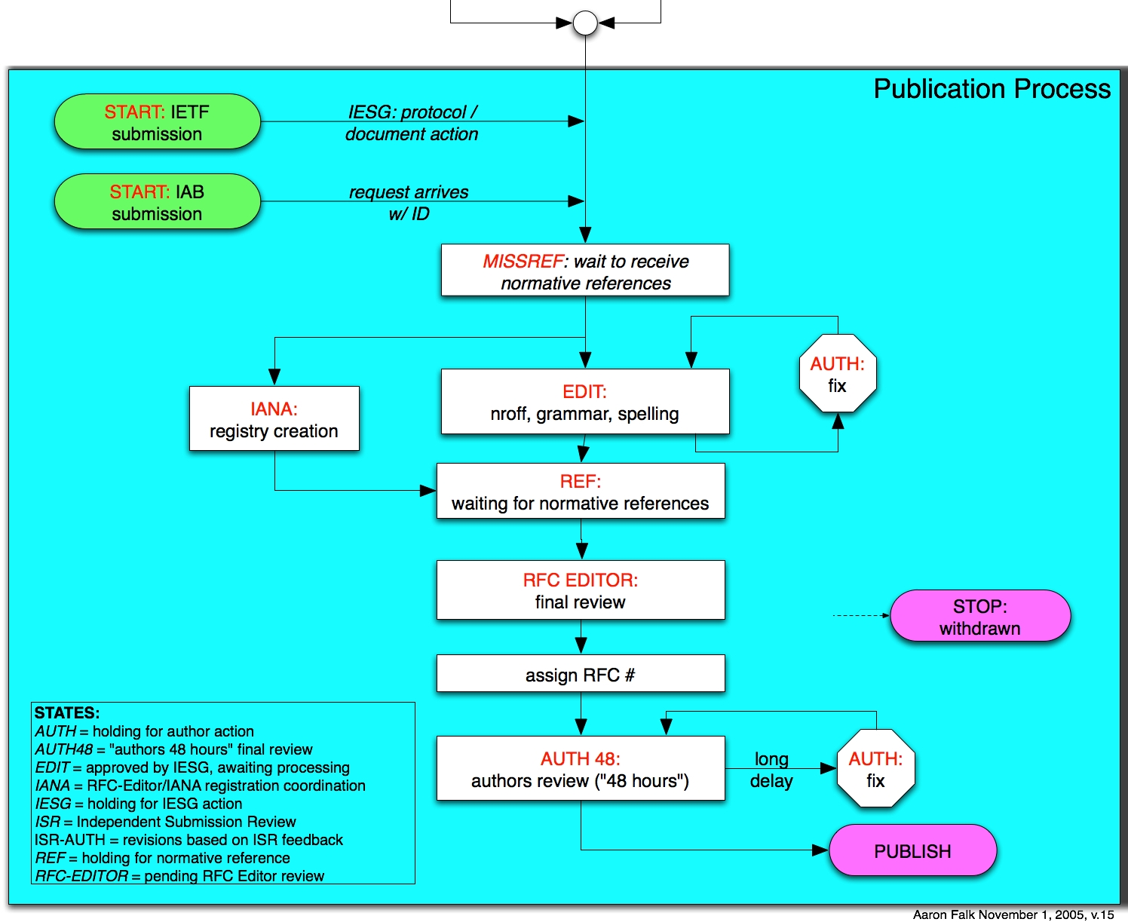
Process Flow Chart

