Slide 1
March 2006
65th IETF Meeting
Dallas, Texas
RFC Editor Report

Slide 2
The Main Story
The RFC Editor has made significant progress towards reducing the publication backlog reported in the past several IETF meetings.
At current rates, backlog will be completely gone before June 2006.

Slide 3
4-Month Summary
November 2005 – February 2006
  Processed Docs ~Pages
  DNPs/Withdrawals: 3
  Total Published: 180* 4577
  *vs. 102 in preceding 4-month period
  Submissions Docs
  IETF Submissions: 121
  Independent Submissions: 7
  Total Submissions: 128

Slide 4

Publication Rate
4-month Submitted/ Published/ Reported @
Period Month Month
  Nov04–Feb05 31.2 13.8 IETF 62
  Mar – Jun 05 34.2 29.8 IETF 63
  Jul – Oct 05 24.8 26.2 IETF 64
  Nov 05-Feb 06 32.5 45.8 IETF 65

Slide 5
Current Queue Breakdown
Count Median Wks Max Wks in State in State
Editable: 99 5.5 # *
Await final RFC review: 25 3.6 11
Await Norm. Ref(s): 43 * *
Await author (AUTH48): 30 3 15
# : Was 10 weeks at IETF 64
*: Not meaningful because of Norm Ref holds

Slide 6
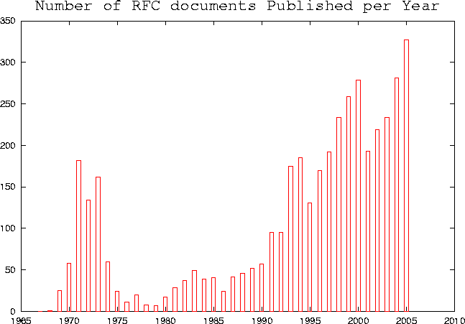
Annual Publication Rate
2003: 235
2004: 281
2005: 327

Slide 7
Other Progress
Automated emails now sent to notify authors of RFC State changes.
XML2RFC
  Using xml2rfc as much as practical in editing RFCs.
  Aim: use XML version for all editing and AUTH48 processing.
  Working with xml2rfc community to make this possible.

Slide 8
Thank you.
  Web site: http://www.rfc-editor.org/
  Interest list: rfc-interest@rfc-editor.org

Slide 9
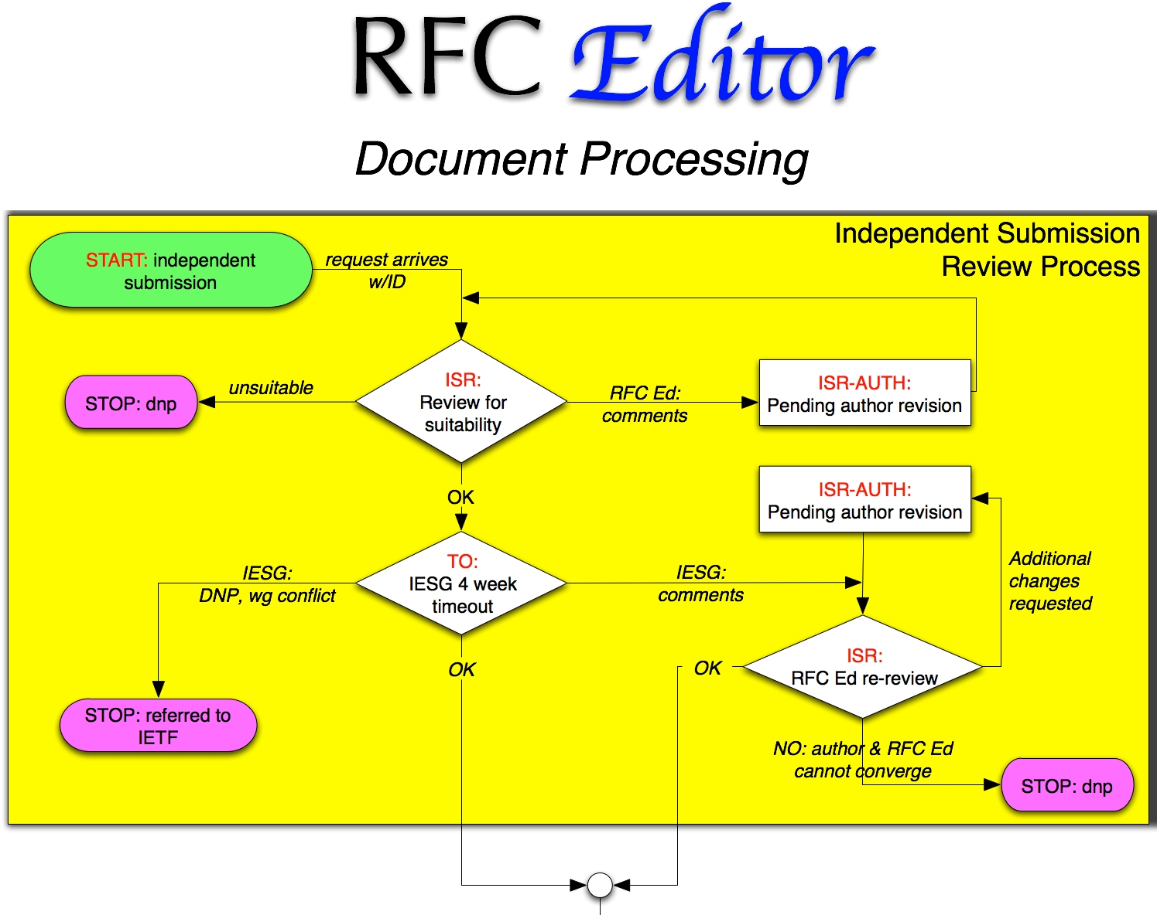
Process Flow Chart

Slide 10
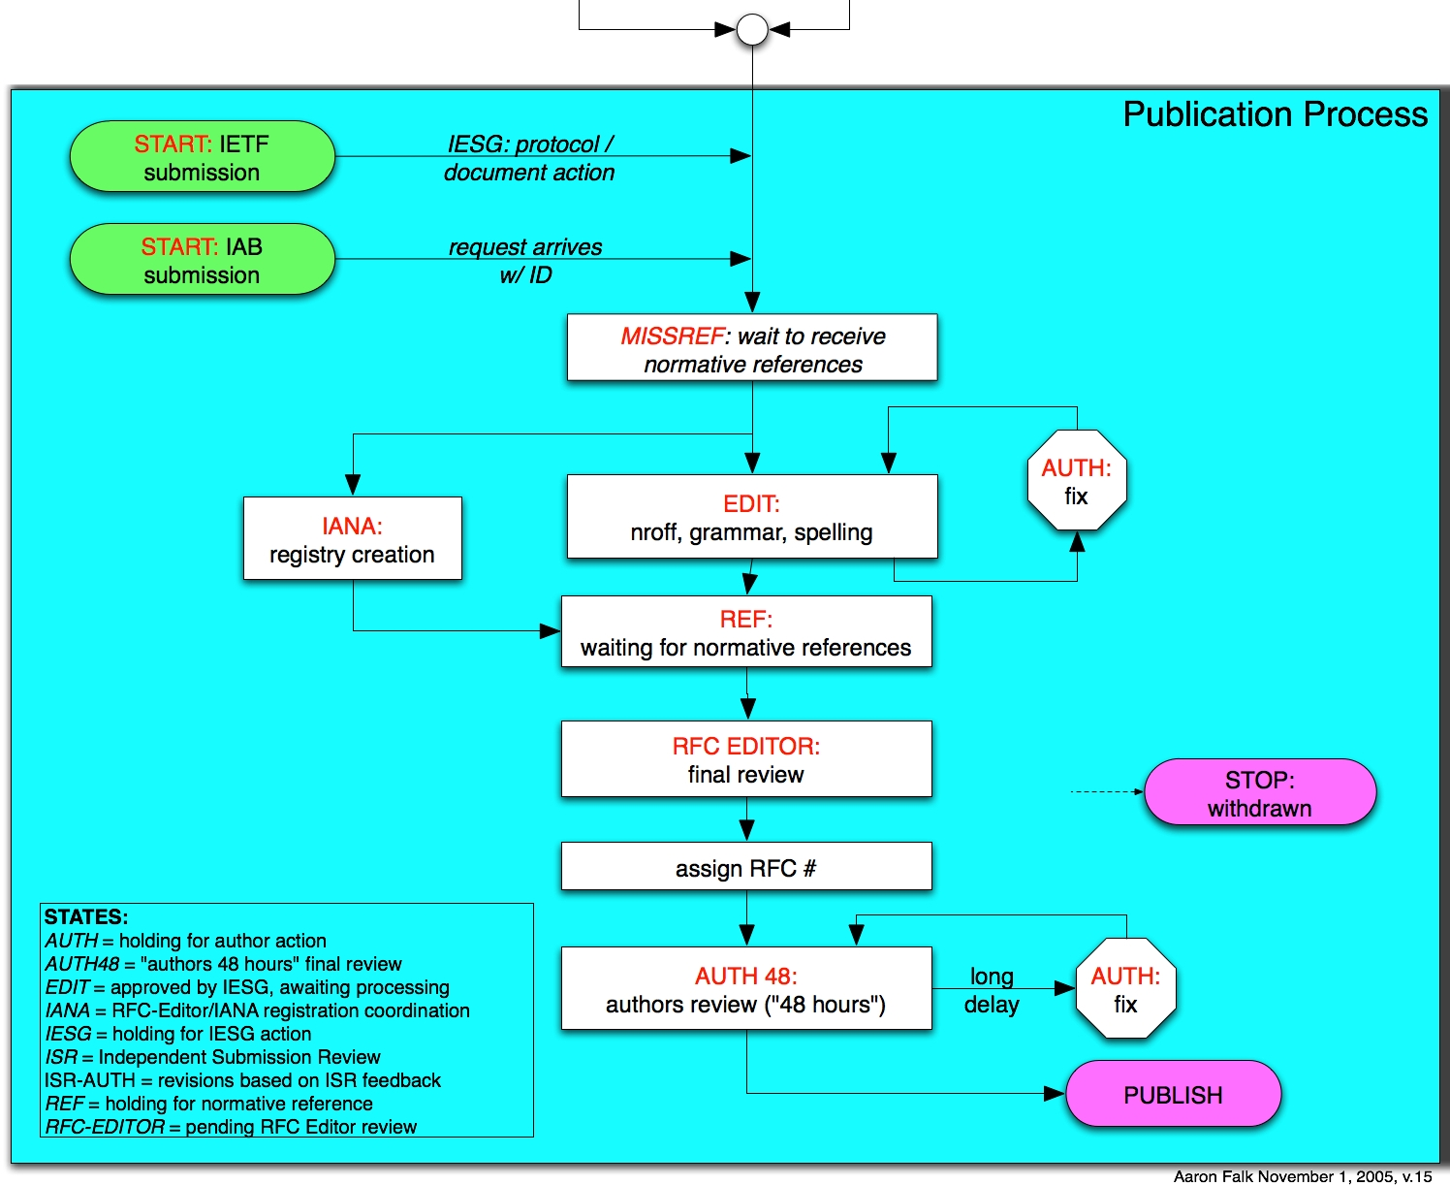
Process Flow Chart

Slide 11
