Slide 1
July 2006
66th IETF Meeting
Montreal, Canada
RFC Editor Report

Slide 2
4-Month Summary
March 2006 – June 2006
  Processed Docs ~Pages
  DNPs/Withdrawals: 2
  Total Published: 158 4557
  Submissions Docs
  IETF WG Submissions: 89
  IETF Individual Submissions: 27
  Independent Submissions: 9
  Total Submissions: 125

Slide 3

Publication Rate
4-month Submitted/ Published/ Reported @
Period Month Month
  Nov04–Feb05 31.2 13.8 IETF 62
  Mar – Jun 05 34.2 29.8 IETF 63
  Jul – Oct 05 24.8 26.2 IETF 64
  Nov 05-Feb 06 32.5 45.8 IETF 65
  Mar – Jun 06 31.25 39.5 IETF 66

Slide 4
Current Queue Breakdown
Count Median Wks Max Wks in State in State
Editable: 66 4.3 # *
Await final RFC review: 28 2.1 9.5
Await Norm. Ref(s): 36 * *
Await author (AUTH48): 34 2.6 12.1
# : Was 10 weeks at IETF 64
Was 5.5 weeks at IETF 65
*: Not meaningful because of Norm Ref holds

Slide 5
Annual Publication Rate
Annual Publication Rate
- 2003: 235
- 2004: 281
- 2005: 327
- 2006*: 256
*January 1- June 30, 2006

Slide 6
Early Copy-Editing Experiment
3 of 6 documents edited during Sept. and Oct. 2005 have entered the RFC Editor queue
1 of those 3 has been published as an RFC
In general, there are a few pages of added text and a few pages of deleted text between the early edit version and approved version.
Second reading yields edits to old text and new text.
More benefit during AUTH48 than regular EDIT (based on one AUTH48 so far).

Slide 7
Early Copy-Editing Experiment
# | Document | Pages | Early Edit Changes | Regular EDIT Changes | AUTH48 Changes | State as of 6/26/06
1 | draft-ietf-secsh-publickey-subsystem-04 | 18 | Few | NA | NA | not in I-D tracker
2 | draft-ietf-aaa-diameter-sip-app-08 (12) | 79 (79) | Lots | Moderate | NA | EDIT
3 | draft-ietf-sip-gruu-05 | 41 | Lots | NA | NA | AD is watching
4 | draft-ietf-mobike-protocol-03 (08) | 30 (38) | Few | Moderate | Few | Published (RFC 4555)
5 | draft-ietf-adslmib-adsl2-03 (08) | 160 (166) | Few | Not yet edited | NA | EDIT*A (IESG state until 6/26/06)
6 | draft-ietf-v6ops-natpt-to-exprmntl-02 | 26 | Moderate | NA | NA | AD evaluation

Slide 8
Other Progress
AUTH48
  Improved timeliness in author responses.
IESG use of RFC Editor Notes
  Special instructions to the RFC Editor are getting excessive; they should be used for minor changes.
  More efficient to approve the updated document.
  Make sure notes are appended to document actions.

Slide 9
Thank you.
  Web site: http://www.rfc-editor.org/
  Interest list: rfc-interest@rfc-editor.org

Slide 10
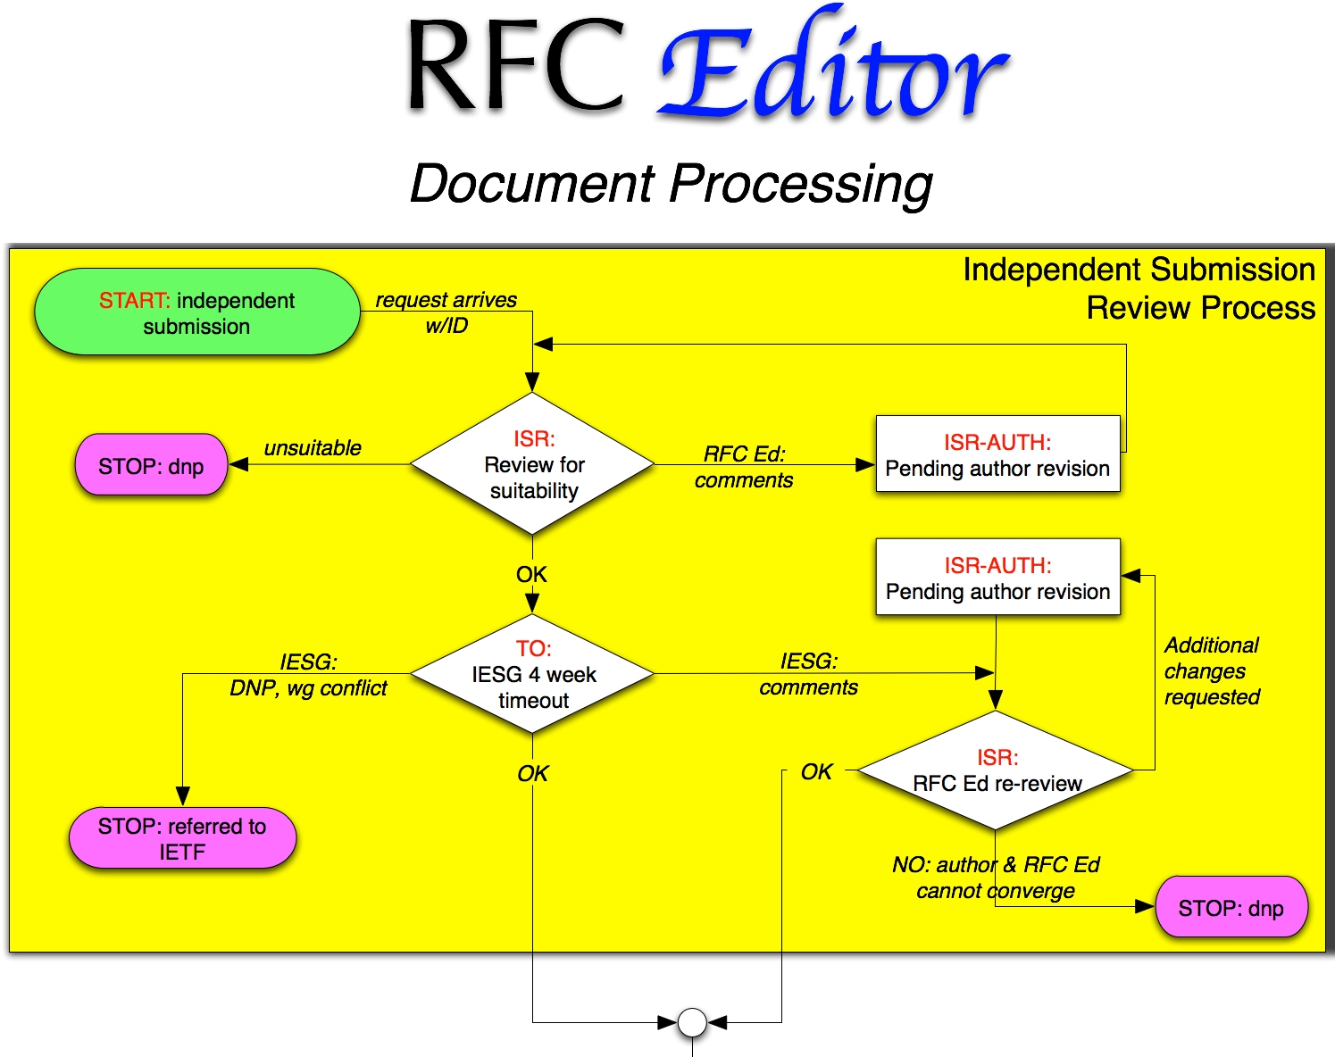
Process Flow Chart

Slide 11
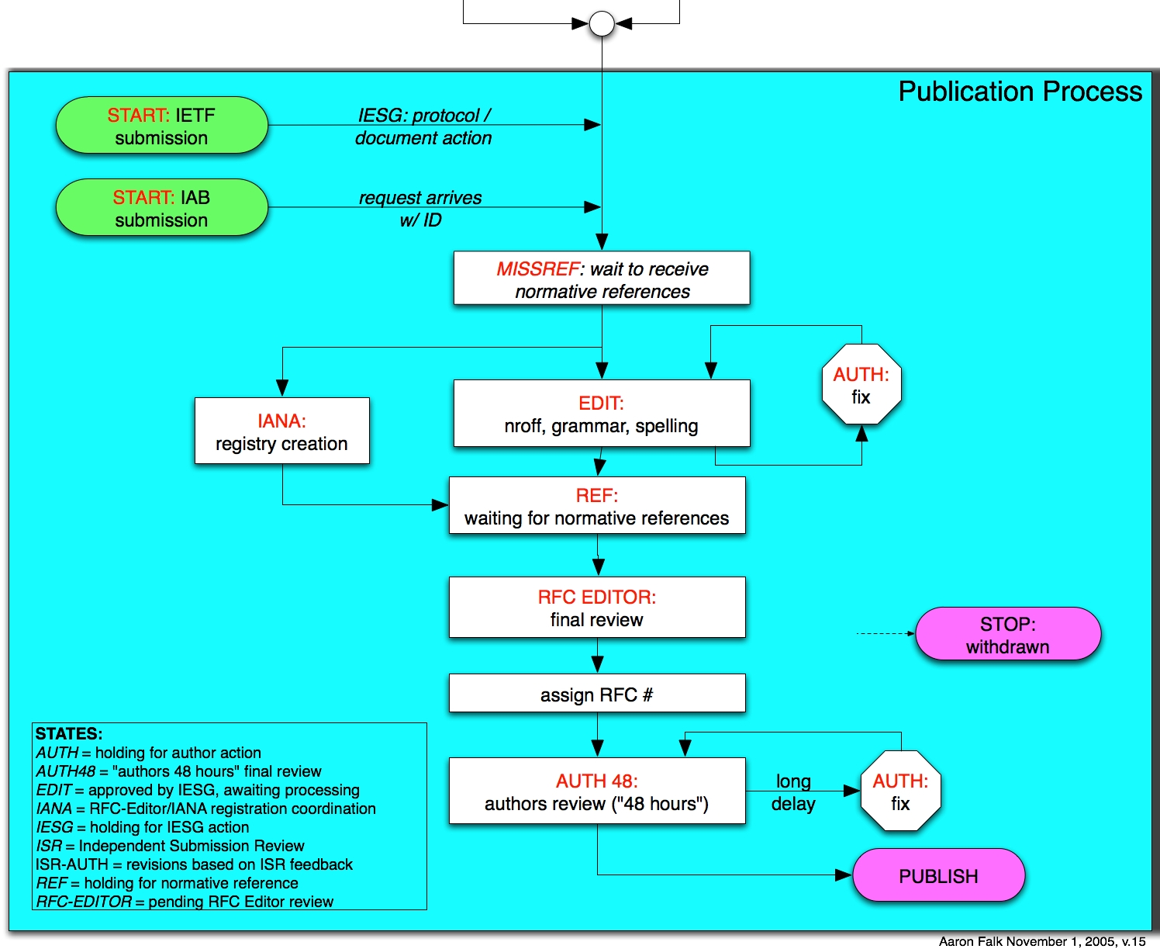
Process Flow Chart

Slide 12
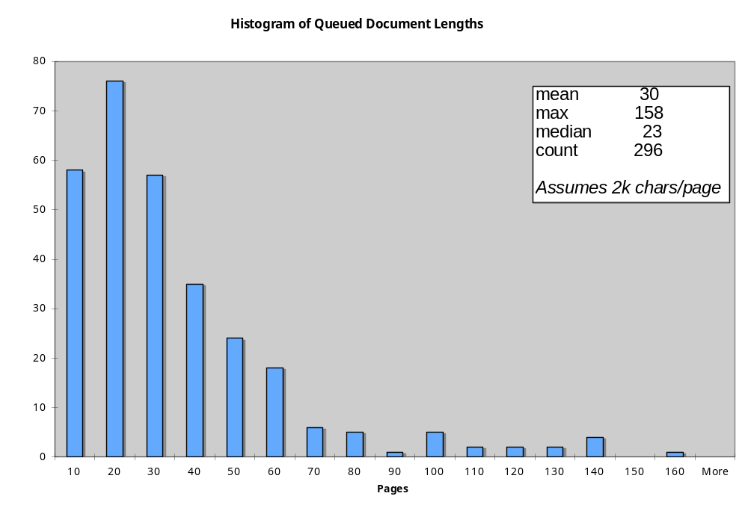

Slide 13
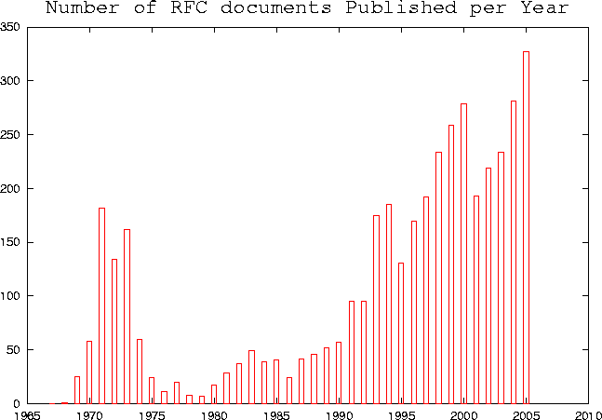
Annual Publication Rate
2003: 235
2004: 281
2005: 327
2006*: 256
*January 1- June 30
2006

Slide 14
Monthly Queue Stats
Monthly RFC Editor Statistics
2006
Jun
2006
May
2006
Apr
2006
Mar
2006
Feb
2006
Jan
* Total submitted
22
30
10
63
36
43
[ New Arrivals: Standards Track ]
- Working Group
7
10
4
41
21
19
- Non Working Group
3
5
1
3
3
3
[ New Arrivals: Informational and Experimental ]
- Working Group
3
9
1
14
7
14
- Non Working Group
9
6
4
5
5
7
* Total published
54
37
43
25
49
55
[ Standards Track ]
- Working Group
32
16
19
12
25
28
- Working Group DNPs/ Withdrawls
0
0
0
0
0
2
- Non Working Group
9
4
3
3
3
2
- Non Working Group DNPs/ Withdrawls
0
0
0
0
0
0
[ Informational and Experimental ]
- Working Group
3
12
8
7
12
11
- Working Group DNPs/ Withdrawls
0
0
0
0
0
0
- Non Working Group
9
5
12
3
9
12
- Non Working Group DNPs/ Withdrawls
1
0
1
0
0
0
* Remaining at the End of this month
179
211
218
251
213
226

