Slide 1
November 2006
67th IETF Meeting
San Diego, California
RFC Editor Report

Slide 2

News
After some 20+ years of service to the Internet Community, Joyce Reynolds has decided to pursue other opportunities.
We are publishing documents with the “IETF Trust” copyright as of November 1, 2006.

Slide 3
3-Month Summary
July 2006 – September 2006
  Processed Docs
  DNPs/Withdrawals: 0
  Total Published: 100
  Submissions Docs
  IETF Submissions: 51
  IAB Submissions: 2
  Individual Submissions: 15
  Independent Submissions: 3
  Total Submissions: 71

Slide 4
Publication Rate
4-month Submitted/ Published/ Reported @
Period Month Month
  Mar – Jun 05 34.2 29.8 IETF 63
  Jul – Oct 05 24.8 26.2 IETF 64
  Nov 05-Feb 06 32.5 45.8 IETF 65
  Mar – Jun 06 31.25 39.5 IETF 66
  July – Sep 06 23.67 33.33 IETF 67

Slide 5
Current Queue Breakdown
Count Median Wks Max Wks in State in State
Editable: 26 1.1 # *
Await final RFC review: 9 2.1 9.4
Await Norm. Ref(s): 27 * *
Await author (AUTH48): 39 3.1 14.2
# : Was 5.5 weeks at IETF 65
Was 4.3 weeks at IETF 66
*: Not meaningful because of Norm Ref holds

Slide 6
Annual Publication Rate
Annual Publication Rate
- 2003: 235
- 2004: 281
- 2005: 327
- 2006*: 362
*January 1- September 30, 2006

Slide 7
Early Copy-Editing Experiment
2 of 6 documents edited a year ago have not yet entered the RFC Editor queue.
1 of 6 has been published as an RFC.
On average, there are 4.5 versions between the early edit version and the approved version.
We are still evaluating the effectiveness of early editing and how it could be improved.
We are improving the training of copy editors.

Slide 8
Early Copy-Editing Experiment
# | Document | Pages | Early Edit Changes | Regular EDIT Changes | AUTH48 Changes | State as of 10/24/06
1 | draft-ietf-secsh-publickey-subsystem-04 (08) | 18 (21) | Few | Few | NA | EDIT*A
2 | draft-ietf-aaa-diameter-sip-app-08 (12) | 79 (79) | Lots | Moderate | NA | RFC-EDITOR
3 | draft-ietf-sip-gruu-05 | 41 | Lots | NA | NA | AD is watching
4 | draft-ietf-mobike-protocol-03 (08) | 30 (38) | Few | Moderate | Few | Published (RFC 4555)
5 | draft-ietf-adslmib-adsl2-03 (08) | 160 (166) | Few | Moderate | Few | AUTH48 (RFC 4706)
6 | draft-ietf-v6ops-natpt-to-exprmntl-02 | 26 | Moderate | NA | NA | Publication Requested :: Revised ID Needed

Slide 9
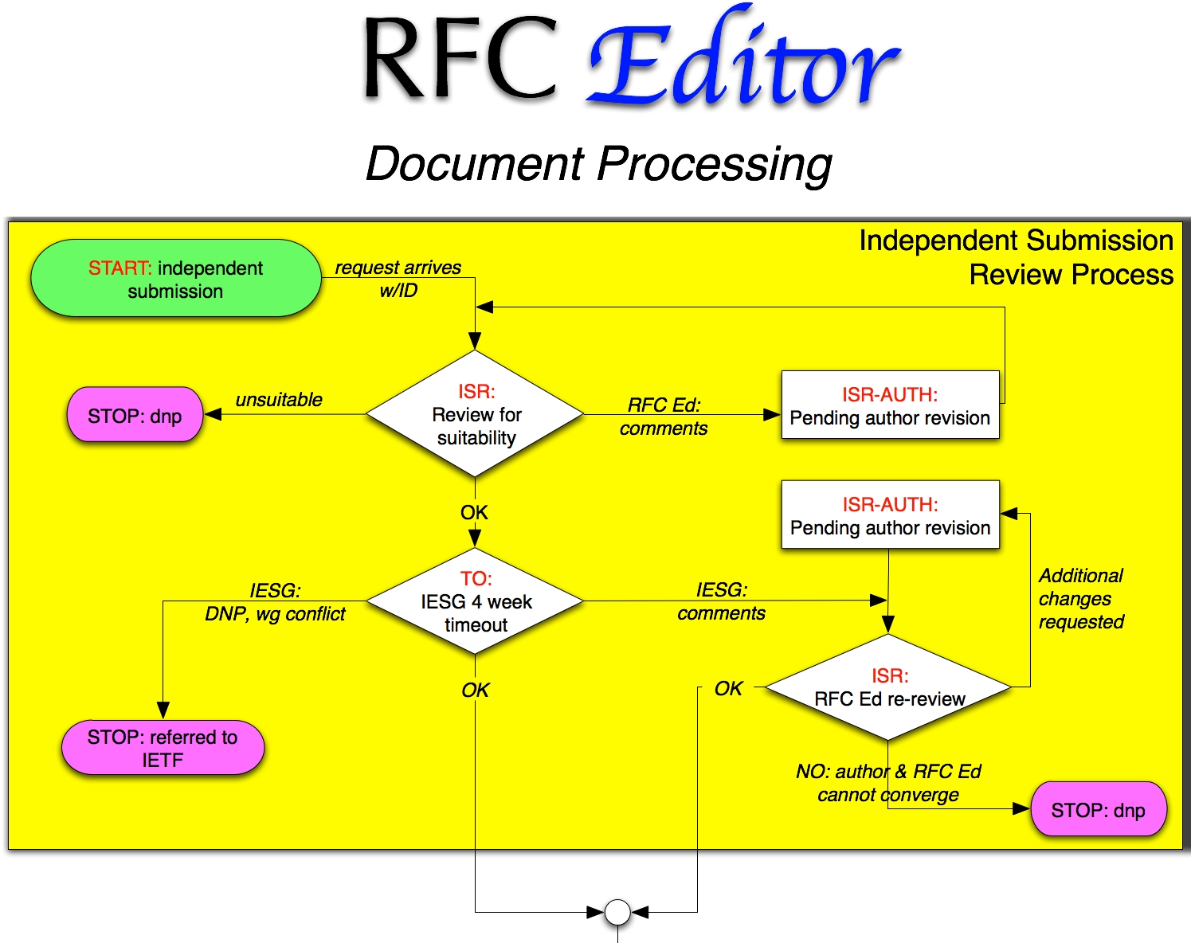
Process Flow Chart

Slide 10
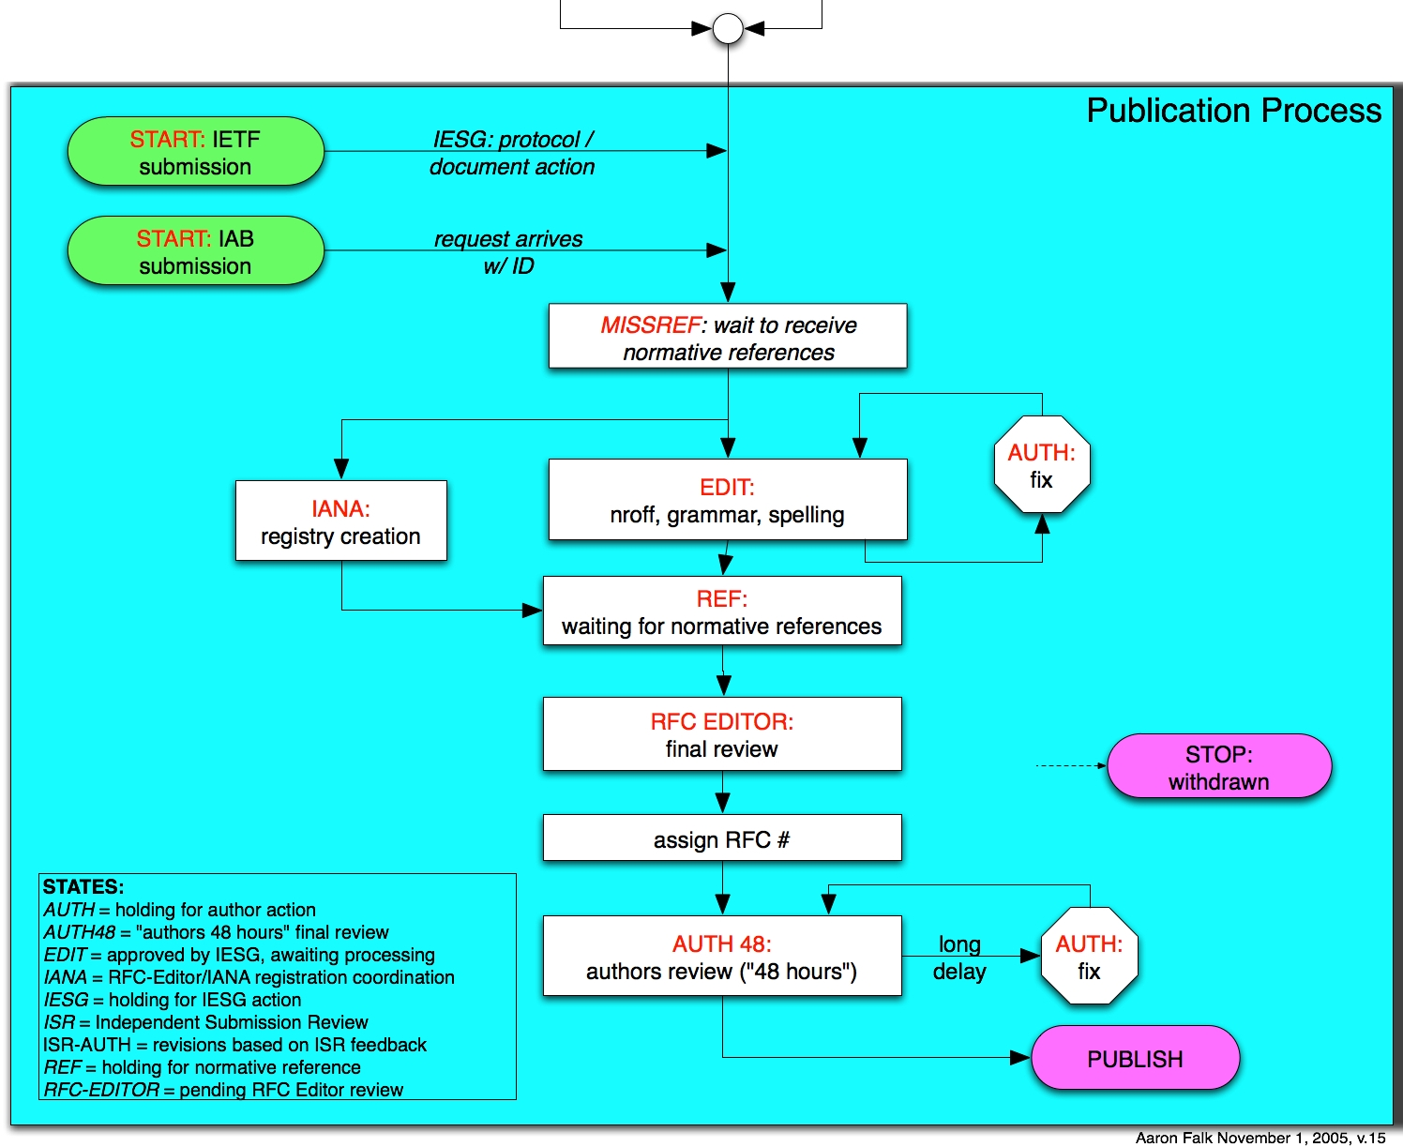
Process Flow Chart

Slide 11
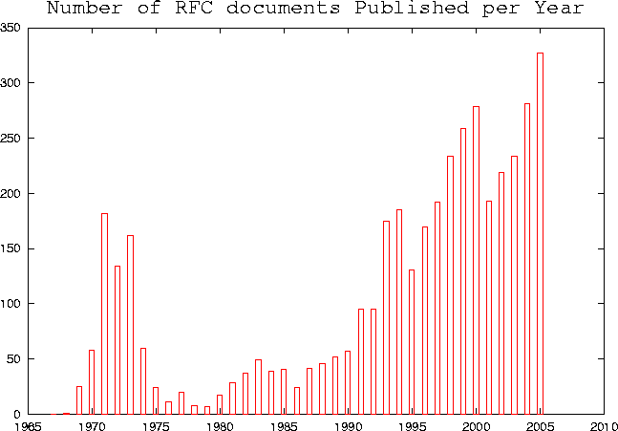
Annual Publication Rate
2003: 235
2004: 281
2005: 327
2006*: 362
*January 1- September 30,
2006

Slide 12
Monthly RFC Editor Statistics
2006
Sep
2006
Aug
2006
Jul
2006
Jun
2006
May
2006
Apr
* Total submitted
25
21
25
22
30
10
[ New Arrivals: Standards Track ]
- Working Group
12
10
10
7
10
4
- Non Working Group
0
2
0
3
5
1
[ New Arrivals: Informational and Experimental ]
- Working Group
6
3
10
3
9
1
- Non Working Group
7
6
5
9
6
4
* Total published
35
35
30
54
37
43
[ Standards Track ]
- Working Group
14
17
18
32
16
19
- Working Group DNPs/ Withdrawls
0
0
0
0
0
0
- Non Working Group
1
1
1
9
4
3
- Non Working Group DNPs/ Withdrawls
0
0
0
0
0
0
[ Informational and Experimental ]
- Working Group
14
15
6
3
12
8
- Working Group DNPs/ Withdrawls
0
0
0
0
0
0
- Non Working Group
5
2
5
9
5
12
- Non Working Group DNPs/ Withdrawls
0
0
1
0
1
* Remaining at the End of this month
150
160
174
179
211
218
All monthly stats are available from www.rfc-editor.org/queue-stats

Slide 13
Thank you.
  Web site: http://www.rfc-editor.org/
  Interest list: rfc-interest@rfc-editor.org

