Slide 1
The RFC Editor --
“How to Write an RFC”
A Tutorial
IETF-62
Minneapolis, MN, USA
March 2005

Slide 2
Goals of this Tutorial
  Introduce newcomers to RFCs, the RFC process, and the RFC Editor.
  Hints for old hands.
    Improve quality of documents
    Hasten publication
  Review some important editorial policies and formatting rules: Gotchas.

Slide 3
Grateful acknowledgment: Avri Doria’s slides from IETF 61 were our starting point.
No time to explain everything in detail
See especially, RFC Editor web site:
http://www.rfc-editor.org

Slide 4
Overview of this Tutorial
Background: The RFC Editor
Overview of the Publication Process
What is in an RFC?
How to Write an RFC
Some Persistent Issues

Slide 5
Background
A (very short) history lesson
  The RFC series
  Jon Postel, The RFC Editor 1970-1988
The RFC Editor today
The RFC Series today
  Relation to the IETF
  Independent submissions

Slide 6
Historical Context
Short chronology of Internet technology:
  1969-1983: ARPAnet protocol development
    NCP, Telnet, FTP, SMTP
  1975-1985: Internet protocol development
    IP, TCP, RIP, ARP, DNS, …
  1985-1990: NSFnet – academic service
  1991-today: Commercial Internet
    HTTP protocol

Slide 7
RFC Document Series
Begun by Steve Crocker [RFC 3] & Jon Postel in 1969
Working drafts and notes, to coordinate ARPAnet research.
  Literally: “requests for comments”
  Informal memos, technical specs, and much more.
1969 – today: series is 36 years old.

Slide 8
The RFC Series
Earliest document series to be published online.
3900+ documents.
An ARCHIVAL series: RFCs are forever!
A nearly-complete record of Internet technical history.
Exception: Internet Experimental Notes (IENs) 1977-1982
  Early development of TCP/IP, Internet architecture.
  Learned that separate series was a Bad Idea, went back to one (RFC) document series.

Slide 9
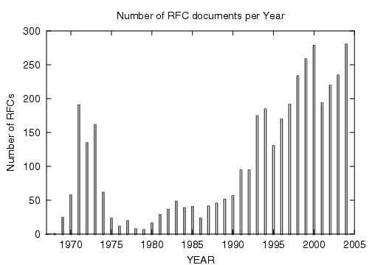
RFC Publication Rate

Slide 10
RFC Editor
Jon Postel quickly became the RFC Editor.
  28 years: 1970 until his death in 1998.
  Postel had an enormous influence on the developing ARPAnet & Internet protocols – known as the “Protocol Czar” and the “Deputy Internet Architect”.
  He established and maintained the consistent style and editorial quality of the RFC series.
  Jon was a 2-finger typist.

Slide 11
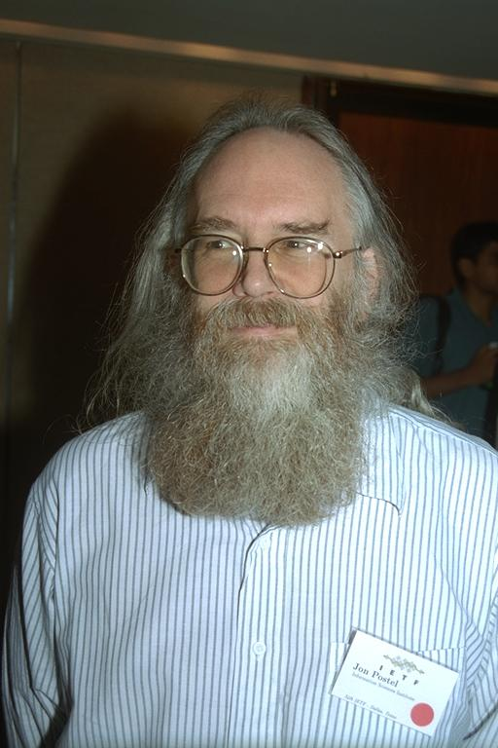
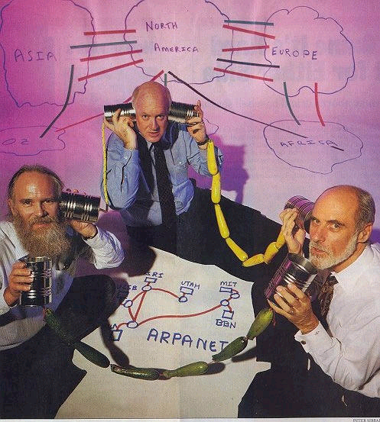
Jon Postel
Newsweek Aug 8, 1994
Photo by Peter Lothberg – IETF34 Aug 1995

Slide 12
Jon Postel’s Playful Side
April 1 RFCs
  A little humorous self-parody is a good thing…
  Most, but not all, April 1 RFCs are satirical documents.
    We expect you can tell the difference ;-)
April 1 submissions are reviewed for cleverness, humor, and topical relation to IETF themes.
  Avian Carriers is famous [RFC 1149]
  The Evil Bit is my favorite [RFC 3514]

Slide 13
As the ARPAnet/Internet went from research to production to commercial, the technical community served by the RFC Editor morphed and grew.
  The IAB created the IETF [1985]
  The standards process crystallized.
  The IETF ate its parent and reorganized [Kobe 1992].
Through these events, the RFC Editor kept right on publishing, adapting the rules to the changing environment but trying hard to maintain consistency, quality, and integrity of RFC series.

Slide 14
The RFC Editor today
A small group at Jon’s long-term home,
  the Information Sciences Institute (ISI) of USC.
  4-5 FTEs
Funded by ISOC.
Current leadership:
  Joyce Reynolds, Postel’s chief editorial assistant 83-98.
  Bob Braden, colleague of Postel 70-98.
  Aaron Falk, newcomer.

Slide 15
The RFC Editor Web site
  http://www.rfc-editor.org
  Search engines for RFCs, Internet Drafts
  Publication queue
  Master index to RFCs: rfc-index.html, .xml
  “Official Internet Protocols Standards” list
  Errata
  Policy changes, news, …

Slide 16
Errata Page
www.rfc-editor.org/errata.html
  A list of technical and editorial errors that have been reported to the RFC Editor.
  Verified by the authors and/or the IESG.
  The RFC Editor search engine results contain hyperlinks to errata, when present.

Slide 17
RFCs and the IETF
RFCs have always been the archival series for Internet standards documents.
The RFC Editor is therefore one component of the standards process, under IAB supervision.[RFC 2026]
An RFC Editorial Board drawn from IETF community provides advice and counsel to the RFC Editor, particularly about independent submissions.
The RFC Editor has a dual loyalty: to the IETF process, and to the RFC series.

Slide 18
Two Kinds of RFCs
IETF submissions
  Most come from Working Groups.
  A few are individual submissions to IESG.
  All are submitted to the RFC Editor by the IESG, after approval and announcement to the community.
RFC Editor (“independent”) submissions
  Submitted directly to RFC Editor.
  IESG reviews for conflict with IETF activity, makes publish/do-not-publish recommendation. RFC Editor has final decision, with advice from Editorial Board.
  Only Experimental or Informational category.

Slide 19
Why Independent Submissions (1)?
Document proprietary protocols
  Encourage companies to publish their protocol designs
  Socially desirable behavior…
Republish output of other standards bodies, to make it easily available to Internet community.
  More socially-desirable behavior

Slide 20
Why Independent Submissions (2)?
Repository of technical history
  To record important new ideas, including perhaps controversial ideas.
  To help counter possible ossification of the IETF technical discourse.
Document minority views in WG discussions
  This may be, but will not always be, a BAD reason.
  RFC Editor listens carefully to what WG chairs and IESG say. IESG can say “[Please] Do Not Publish Now”, providing up to 1.5 years delay.

Slide 21
Some Common Questions
Why does every RFC say “Network Working Group” at the top?
  A reminder of our history [RFC 3] (1969).
“I want to read RFC 219, but the index says “not online”.
  The early archive (RFCs 1-800) did not survive the changeover from TOPS20 to Unix around 1983.
  Volunteers have been retyping early RFCs.
  There are still about 80 that have not been typed and proof-read.

Slide 22
Common Question
Why do Internet Drafts expire after 6 months?
  Experience with RFCs in the early days showed the value of having ONE archival series, the RFC series. To avoid accidentally creating a competing archival series, the early IAB made I-Ds expire.
  There has been much heated discussion about whether this is still a good idea.

Slide 23
The Internet Standards process
RFC 2026 rules.
It defines document maturity levels:
  Standards track: Proposed, Draft, Standard.
  Non-standards track: Experimental, Informational, Historical.
  Not quite either: Best Current Practice.
Shown on RFC header as “Category:”
  Except, one category “Standards Track”
A published RFC can NEVER change, but its category can change (see rfc_index.txt).

Slide 24
RFC Publication Process
Overview
Queue states
AUTH48 procedure

Slide 25
Publication Process: Overview (1)
First published as an Internet Draft
  Send us the nroff or xml2rfc source, if available.
RFC Editor
  Copy-edits for clarity, syntax, punctuation, …
  Creates official nroff source containing editorial changes
  Makes many consistency checks
IANA acts on IANA Considerations
  Creates new registries, assign numbers, informs RFC Editor
  RFC Editor plugs assigned numbers into document.

Slide 26
Publication Process: Overview (2)
Publication may be held up by other RFCs.
  “REF” state: doc set linked by Normative refs must be published simultaneously.
An RFC # is assigned.
Document and diff file sent to authors for final check
  “AUTH48” state.
  All named authors are responsible.
Finished document added to archive and index.
  Announcement on ietf-announce list.
  .nroff files archived, for later revision.

Slide 27
RFC Formats
Submission
Editing
Publication
ASCII .txt
ASCII .txt
mark up
nroff
.nroff
.nroff
(.nroff
Saved)
EDIT
xml2rfc
.xml

Slide 28
The RFC Editor Does Edit …
At least, for correct syntax and punctuation.
Ideally, to improve clarity, consistency, and quality of the prose.
To maintain consistent format and style.
  Using the format and style that many, many years of experience have been found to work well.

Slide 29
The RFC Editor checks many things
  Header format and contents
  Title format
  Abstract length and format
  Table of Contents
  Required sections are present
  Spell check
  Pure ASCII; max 72 char lines; no hyphenation, etc.
  Line spacing: remove “widows”
  ABNF/MIB/XML passes mechanical checker
  Citations match references
  Most recent RFCs/I-Ds cited
  References split into Normative, Informative
  Boilerplate
  No uncaught IANA actions

Slide 30
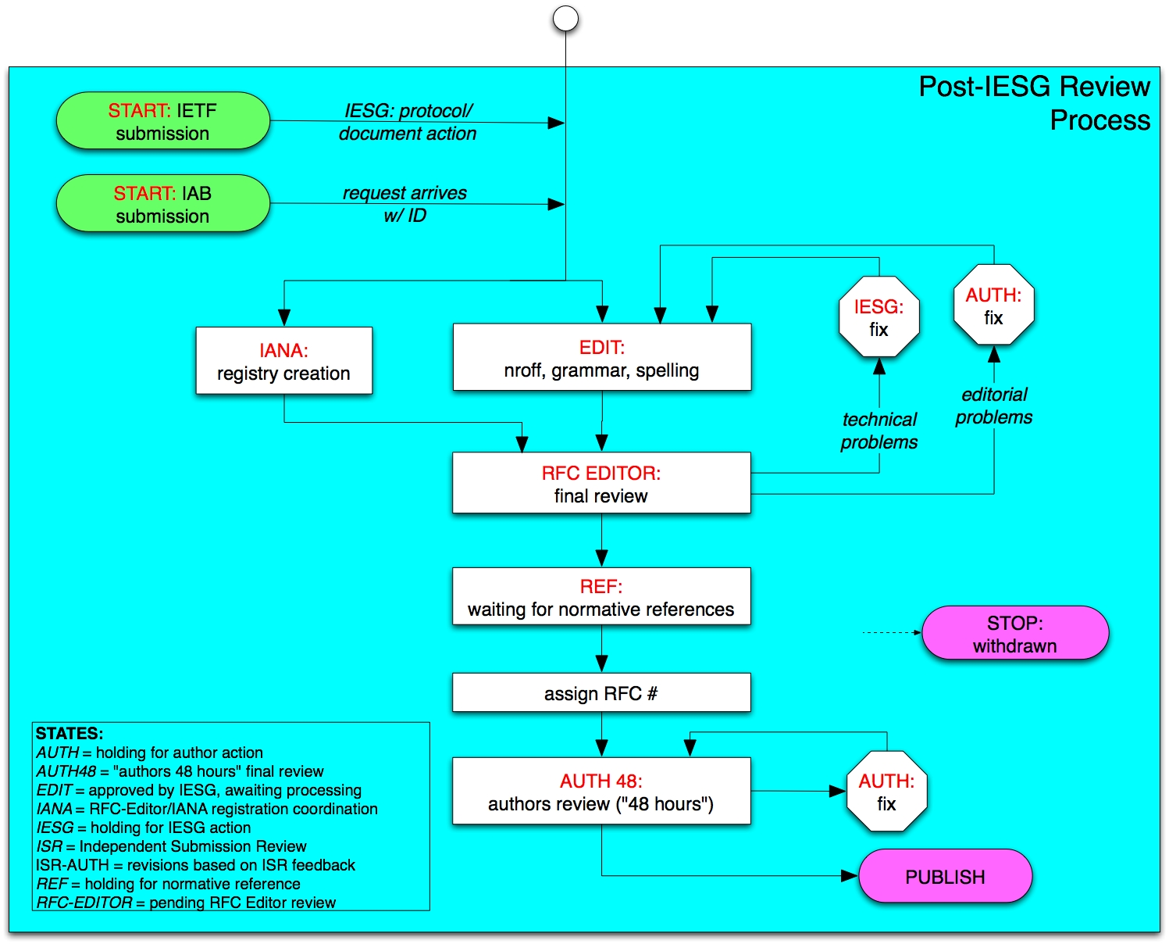

Slide 31
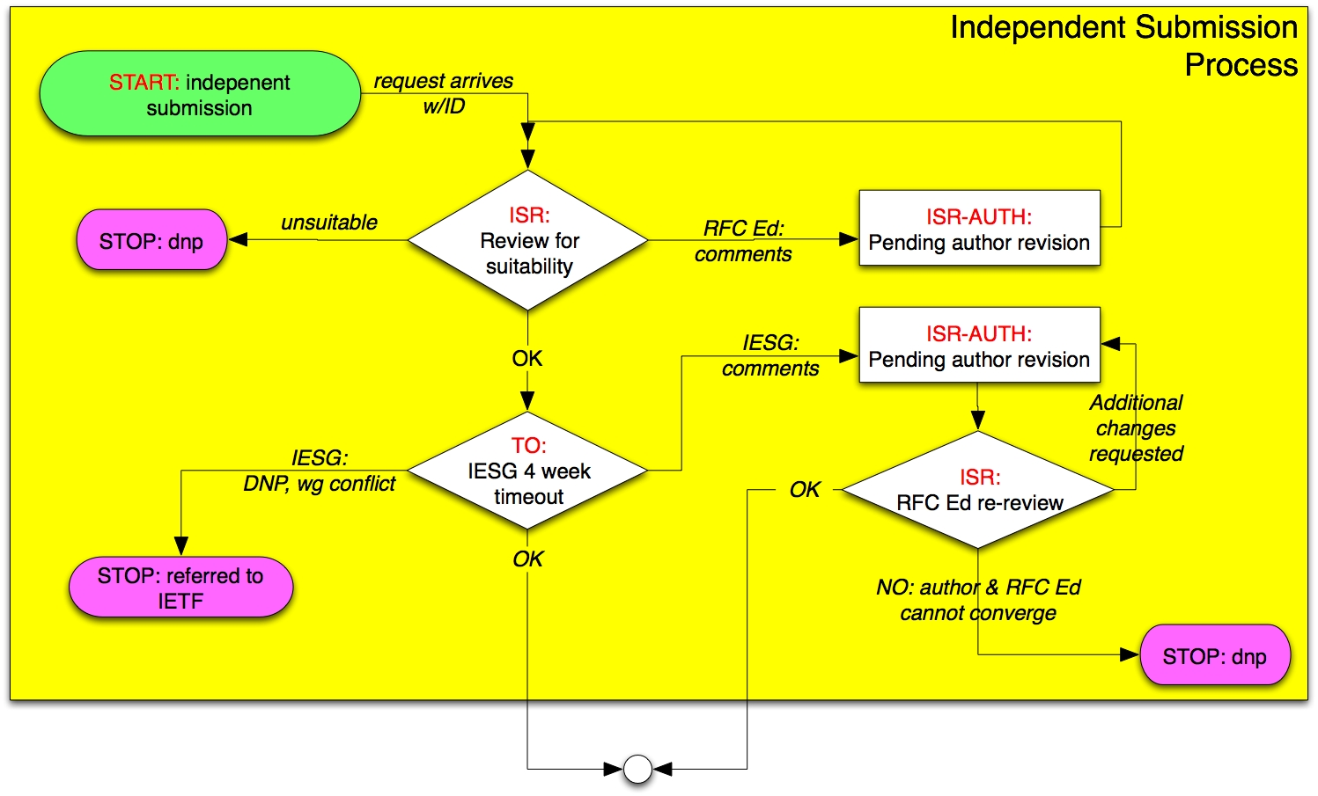

Slide 32
AUTH48 State: Final Author Review
Authors given rfcxxxx.txt file and diff file (.html)
Last-minute editorial changes allowed
  But should not be technically substantive or too extensive,
  else, AD, WG chair must OK.
This process can involve a fair amount of work & time (AT LEAST 48 hours)!
  All listed authors must sign off on final document
  Critical that editors take it seriously - review the entire document, not just the diffs.
  Your last chance to avoid enrollment in the Errata Hall of Infamy!

Slide 33
What is in an RFC?
General Policies
Discuss some important parts
  First page: header, title, abstract, …
  Body: IANA Considerations, Security Considerations, References
  Boilerplate

Slide 34
General RFC Policies
  Immutability
  Not all RFC’s are standards
  Language - all RFCs in English
    RFC2026 allows translations
      British English is allowed in principle, but…
  Consistent Publication Format
    ASCII (also .txt.pdf for Windows victims)
    Also .ps or .pdf (special process for handling)

Slide 35
RFC Formatting Rules
ASCII, 72 char/line.
58 lines per page, followed by FF (^L).
No overstriking or underlining.
No “filling” or (added) hyphenation across a line.
<.><sp><sp> between sentences.
No footnotes.

Slide 36
Parsing an RFC
  Header
  Title
  Header boilerplate (Short copyright, Status of Memo)
  IESG Note (when requested by IESG)
  Abstract
  Table of Contents (not req’d for short docs)
  Body
  Authors’ Addresses
  IPR boilerplate
    See RFC 3667/BCP 78, RFC 3668/BCP 79.

Slide 37
RFC Header
Network Working Group T. Berners-Lee
Request for Comments: 3986 W3C/MIT
STD: 66 R. Fielding
Updates: 1738 Day Software
Obsoletes: 2732, 2396, 1808 L. Masinter
Category: Standards Track Adobe Systems
January 2005
STD number: labels a standard (as opposed to a document)
  One STD may include a set of related RFCs.
  An STD number will be re-assigned to replacement RFC(s)
  IETF considering elaboration of STD idea into an “Internet Standards Document (ISD)”
Updates, Obsoletes: relation to earlier RFCs..

Slide 38
RFC Header: another example
Network Working Group T. Berners-Lee
Request for Comments: 2396 MIT/LCS
Updates: 1808, 1738 R. Fielding
Category: Standards Track U. C. Irvine
L. Masinter
Xerox Corporation
August 1998
Corresponding RFC Index entry (search on “2396”)
RFC2396
T. Berners-Lee, R.
Fielding, L.
Masinter
August
1998
ASCII
Obsoleted by RFC3986,
Updates RFC1808,
RFC1738, Updated by
RFC2732
Errata
DRAFT
STANDARD
Note fields that were not known when RFC was published

Slide 39
More First-Page Stuff
Title
Uniform Resource Identifier (URI): Generic Syntax
Status of This Memo
This document specifies an Internet standards track protocol for the Internet community, and requests discussion and suggestions for improvements. Please refer to the current edition of the "Internet Official Protocol Standards" (STD 1) for the standardization state and status of this protocol. Distribution of this memo is unlimited.
Copyright Notice
Copyright (C) The Internet Society (2005).
Abstract

Slide 40
Authors in Header
  Limited to lead authors, document editors.
    There must be very good reason to list more than 5
    All authors in header responsible for 48 hours review.
    Authors section should provide unambiguous contact points.
    Others can be included in Contributors and/or Acknowledgments sections.

Slide 41
Title and Abstracts
Titles
  Should be thoughtfully chosen
  No unexpanded abbreviations - except for very well known (eg, IP, TCP, HTTP, MIME, MPLS…)
Abstracts
  Carefully written for clarity (HARD to write!)
  No unexpanded abbreviations (again, except well-known)
  No citations
  Less than 20 lines! Shorter is good.
  Not a substitute for the Introduction; redundancy is OK.

Slide 42
Body of RFC
First section should generally be “1. Introduction”.
Following special sections may appear:
  Contributions, Acknowledgments
  Internationalization Considerations
      When needed -- see Sect 6, RFC 2277/BCP 18.
  References
Sections that MUST appear:
  Security Considerations
  IANA Considerations

Slide 43
References
Normative vs. Informative
  Normative refs in stds track documents can hold up pub.
  [Normative gets over-used]
Recommend against numeric citations [37].
Citations and references must match.
Handy file of RFC reference text:
  ftp://ftp.rfc-editor.org/in-notes/rfc-ref.txt

Slide 44
Copyrights and Patents
Copyright Issues
  Specified in RFC 3978/BCP 78 “IETF Rights in Contributions”
  Independent submissions: RFC Editor rules, but generally follows IETF rules.
  Differences should be of interest only to lawyers.
Patent (“IPR”) issues
  RFC boilerplate specified in RFC 3979/BCP 79
  “Intellectual Property Rights in IETF Technology”

Slide 45
Security Considerations
Security Considerations section is required.
IESG is (rightfully!) suspicious of “There are no security considerations in this document.”
  There are security considerations in nearly everything.
  The IESG wants in-depth, meaningful SC sections.
See: RFC 3552: “Guidelines for Writing RFC Text on Security Considerations”

Slide 46
IANA Considerations
Primary input to IANA
Defines:
  Individual code points, in one place.
  New registries (number spaces), with instructions on future assignment rules.
Section is required in draft, but “No IANA Considerations” section will be removed by RFC Editor.
See: RFC 2434, “Guidelines for Writing an IANA Considerations Section in RFCs”

Slide 47
How to Write an RFC
Some editorial guidelines
Improving your writing
Tools
MIBs and formal languages

Slide 48
Writing an RFC
Primary goal is clear, unambiguous technical prose
The RFC Editor staff generally follows two sources for style advice:
  Strunk & White (4th Edition, 2000)
  "A Pocket Style Manual" by Diana Hacker (4th Ed., 2004).
In any case, internally consistent usage is required.

Slide 49
Writing RFCs
Simple fact: writing clear, unambiguous technical prose is HARD !!
  Reread RFC 793 for inspiration and example.
Not literary English, but comprehensibility would be nice!
  Avoid ambiguity
  Use consistent terminology and notation
  Define each term and abbreviation at first use.
  Expand every abbreviation at first use.

Slide 50
Lean and Mean
You can often improve your writing by simply crossing out extraneous words that are extra.
  Look at each sentence and ask yourself: “Do I need every word I have written to make my meaning clear and unambiguous?”
  English professors call it the “Lard Factor” (LF) [Lanham79]
  “If you’ve not paid attention to your own writing before, think of a LF of 1/3 to ½ as normal and don’t stop revising until you’ve removed it.” [Lanham79]
  [Lanham79] Richard Lanham, “Revising Prose”, Scribner’s, New York, 1979

Slide 51
A (real) example
"When the nature of a name is decided one must decide whether the name should be of fixed length or whether it is variable length." (25 words)
A. “One must decide whether the length of a name should be fixed or variable.” (14 words, LF = .44)
B. “We may choose fixed or variable length for a particular class of name.” (13 words)
C. “A name may have fixed or variable length.”
(7 words, LF = .72)

Slide 52
Another real example
"One way to avoid a new administrative overhead would be for individuals to be able to generate statistically unique names." (20)
A. “We can avoid new administrative overhead by allowing individuals to generate statistically unique names.” (14, LF = .30)
B. “Allowing individuals to generate statistically unique names will avoid new administrative overhead.” (12, LF = .40)

Slide 53
How about:
“New administrative overhead can be avoided by allowing individuals to generate statistically-unique names.”
Compare to:
“The nail has been hit on the head by you!”
Passive voice: generally a bad idea…

Slide 54
Another (reality-based) Example
Original: “This is the kind of situation in which the receiver is the acknowledger and the sender gets the acknowedgments.” (19)
“We observe that an acknowledgment action is taking place from the receiver and the sender.” (15, LF=.21)
“The receiver returns acknowledgments to the sender.” (7, LF=.63)

Slide 55
Writing Hints
Simple declarative sentences are good.
  Flowery, literary language is not good.
  Say enough, but not more than enough
Avoid long, involuted sentences. You are not James Joyce.
  Do not overuse “;” “, and” “, or” to create compound sentences.
Make parallel clauses parallel in syntax.
Bad: “… whether the name should be of fixed length or whether it is variable length”.

Slide 56
A Few Common Errors
“Which”s that should be “that”s.
  “Which” is used parenthetically and follows a comma.
  “The interface which the users sees is too complex.”
  that /
  Or better: “The user interface is too complex.”
Should be a comma before last item of series:
  “TCP service is reliable, ordered, and full-duplex”
  Avoids ambiguity, clearly shows parallelism.

Slide 57
A Few Common Errors
Punctuation outside quote marks:
“This is a sentence”{.|?|!}
  RFC Editor conventions to avoid computer language ambiguities.
Some Protocol Engineers over-capitalize Words.
Keep your sentences short and direct.
  Don’t make simple things complex

Slide 58
Format for Readabilty
Careful use of indentation and line spacing can make huge improvement in readability.
  Goes a long way to make up lack of fancy fonts.
  Bullets can often help.
High density on the page may be the enemy of clarity and readability

Slide 59
Hard to read
3.1 RSVP Message Formats
3.1.1 Common Header
The fields in the common header are as
follows:
Flags: 4 bits
0x01-0x08: Reserved
No flag bits are defined yet.
Send_TTL: 8 bits
The IP TTL value with which the message is
sent. See Section 3.8.

Slide 60
Easier to Read
3.1 Message Formats
3.1.1 Common Header
The fields in the common header are as
follows:
Flags: 4 bits
0x01-0x08: Reserved
No flag bits are defined yet.
Send_TTL: 8 bits
The IP TTL value with which the message is sent. See Section 3.8.

Slide 61
iceberg

Slide 62
Preserving the Meaning
A comment that does not faze us:
“How dare you change my perfect prose…”?
  Sorry… we are just doing our job. See earlier.
A comment that concerns us very much:
“You have changed the meaning of what I wrote”.
  Often, because we misunderstood what you meant.
  That implies that your prose is ambiguous.
  You should recast the sentence/paragraph to make it clear and unambiguous, so even the dumb RFC Editor cannot mistake the meaning. ;-)

Slide 63
Internet Drafts
A well-formed RFC starts with a well-formed I-D
Surviving IESG review:
  http://www.ietf.org/ID-Checklist.html
  http://www.ietf.org/ietf/1id-guidelines.txt

Slide 64
Text Formatting Tools
Author tools: www.rfc-editor.org/formatting.html
  xml2rfc
  nroff
  Microsoft word templates
  LaTeX
RFC Editor does final RFC formatting using venerable Unix tool nroff –ms.

Slide 65
xml2rfc
Read RFC2629.txt - Marshall Rose
  Writing I-Ds and RFCs using XML
  Explains use of DTD for RFC production
Engine to convert .xml to .txt or to .nroff available online at: http://xml.resource.org/
  If you use xml2rfc, give the .xml file to the RFC Editor! It saves us doing the markup on your document.
Xml2rfc resources at: http://xml.resource.org/

Slide 66
nroff, groff
Handy templates for authors using nroff:
  ftp.rfc-editor.org/in-notes/rfc-editor/2-nroff.template
    Published in 1991 - J. Postel
    Gives instructions on using macros for creating RFCs
  www.1-4-5.net/~dmm/generic_draft.tar.gz
    Updated nroff template maintained by David Meyer.
If you use nroff –ms (without a private make file), give the .nroff source to the RFC Editor.

Slide 67
Microsoft word templates
2-word-template.doc
  Published in 2002 - T. Hain
  Using Microsoft Word to create Internet Drafts and RFCs
  www.ietf.org/rfc/rfc3285.txt
Template can be found at:
  ftp.rfc-editor.org/in-notes/rfc-editor/2-Word.template.rtf
  ftp.rfc-editor.org/in-notes/rfc-editor/crlf.exe
  And at the IETF web site.
  Updated version: www.isi.edu/touch/tools (J. Touch)

Slide 68
LaTeX
Mostly private templates and methods
Sometimes causes difficulty when documents are inherited by new authors.
Tool for conversion of LaTeX to text:
  www.cs.columbia.edu/IRT/software/l2x/
There are private tools to convert LaTeX subset to nroff.

Slide 69
MIB RFCs – Important special case
MIB references
  O&M Web Site at www.ops.ietf.org/
  MIB doctors at www.ops.ietf.org/mib-doctors.html
  MIB Review: draft-ietf-ops-mib-review-guidelines
Tools
  http://www.ops.ietf.org/mib-review-tools.html
  smilint at www.ibr.cs.tu-bs.de/projects/libsmi/
  SMICng at www.snmpinfo.com/

Slide 70
Use of Formal Languages
Formal languages and pseudo-code can be useful as an aid in explanations, although English remains the primary method of describing protocols.
Pseudo-code judged on the basis of clarity.
Formal Languages (e.g., ABNF, XML, ASN.1 (MIBs))
  Requires normative reference to language specification
  RFC Editor will run verifier program.
www.ietf.org/IESG/STATEMENTS/pseudo-code-in-specs.txt
ftp.rfc-editor.org/in-notes/rfc-editor/UsingPseudoCode.txt

Slide 71
Persistent Issues about RFCs
Normative references
  Practical effect: can hold up publication
  Some disagreement on what should be Normative
MUST/MAY/SHOULD/… applicability words
  Do they belong in Informative documents at all?
  Tend to overuse – makes doc sound important.
  Worse, often inconsistent use.
URLs in RFCs
  Some are more stable than others …

Slide 72
Persistent Issues
Author contact information
  Seems important, but hard to keep it current
  RFC Editor gets many queries from newbies.
  Ideal: maintain database of current email addresses; daunting job.
Update and Obsolete relationships
  Some disagreement on what they mean
  At best, only high-order bit of complex relationship

Slide 73
Persistent Issues
“What are the current Internet standards?”
  STD sub-series is supposed to define this.
In practice, reality is so complex that this is probably not even a valid question.
  RFC Editor supports ISD (Internet Standard Document) [Newtrk] as a more systematic and complete definition.
What is meaning of Historic category?
  “Really Bad”, or just “well, not very current…”?

Slide 74
Authoritative references
Overview of RFC publication:
www.rfc-editor.org/howtopub.html
“Instructions to Request for Comments (RFC) Authors”. Draft-rfc-editor-rfc2223bis-08.txt aka ftp.rfc-editor.org/in-notes/rfceditor/instructions2authors.txt

Slide 75
Thank you
Questions? Comments?
mailto:edu-discuss@ietf.org
mailto:rfc-editor@rfc-editor.org

