Slide 1
RFC Editor Tutorial
IETF 66
Montreal, Quebec
9 July 2006

Slide 2
Overview of this Tutorial
Background: The RFC Series and the RFC Editor
The Publication Process
Contents of an RFC
How to Write an RFC
Conclusion

Slide 3
The RFC Series
Earliest document series to be published online.
  1969 – today: 36 years old.
  4500+ documents.
An ARCHIVAL series: RFCs are forever!
A comprehensive record of Internet technical history

Slide 4
RFCs
RFC document series
  Begun by Steve Crocker [RFC 3] and Jon Postel in 1969.
  Informal memos, technical specs, and much more.
Jon Postel quickly became the RFC Editor.
  28 years: 1970 until his death in 1998.
  He established and maintained the consistent style and editorial quality of the RFC series.
  Jon was a 2-finger typist.

Slide 5
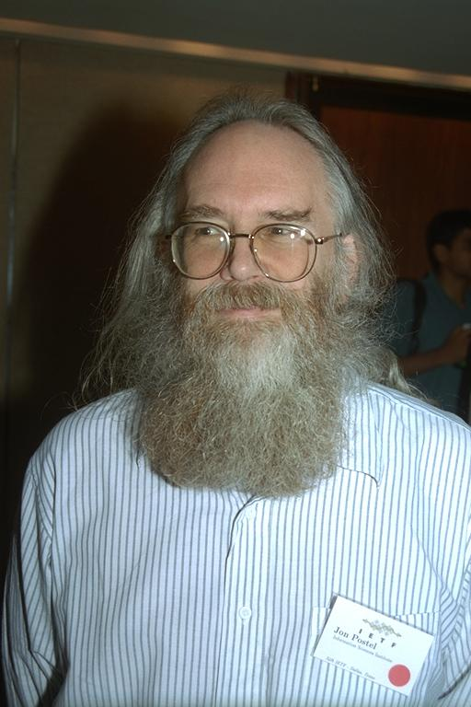
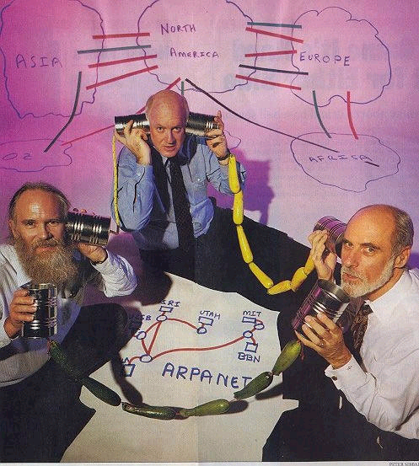
Jon Postel
  Postel had an enormous influence on the developing ARPAnet &
  Internet protocols – the “Protocol Czar” and the “Deputy
  Internet Architect” as well as the IANA and RFC Editor.
Photo by Peter Lothberg – IETF34 Aug 1995
Newsweek Aug 8, 1994

Slide 6
Historical Context of RFC Series
1969: Building ARPAnet RFC 1
1975: TCP/IP research begun ~RFC 700
    Recorded in separate IEN series
1983: Internet born 1 Jan ~RFC 830
1985: IETF created ~RFC 950
1993: Modern IESG/IAB org ~RFC 1400
1998: Postel passed away ~RFC 2430
Today ~RFC 4500

Slide 7
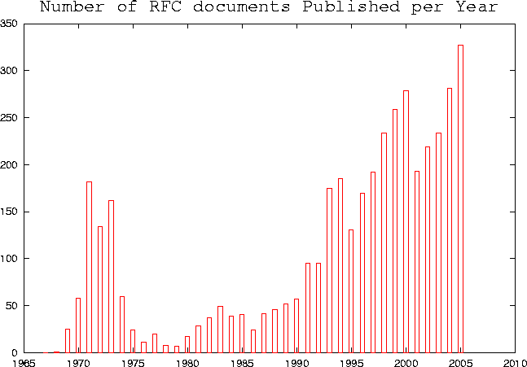
RFC Publication Rate
Internet
Arpanet
Number of RFCs
Year

Slide 8
Jon Postel’s Playful Side
April 1 RFCs
  A little humorous self-parody is a good thing…
  Most, but not all, April 1 RFCs are satirical documents.
    We expect you can tell the difference ;-)
April 1 submissions are reviewed for cleverness, humor, and topical relation to IETF themes.
  Avian Carriers is famous [RFC 1149]
  Evil Bit is a favorite [RFC 3514]

Slide 9
The RFC Editor today
A small group at Jon’s long-term home,
  the Information Sciences Institute (ISI) of USC.
  ~6 FTEs
Under contract with ISOC/IASA
Current leadership:
  Joyce Reynolds, Postel’s chief editorial assistant 83-98.
  Bob Braden, colleague of Postel 1970-1998.
  Aaron Falk
RFC Editorial Board
  Provides advice and counsel to the RFC Editor, particularly about independent submissions.

Slide 10


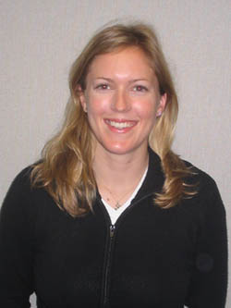

Editorial Staff
Joyce Reynolds
Sandy Ginoza
Alice Hagens
Eric Nord

Slide 11
The RFC Editor Web site
  http://www.rfc-editor.org
  Search engines for RFCs, Internet Drafts
  RFC publication queue
  Master index of RFCs
    ftp://ftp.rfc-editor.org/in-notes/rfc-index.txt, .xml
  “Official Internet Protocols Standards” list
  Policy changes, news, FAQ, and more
  Errata (see next slide)

Slide 12
Errata Page
www.rfc-editor.org/errata.html
  A list of technical and editorial errors that have been reported to the RFC Editor.
  Verified by the authors and/or the IESG.
  The RFC Editor search engine results contain hyperlinks to errata, when present.
Pending errata - a file of emails
  Claimed errata that have been reported to the RFC Editor, but not verified or posted to errata.html.

Slide 13
RFCs and the IETF
It was natural to adapt the existing RFC series to publication of Internet standards specifications.
  Informally: mid 1980s
  Formally: RFC 1602 (1994), RFC 2026 (1996)

Slide 14
RFC Categories
RFC 2026 defines specification maturity levels:
  Standards track: Proposed, Draft, Standard.
  Non-standards track: Experimental, Informational, Historic.
  “Almost standard”: Best Current Practice.
Shown on RFC header as “Category:”
  Except, one category “Standards Track” for PS, DS, S.
  Often called "status".
A published RFC can NEVER change, but its
category can change (see rfc-index.txt).

Slide 15
Sources for RFCs
IETF submissions
  Mostly from Working Groups.
  Rest are individual submissions via the IESG.
  All are submitted to the RFC Editor by the IESG after approval process [RFC2026].
IAB submissions
  Submitted directly by IAB Chair
  Informational category

Slide 16
More RFC Sources
RFC Editor (“independent”) submissions
  Submitted directly to RFC Editor.
  RFC Editor reviews and decides whether publication is appropriate.
  IESG reviews for conflict with any WG, makes publish/do-not-publish recommendation.
  RFC Editor has final decision, with advice from Editorial Board.
  Only Experimental or Informational category.
IRTF submissions: see draft-irtf-rfcs-00.txt

Slide 17
Review of Independent Submissions
RFC Editor finds competent reviewer(s), with advice and aid from the Editorial Board.
Possible conclusions:
  Out of scope for RFC series.
  Incompetent or redundant, not worth publication.
  Important, but should go through IETF process first ("Throw it over the wall to the IESG!")
  Serious flaws – report to author, reject for now.
  Suggest changes to author, then OK to publish.
  Great! Publish it.

Slide 18
RFC Sub-Series
All RFCs are numbered sequentially.
There was a desire to identify significant subsets of RFCs, so Postel invented “sub-series“. An RFC may have a sub-series designator.
    e.g., “RFC 2026, BCP 9”
Sub-series designations:
  BCP Best Current Practice category
  STD Standard category
  FYI Informational category: user documentation

Slide 19
STD Sub-Series
Originally: all protocol specs were expected to quickly reach (full) Standard category.
  Then the STD sub-series would include all significant standards documents.
  Of course, it did not work out that way; most standards-track documents do not get beyond Proposed Standard.
  See "Official Internet Protocol Standards"
    See: www.rfc-editor.org/rfcxx00.html (occasionally published as STD 1) for the REAL list of current relevant standards-track docs.

Slide 20
STD Sub-Series
STDs were overloaded to represent “complete standards”; one STD # can contain multiple RFCs.
Examples:
  STD 5 = “IP”, includes RFCs 791, 792, 919, 922, 950, 1112
  STD 13 = “DNS”, includes RFCs 1034, 1035
  STD 12 = “Network Time Protocol”, currently no RFCs.

Slide 21
STDs as Protocol Names
Really, "RFCxxxx" is only a document name.
  But, people often talk about "RFC 821" or "821" when they mean "SMTP".
As protocols evolve, RFC numbers make confusing names for protocols. Postel hoped that STD numbers would function as protocol names.
  But reality is too complicated for this to work well.
  It HAS been working for BCPs.
We need a better way to name protocols.
  ISD (Internet Standards Document) proposal ??

Slide 22
2. RFC Publication Process
Overview
Queue states
AUTH48 procedure

Slide 23
Publication Process: Overview (1)
First published as an Internet Draft
  A well-formed RFC starts with a well-formed I-D.
    http://www.ietf.org/ID-Checklist.html
    http://www.ietf.org/ietf/1id-guidelines.txt
  Send us the xml2rfc or nroff -ms source, if available.

Slide 24
Publication Process: Overview (2)
RFC Editor
  Edits and formats the document
  Makes many consistency checks
IANA acts on IANA Considerations
  Creates new registries and assigns numbers.
  RFC Editor plugs assigned numbers into document.

Slide 25
Publication Process: Overview (3)
An RFC # is assigned.
Document and diff file sent to authors for final check
  “AUTH48” state.
  All named authors are responsible.
Finished document added to archive and index.
  Announcement on ietf-announce list.
  Mirrored at IETF site, other sites.
  Nroff, xml files archived, for later revisions.

Slide 26
Markup in Editing (1)
When xml2rfc is not used:
ASCII publication markup done using nroff –ms.
  Nroff provides direct, explicit format control
Final products -- files created and archived:
  rfcxxxx.txt: ASCII file of RFC
  rfcxxxx.nroff: markup that produces rfcxxxx.txt

Slide 27
Markup in Editing (2)
When xml2rfc is used and .xml is submitted:
  We edit the .xml as much as possible, then
  use xml2rfc to convert .xml to .nroff.
  We make final formatting changes by editing .nroff.
Then we also archive:
  rfcxxxx.xml: Partially edited version.
Ideal: edit only .xml, make final .txt using xml2rfc.
  Working with xml2rfc developers to make this possible.

Slide 28
Normative References
Set of RFCs linked by Normative refs must be published simultaneously.
Two hold points:
  MISSREF state: a doc with Norm Ref to a doc not yet received by RFC Editor.
  REF state: a doc that is edited but waiting for dependent docs to be edited.

Slide 29
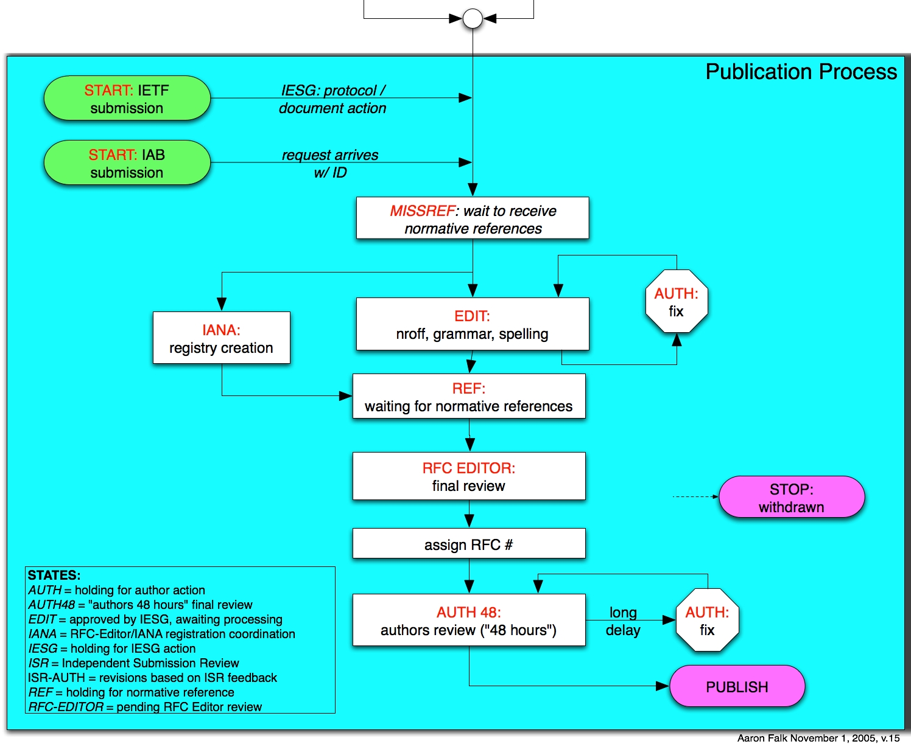
Process Flow Chart

Slide 30
AUTH48 State: Final Author Review
Last-minute editorial changes allowed – But should not be substantive or too extensive.
  Else, must get OK from AD, WG chair.
This process can involve a fair amount of work & time
  AT LEAST 48 hours!
  All listed authors must sign off on final document
  Authors should take it seriously - review the entire document, not just the diffs.
  Your last chance to avoid enrollment in the
  Errata Hall of Infamy!

Slide 31
3. Contents
  Header
  Title
  Header boilerplate (Short copyright, Status of Memo)
  IESG Note (when requested by IESG)
  Abstract
  Table of Contents (not req’d for short docs)
  Body
  Authors’ Addresses
  IPR boilerplate
    See RFC 3667/BCP 78, RFC 3668/BCP 79.

Slide 32
RFC Header
Network Working Group T. Berners-Lee
Request for Comments: 3986 W3C/MIT
STD: 66 R. Fielding
Updates: 1738 Day Software
Obsoletes: 2732, 2396, 1808 L. Masinter
Category: Standards Track Adobe Systems
January 2005
STD sub-series number 66
Updates, Obsoletes: relation to earlier RFCs.
  Please note this information in a prominent place in your Internet-Draft; preferably the header.

Slide 33
RFC Header: Another Example
Network Working Group T. Berners-Lee
Request for Comments: 2396 MIT/LCS
Updates: 1808, 1738 R. Fielding
Category: Standards Track U. C. Irvine
L. Masinter
Xerox Corporation
August 1998
Corresponding RFC Index entry (search on “2396”)
RFC2396
T. Berners-Lee, R.
Fielding, L.
Masinter
August
1998
ASCII
Obsoleted by RFC3986,
Updates RFC1808,
RFC1738, Updated by
RFC2732
Errata
DRAFT
STANDARD
Red fields were not known when RFC was published

Slide 34
Authors in Header
Limited to lead authors, document editors.
There must be very good reason to list more than 5.
Each author in the header must give approval during AUTH48 review.
Each author in the header should provide unambiguous contact information in the Authors’ Addresses section.
Other names can be included in Contributors and/or Acknowledgments sections.

Slide 35
Titles
Should be thoughtfully chosen
No un-expanded abbreviations - except for very well- known ones (e.g., IP, TCP, HTTP, MIME, MPLS)
We like short, snappy titles, but sometimes we get titles like:
  “An alternative to XML Configuration Access Protocol (XCAP) for manipulating resource lists and authorization lists, Using HTTP extensions for Distributed Authoring and Versioning (DAV)”

Slide 36
Abstracts
Carefully written for clarity (HARD to write!)
No un-expanded abbreviations (again, except well-known)
No citations
  Use “RFC xxxx”, not “[RFCxxxx]” or “[5]”
Less than 20 lines! Shorter is good.
Not a substitute for the Introduction;
redundancy is OK.
We recommend starting with “This document…”

Slide 37
Body of RFC
First section should generally be “1. Introduction”.
Special sections that may appear:
  References
  Contributors, Acknowledgments
  Internationalization Considerations
      When needed -- see Section 6, RFC 2277/BCP 18.
Sections that MUST appear:
  Security Considerations
  IANA Considerations

Slide 38
References
Normative vs. Informative
  Normative refs can hold up publication.
  [RFC Editor opinion: Normative gets over-used]
We STRONGLY recommend against numeric citations "[37]".
Citations and references must match.
Handy file of RFC reference text:
  ftp://ftp.rfc-editor.org/in-notes/rfc-ref.txt
Include draft strings of any I-Ds.

Slide 39
Copyrights and Patents
Copyright Issues
  Specified in RFC 3977/BCP 77 “IETF Rights in Contributions”
  Independent submissions: generally follow IETF rules
Patent (“IPR”) issues
  RFC boilerplate specified in RFC 3978/BCP 78
  “Intellectual Property Rights in IETF Technology”
Generally, you supply the correct boilerplate in the Internet Draft, and the RFC Editor will supply the correct boilerplate in the RFC.

Slide 40
Security Considerations Section
Security Considerations section required in every RFC.
See RFC 3552: “Guidelines for Writing RFC Text on Security Considerations”
Important!

Slide 41
IANA Considerations Section
Primary input to IANA
Defines:
  Individual code points, in one place
  New registries (number spaces), with future assignment rules.
Section is required in draft
  But “No IANA Considerations” section will be removed by RFC Editor.
See RFC 2434, “Guidelines for Writing an IANA Considerations Section in RFCs”

Slide 42
Current Internet Standards
“What are the current Internet standards?”
  See STD 1: “Official Internet Protocol Standards”
  In practice, reality is so complex that this is probably not even a valid question.
    “Roadmaps” are desirable
    ISDs might be better

Slide 43
4. How to Write an RFC
Some editorial guidelines
Improving your writing
Preparation tools
MIBs and formal languages
“Instructions to Request for Comments (RFC) Authors”. draft-rfc-editor-rfc2223bis-08.txt aka
ftp.rfc-editor.org/in-notes/rfceditor/instructions2authors.txt

Slide 44
General Editorial Guidelines
  Immutability – once published, never change
  Not all RFCs are standards
  All RFCs in English
    RFC 2026 allows translations
    British English is allowed in principle, but there is some preference for American English.
  Consistent Publication Format
    ASCII (also .txt.pdf for Windows victims)
    Also .ps or .pdf (special process for handling)

Slide 45
RFC Formatting Rules
ASCII, 72 char/line.
58 lines per page, followed by FF (^L).
No overstriking or underlining.
No “filling” or (added) hyphenation across a line.
<.><sp><sp> between sentences.
No footnotes.

Slide 46
RFC Editing
For correct syntax, spelling, punctuation: always.
  Sometimes exposes ambiguities
To improve clarity and consistency: sometimes.
  e.g., expand each abbreviation when first used.
To improve quality of the technical prose: occasionally.
By general publication standards, we edit lightly.
  Balance: author preferences against consistency and accepted standards of technical English.

Slide 47
Preserving the Meaning
A comment that does not faze us:
“How dare you change my perfect prose?”
  Just doing our job as editors!
A comment that concerns us very much:
“You have changed the meaning of what I wrote”.
  Often, because we misunderstood what you meant.
  That implies that your prose is ambiguous.
  You should recast the sentence/paragraph to make it clear and unambiguous, so even the RFC Editor cannot mistake the meaning. ;-)

Slide 48
The RFC Editor checks many things
  Header format and content
  Title format
  Abstract length and format
  Table of Contents
  Presence of required sections
  No uncaught IANA actions
  Spelling checked
  ABNF/MIB/XML OK, using algorithmic checker
  Citations match references
  Most recent RFC/I-D cited
  Pure ASCII, max 72 char lines, hyphens, etc.
  Header and footer formats
  Page breaks do not create “orphans”
  References split into Normative, Informative
  Boilerplate OK

Slide 49
Writing RFCs
Simple fact: writing clear, unambiguous technical prose is very HARD !!
Not literary English, but comprehensibility would be nice!
  Avoid ambiguity.
  Use consistent terminology and notation.
    If you choose “4-bit”, then use it throughout (not “four-bit”).
  Define each term and abbreviation at first use.
  Expand every abbreviation at first use.

Slide 50
Style
Primary goal: clear, unambiguous technical prose.
The RFC Editor staff generally follows two sources for style advice:
  Strunk & White (4th Ed., 2000)
  "A Pocket Style Manual" by Diana Hacker (4th Ed., 2004)
In any case, internally consistent usage is objective.

Slide 51
Sentence Structure
Simple declarative sentences are good.
  Flowery, literary language is not good.
  Goal: Simple descriptions of complex ideas.
Avoid long, involuted sentences. You are not James Joyce.
  Use “;” | “, and” | “, or” sparingly to glue successive sentences together.
Make parallel clauses parallel in syntax.
  Bad: “… whether the name should be of fixed length or whether it is variable length”.

Slide 52
Grammar Tips
Avoid passive voice (backwards sentences).
  “The nail was hit on the head by you.”
  “In this section, the network interface is described.”
  vs. “This section describes the network interface.”
“which” vs. “that”
  “which” is used parenthetically and follows a comma.
  “The interface which the users see is too complex.”
  that /
  Or better: “The user interface is too complex.”
Some Protocol Engineers over-capitalize Nouns.

Slide 53
Punctuation Conventions
A comma before the last item of a series:
  “TCP service is reliable, ordered, and full-duplex”
  Avoids ambiguities, clearly shows parallelism.
Punctuation outside quote marks:
“This is a sentence”{.|?|!}
  To avoid computer language ambiguities.

Slide 54
Lean and Mean
You often improve your writing by simply crossing out extraneous extra words.
  Look at each sentence and ask yourself,
  “Do I need every word to make my meaning clear and unambiguous?”
  English professors call it the “Lard Factor” (LF) [Lanham79]
  “If you’ve not paid attention to your own writing before, think of a LF of ⅓ to ½ as normal and don’t stop revising until you’ve removed it.” [Lanham79]
[Lanham79] Richard Lanham, “Revising Prose”, Scribner’s, New York, 1979.

Slide 55
A Real Example
"When the nature of a name is decided one must decide whether the name should be of fixed length or whether it is variable length." (25 words)
“One must decide whether the length of a name should be fixed or variable.” (14 words, LF = .44)
“We may choose fixed or variable length for a particular class of name.” (13 words)
“A name may have fixed or variable length.”
(7 words, LF = .72)

Slide 56
Another Real Example
"One way to avoid a new administrative overhead would be for individuals to be able to generate statistically unique names." (20 words)
“New administrative overhead can be avoided by allowing individuals to generate statistically unique names.”
(14 words, LF = .30)
“Allowing individuals to generate statistically unique names will avoid new administrative overhead.”
(12 words, LF = .40)

Slide 57
Another (reality-based) Example
“This is the kind of situation in which the receiver is the acknowledger and the sender gets the acknowledgments.” (19 words)
“An acknowledgment action is taking place from the receiver and the sender.” (11, LF=.42)
“The receiver returns acknowledgments to the sender.” (7, LF=.63)

Slide 58
Another Real Example
“Also outside the scope are all aspects of network security which are independent of whether a network is a PPVPN network or a private network (for example, attacks from the Internet to a web-server inside a given PPVPN will not be considered here, unless the way the PPVPN network is provisioned could make a difference to the security of this server).”
  Two sentences!!
  “make a difference to” -> “affect”

Slide 59
iceberg

Slide 60
Format for Readability
Careful use of indentation and line spacing can greatly improve readability.
  Goes a long way to compensate for single font.
  Bullets often help.
  High density on a page may be the enemy of clarity and readability.
The RFC Editor will format your document according to these guidelines, but it is helpful if you can do it in the I-D.

Slide 61
Hard to read
3.1 RSVP Message Formats
3.1.1 Common Header
The fields in the common header are as
follows:
Flags: 4 bits
0x01-0x08: Reserved
No flag bits are defined yet.
Send_TTL: 8 bits
The IP TTL value with which the message is
sent. See Section 3.8.

Slide 62
Formatted for Easier Reading
3.1. Message Formats
3.1.1. Common Header
The fields in the common header are as
follows:
Flags: 4 bits
0x01-0x08: Reserved
No flag bits are defined yet.
Send_TTL: 8 bits
The IP TTL value with which the message is
sent. See Section 3.8.

Slide 63
Text Formatting Tools
Author tools: www.rfc-editor.org/formatting.html
  xml2rfc
  nroff
  Microsoft word templates
  LaTeX
RFC Editor does final RFC formatting using venerable Unix tool nroff –ms.

Slide 64
xml2rfc
Read RFC2629.txt - Marshall Rose
  Writing I-Ds and RFCs using XML
  Explains use of DTD for RFC publication
Engine to convert xml to txt or nroff. Available online at: http://xml.resource.org/
  If you use xml2rfc, send the xml file to the RFC Editor. It will save us work on your document.
“An XML2RFC Template for Documents Containing a MIB module”
  draft-harrington-xml2rfc-mib-doc-template-00.txt

Slide 65
nroff, groff
Handy templates for authors using nroff:
  ftp.rfc-editor.org/in-notes/rfc-editor/2-nroff.template
    Published in 1991 - J. Postel
    Gives instructions on using macros for creating RFCs
  www.1-4-5.net/~dmm/generic_draft.tar.gz
    Updated nroff template maintained by David Meyer.
If you use nroff –ms (without a private make file), give the nroff source to the RFC Editor.

Slide 66
MIB RFCs: A Special Case
MIB references
  O&M Web Site at www.ops.ietf.org/
  MIB doctors at www.ops.ietf.org/mib-doctors.html
  MIB Review: See RFC 4181, BCP 111: “Guidelines for Authors and Reviewers of MIB Documents”
Tools
  http://www.ops.ietf.org/mib-review-tools.html
  smilint at www.ibr.cs.tu-bs.de/projects/libsmi/
  SMICng at www.snmpinfo.com/
MIB boilerplate
  The Internet-Standard Management Framework:
    www.ops.ietf.org/mib-boilerplate.html
  Security Considerations: www.ops.ietf.org/mib-security.html

Slide 67
Use of Formal Languages
Formal languages and pseudo-code can be useful as an aid in explanations, although English remains the primary method of describing protocols.
Pseudo-code judged on the basis of clarity.
Formal Languages (e.g., ABNF, XML, ASN.1 (MIBs))
  Requires a normative reference to language specification
  RFC Editor will run verifier program.
www.ietf.org/IESG/STATEMENTS/pseudo-code-in-specs.txt
ftp.rfc-editor.org/in-notes/rfc-editor/UsingPseudoCode.txt

Slide 68
5. Conclusion: Problem Areas (1)
Normative references
  Practical effect: can hold up publication
MUST/MAY/SHOULD/… requirement words
  Do they belong in Informative documents at all?
  Tend to overuse – makes it sound important.
  Worse, often inconsistent use

Slide 69
Problem Areas (2)
URLs in RFCs
  Some are more stable than others…
Updates and Obsoletes relationships
  Some disagreement on what they mean
  At best, only high-order bit of complex relationship
  RFC Editor hopes ISD (Internet Standard Document) [Newtrk] will be more systematic and complete.

Slide 70
Hints to Authors
Respond promptly to all messages from RFC Ed.
Read your I-D carefully before submission, as you would read the final document in AUTH48!
If your I-D is in the queue, and you see typos or have a new email address, send us an email.
DON’T use numeric citations.
Avoid gratuitous use of requirement words (MUST, etc.)
Craft title and abstract carefully.
Remember that your document should be understandable by people who are not deep experts in the subject matter.

Slide 71
A Common Question from Authors
Why is my document not published yet?
  IANA Considerations
  Normative References
  All authors signing off on the document

Slide 72
Authoritative References
Overview of RFC publication:
www.rfc-editor.org/howtopub.html
“Instructions to Request for Comments (RFC) Authors”. draft-rfc-editor-rfc2223bis-08.txt aka
ftp.rfc-editor.org/in-notes/rfc-editor/instructions2authors.txt

Slide 73
Thank you …
Questions? Comments?
mailto:rfc-editor@rfc-editor.org
mailto: rfc-interest@rfc-editor.org

