Slide 1
RFC Editor Tutorial
IETF 68
Prague, Czech Republic
18 March 2007

Slide 2
Overview of this Tutorial
Background: The RFC Series and the RFC Editor
The Publication Process
Contents of an RFC
How to Write an RFC
Conclusion

Slide 3
The RFC Series
Earliest document series to be published online.
  1969 – today: 38 years old.
  4500+ documents.
An ARCHIVAL series: RFCs are forever!
A comprehensive record of Internet technical history

Slide 4
RFCs
RFC document series
  Begun by Steve Crocker (RFC 3) and Jon Postel in 1969.
  Informal memos, technical specs, and much more.
Jon Postel quickly became the RFC Editor.
  28 years: 1970 until his death in 1998.
  He established and maintained the consistent style and editorial quality of the RFC series.
  Jon was a 2-finger typist.

Slide 5
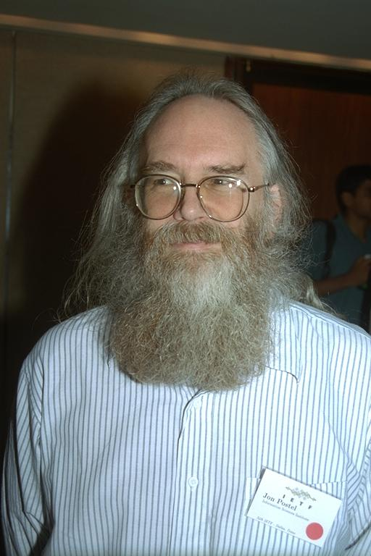
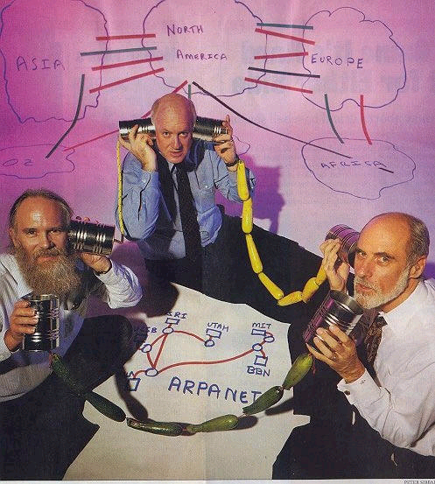
Jon Postel
  Postel had an enormous influence on the developing ARPAnet &
  Internet protocols – the “Protocol Czar” and the “Deputy
  Internet Architect” as well as the IANA and RFC Editor.
Photo by Peter Lothberg – IETF34 Aug 1995
Newsweek Aug 8, 1994

Slide 6
Historical Context of RFC Series
1969: Building ARPAnet RFC 1
1975: TCP/IP research begun ~RFC 700
    Recorded in separate IEN series
1983: Internet born 1 Jan ~RFC 830
1985: IETF created ~RFC 950
1993: Modern IESG/IAB org ~RFC 1400
1998: Postel passed away ~RFC 2430
Today ~RFC 4800

Slide 7
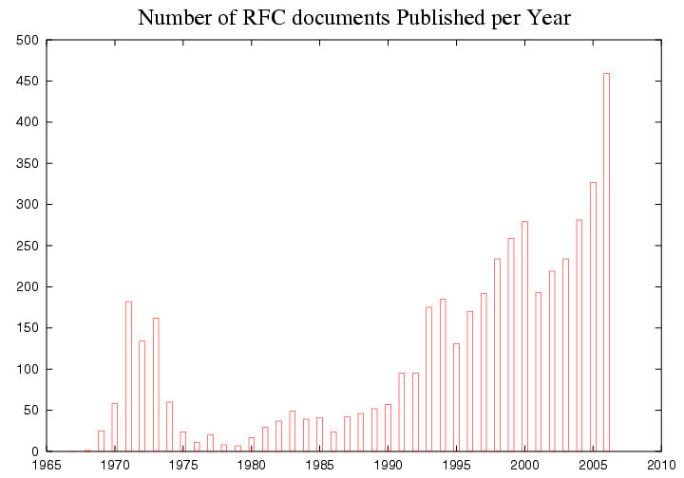
RFC Publication Rate
Internet
Number of RFCs
Arpanet
Year

Slide 8
Jon Postel’s Playful Side
April 1st RFCs
  A little humorous self-parody is a good thing…
  Most, but not all, April 1st RFCs are satirical documents.
  We expect you can tell the difference ;-)
April 1st submissions are reviewed for cleverness, humor, and topical relation to IETF themes.
  Avian Carriers is famous (RFC 1149)
  Evil Bit is a favorite (RFC 3514)
April 1st submissions are the only RFCs-to-be that do not need to be published as Internet-Drafts. Please send directly to rfc-editor@rfc-editor.org.

Slide 9
The RFC Editor today
A small group at Jon’s long-term home,
  the Information Sciences Institute (ISI) of USC.
  ~6 FTEs
Under contract with ISOC/IASA
Current leadership:
  Bob Braden, colleague of Postel 1970-1998.
  Sandy Ginoza, editor of RFCs for 7 years.
RFC Editorial Board
  Provides advice and counsel to the RFC Editor, particularly about independent submissions.

Slide 10
The RFC Editor Web Site
  http://www.rfc-editor.org
  Official repository and master index of RFCs
    ftp://ftp.rfc-editor.org/in-notes/rfc-index.txt, .xml
  Search engines for RFCs, Internet Drafts
  “Official Internet Protocols Standards” list
  RFC publication queue
  Policy changes, news, FAQ, and more
  Errata (see next slide)

Slide 11
Errata Page
www.rfc-editor.org/errata.html
  A list of technical and editorial errors that have been reported to the RFC Editor.
  Verified by the authors and/or the IESG, unless marked “UNVERIFIED”.
  The RFC Editor search engine results contain hyperlinks to errata, when present.
Pending errata - a file of emails
  ftp://ftp.rfc-editor.org/in-notes/pending-errata/pending-errata.msgs
  Claimed errata that have been reported to the RFC Editor, but not yet verified or posted to errata.html.

Slide 12
RFCs and the IETF
It was natural to adapt the existing RFC series to publication of Internet standards specifications.
  Informally: mid 1980s
  Formally: RFC 1602 (1994), RFC 2026 (1996)

Slide 13
RFC Categories
RFC 2026 defines specification maturity levels:
  Standards track: Proposed, Draft, Standard.
  Non-standards track: Experimental, Informational, Historic.
  “Almost standard”: Best Current Practice.
Shown on RFC header as “Category:”
  Except, one category “Standards Track” for PS, DS, S.
  Often called "status".
A published RFC can NEVER change, but its
category can change (see rfc-index.txt).

Slide 14
Sources for RFCs
IETF submissions
  Mostly products of Working Groups
  Rest are individual submissions via the IESG.
  Submitted to the RFC Editor by the IESG after approval process [RFC2026].
Independent submissions
  Submitted directly to the RFC Editor
  See http://www.rfc-editor.org/indsubs.html
IAB submissions
  Submitted directly by IAB Chair
IRTF submissions
  Submitted directly by IRTF Chair

Slide 15
Review of Independent Submissions
Only Experimental or Informational category.
RFC Editor finds competent reviewer(s), with advice and aid from the Editorial Board.
Possible conclusions:
  Out of scope for RFC series.
  Incompetent or redundant, not worth publication.
  Important, but should go through IETF process first ("Throw it over the wall to the IESG!")
  Serious flaws – report to author, reject for now.
  Suggest changes to author, then OK to publish.
  Great! Publish it.
IESG reviews for conflict with any WG, makes publish/do-not-publish recommendation.
RFC Editor has final decision, with advice from Editorial Board.

Slide 16
RFC Sub-Series
All RFCs are numbered sequentially.
There was a desire to identify significant subsets of RFCs, so Postel invented “sub-series”. An RFC may have a sub-series designator.
    e.g., “RFC 2026, BCP 9”
Sub-series designations:
  BCP Best Current Practice category
  STD Standard category
  FYI Informational category: user documentation

Slide 17
STD Sub-Series
Originally: all protocol specs were expected to quickly reach (full) Standard category.
  Then the STD sub-series would include all significant standards documents.
  Of course, it did not work out that way; most standards-track documents do not get beyond Proposed Standard.
  See "Official Internet Protocol Standards"
    See: www.rfc-editor.org/rfcxx00.html (occasionally published as STD 1) for the REAL list of current relevant standards-track docs.

Slide 18
STD Sub-Series
STDs were overloaded to represent “complete standards”; one STD # can contain multiple RFCs.
Examples:
  STD 5 = “IP”, includes RFCs 791, 792, 919, 922, 950, 1112
    NB: When multiple RFCs make up a sub-series doc (for example, ftp://ftp.rfc-editor.org/in-notes/std/std5.txt) the file starts with
    [Note that this file is a concatenation of more than one RFC.]
  STD 13 = “DNS”, includes RFCs 1034, 1035
  STD 12 = “Network Time Protocol”, currently no RFCs.

Slide 19
STDs as Protocol Names
Really, "RFCxxxx" is only a document name.
  But, people often talk about "RFC 821" or "821" when they mean "SMTP".
As protocols evolve, RFC numbers make confusing names for protocols. Postel hoped that STD numbers would function as protocol names.
  But reality is too complicated for this to work well.
  It HAS been working for BCPs.
We need a better way to name protocols.
  ISD (Internet Standards Document) proposal ??

Slide 20
2. RFC Publication Process
Overview from the Authors’ Perspective
More Details on Queue States

Slide 21
Overview from the Authors’ Perspective
Step 0: Write an Internet-Draft
  IESG approval -> your document is added to the queue
Step 1: Send your source file (if you have one).
  questions from the RFC Editor
Step 2: Answer questions.
Step 3: See your document progress.
  AUTH48 notification with a pointer to the edited version
Step 4: Review your document carefully and
send changes / approvals for publication.
Step 5: Publication!

Slide 22
Step 0: Write an Internet-Draft
A well-formed RFC starts with a well-formed I-D.
  http://www.ietf.org/ID-Checklist.html
  http://www.ietf.org/ietf/1id-guidelines.txt
Authoring tools
  http://www.rfc-editor.org/formatting.html
  http://tools.ietf.org//inventory/author-tools
  More on this later.

Slide 23
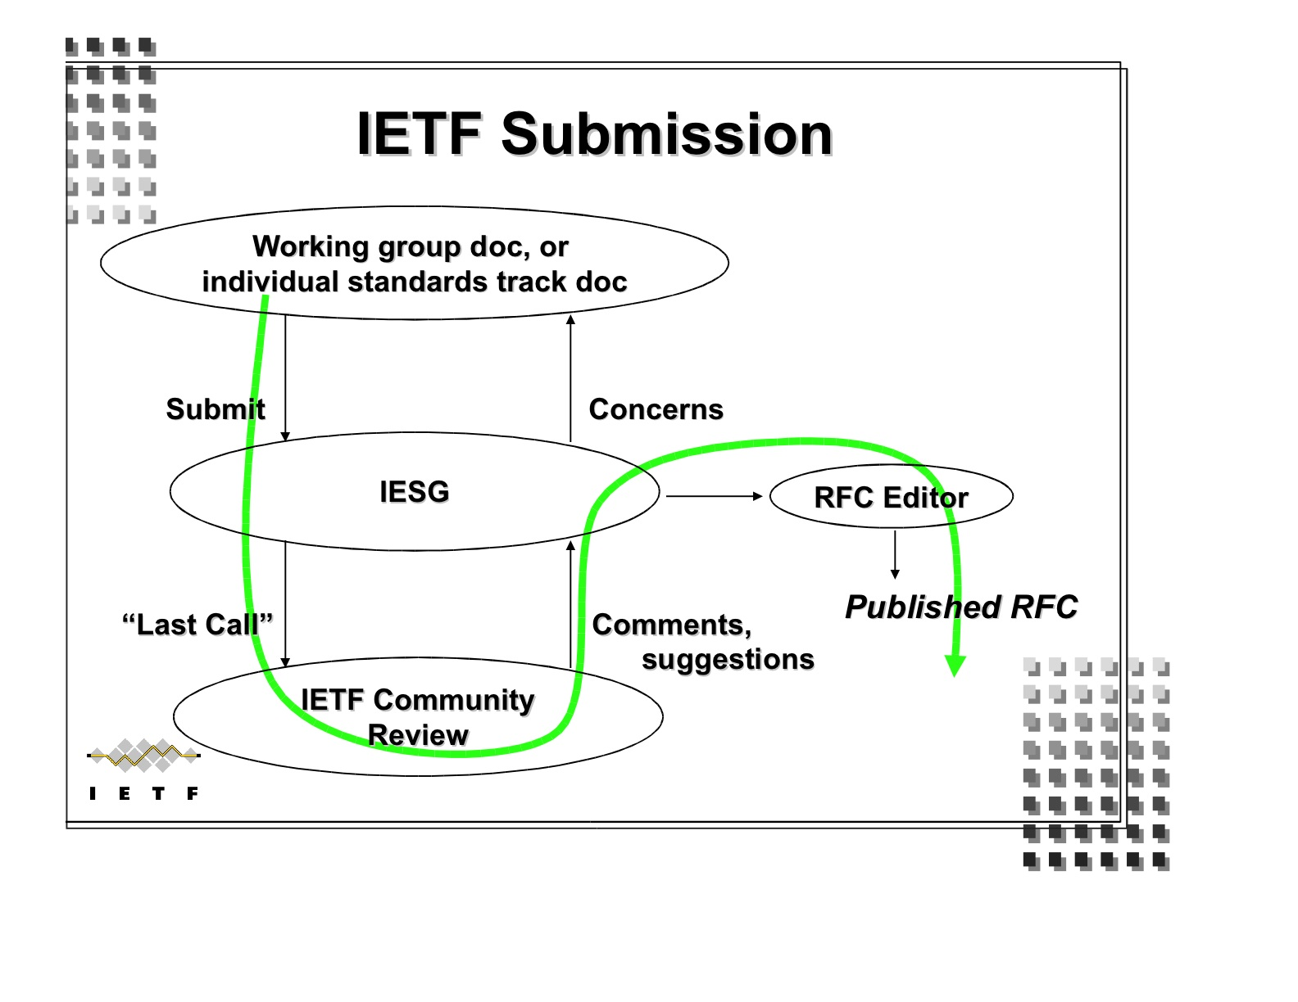
A Generic Case: draft-ietf-wg-topic-05
Let’s say your document has been approved by the IESG…
figure from Scott Bradner’s Newcomer’s Presentation

Slide 24

Step 1: Send your source file.
From: rfc-editor@rfc-editor.org
Subject: [RFC State] <draft-ietf-wg-topic-05> has been added to RFC Editor database.
Your document has been added to the queue (www.rfc-editor.org/queue.html).
Please send us your nroff or xml source file.
  Let us know if there are any changes between the version you send and the IESG-approved version.
If you don’t have one, don’t worry, we will use the Internet-Draft text to create an nroff file.

Slide 25
Step 2: Answer questions.
From: rfc-editor@rfc-editor.org
Subject: draft-ietf-wg-topic-05
Please reply to questions about your draft. Typically, these questions are about
  missing citations
    Ex: [RFC4301] appears as a normative reference, where would you like to cite it in the text?
  inconsistent terminology
    Ex: Which form of the term should be used throughout?
      RESTART Flag / Re-Start flag / Restart Flag
  unclear sentences

Slide 26
Step 3: See your document progress.
From: rfc-editor@rfc-editor.org
Subject: [RFC State] <draft-ietf-wg-topic-05> has changed state
Basic Process
IANA and/or REF holds
Also, you can check http://www.rfc-editor.org/queue.html

Slide 27
Step 4: Review your document carefully.
From: rfc-editor@rfc-editor.org
Subject: AUTH48 [SG]: RFC 4999 <draft-ietf-wg-topic-05>
This is your chance to review the edited version.
We send pointers to the txt and diff files
  and the XML file (when AUTH48 in XML)
Submit changes by sending OLD/NEW text or indicating global changes.
  Insert directly into the XML file (when AUTH48 in XML)
Each author listed on the first page must send their approval before the document is published.

Slide 28
Step 5: Publication!
Announcement sent to lists:
  ietf-announce@ietf.org and rfc-dist@rfc-editor.org
Canonicial URI:
  http://www.rfc-editor.org/rfc/rfcXXXX.txt
Also available here:
  ftp://ftp.rfc-editor.org/in-notes/rfcXXXX.txt
Mirrored at IETF site and other sites.
txt, nroff, and XML files archived.

Slide 29
More details on queue states
Normative References
  Set of RFCs linked by normative refs must be published simultaneously.
  Two hold points:
    MISSREF state: a doc with norm. ref to a doc not yet received by RFC Editor.
    REF state: a doc that is edited but waiting for dependent docs to be edited.
IANA
  Acts on IANA Considerations section (more on this later).
  Creates new registries and assigns numbers.
Notes:
More details on queue states!

Slide 30
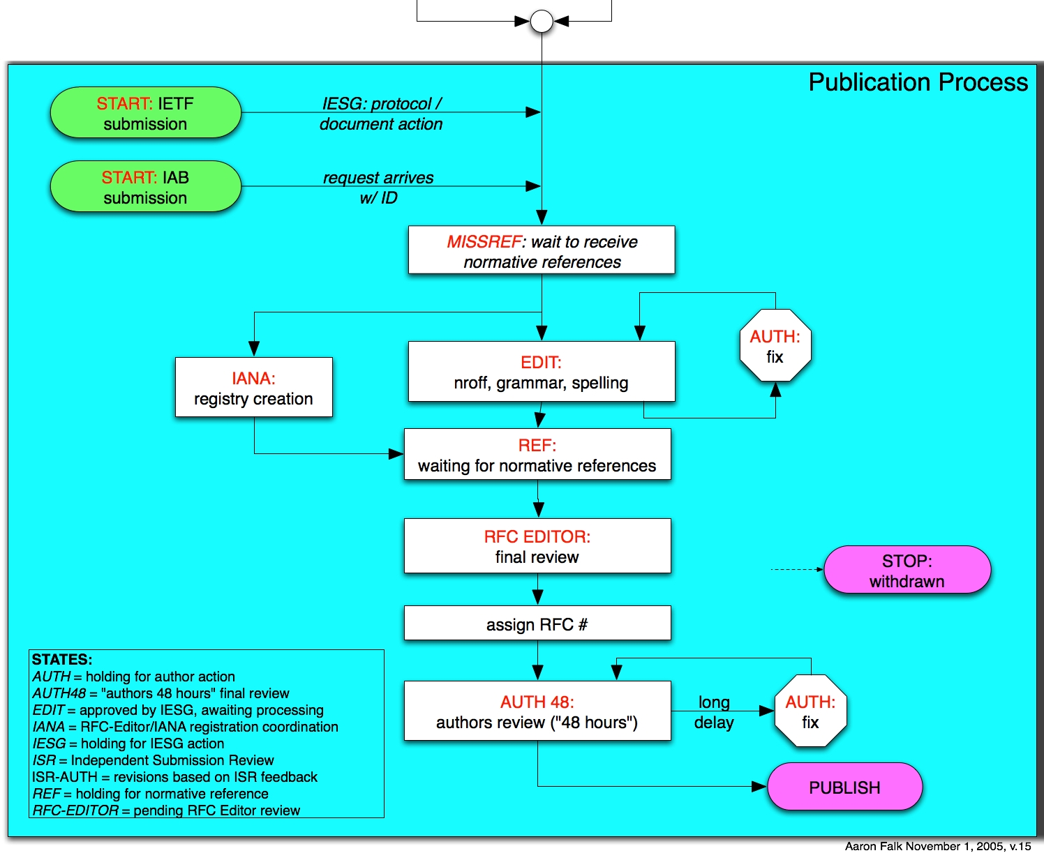
Process Flow Chart

Slide 31
More about AUTH48: Final Author Review
Last-minute editorial changes allowed – But should not be substantive or too extensive.
  Else, must get OK from AD, WG chair.
This process can involve a fair amount of work & time
  AT LEAST 48 hours!
  All listed authors must sign off on final document
  Authors should take it seriously - review the entire document, not just the diffs.
  Your last chance to avoid enrollment in the Errata Hall of Infamy!

Slide 32
3. Contents of an RFC
  Header
  Title
  Header boilerplate (Short copyright, Status of Memo)
  IESG Note (when requested by IESG)
  Abstract
  Table of Contents (not required for short docs)
  Body
  References
  Authors’ Addresses
  IPR boilerplate

Slide 33
RFC Header
Network Working Group T. Berners-Lee
Request for Comments: 3986 W3C/MIT
STD: 66 R. Fielding
Updates: 1738 Day Software
Obsoletes: 2732, 2396, 1808 L. Masinter
Category: Standards Track Adobe Systems
January 2005
STD sub-series number 66
Updates, Obsoletes: relation to earlier RFCs.
  Please note this information in a prominent place in your Internet-Draft; preferably the header.

Slide 34
RFC Header: Another Example
Network Working Group T. Berners-Lee
Request for Comments: 2396 MIT/LCS
Updates: 1808, 1738 R. Fielding
Category: Standards Track U. C. Irvine
L. Masinter
Xerox Corporation
August 1998
Corresponding RFC Index entry (search on “2396”)
RFC2396
T. Berners-Lee, R.
Fielding, L.
Masinter
August
1998
ASCII
Obsoleted by RFC3986,
Updates RFC1808,
RFC1738, Updated by
RFC2732
Errata
DRAFT
STANDARD
Red fields were not known when RFC was published

Slide 35
Authors in Header
Limited to lead authors, document editors.
There must be very good reason to list more than 5.
Each author in the header must give approval during AUTH48 review.
Each author in the header should provide unambiguous contact information in the Authors’ Addresses section.
Other names can be included in Contributors and/or Acknowledgments sections.

Slide 36
Titles
Should be thoughtfully chosen
No un-expanded abbreviations - except for very well- known ones (e.g., IP, TCP, HTTP, MIME, MPLS)
We like short, snappy titles, but sometimes we get titles like:
  “An alternative to XML Configuration Access Protocol (XCAP) for manipulating resource lists and authorization lists, Using HTTP extensions for Distributed Authoring and Versioning (DAV)”

Slide 37
Abstracts
Carefully written for clarity (HARD to write!)
No un-expanded abbreviations (again, except well-known)
No citations
  Use “RFC xxxx”, not “[RFCxxxx]” or “[5]”
Less than 20 lines! Shorter is good.
Not a substitute for the Introduction;
redundancy is OK.
We recommend starting with “This document…”

Slide 38
Body of RFC
First section should generally be “1. Introduction”.
Special sections that may appear:
  Contributors, Acknowledgments
  Internationalization Considerations
      When needed -- see Section 6, RFC 2277/BCP 18.
Sections that MUST appear:
  Security Considerations
  IANA Considerations

Slide 39
Security Considerations Section
Security Considerations section required in every RFC.
See RFC 3552: “Guidelines for Writing RFC Text on Security Considerations”
Important!

Slide 40
IANA Considerations Section
What is an IANA Considerations section?
  A guide to IANA on what actions will need to be performed
  A confirmation if there are NO IANA actions
Section is required in draft
  But “No IANA Considerations” section will be removed by RFC Editor.

Slide 41
Why is this section important?
Forces the authors to ‘think’ if anything should be requested from IANA
A clear IANA Considerations section will allow the IANA to process the IANA Actions more quickly
Establishes documented procedures

Slide 42
What should be included in the IANA Considerations section?
  What actions is the document requesting of IANA
  Individual number or name registrations
  New registries (number or name spaces)
  Registration procedures for new registries
  Reference changes to existing registrations
  BE CLEAR AND DESCRIPTIVE IN YOUR INSTRUCTIONS
  (IANA is not the expert for your name or number space)

Slide 43
Review of IANA Considerations
IANA Consideration sections are reviewed before the document is published as an RFC
  During IESG Last Call
  During IESG Evaluation
  IANA will also review your section at any time by request
If you do not have an IC section or if your IC section is not complete, your document will not move forward

Slide 44
Where to get help on writing this section
See RFC 2434, “Guidelines for Writing an IANA Considerations Section in RFCs”
  Soon to be replaced by RFC2434bis
Look at existing registries for examples
Ask IANA
  Available at the IANA booth at IETF meetings
  Send an e-mail [iana@iana.org] or [michelle.cotton@icann.org]

Slide 45
References
Normative vs. Informative
  Normative refs can hold up publication.
Please do not use numeric citations (e.g., "[37]”) unless you submit an XML source file.
Citations and references must match.
Handy file of RFC reference text:
  ftp://ftp.rfc-editor.org/in-notes/rfc-ref.txt
Include draft strings of any I-Ds.

Slide 46
Copyrights and Patents
Copyright Issues
  Specified in RFC 3977/BCP 77 “IETF Rights in Contributions”
  Independent submissions: generally follow IETF rules
Patent (“IPR”) issues
  RFC boilerplate specified in RFC 3978/BCP 78
  “Intellectual Property Rights in IETF Technology”
  Recently updated by RFC 4748/BCP 78.
Generally, you supply the correct boilerplate in the Internet Draft, and the RFC Editor will supply the correct boilerplate in the RFC.

Slide 47
4. How to Write an RFC
Some editorial guidelines
Improving your writing
Preparation tools
MIBs and formal languages
“Instructions to Request for Comments (RFC) Authors”. draft-rfc-editor-rfc2223bis-08.txt aka
ftp.rfc-editor.org/in-notes/rfceditor/instructions2authors.txt

Slide 48
General Editorial Guidelines
Immutability – once published, never change
All RFCs in English
  RFC 2026 allows translations
  British English is allowed in principle, but there is some preference for American English.
Consistent Publication Format
  ASCII (also .txt.pdf for Windows victims)
  Also .ps or .pdf (special process for handling)

Slide 49
RFC Formatting Rules
ASCII, 72 char/line.
58 lines per page, followed by FF (^L).
No overstriking or underlining.
No “filling” or (added) hyphenation across a line.
<.><sp><sp> between sentences.
No footnotes.

Slide 50
RFC Editing
For correct syntax, spelling, punctuation.
  We use these sources:
    The Elements of Style, Strunk & White (4th Ed., 2000)
    A Pocket Style Manual, Diana Hacker (4th Ed., 2004)
    Merriam-Webster (http://www.merriam-webster.com)
To improve clarity and consistency.
To improve quality of the technical prose.
By general publication standards, we edit lightly.
  Balance: author preferences against consistency and accepted standards of technical English.

Slide 51
Writing RFCs
Simple fact: writing clear, unambiguous technical prose is very HARD !!
Goal: Easy to read, hard to misunderstand.
  Avoid ambiguity.
  Use consistent terminology and notation.
    If you choose “4-bit”, then use it throughout (not “four-bit”).
  Define each term at first use.
  Expand each abbreviation at first use.

Slide 52
Preserving the Meaning
A comment that concerns us very much:
“You have changed the meaning of what I wrote”.
  Because we misunderstood what you meant.
  That implies that your prose is ambiguous.
  You should recast the sentence/paragraph to make it clear and unambiguous, so even the RFC Editor cannot mistake the meaning. ;-)

Slide 53
The RFC Editor checks many things
  Header format and content
  Title format
  Abstract length and format
  Table of Contents
  Presence of required sections
  No uncaught IANA actions
  Spelling checked
  ABNF/MIB/XML OK, using algorithmic checker
  Citations match references
  Most recent RFC/I-D cited
  Pure ASCII, max 72 char lines, hyphens, etc.
  Header and footer formats
  Page breaks do not create “orphans”
  References split into Normative, Informative
  Boilerplate OK

Slide 54
Grammar Tips
Avoid passive voice.
“which” (non-restrictive) vs. “that” (restrictive)
  “which” is used parenthetically and follows a comma.
    The Foo Protocol, which is less robust, may be more vulnerable to session hijacking.
  “that” introduces information essential to the meaning.
    A protocol that is less robust may be more vulnerable to session hijacking.
Some Protocol Engineers over-capitalize Nouns.

Slide 55
Punctuation Conventions
A comma before the last item of a series:
  “TCP service is reliable, ordered, and full-duplex”
  Avoids ambiguities, clearly shows parallelism.
Punctuation outside quote marks:
“This is a sentence”{.|?|!}
  To avoid computer language ambiguities.
“i.e.,” and “e.g.,” are followed by commas.

Slide 56
Lean and Mean
You often improve your writing by simply crossing out extraneous extra words.
  Look at each sentence and ask yourself,
  “Do I need every word to make my meaning clear and unambiguous?”
  English professors call it the “Lard Factor” (LF) [Lanham79]
  “If you’ve not paid attention to your own writing before, think of a LF of ⅓ to ½ as normal and don’t stop revising until you’ve removed it.” [Lanham79]
[Lanham79] Richard Lanham, “Revising Prose”, Scribner’s, New York, 1979.

Slide 57
A Real Example
"When the nature of a name is decided one must decide whether the name should be of fixed length or whether it is variable length." (25 words)
“One must decide whether the length of a name should be fixed or variable.” (14 words, LF = .44)
“We may choose fixed or variable length for a particular class of name.” (13 words)
“A name may have fixed or variable length.”
(7 words, LF = .72)

Slide 58
Another (reality-based) Example
“This is the kind of situation in which the receiver is the acknowledger and the sender gets the acknowledgments.” (19 words)
“An acknowledgment action is taking place from the receiver and the sender.” (11, LF=.42)
“The receiver returns acknowledgments to the sender.” (7, LF=.63)

Slide 59
Another Real Example
“Also outside the scope are all aspects of network security which are independent of whether a network is a PPVPN network or a private network (for example, attacks from the Internet to a web-server inside a given PPVPN will not be considered here, unless the way the PPVPN network is provisioned could make a difference to the security of this server).”
  Two sentences!!
  “make a difference to” -> “affect”

Slide 60
iceberg

Slide 61
Format for Readability
Careful use of indentation and line spacing can greatly improve readability.
  Goes a long way to compensate for single font.
  Bullets often help.
    xml2rfc tip: You can set the list element’s style attribute to symbols, letters, numbers, and more
  High density on a page may be the enemy of clarity and readability.
The RFC Editor will format your document according to these guidelines, but it is helpful if you can do it in the I-D.

Slide 62
Hard to read
3.1 RSVP Message Formats
3.1.1 Common Header
The fields in the common header are as
follows:
Flags: 4 bits
0x01-0x08: Reserved
No flag bits are defined yet.
Send_TTL: 8 bits
The IP TTL value with which the message is
sent. See Section 3.8.

Slide 63
Formatted for Easier Reading
3.1. Message Formats
3.1.1. Common Header
The fields in the common header are as
follows:
Flags: 4 bits
0x01-0x08: Reserved
No flag bits are defined yet.
Send_TTL: 8 bits
The IP TTL value with which the message is
sent. See Section 3.8.

Slide 64
Text Formatting Tools
Author tools: www.rfc-editor.org/formatting.html
  xml2rfc
  nroff
  Microsoft word template
  LaTeX
RFC Editor does final RFC formatting using venerable Unix tool nroff –ms.

Slide 65
xml2rfc (http://xml.resource.org)
The xml2rfc tool converts an XML source file to text, HTML, or nroff. RFC 2629 and its unofficial successor define the format.
Templates available from www.rfc-editor.org/formatting.html.
  template-bare.xml (by Elwyn Davies) that goes with his xml2rfc tutorial.
  draft-harrington-text-mib-doc-template.xml (by David Harrington) for documents containing MIBs.

Slide 66
nroff, groff
Handy templates for authors using nroff:
  ftp.rfc-editor.org/in-notes/rfc-editor/2-nroff.template
    Published in 1991 by J. Postel. Updated October 2006.
    Gives instructions on using macros for creating RFCs.
  www.1-4-5.net/~dmm/generic_draft.tar.gz
    Updated nroff template maintained by David Meyer.
If you use nroff –ms (without a private make file), give the nroff source to the RFC Editor.

Slide 67
MIBs: A Special Case
MIB references
  O&M Web Site at www.ops.ietf.org/
  MIB doctors at www.ops.ietf.org/mib-doctors.html
  MIB Review: See RFC 4181, BCP 111: “Guidelines for Authors and Reviewers of MIB Documents”
Tools
  http://www.ops.ietf.org/mib-review-tools.html
  smilint at www.ibr.cs.tu-bs.de/projects/libsmi/
  SMICng at www.snmpinfo.com/
MIB boilerplate
  The Internet-Standard Management Framework:
    www.ops.ietf.org/mib-boilerplate.html
  Security Considerations: www.ops.ietf.org/mib-security.html

Slide 68
Use of Formal Languages
Formal languages and pseudo-code can be useful as an aid in explanations, although English remains the primary method of describing protocols.
Pseudo-code judged on the basis of clarity.
  http://www.ietf.org/IESG/STATEMENTS/pseudo-code-in-specs.txt
Formal Languages (e.g., ABNF, XML, ASN.1 (MIBs))
  Requires a normative reference to language specification
  RFC Editor will run verifier program.
  ABNF parser: http://rtg.ietf.org/~fenner/abnf.cgi

Slide 69
5. Conclusion: Hints to Authors
Read your I-D carefully before submission, as you would read the final document in AUTH48!
Respond promptly to all messages from the RFC Editor.
If your I-D is in the queue, and you see typos or have a new email address, send us an email.
Don’t use numeric citations (unless you submit an XML file).
Avoid gratuitous use of requirement words (MUST, etc.)
Craft title and abstract carefully.
Remember that your document should be understandable by people who are not deep experts in the subject matter.

Slide 70
Ongoing Issues
Normative references
  Practical effect: can hold up publication
MUST/MAY/SHOULD/… requirement words
  Do they belong in Informative documents at all?
  Tend to be overused or used inconsistently.
URLs in RFCs
  Some are more stable than others…
Updates and Obsoletes relationships
  Some disagreement on what they mean
  At best, only high-order bit of complex relationship
  RFC Editor hopes ISD (Internet Standard Document) [Newtrk] will be more systematic and complete.

Slide 71
Authoritative References
Overview of RFC publication:
www.rfc-editor.org/howtopub.html
“Instructions to Request for Comments (RFC) Authors” draft-rfc-editor-rfc2223bis-08.txt aka
ftp.rfc-editor.org/in-notes/rfc-editor/instructions2authors.txt

Slide 72
Thank you.
Questions? Comments?
RFC Editor Desk at IETF 68
  Mon. - Wed., 9:30 am - 4:00 pm
Web site: http://www.rfc-editor.org
Contact Us: rfc-editor@rfc-editor.org
Interest List: rfc-interest@rfc-editor.org

