Slide 1
RFC Editor Tutorial
IETF 71
Philadelphia, Pennsylvania
9 March 2008

Slide 2
Overview of this Tutorial
Background: The RFC Series and the RFC Editor
The Publication Process
Contents of an RFC
How to Write an RFC
Conclusion

Slide 3
The RFC Series
Earliest document series to be published online.
  1969 – today: 39 years old.
  5000+ documents.
An ARCHIVAL series: RFCs are forever!
A comprehensive record of Internet technical history

Slide 4
RFCs
RFC document series
  Begun by Steve Crocker [RFC3] and Jon Postel in 1969.
  Informal memos, technical specs, and much more.
Jon Postel quickly became the RFC Editor.
  28 years: 1970 until his death in 1998.
  He established and maintained the consistent style and editorial quality of the RFC series.
  Jon was a 2-finger typist.

Slide 5
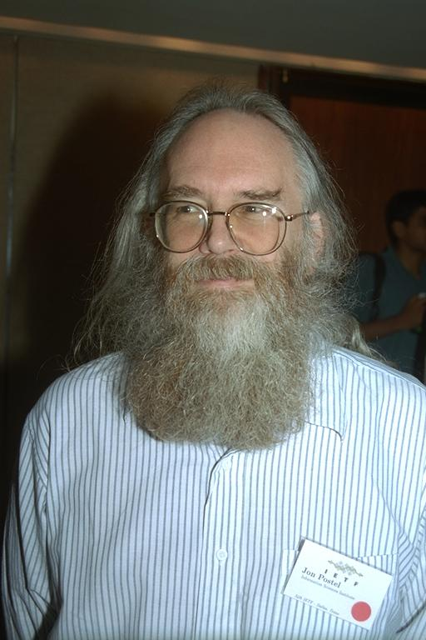
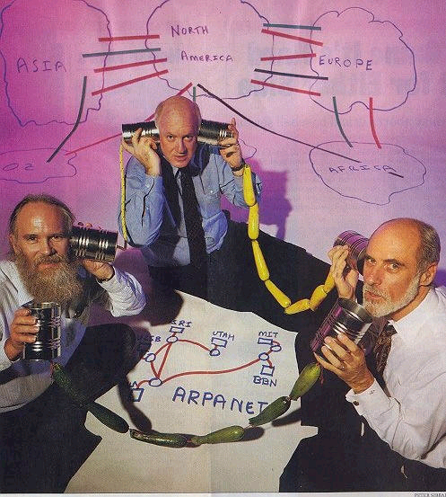
Jon Postel
  Postel had an enormous influence on the developing ARPAnet &
  Internet protocols – the “Protocol Czar” and the “Deputy
  Internet Architect” as well as the IANA and RFC Editor.
Photo by Peter Lothberg – IETF34 Aug 1995
Newsweek Aug 8, 1994

Slide 6
Historical Context of RFC Series
1969: Building ARPAnet RFC 1
1975: TCP/IP research begun ~RFC 700
    Recorded in separate IEN series
1983: Internet born 1 Jan ~RFC 830
1985: IETF created ~RFC 950
1993: Modern IESG/IAB org ~RFC 1400
1998: Postel passed away ~RFC 2430
Today ~RFC 5100

Slide 7
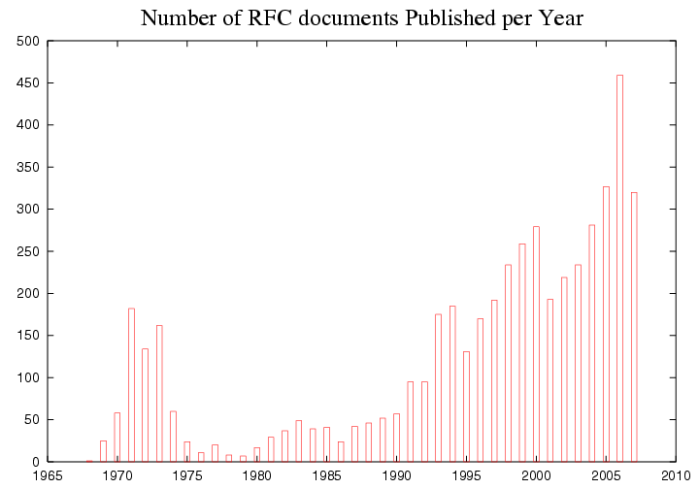
RFC Publication Rate
Internet
Number of RFCs
Arpanet
Year

Slide 8
Jon Postel’s Playful Side
April 1 RFCs
  A little humorous self-parody is a good thing…
  Most, but not all, April 1 RFCs are satirical documents.
    We expect you can tell the difference ;-)
April 1 submissions are reviewed for cleverness, humor, and topical relation to IETF themes.
  Avian Carriers is famous [RFC1149]
  Evil Bit is a favorite [RFC3514]

Slide 9
The RFC Editor today
A small group at Jon’s long-term home,
  the Information Sciences Institute (ISI) of USC.
  ~6 FTEs
Under contract with ISOC/IASA
Current leadership:
  Bob Braden, colleague of Postel 1970-1998.
  Sandy Ginoza, editor of RFCs for 8 years.
RFC Editorial Board
  Provides advice and counsel to the RFC Editor, particularly about independent submissions.

Slide 10
The RFC Editor Web Site
  http://www.rfc-editor.org
  Search engines for RFCs, Internet Drafts
  RFC publication queue
  Master index of RFCs
    ftp://ftp.rfc-editor.org/in-notes/rfc-index.txt, .xml
  “Official Internet Protocols Standards” list
  Policy changes, news, FAQ, and more
  Errata

Slide 11
RFCs and the IETF
It was natural to adapt the existing RFC series to publication of Internet standards specifications.
  Informally: mid 1980s
  Formally: RFC 1602 (1994), RFC 2026 (1996)

Slide 12
RFC Categories
RFC 2026 defines specification maturity levels:
  Standards track: Proposed, Draft, Standard.
  Non-standards track: Experimental, Informational, Historic.
  “Almost standard”: Best Current Practice.
Shown on RFC header as “Category:”
  Except, one category “Standards Track” for PS, DS, S.
  Often called "status".
A published RFC can NEVER change, but its
category can change (see rfc-index.txt).

Slide 13
Sources for RFCs
IETF submissions
  Mostly from Working Groups.
  Rest are individual submissions via the IESG.
  All are submitted to the RFC Editor by the IESG after approval process [RFC2026].
IAB submissions
  Submitted directly by IAB Chair
  Informational category
RFC Editor (independent) submissions
  Only Experimental or Informational category.
IRTF submissions

Slide 14
AD-sponsored (Individual)
RFC Editor (Independent)
Post as an Internet-Draft.
Contact the relevant AD.
Standards Track, Experimental, or Informational category.
See ION http://www.ietf.org/IESG/content/ions/ion-ad-sponsoring.html
Contact the RFC Editor.
RFC Editor reviews and decides whether publication is appropriate.
IESG reviews for conflict with any WG, makes publish/do-not-publish recommendation.
RFC Editor has final decision, with advice from Editorial Board.
Only Experimental or Informational category.
See www.rfc-editor.org/indsubs.html and RFC 4846.
For a discussion of when a document cannot be processed as an independent submission, see RFC 3932.

Slide 15
Review of Independent Submissions
RFC Editor finds competent reviewer(s), with advice and aid from the Editorial Board.
Possible conclusions:
  Out of scope for RFC series.
  Incompetent or redundant, not worth publication.
  Important, but should go through IETF process first ("Throw it over the wall to the IESG!")
  Serious flaws – report to author, reject for now.
  Suggest changes to author, then OK to publish.
  Great! Publish it.
See www.rfc-editor.org/indsubs.html and RFC 4846 for more info

Slide 16
RFC Sub-Series
All RFCs are numbered sequentially.
There was a desire to identify significant subsets of RFCs, so Postel invented “sub-series“. An RFC may have a sub-series designator.
    e.g., “RFC 2026, BCP 9”
Sub-series designations:
  BCP Best Current Practice category
  STD Standard category
  FYI Informational category: user documentation

Slide 17
STD Sub-Series
Originally: all protocol specs were expected to quickly reach (full) Standard category.
  Then the STD sub-series would include all significant standards documents.
  Of course, it did not work out that way; most standards-track documents do not get beyond Proposed Standard.
  See "Official Internet Protocol Standards"
    See: www.rfc-editor.org/rfcxx00.html for the REAL list of current relevant standards-track docs.

Slide 18
STD Sub-Series
STDs were overloaded to represent “complete standards”; one STD # can contain multiple RFCs.
Examples:
  STD 5 = “IP”, includes RFCs 791, 792, 919, 922, 950, 1112
    NB: When multiple RFCs make up a sub-series doc (for example, ftp://ftp.rfc-editor.org/in-notes/std/std5.txt) the file starts with
    [Note that this file is a concatenation of more than one RFC.]
  STD 13 = “DNS”, includes RFCs 1034, 1035
  STD 12 = “Network Time Protocol”, currently no RFCs.

Slide 19
STDs as Protocol Names
Really, "RFCxxxx" is only a document name.
  But, people often talk about "RFC 821" or "821" when they mean "SMTP".
As protocols evolve, RFC numbers make confusing names for protocols. Postel hoped that STD numbers would function as protocol names.
  But reality is too complicated for this to work well.
  It HAS been working for BCPs.
We need a better way to name protocols.
  ISD (Internet Standards Document) proposal?

Slide 20
Overview of this Tutorial
Background: The RFC Series and the RFC Editor
The Publication Process
Contents of an RFC
How to Write an RFC
Conclusion

Slide 21
Overview from the Authors’ Perspective
Step 0: Write an Internet-Draft.
  IESG approval -> your document is added to the queue
Step 1: Send your source file.
  questions from the RFC Editor
Step 2: Answer questions.
  AUTH48 notification with a pointer to the edited version
Step 3: Review your document carefully and
send changes / approvals for publication.
Step 4: See your document progress.
Step 5: Publication!

Slide 22
Step 0: Write an Internet-Draft
A well-formed RFC starts with a well-formed I-D.
  http://www.ietf.org/ID-Checklist.html
  http://www.ietf.org/ietf/1id-guidelines.txt
Authoring tools
  http://www.rfc-editor.org/formatting.html
  http://tools.ietf.org/inventory/author-tools
  More on this later.

Slide 23
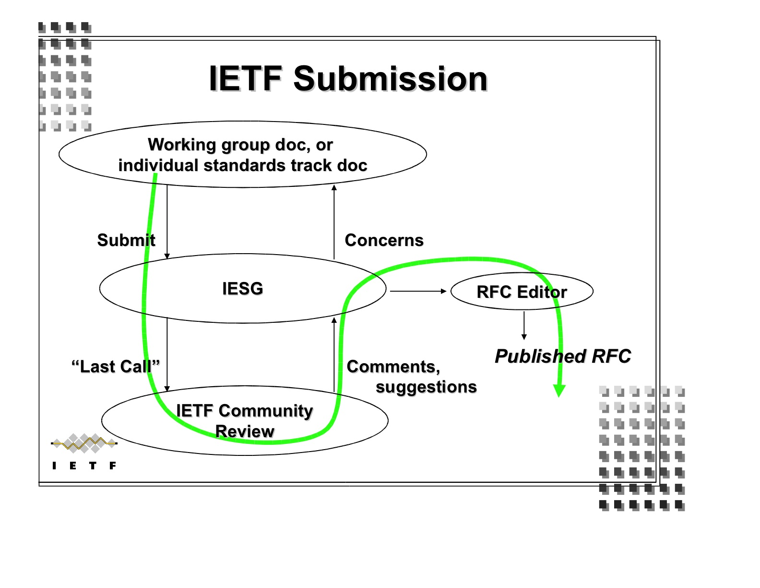
A Generic Case: draft-ietf-wg-topic-05
Let’s say your document has been approved by the IESG…
figure from Scott Bradner’s Newcomer Presentation

Slide 24

Step 1: Send your source file.
From: rfc-editor@rfc-editor.org
Subject: [RFC State] <draft-ietf-wg-topic-05> has been added to RFC Editor database.
Your document has been added to the queue (www.rfc-editor.org/queue.html).
Please send us your nroff or xml source file.
  Let us know if there are any changes between the version you send and the IESG-approved version.
If you don’t have one, don’t worry, we will use the Internet-Draft text to create an nroff file.

Slide 25
Step 2: Answer questions.
From: rfc-editor@rfc-editor.org or *@isi.edu
Subject: draft-ietf-wg-topic-05
Please reply to questions about your draft. Typically, these questions are about
  missing citations
    Ex: [RFC4301] appears as a normative reference, where would you like to cite it in the text?
  inconsistent terminology
    Ex: Which form of the term should be used throughout?
      RESTART Flag / Re-Start flag / Restart Flag
  unclear sentences

Slide 26
Step 3: See your document progress.
From: rfc-editor@rfc-editor.org
Subject: [RFC State] <draft-ietf-wg-topic-05> has changed state
Basic Process
IANA and/or REF holds
Also, you can check http://www.rfc-editor.org/queue.html

Slide 27
More details on queue states
Normative References
Set of RFCs linked by normative refs must be published simultaneously.
Two hold points:
  MISSREF state: a doc with norm. ref to a doc not yet received by RFC Editor.
  REF state: a doc that is edited but waiting for dependent docs to be edited.
IANA
Acts on IANA Considerations section (more on this later).
Creates new registries and assigns numbers.
Notes:
More details on queue states!

Slide 28
Step 4: Review your document carefully.
From: rfc-editor@rfc-editor.org
Subject: AUTH48 [SG]: RFC 4999 <draft-ietf-wg-topic-05>
This is your chance to review the edited version.
We send pointers to the txt and diff files
  and the XML file (when AUTH48 in XML)
Submit changes by sending OLD/NEW text or indicating global changes.
  Insert directly into the XML file (when AUTH48 in XML)
Each author listed on the first page must send their approval before the document is published.

Slide 29
More about AUTH48: Final Author Review
Last-minute editorial changes allowed – But should not be substantive or too extensive.
  Else, must get OK from AD, WG chair.
This process can involve a fair amount of work & time
  AT LEAST 48 hours!
  All listed authors must sign off on final document
  Authors should take it seriously - review the entire document, not just the diffs.
  Your last chance to avoid enrollment in the Errata Hall of Infamy!

Slide 30
Step 5: Publication!
Announcement sent to lists:
  ietf-announce@ietf.org and rfc-dist@rfc-editor.org
Canonical URI:
  http://www.rfc-editor.org/rfc/rfcXXXX.txt
Also available here:
  ftp://ftp.rfc-editor.org/in-notes/rfcXXXX.txt
Mirrored at IETF site and other sites.
NROFF and XML source files archived for later revisions.

Slide 31
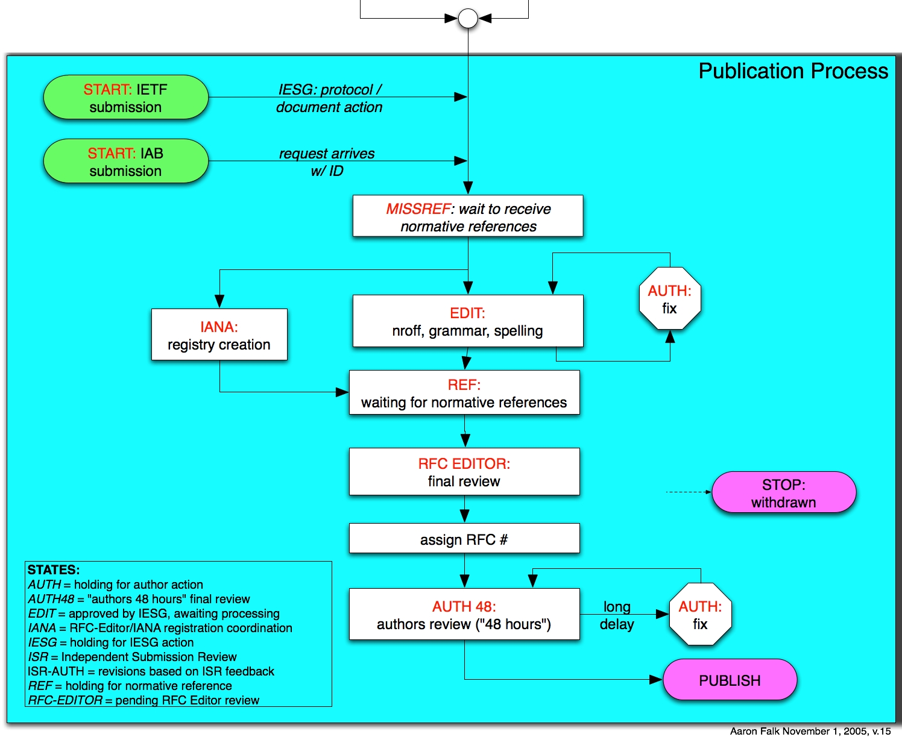
Process Flow Chart

Slide 32
Errata Page
www.rfc-editor.org/errata.php
  A list of technical and editorial errors that have been reported to the RFC Editor.
  Verified by the authors and/or the IESG, unless marked “Reported”.
  The RFC Editor search engine results contain hyperlinks to errata, when present.
How to report errata
  Use the online form available from the errata page

Slide 33
Overview of this Tutorial
Background: The RFC Series and the RFC Editor
The Publication Process
Contents of an RFC
How to Write an RFC
Conclusion

Slide 34
3. Contents of an RFC
  Header
  Title
  Header boilerplate (Status of Memo)
  IESG Note (when requested by IESG)
  Abstract
  Table of Contents (not required for short docs)
  Body
  Authors’ Addresses
  IPR boilerplate
    See RFC 3667/BCP 78, RFC 3668/BCP 79.

Slide 35
RFC Header
Network Working Group T. Berners-Lee
Request for Comments: 3986 W3C/MIT
STD: 66 R. Fielding
Updates: 1738 Day Software
Obsoletes: 2732, 2396, 1808 L. Masinter
Category: Standards Track Adobe Systems
January 2005
STD sub-series number 66
Updates, Obsoletes: relation to earlier RFCs.
  Please note this information in a prominent place in your Internet-Draft; preferably the header.

Slide 36
RFC Header: Another Example
Network Working Group T. Berners-Lee
Request for Comments: 2396 MIT/LCS
Updates: 1808, 1738 R. Fielding
Category: Standards Track U. C. Irvine
L. Masinter
Xerox Corporation
August 1998
Corresponding RFC Index entry (search on “2396”)
RFC2396
T. Berners-Lee, R.
Fielding, L.
Masinter
August
1998
ASCII
Obsoleted by RFC3986,
Updates RFC1808,
RFC1738, Updated by
RFC2732
Errata
DRAFT
STANDARD
Red fields were not known when RFC was published

Slide 37
Authors in Header
Limited to lead authors, document editors.
There must be very good reason to list more than 5.
Each author in the header must give approval during AUTH48 review.
Each author in the header should provide unambiguous contact information in the Authors’ Addresses section.
Other names can be included in Contributors and/or Acknowledgments sections.

Slide 38
Titles
Should be thoughtfully chosen
No un-expanded abbreviations - except for very well- known ones (e.g., IP, TCP, HTTP, MIME, MPLS)
We like short, snappy titles, but sometimes we get titles like:
  “An alternative to XML Configuration Access Protocol (XCAP) for manipulating resource lists and authorization lists, Using HTTP extensions for Distributed Authoring and Versioning (DAV)”

Slide 39
Abstracts
Carefully written for clarity (HARD to write!)
No un-expanded abbreviations (again, except well-known)
No citations
  Use “RFC xxxx”, not “[RFCxxxx]” or “[5]”
Less than 20 lines! Shorter is good.
Not a substitute for the Introduction;
redundancy is OK.
We recommend starting with “This document…”

Slide 40
Body of an Internet-Draft
First section should generally be “1. Introduction”.
Special sections that may appear:
  Contributors, Acknowledgments
  Internationalization Considerations
      When needed -- see Section 6, RFC 2277/BCP 18.
Sections that MUST appear:
  IANA Considerations
  Security Considerations
  References (Normative and/or Informative)

Slide 41
Security Considerations Section
Security Considerations section required in every RFC.
See RFC 3552: “Guidelines for Writing RFC Text on Security Considerations”
Important!

Slide 42
IANA Considerations Section
What is an IANA Considerations section?
  A guide to IANA on what actions will need to be performed
  A confirmation if there are NO IANA actions
Section is required in draft
  But “No IANA Considerations” section will be removed by RFC Editor.

Slide 43
Why is this section important?
Forces the authors to ‘think’ if anything should be requested from IANA
A clear IANA Considerations section will allow the IANA to process the IANA Actions more quickly
Establishes documented procedures

Slide 44
What should be included in the IANA Considerations section?
  What actions is the document requesting of IANA
  Individual number or name registrations
  New registries (number or name spaces)
  Registration procedures for new registries
  Reference changes to existing registrations
  BE CLEAR AND DESCRIPTIVE IN YOUR INSTRUCTIONS
  (IANA is not the expert for your name or number space)

Slide 45
Review of IANA Considerations
IANA Consideration sections are reviewed before the document is published as an RFC
  During IESG Last Call
  During IESG Evaluation
  IANA will also review your section at any time by request
If you do not have an IC section or if your IC section is not complete, your document will not move forward

Slide 46
Where to get help on writing this section
See RFC 2434, “Guidelines for Writing an IANA Considerations Section in RFCs”
  Soon to be replaced by RFC2434bis
Look at existing registries for examples
Ask IANA
  Available at the IANA booth at IETF meetings
  Send an e-mail [iana@iana.org] or [michelle.cotton@icann.org]

Slide 47
References
Normative vs. Informative
  Normative refs can hold up publication.
We STRONGLY recommend against numeric citations "[37]".
Citations and references must match.
Handy file of RFC reference text:
  ftp://ftp.rfc-editor.org/in-notes/rfc-ref.txt
Include draft strings of any I-Ds.

Slide 48
Copyrights and Patents
Copyright Issues
  Specified in RFC 3977/BCP 77 “IETF Rights in Contributions”
  Independent submissions: generally follow IETF rules
Patent (“IPR”) issues
  RFC boilerplate specified in RFC 3978/BCP 78
  “Intellectual Property Rights in IETF Technology”
  Recently updated by RFC 4748/BCP 78.
Generally, you supply the correct boilerplate in the Internet Draft, and the RFC Editor will supply the correct boilerplate in the RFC.

Slide 49
Overview of this Tutorial
Background: The RFC Series and the RFC Editor
The Publication Process
Contents of an RFC
How to Write an RFC
Conclusion

Slide 50
4. How to Write an RFC
Some editorial guidelines
Improving your writing
Preparation tools
MIBs and formal languages
“Instructions to Request for Comments (RFC) Authors”. draft-rfc-editor-rfc2223bis-08.txt aka
ftp.rfc-editor.org/in-notes/rfc-editor/instructions2authors.txt

Slide 51
General Editorial Guidelines
Immutability – once published, never change
Not all RFCs are standards
All RFCs in English
  RFC 2026 allows translations
  British English is allowed in principle, but there is some preference for American English.
Consistent Publication Format
  ASCII (also .txt.pdf for Windows victims)
  Also .ps or .pdf (special process for handling)

Slide 52
RFC Formatting Rules
ASCII, 72 char/line.
58 lines per page, followed by FF (^L).
No overstriking or underlining.
No “filling” or (added) hyphenation across a line.
<.><sp><sp> between sentences.
No footnotes.

Slide 53
RFC Editing
For correct syntax, spelling, punctuation: always.
  Sometimes exposes ambiguities
To improve clarity and consistency: sometimes.
  e.g., expand each abbreviation when first used.
To improve quality of the technical prose: occasionally.
By general publication standards, we edit lightly.
  Balance: author preferences against consistency and accepted standards of technical English.

Slide 54
Preserving the Meaning
A comment that does not faze us:
“How dare you change my perfect prose?”
  Just doing our job as editors!
A comment that concerns us very much:
“You have changed the meaning of what I wrote”.
  Often, because we misunderstood what you meant.
  That implies that your prose is ambiguous.
  You should recast the sentence/paragraph to make it clear and unambiguous, so even the RFC Editor cannot mistake the meaning. ;-)

Slide 55
The RFC Editor checks many things
  Header format and content
  Title format
  Abstract length and format
  Table of Contents
  Presence of required sections
  No uncaught IANA actions
  Spelling checked
  ABNF/MIB/XML OK, using algorithmic checker
  Citations match references
  Most recent RFC/I-D cited
  Pure ASCII, max 72 char lines, hyphens, etc.
  Header and footer formats
  Page breaks do not create “orphans”
  References split into Normative, Informative
  Boilerplate OK

Slide 56
Writing RFCs
Not literary English, but comprehensibility would be nice!
Avoid ambiguity.
Use consistent terminology and notation.
  If you choose “4-bit”, then use it throughout (not “four-bit”).
Define each term at first use.
Expand every abbreviation at first use.
See the abbreviations and terms lists available from http://www.rfc-editor.org/howtopub.html

Slide 57
Style
Primary goal: clear, unambiguous technical prose.
The RFC Editor staff generally follows two sources for style advice:
  Strunk & White (4th Ed., 2000)
  "A Pocket Style Manual" by Diana Hacker (4th Ed., 2004)
In any case, internally consistent usage is objective.
See the RFC style guide available from http://www.rfc-editor.org/howtopub.html

Slide 58
Sentence Structure
Simple declarative sentences are good.
  Flowery, literary language is not good.
  Goal: Simple descriptions of complex ideas.
Avoid long, involuted sentences. You are not James Joyce.
  Use “;” | “, and” | “, or” sparingly to glue successive sentences together.
Make parallel clauses parallel in syntax.
  Bad: “… whether the name should be of fixed length or whether it is variable length”.

Slide 59
Grammar Tips
Avoid passive voice (backwards sentences).
  “In this section, the network interface is described.”
  vs. “This section describes the network interface.”
Some Protocol Engineers over-capitalize Nouns.
“which” vs. “that”
For example:
  (non-restrictive which: all RST attacks rely on brute-force)
It should be noted that RST attacks, which rely on brute-force, are relatively easy to detect at the TCP layer.
  (restrictive that: only *some* RST attacks rely on brute-force)
It should be noted that RST attacks that rely on brute-force are relatively easy to detect at the TCP layer.

Slide 60
Punctuation Conventions
A comma before the last item of a series:
  “TCP service is reliable, ordered, and full-duplex”
  Avoids ambiguities, clearly shows parallelism.
Punctuation outside quote marks:
“This is a sentence”{.|?|!}
  To avoid computer language ambiguities.

Slide 61
Lean and Mean
You often improve your writing by simply crossing out extraneous extra words.
  Look at each sentence and ask yourself,
  “Do I need every word to make my meaning clear and unambiguous?”
  English professors call it the “Lard Factor” (LF) [Lanham79]
  “If you’ve not paid attention to your own writing before, think of a LF of ⅓ to ½ as normal and don’t stop revising until you’ve removed it.” [Lanham79]
[Lanham79] Richard Lanham, “Revising Prose”, Scribner’s, New York, 1979.

Slide 62
A Real Example
"When the nature of a name is decided one must decide whether the name should be of fixed length or whether it is variable length." (25 words)
“One must decide whether the length of a name should be fixed or variable.” (14 words, LF = .44)
“We may choose fixed or variable length for a particular class of name.” (13 words)
“A name may have fixed or variable length.”
(7 words, LF = .72)

Slide 63
Another Real Example
"One way to avoid a new administrative overhead would be for individuals to be able to generate statistically unique names." (20 words)
“New administrative overhead can be avoided by allowing individuals to generate statistically unique names.”
(14 words, LF = .30)
“Allowing individuals to generate statistically unique names will avoid new administrative overhead.”
(12 words, LF = .40)

Slide 64
Another (reality-based) Example
“This is the kind of situation in which the receiver is the acknowledger and the sender gets the acknowledgments.” (19 words)
“An acknowledgment action is taking place from the receiver and the sender.” (11, LF=.42)
“The receiver returns acknowledgments to the sender.” (7, LF=.63)

Slide 65
Another Real Example
“Also outside the scope are all aspects of network security which are independent of whether a network is a PPVPN network or a private network (for example, attacks from the Internet to a web-server inside a given PPVPN will not be considered here, unless the way the PPVPN network is provisioned could make a difference to the security of this server).”
  Two sentences!
  “make a difference to” -> “affect”

Slide 66
iceberg

Slide 67
Format for Readability
Careful use of indentation and line spacing can greatly improve readability.
  Goes a long way to compensate for single font.
  Bullets often help.
  High density on a page may be the enemy of clarity and readability.
The RFC Editor will format your document according to these guidelines, but it is helpful if you can do it in the I-D.

Slide 68
Hard to read
3.1 RSVP Message Formats
3.1.1 Common Header
The fields in the common header are as
follows:
Flags: 4 bits
0x01-0x08: Reserved
No flag bits are defined yet.
Send_TTL: 8 bits
The IP TTL value with which the message is
sent. See Section 3.8.

Slide 69
Formatted for Easier Reading
3.1. Message Formats
3.1.1. Common Header
The fields in the common header are as
follows:
Flags: 4 bits
0x01-0x08: Reserved
No flag bits are defined yet.
Send_TTL: 8 bits
The IP TTL value with which the message is
sent. See Section 3.8.

Slide 70
Text Formatting Tools
Author tools: www.rfc-editor.org/formatting.html
  xml2rfc
  nroff
  Microsoft word template
  LaTeX
RFC Editor does final RFC formatting using venerable Unix tool nroff –ms.

Slide 71
xml2rfc (http://xml.resource.org)
The xml2rfc tool converts an XML source file to text, HTML, or nroff. RFC 2629 and its unofficial successor (http://xml.resource.org/authoring/draft-mrose-writing-rfcs.html) define the format.
XML templates are available from
http://www.rfc-editor.org/formatting.html:
  For a generic I-D (by Elwyn Davies)
  For an I-D containing a MIB (by David Harrington)

Slide 72
nroff, groff
Handy templates for authors using nroff:
  ftp.rfc-editor.org/in-notes/rfc-editor/2-nroff.template
    Published in 1991 by J. Postel. Updated October 2006.
    Gives instructions on using macros for creating RFCs.
  www.1-4-5.net/~dmm/generic_draft.tar.gz
    Updated nroff template maintained by David Meyer.
If you use nroff –ms (without a private make file), give the nroff source to the RFC Editor.

Slide 73
MIB RFCs: A Special Case
MIB references
  O&M Web Site at www.ops.ietf.org/
  MIB doctors at www.ops.ietf.org/mib-doctors.html
  MIB Review: See RFC 4181, BCP 111: “Guidelines for Authors and Reviewers of MIB Documents”
Tools
  http://www.ops.ietf.org/mib-review-tools.html
  smilint at www.ibr.cs.tu-bs.de/projects/libsmi/
  SMICng at www.snmpinfo.com/
MIB boilerplate
  The Internet-Standard Management Framework:
    www.ops.ietf.org/mib-boilerplate.html
  Security Considerations: www.ops.ietf.org/mib-security.html

Slide 74
Use of Formal Languages
Formal languages and pseudo-code can be useful as an aid in explanations, although English remains the primary method of describing protocols.
Pseudo-code judged on the basis of clarity.
Formal Languages (e.g., ABNF, XML, ASN.1 (MIBs))
  Requires a normative reference to language specification
  RFC Editor will run verifier program.
www.ietf.org/IESG/STATEMENTS/pseudo-code-in-specs.txt
ftp.rfc-editor.org/in-notes/rfc-editor/UsingPseudoCode.txt

Slide 75
Overview of this Tutorial
Background: The RFC Series and the RFC Editor
The Publication Process
Contents of an RFC
How to Write an RFC
Conclusion

Slide 76
5. Conclusion: Hints to Authors
Read your I-D carefully before submission, as you would read the final document in AUTH48!
Respond promptly to all messages from RFC Ed.
If your I-D is in the queue, and you see typos or have a new email address, send us an email.
DON’T use numeric citations (unless you submit an XML file).
Avoid gratuitous use of requirement words (MUST, etc.)
Craft title and abstract carefully.
Remember that your document should be understandable by people who are not deep experts in the subject matter.

Slide 77
Ongoing Issues
Normative references
  Practical effect: can hold up publication
MUST/MAY/SHOULD/… requirement words
  Do they belong in Informational documents at all?
  Tend to be overused or used inconsistently.
URLs in RFCs
  Some are more stable than others…
Updates and Obsoletes relationships
  Some disagreement on what they mean
  At best, only high-order bit of complex relationship
  RFC Editor hopes ISD (Internet Standard Document) [Newtrk] will be more systematic and complete.

Slide 78
Q: Why hasn’t my document been published yet?
A: You can check the state of your document online at www.rfc-editor.org/queue.html
  “IANA” indicates waiting on IANA considerations
  “REF” indicates there are normative references
  “AUTH48” indicates each author must send final approval of the document

Slide 79
Q: What if one of the authors cannot be located during AUTH48?
A: You have several options:
An AD can approve the document in place of the unavailable author. See http://www.ietf.org/IESG/STATEMENTS/auth48-announcement.txt
The author can be moved to a Contributors or Acknowledgments section.

Slide 80
Authoritative References
Overview of RFC publication:
www.rfc-editor.org/howtopub.html
“Instructions to Request for Comments (RFC) Authors”. draft-rfc-editor-rfc2223bis-08.txt aka
ftp.rfc-editor.org/in-notes/rfc-editor/instructions2authors.txt

Slide 81
The IETF Web Site & IETF Tools
http://www.ietf.org
  Working Group charters, mailing lists
  Meeting agendas and proceedings
  I-D Submission and I-D Tracker
  IESG actions
http://tools.ietf.org
  Tools for preparing drafts, viewing drafts, communicating, following IETF meetings

Slide 82
Thank you
Questions? Comments?
Ask us now!
IETF 71: Stop by the RFC Editor or IANA Desks.
RFC Editor Interest List: rfc-interest@rfc-editor.org
Email: rfc-editor@rfc-editor.org

