Slide 1
Website Catalog
Group 6:
Cory Sherman
Gon Kim
Chris Huang

Slide 2
Project Description
Catalog top web domains and data about them
Data parsed from Alexa and WebsiteOutlook
Top 500 domains, 100 Unicode, 29 incomplete
BST breadth-first traversal
Hash buckets

Slide 3
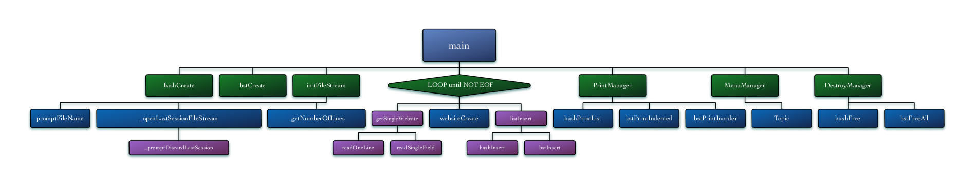
Structure Chart
Breadth-first traversal

Slide 4
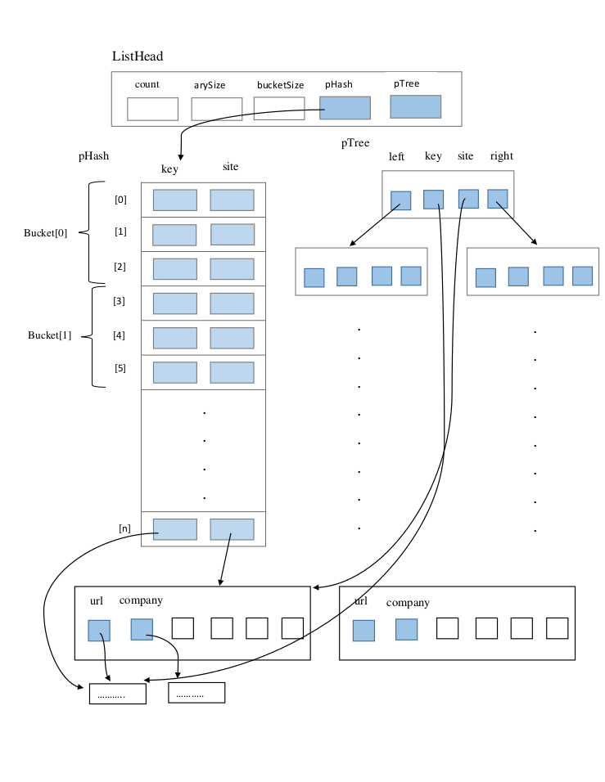
Data Structure Diagram
Hash buckets

Slide 5
Demonstration

