Slide 1
Point of Sale GUI
Cory Wilson

Slide 2
Description
My project is a Graphical User Interface that is design for use as a Point of Sale system at a restaurant.
The GUI is designed to track current orders, total them.
The GUI tracks the time it takes from order initialization until completion
My file input is from a .csv file that contains the prices of the items.
The output the total gross revenue for the day

Slide 3
Goals
Goal{01} = 'Read/Write info from a .csv file.';
Goal{02} = 'Open a GUI with a push button';
Goal{03} = 'Control multiple GUIs based on a master GUI';
Goal{04} = 'Initiate a timer from a start to end and compile that data';
Goal{05} = 'track revenue from the POS system’;
Goal{06} = 'have a password protected function for manager use';
Goal{07} = 'Apply discounts to order totals’;
Goal{08} = 'Alert the operator when inventory is low’;
Goal{09} = 'Populate a pop up menu from an outside source’; (commented out because I tried to simplify my GUI to complete the project.)
Goal{10} = 'compile a ''suggested order'' list based on product sold that day’
Goals in red were not completed.

Slide 4
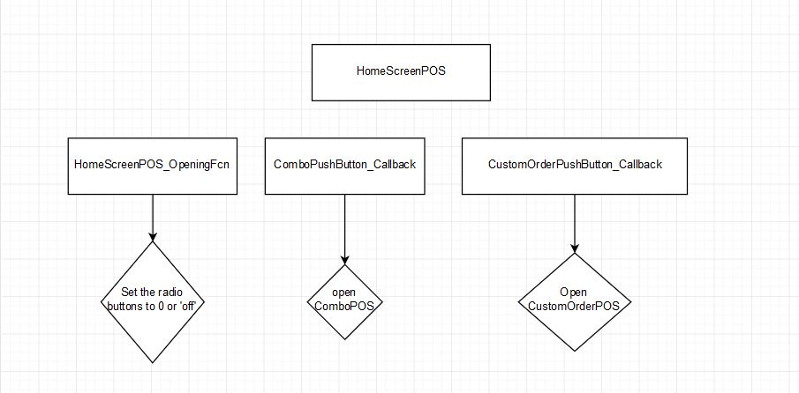
Flow Control

Slide 5
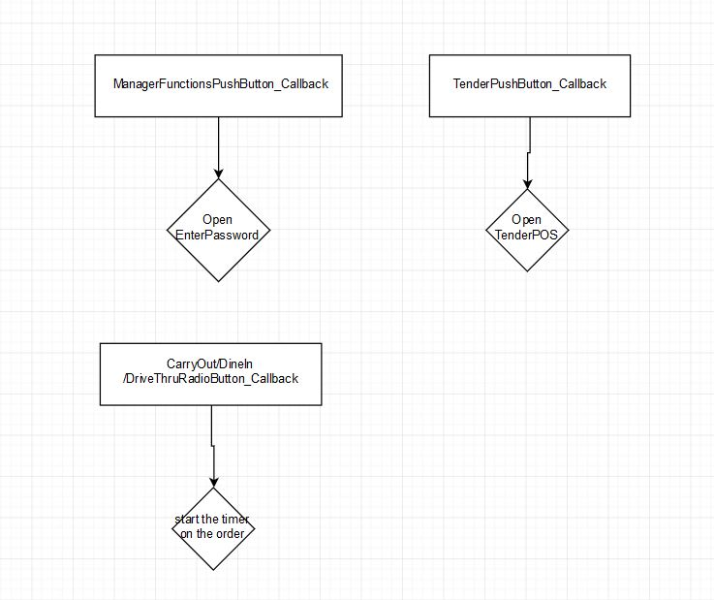
Flow Control

Slide 6
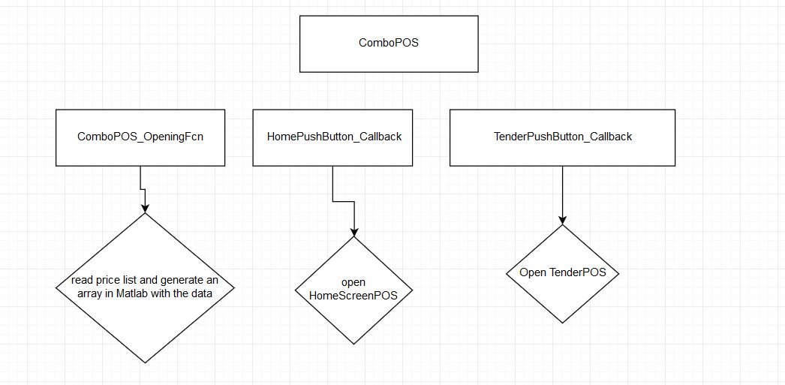
Flow Control

Slide 7
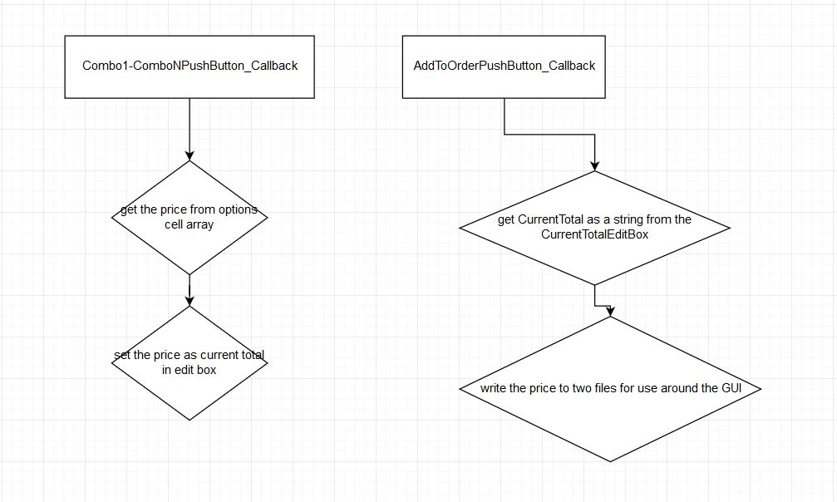
Flow Control

Slide 8
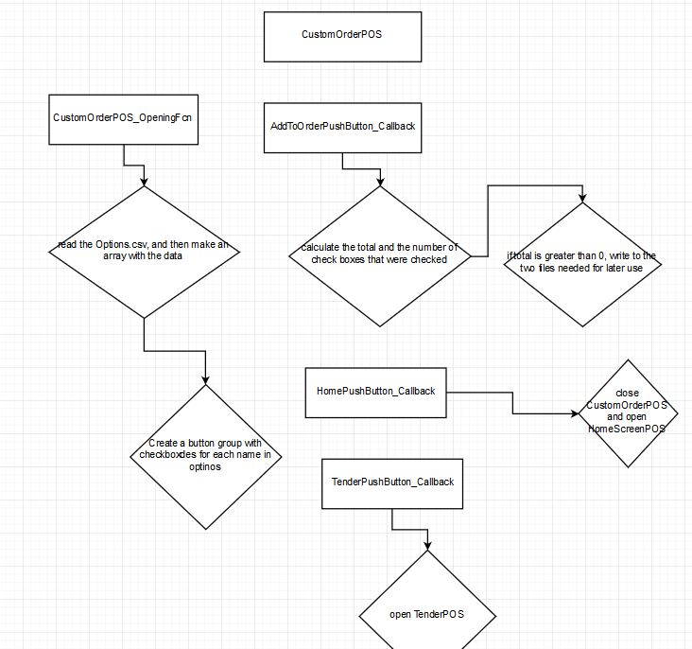
Flow Control

Slide 9
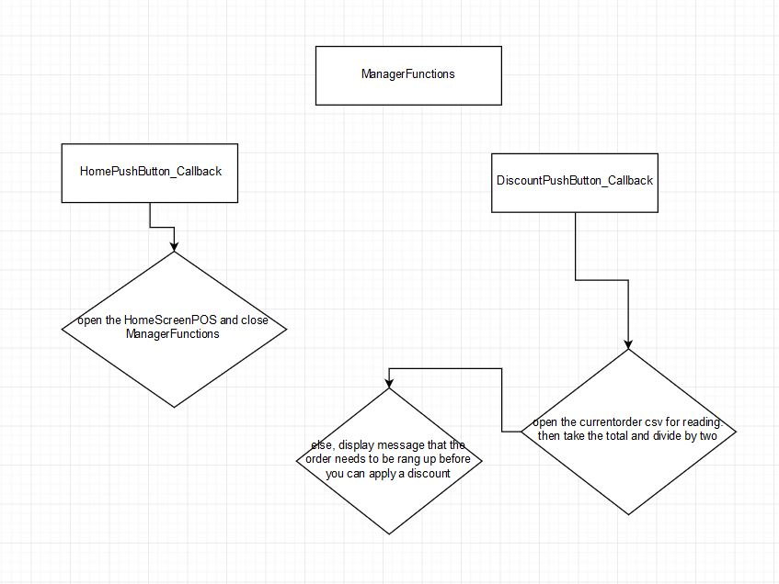
Flow Control

Slide 10
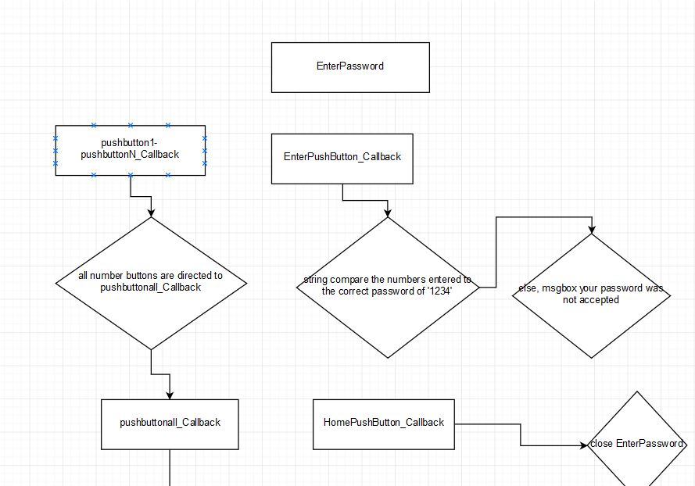
Flow Control

Slide 11
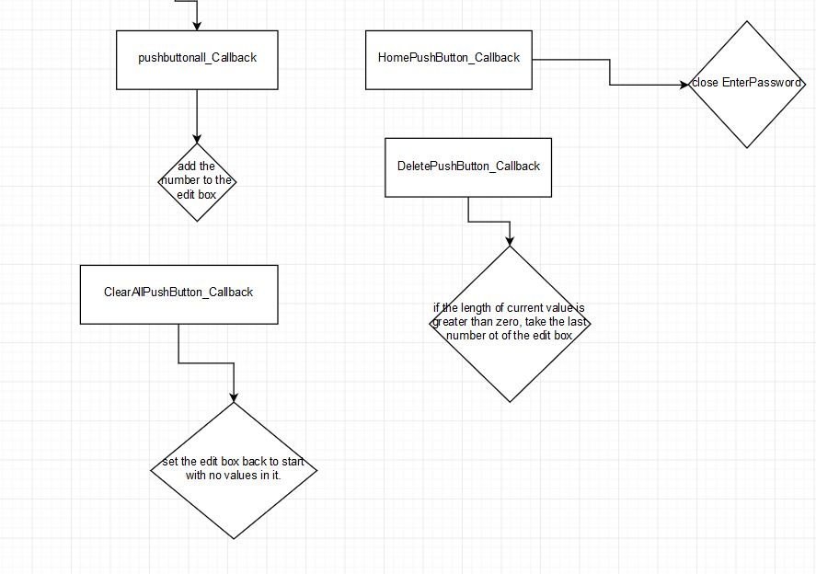
Flow Control

Slide 12
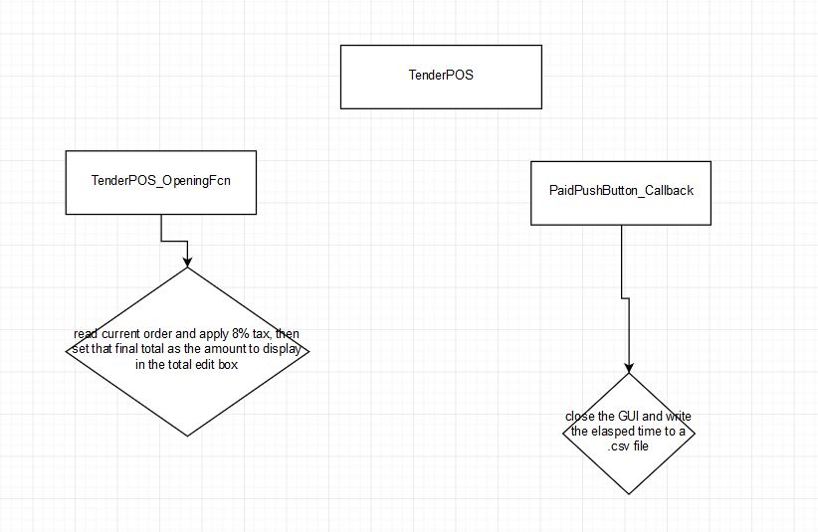
Flow Control

Slide 13
Problems Encountered
I had issues trying to get the sandwiches GUI to function. The checkboxes differed from the push buttons in the ComboPOS in that in the add to order callback, I need to be able to see which boxes had been checked and sum their prices.
I had some issues with the application of the discounts. I could not figure out a sufficient way to have the push button callback for the discount pull the information from another GUI.

Slide 14
Future Works
If I had more time for this project, I believe I could restructure the GUI to fit what I know how to do, instead of know what I want to do and trying to figure out how to do it. i.e. restructure the GUI
If I had more time, I would’ve liked to have the inventory management system accompany the Point of Sale system.

