Slide 1
Impact of climate change on
Extreme Sea Levels
Khin Nawarat
PhD candidate
Coastal and Urban Risk & Resilience Department

Slide 2

Contents
1
What is the driver of coastal flooding?
2
including the climate change impacts
3
Methodology details
4
Regional workshops
5
Towards application

Slide 3
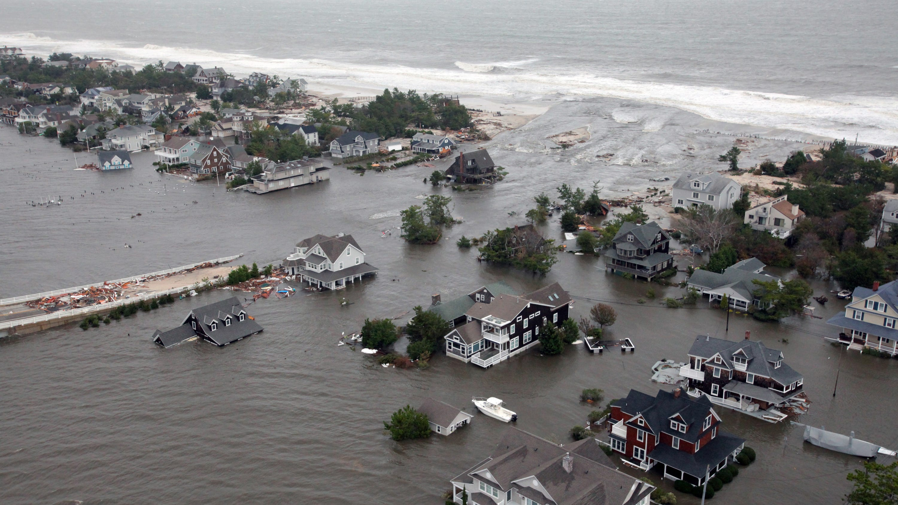
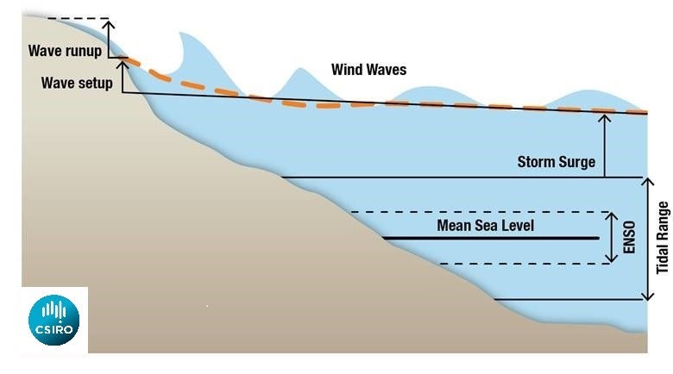
Extreme sea level
tide + storm surge + wave setup + sea level rise
[Credit: USA TODAY NEWS]

Slide 4
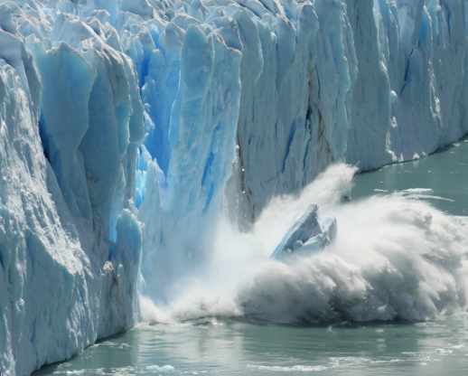
Relative sea level rise
Relative sea level rise contributes to increases in the frequency and severity of coastal flooding in low-lying areas and to coastal erosion along most sandy coasts
(high confidence).

Slide 5
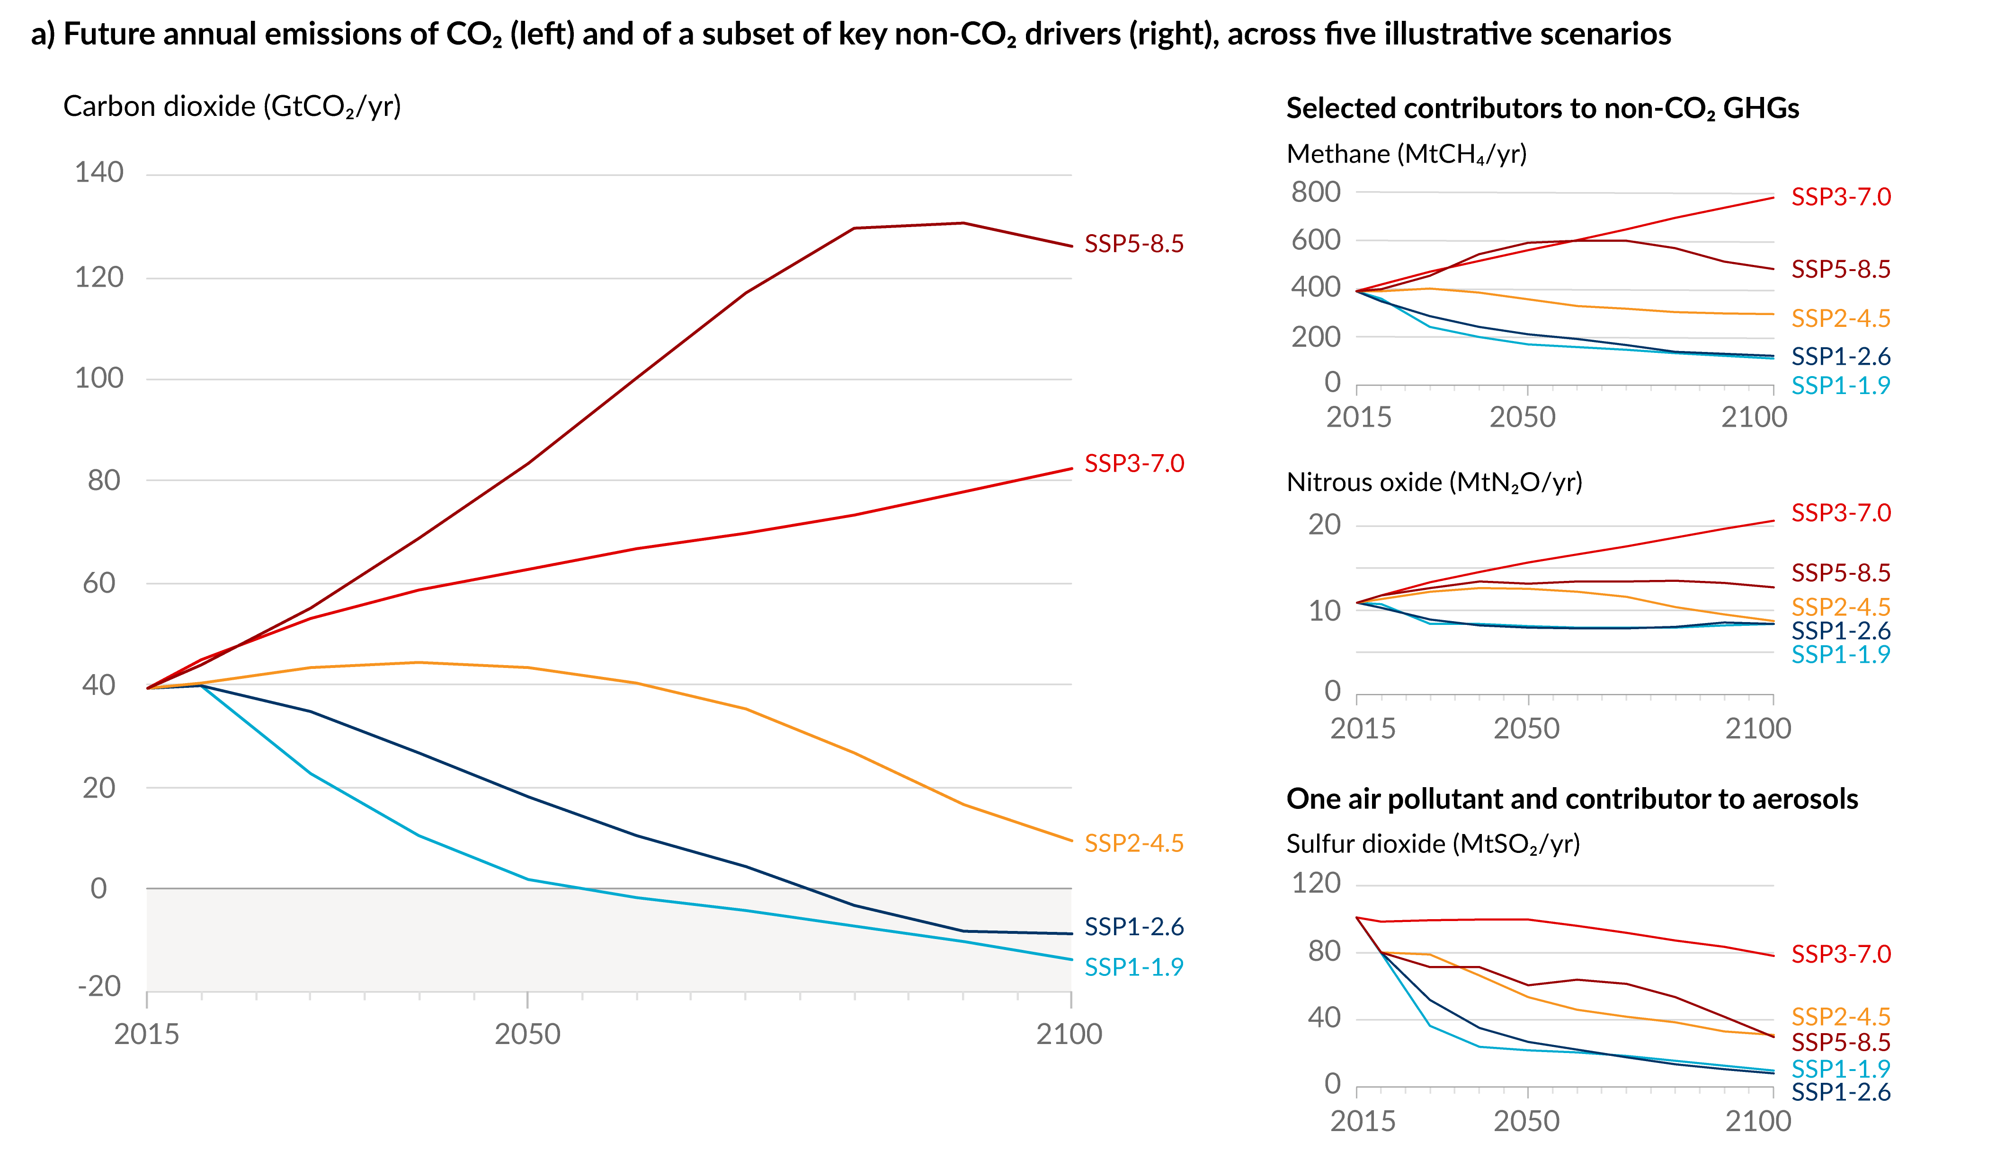
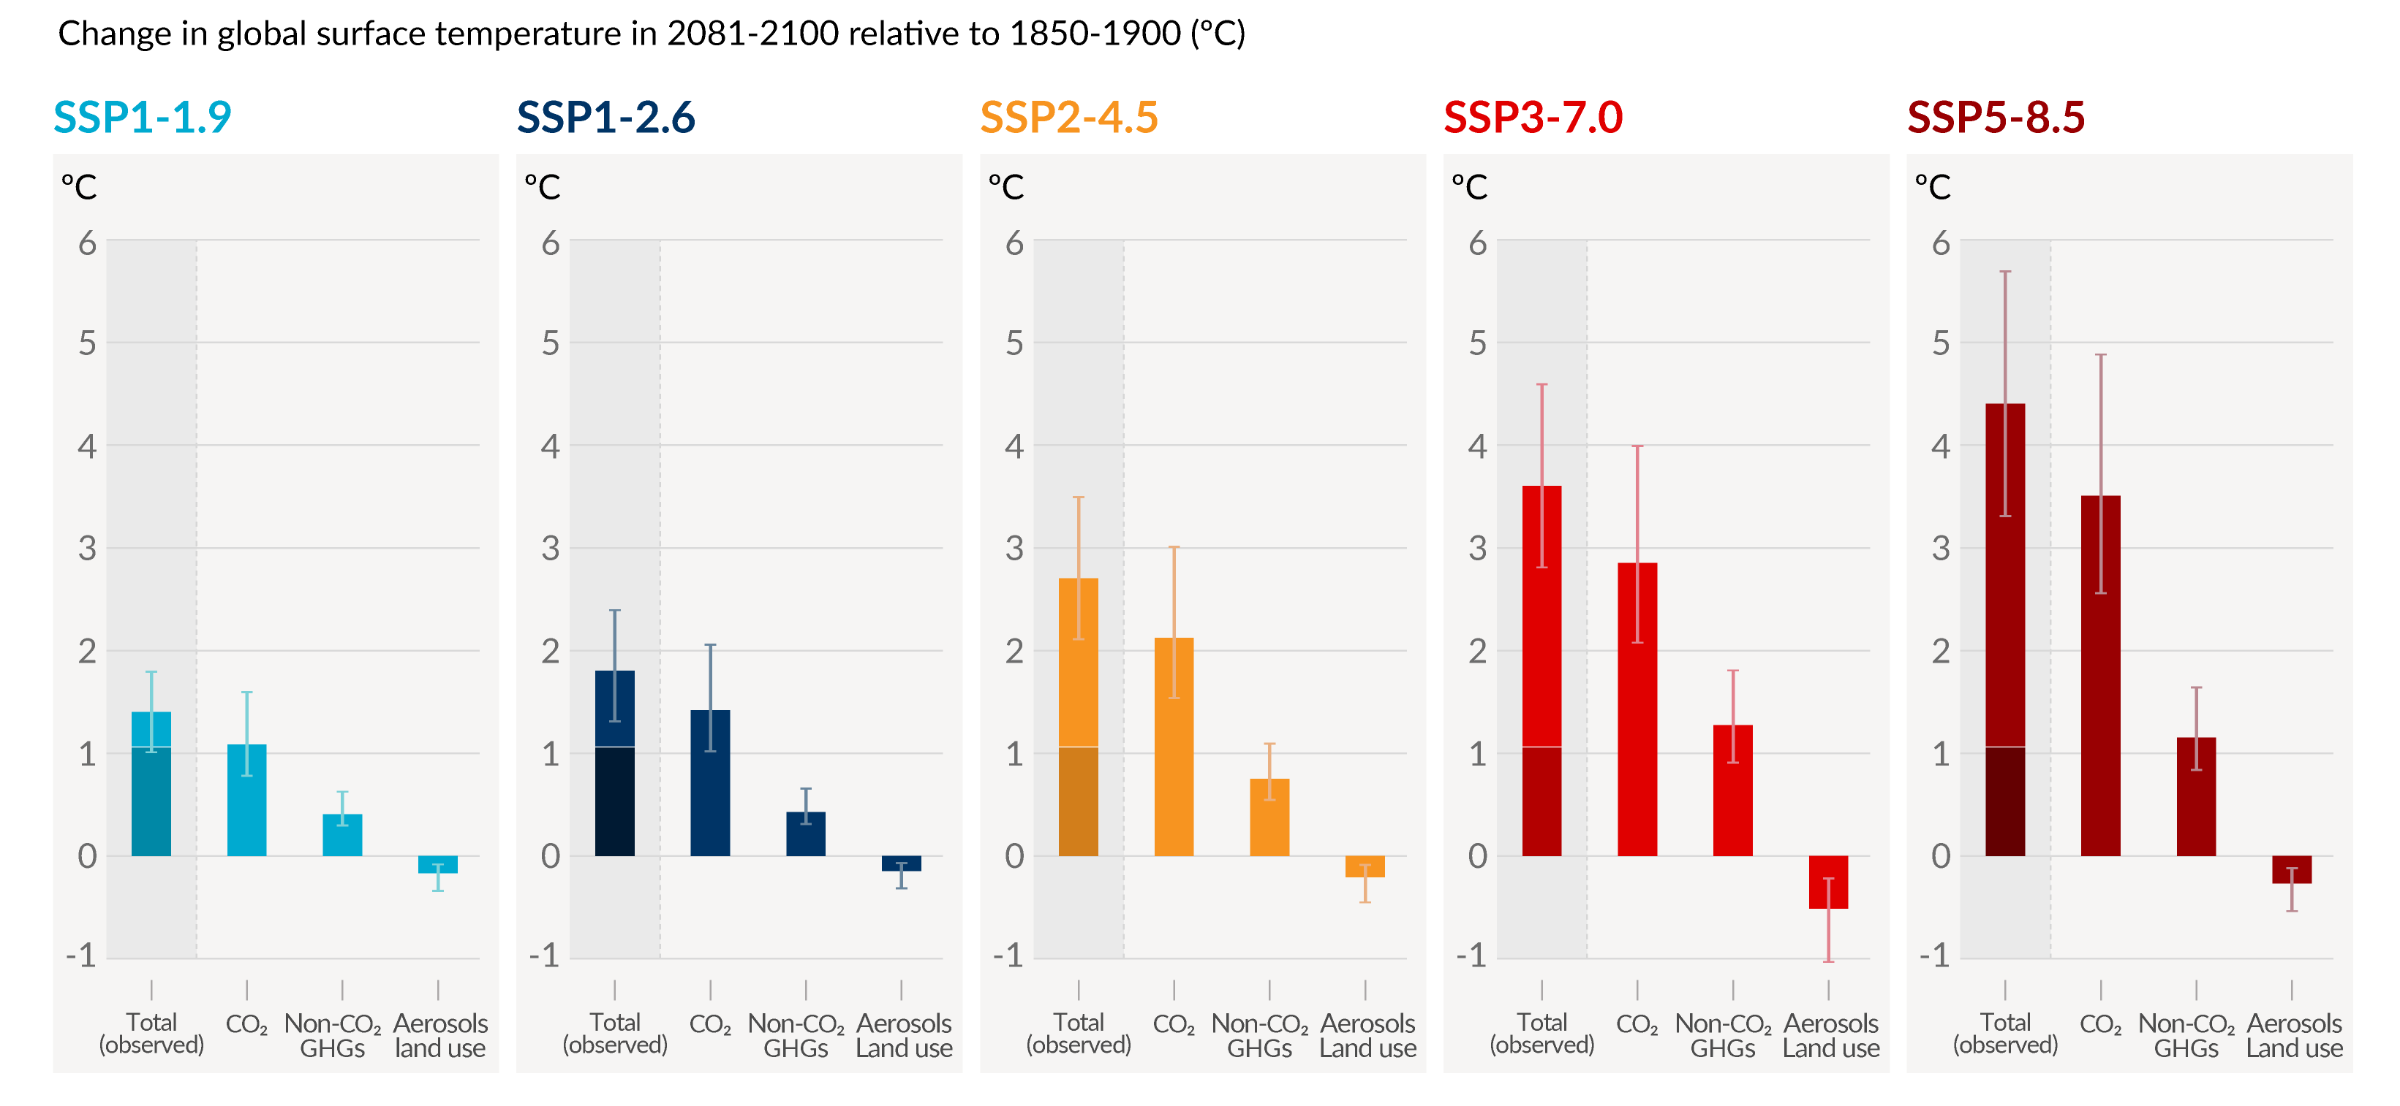
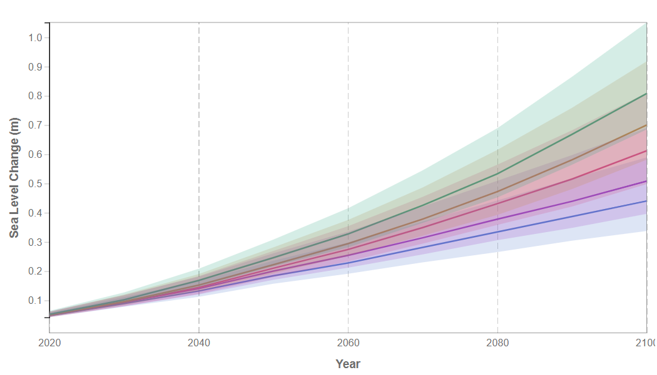
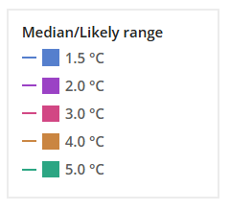
sea level rise by warming levels
~4.5°C
~4°C
~3°C
~2°C
~1.5°C

Slide 6
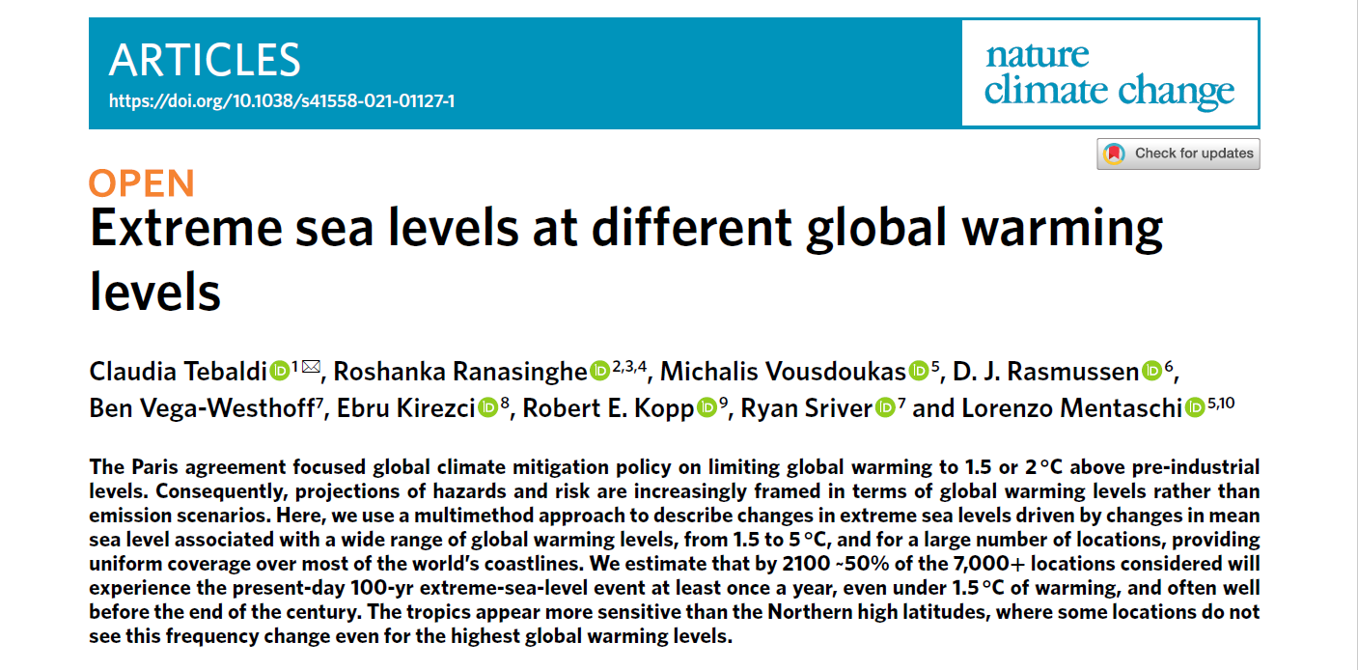
Publication after AR6 WGI
In which part of the world a 100-year event will becoming an annual event if global warming reached 1.5°C – 5°C by the end of 21st century?

Slide 7

Under which warming level?
100-yr
coastal setback line definition
1yr
coastal zone management for storm erosion

Slide 8
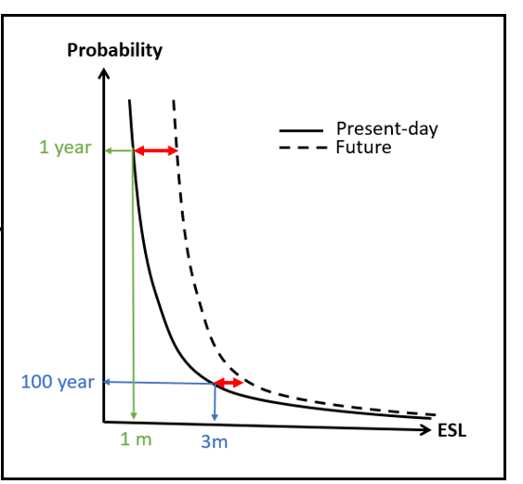

Probability
TWL

Slide 9
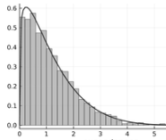
Integrating uncertainty
present-day ESL
100-yr
100-yr
100-yr
100-yr
100-yr
+
randomly picked SLR (x°C)
=
50-yr
future ESL under x°C
70-yr
20-yr
80-yr
1-yr

Slide 10
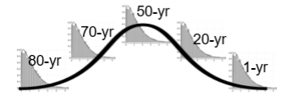
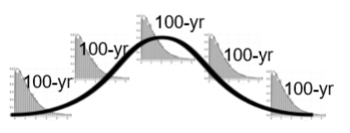
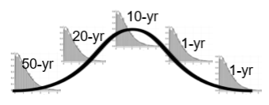
6 alternatively paired ESL projections for x°C
3 present-day ESL datasets
2 sea level rise projections for x°C
ESL full convolution for x°C
most likely
Vousdoukas et al. (2018)
Rasmussen et al. (2018)
best-case
worst-case
Kireczi et al. (2018)
Vega-Westhoff et al. (2019)
Rasmussen et al. (2018)

Slide 11
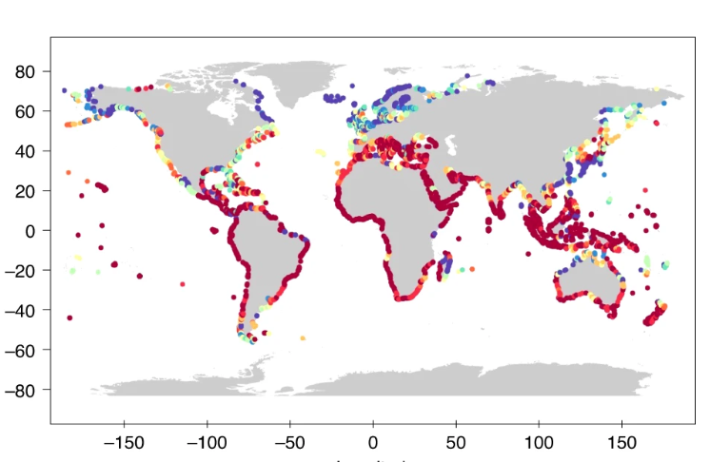
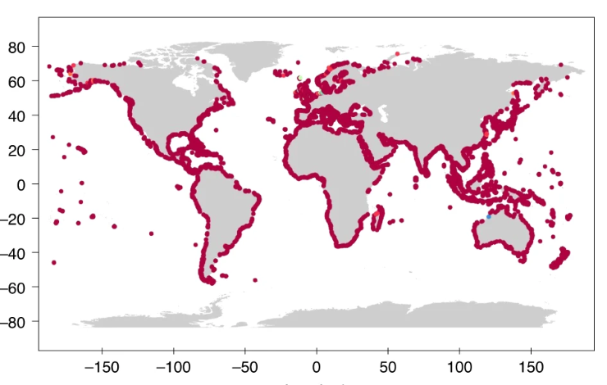
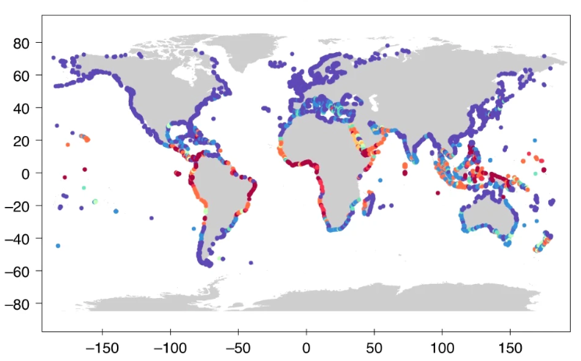

Present-day 100-yr ESL event to become at least an annual event – under which GWL?
lower
most likely
upper
“~50% of the locations considered will experience the present-day 100-yr extreme-sea-level event at least once a year, even under 1.5 °C of warming”

Slide 12
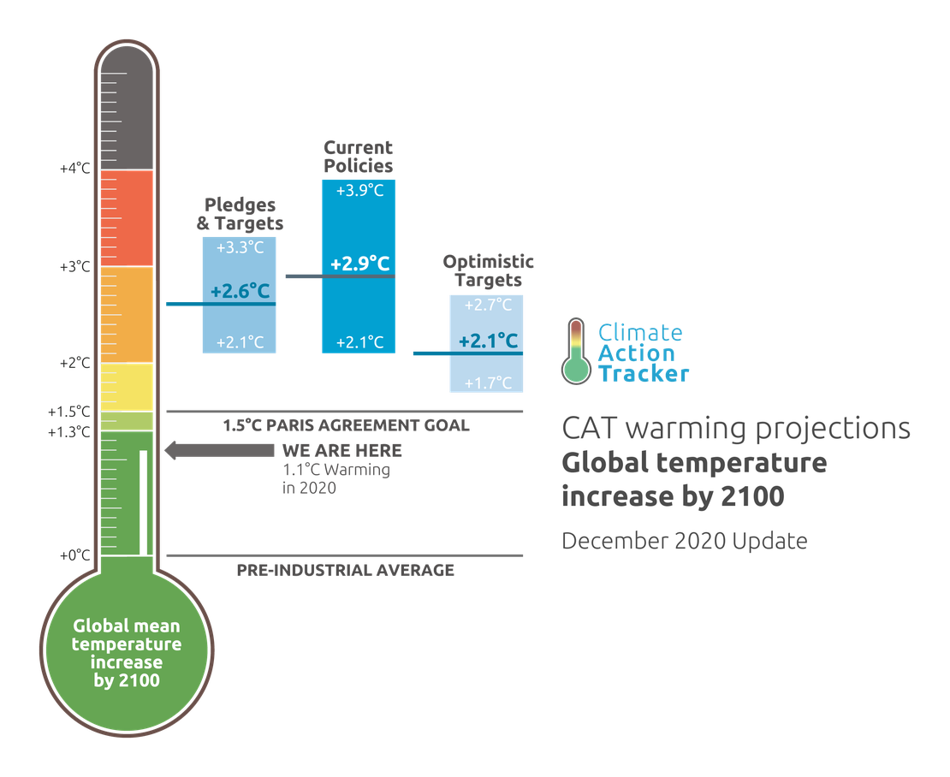

for climate resilient coastlines, we need
3°C
Projections for different global warming levels and return periods

Slide 13
Different return periods
200-yr
insurance premia
100-yr
coastal setback line definition
50-yr
port and harbour design
1-yr and 10-yr
coastal zone management for storm erosion

Slide 14
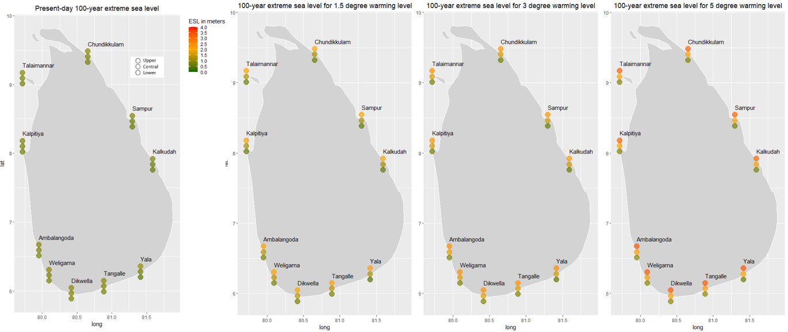
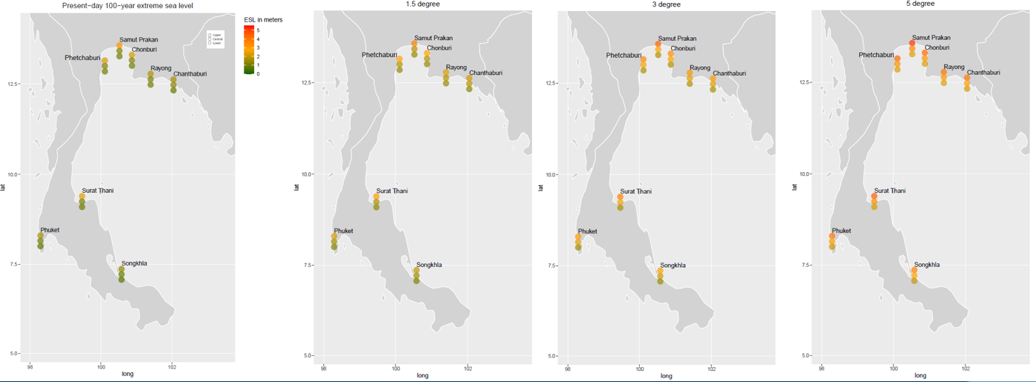
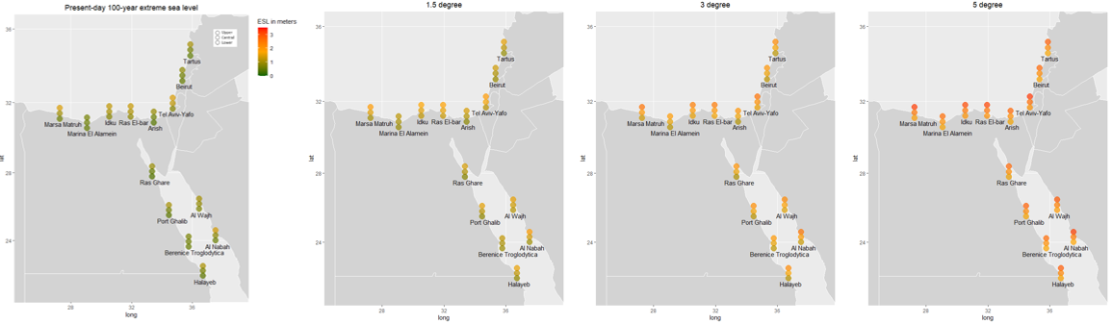
GWL impact on other RPs –Sri-Lanka, Thailand, Egypt
Locations | +1.5° C | +3° C | +5° C
El-Alamein | 2080 [2040 - >2100] | 2070 [2040 - >2100] | 2060 [2030 - 2100]
Alexandria | 2080 [2040 - >2100] | 2070 [2040 - >2100] | 2060 [2030 - 2090]
Kafr-El-Sheikh | 2080 [2040 - >2100] | 2070 [2040 - >2100] | 2060 [2040 - 2100]
Damietta | 2080 [2040 - >2100] | 2070 [2040 - >2100] | 2060 [2040 - >2100]
Port-Said | 2090 [2040 - >2100] | 2070 [2040 - >2100] | 2060 [2030 - >2100]

Slide 15
GWL impact on other RPs – Egypt, Thailand, Sri-Lanka
ESLs around all these countries are projected to rise significantly, with potential increases ranging from two-fold to several times the current levels.
ESL increase is higher for 1 yr and 10 yr RP ESLs, and there is not that much difference among the increases (%) for other RP ESLs
The increase in ESLs becomes highly pronounced for GWL > 3°C.
Achieving Paris agreement temperature target will have more adaptation time for the Nile Delta

Slide 16
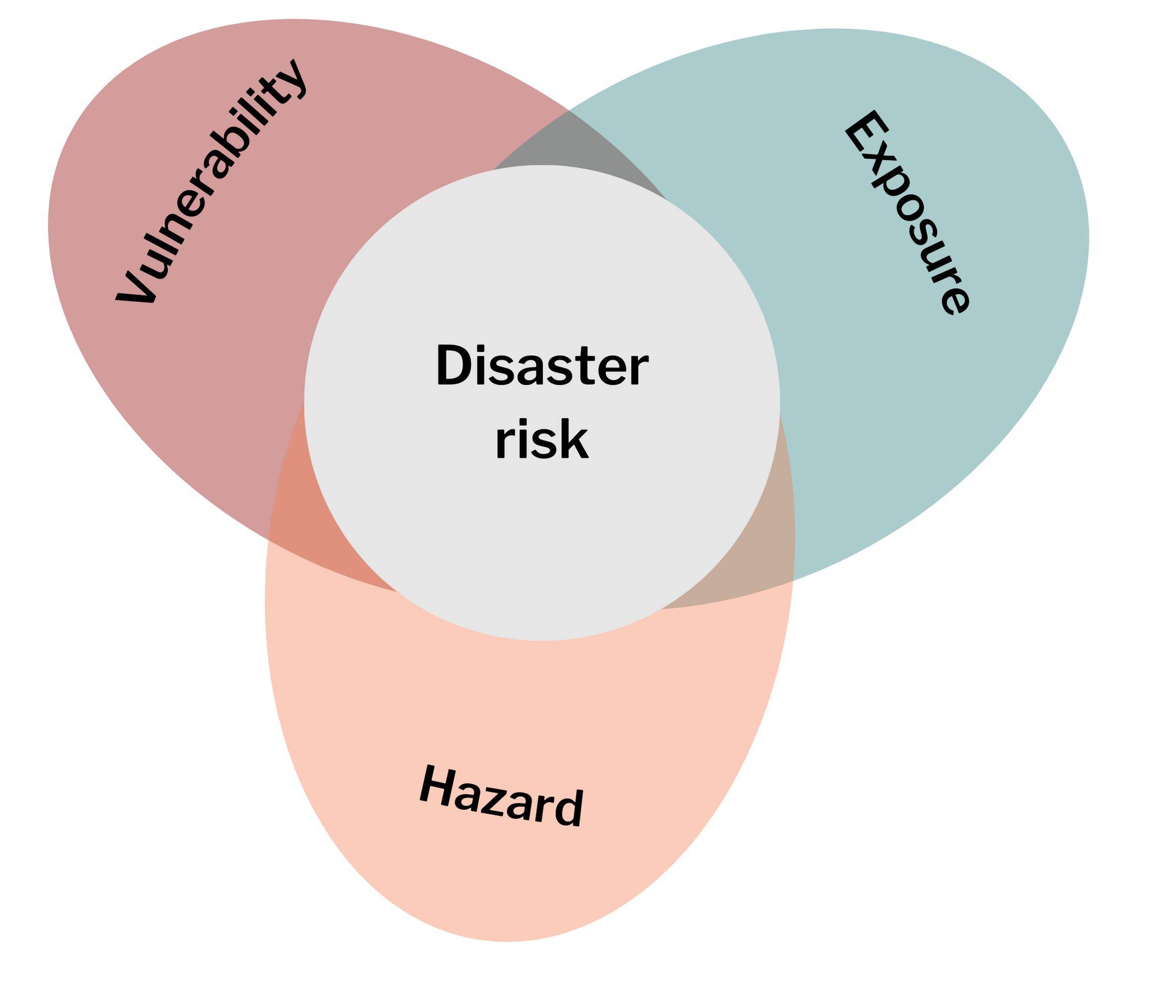
Application towards climate resilient coastline
Climate change integrated coastal flood maps
coastal flood risk assessment
Adaptation measures and future planning
CC impact in the driver
projections of ESL based on hydrodynamic modelling or observed data
coastal flood maps
forced by ESL projections and based on high resolution elevation models (Fully dynamic coastal flood modeling (SFINCS))
coastal flood defenses, relocate, retreat, accommodate, etc.

Slide 17

Thank you
Contact: k.nawarat@un-ihe.org

