Slide 1
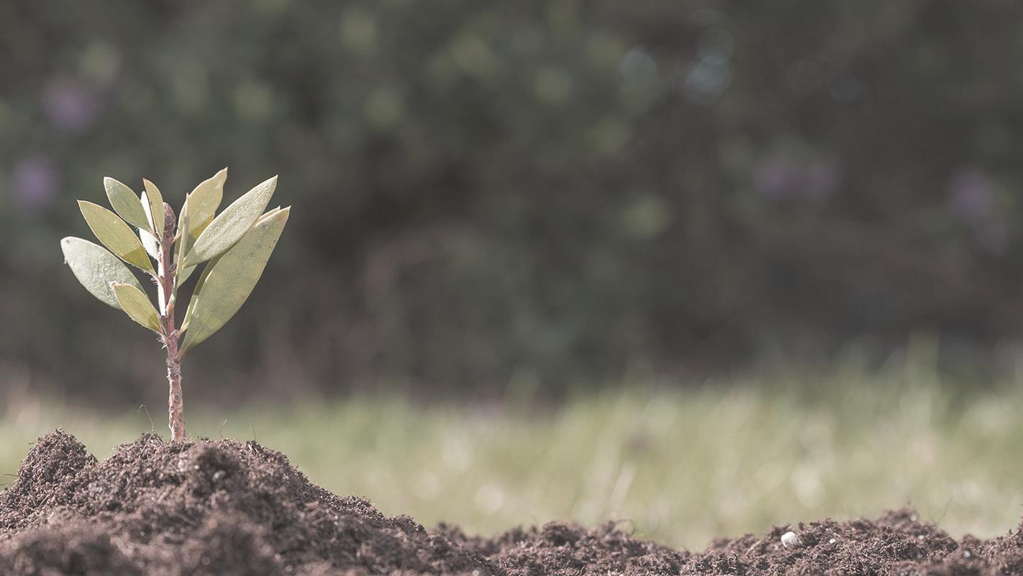
Présentation Projet PII
VESSE Léo (Chef de projet)
AING Olivia
LERUEZ Thomas
UNGARO Cosimo

Slide 2
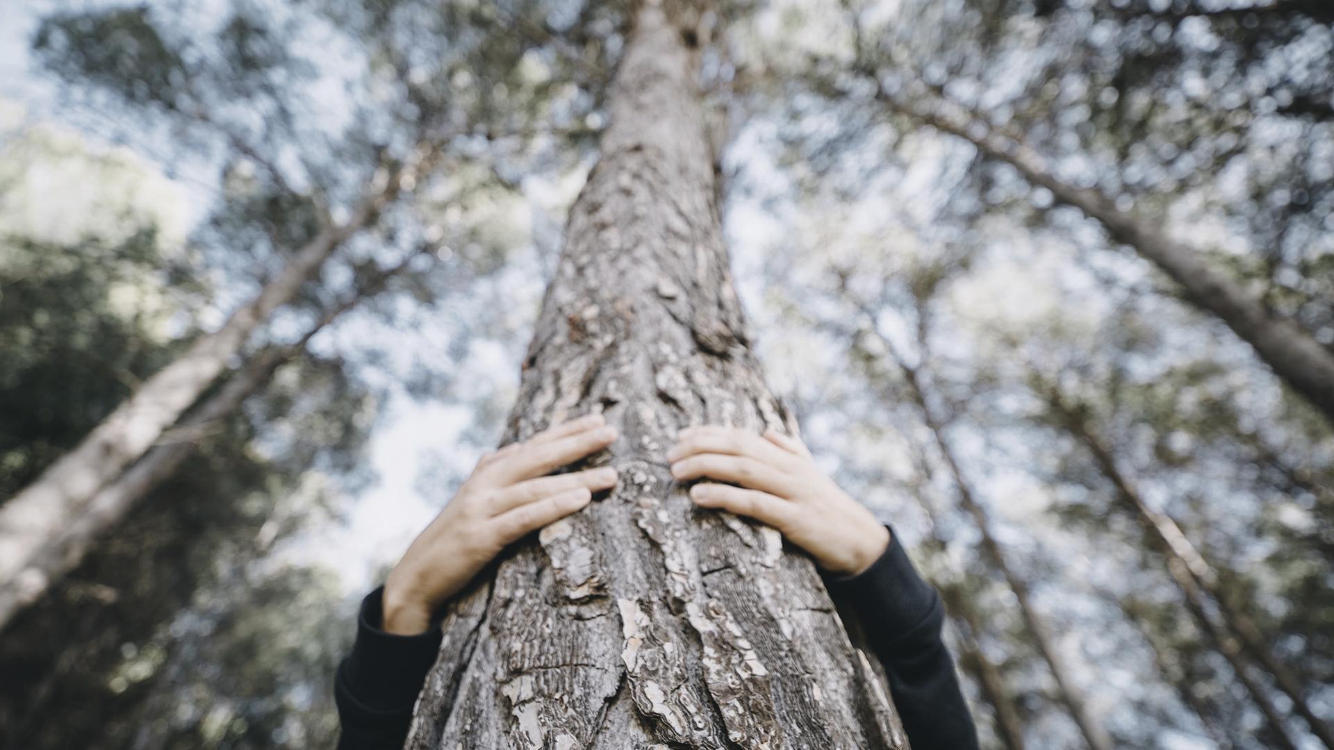
Introduction
Plateforme WEB
AMAP
Circuits courts
Jardins partagés
Particuliers

Slide 3
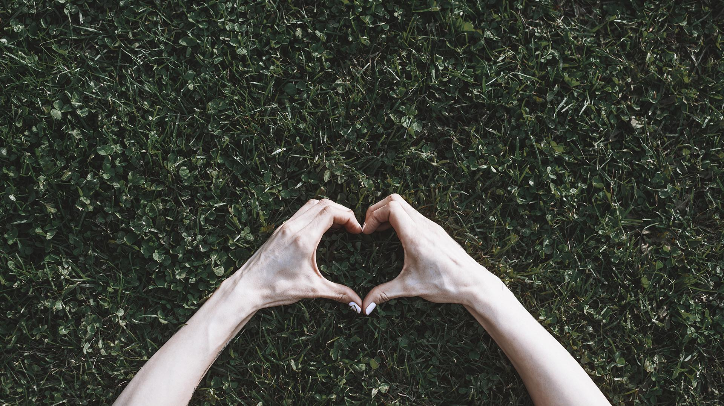
PLAN
01
02
03
Etat de l’art
Concept...
GdP
Plateformes existantes
... et innovations
Gestion de Projet
Matrice SWOT
Gantt
Matrice RACI

Slide 4
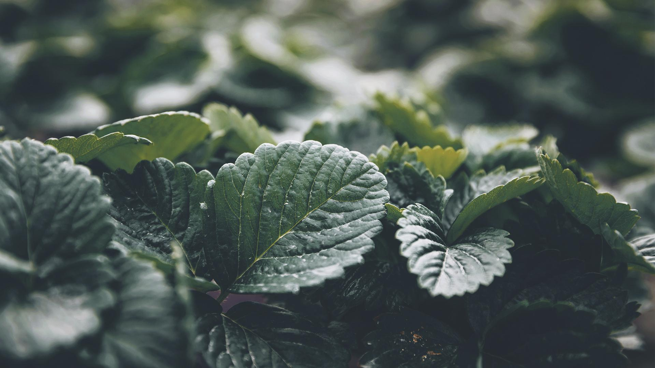
01
Introduction
Quelles sont les plateformes existantes?
Que proposent-elles?

Slide 5

106 018
Exploitations en circuits courts en 2016
Source: agriculture.gouv.fr

Slide 6
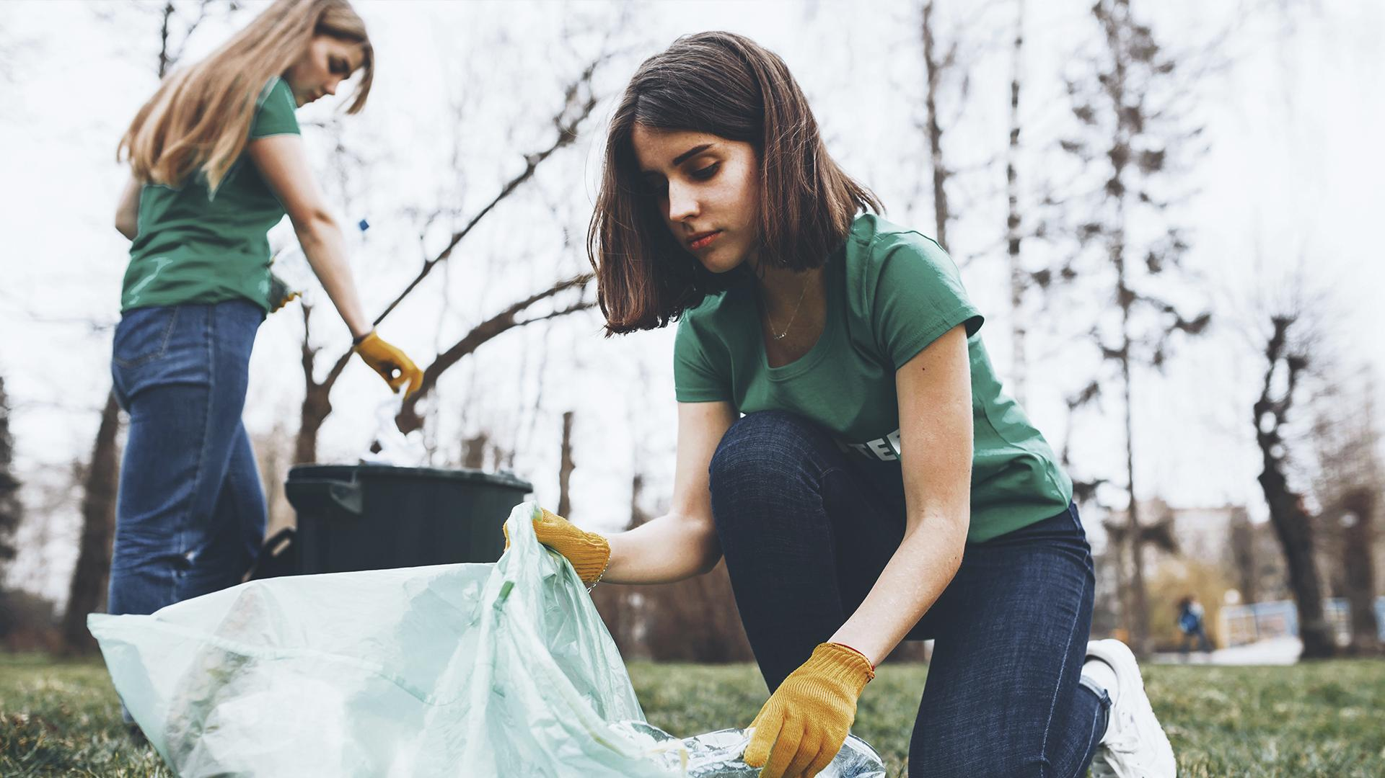
Différents types d’organismes

Slide 7
Différents types d’organismes
1
2
3
4
AMAP
Circuits courts
Producteurs locaux
Particuliers
Associations Pour le Maintien de l’Agriculture Paysanne
Organisations de vente directe
Producteurs ayant une exploitation et souhaitants faire de la vente directe
Jardins privés et partagés

Slide 8
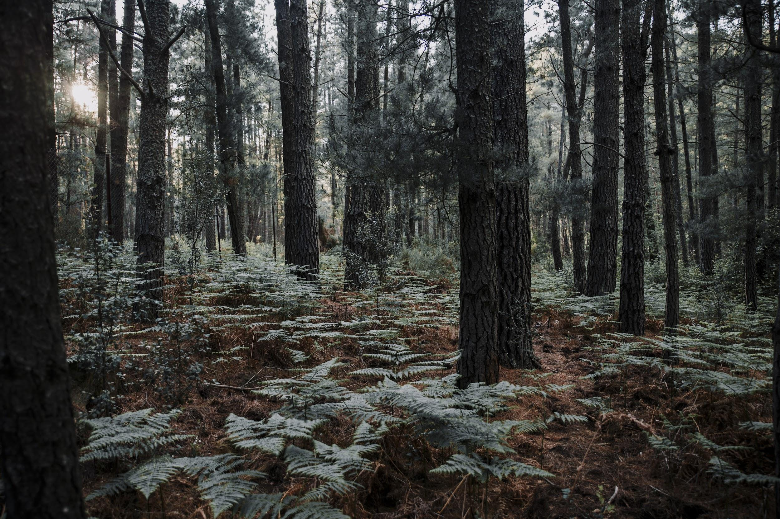
Identification des plateformes existantes
AMAP et Circuits Cours
Producteurs et Particuliers
- Site officiel des AMAP
Plateformes éparses
- CC: généralement pas de site Web
Mailing-List

Slide 9
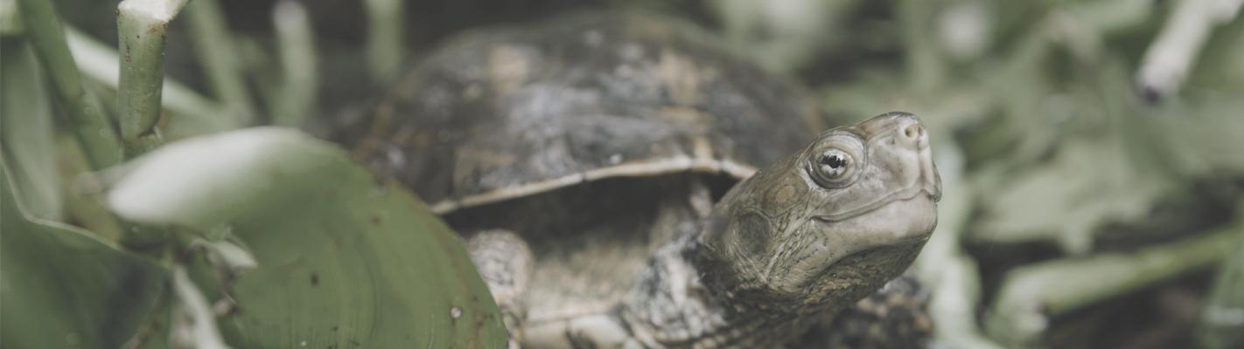
Problématique
De nombreuses plateformes existent déjà

Slide 10
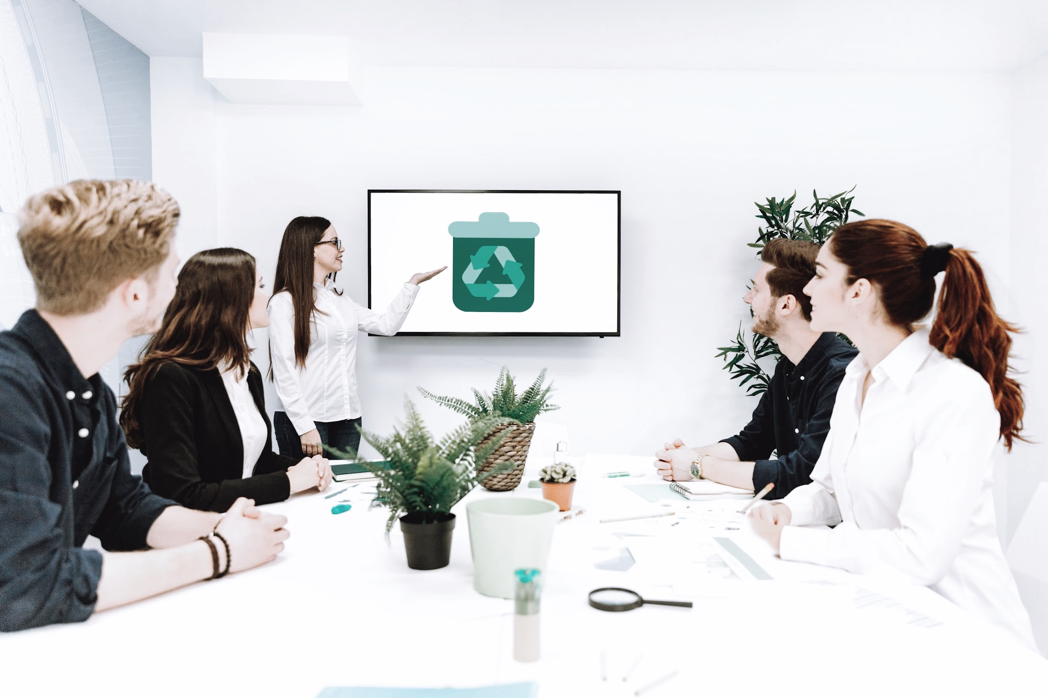
Plateformes existantes
Economie.gouv.fr
Ministère de l’Agriculture et de la Souveraineté Alimentaire
Frais et Local
La Ruche qui dit Oui!
Le Marché Vert
LEAF
Fruit and Food

Slide 11
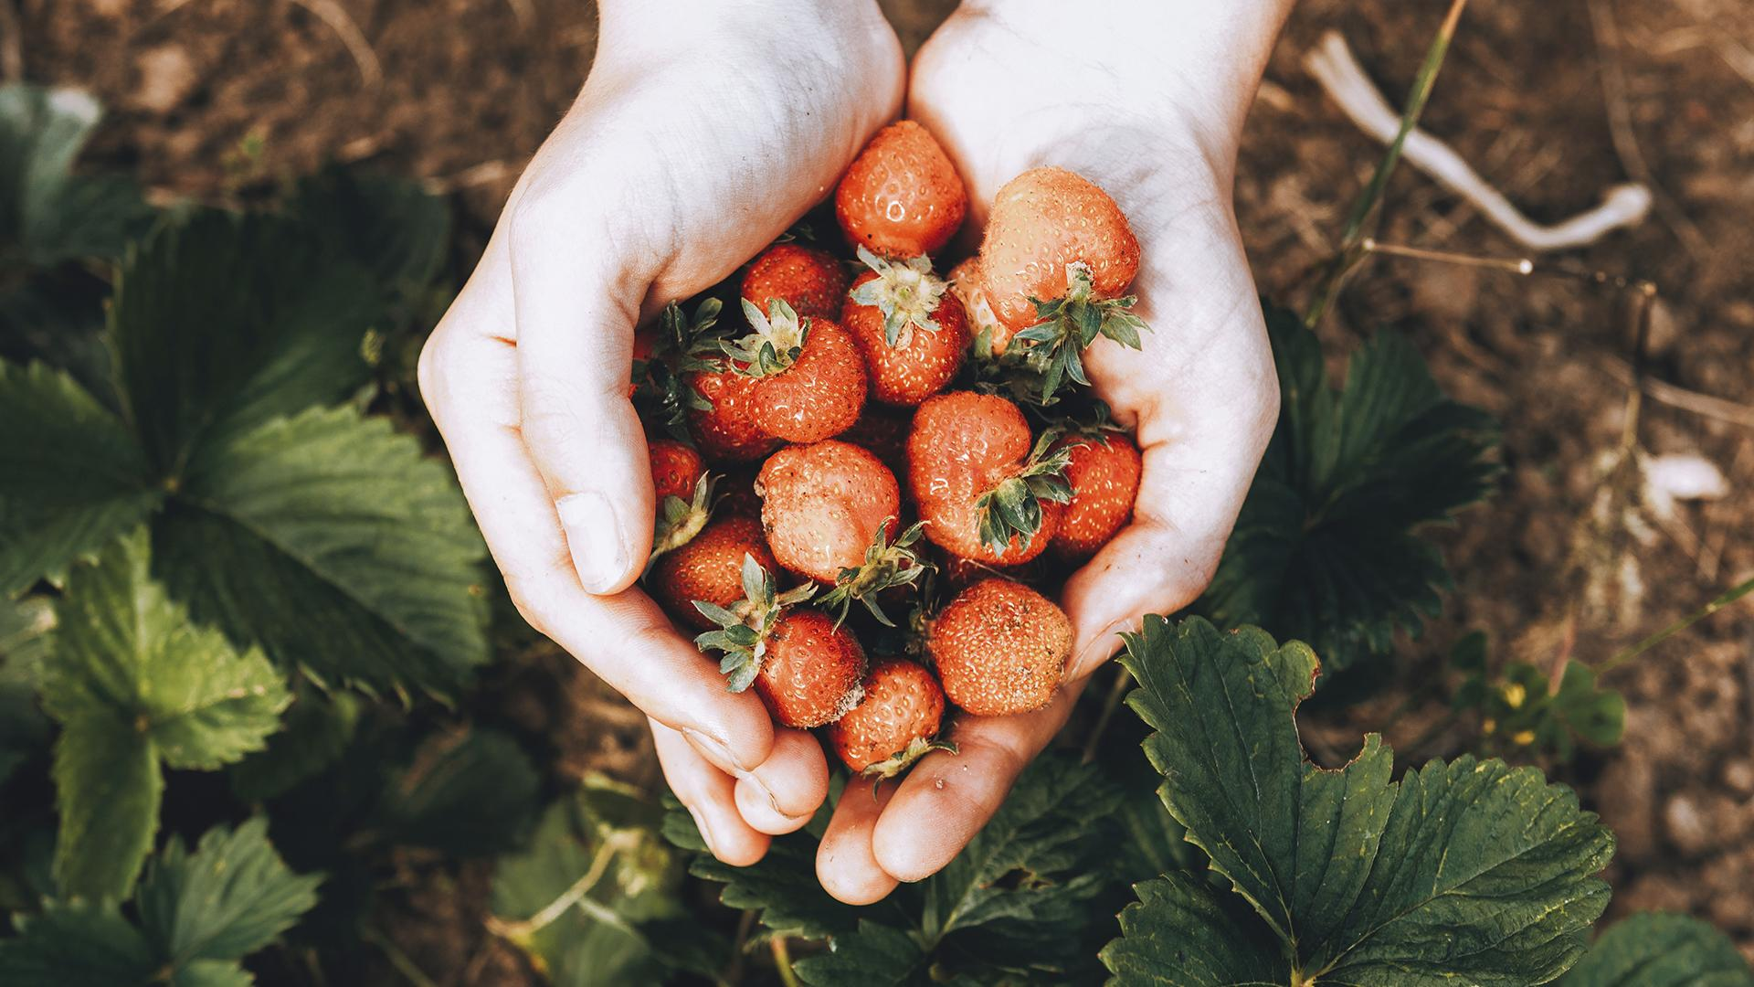
02
Concept...
... et innovations

Slide 12
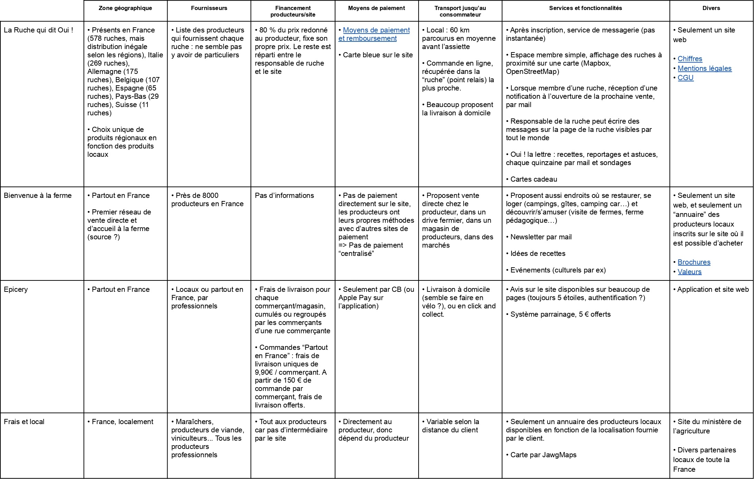

Slide 13
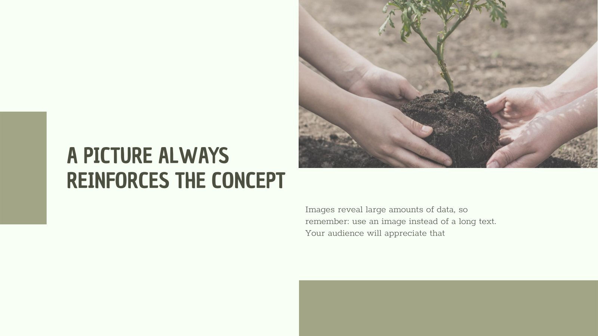
Concept
Plateforme de vente de fruits et légumes
Simple d’utilisation et intuitive, où particuliers et professionnels peuvent vendre et acheter

Slide 14
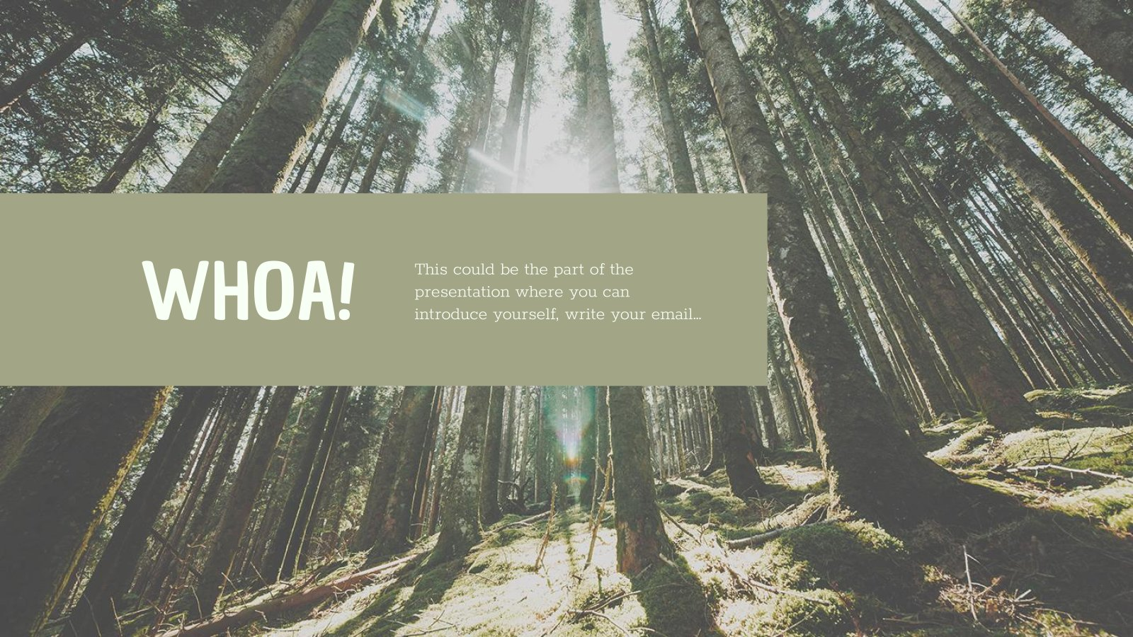
Innovations
Service de messagerie (instantanée ?)
Fil d’actualité
Carte
Trajets optimisés
Recettes
Statistiques

Slide 15
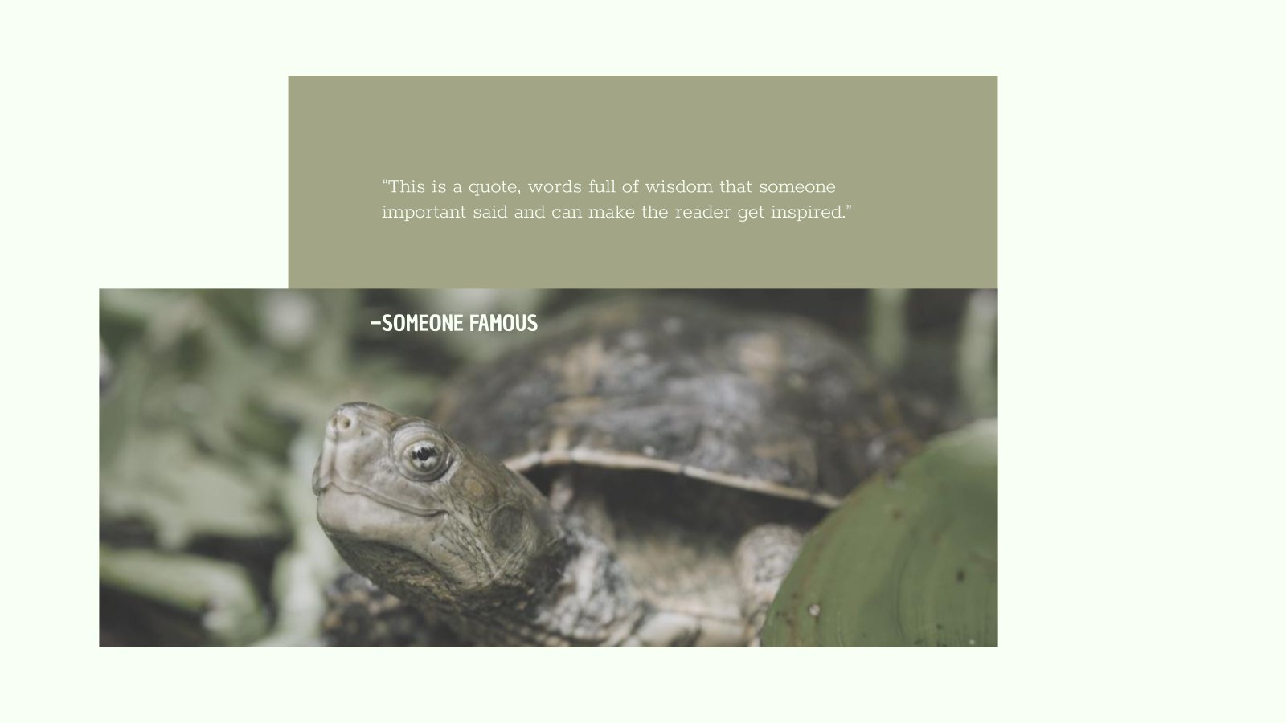

Slide 16
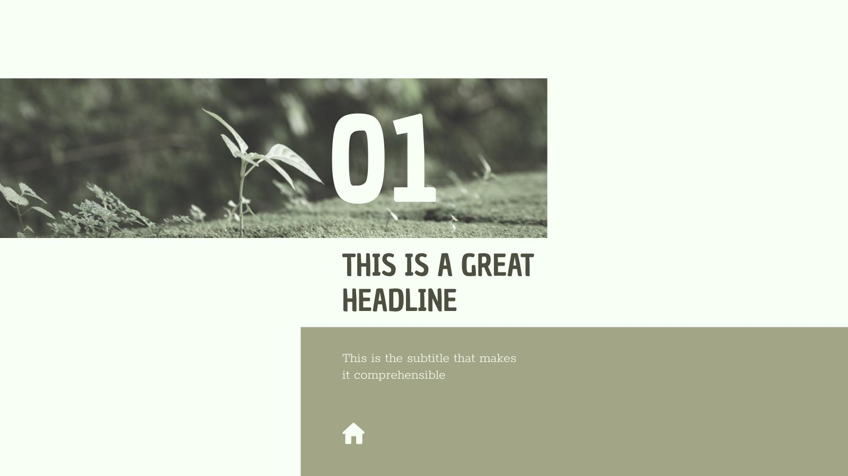

This slide is only for Premium users

Slide 17
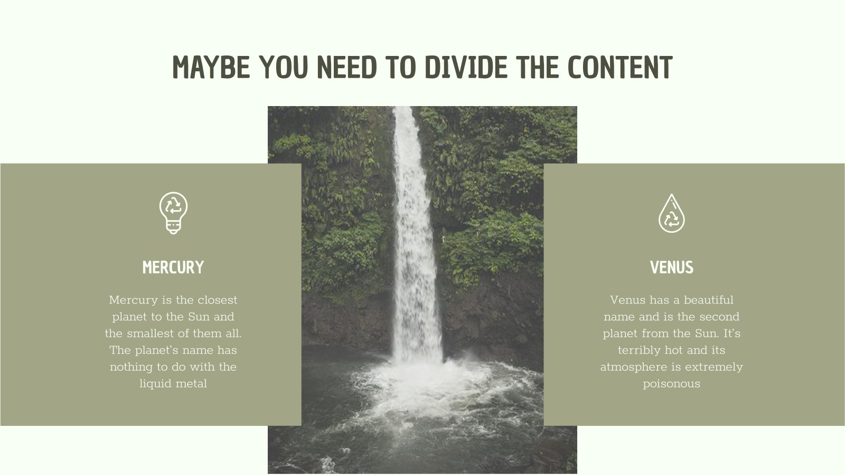
This slide is only for Premium users

Slide 18
YOU COULD USE THREE COLUMNS, WHY NOT?
MARS
JUPITER
MERCURY
Despite being red, Mars is a cold place, not hot. It’s full of iron oxide dust, which gives the planet its reddish cast
It’s a gas giant and the biggest planet in our Solar System. Jupiter is the fourth-brightest object in the sky
Mercury is the closest planet to the Sun and the smallest one in the Solar System—it’s only a bit larger than our Moon

Slide 19
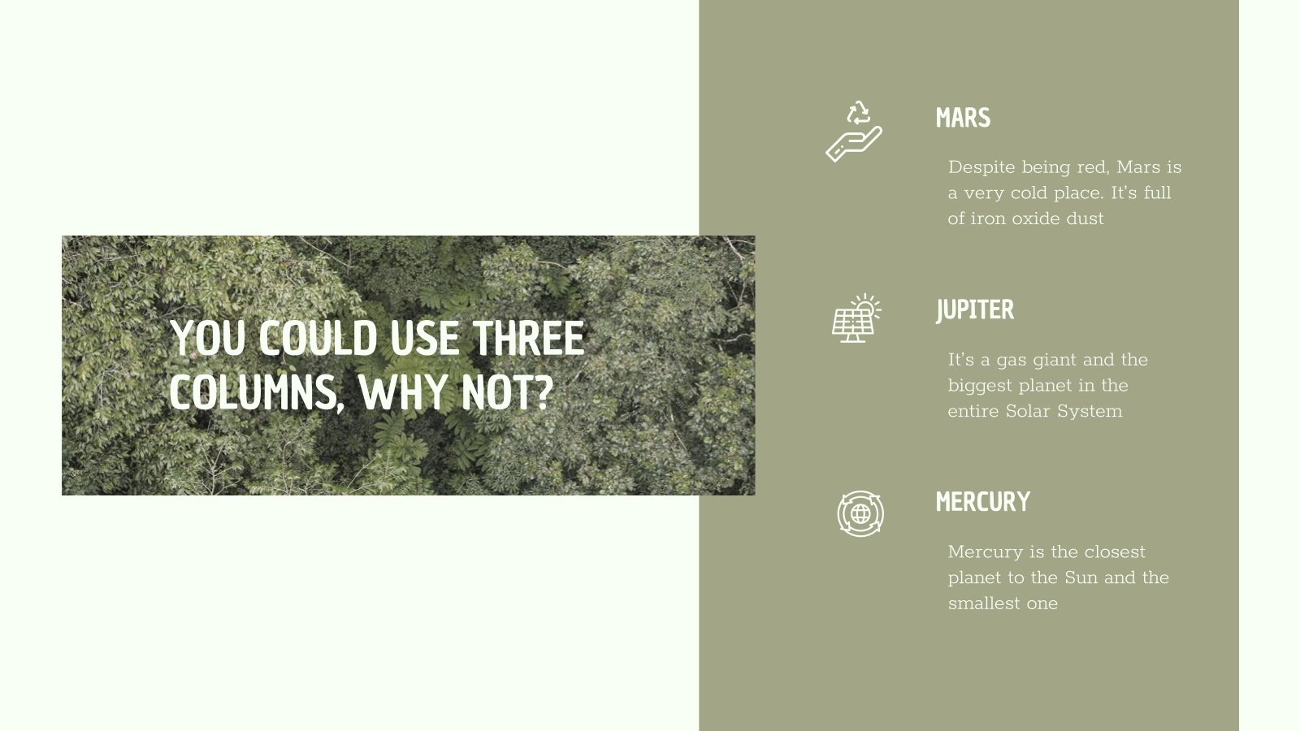
This slide is only for Premium users

Slide 20
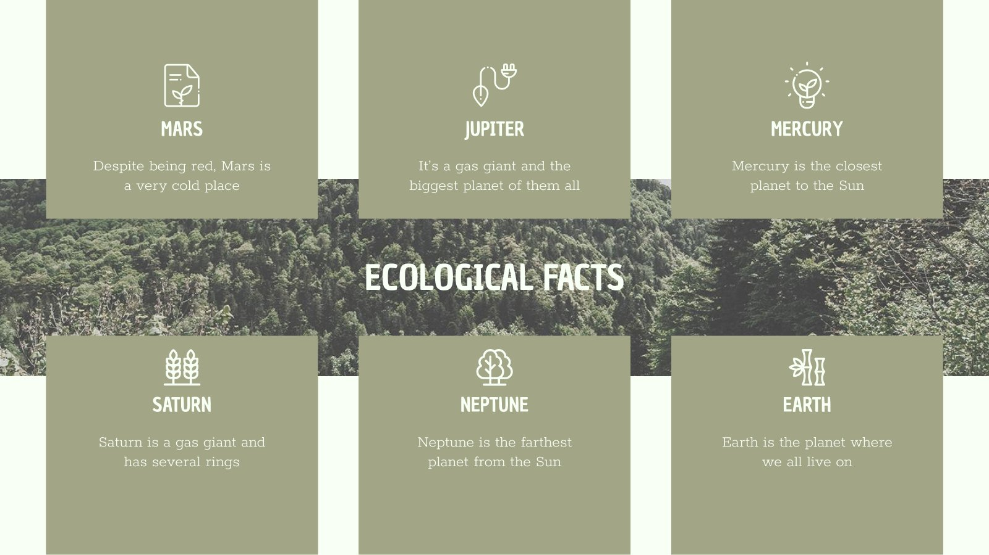
This slide is only for Premium users

Slide 21
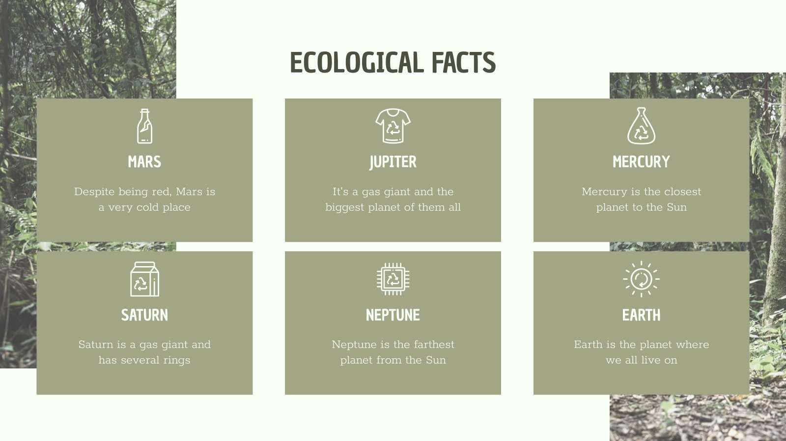

Slide 22
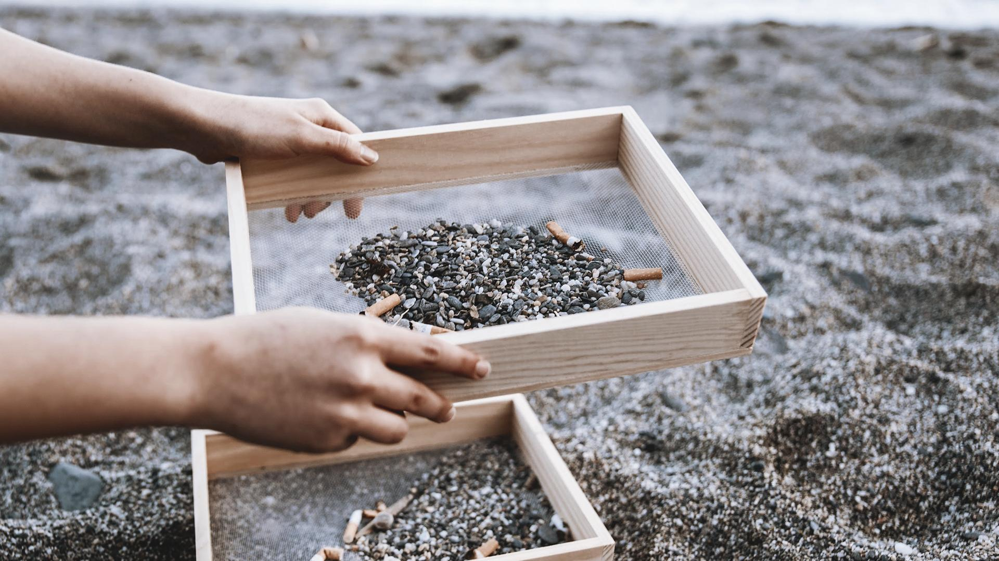
A PICTURE ALWAYS REINFORCES THE CONCEPT
Images reveal large amounts of data, so remember: use an image instead of long texts. Your audience will appreciate that

Slide 23


Slide 24
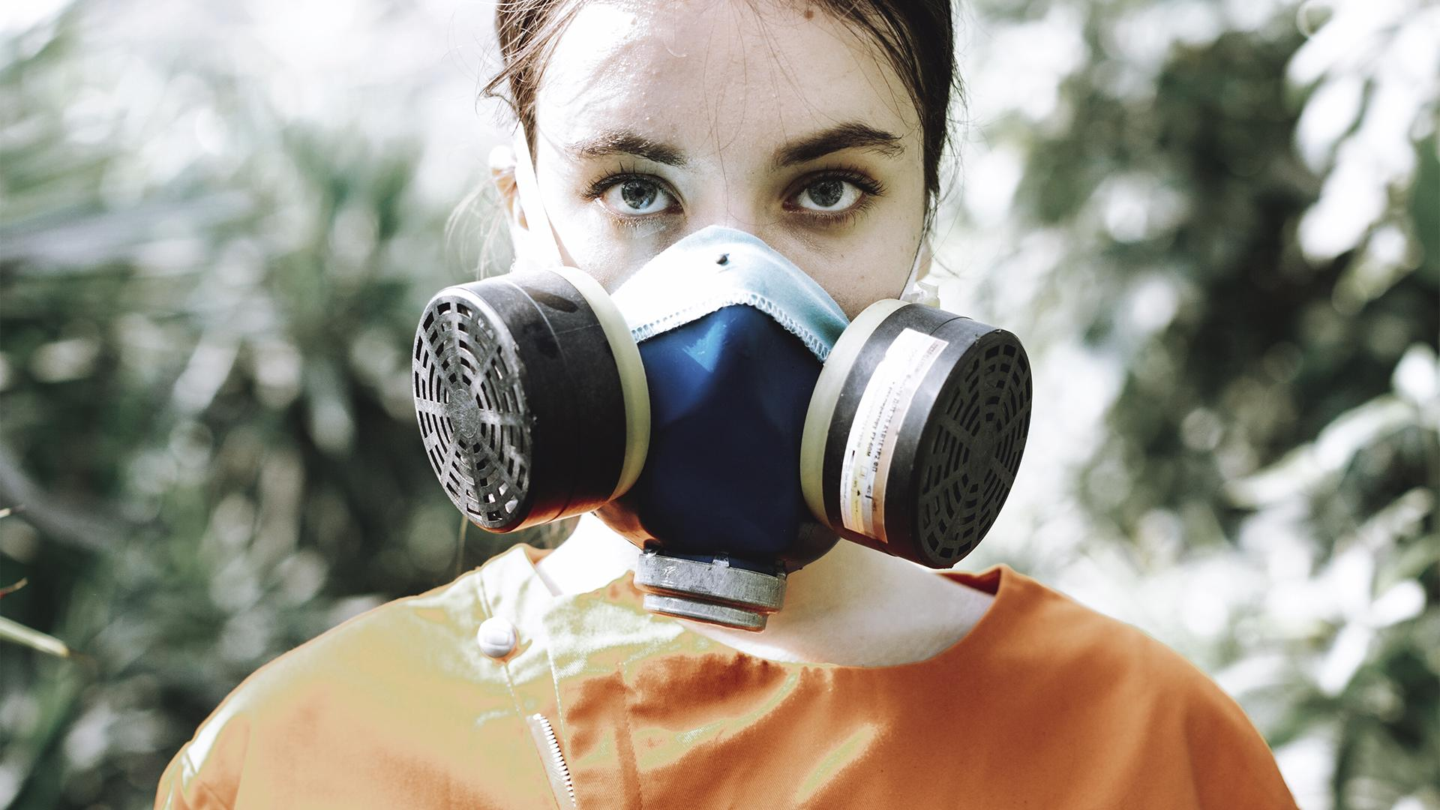
AWESOME WORDS

Slide 25
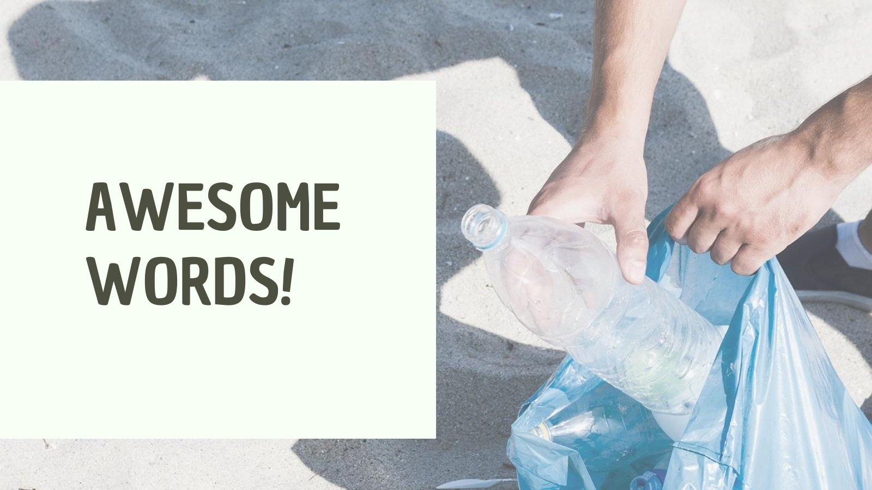
This slide is only for Premium users

Slide 26
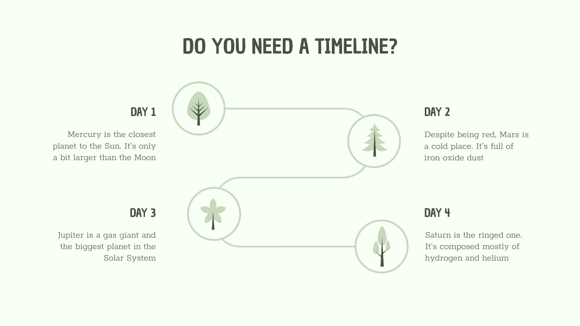
This slide is only for Premium users

Slide 27
REINFORCE THE CONCEPT USING INFOGRAPHICS!
20%
30%
50%
MERCURY
VENUS
MARS
It’s the closest planet to the Sun and is only a bit larger than our Moon
Venus has a beautiful name, but it’s terribly hot, even hotter than Mercury
Despite being red, Mars is a cold place, not hot. It’s full of iron oxide dust

Slide 28
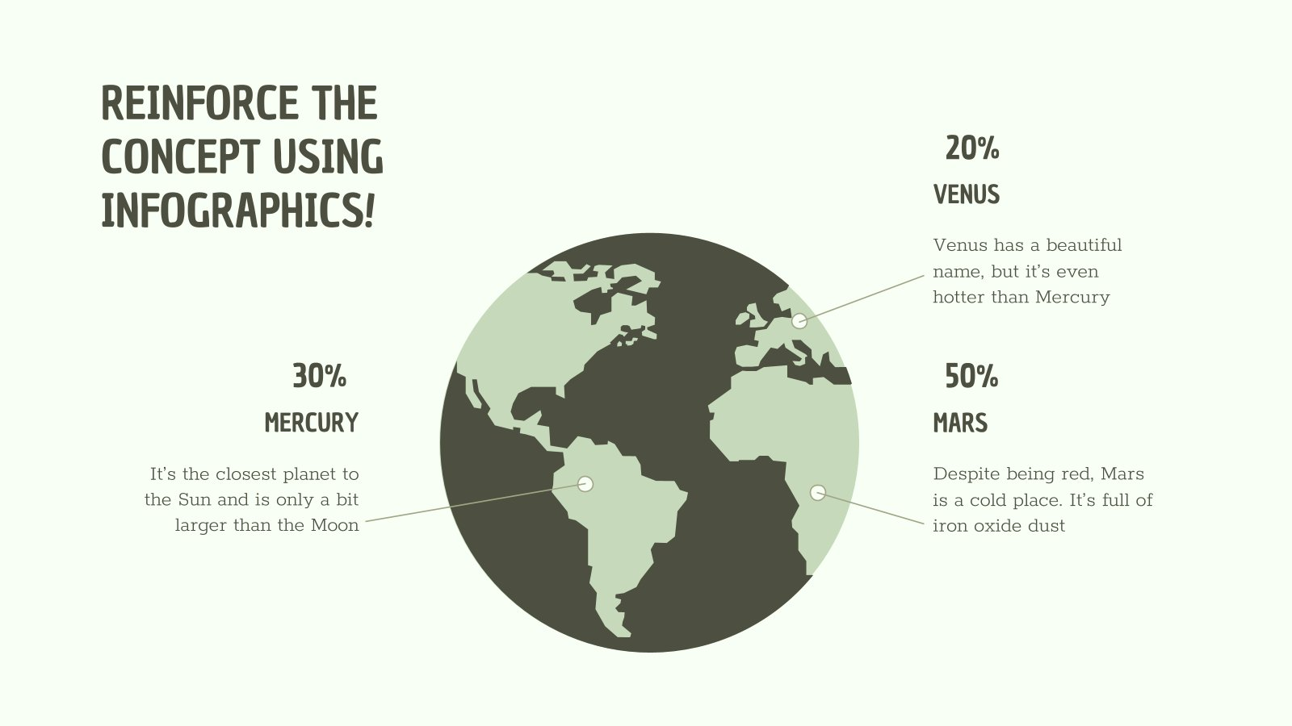
This slide is only for Premium users

Slide 29
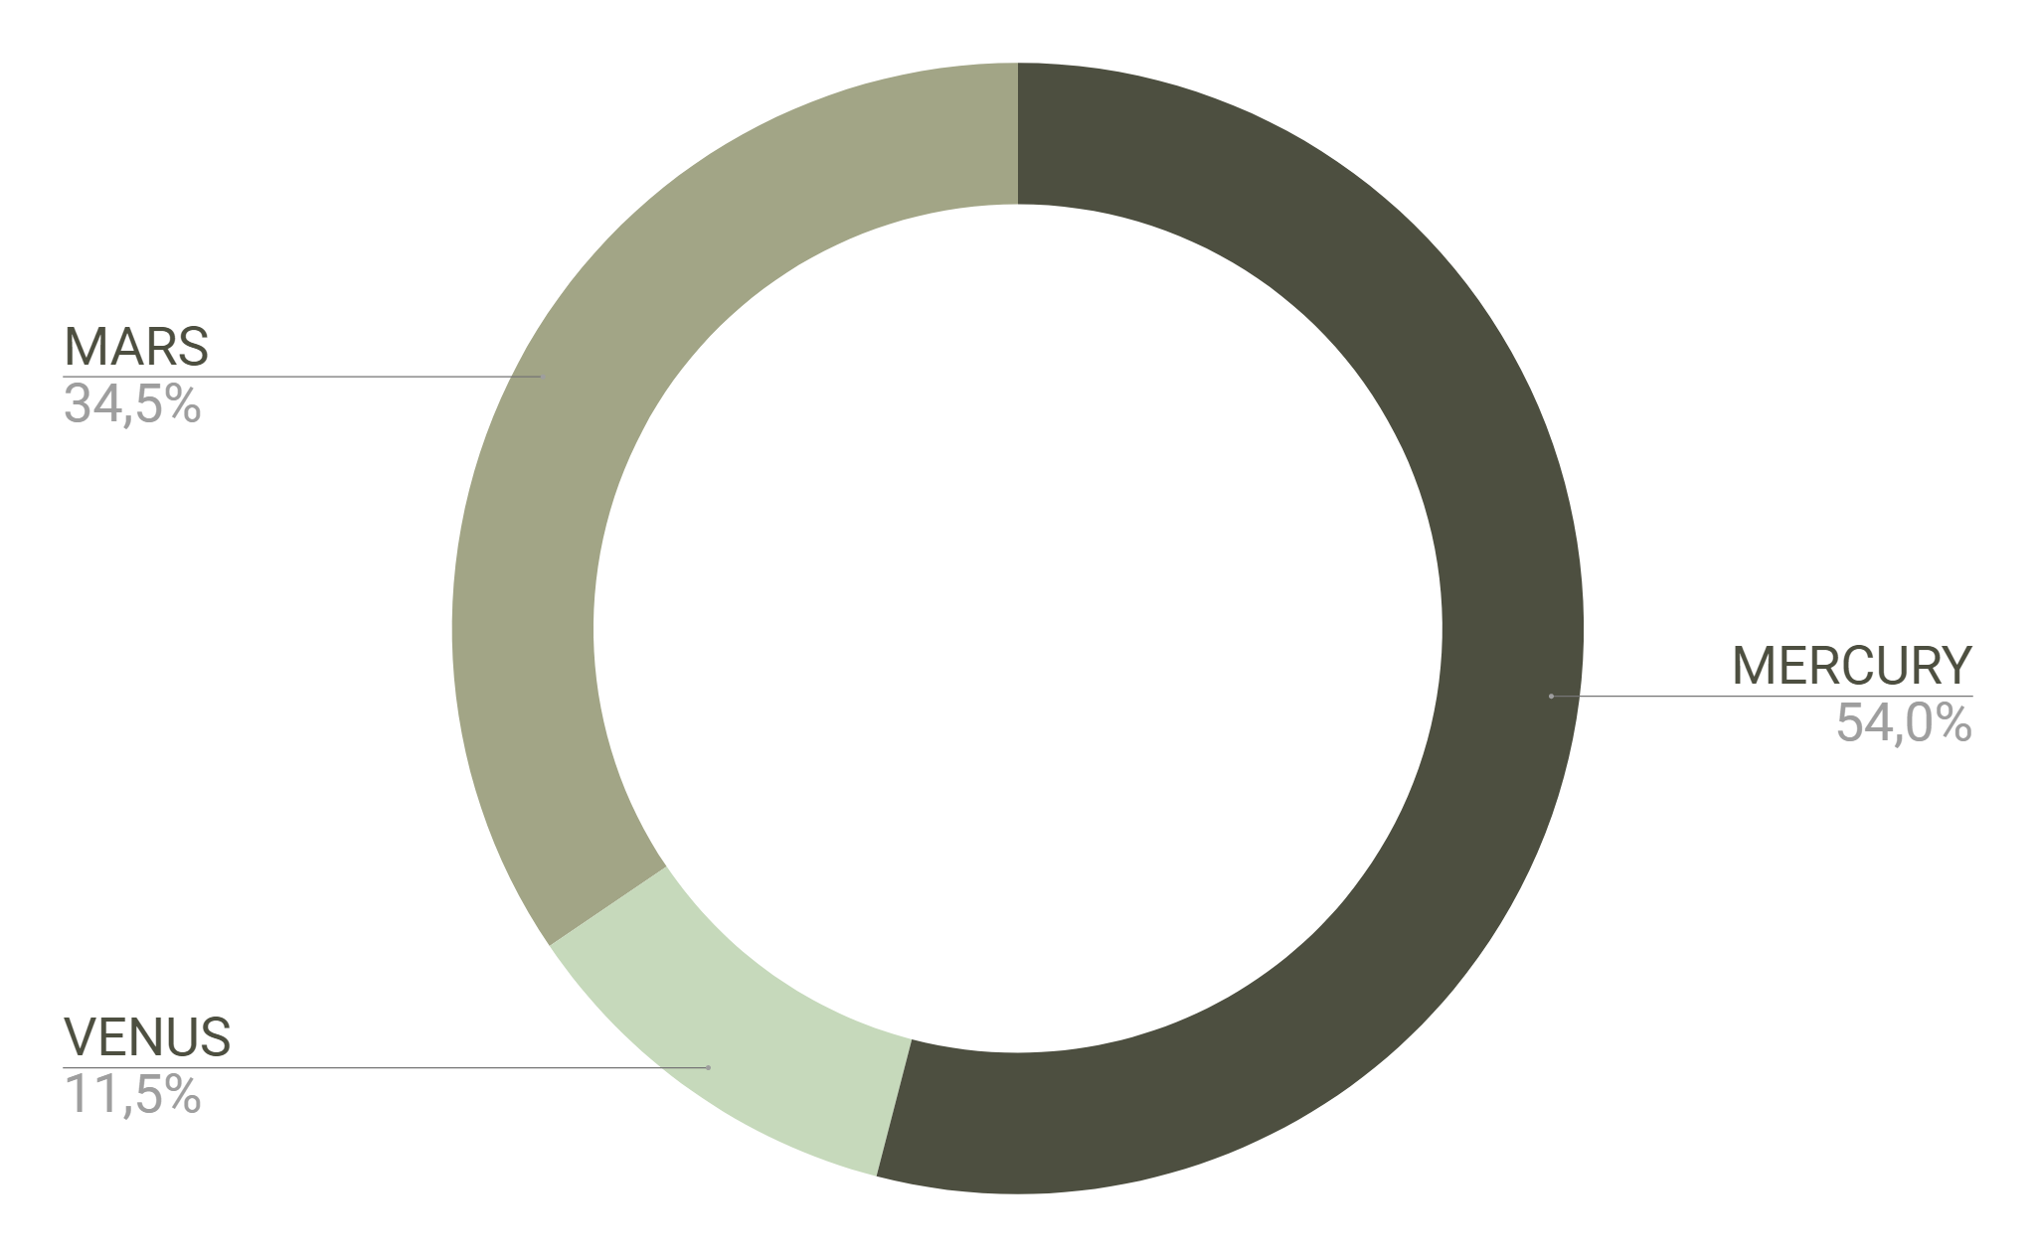
IF YOU WANT TO MODIFY THIS GRAPH, CLICK ON IT, FOLLOW THE LINK, CHANGE THE DATA AND REPLACE IT
MARS
Despite being red, Mars is a cold place, not hot
MERCURY
Mercury is the closest planet to the Sun
VENUS
Venus has a beautiful name, but it’s terribly hot

Slide 30
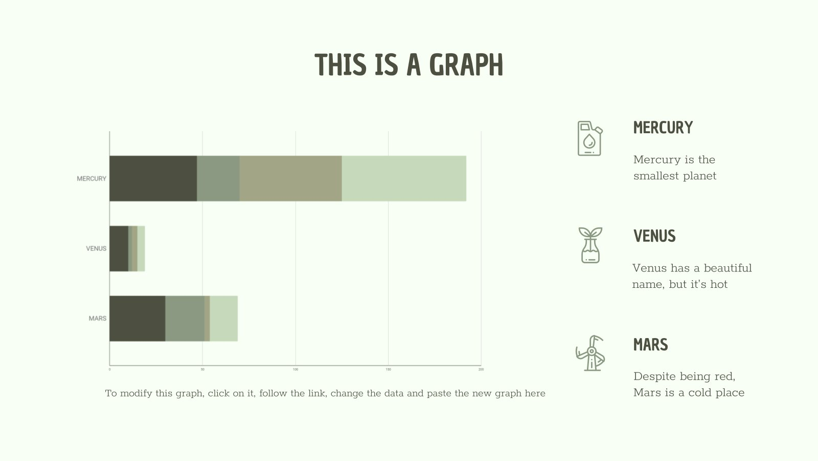
This slide is only for Premium users

Slide 31

INFOGRAPHICS MAKE YOUR IDEA UNDERSTANDABLE…
JUPITER
MERCURY
It’s a gas giant and the biggest planet in our Solar System
Mercury is the closest planet to the Sun,is a bit larger than Moon
VENUS
MARS
Venus has a beautiful name, but it’s even hotter than Mercury
Despite being red, Mars is a very cold place, not hot at all

Slide 32
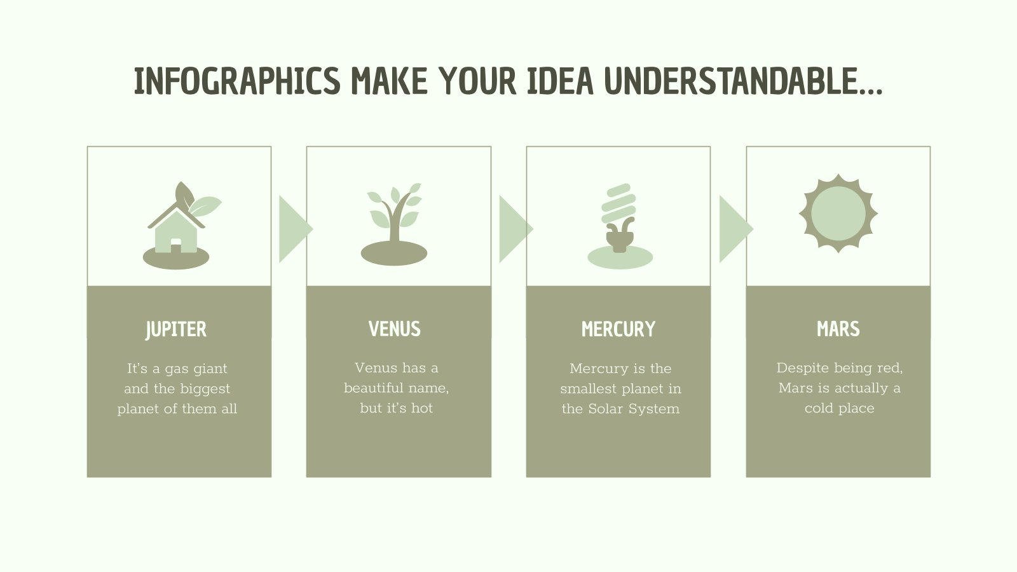
This slide is only for Premium users

Slide 33
… AND THE SAME GOES FOR TABLES
 | MASS (earths) | DIAMETER (earths) | SURFACE GRAVITY (earths)
MERCURY | 0,06 | 0,38 | 0,38
MARS | 0,11 | 0,53 | 0,38
SATURN | 95,2 | 9,4 | 1,16

Slide 34
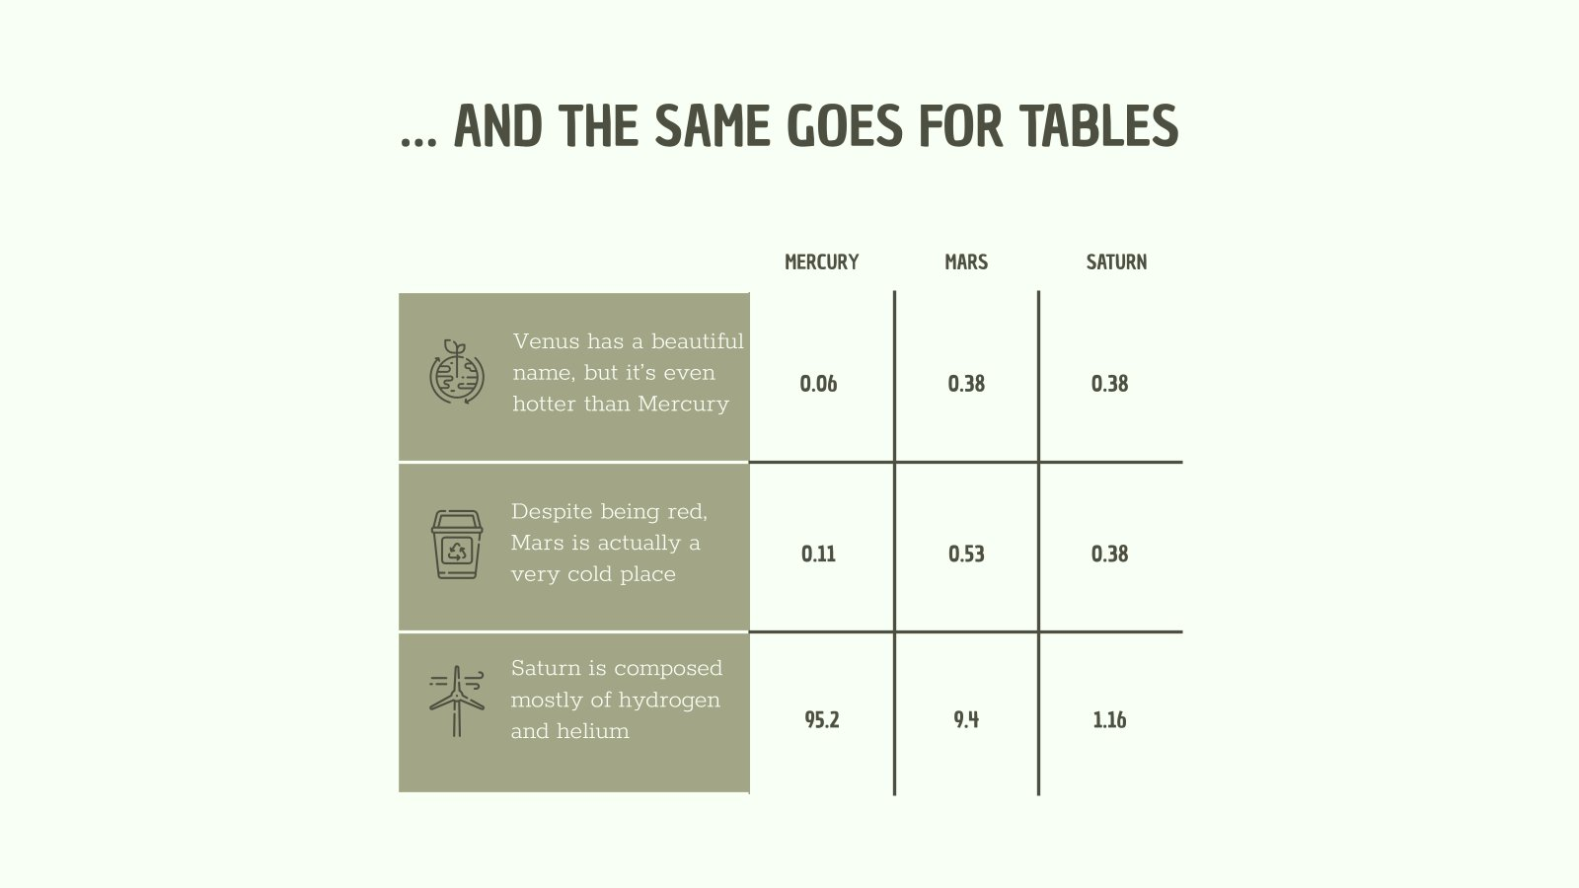
This slide is only for Premium users

Slide 35
THIS IS A MAP
MERCURY
JUPITER
Mercury, is the closest planet
It’s the biggest planet of all
MARS
VENUS
Despite being red, Mars is a cold place
Venus has a beautiful name,

Slide 36
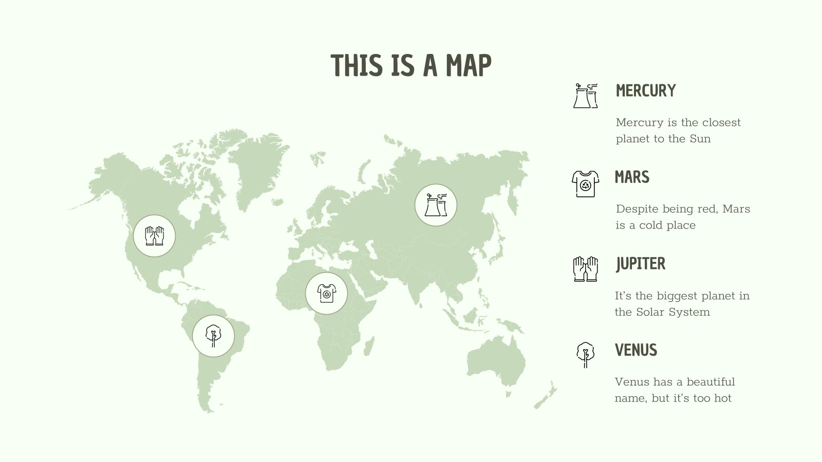
This slide is only for Premium users

Slide 37
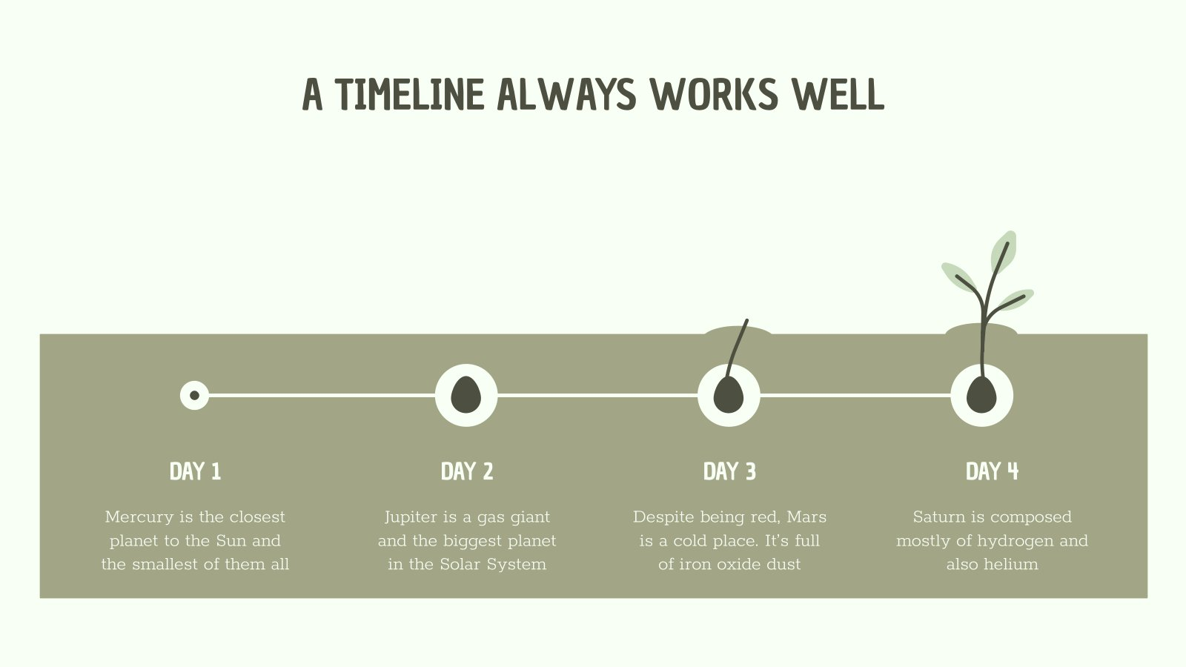
This slide is only for Premium users

Slide 38
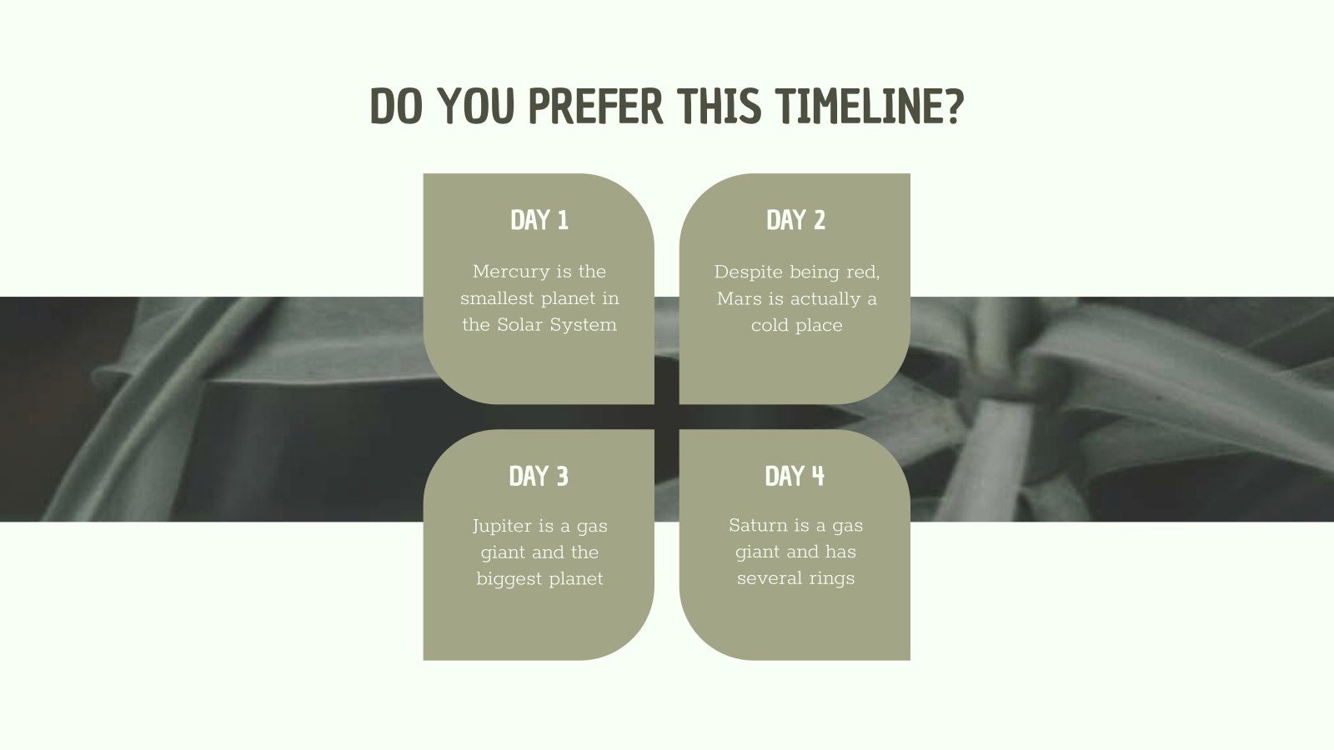
This slide is only for Premium users

Slide 39
HOW ABOUT THE PERCENTAGES?
MERCURY
JUPITER
40%
Mercury is the closest planet to the Sun
It’s the biggest planet in our Solar System
10%
30%
MARS
VENUS
Despite being red, Mars is a cold place
20%
Venus has a beautiful name, but it’s hot

Slide 40
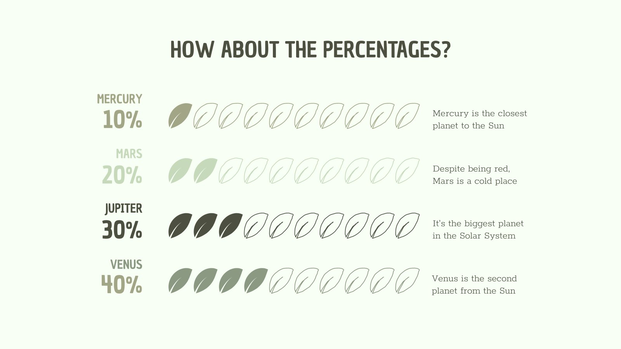
This slide is only for Premium users

Slide 41
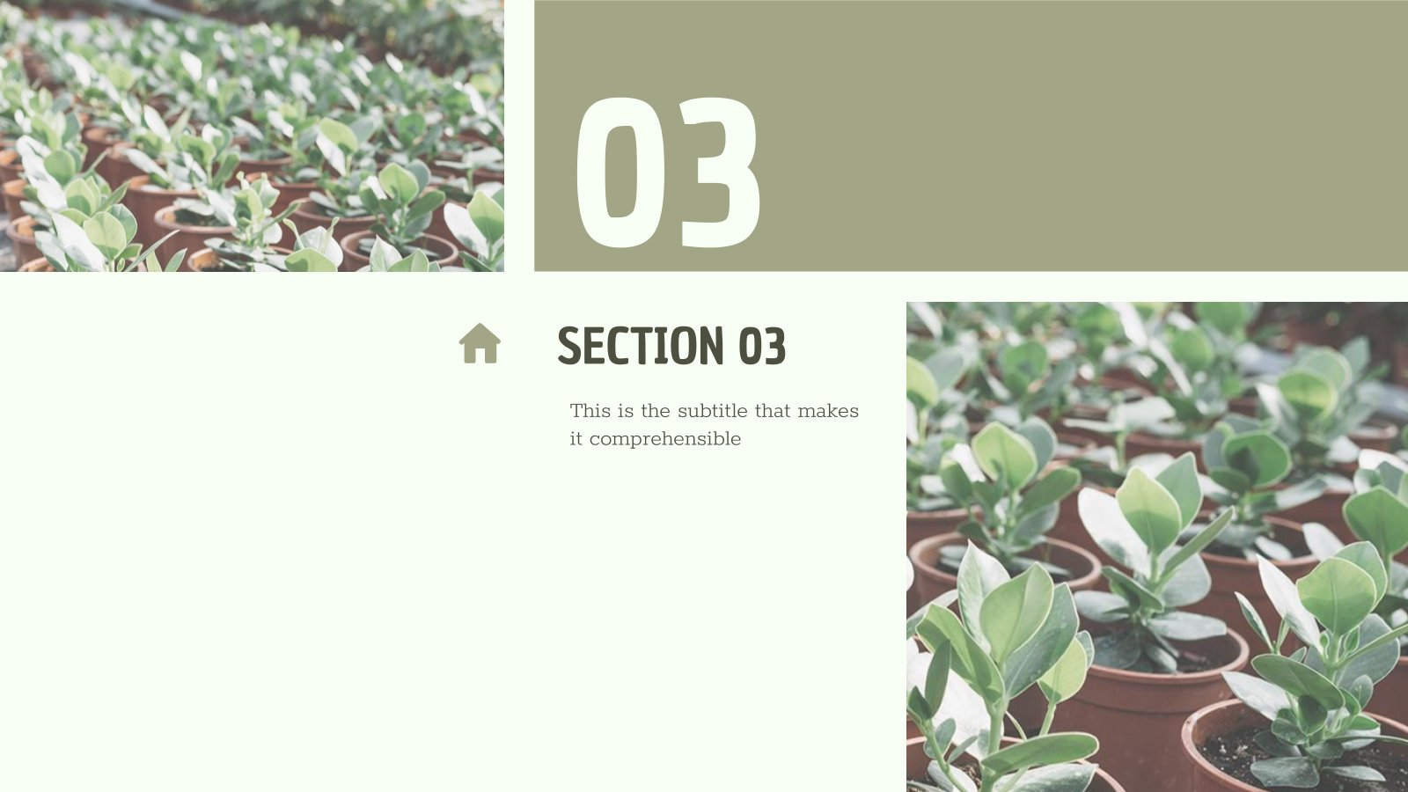
This slide is only for Premium users

Slide 42
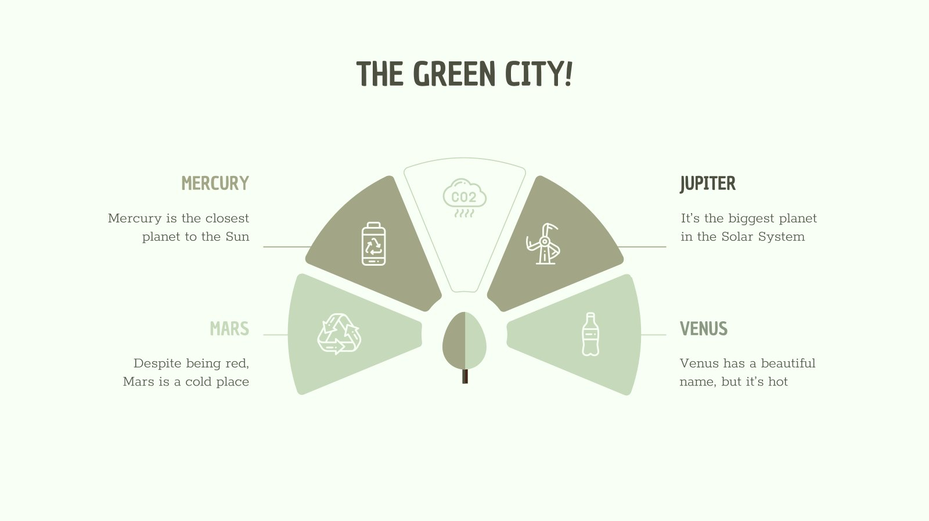
This slide is only for Premium users

Slide 43
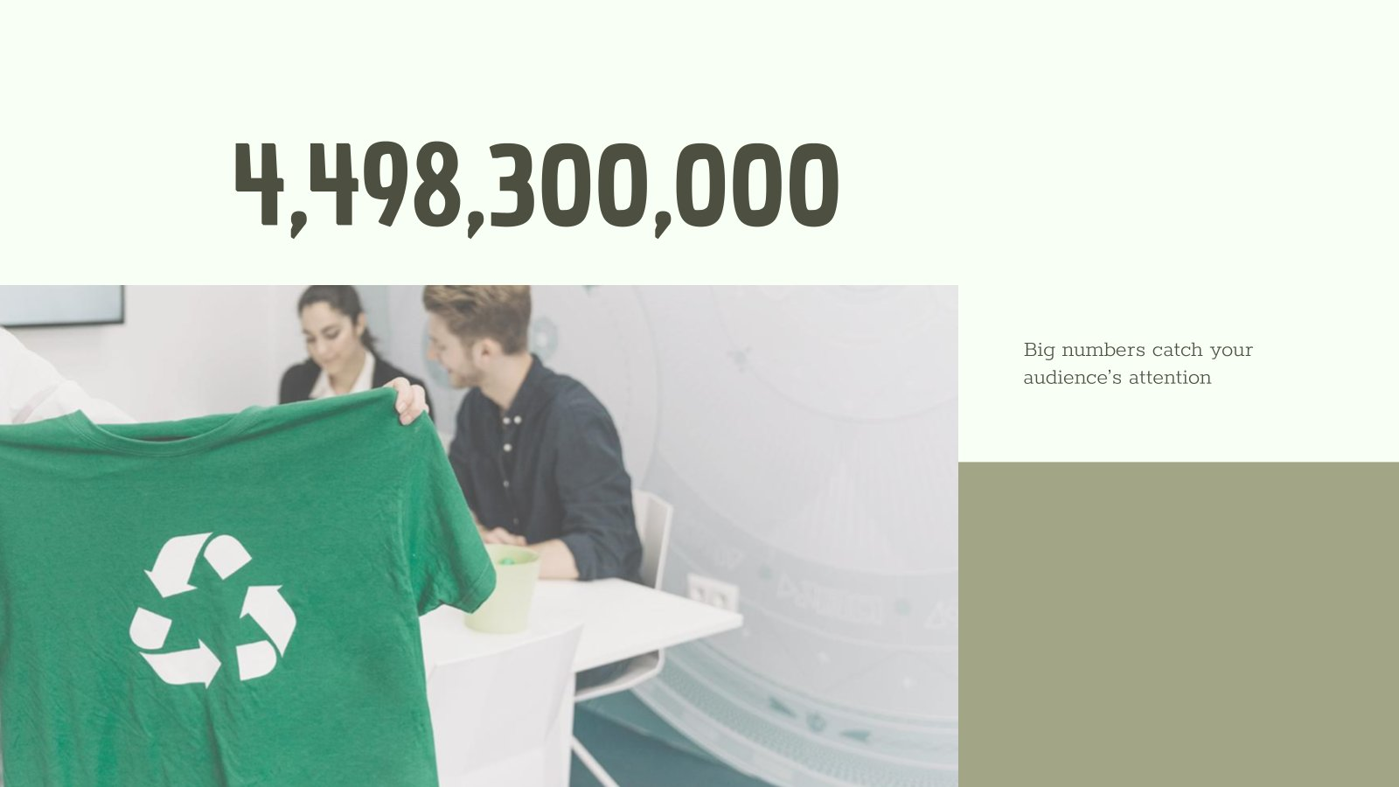
This slide is only for Premium users

Slide 44
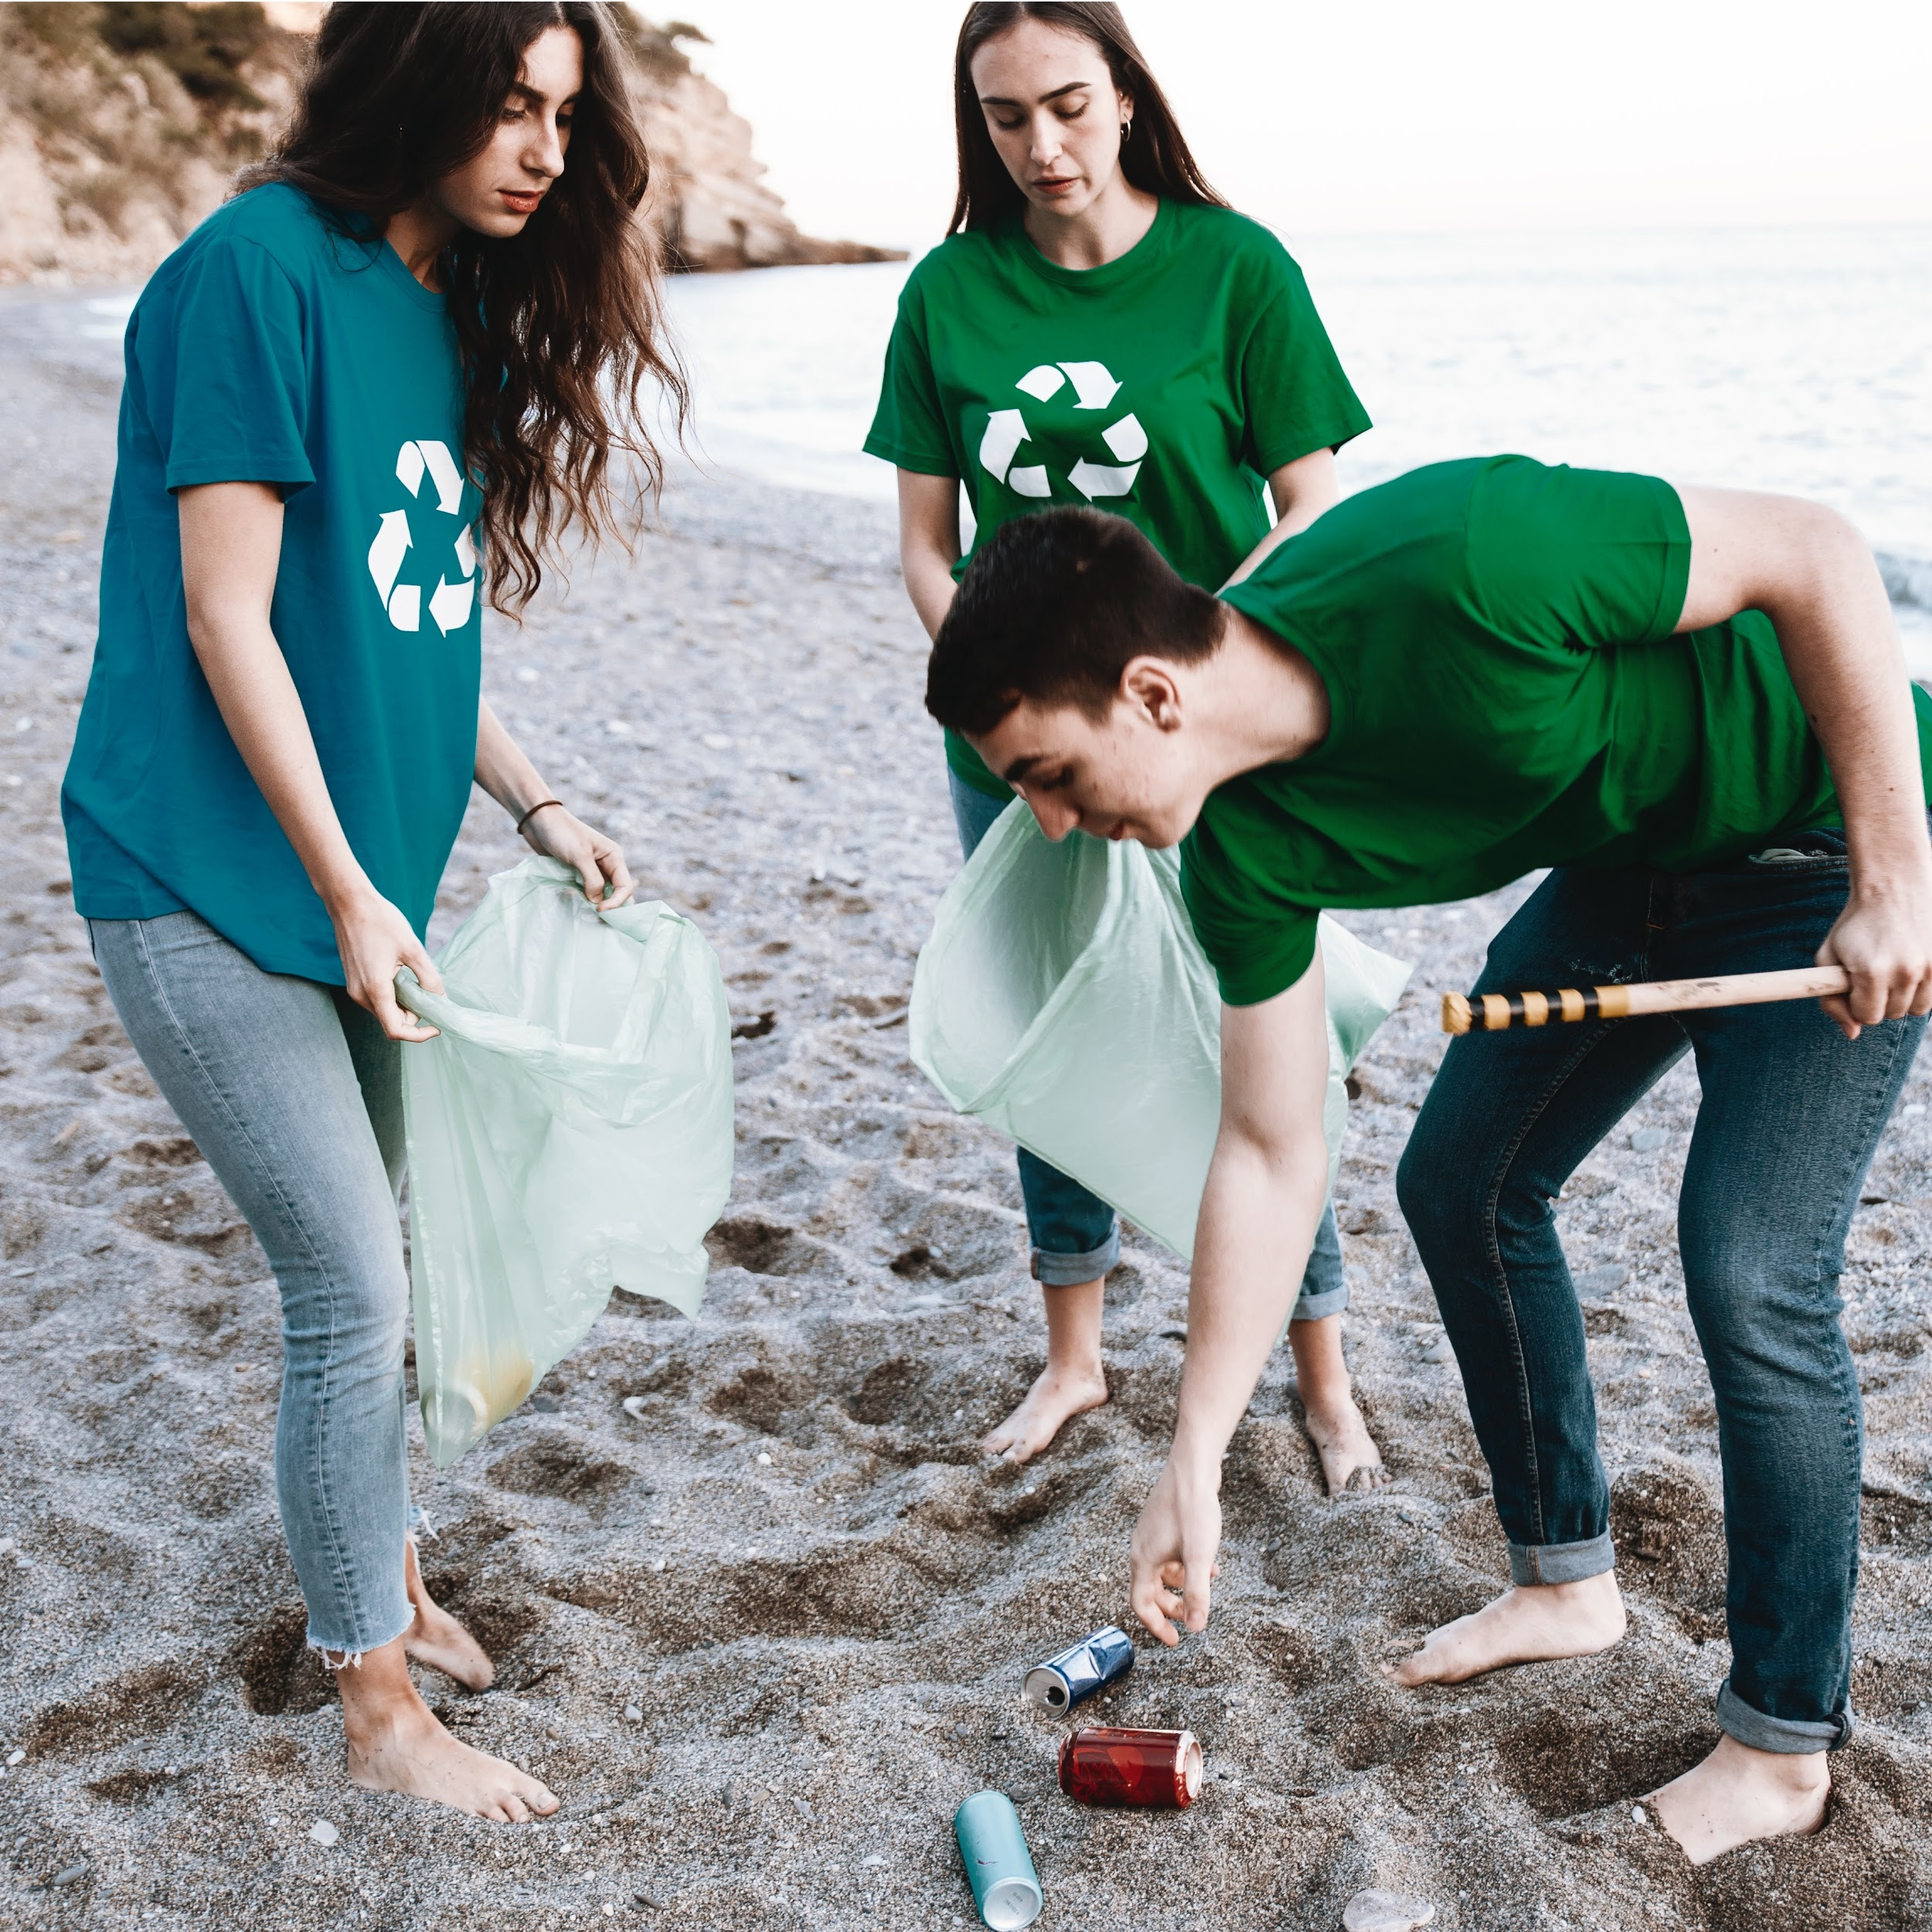
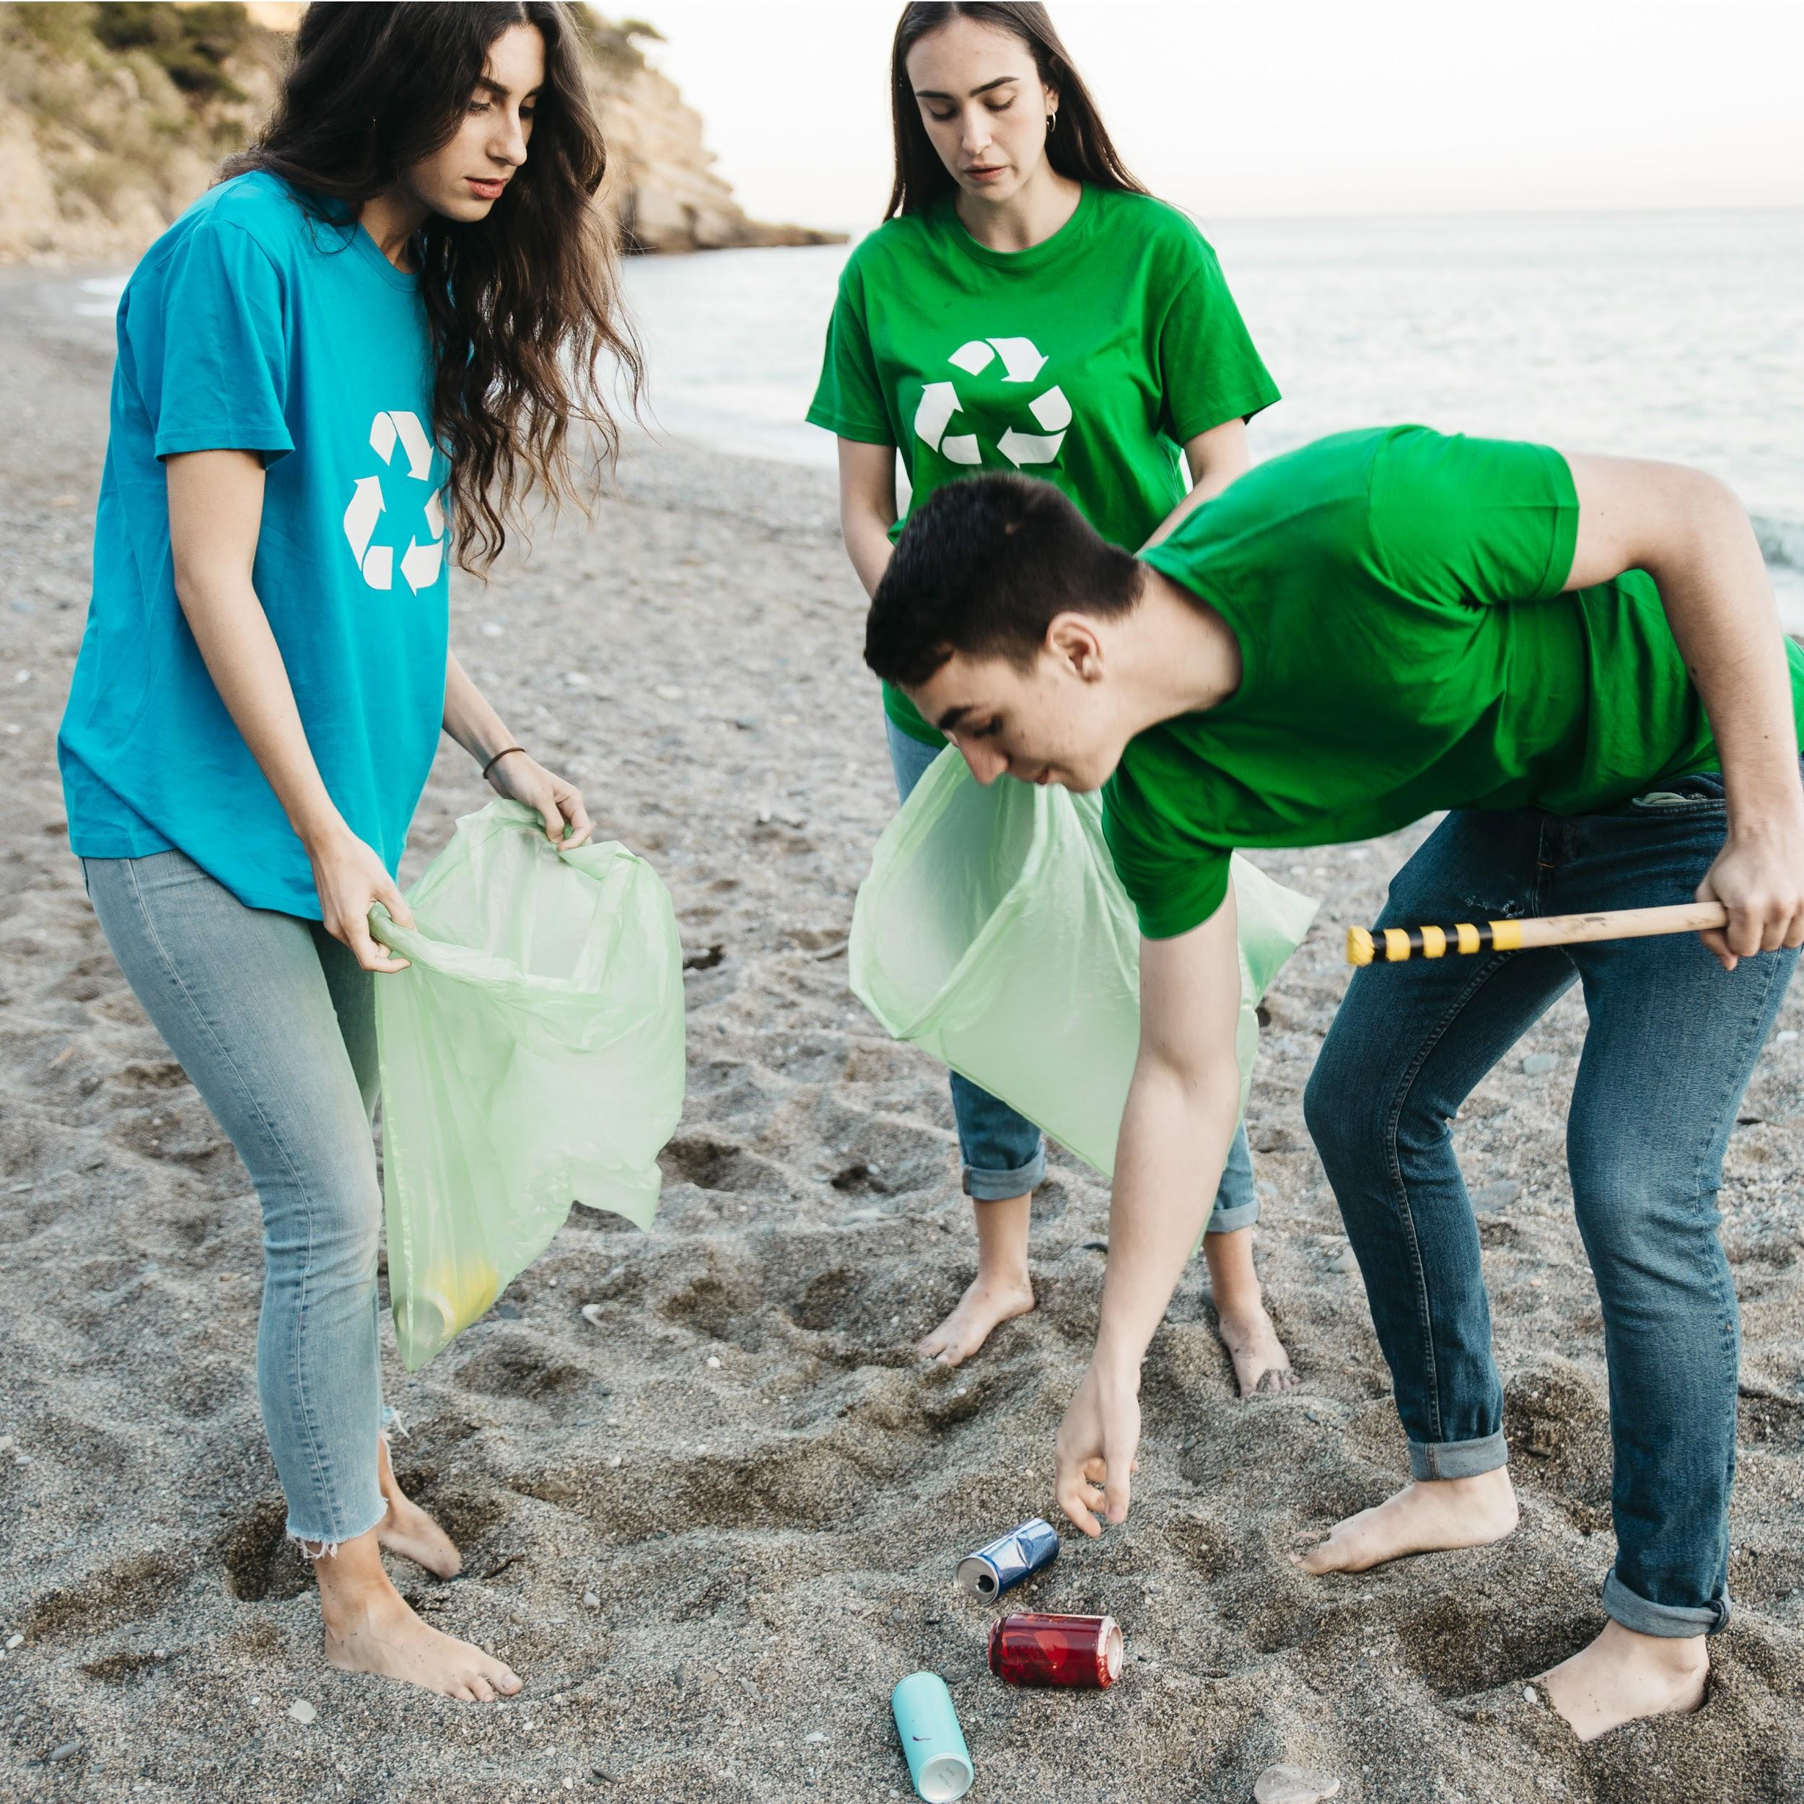
333,000.00
24h 37m 23s
386,000 km
earths is the Sun’s mass
is Jupiter’s rotation period
is the distance between the Earth and the Moon

Slide 45
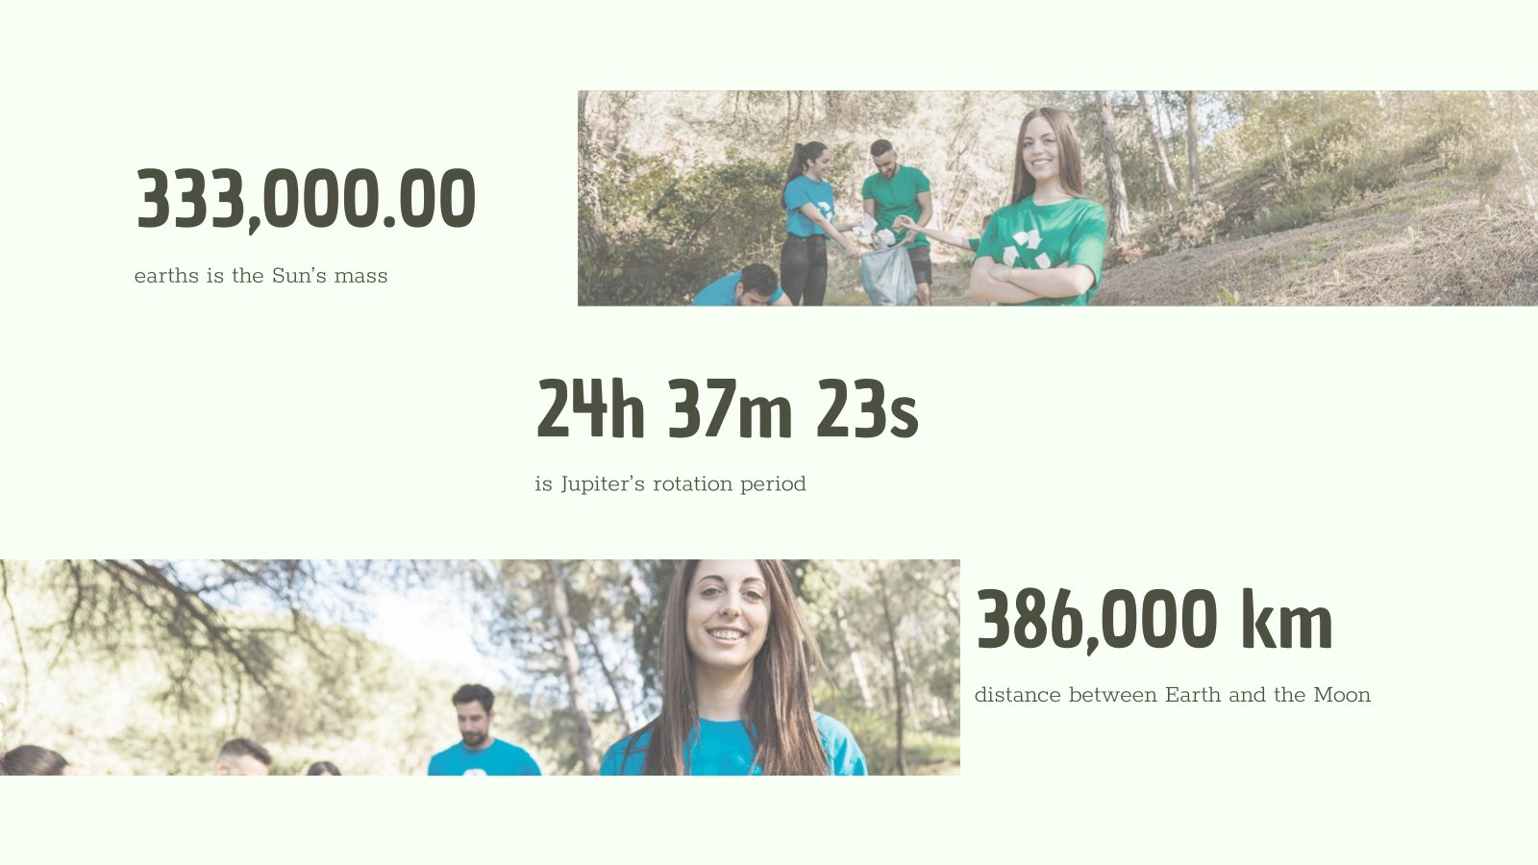
This slide is only for Premium users

Slide 46
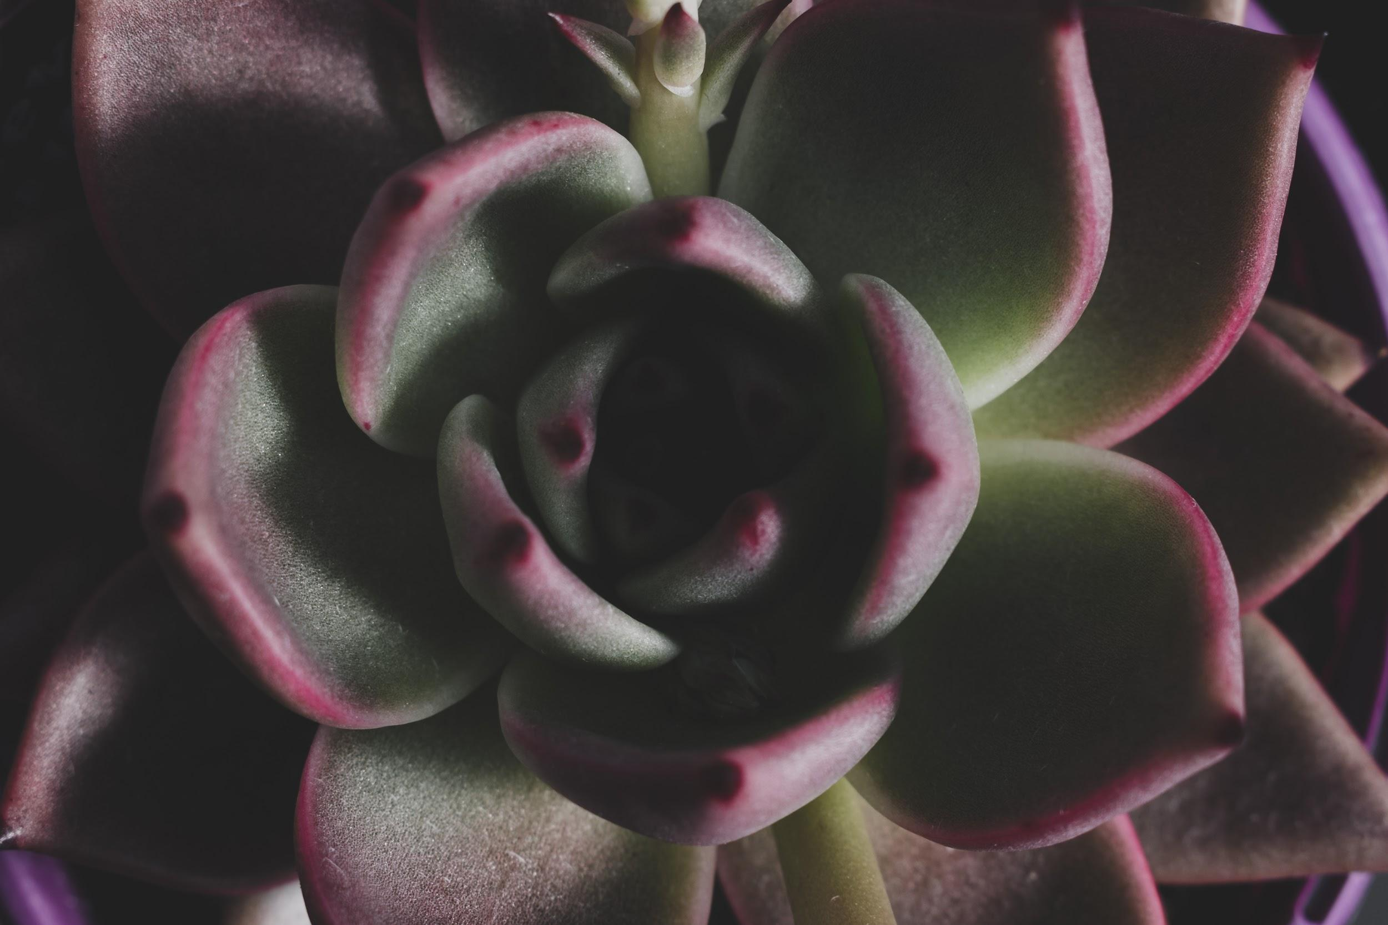
SOMETIMES, REVIEWING CONCEPTS IS A GOOD IDEA
MARS
JUPITER
MERCURY
Despite being red, Mars is a cold place, not hot. The planet is full of iron oxide
It’s the biggest planet in our Solar System and the fourth-brightest object
Mercury is the closest planet to the Sun, is a bit larger than our Moon

Slide 47
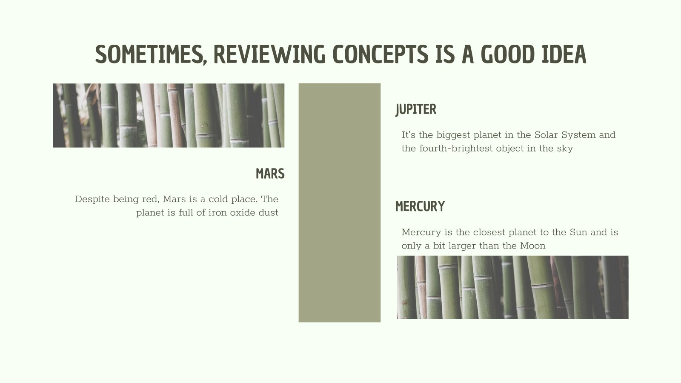
This slide is only for Premium users

Slide 48
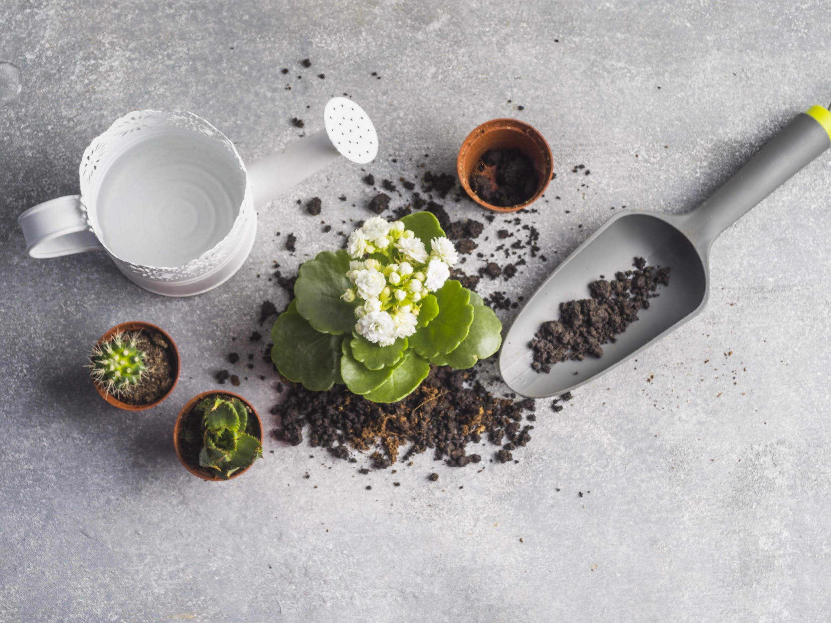
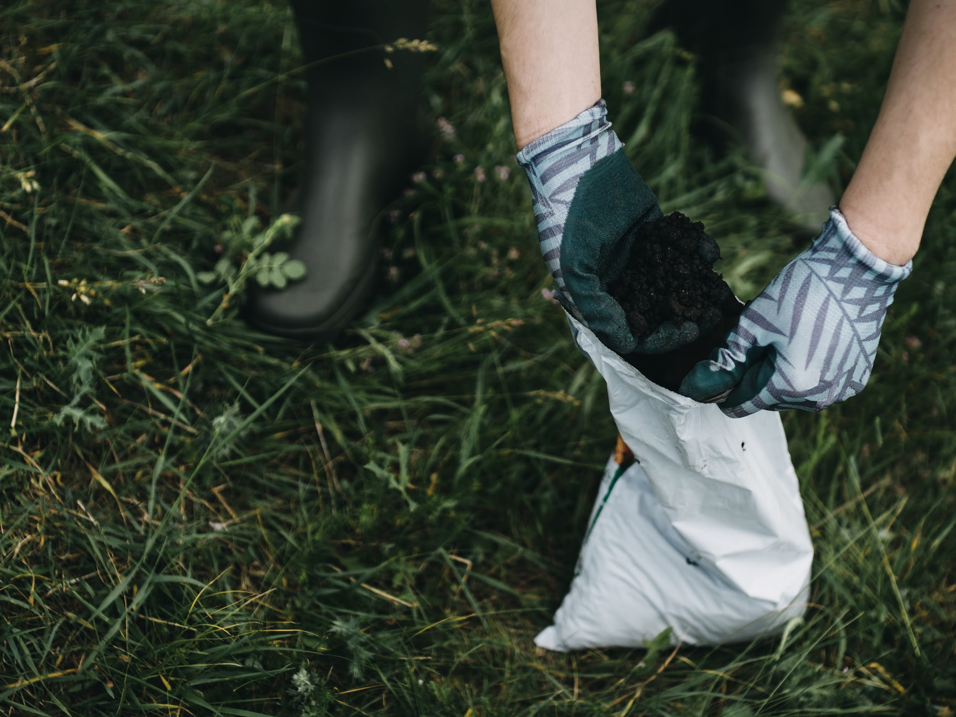
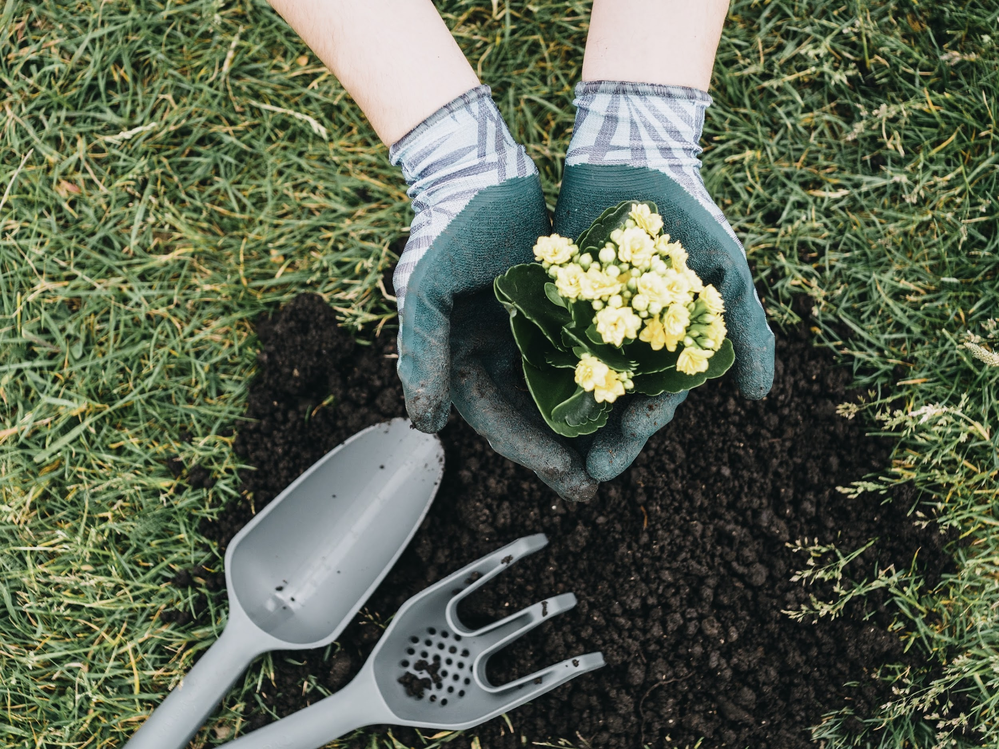
OUR SERVICES
$35
$60
$85
You can explain your product or your service Characteristic
You can explain your product or your service Characteristic
You can explain your product or your service Characteristic
BASIC
PRO
PREMIUM

Slide 49
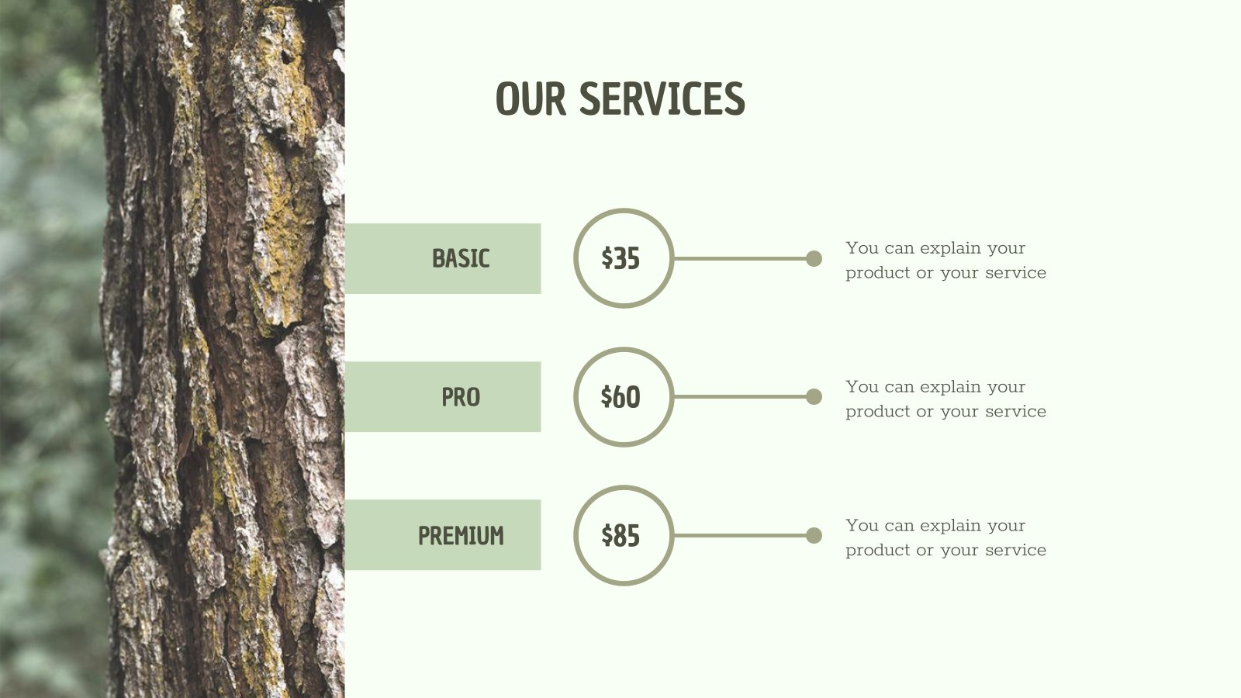
This slide is only for Premium users

Slide 50
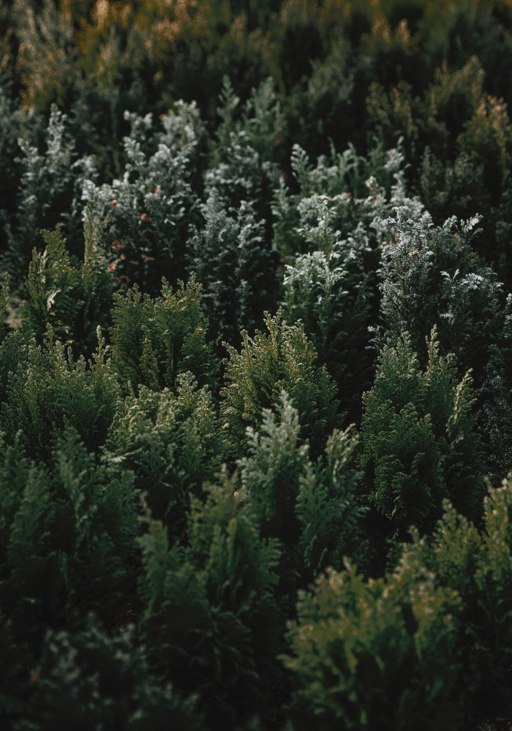
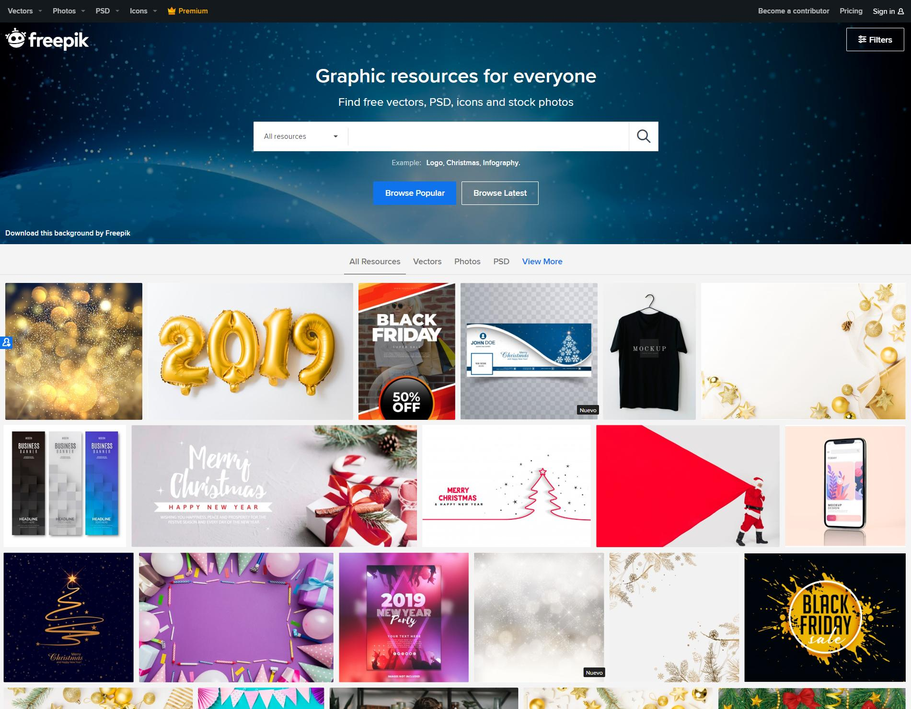
DESKTOP SOFTWARE
You can replace the image on the screen with your own work. Just delete this one, add yours and send it to the back

Slide 51
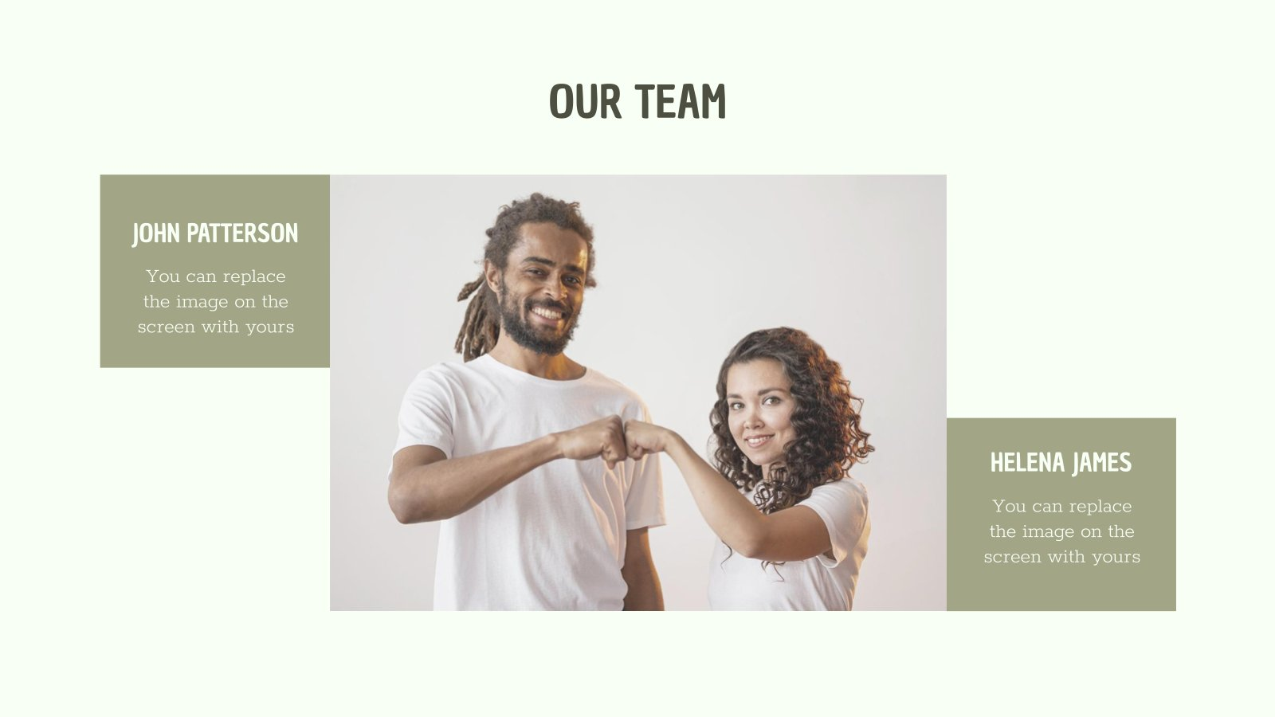
This slide is only for Premium users

Slide 52
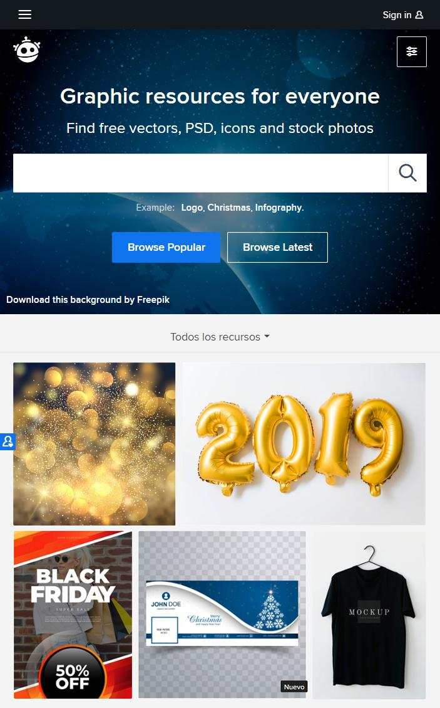
TABLET APP
You can replace the image on the screen with your own work. Just delete this one, add yours and send it to the back

Slide 53
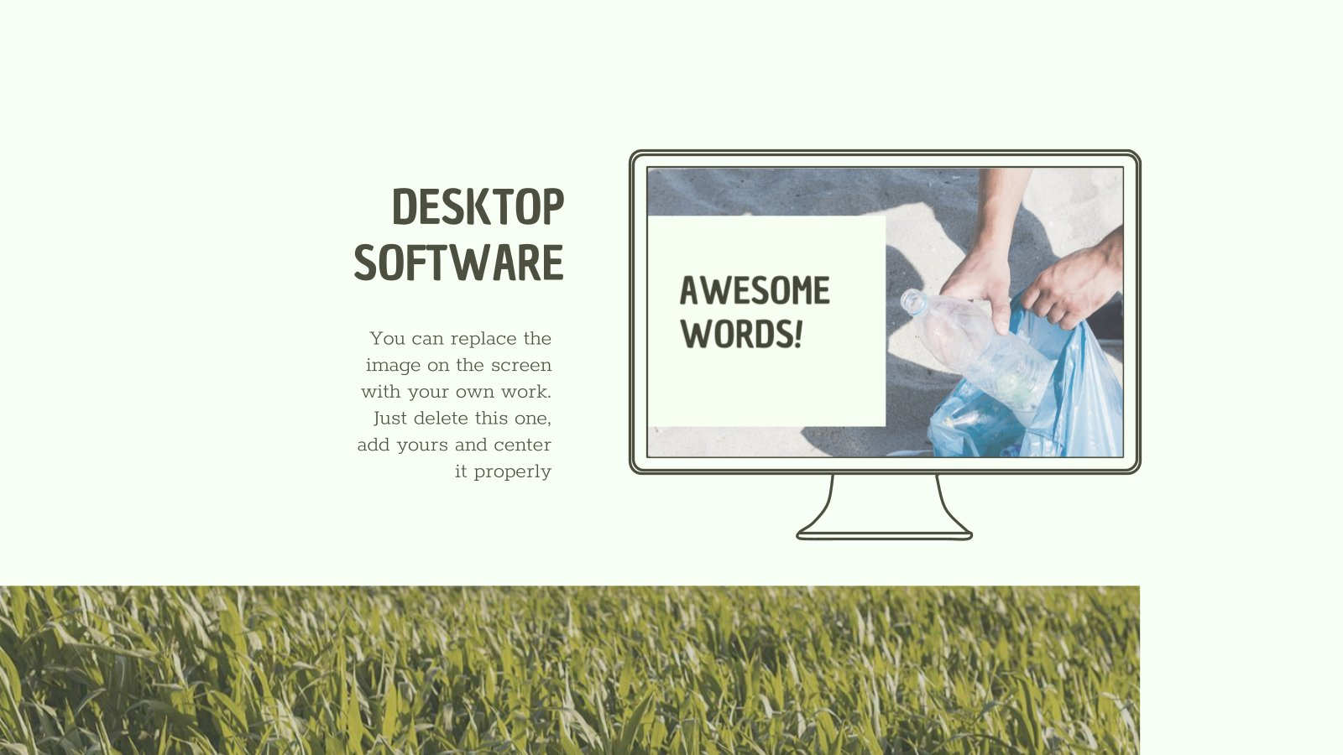
This slide is only for Premium users

Slide 54
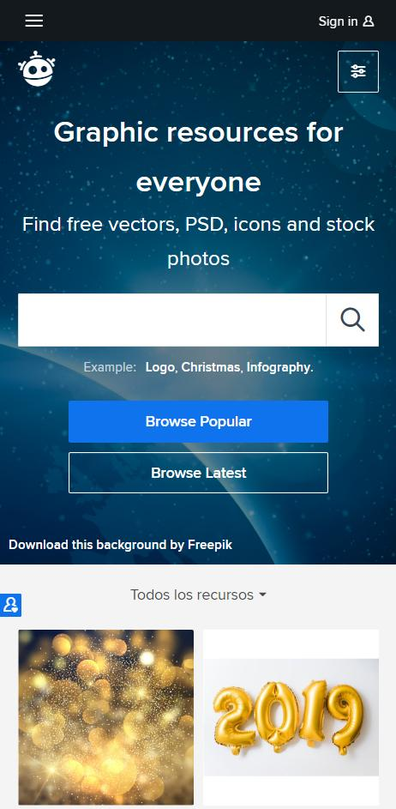
MOBILE WEB
You can replace the image on the screen with your own work. Just delete this one, add yours and send it to the back

Slide 55
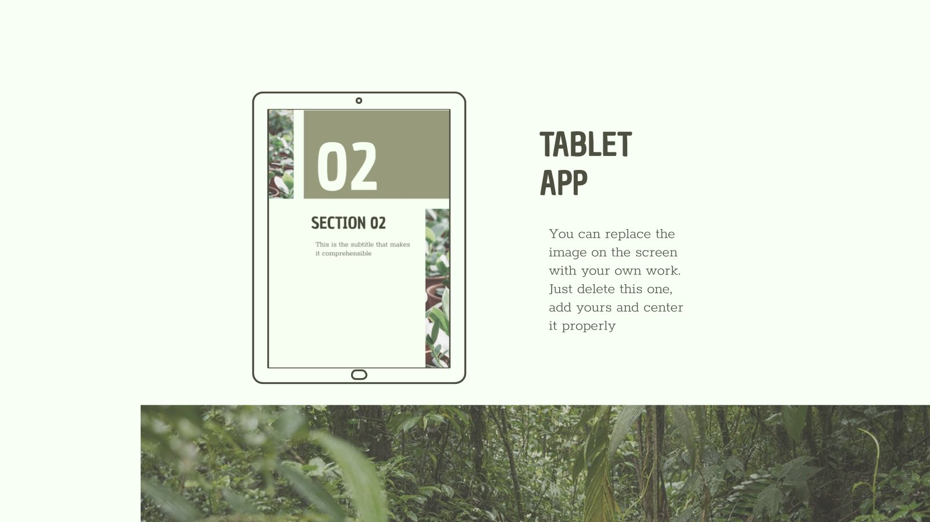
This slide is only for Premium users

Slide 56

OUR TEAM
HELENA JAMES
JOHN PATTERSON
JENNY DOE
Replace the image on the screen with your own
Replace the image on the screen with your own
Replace the image on the screen with your own

Slide 57

This slide is only for Premium users

Slide 58

THANKS!
Does anyone have any questions? addyouremail@freepik.com +91 620 421 838 Yourcompany.com

Slide 59


Slide 60

This slide is only for Premium users

Slide 61

This slide is only for Premium users

Slide 62
RESOURCES
ICON
Ecology
PHOTOS
Farm concept with hands holding strawberries
Group volunteers collecting trash beach
Close up green leaves plant
Two friends mountains
Watering can with seedling soil granite floor
Hand holding soil from packet
Hand holding flowering plant his hand
Trees ferns growing forest
Full frame plants
Fantastic scene with beautiful plant
Unrecognizable person hugging tree
Female hand making heart shape green grass
Close up green leaves plant
Business partners looking female manager giving presentation with recycle icon screen
Volunteer beach concept with cigarettes

Slide 63

This slide is only for Premium users

Slide 64
Instructions for use
In order to use this template, you must credit Slidesgo by keeping the Credits slide.
You are allowed to:
- Modify this template.
- Use it for both personal and commercial projects.
You are not allowed to:
- Sublicense, sell or rent any of Slidesgo Content (or a modified version of Slidesgo Content).
- Distribute Slidesgo Content unless it has been expressly authorized by Slidesgo.
- Include Slidesgo Content in an online or offline database or file.
- Offer Slidesgo templates (or modified versions of Slidesgo templates) for download.
- Acquire the copyright of Slidesgo Content.
For more information about editing slides, please read our FAQs:
https://slidesgo.com/faqs

Slide 65





Storyset
Create your Story with our illustrated concepts. Choose the style you like the most, edit its colors, pick the background and layers you want to show and bring them to life with the animator panel! It will boost your presentation. Check out How it Works.
Pana
Amico
Bro
Rafiki
Cuate

Slide 66
Fonts & colors used
This presentation has been made using the following fonts:
Chau Philomene One
(https://fonts.google.com/specimen/Chau+Philomene+One)
Rokkitt
(https://fonts.google.com/specimen/Rokkitt)
#4d4f40
#a2a586
#c6d9bb
#f8fff5

Slide 67
Use our editable graphic resources...
You can easily resize these resources keeping the quality. To change the color just ungroup the resource and click on the object you want to change. Then click on the paint bucket and select the color you want. Don’t forget to group the resource again when you’re done.

Slide 69
...and our set of editable icons
You can resize these icons keeping the quality.
You can change the stroke and fill color; just select the icon and click on the paint bucket/pen.

Slide 70
Business Icons

Slide 71
Avatar Icons

Slide 72
Creative Process Icons

Slide 73
Educational Process Icons

Slide 74
Help & Support Icons

Slide 75
Medical Icons

Slide 76
Nature Icons

Slide 77
Performing Arts Icons

Slide 78
SEO & Marketing Icons

Slide 79
Teamwork Icons

Slide 80


