Slide 1
Refactoring Sequential Java Code for Concurrency via Concurrent Libraries
Danny Dig (MIT → UPCRC Illinois)
John Marrero (MIT)
Michael D. Ernst (MIT → U of Washington)
ICSE 2009
Notes:
Hello – I am Danny Dig. I will present an interactive refactoring tool that allows programmers to introduce concurrency into a sequential program
in an incremental and iterative manner.
I worked on this tool while I was a postdoc MIT, where I worked with an undergrad student John Marrero and with Michael Ernst. Meanwhile I moved back to University of Illinois where I am a principal investigator in the Universal Parallel Computing research Center (UPCRC), funded by Microsoft and Intel

Slide 2
The Shift to Multicores Demands Work from Programmers
Users expect that new generations of computers run faster
Programmers must find and exploit parallelism
A major programming task:
refactoring sequential apps for concurrency
Notes:
Users expect that each new generation of computers runs their programs faster.
The industry's shift to multicores.
demands that programmers find and exploit parallelism in their applications if they want to reap the same performance benefits as in the past.
In the multicore era, a major programming task is to refactor sequential apps for concurrency (i.e., take an existing sequential app and make it concurrent while preserving the original functionality)

Slide 3
Updating Shared Data Must Execute Atomically
public class Counter {
int value = 0;
public int getCounter() {
return value;
}
public void setCounter(int counter) {
this.value = counter;
}
public int inc() {
return ++value;
}
}
read value
compute value + 1
store value
Notes:
Let me illustrate refactoring to concurrency with a Real example from Apache Tomcat webserver
Class Counter is used to count hits on a webpage. It contains a data field called value, two accessor methods (getter and setter) and an increment method which increments the value each time a page is visited.
Behind the ++value are disguised three operations: read the current value, compute value + 1, and store result to the variable
When executing this code under multiple threads that all request access to the same webpage, a thread interleaving can occur after one thread reads the value. This can result in a “lost update”
The problem is that these three operations must execute atomically.

Slide 4
Locking Has Too Much Overhead
public class Counter {
int value = 0;
public int getCounter() {
return value;
}
public void setCounter(int counter) {
this.value = counter;
}
public synchronized int inc() {
return ++value;
}
}
Notes:
Real example from Apache Tomcat
The traditional solution is to put a lock around the ++value, but
the overhead of acquiring and releasing the lock far outspends the useful computation, which can drastically reduce the scalability
-

Slide 5
Locking is Error-Prone
public class Counter {
int value = 0;
public int getCounter() {
return value;
}
public void setCounter(int counter) {
this.value = counter;
}
public synchronized int inc() {
return ++value;
}
}
synchronized
synchronized
Notes:
This code is not yet correct, because it also needs locks around the other accesses to the field
This illustrates that working with locks is error-prone:
too few locks can lead to data races
too many locks can lead to deadlocks or kill the scalability of the program

Slide 6
Refactoring for Concurrency: Goals
Thread-safety
- preserve invariants under multiple threads
Scalability
- performance improves with more parallel resources
Delegate the challenges to concurrent libraries:
- java.util.concurrent in Java 5
- addresses both thread-safety and scalability
AtomicInteger from java.util.concurrent
in the Counter example
Notes:
Refactoring sequential programs to concurrency is challenging because of two conflicting goals:
- First: the concurrent program needs to be thread-safe, meaning it must preserve the same invariants like the original program, even when executed under multiple threads
- Second: the concurrent program needs to scale, meanings that performance continues to improve when adding more cores
One way to ease the burden on the programmer is to delegate these challenges to a library
Java standard library has been extended with a package (java.util.concurrent). The library addresses both the thread-safety and the scalability
Revisiting our page hits counter, the programmer can use AtomicInteger provided byt java.util.concurrent

Slide 7
Refactoring For Concurrency is Challenging
Manual refactoring to java.util.concurrent is:
Labor-intensive: changes to many lines of code
(e.g., 1019 LOC changed in 6 open-source projects when converting to AtomicInteger and ConcurrentHashMap)
Error-prone: the programmer can use the wrong APIs
(e.g., 4x misused incrementAndGet instead of getAndIncrement)
Omission-prone: programmer can miss opportunities to use the new, efficient APIs
(e.g., 41x missed opportunities in the 6 open-source projects)
Goal: make concurrent libraries easy to use
Notes:
If the programmer wants to enjoy the thread-safety and scalability of these library classes, she needs to refactor existing code to use these library classes.
Manual refactoring has several problems:
- it is labor-intensive and slow (since it requires changes to many lines of code)
In 6 open-source projects converted to use AtomicInteger and ConcurrentHashMap, the developers changed over 1000 LOC
- it is error prone (the programmer might use the wrong API method among several slightly similar APIs)
- the programmer might miss oportunities to use the new API methods

Slide 8
Outline
Concurrencer, our interactive refactoring tool
Making programs thread-safe
- convert int field to AtomicInteger
- convert HashMap field to ConcurrentHashMap
Making programs multi-threaded
- convert recursive divide-and-conquer to task parallelism
Evaluation
Notes:
I will present our tool Concurrencer which enables Java programmers to refactor sequential code for concurrency by converting to j.u.c utilities. Concurrencer is interactive: the programmer selects a shared data and a target refactoring, and Concurrencer analyzes all accesses to shared data and applies the transformations. Concurrencer is integrated with Eclipse refactoring engine.
Currently it supports three refactorings:
We previously cataloged the transformations in 5 open-source projects that were manually parallelized. These two transformations were among the most commonly used in practice.
case-studies evaluation shows that it is very useful.
I will present the first refactoring that makes the access to an int field thread-safe by converting the int to AtomicInteger

Slide 9
AtomicInteger in java.util.concurrent
Lock-free programming on single integer variable
Update operations execute atomically
Uses efficient machine-level atomic instructions (Compare-and-Swap)
Offers both thread-safety and scalability
Notes:
J.u.c provides a class AtomicInteger, which is essentially a wrapper over an int value, which makes the access thread-safe, without requiring programmer to use any locks.
AtomicInteger provides update methods wich execute atomically
AtomicInteger is very scalable: rather than using locks to guard the updates, it uses efficient machine-level CAS instructions available on modern processors

Slide 10
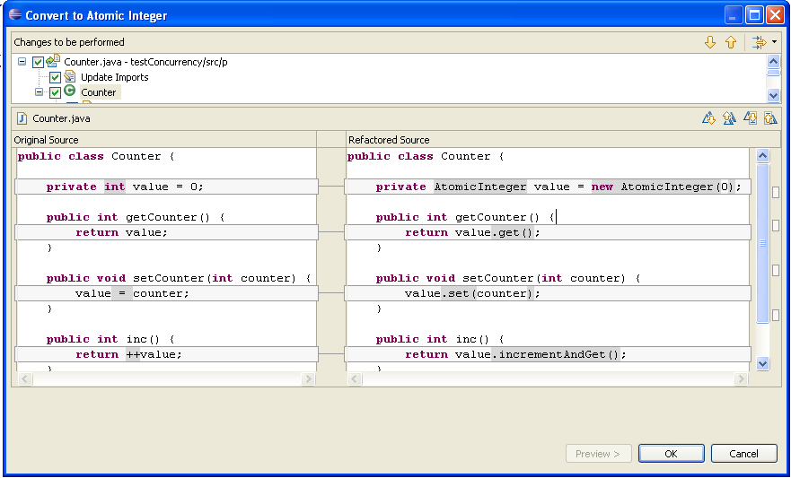
Convert int to AtomicInteger
Initialization
Read Access
Write Access
Prefix Expression
Notes:
Revisiting our Counter example, the programmer selects the shared data field, and targets it with Convert to AtomicInteger refactoring. Concurrencer makes all accesses thread-safe. This screenshot shows a preview of the transformations that Concurrencer is going to apply.
Concurrencer changes the type declaration and initializes the field.
Initialization: uses the field initializer expression,
Concurrencer replaces read accesses with a call to get() which returns the same type int, so clients of this code are unaffected.
Concurrencer replaces Write-access with a call to set()
Update expressions: prefix update expression is replaced with the atomic call incrementAndGet
For a complete list of transformations that Concurrencer applies for other cases, see the paper.

Slide 11
Transformations: Removing Synchronization Block
public class Counter {
int value = 0;
...
public synchronized int inc() {
return ++value;
}
}
public class Counter {
AtomicInteger value = new AtomicInteger(0);
...
public int inc() {
return value.incrementAndGet();
}
}
Concurrencer removes the synchronization iff for all blocks:
- after conversion, the block contains exactly one call to the atomic API
- the block accesses a single field
Notes:
Concurrencer converts both a sequential program into one which is thread-safe, and also an already thread-safe program into one which is more scalable
If the original code contained locks, Concurrencer removes synchronization block because it is superfluous
This analysis determines whether it is safe to remove the synchronization
a. after the conversion, the block contains exactly one call to the AtomicInteger API (it would be wrong the remove the lock if the block had 2 API calls, because even though each of them is atomic, a thread interleaving can still occur between 2 consecutive API calls)
b. the block acceses one single field (since AtomicInteger can maintain invariants only over one single field)
These two conditions must hold for all synchronized blocks that access the refactored field

Slide 12
Outline
Concurrencer, our interactive refactoring tool
Making programs thread-safe
- convert int field to AtomicInteger
- convert HashMap field to ConcurrentHashMap
Making programs multi-threaded
- convert recursive divide-and-conquer to task parallelism
Evaluation
Notes:
Next I will present the second refactoring, that makes access to a hashMap field thread-safe, by converting hashMap to ConcurrentHashMap

Slide 13
“Put If Absent” Pattern Must Be Atomic
HashMap<String, File> cache = new HashMap<String, File>();
public void service(Request req, Response res) {
...
String uri = req.requestURI().toString();
...
File resource = cache.get(uri);
if (resource == null) {
resource = new File(rootFolder, uri);
cache.put(uri, resource);
}
...
}
Notes:
This code is Real example from GlassFish project, an application server used for building online communities
This is a cache implemented as a Map from URI to files in the file system
Illustrates a common pattern of updating a map, called putIfAbsent
Test whether the map contains a value corresponding to the key stored in the uri variable
- if not, create the value resource
and put the key,value pair in the map
The sequential semantics of the service method is to insert a key-value pair only if the key was not previously mapped. .
When multiple threads access the map, a thread interleaving can occur here. A thread can overwrite a <key,value> pair that was placed before in the map, which destroys the sequential semantics of putIfAbsent .
Again, what we need here is atomic execution of these two map operations.

Slide 14
Locking the Entire Map Reduces Scalability
HashMap<String, File> cache = new HashMap<String, File>();
public void service(Request req, Response res) {
...
String uri = req.requestURI().toString();
...
synchronized(lock){
File resource = cache.get(uri);
if (resource == null) {
resource = new File(rootFolder, uri);
cache.put(uri, resource);
}
}
...
}
Notes:
Real example from GlassFish
The traditional way is to put a common lock around the update. This common lock is used by all the threads that access the map, but this prevents any other thread from accessing the map, which reduces the scalability of the cache application

Slide 15
ConcurrentHashMap in java.util.concurrent
Uses fine-grained locking (e.g., lock-striping)
N locks, each guarding a subset of the hash buckets
Enables all readers to run concurrently
Enables a limited number of writers to update the map concurrently
Notes:
A much better solution is to use ConcurrentHashMap provided by java.util.concurrent.
ConcurrentHashMap uses a different locking strategy that offers much better scalability.
It uses a fine-grained locking mechanism (called lock-stripping). The implementation uses a number N locks, each of them guarding a subset of the hash buckets.
Concurrent HashMap enables all readers to run concurrently, and allows a limited number of writers to update the map concurrently

Slide 16
New APIs in ConcurrentHashMap
ConcurrentHashMap provides three new update methods:
- putIfAbsent(key, value)
- replace(key, oldValue, newValue)
- remove(key, value)
Each update method:
- supersedes several calls to Map operations,
- but executes atomically
Notes:
ConcurrentHashMap provides three new update methods.
putIfAbsent, conditional replace, and a conditional remove

Slide 17
Concurrencer Replaces Update Operation with putIfAbsent()
HashMap cache;
ConcurrentHashMap cache;
String uri =
req.requestURI().toString();
...
File resource =cache.get(uri);
if (resource == null) {
resource = new File(rootFolder,uri);
cache.put(uri, resource);
}
String uri =
req.requestURI().toString();
...
cache.putIfAbsent(uri,
new File(rootFolder, uri);
Notes:
Lets revisit our previous example with the cache. The programmer selects the cache field and targets it with ConvertToConcurrentHashMap refactoring.
Concurrencer finds the pattern that matches the putIfAbsent and replaces that code with a call to putIfAbsent
Before invoking putIfAbsent, the value to be inserted must be available.
In this code snapshot the value is simply created by invoking a constructor, Concurrencer constructs the value similarly.
However, the creational code may span multiple statements, and the pattern elements may not be on adjacent statements.
Concurrencer extracts it into a creational method and invokes this method to construct the value
Such transformations can not be performed by a simple find-and-replace, but require traversing the AST

Slide 18
Enabling program analysis for
Convert to ConcurrentHashMap
The creational code is always invoked before calling putIfAbsent
#1. Side-effects analysis
- conservative analysis (MOD Analysis) warns the user about potential side-effects
#2. Read/write analysis determines whether to delete testValue
Notes:
In the refactored code, the creational code is always invoked before calling the putIfAbsent, regardless of whether the key,value pair will be placed in the map.
this can result in a different behavior than the original sequential code, If the creational code has side-effects,
Our conservative program analysis warns the user about potential side effects: when the creational code assigns to fields or method arguments, or when a method is called on a field or local variable, or when a field is passed as argument
Second, a read/write analysis determines:
- if the created value is read after map.put (if so, need to store it in a temporary variable)
-

Slide 19
Outline
Concurrencer, our interactive refactoring tool
Making programs thread-safe
- convert int field to AtomicInteger
- convert HashMap field to ConcurrentHashMap
Making programs multi-threaded
- convert recursive divide-and-conquer to task parallelism
Evaluation
Notes:
Typically, a user would first make a program thread-safe, and then make the program run concurrently under multiple threads. Concurrencer supports both kinds of transformations: the first two refactorings I presented are enabling transformations, the third refactoring makes a program run concurrently.
Using Concurrencer, a programmer can convert a sequential divide-and-conquer to a parallel program that uses tasks parallalelism

Slide 20
Challenge: How to Keep All Cores Busy
Parallelize computationally intensive problems
(fine-grained parallelism)
Many computationally intensive problems take the form of divide-and-conquer
Classic examples: mergesort, quicksort, search, matrix / image processing algorithms
Sequential divide-and-conquer are good candidates for parallelization when tasks are completely independent
- operate on different parts of the data
- solve different subproblems
Notes:
To take advantage of the increasing number of processors, the programmer needs to parallelize the computationally-intensive problems, in a fine-grained manner, so that all cores are busy doing useful work
Many computationally intensive problems take the form of divide and conquer (examples)
Sequential divide-and-conquer are natural candidates for parallelization when recursion tasks are completely independent...
This often holds in divide-and-conquer algorithms, even those not originally intended for parallel implementations

Slide 21
Sequential and Parallel Divide-and-Conquer
solve (Problem problem) {
if (problem.size <= BASE_CASE )
solve problem directly
else {
split problem into tasks
solve each task
compose result from subresults
}
}
solve (Problem problem) {
if (problem.size <= SEQ_THRESHOLD )
solve problem sequentially
else {
split problem into tasks
In Parallel (fork){
solve each task
} wait for all tasks (join)
compose result from subresults
}
}
Notes:
Left hand-side shows a sequential divide and conquer
Right-hand side shows a parallel divide and conquer

Slide 22
ForkJoinTask Framework in Java 7
Main class ForkJoinTask (a lightweight thread-like entity)
- fork() spawns a new task
- join() waits for task to complete
- forkJoin() syntactic sugar for spawn/wait
- compute() encapsulates the task's computation
Framework contains a work-stealing scheduler with good load balancing [Lea'00]
Notes:
ForkJoin framework to be released in Java 7, is designed for fine-grained task parallelism
Main class in the framework is ForkJoinTask (which is thread-like entity, but has a much lighter overhead) This makes it suitable for divide-and-conquer algorithms that typically spawn several thousands tasks
It offers a few APIs:
- fork spawns a new subtask
- join waits for the forked subtask to complete. Join doesn't suspend the worker thread but schedules other subtasks for execution
- forkJoin syntactic sugar
- compute encapsulates a tasks's computationt. It is he hookup method which needs to be overriden by the programmer
At the heart of the framework lies a dynamic scheduler that achieves good load balancing based on efficient work-stealing

Slide 23
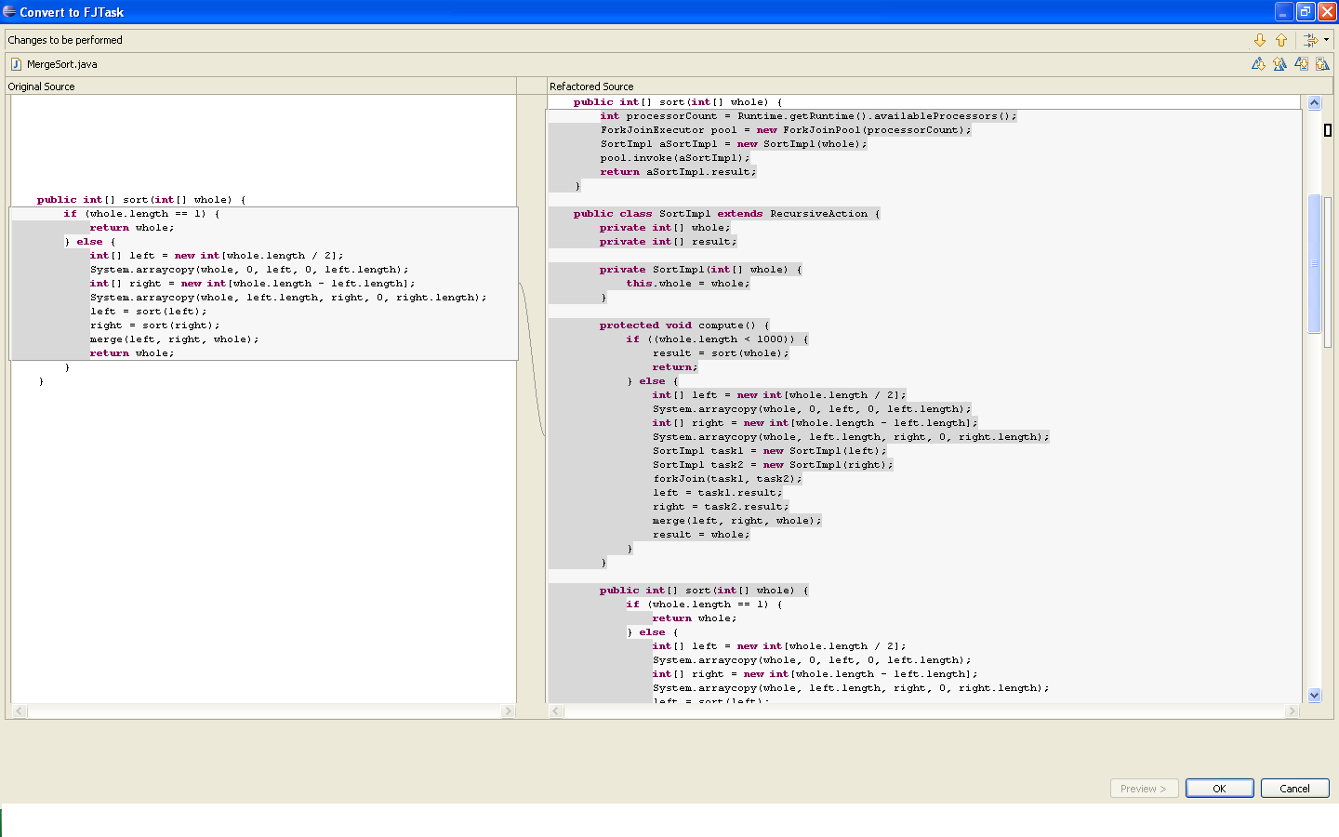
Concurrencer Parallelizes MergeSort
reimplement original method
subclass RecursiveAction
fields for input/output
task constructor
implement compute()
replace basecase with SeqThr
create parallel tasks
forkJoin the parallel tasks
fetch results from tasks
copy original sort method
for use in the sequential case
Notes:
The programmer selects the recursive divide-and-conquer sort method, and concurrencer converts it into code which runs the recursive tasks in parallel.
The programmer needs only to specify the Sequential-threshold as input argument for the transformation.
Concurrencer generates an inner Class which subclases RecursiveAction, one kind of FJTask
Since the compute method neither takes arguments, nor returns values, the class declares fields to store the input and output of the computation
Concurrencer uses the original sort method as the skeleton for computation
(i) changes the base case with a sequential threshold
(this is the only input parameter supplied by the user)
(ii) replaces recursive calls with instantiating subtaks and fork/joins them
(iii) assembles the result from subresults
Concurrencer preseves the original signature of the sort method, so that Callers of the method are unaffected
It reimplements the method by creating a pool of threads, equal with the number of cores available at runtime,
Then it creates the parent task for the problem, and calls invoke on it. This blocks until all the computations finished.
Concurrencer fetches the result from the result field

Slide 24
Outline
Concurrencer, our interactive refactoring tool
Making programs thread-safe
- convert int field to AtomicInteger
- convert HashMap field to ConcurrentHashMap
Making programs multi-threaded
- convert recursive divide-and-conquer to task parallelism
Evaluation
Notes:
Evaluation through case studies

Slide 25
Research Questions
Q1: Is Concurrencer useful? Does it save programmer effort?
Q2: Is the refactored code correct? How does manually-refactored code compare with code refactored with Concurrencer?
Q3: What is the speed-up of the parallelized code?
Notes:
To evaluate the effectiveness of Concurrencer, we answer the following questions:
Q1 - Q3

Slide 26
Case-study Evaluation
Case-study 1:
- 6 open-source projects using AtomicInteger or ConcurrentHashMap
- used Concurrencer to refactor the same fields as the developers did
- evaluates usefulness and correctness
Case-study 2:
- used Concurrencer to refactor 6 divide-and-conquer algorithms
- evaluates usefulness, correctness and speed-up
Notes:
To answer this questions, we conduct two case-studies.
For the first experiment,
We took 6 open-source projects that use AtomicInteger or ConcurrenthashMap. We found the previous versions of these projects that do not use this concurrent classes, and we used Concurrencer to refactor the same fields that the open-source developers refactored
Second experiment: we used concurrencer to refactor 6 divide-and-conquer.

Slide 27
Q1: Is Concurrencer Useful?
Notes:
The next-tolast column shows the lines of code that were manually changed, and the last column shows the LOC that Concurrencer could handle.
Using Concurrencer, the programmer would have saved changing about 13OO LOC.
MINA – Apache network framework which helps users develop high performance and high scalability network applications
Tomcat – pure Java implementation of HTTP webserver
Struts – an Apache web framework for developing web applications using a MVC architecture
GlassFish – is an N-tier application server (used frequently for building online comunities); It integreates webserver with an efficient networking framework
JaxLib – efficient library for I/O stream
Zimbra – is an infrastructure for enabling collaborative authoring of documents

Slide 28
Q2: Is the Refactored Code Correct?
1. Thread-safety: omission of atomic methods
2. Incorrect values: errors in using atomic methods
Open-source developers misused getAndIncrement instead of
incrementAndGet 4 times
- can result in off-by-one values
Concurrencer used the correct method
Notes:
Second question: is the refactored code correct. How does the code converted with Concurrencer compares with the manually converted code?
We split this question into two subquestions:
1. Omissions to use the atomic methods, can make some field accesses thread-unsafe
2. Second, errors in using the correct APIs can result in computing incorrect value

Slide 29
Q3: What is the Speedup of the Parallelized Algorithms?
Notes:
Speedup for the recursive divide-and-conquer algorithms that were parallelized with Concurrencer

Slide 30
Conclusions
Introducing concurrency is hard
Convert “introduce concurrency” into “introduce parallel library”
- still tedious, error- and omission-prone
Concurrencer is more effective than manual refactoring
http://refactoring.info/tools/Concurrencer
Future work:
- support more refactorings, e.g., convert Array to ParallelArray
Notes:
Refactoring sequential programs for concurrency is not trivial.
As library developers make better concurrent libraries, “the intoduce concurrency” problem becomes “introduce a library” problem.
Manual refactoring via concurrent libraries is still tedious, …
We presented Concurrencer, and interactive refactoring tool which supports three refactorings and the evaluation shows that the tool is more effective
These three refactorings are just the beginning of building a toolset of refactorings for concurrency. In the future we plan to implement other refactorings, like the ones that introduce data parallelism by converting an Array to ParallelArray, library class that contains operations like parallel map, parallel reduce. The main challenges will be to design a static analysis that can determine unique traversal and uniqueness of elements accurately and fast enough for an interactive tool

Slide 31
BACK UP slides

Slide 32
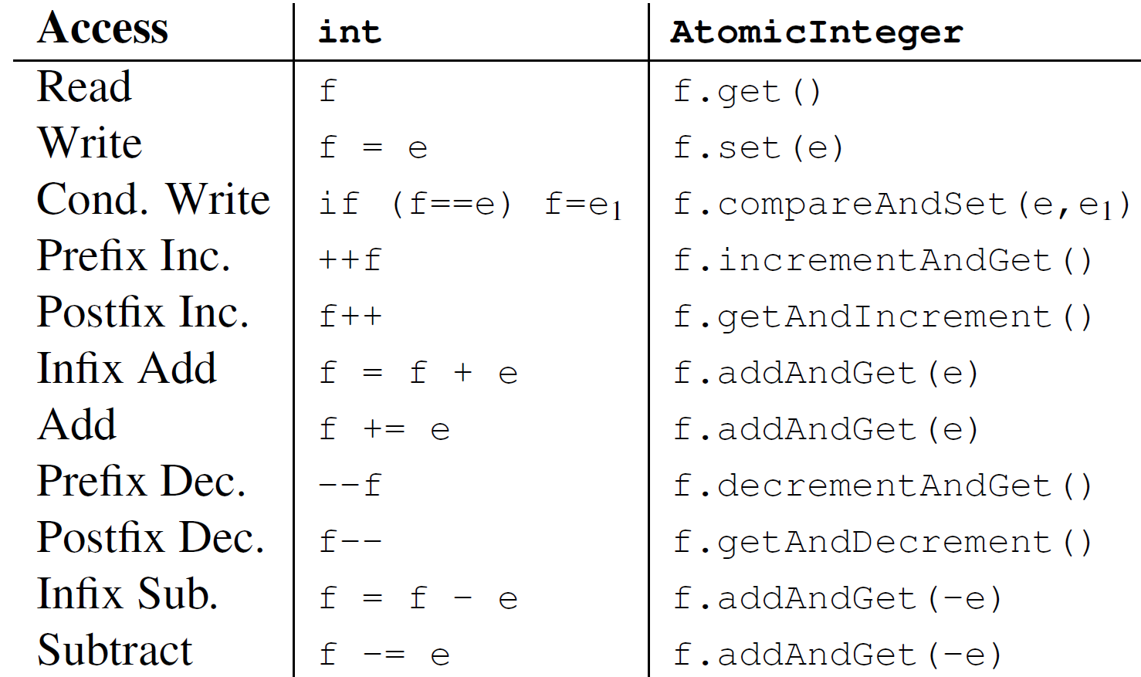
Convert int to AtomicInteger
- transformations -
Notes:
Revisiting our Counter example, the programmer selects the shared data field, and targets it with Convert to AtomicInteger refactoring. Concurrencer makes all accesses thread-safe. This screenshot shows a preview of the transformations that Concurrencer is going to apply.
Concurrencer changes the type declaration and the initialization of the
Initialization: uses the field initializer expression, or the default value 0 if there is no field initializer.
Concurrencer replaces read accesses with a call to get() which returns the same type int, so clients are unaffected.
Concurrencer replaces Write-access with a call to set()
Update expressions: prefix update expression is replaced with the atomic call incrementAndGet

Slide 33
Two consecutive inc() return same value
get value
do value + 1
set value
public int inc() {
return ++value;
}
Thread
A
value = 9
9 + 1 = 10
value = 10
Thread
B
value = 9
9 + 1 = 10
value = 10

Slide 34
Outline
Concurrencer, our interactive transformation tool
- convert int field to AtomicInteger
- convert HashMap field to ConcurrentHashMap
- convert recursive divide-and-conquer to ForkJoin parallelism
Empirical evaluation
Notes:
I will present our vision for parallelizing program transformations

Slide 35
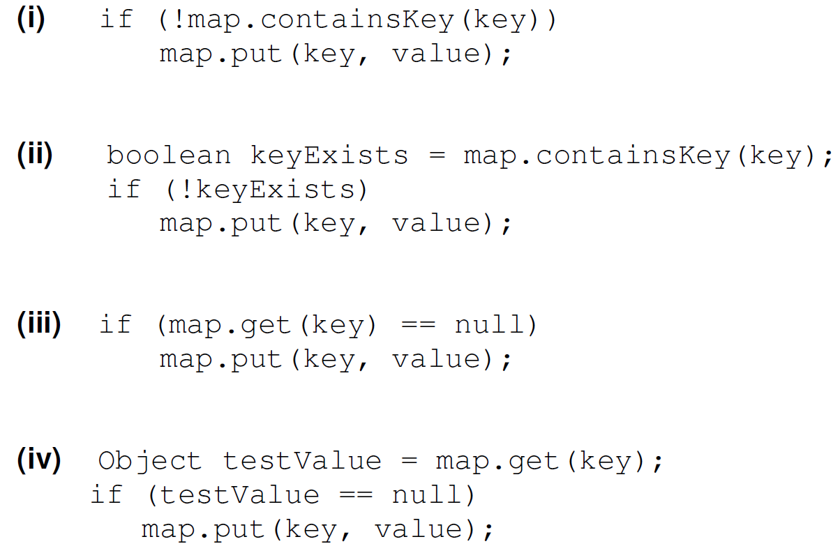
Basic Patterns that Concurrencer Replaces with map.putIfAbsent(key, value)
Notes:
A programmer selects the shared-data, in this case a HashMap field and chooses the refactoring which converts the field to ConcurrentHashMap.
These are the transformations needed

Slide 36
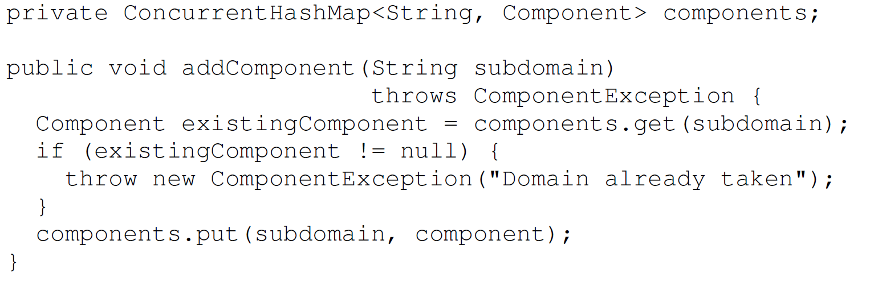
putIfAbsent Pattern not Currently Handled
Notes:
One way to simplify parallel programming is to hide parallelism behind domain-specific environments.
The term environment is a generic term that denotes languages, libraries or frameworks.
Many such DSEs are currently ported to take advantage of the multicores, including languages like Mathematica and LabView, libraries like Apple's core audio, and frameworks like PureMVC, framework for separating presentation and logic in Flash applications.
Ideally, the application programmer can get great speed-up by just using the DSEs, without learning parallel programming. This is fantastic when it works.

Slide 37
Read/write analysis for putIfAbsent() with creational code
public void service(Request req,
Response res){
...
File resource =cache.get(uri);
if (resource == null) {
for (int i; i < uri.length; i++){
... initialization code
}
resource = new File(rootFolder, uri);
cache.put(uri, resource);
}
print(resource);
}
public void service(Request req,
Response res){
...
File resource =cache.get(uri);
File newResource = createResource();
if (cache.putIfAbsent(uri,
newResource)== null){
resource = newResource;
}
print(resource);
}
File createResource(){
for (int i; i < uri.length; i++){
... initialization code
}
resource = new File(rootFolder, uri);
return resource;
}
Notes:
In many cases, the code which creates the value is more involved than one statement.
Since the value to be inserted must be available before invoking the putIfAbsent, Concurrencer extracts the creational code into a new method (createResource) and calls this creational method before invoking the putIfAbsent.
As you can notice, the semantics of the refactored code are different than of the original code. In the original code, the creational code was invoked iff the <key,value> was inserted in the map. In the refactored code, the creational method is invoked always, regardless of whether the key,value is inserted in the map.
This can be problematic, especially if the creational code was side effects.

Slide 38
Using putIfAbsent() with creational code
public void service(Request req,
Response res){
...
File resource =cache.get(uri);
if (resource == null) {
for (int i; i < uri.length; i++){
... initialization code
}
resource = new File(rootFolder, uri);
cache.put(uri, resource);
}
}
public void service(Request req,
Response res){
...
cache.putIfAbsent(uri,
createResource());
}
File createResource(){
for (int i; i < uri.length; i++){
... initialization code
}
resource = new File(rootFolder, uri);
return resource;
}
Notes:
In many cases, the code which creates the value is more involved than one statement.
Since the value to be inserted must be available before invoking the putIfAbsent, Concurrencer extracts the creational code into a new method (createResource) and calls this creational method before invoking the putIfAbsent.
As you can notice, the semantics of the refactored code are different than of the original code. In the original code, the creational code was invoked iff the <key,value> was inserted in the map. In the refactored code, the creational method is invoked always, regardless of whether the key,value is inserted in the map.
This can be problematic, especially if the creational code was side effects.

Slide 39
Code Patterns: remove() and replace()
if(hm.containsKey("a_key"))
hm.remove("a_key");
...
hm.remove("a_key");
if(hm.containsKey("a_key"))
hm.put("a_key", "a_value");
...
hm.replace("a_key", "a_value");

Slide 40
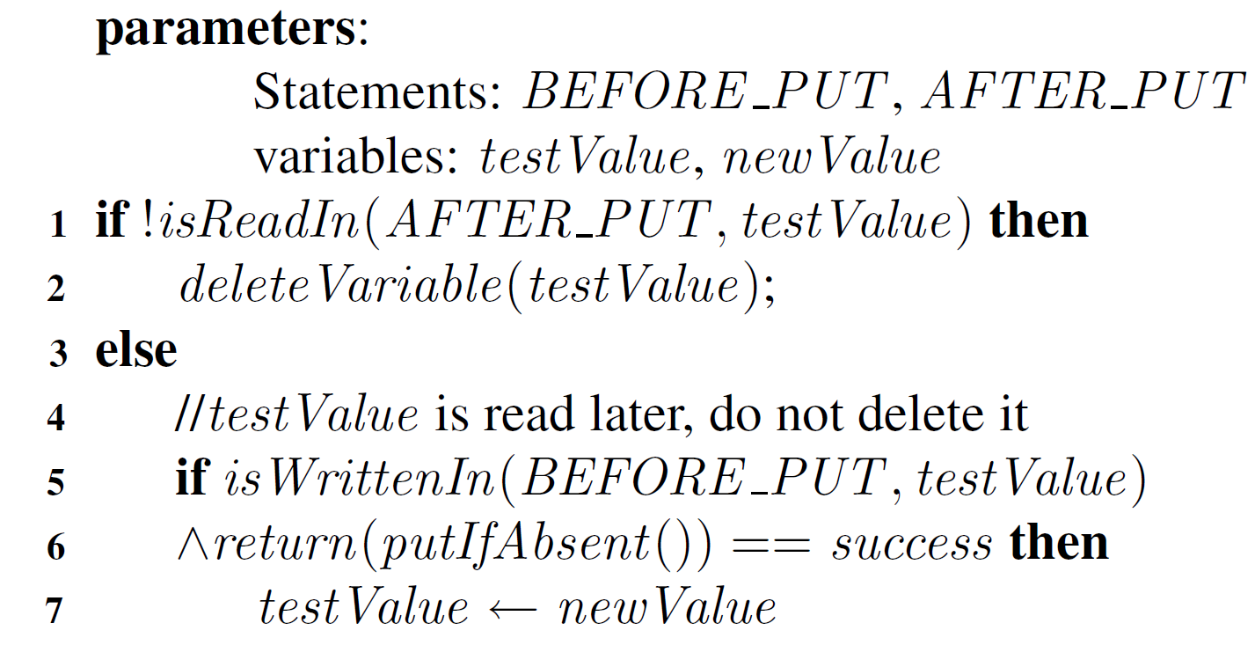
Enabling program analysis for
Convert to ConcurrentHashMap
#1. Read/write analysis determines whether to delete testValue:
Notes:
Side effects: when the creational code assigns to fields or method arguments, or when a method is called on a field or local variable, or when a field is passed as argument
Second, is a read/write analysis that determines:
- if the created value is read after map.put (if so, need to store it in a temporary variable)
-

Slide 41
Outline
Concurrencer, our interactive transformation tool
- convert int field to AtomicInteger
- convert HashMap field to ConcurrentHashMap
- convert recursive divide-and-conquer to ForkJoin parallelism
Empirical evaluation
Interactive, first-class program transformations
Notes:
I will present our vision for parallelizing program transformations

Slide 42
Outline
Concurrencer, our interactive transformation tool
- convert int field to AtomicInteger
- convert HashMap field to ConcurrentHashMap
- convert recursive divide-and-conquer to ForkJoin parallelism
Empirical Evaluation
Notes:
I will conclude with my thougths on interactive transformations for parallelization

Slide 43
Outline
Concurrencer, our extension to Eclipse's refactoring engine
- convert int field to AtomicInteger
- convert HashMap field to ConcurrentHashMap
- convert recursive divide-and-conquer to Fork/Join parallelism
Empirical Evaluation

Slide 44
Example MergeSort with Fork/Join Framework
class MergeSort extends RecursiveAction {
int[] toSort;
int[] result; // sorted array
MergeSort(int[] toSort){
...
}
protected void compute() {
if (toSort.length < Sequential_Threshold) {
result = seqMergeSort(toSort);
} else {
MergeSort leftTask = new MergeSort(left);
MergeSort rightTask = new MergeSort(right);
forkJoin(leftTask, rightTask);
result = merge(leftTask.result, rightTask.result);
}
}
private int[] seqMergeSort(int[] toSort) {
if (toSort.length == 1)
return toSort;
else { // left = 1st half ; right = 2nd half
seqMergeSort(left); seqMergeSort(right);
return merge(left, right);
}
}
Notes:
The programmer selects the recursive divide-and-conquer sort method, and concurrencer converts it into code which runs the recursive tasks in parallel.
The programmer needs only to specify the Sequential-threshold as input argument for the transformation.

Slide 45
Transformations for ExtractFJTask
class MergeSort extends RecursiveAction {
int[] toSort;
int[] result; // sorted array
MergeSort(int[] listToSort){
...
}
protected void compute() {
if (toSort.length < Sequential_Threshold) {
result = seqMergeSort(toSort);
} else {
MergeSort leftTask = new MergeSort(left);
MergeSort rightTask= new MergeSort(right);
forkJoin(leftTask, rightTask);
result = merge(leftTask.result, rightTask.result);
}
}
private int[] seqMergeSort(int[] toSort) {
if (toSort.length == 1)
return toSort;
else {
seqMergeSort(left); seqMergeSort(right);
return merge(left, right);
}
}
Subclass FJTask
- fields for args, result
- constructor
Notes:
Concurrencer generates the Class MergeSort which subclases RecursiveAction, one kind of FJTask
Since the compute method neither takes arguments, nor returns values, the class declares fields to store the input and output of the computation
Concurrencer generates result field because the original sort method returns an int[]

Slide 46
Transformations for ExtractFJTask
class MergeSort extends RecursiveAction {
int[] toSort;
int[] result; // sorted array
MergeSort(int[] listToSort){
...
}
protected void compute() {
if (toSort.length < Sequential_Threshold) {
result = seqMergeSort(toSort);
} else {
MergeSort leftTask = new MergeSort(left);
MergeSort rightTask= new MergeSort(right);
forkJoin(leftTask, rightTask);
result = merge(leftTask.result, rightTask.result);
}
}
private int[] seqMergeSort(int[] toSort) {
if (toSort.length == 1)
return toSort;
else {
seqMergeSort(left); seqMergeSort(right);
return merge(left, right);
}
}
Implement compute()
- replace base case with
SequentialThreshold
- fork, join subtasks
- combine results
Notes:
Implementing compute:
Concurrencer uses the original sort method as the skeleton for computation
(i) changes the base case with a sequential threshold
(this is the only input parameter supplied by the user)
(ii) replaces recursive calls with instantiating subtaks and fork/joins them
(iii) assembles the result from subresults

Slide 47
Transformations for ExtractFJTask:
Reimplement the original sort method
public int[] sort(int[] toSort){
ForkJoinExecutor pool =
new ForkJoinPool(Runtime.getRuntime().availableProcessors());
MergeSort sortObj = new MergeSort(toSort);
pool.invoke(sortObj);
return sortObj.result;
}
Notes:
Concurrencer preseves the original signature of the sort method, so that Callers of the method are unaffected
It reimplements the method by creating a pool of threads, equal with the number of cores available at runtime,
Then it creates the parent task for the problem, and calls invoke on it. This blocks until all the computations finished.
Concurrencer fetches the result from the result field

Slide 48
Computation Tree for MergeSort
MergeSort(1,400)
MergeSort(1,200)
merge
MergeSort(201,400)
merge
merge
MergeSort(1,100)
MergeSort(101,200)
MergeSort(201,300)
MergeSort(301,400)
Notes:
This example shows the computation tree for a mergesort of 400 hundred elements.
The bubbles are the runable computation tasks.
The arrows show that a task forks subtasks
On this example, assume that the sequential threshold is array.length = 100
If you would run this on two threads, one thread can execute the blue tasks, the other thread can execute in parallel the grey tasks

Slide 49
Fork/Join Framework in Java 7
The nature of fork/join tasks:
- tasks are CPU-bound
- tasks only need to synchronize across subtasks, thus need efficient scheduling
- many tasks (e.g., millions)
Threads are not a good fit for this kind of computation
- heavyweight: overhead (creating, scheduling, destroying) might outperform useful computation
Fork/Join tasks are lightweight:
- start a pool of worker threads (= # of CPUs)
- map many tasks to few worker threads
- effective scheduling based on work-stealing
Notes:
Given the nature of the recursive tasks, regular threads are not fitted for this kind of computation.
- the tasks are CPU -bound, they do not block on I/O, need efficient scheduling, only need to synchronize when waiting for subtasks

Slide 50
Fork/Join Framework in Java 7
Scheduling based on work-stealing (a-la Cilk)
- Each worker thread maintains a scheduling DEQUE
- Subtasks forked from tasks in a worker thread are pushed on the same dequeue
- Worker threads process their own deques in LIFO order
- When idle, worker threads steal tasks from other workers in FIFO order
Advantages:
- low contention for the DEQUE
- stealing from the tail ensures getting larger chunks of work, thus stealing becomes infrequent

Slide 51
Example Fibonacci with Fork/Join Parallelism
class Fibonacci {
int number;
int result;
Fibonacci(int n){
number = n;
}
protected void compute() {
if (number < Sequential_Threshold) {
result = seqFibonacci(number);
} else {
INVOKE_IN_PARALLEL {
Fibonacci f1 = new Fibonacci(number-1);
Fibonacci f2 = new Fibonacci(number-2);
}
result = f1.result + f2.result;
}
}
private int seqFibonacci(int number) {
if (number < 2)
return number;
return seqFibonacci(number - 1) + seqFibonacci(number - 2);
}
}

Slide 52
Computing max value from an array
class ComputeMax extends RecursiveAction{
int max;
int[] array;
private int start;
private int end;
public ComputeMax(int[] randomArray, int i, int length) {
this.array = randomArray;
this.start = i;
this.end = length;
}
protected void compute() {
if (end - start < 500)
computeMaxSequentially();
else {
int midrange = (end - start) / 2;
ComputeMax left = new ComputeMax(array, start, start+midrange);
ComputeMax right = new ComputeMax(array, start + midrange, end);
forkJoin(left, right);
max = Math.max(left.max, right.max);
}
}
public void computeMaxSequentially() {
max = Integer.MIN_VALUE;
for (int i = start; i < end; i++) {
max = Math.max(max, array[i]);
}
}

Slide 53
Fork/Join Transformations
1. Create a task class which extends one of the subclasses of FJTask
- fields to hold arguments and result
- constructor which initializes the arguments
- define compute()
2. Implementing compute()
- replace the original base case with threshold check
- create subtasks, fork them in parallel, join each one of them
- combine results
3. Replace the call to the original method with one that creates the task pool

