Slide 1

Team Singularity A-recognition Project
COS 301 – Demonstration 1

Slide 2

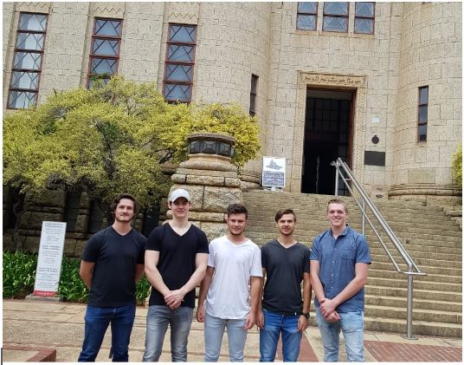
Meet the team

Slide 3

Richard Mcfadden
Group leader
Backend developer
I am a very hard worker and quick learner who has experience in Java, C++, C#, Python, Angular.js and various other web development languages as well as experience in facial detection and recognition in Python. I really enjoy gaining knowledge in the fields of Artificial Intelligence and Computer Networks.
Meet the Team
Project Overview
Technology Overview

Slide 4
Jarrod Goschen
Task Manager
Backend developer
Driven and determined to better myself, I am experienced in C++ with a course focused on software development in almost all popular frameworks. An artificial intelligence student and experienced with technologies such as Unity.
Meet the Team
Project Overview
Technology Overview

Slide 5
Adrian le Grange
AI and Computer Vision
Backend developer
I am self-driven and have experience with robotics and the Unity Game Engine. I am confident in the C, C++ and Java languages and can easily adapt. I enjoy creating cool things (such as this project) and is always looking for an opportunity to expand my knowledge. My favourite areas of study are operating systems, computer graphics, and artificial intelligence.
Meet the Team
Project Overview
Technology Overview

Slide 6
Kyle Olivier
Front end development
Documentation
User interface design
Have an extensive understanding of Java and C# coding. Interested in the design and implementation of user-friendly interfaces and programming techniques. Working on further enhancing my networking and information systems architecture knowledge currently.
Meet the Team
Project Overview
Technology Overview

Slide 7
Alessio Rossi
Scrum Master
Frontend/Backend development
A quick and determined learner with knowledge in the Java and C++ fields. Currently developing knowledge in the Artificial Intelligence realm as well as being security and performance conscience. Self driven and a hard worker to put out the best result possible.
Meet the Team
Project Overview
Technology Overview

Slide 8
Project Overview
Develop an access control system using facial recognition
Deploy an elegant booking system to secure meeting rooms
Provide an alert system to notify security as well as the administrators of unauthorized attempts
Provide a subsystem to provide OTP’s to guests to gain access
Employ AI to train and develop for a more accurate system over time
Meet the Team
Project Overview
Technology Overview

Slide 9
Technology Overview
Continuous Integration: Travis CI
Version Control: Git (Hosted on github.com)
Front-End Framework: Angular 7
Data Storage: Firestore
Project Management: Zenhub
Face Detection: OpenCV
Facial Recognition: EasyFaceNet
Meet the Team
Project Overview
Technology Overview

Slide 10
LIVE demonstration

