Slide 1

COS 301 Dark nites Defendr
The frist demmo

Slide 2
The team
Name:
Role:
Ruslynn Appana
Jeandre Botha
Muhammed Carrim
Sisa Khoza
Christiaan Opperman
Developer
Leader/ Developer
Developer
Developer/ Group administrator
Developer/ Driver

Slide 3

The project
About:
We are implementing the Defendr project our clients, advance. The project will provide services such protection against DOS attack and network load-balancing for the connected applications without increasing response time. The system will also provide various user interfaces for: monitoring metrics such as packets per second and total packets passing through the system, backlisting and whitelisting IP’s and dynamically adding & removing backends.

Slide 4
The project
Approach:
App user
DOS protector
Load-Balancer
Applications
User interfaces

Slide 5
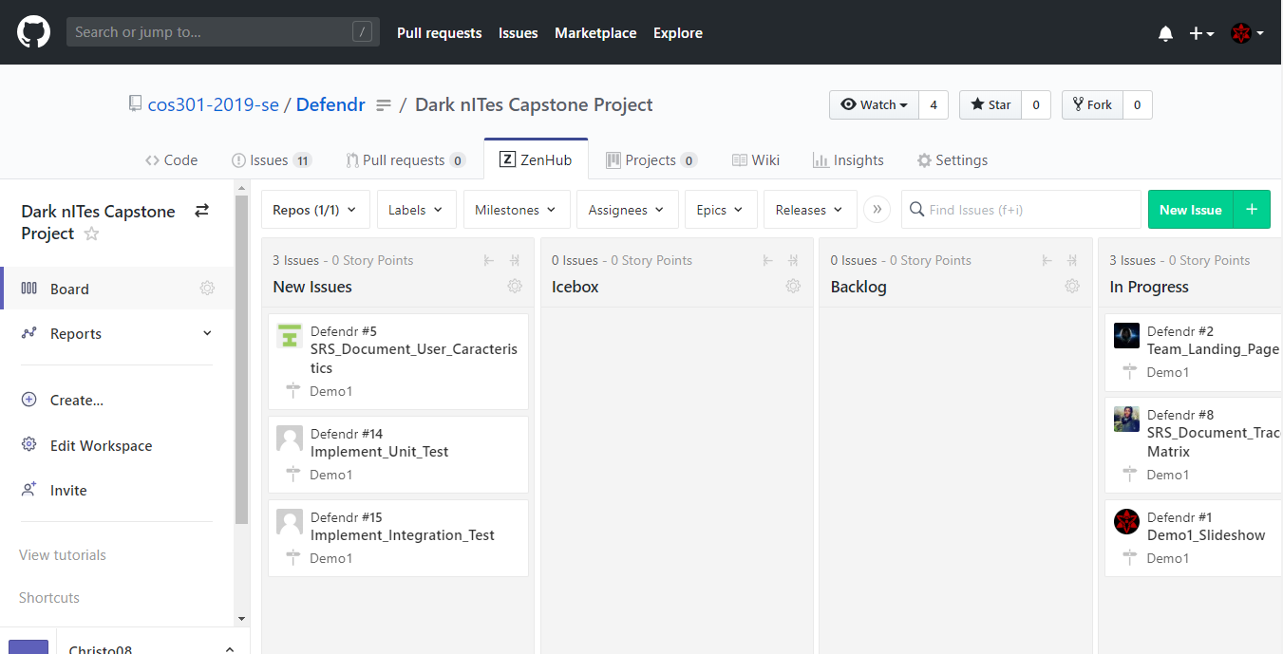
The project magnet

Slide 6
Live Demo

