Slide 1

COS 301 Dark nites Defendr
The First Demo

Slide 2
Roles
Name | Coding | Documentation
Ruslynn Appana | Unit Testing and Dynamic Blacklisting | Quality Requirements and Constraints
Jeandre Botha | Dynamic Blacklisting and implementation of the Controller | Testing policy
Muhammed Carrim | Interface design and implementation | System architectural designs
Sisa Khoza | Database creation and functionality | Coding Standard
Christiaan Opperman | Database creation and functionality | Deployment model
All |  | User manual

Slide 3
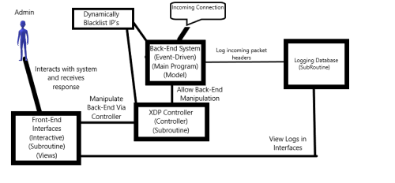
Architectural designs:
System Type
Interactive Subsystem
2. Event-Driven Subsystem
Architectural Style
MVC
Main Prog and Subroutine
Event-Driven

Slide 4
Core quality requirements
Monitorability: The system will be monitored through a GUI which displays packet rates (total and per pool), drop rates, heat-map, packet size, internal overhead and white and black listed IPs
Security: Role based authentication will be used to ensure security is maintained.
Performance: The step by step actions taken by the system will be. This includes the time when a packet arrives, the IP address, the location the IP address originates from and as well as the category of threat placed for the IP address. Having this information logged will ensure the performance of the system if any tests had to be done to ensure the validity of the systems work
Maintainability: The developers of the Defendr system at Dark nITes all follow the practices set out in their coding standard document. This document is based on the current and most used practices of coding in the world and will ensure consistency throughout all code for the system

Slide 5
Live Demo

