Slide 1

COS 301 Dark nites Defendr
The Third Demo

Slide 2
Roles
Ruslynn Appana: Metrics, unit testing
Jeandre Botha: Load balancing, unit testing
Muhammed Carrim: Load balancing, Dynamically managing back ends
Sisa Khoza: Monitoring, metrics
Christiaan Opperman: Load balancing, user manage interfaces, intergration testing

Slide 3
Project’s requirements
Dynamically adding/removing back-ends
Multiple load-balancing algorithms
Direct Server Return
Auto drop packets from offending IPs
Allow IP after an exponential timeout period
Metrics with Prometheus and Grafana
Modern UI
Alarming developers of dos attacks

Slide 4
Project’s requirements
Role based sign in
Dropping packets based on country
Recording real time logs
Dynamic blacklisting of IPs
Load-balancing
Blacklisting of IPs
DOS detection based on #pps and number of connections

Slide 5
Use cases since demo 2
Dynamically managing back ends
Dropping packets based on country
Load balancing
Direct Server Return
Recording real time logs
Metrics with Prometheus
Bonus: User management interfaces

Slide 6
Requirements left
Multiple load-balancing algorithms
Allow IP after a timeout period
DOS detection based on number of connections
Alarming developers of DoS attacks

Slide 7
Live Demo

Slide 8
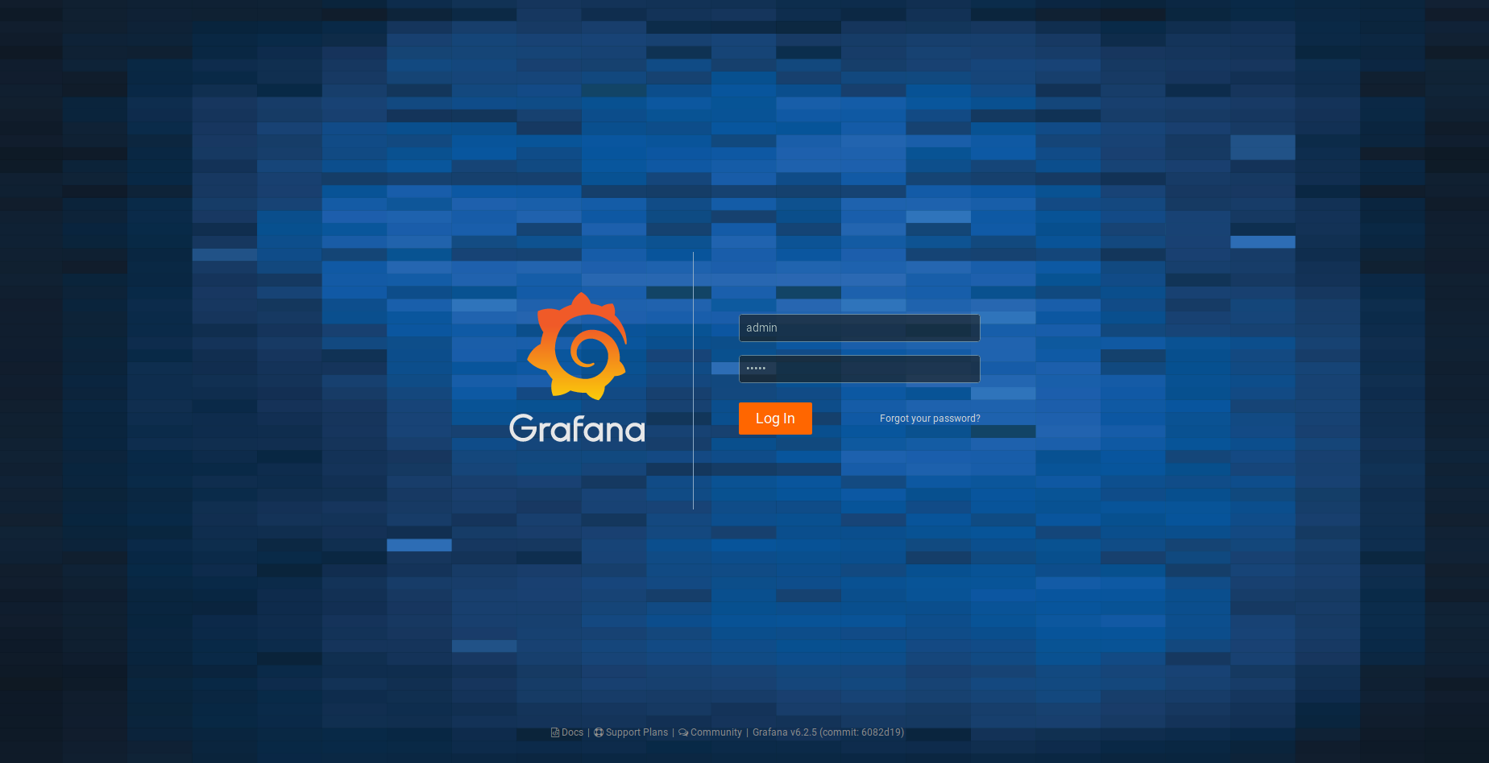
Grafana - Login

Slide 9
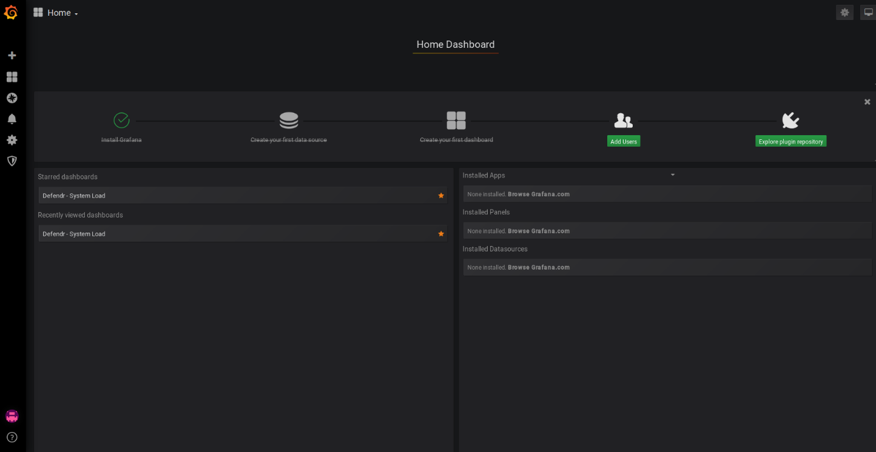
Home Dashboard

Slide 10
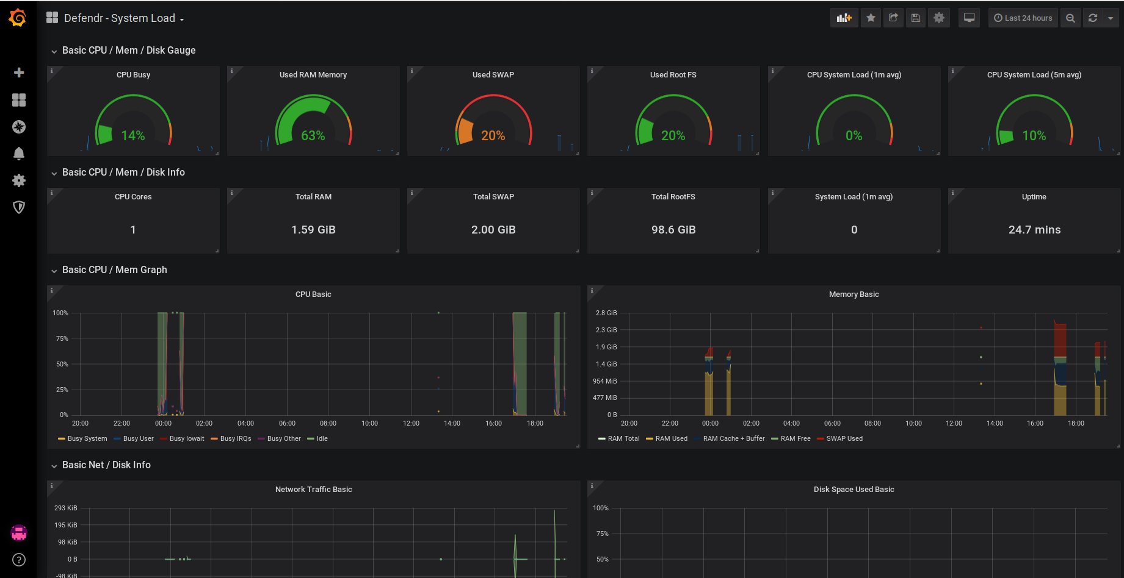
System Load

