Slide 1

COS 301 Dark nites Defendr
The Third Demo

Slide 2
Roles
Muhammed Carrim:
Christiaan Opperman:
Link the interface will database and the security of the interface.
Jeandre Botha:
Interface redesign
Implemented Load balancer.
Sisa Khoza:
Ruslynn Appana:

Slide 3
Core functionality
DOS protection.
Load balancing.
Metrics with Grafana.
Modern UI.

Slide 4
Impressive aspect

Slide 5
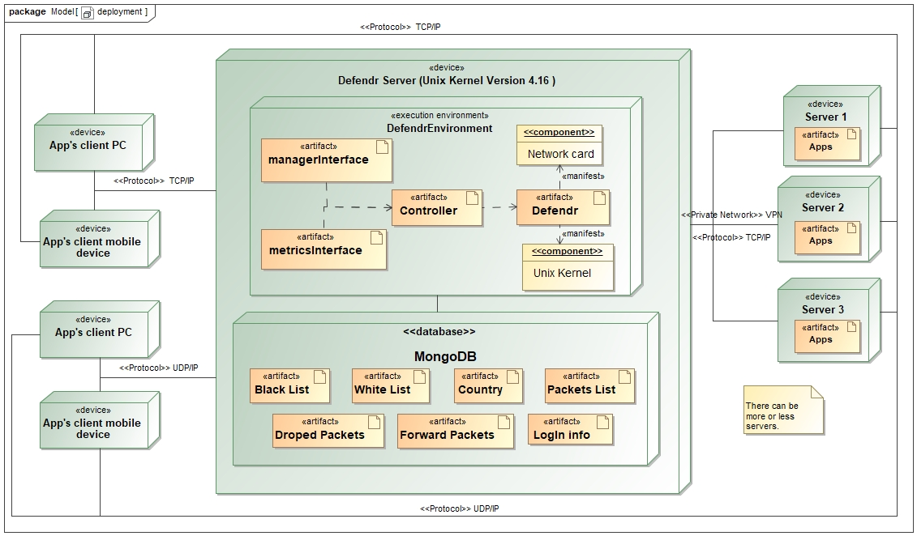
Deployment diagram

Slide 6
List of what is left

Slide 7
Stand-out extension

Slide 8
Live Demo

