Slide 1

COS 301 Dark nites Defendr
The Fourth Demo

Slide 2
Roles
Muhammed Carrim:
DDOS Attack Test,
Helped with Load Balancing
Christiaan Opperman:
Link the interface will database and the security of the interface.
Jeandre Botha:
Interface redesign
Implemented Load balancer.
Sisa Khoza:
Metrics, Database Integration with Metrics
Ruslynn Appana:
Interface redesign
Maintenance of all existing code to standards

Slide 3
Core functionality
DOS protection.
Load balancing.
Metrics with Grafana.
Modern UI.

Slide 4
Impressive aspect
Can protect against DDOS attack instead of DOS only.
Heatmap of Incoming Traffic.
Different Load Balancing Algorithms
Shell file to install all dependancies

Slide 5
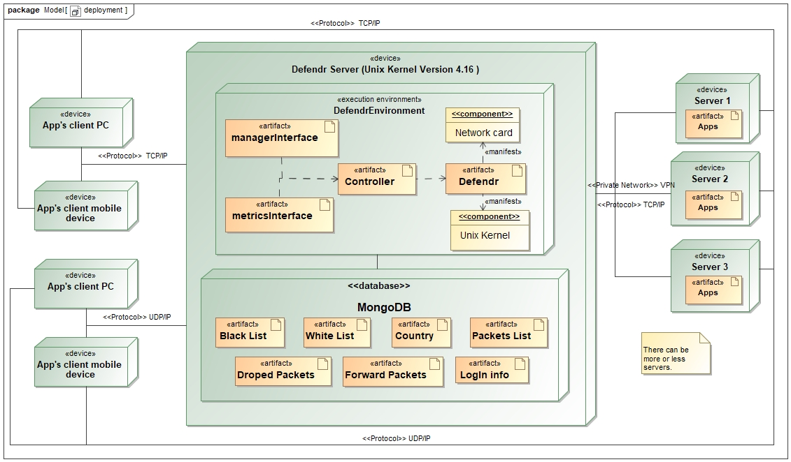
Deployment diagram

Slide 6
List of what is left
Optimizing database connection
Adding triggers to database
Exponential counter for blacklisting
Improving interface to backend compatibility

Slide 7

Stand-out extension
Logging provides capabilities for forensic investigation into possible attacks
Can protect any backend server that is registered with the device
Possibility to defend against SYN attacks from number of connections implementation
Documentation is user friendly

Slide 8
Design Patterns
Kernel files design patterns:
Singleton
Chain of responsibility
Controller
Interface design patterns:
Façade
Singleton implemented with a façade

Slide 9
System Security
Disabling of USB ports
SHA 512 for hashing
32 letter for slat
3 attempts for the password before a 1min time out
Three roles-based access:
Role | Permission
New | None
User | Read
Admin | Read & write

Slide 10
Live Demo

Slide 11
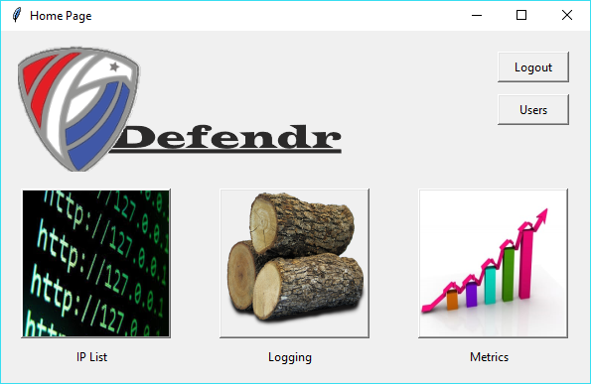
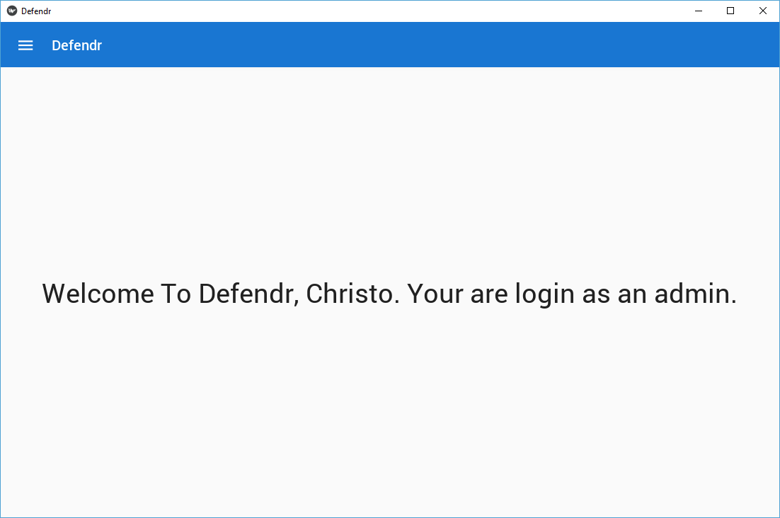
New interface
Old:
New:

Slide 12
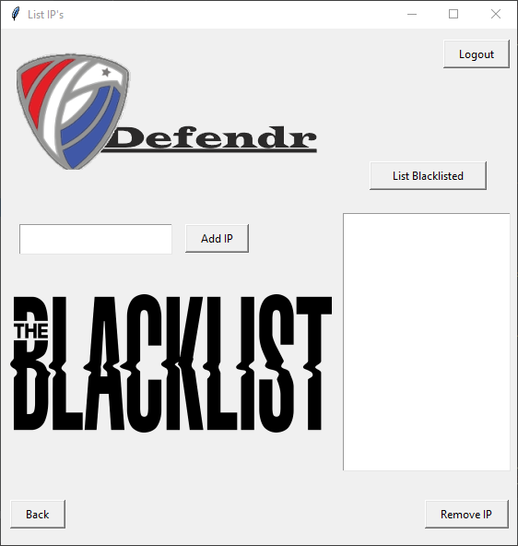
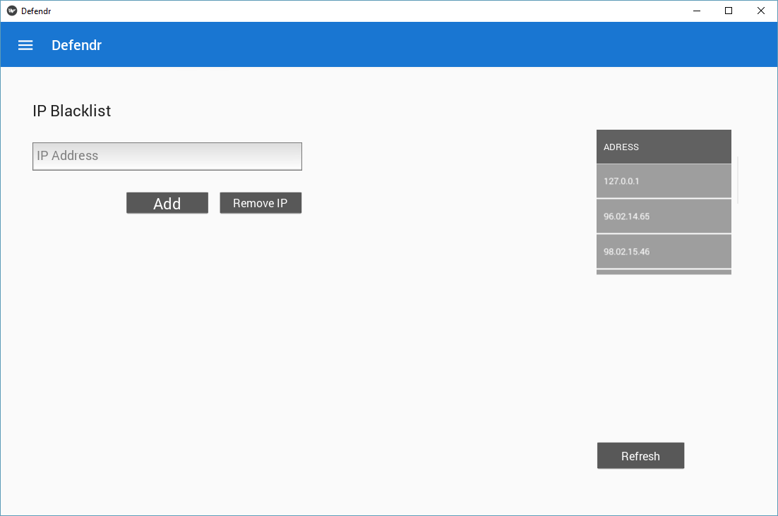
Old:
New:

Slide 13
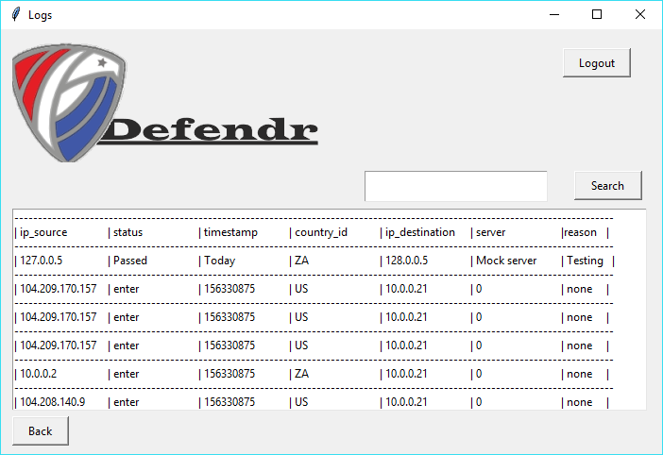
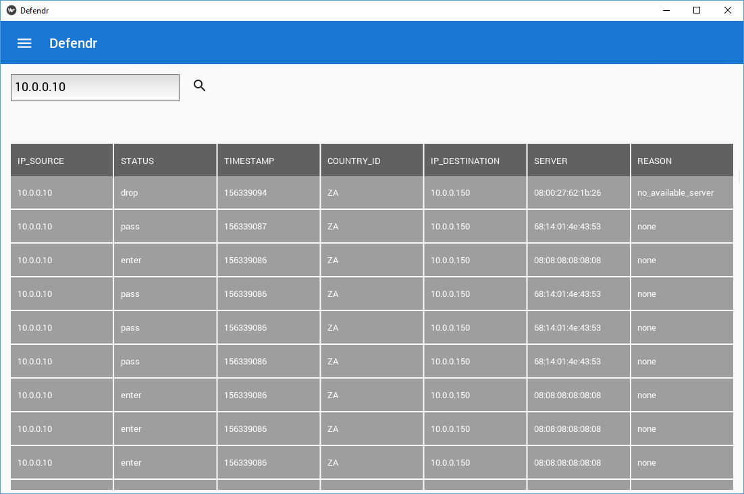
Old:
New:

Slide 14
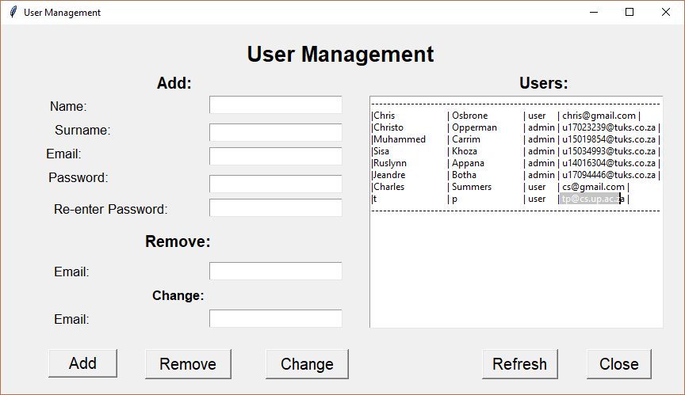
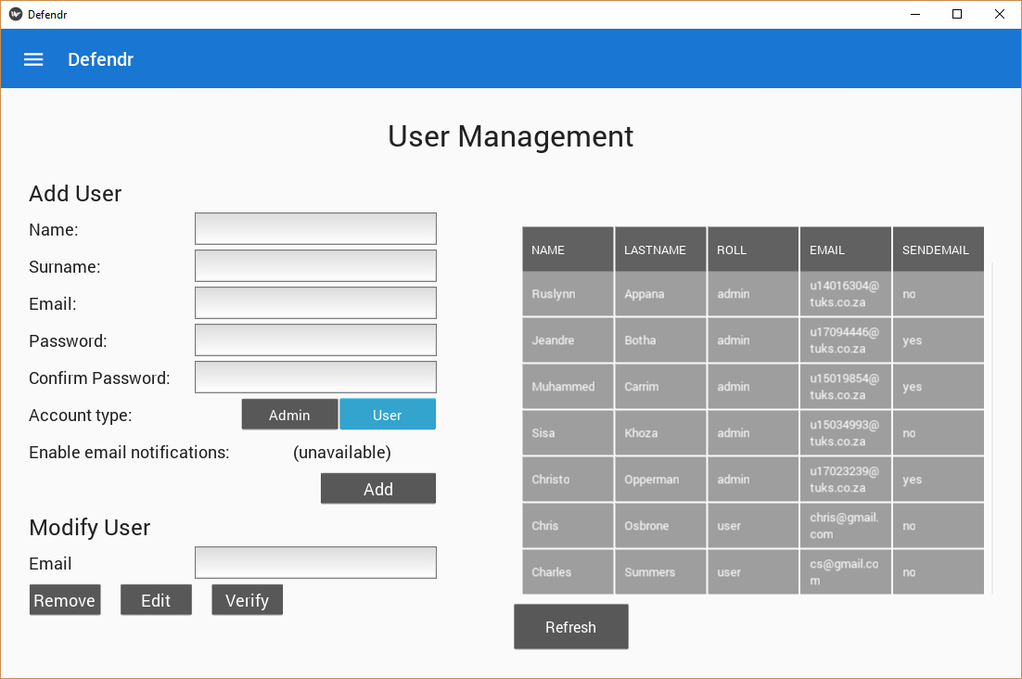
Old:
New:

Slide 15
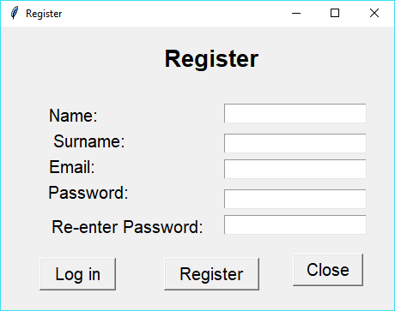
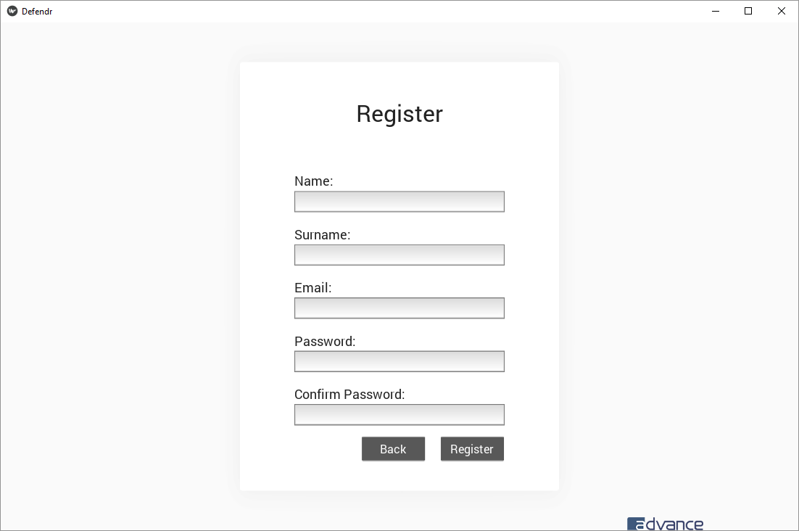
Old:
New:

