Slide 1
Allocating Dynamic Kernel Memory in Low-Memory Microcontrollers
COS 316: Principles of Computer System Design
Lecture 14
Amit Levy & Ravi Netravali

Slide 2
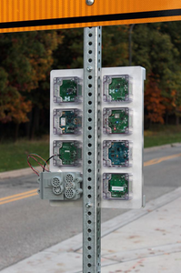


Microcontrollers Becoming Platforms
Fitness watches support different activities
USB security keys perform multiple functions
  U2F, SSH, GPG, HOTP
Sensor networks run several experiments at once
Notes:
* Historically, microcontrollers have been single-purpose devices. Becoming software platforms
* Fitness watches: different activities, let end-users install apps.
* Authentication keys several functions concurrently
* Sensor networks consolidating
* All involves more apps, more (&more complex) OS services
* This should scare you!

Slide 3




Embedded Software Isn’t Ready
Run all code in a single address space
Trust all code
Can’t update components
Can’t recover components
Notes:
* Example systems: TinyOS, FreeRTOS, Contiki, mbed
* All code compiled together and run in a single address space.
* No separation between apps, OS services & glue code.
* Every line of code is trusted.
* Can’t update or recover components

Slide 4
Safe Multiprogramming by Isolating Applications and OS Services
Notes:
* In order to multiprogram microcontrollers safely we need to isolate applications and OS services
* When we look at these microcontrollers, not obvious how to provide isolation.

Slide 5
Can’t Use Normal Isolation Techniques
Limited memory: 64 kB of RAM
  Memory isolation techniques limit granularity
  malloc can fail!
No page virtualization
  Instead protection bits for 8 memory regions
Moore’s Law doesn’t fix the problem
  Sleep current is limiting factor
  Memory capacity < 10x in 15 years
Notes:
* Microcontrollers are very different from servers, desktops and phones.
* Extremely limited memory. 64 kB is pretty typical, but as little as 16 kB of RAM.
* This means that just using memory isolation, like a process or microkernel service, will limit us to only a handful of isolated components.
* Heap allocation is more dangerous: likely to run out of resources. Typically completely avoid heap allocation
* No page virtualization or segmentation, so can’t implement memory isolation in the same way

Slide 6
Microcontrollers demand new multiprogramming abstractions.
Notes:
* Linux isn’t going to be the solution
* TinyOS or contiki aren’t going to be the solution
* Instead, microcontroller platforms demand totally new multiprogramming abstractions

Slide 7
How to Multiprogram a Microcontroller
Use type safety to isolate most of the system
Use memory isolation sparingly
  Preemtive scheduling
  Recover or update components at runtime
Support dynamic workloads without malloc
Tock
Kernel written in Rust
Processes abstraction using Memory Protect Unit (MPU)
Grants: mechanism to account for dynamic workloads
Notes:
* kernel in Rust: leverages Rust’s type safety to isolate most components at a very fine granularity with almost no overhead.
* Process abstraction using the limited memory protection mechanisms.
* Processes have higher overhead than kernel isolation, but can run untrusted application code installed separately
* Tension between dynamic application behavior and dependable kernel
* Grants: mechanism for allocating process accounting state safely and efficiently

Slide 8
Outline
Security Model & Design Principles
Two Isolation Mechanisms
Grants
Notes:
* Focus: Security model and design principles
* Describe: Architecture: two isolation mechanisms
* Explain: how Grants allows a dependable kernel to service highly concurrent dynamic application requests in a memory efficiency manner
* Conclude: a case study of Signpost followed by limitations and future work.

Slide 9
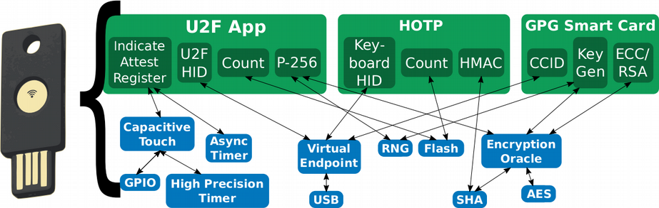
Security in a Multiprogrammable MCU
Let’s consider a programmable USB security key
Notes:
* Consider a programmable USB security key.
* Pretty complex: run a number of applications concurrently: two-factor auth. protocols, GPG smart card, SSH authentication...
* Who writes the software for these devices?

Slide 10
Board Integrators
Build the hardware
Combine core kernel, MCU-specific glue code & drivers
Complete control over firmware
Notes:
* Build the hardware
* Take an embedded OS, like Tock, hardware glue code, device drivers, build a base firmware image.
* Complete control over hardware and firmware image.
* Trust them completely

Slide 11
Kernel Component Developers
Build most kernel functionality
Source code available to board integrators
But auditing won’t catch all bugs
Notes:
* Most OS services: device drivers, hardware multiplexing layers, communication protocols… come from a variety of kernel developers
* Peripheral chip vendor, open source community
* Source code available to audit, but won’t catch all bugs.
* Important to isolate these components.
* I want know that some communication protocol implementation I downloaded from GitHub isn’t able to leak my private key if it has a bug in it.

Slide 12
Application Developers
Implement end-user functionality
“Third-party” developers: unknown to board integrators
Modeled as malicious
Notes:
* Functionality end-users care about
* Installed by end-users
* Applications cannot be tested, let alone audited.
* Malicious: compromise secrecy or integrity. Block system progress.

Slide 13
Design Principles
Isolation guarantees should be clear
  What exactly can a component do?
System should be dependable
  Unanticipated runtime behavior shouldn’t cause crashes
Maximize concurrency
  I/O operations can overlap
Minimize resource consumption
  Resources don’t dictate isolation granularity
Maximize programmability
  Applications will have unknown behavior
Notes:
This security model, and the goal of supporting a software platform, leads to a set of design principles for Tock.

Slide 14


Tock’s Two Isolation Models
Capsules
Compile-time
Kernel
Limited trust
Fine grained
Processes
Runtime
Applications
Potentially malicious
Coarse grained
Notes:
* Capsules are a compile-time enforced isolation mech. used for kernel components.
* Kernel in Rust, capsule mechanism uses type-safety to ensure kernel can’t violate secrecy/integrity. No cost.
* Processes are hardware-enforced at runtime used for applications.
* Processes are modeled as malicious. Stronger model than capsules, namely cannot exhaust CPU.
* However, using a process to isolate a component takes up significantly more memory than a capsule

Slide 15
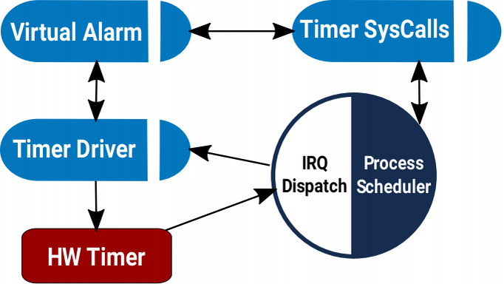
Capsules
A Rust module and structs
Event-driven execution
Communicate via references & method calls
Notes:
* Rust module, struct, fields, methods, static variables.
* Scheduled in response to hardware events or system calls
* But communicate internally directly, via methods rather than through events/channels, and share a single stack
* Can encapsulate sensitive state in private fields and enforce a narrow interface through methods calls. Only at compile time.
* No heap
* All system I/O is asynchronous

Slide 16
Capsule Isolation
struct DMAChannel {
length: u32,
base_ptr: *const u8,
}
impl DMAChannel {
fn set_dma_buffer(&self, buf: &'static [u8]) {
self.length = buf.len();
self.base_ptr = buf.as_ref();
}
}
Exposes the DMA base pointer and length as a Rust slice*
Type-safety guarantees user has access to memory
Notes:
* Example of pretty rich isolation semantics
* From DMA capsule for one of the MCUs
* DMAChannel capsule sets length and base pointer in MMIO registers.
* Don’t want to expose this to clients
* Instead, fields are private, and clients sets buffer through a method that takes a Rust slice.
* Normally enforce this with specialized hardware

Slide 17
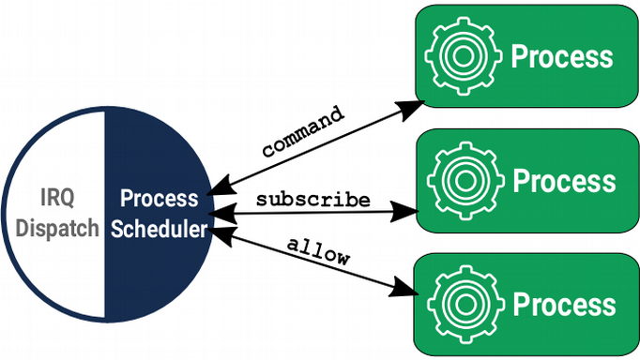
Processes
Hardware-isolated concurrent executions of programs
  Logical memory region: stack, heap, static variables
  Uses the ARM Memory Protection Unit (MPU) to protect memory regions without virtualization
Scheduled preemptively
System calls & IPC for communication
Updated dynamically
Notes:
* Similar to processes in general purpose OS, but different from, e.g., tasks in FreeRTOS
* Each process has a dedicated region of memory. Therefore, only limited number.
* But scheduled preemtively
* Isolation enforced using a hardware mechanism called MPU, available on recent Cortex-Ms.
* MPU doesn’t have page virtualization, but can set read/write/execute bits on up to 8 regions as small as 32 bytes.
* Using the MPU for process isolation differs from MMU.

Slide 18
Processes vs. Capsules
Capsules
Isolated by compiler
Shared stack, no heap
Cooperative
Rust only
Method calls
Replaceable at compile-time
Processes
Isolated at run-time
Dedicated stack & heap
Preemptive
Any language
Context switch
Replaceable at runtime
Different isolation mechanisms for different use cases
Notes:
* Recap, two mechanisms for different use cases
* Processes are generally more flexible, but impose a pretty significant cost for isolation.
Capsules have very low cost---they have virtually no overhead at runtime---, and won’t crash due to resource exhaustion, but can only be updated at compile-time, have to be written in Rust and can’t execute long-running computations.

Slide 19
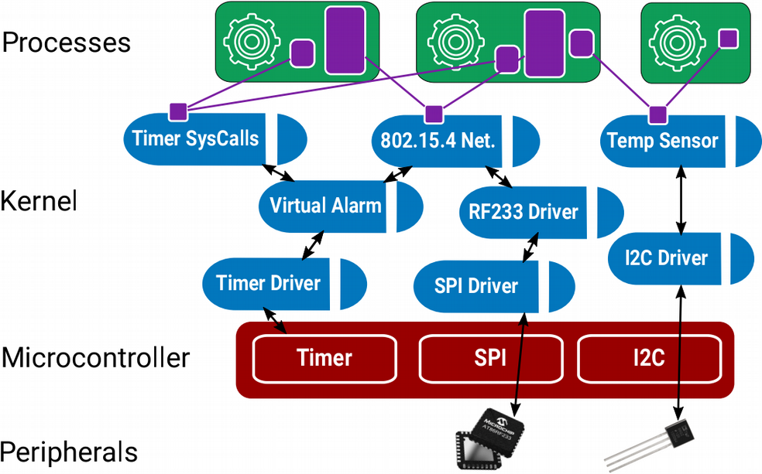
Application Developers
Kernel component developers
Board Integrators
Notes:
These differences affect what purpose each of these mechanisms serve in a particular system.
This diagram shows a subset of one the platforms we use Tock on.
Board integrators build the hardware platform itself, and either write or adapt the MCU glue-code.
Peripheral drivers, virtualization layers, communication protocols, etc, are written by kernel developers as capsules.
And processes host applications.
This is a fairly complex system, but because most of the components are isolated, we can look at each independently.

Slide 20
A static kernel needs resources to respond to unpredictable process requests
Notes:
* So far, two isolation mechanisms, one kernel another for applications.
* Kernel is statically allocated, similar to TinyOS/FreeRTOS, so dependable.
* But also want to support dynamic application workloads.
* Process isolation let us do this, but
* The static kernel needs to respond to requests from an unpredictable process workload.

Slide 21
Working Example: Timer Driver
Software Timer Driver
Kernel
HW Alarm
Notes:
* Consider a software timer driver that lets processes create timers using a single hardware alarm.
* No heap, so shouldn’t crash
* What happens when we consider process workload
* Driver is going to have to keep some state for each virtual timer.
* But don’t know ahead of time if:
- One process or several?
- How many will use it?
- Will one process use a bunch?
* How do we allocate state for each virtual timer?

Slide 22
Statically allocating timer state?
Software Timer Driver
Static allocation must trade off memory efficiency and maximum concurrency
Notes:
* This is a problem systems have tackled before…
* One option is to statically allocate a fixed number of slots. This is what TinyOS does.
* Two drawbacks:
1. Wasting precious memory if we don’t use all slots
2. If we use up all slots, can’t service more requests. Maximum amount of concurrency the system can support

Slide 23
What About Dynamic Allocation?
Software Timer Driver
Notes:
* Another option: relent hard stance against a kernel heap allocation, and dynamically allocate slots
* Allocate new slots from a shared kernel heap.

Slide 24
What About Dynamic Allocation?
Software Timer Driver

Slide 25
What About Dynamic Allocation?
Software Timer Driver

Slide 26
What About Dynamic Allocation?
Software Timer Driver
Notes:
We’ll, of course, do the same for other drivers

Slide 27
What About Dynamic Allocation?
AES Driver
Software Timer Driver
Bluetooth Driver
Can lead to unpredictable shortages.
One process’s demands impacts capabilities of others.
Notes:
* Can run out of memory in an unpredictable way.
* Impact not isolated to a single component:
- Failure may result from any driver that uses the kernel heap, even if it’s that driver’s first allocation
- Failure may result from a process that doesn’t even use the timer driver
* Very reason most systems avoid heap allocation in the first place.

Slide 28
Separate kernel heap for each process
Notes:
* Repeat: want to support dynamic process workloads, but want a system that’s overall dependable.
* Requests from one process shouldn’t impact another process’s ability to use resources.
* Insight is to maintain separate kernel heaps for each process.
* Grants a mechanism to achieve that safely.

Slide 29
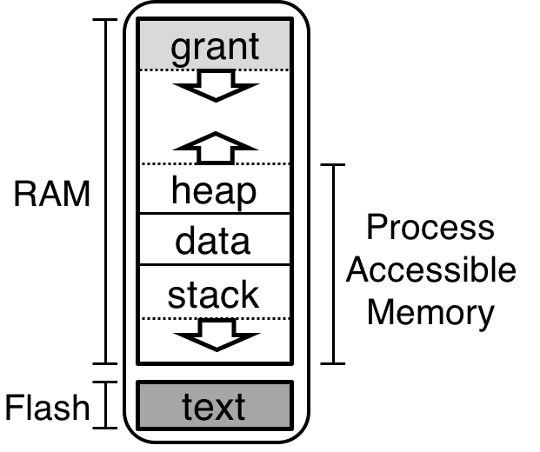
Grants
Safely account for process-specific kernel heaps
Allocations for one process do not affect others
System proceeds if one grant section is exhausted
All process resources freed on process termination
Notes:
* Mechanism to account for process specific kernel heaps
* Grant allocations for one process don’t affect others
* If one process’s grant section is exhausted, the rest proceeds
* All process resources, including grant section, can be reclaimed immediately
* Safe even if capsules that use grants are buggy

Slide 30
Grants:
Kernel heap safely borrowed from processes
Software Timer Driver
Grants balance safety and reliability of static allocation with flexibility of dynamic allocation
Notes:
* Back to our timer example
- See why this solves the memory efficiency + concurrency tradeoff of static and dependability problem of dynamic
* Process requests for timer => new grant allocated
* More than one request? more grants are allocated.
* Memory exhausted? kill the process, no affect on the rest of the system.
* And can restart process immediately because we know references are contained.
* How??

Slide 31
Grants uses the type-system to ensure references only accessible when process is live
fn enter<'a, F>(&'a self, pid: ProcId, f: F) → where
F: for<'b> FnOnce(&'b mut T)
// Can’t operate on timer data here
timer_grant.enter(process_id, |timer| {
// Can operate on timer data here
if timer.expiration > cur_time {
timer.fired = true;
}
});
// timer data can’t escape here
Notes:
Remember that capsules aren’t totally trusted. So it’s important that we have a way of ensuring that references don’t leak from grant section in one process to another.
Here we rely again on the Rust type system. A particular grant allocation can only be accesses within a closure. The Rust lifetimes assigned to the values passed into the closure ensure, at compile time, that grant memory can never escape the closure.

Slide 32
Resource Management in Tock
Extremely limited memory limits isolation with traditional mechanisms
Capsules decouple isolation from concurrency
Still need dynamic allocations in static components
Grants “borrow” memory from processes to service process requests
Need to ensure grants for different processes can’t reference each other

