Slide 1

Intro: What is a System?
COS 316: Principles of Computer System Design
Lecture 1
Amit Levy & Ravi Netravali

Slide 2
Today: Systems!
Next time: Course Overview, Syllabus, …

Slide 3
Example Systems
Operating system (OS) kernel
The Internet
Database
Distributed file system
Web framework
Game engine

Slide 4
What is a System?
Provides an interface to underlying resources
Mediates access to shared resources
Isolates applications
Abstracts complexity
Abstracts differences in implementation

Slide 5
Example System: OS Kernel
Interface: system calls
Underlying resources: hardware (CPU, memory, network, disk)
Isolation: Firefox, terminal, zoom, … don’t worry about each other
Abstraction: Collection of system calls
Instead of specific protocols for using specific devices
Don’t need to rewrite Firefox to display on new monitors, or save to new disks, or …

Slide 6
Systems Stack (terminal)
Application
OS
Filesystem
TTY
Hardware

Slide 7
Systems Stack (Firefox)
Application
Layout engine
JS VM
Database
Window manager
OS
Network
Scheduler
Graphics
Filesystem
Hardware

Slide 8
Systems Stack (Firefox to Wikipedia)
Application
Application
Distributed Systems
Internet
Network
Network
Network
OS
OS
FS
OS
FS
Hardware
Hardware
Hardware

Slide 9
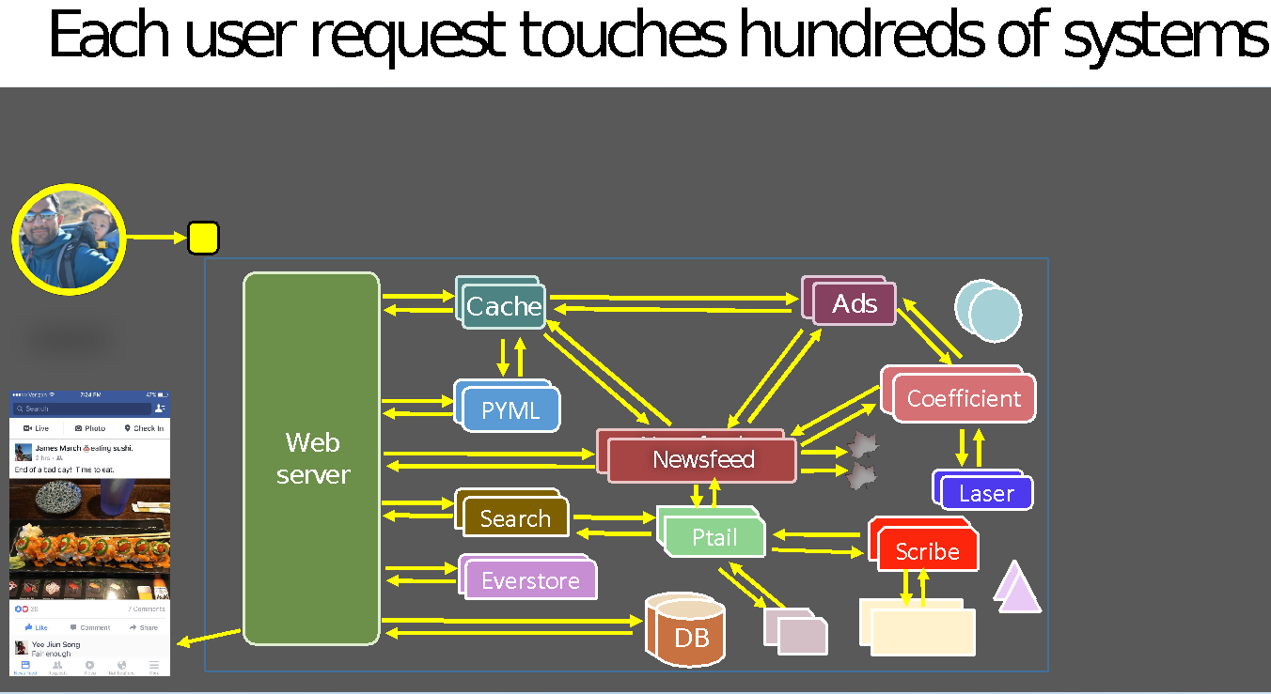
So Many Systems…
[Slide from Kaushik Veeraraghavan Talk’s on Kraken at OSDI 2016]

Slide 10

Systems Are Everywhere!
People use applications
Applications are built on systems
On systems on systems on systems…
If you’re building applications
Useful to understanding underlying systems
What could be causing X?
Why can’t they do Y?
What can I trust Z to do or not?
If you’re building systems ☺
That’s what this is all about!
Useful to understanding your underlying systems
Web Server
Network
OS

Slide 11
Why do we build systems?
Sharing: Mediates access to shared resources
Portability: Abstract differences in underlying implementations
Safety: Isolate resources and other applications from faulty apps
Abstraction: Make complex resources easier to use

Slide 12
Build you a Netflix for Great Good
Video storage
Video encoding
Video delivery over network
User authentication
Stream authorization
Metadata indexer
Search & recommendations
Comments/reviews
...

Slide 13
Build you a [mini-]Netflix for Great Good
How many users? ~5
Can everyone access everything? Yes
How many movies? ~100
How large are movies? ~20GB/hour x ~2 hours = ~40GB/movie
Max simultaneous streams? ~2
Lots of metadata to search? No! Just 100 movies, a tiny list
How are movies acquired? Hrmm.... let's ignore that ;)

Slide 14
Build you a [mini-]Netflix for Great Good
5 users
100 movies
40GB per movie
<=2 streams
How much storage?
100 * 40GB = ~4TB
How much bandwidth?
20GB / 3600 * 2 = ~91Mbps
Less with encoding
How much CPU?
May be best to encode each stream on-the-fly
Only 2 streams, so a few cores at full capacity should work

Slide 15
Build you a [mini-]Netflix for Great Good
~4TB storage
~91Mbps max bandwidth
~8 cores
Application
Auth.
Database
Encoder
Video files
OS
Network
Filesystem
Scheduler
Hardware

Slide 16
Build you a [large-]Netflix for Great Good
How many users? millions
Can everyone access everything? No
How many movies? ~1000s
Max simultaneous streams? ~1000s
Lots of metadata to search? Yes! Milliions of movies
How are movies acquired? let's stil ignore that ;)

Slide 17
Why Are Systems Challenging? Part-1a
Correctness
Incorrect system => incorrect applications
Correctly implement interface’s guarantees
Performance
Slow system => slow applications
Make system fast enough
Security
Insecure system => insecure applications
Build security into the system

Slide 18
Why Are Systems Challenging? Part-1b
Distributed storage system that keeps data forever (e.g., videos)
Correctness
Accurately retain data forever. Really delete data on deletes.
Performance
Fast and highly concurrent.
Security
Only allow authorized users to retrieve data
Notes:
Correctness: Cannot lose data. Even if disks, machines, rack, and even datacenters fail!
Must accurately retain data. Even if cosmic rays flip some bits!
Deleted data must really be deleted.
Performance
Fast to store data (upload a video)
Fast to retrieve data (stream a video)
Highly concurrent: enable storing and retrieving many videos at the same time
Security

Slide 19
Why Are Systems Challenging? Part-2a
How general should an interface be?
More general => supports more application-level functionality
Less general => easier to implement, easier correctness, better performance, easier security
How portable should an interface be?
More portable => supports more underlying resources
Less portable => …
Design tradeoffs!

Slide 20
Why Are Systems Challenging? Part-2b
Distributed cache that provides fast access to popular data
How general should an interface be?
Read(key)
Write(key, value)
Read_transaction(<keys>)
Write_transaction(<keys>)
Read_and_write_transaction(<read_keys>, <write_keys>)
…
Design tradeoffs!
Notes:
Design tradeoffs: More general interface is more useful … but more places to get security wrong … more places to try to optimize for performance … more implementation that is necessary …

Slide 21
Why Are Systems Challenging? Part-2c
Distributed cache that provides fast access to popular data
How portable should an interface be?
Cache in DRAM
Cache on SSD
Cache on NVM
Cache on HDD
…
Design tradeoffs!
Notes:
Design tradeoffs: More portable interface is more reusable… but more work … and need an interface that works for all of them (or specialize) …

Slide 22
General vs Portable Interfaces
Cache A:
Read, Write on DRAM, SSD, NVM, HDD
Cache B:
Read, Write, Read Transaction, Write Transaction on SSD
Which cache is more general? More portable?
PL Example: Javascript vs Assembly?
Notes:
JavaScript is more portable than assembly but less general (i.e. you can't do pointer arithmetic in JavaScript so hard to implement certain kinds of algorithms, or access the GPU or whatever)

Slide 23
Systems We Will Cover In This Class
Application
Distributed Systems
Networking
Operating Systems
Security
Distributed Systems
Security
Network
Network
OS
OS
Security
Hardware
Hardware

Slide 24
Summary
Application
Distributed Systems
Security
Network
Network
Systems abstract underlying resources
Systems are everywhere
Systems are challenging and interesting and cool
This class is about systems: details next lecture
OS
OS
Security
Hardware
Hardware

Slide 25
Why Do I Love Systems?!
Work on the “hard” problems, so applications don’t have to
Correctness as a puzzle: reason through all corner cases
Performance is a different type of puzzle:
Where are bottlenecks, how to speed them up?
Art of reasoning about tradeoffs: e.g., Interface vs. Performance
Multiplicative impact: improving systems improves all apps built on them

