Slide 1
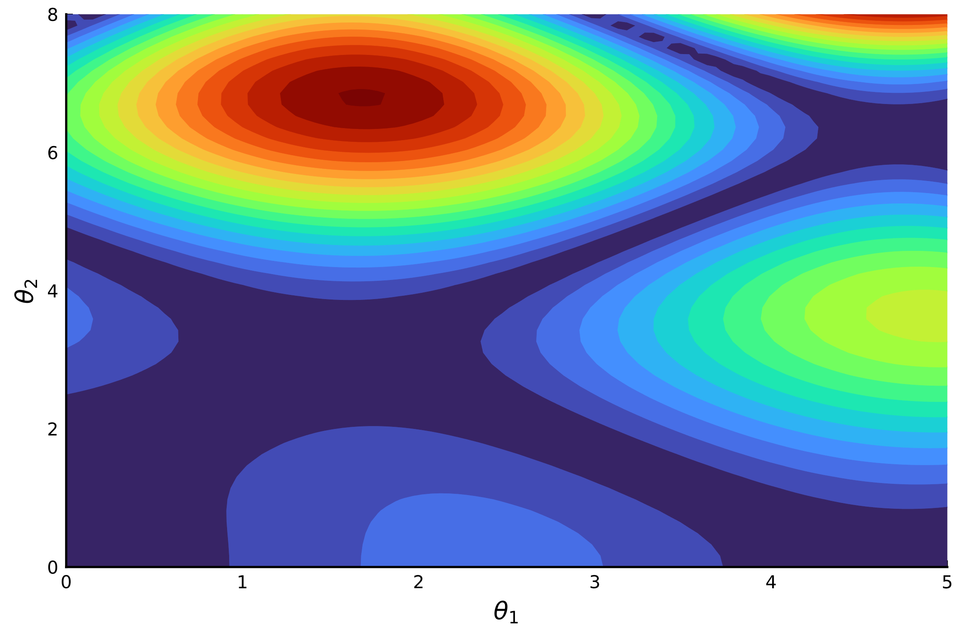





$$b_{3}$$
$$b_{2}$$
$$b_{1}$$
$$b_{5}$$
$$b_{4}$$

Slide 2


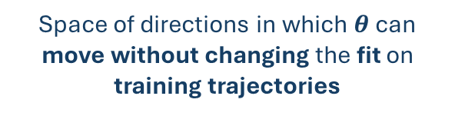







MOD ensemble training process
Single step of model training
Routing along the level curves of the model loss function
(training process in parameter space)
Direction maximizing the disagreement between the reconstructed vector fields in OOD points
$$b_{3}$$
$$∇_{θ}{dis}_{S}(b_{1},b_{2}, θ)$$
$$b_{2}$$
$$H_{0}$$
update direction
$$Θ$$
$$b_{1}$$
Space of directions in which $θ$ can move without changing the fit on training trajectories
$$b_{5}$$
$$b_{4}$$

