Slide 1
Advanced Database Design SQL Basics
Gregory S. DeLozier, Ph.D.
gdelozie@kent.edu

Slide 2
Topics
SQL
SQL Statements
Search Optimization
Object Relational Mapping

Slide 3
SQL STATEMENTS

Slide 4
Select
For a single table
Returns a subset of columns
Returns a subset of rows (based on where)
Orders rows
Groups rows

Slide 5
Select
For a multiple tables
Creates a larger view onto both tables
“where” defines connection between tables
Returns a subset of columns and rows as before
Orders rows, groups rows

Slide 6
Select Example
ID | Name | Kind | Age
1 | Suzy | Dog | 12
2 | Sandy | Cat | 4
3 | Whiskers | Hamster | 2
This is a “flat file”

Slide 7
Select Example
ID | Name | Kind | Age
1 | Suzy | Dog | 12
2 | Sandy | Cat | 4
3 | Whiskers | Hamster | 2
select name,kind from animals
Name | Kind
Suzy | Dog
Sandy | Cat
Whiskers | Hamster

Slide 8
Select Example
ID | Name | Kind | Age
1 | Suzy | Dog | 12
2 | Sandy | Cat | 4
3 | Whiskers | Hamster | 2
select name,kind from animals where age > 10
Name | Kind
Suzy | Dog

Slide 9
Select Example
ID | Name | KindID | Age
1 | Suzy | 22 | 12
2 | Sandy | 31 | 4
3 | Whiskers | 45 | 2
4 | Heidi | 22 | 13
ID | Kind
22 | Dog
31 | Cat
45 | Hamster
This is relational data

Slide 10
Select Example
ID | Name | KindID | Age
1 | Suzy | 22 | 12
2 | Sandy | 31 | 4
3 | Whiskers | 45 | 2
4 | Heidi | 22 | 13
ID | Kind
22 | Dog
31 | Cat
45 | Hamster
This is a relation

Slide 11
Select Example
ID | Name | KindID | Age
1 | Suzy | 22 | 12
2 | Sandy | 31 | 4
3 | Whiskers | 45 | 2
4 | Heidi | 22 | 13
ID | Kind
22 | Dog
31 | Cat
45 | Hamster
This is a many-to-one relation

Slide 12
Select Example
ID | Name | KindID | Age
1 | Suzy | 22 | 12
2 | Sandy | 31 | 4
3 | Whiskers | 45 | 2
4 | Heidi | 22 | 13
ID | Kind
22 | Dog
31 | Cat
45 | Hamster
select name,kind

Slide 13
Select Example
ID | Name | KindID | Age
1 | Suzy | 22 | 12
2 | Sandy | 31 | 4
3 | Whiskers | 45 | 2
4 | Heidi | 22 | 13
ID | Kind
22 | Dog
31 | Cat
45 | Hamster
select name,kind
from animals, kinds

Slide 14
Select Example
ID | Name | KindID | Age
1 | Suzy | 22 | 12
2 | Sandy | 31 | 4
3 | Whiskers | 45 | 2
4 | Heidi | 22 | 13
ID | Kind
22 | Dog
31 | Cat
45 | Hamster
select name,kind
from animals, kinds

Slide 15
Select Example
ID | Name | KindID | Age
1 | Suzy | 22 | 12
2 | Sandy | 31 | 4
3 | Whiskers | 45 | 2
4 | Heidi | 22 | 13
ID | Kind
22 | Dog
31 | Cat
45 | Hamster
select name,kind
from animals, kinds
where animals.kindid = species.id

Slide 16
Select Example
ID | Name | KindID | Age
1 | Suzy | 22 | 12
2 | Sandy | 31 | 4
3 | Whiskers | 45 | 2
4 | Heidi | 22 | 13
ID | Kind
22 | Dog
31 | Cat
45 | Hamster
Name | Kind
Suzy | Dog
Sandy | Cat
Whiskers | Hamster
select name,kind
from animals, kinds
where animals.kindid = species.id

Slide 17
Select Example
ID | Name | KindID | Age
1 | Suzy | 22 | 12
2 | Sandy | 31 | 4
3 | Whiskers | 45 | 2
4 | Heidi | 22 | 13
ID | Kind
22 | Dog
31 | Cat
45 | Hamster
select name,kind
from animals, kinds
where animals.kindid = species.id
and animals.age > 10
Name | Kind
Suzy | Dog
Heidi | Dog

Slide 18
DATA JOINS

Slide 19
Join
For a multiple tables
Creates views on multiple tables
Rows can be “connected” as with select

Slide 20
Join Example
ID | Name | KindID | Age
1 | Suzy | 22 | 12
7 | Chipper | 25 | 6
2 | Sandy | 31 | 4
3 | Whiskers | 45 | 2
4 | Heidi | 22 | 13
ID | Kind
22 | Dog
31 | Cat
37 | Fish
45 | Hamster
Add some rows that do not relate…

Slide 21
Join Example
ID | Name | KindID | Age
1 | Suzy | 22 | 12
7 | Chipper | 25 | 6
2 | Sandy | 31 | 4
3 | Whiskers | 45 | 2
4 | Heidi | 22 | 13
ID | Kind
22 | Dog
31 | Cat
37 | Fish
45 | Hamster
Related rows…

Slide 22
Join Example
ID | Name | KindID | Age
1 | Suzy | 22 | 12
7 | Chipper | 25 | 6
2 | Sandy | 31 | 4
3 | Whiskers | 45 | 2
4 | Heidi | 22 | 13
ID | Kind
22 | Dog
31 | Cat
37 | Fish
45 | Hamster
Unrelated rows… how do we handle these?

Slide 23
Join Types
Animals
Related
Species

Slide 24
Cross Join
LETTERS
A
B
C
D
NUMBERS
1
2
3

Slide 25
Cross Join
LETTERS
A
B
C
D
NUMBERS
1
2
3
Select * from letters, numbers

Slide 26
Cross Join
LETTERS
A
B
C
D
NUMBERS
1
2
3
A 1
A 2
A 3
B 1
B 2
B 3
C 1
C 2
C 3
D 1
D 2
D 3
Select * from letters, numbers

Slide 27
Cross Join
LETTERS
A
B
C
D
NUMBERS
1
2
3
A 1
A 2
B 1
B 2
C 1
C 2
D 1
D 2
Select * from letters, numbers where n <= 2

Slide 28
Inner Join
Related
Rows
Animals
Species

Slide 29
Inner Join
Related
Rows
Animals
Species
Name | Kind
Suzy | Dog
Sandy | Cat
Whiskers | Hamster
Heidi | Dog

Slide 30
Join Example
ID | Name | KindID | Age
1 | Suzy | 22 | 12
7 | Chipper | 25 | 6
2 | Sandy | 31 | 4
3 | Whiskers | 45 | 2
4 | Heidi | 22 | 13
ID | Kind
22 | Dog
31 | Cat
37 | Fish
45 | Hamster
Unrelated rows…

Slide 31
Outer Join
Animals
Related
Rows
Species
Name | Kind
Suzy | Dog
Sandy | Cat
Whiskers | Hamster
<null> | Fish
Chipper | <null>
Heidi | Dog

Slide 32
Left Outer Join
Animals
Related
Rows
Species
Name | Kind
Suzy | Dog
Sandy | Cat
Whiskers | Hamster
Chipper | <null>
Heidi | Dog

Slide 33
Right Outer Join
Animals
Related
Rows
Species
Name | Kind
Suzy | Dog
Sandy | Cat
Whiskers | Hamster
<null> | Fish
Heidi | Dog

Slide 34
(Full) Outer Join
Animals
Related
Rows
Species
Name | Kind
Suzy | Dog
Sandy | Cat
Whiskers | Hamster
<null> | Fish
Chipper | <null>
Heidi | Dog

Slide 35
SEARCH Optimization

Slide 36
Looking at Query Optimization
Tables vs Indices
A table is a set of records
An index is a tree (usually) that can be searched
For a single field
For multiple fields
The tree result is an index (i.e. row number)
It matters a great deal if indices are created
Good examples online for SQLIte

Slide 37
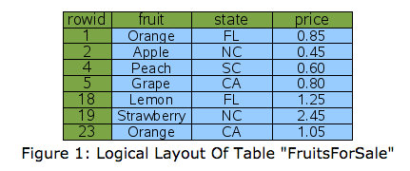
Optimizer Strategies

Slide 38
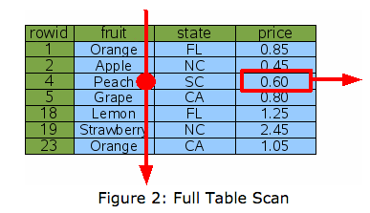
Full Table Scan

Slide 39

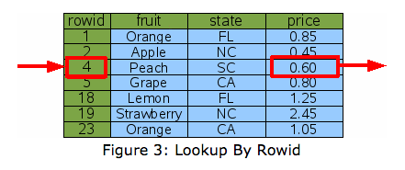
Row Number Fetch

Slide 40

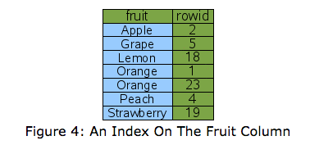
Create an Index

Slide 41
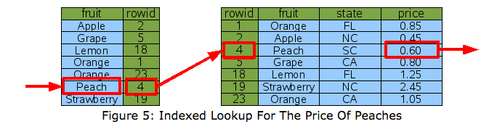
Using an Index

Slide 42
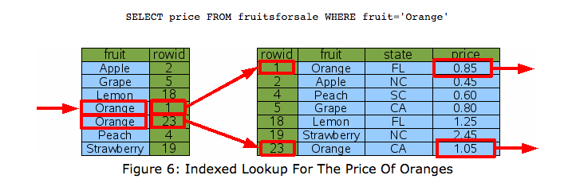
Using an Index

Slide 43
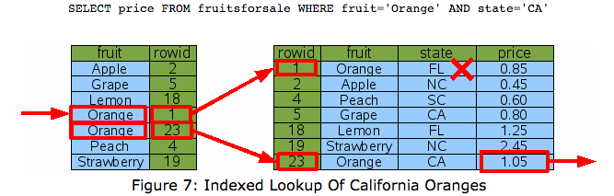
Using an Index

Slide 44
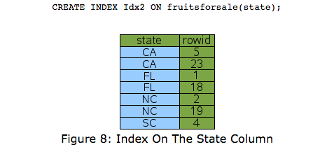
Creating an Alternate Index

Slide 45
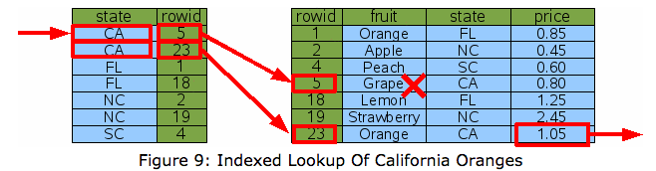
Using an Alternate Index

Slide 46
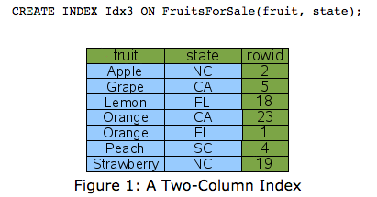
Creating a Multiple Column Index

Slide 47
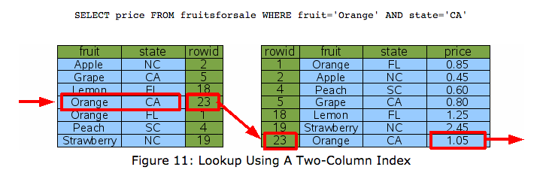
Using a Multiple Column Index

Slide 48
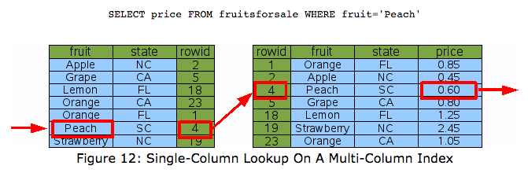
Using a Multiple Column Index

Slide 49
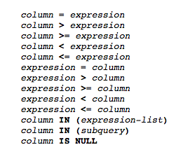
Using Index Values
Where clause can search using:
> create index myindex on mytable(a,b…)

Slide 50
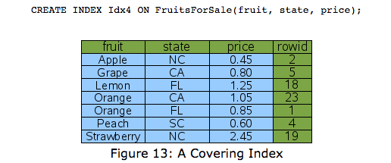
Creating a Covering Index

Slide 51
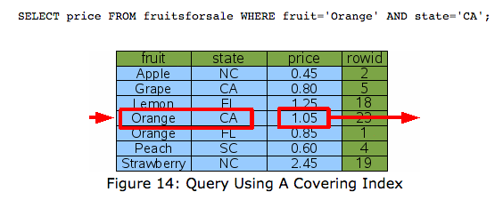
Using a Covering Index

Slide 52
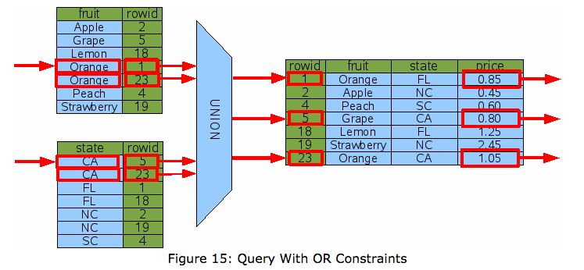
Using an OR search

Slide 53

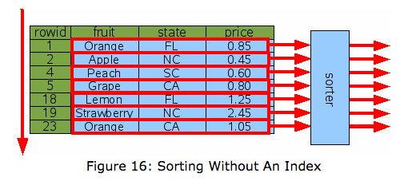
Sorting

Slide 54
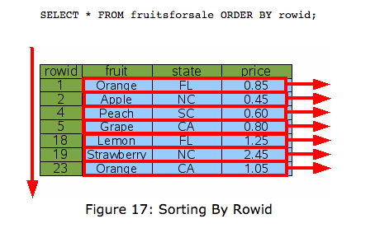
Sorting

Slide 55
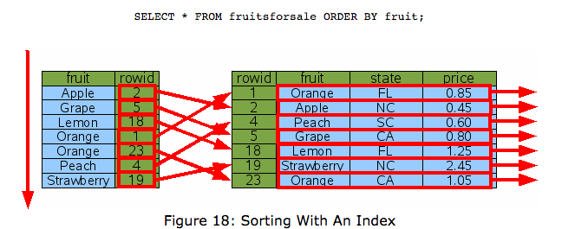
Sorting

Slide 56
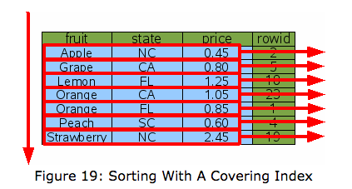
Sorting

Slide 57
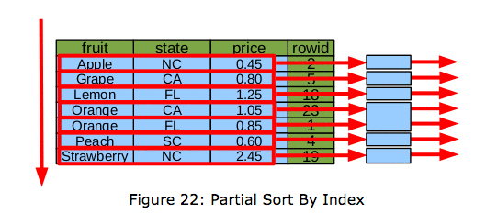
Partial Sorting

Slide 58
Optimizer Strategies
SQLite uses query strategies
http://www.sqlite.org/queryplanner.html
SQLite planner does optimization
Uses strategies to decide how to search
ttps://www.sqlite.org/optoverview.html
Query plans come with explanations
http://www.sqlite.org/eqp.html

Slide 59
OBJECT RELATIONAL MAPPING

Slide 60
Object Relational Mapper - Review
Creates a map between data and objects
Program in terms of your application objects
Data:
<name> <address> <phone>
Object:
Class Person:
name = ‘ ‘
address = ‘ ‘
phone = ‘ ‘

Slide 61
Object Relational Mapper
Creates a map between operations:
Create table -> Object class initialization
Create record -> Object initialization
Update, Delete record -> Object methods
Searches -> Class methods using object descriptions
Key enforcement -> Relationship management

Slide 62
ACID CRITERIA

Slide 63
ACID CRITERIA
Common properties of relational databases
Atomic
Consistent
Isolated
Durable
https://en.wikipedia.org/wiki/ACID

Slide 64
Atomic
All or nothing
No partial transactions

Slide 65
Consistent
All data meets constraints
No violation states

Slide 66
Isolated
Concurrent transactions cant see each other’s stats
There must be a sequential equivalent

Slide 67
Durable
Any committed transaction must be permanent
No excuses
Not even power outages or crashes

Slide 68
CHINOOK EXAMPLE DATABASE

Slide 69
An Example Database
Chinook – Music Store database
Reasonable example of a relational databases
Tunes, tracks, albums, artists, genres, customers
Available in lots of formats
https://chinookdatabase.codeplex.com/

Slide 70
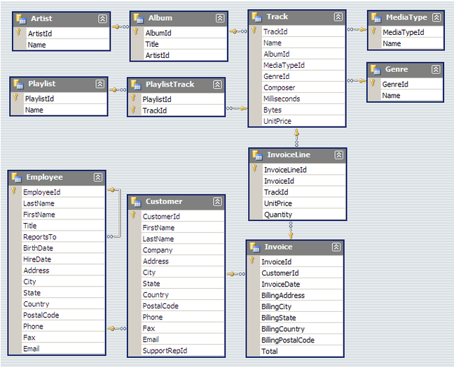
Get a serious database

