Slide 1
Advanced Database Design Lecture 8
Gregory S. DeLozier, Ph.D.
gdelozie@kent.edu

Slide 2
This Week’s Topics
Mongo review
Starting with Mongo in Python
Implementing the Todo app with Mongo
Midterm
Homework

Slide 3
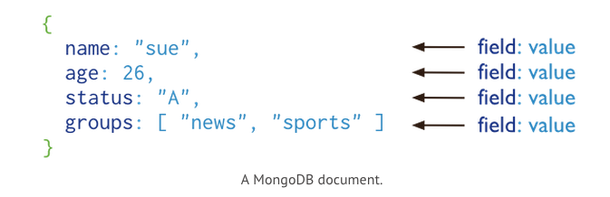
MongoDB

Slide 4
Mongo
$ mongo
> show dbs
admin (empty)
local 0.078GB
orthovis 0.078GB
test (empty)
> use mydata

Slide 5
Mongo
> db
mydata
> j = {name : "greg"}
> k = { x : 31 }
> db.stuff.insert(j)
> db.stuff.insert(k)

Slide 6
Mongo
> show dbs
…
> show collections
…
db.stuff.find()
{ objects in collection }

Slide 7
Mongo
> cursor = db.stuff.find()
> while (cursor.hasNext()) printjson(cursor.next())
(… list …)
- or –
> cursor[2] // treat as array

Slide 8
Mongo
> cursor = db.stuff.find({age:31})
(or)
> document = db.stuff.findOne({age:31})

Slide 9
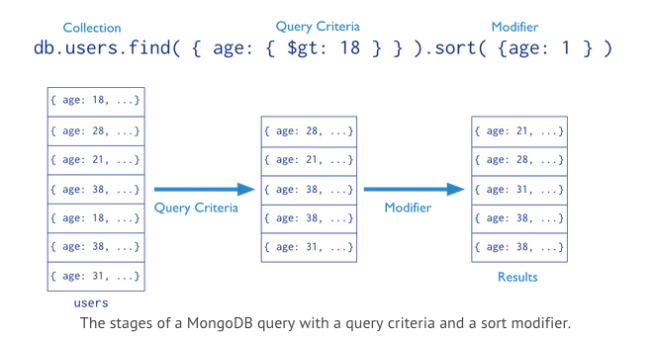
Mongo

Slide 10
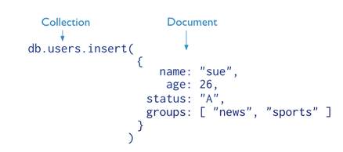
Mongo

Slide 11
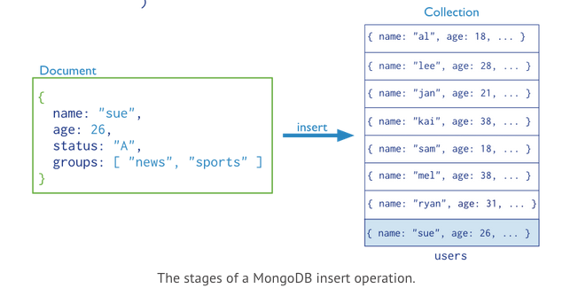
Mongo

Slide 12
Mongo
> db.stuff.remove()
> db.stuff.remove({age:31})
> db.stuff.remove({age:31},1)

Slide 13
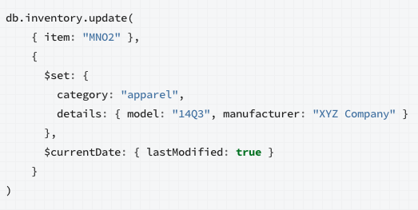
Mongo

Slide 14
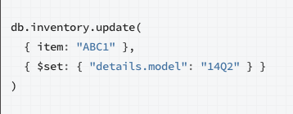
Mongo

Slide 15
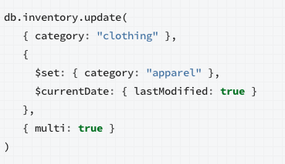
Mongo

Slide 16
MongoDB
Demo Time!

Slide 17
PyMongo
Mongo client software
Python → pymongo
pymongo is dictionary based
It's important to know how python dictionaries work
Demo time!

Slide 18
PyMongo
import pymongo
client = pymongo.MongoClient()
db = client.<database_name>
db = client.stuff

Slide 19
PyMongo
import datetime
item = {"author": "Mike",
"text": "My first blog post!",
"tags": ["mongodb", "python", "pymongo"],
"date": datetime.datetime.utcnow()}
db.stuff.insert(item)

Slide 20
PyMongo
import datetime
item = {"author": "Mike",
"text": "My first blog post!",
"tags": ["mongodb", "python", "pymongo"],
"date": datetime.datetime.utcnow()}
db.stuff.insert(item)
print db.collection_names

Slide 21
PyMongo
db.stuff.find_one()
db.stuff.find_one({"author":"Mike"})
db.stuff.find_one({"_id":id}) #<---- not string

Slide 22
PyMongo
db.stuff.find ()
db.stuff.find ({"author":"Mike"})
posts.find({"date": {"$lt": d}}).sort("author")

Slide 23
PyMongo
db.stuff.save (<item>)
db.stuff.update ({"author":"Mike"},
{"$set":{age:44}})
db.stuff.remove({"author":"Mike"})

Slide 24
MongoDB
Resources
http://www.mongodb.org
http://www.mongodb.org/about/introduction/
http://docs.mongodb.org/manual/
https://mongolab.com/

