Slide 1
Software Testing Methodology
Lecture 10
Gregory S. DeLozier, Ph.D.

Slide 2
A Brief Refresher
So where were we?

Slide 3
Reasons For Failure
Wrong requirements
Defective code
Defective tools
Problem in execution environment
This probably is the most common reason for outage
Really expensive
Sophisticate software architectures are making it worse

Slide 4
Reasons for Environmental Failure
Missing dependencies
Libraries
Tools
Volumes
Ports
Connections
Credentials

Slide 5
Reasons for Environmental Failure
Lack of capacity
Memory
Disk space
CPU speed
Network Bandwidth
Parallel capacity

Slide 6
Reasons for Environmental Failure
Changes in the environment
Additional activity
Capacity consumption
Connectivity issues
Patches
Interference – side effects from other work
Malware
Credentialing issues
Power failure

Slide 7
How does this relate to testing?
Testing the environmental requirements
Repeating that test on the target environments
Periodically verifying the target environment
Environmental assessment in case of failure

Slide 8
Programmatic Solutions
Remote control of machines
Write function in, say, python
Part of the function is executed remotely
These allow you to program remote machines
Functions to set things up – configuration
Functions to return values – testing
Paramiko – remote control
Fabric – convenient configuration
Yarn – alternative for Python 3.x

Slide 9
Paramiko
www.paramiko.org
Implements SSH for remote login
Very low-level
http://jessenoller.com/blog/2009/02/05/ssh-programming-with-paramiko-completely-different

Slide 10
Paramiko Example
import paramiko
ssh = paramiko.SSHClient()
ssh.connect('127.0.0.1', username='jesse', password='lol')
ssh.set_missing_host_key_policy( paramiko.AutoAddPolicy()) <- add
stdin, stdout, stderr = ssh.exec_command("uptime")
type(stdin)
stdout.readlines()
['13:35 up 11 days, 3:13, 4 users, load averages: 0.14 0.18 0.16\n']

Slide 11
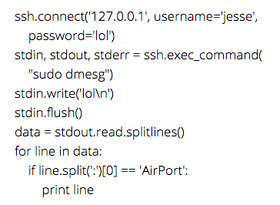
More Paramiko

Slide 12
Some Notes
Paramiko is a challenging installation on Windows
You can install Vagrant and use it there
You can use it on PythonAnywhere (already installed)
You can use it on Codio (easy to install)
You can use it from any Ubuntu/Linux box
If you really want to install it on windows, I can try to help.

Slide 13
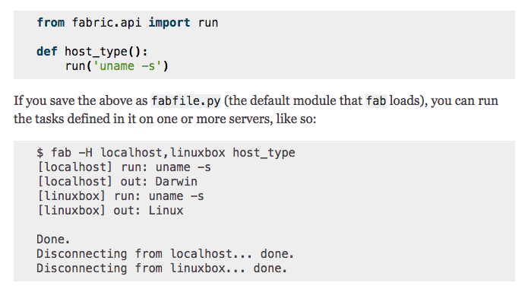
Fabric – a Python 2.7 remote solution

Slide 14
Fabric Issues
http://www.fabfile.org/
Only Python 2.7 at this time
Author is not porting
Ports are available

Slide 15
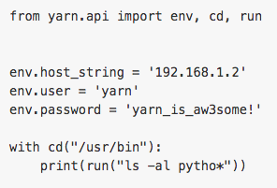
Yarn – a Fabric Replacement
https://github.com/Python-Yarn/Yarn
Written in Python 3
Uses Paramiko
Very easy to use :

Slide 16
Yarn Demo
Demo Time

Slide 17
So… About Yarn
Turns out that Yarn code is broken for use with passwords.
Oops. ☺
I wrote a simple replacement module – remote_api.py
Uses paramiko
Implements env/cd/run commands like Yarn & Fabric
Someday Fabric will be ported.

Slide 18
Test Driven Infrastructure
Design a test to verify some aspect of infrastructure
Watch the test fail
Fix the problem
Probably a dependency
Ideally, with automation
Run the test again

Slide 19
Aside: the “private.py” file
Use a private credentials file that doesn’t check in
user=”myusername"
password=”MyPa$$w0rd"
Add “private.py” to .gitignore
Then use this to get user and password
from private import user, password

Slide 20
Basic Example of a Remote Query
from remote_api import env,cd,run
from private import user, password
env.host_string = 'ssh.pythonanywhere.com’
env.user = user
env.password = password
with cd("~"):
print(run("ls -l"))

Slide 21
Basic Plan
Write Unit Tests to Verify Requirements
These will eventually become regression tests for the environment
Write Remote Methods to Set Up Environment
These will make the tests pass
These will become the basis for automated deployment

Slide 22
Requirements for RemoteAPI
Controller machine
Python3
Paramiko
remote_api.py
Access to target machine
Target machine
SSH login capability
Bash shell
Credentials for login account (password or possibly key file)

Slide 23
Possibilities for Homework Access
You can use Codio -> PA (paid, since Codio and PA ssh cost money)
You can use Codio -> Codio (paid since Codio costs money)
You can use your machine to ssh into KSU computer (free-ish ☺ )
You can use Vagrant
You can use your machine to SSH into a raspberry pi
…etc
(In the future, I will be requiring a paid cloud account...)

Slide 24
Demo Time!
All of this either is already in the repo or will be put there
(Remind me to put it there!)
Mission:
1. Verify that the server is available
2. Set up the requirements for the Django application
3. Verify that the Django (superlist) application is installed
4. Verify that the Django application is running

Slide 25
Requirements Quick Reference
We need a server
git
git config –global user.username, etc.
Python3
pip3 (pip3 install --upgrade pip)
pip3 install django
(pip3 install -- upgrade selenium)

Slide 26
Getting the Source
Clone the repository or get the files
$ git clone https://github.com/hjwp/book-example.git
(then use branch command, or…)
$ wget https://github.com/hjwp/book-example/archive/chapter_07.zip
Unzip the zip file
$ unzip *.zip
$ cd book*

Slide 27
Preparing the Application
…In the source directory
$ cd book-example-chapter_07
...run the data migrations
“python3 manage.py migrate”
…start the application
“python3 manage.py runserver”
This will terminate with logout, of course.
You can sleep and while sleeping run your webdriver tests

Slide 28
What Are The Limits?
Obtaining servers from the cloud and verifying
Linode, DigitalOcean, Amazon, and Azure all have APIs
All are accessible from Python
Initial configuration
Start with root account
Possible to change to user account for later setup
Package installation
Remote operation of Git, etc.
Application configuration
External configuration
Internal work via WebDriver

Slide 29
Does TDD work here?
I claim that it does
I claim that simple tools are better
(until they become inadequate)
I claim that reliable setup leads to reliable environments
I claim that this approach creates
reusable deployment assets
Useful regression tests for the environment and application
Conclusion
This definitely works
It’s malpractice _not_ to use these kinds of tools.

Slide 30
Homework – last week revisited
Get a remote computer running
Vagrant or cloud computer
Execute some yarn remote_api commands against it
Use python unittest framework to test some setup parameters
Is <?> installed?
Is <?> directory created?
Does this directory have the right permissions?
…etc
As always, send me something showing that you did this.

Slide 31
Homework – Last two weeks
Use the remote API methods to test an application in all phases:
Test the environment, packages, etc.
Test that the application is installed correctly.
Test that the application is running.
Test that the application is working correctly, using the tests previously written for the application.
You have to have a running application to do this. If time allows, automate the installation of the application.
For what it’s worth, at the end of this lecture, the application was up and running and we could have opened it in a web browser.
I’m having a difficult time finding a way to have remote_api start the django app and leave it running. It’s not something we normally do with the django development server. You may either start the server manually, or wait for me to post something, or you can try out nginx per the book instructions.

Slide 32
Homework Rules
On the subject line:
“Testing” or “STM”
“HWn” where n is a number
A phrase describing the work
(NYPL, Calculator, etc)
In the body of the email:
Your Kent State email address as text (e.g. gdelozie@kent.edu)
Email text – whatever you want to say
PDFs
Images (jpg, png)
NOTHING ELSE
All homework is due before the class session in finals week

Slide 33
Things we will cover in “lightning talks”
We will cover the following additional chapters:
11 – Forms
13 – Javascript
15,16 – Mocking
17 – Logging
18 – Outside-In
19 – Test Isolation
22 – Test Architecture and Topics

Slide 34
Regarding Software Engineering (Spring 16)
We will be using this book for some topics in SWE
Continuous Integration
Deployment preparation
Deployment management and DevOps
Environment validation and testing
Authentication and Security
Database migration
A few other things here and there. ☺

