Slide 1
Wireless technology AC data receiver
Present by:Andrew Spenn,Anil Gonul, Ching-Ling Wang
Professor Dr. Min Kyung An

Slide 2
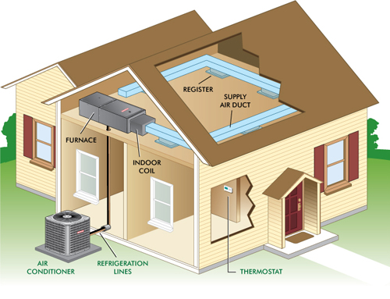
Problem Statement
To solve problems for inconvenient of retrieving the data from long distance and spread around the perimeter

Slide 3
Requirements Engineering
System | User
The machine will generate the data The send device will retrieve the data from the machine and translate as an UDP message Than the send device will address the message(temperature, pressure to the receiver device every period of time. The receiver device will collect the data and detect if connected to the send device. The receiver device will translate the message Than it shall show the message(temperature, pressure ,timestamp). | The receiver device shall show the data send by the other send device so that the user can know the right amount of pressure and temperature from the distanced machine.

Slide 4
User and system Requirements
Skate holder | Actors goal | User case
AC repairer | repair AC | Using the device data to manger which action they should do to fix the AC
IT staff | installing and maintaining the system | When the monitor does not show the correctness of data. Every period of time should have a system upgrade since AC may have new process
Repair | Fix the device | When the device is broke

Slide 5
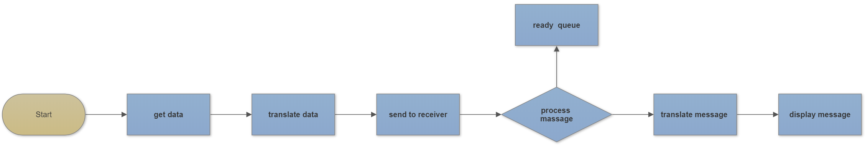
System Modeling activity model
Notes:
Behavioral models: Data-driven modeling
 An activity model

Slide 6
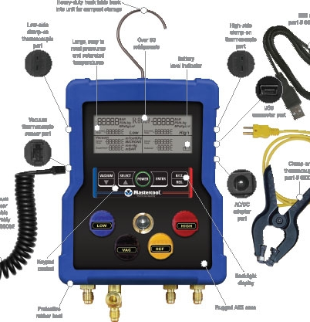
Data set
Pressure And Vacuum Display:
PSI, Bar, MPa, Kg/cm2
Temperature Display:
-40° - 200°F (-4 - 93°C)

Slide 7
libraries
network | interface
java.io.IOException java.net.DatagramPacket java.net.DatagramSocket java.net.SocketException java.net.InetAddress; java.net.UnknownHostException; java.awt.EventQueue; | javax.swing.JFrame; javax.swing.JPanel; javax.swing.border.EmptyBorder; javax.swing.JTextField; javax.swing.JFrame; javax.swing.JPanel; javax.swing.event.ChangeListener; javax.swing.event.ChangeEvent;

Slide 8
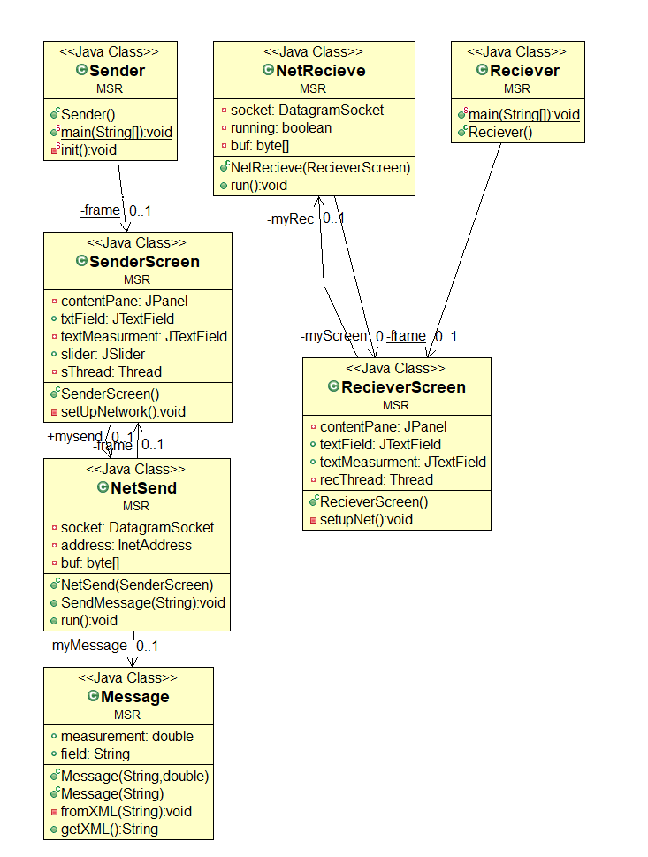
functions

Slide 9
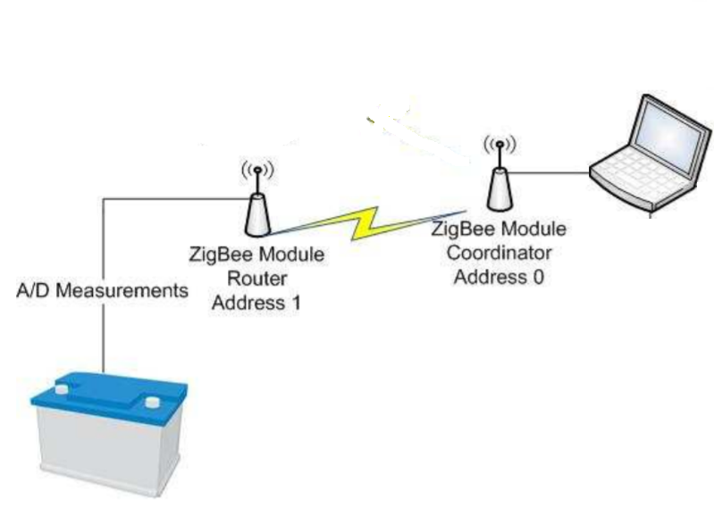
Architectural patterns
protocol
Point to point。
Notes:
網路的構成方式又稱為拓樸（topology）。ZigBee支援點對點（point-to-point）、單點對多點（point-to-multipoint）或者星狀（star）以及網狀（Mesh）架構，每個網路設備都稱作「節點」。
設置ZigBee網路時，要決定每個裝置（節點）的任務：
協調器（Coordinator）：ZigBee網路包含唯一的協調器，管理網路的設置。
路由器（Router）：同一個網路可以包含多個路由，負責轉發其他節點的訊號。
終端（Endpoint）：同一個網路可以包含多個終端，ZigBee的終端無法直接和其他終端通訊。
點對點（point-to-point）拓樸
點對點通訊，指的是兩個網路設備直接相連。像手機藍牙連接Arduino藍牙序列埠模組，或者手機畫面透過Miracast/WiFi-Direct技術投影到電視機，都是點對點連線

Slide 10
Allocation of job
protocol
name | task
Andrew Spenn | Function: Send Receive Translate display
Anil Gonul | Hardware, fixing function erros
Ching-Ling Wang | Research imformation Powerpiont function ready Queue
Notes:
網路的構成方式又稱為拓樸（topology）。ZigBee支援點對點（point-to-point）、單點對多點（point-to-multipoint）或者星狀（star）以及網狀（Mesh）架構，每個網路設備都稱作「節點」。
設置ZigBee網路時，要決定每個裝置（節點）的任務：
協調器（Coordinator）：ZigBee網路包含唯一的協調器，管理網路的設置。
路由器（Router）：同一個網路可以包含多個路由，負責轉發其他節點的訊號。
終端（Endpoint）：同一個網路可以包含多個終端，ZigBee的終端無法直接和其他終端通訊。
點對點（point-to-point）拓樸
點對點通訊，指的是兩個網路設備直接相連。像手機藍牙連接Arduino藍牙序列埠模組，或者手機畫面透過Miracast/WiFi-Direct技術投影到電視機，都是點對點連線

Slide 11
Future attribute

Slide 12
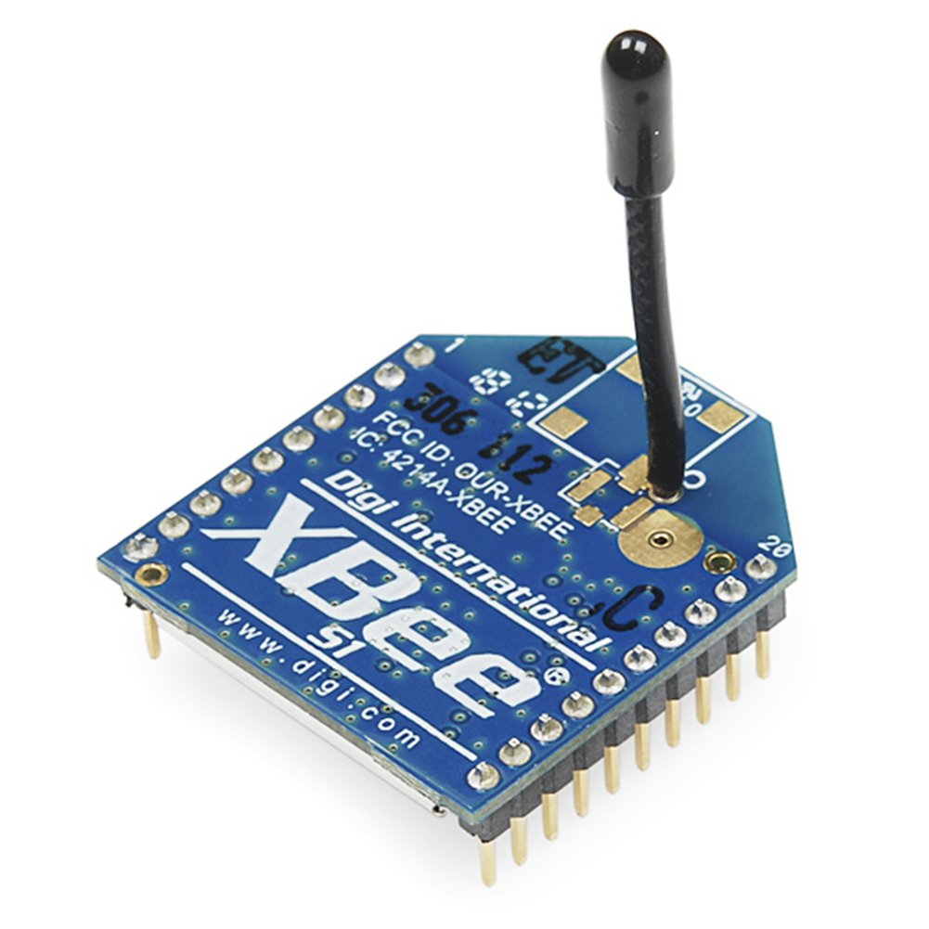
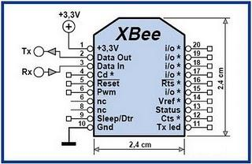
Digi XBee 1mW Wire Antenna
allow a very reliable and simple communication between microcontrollers, computers, systems, really anything with a serial port! Point to point and multi-point networks are supported.
Notes:
工作電壓：2.8 ~ 3.4 V
20個針腳：含9個數位I/O及5個類比輸入腳（與數位腳共用）；針腳間距為2.0mm。
內建鞭形天線
室內傳輸距離：30公尺
室外傳送距離（無遮蔽物）：100公尺
無線工作頻率：2.4GHz
無線傳輸資料速率：250Kbps
This is the very popular 2.4GHz XBee module from Digi. These modules take the 802.15.4 stack (the basis for Zigbee) and wrap it into a simple to use serial command set. These modules
Features: 3.3V @ 50mA 250kbps Max data rate 1mW output (+0dBm) 300ft (100m) range Wire antenna Fully FCC certified 6 10-bit ADC input pins 8 digital IO pins 128-bit encryption Local or over-air configuration AT or API command set

Slide 13
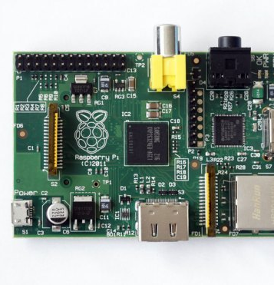
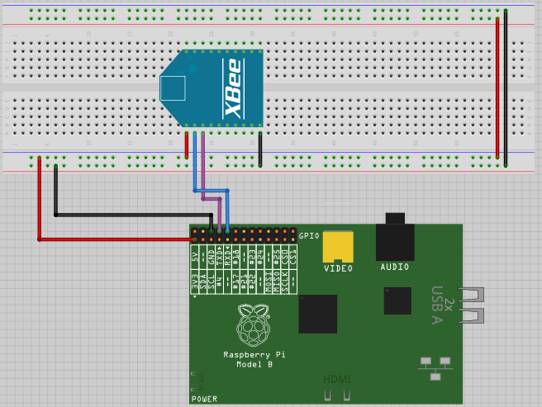
Raspberry Pi
The Raspberry Pi is a very cheap computer that runs Linux, but it also provides a set of GPIO (general purpose input/output) pins that allow you to control electronic components for physical computing and explore the Internet of Things (IoT).
Usesage:To display the messages

Slide 14
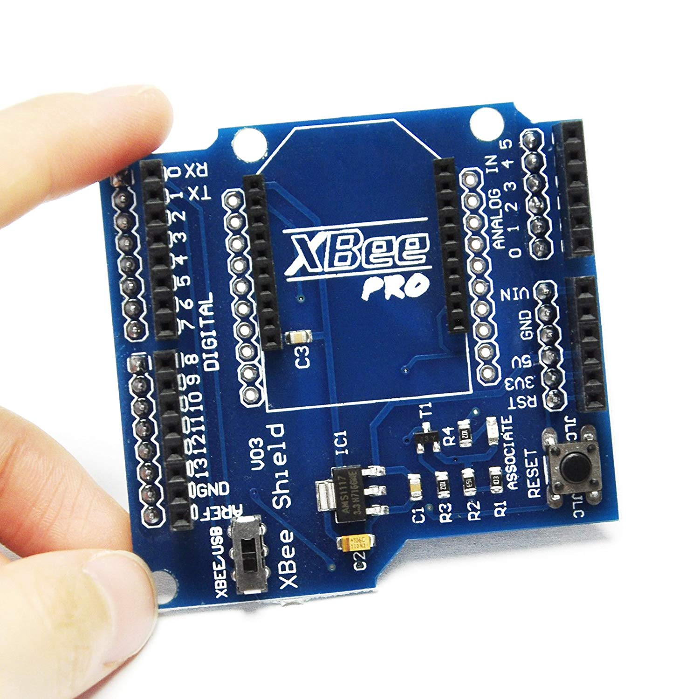
Wireless Control For ZigBee Arduino
PC via a USB cable directly connected with XBee adapters
Notes:
It is a fully Assembled shield without the XBee module.
3.3V and 5V dual power output
3.3V and 5V IO compatible
USB 2.0 protocol
BitBang mode ready
Easily connected to a PC via mini USB cable
XBee-setting support software X-CTU
Usage 1: PC via a USB cable directly connected with XBee adapters
Usage 2: Bluetooth Bee configure or use as a data-transmission
Usage 3: ARDUINO BOARD PRO MINI Downloader
It can be used for programming or communicating with board which basic Arduino but without USB interface
Easily connected to a PC via mini USB cable.
Bee Adapter is a compact USB to serial adapter equipped with BEE (20pin 2.0mm) sockets, can achieve a simple two crunodal ZigBee network.

Slide 15
