Slide 1

Extracting the Speed of Sound from Heavy Ion Collisions using iEBE-MUSIC – a (3+1)D Hydrodynamical Collision Model
By Christian Schmidt, 11/8/2026, at the
Fall 2026 TAOAPS Section Meeting

Slide 2
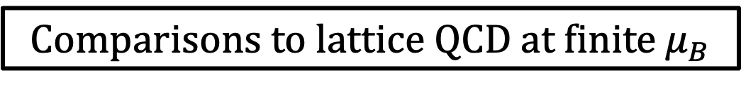
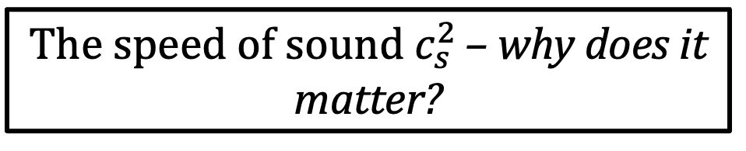

Structure of the Talk
The speed of sound $c_{s}^{2}$ – why does it matter?
iEBE-MUSIC along the BES energies
Extracting $c_{s}^{2}$ from model data
Comparisons to lattice QCD at finite $μ_{B}$

Slide 3
The speed of sound c_{s}² – why does it matter?
Heavy-ion collisions emulate conditions of similar temperature and energy density as those immediately after the Big Bang.
By studying the physical properties of the matter produced in heavy ion collisions with varying collision energy, we can study the time (temperature) evolution of the early universe.

Slide 4
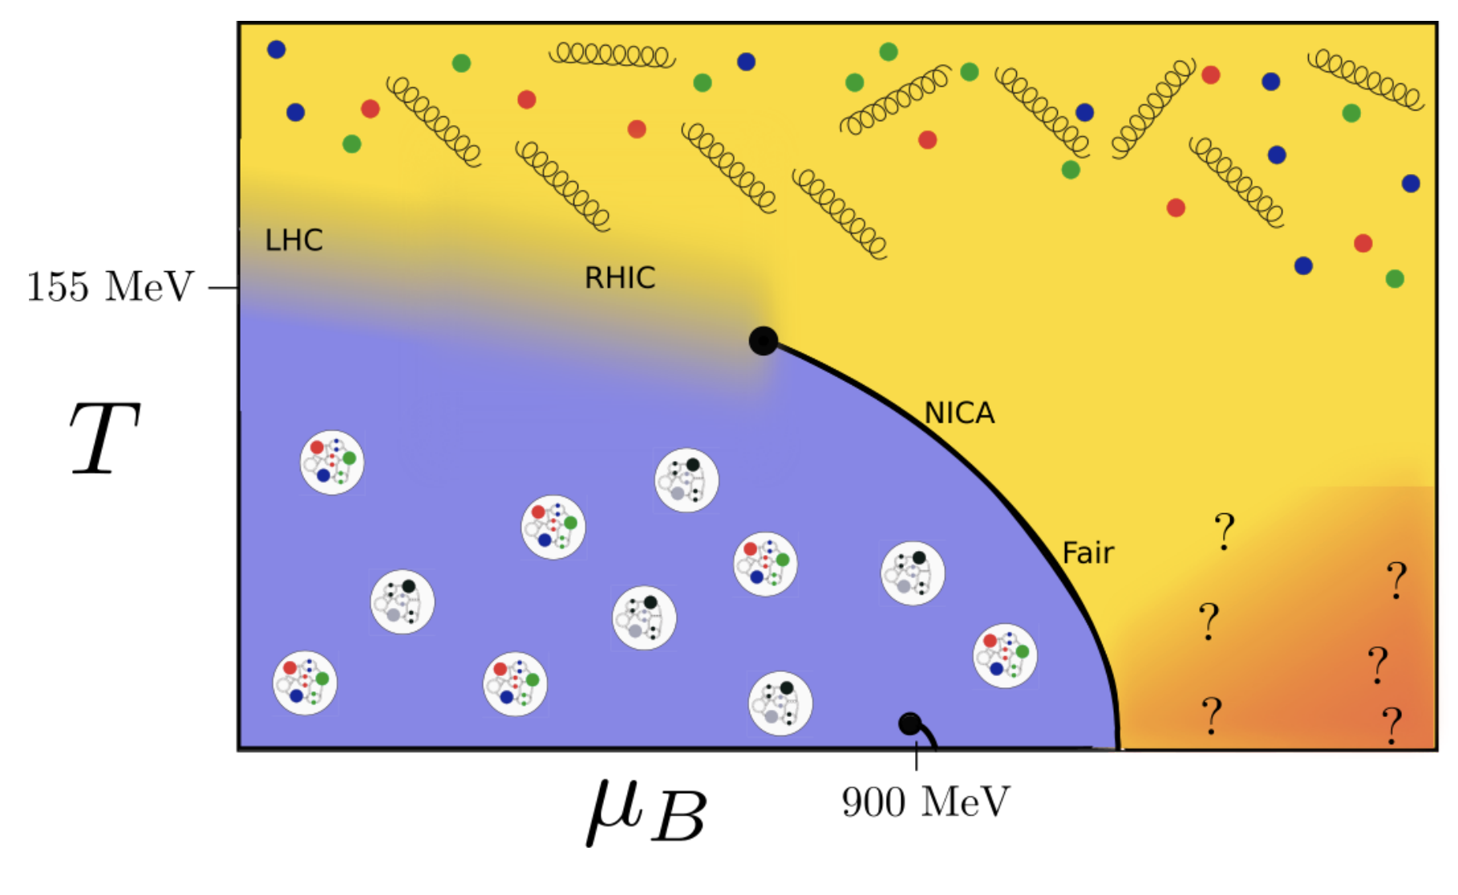
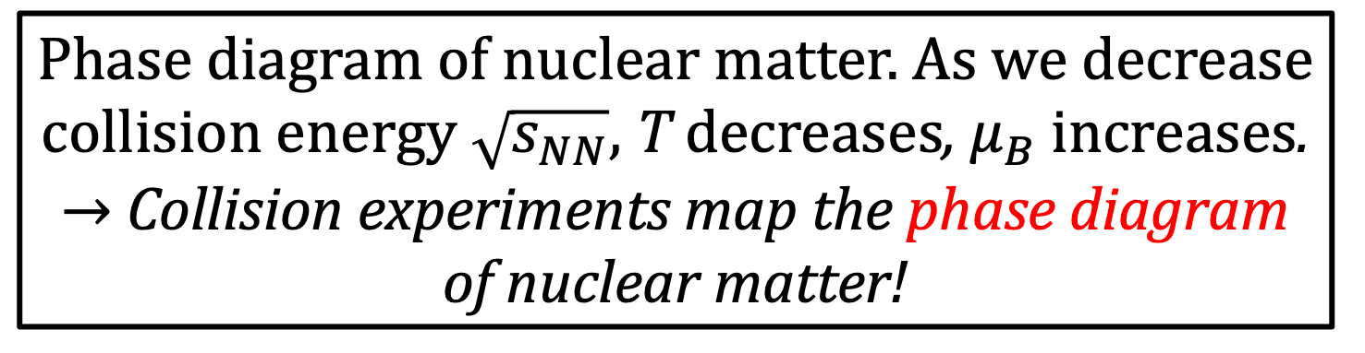
The speed of sound c_{s}² – why does it matter?
[Guenther, arXiv:2010.15503]
Phase diagram of nuclear matter. As we decrease collision energy $\sqrt{s_{NN}}$, T decreases, $μ_{B}$ increases.
→ Collision experiments map the phase diagram of nuclear matter!

Slide 5
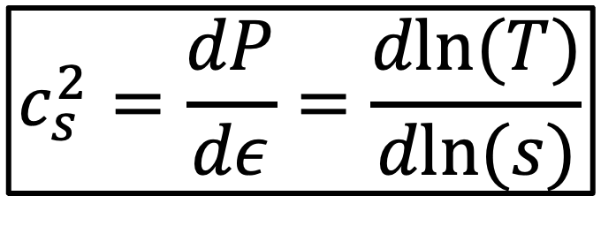
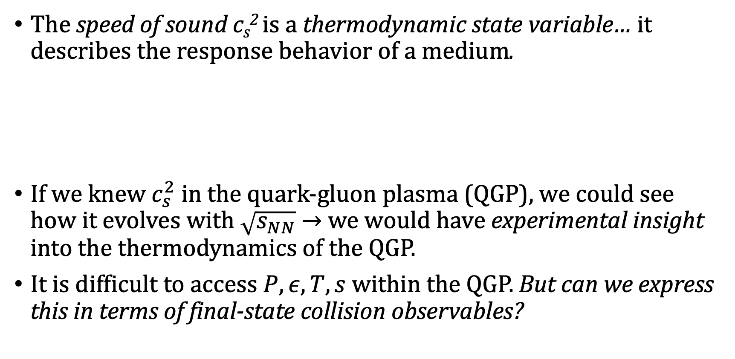
The speed of sound c_{s}² – why does it matter?
The speed of sound c_{s}² is a thermodynamic state variable… it describes the response behavior of a medium.
If we knew $c_{s}^{2}$ in the quark-gluon plasma (QGP), we could see how it evolves with $\sqrt{s_{NN}}$ → we would have experimental insight into the thermodynamics of the QGP.
It is difficult to access $P, ε, T, s$ within the QGP. But can we express this in terms of final-state collision observables?
$$c_{s}^{2}=\frac{dP}{dε}=\frac{dln(T)}{dln(s)}$$

Slide 6
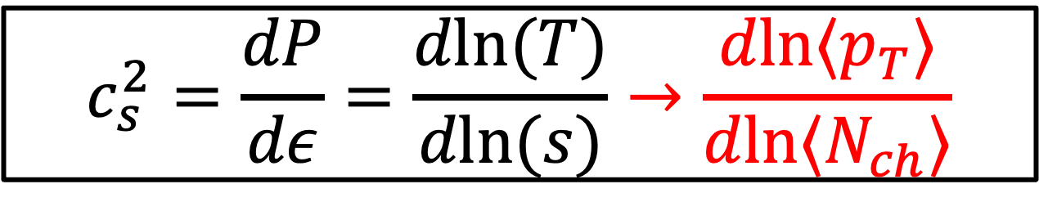
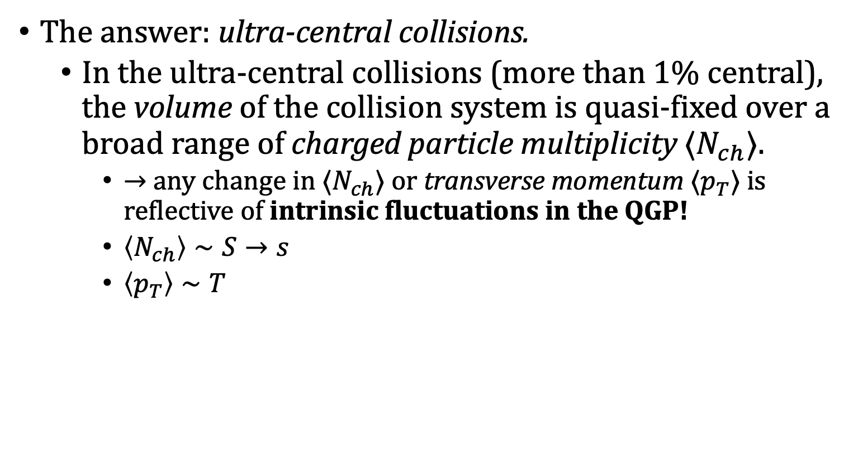
The speed of sound c_{s}² – why does it matter?
[Gardim, arXiv:1908.09728]
The answer: ultra-central collisions.
  In the ultra-central collisions (more than 1% central), the volume of the collision system is quasi-fixed over a broad range of charged particle multiplicity $⟨N_{ch}⟩$.
    → any change in $⟨N_{ch}⟩$ or transverse momentum $⟨p_{T}⟩$ is reflective of intrinsic fluctuations in the QGP!
    $\left\langle N_{ch}\right\rangle ∼S→s$
    $\left\langle p_{T}\right\rangle ∼T$
$$c_{s}^{2}=\frac{dP}{dε}=\frac{dln(T)}{dln(s)}→\frac{dln⟨p_{T}⟩}{dln⟨N_{ch}⟩}$$

Slide 7

iEBE-MUSIC along the BES energies
$$\sqrt{s_{NN}}$$
iEBE-MUSIC is a (3+1)D hydrodynamical collision model.
  (3+1)D – Model is able to describe longitudinal dynamics of collisions with incomplete Lorentz contraction.
  Hydrodynamical – Model uses the nearly-inviscid fluid description of the QGP to apply the equations of relativistic hydrodynamics to heavy-ion collisions.
  Collision model – Models for heavy ion collisions are designed to replicate and extend experimental studies in a controlled environment. This involves the integration of various codes (dependencies) that model the different stages of the collision evolution
  (3D MC Glauber → KoMPoST → MUSIC → iSS → UrQMD).

Slide 8
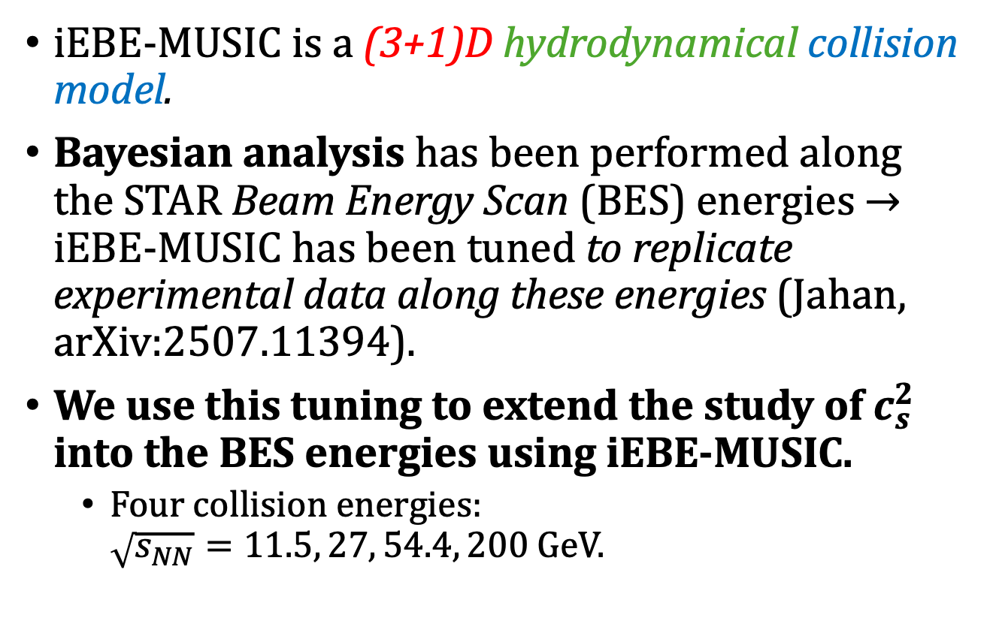
iEBE-MUSIC along the BES energies
$$\sqrt{s_{NN}}$$
iEBE-MUSIC is a (3+1)D hydrodynamical collision model.
Bayesian analysis has been performed along the STAR Beam Energy Scan (BES) energies → iEBE-MUSIC has been tuned to replicate experimental data along these energies (Jahan, arXiv:2507.11394).
We use this tuning to extend the study of $c_{s}^{2}$ into the BES energies using iEBE-MUSIC.
  Four collision energies:
  $\sqrt{s_{NN}}=11.5, 27, 54.4, 200$ GeV.

Slide 9
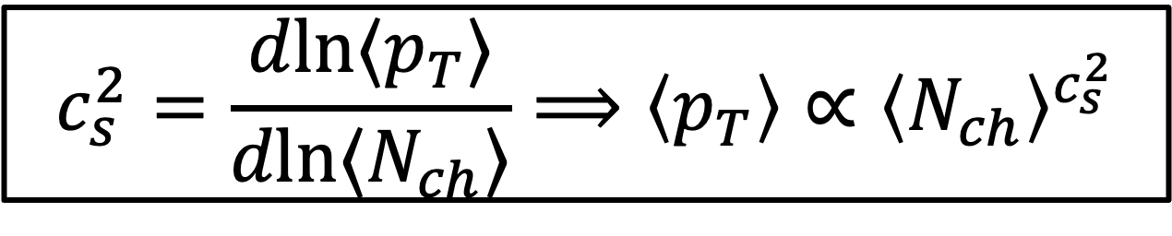
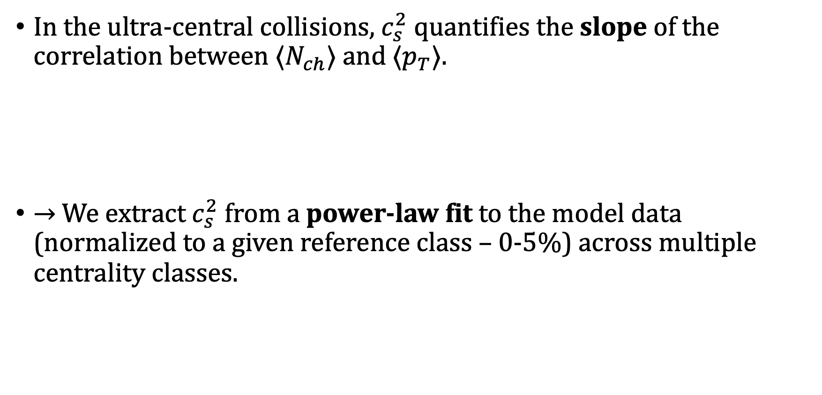

Extracting $c_{s}^{2}$ from model data
In the ultra-central collisions, $c_{s}^{2}$ quantifies the slope of the correlation between $⟨N_{ch}⟩$ and $⟨p_{T}⟩$.
→ We extract $c_{s}^{2}$ from a power-law fit to the model data (normalized to a given reference class – 0-5%) across multiple centrality classes.
$$c_{s}^{2}=\frac{dln⟨p_{T}⟩}{dln⟨N_{ch}⟩}⟹\left\langle p_{T}\right\rangle ∝{\left\langle N_{ch}\right\rangle }^{c_{s}^{2}}$$

Slide 10
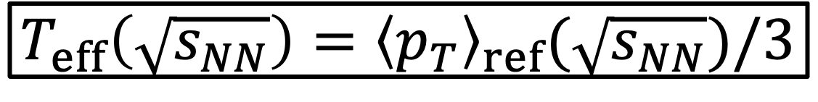
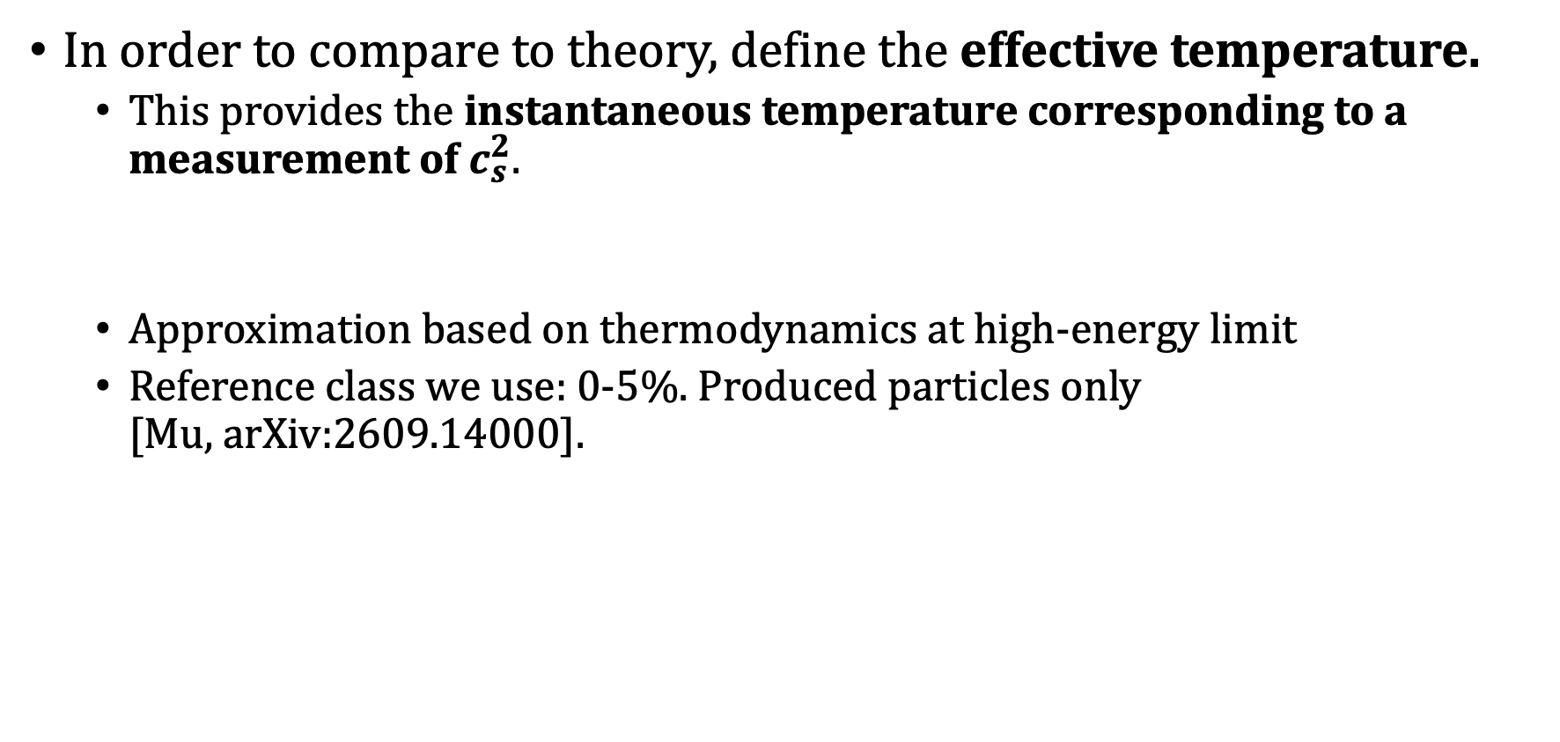
Extracting $c_{s}^{2}$ from model data
In order to compare to theory, define the effective temperature.
  This provides the instantaneous temperature corresponding to a measurement of $c_{s}^{2}$.
  Approximation based on thermodynamics at high-energy limit
  Reference class we use: 0-5%. Produced particles only
  [Mu, arXiv:2609.14000].
$$T_{eff}\left(\sqrt{s_{NN}}\right)={\left\langle p_{T}\right\rangle }_{ref}(\sqrt{s_{NN}})/3$$

Slide 11
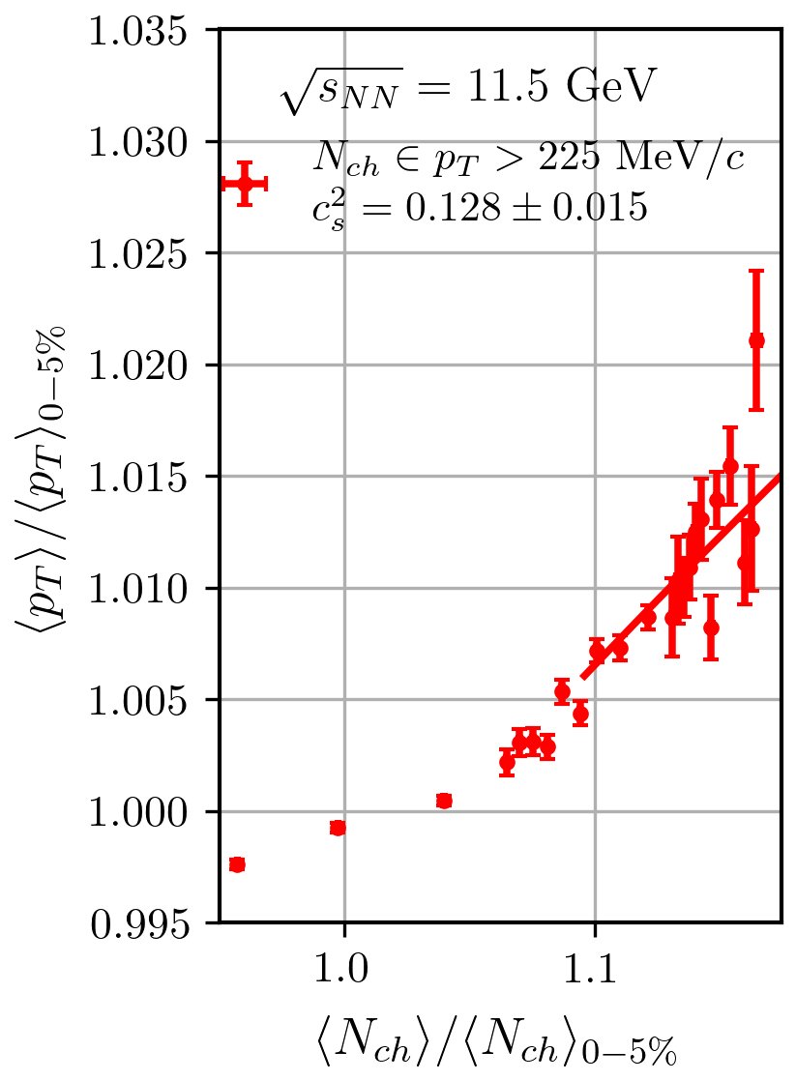
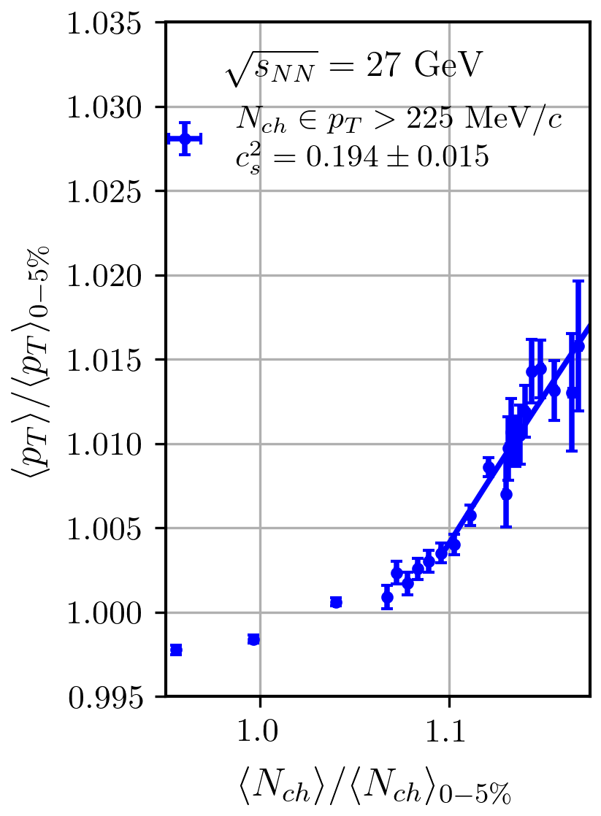
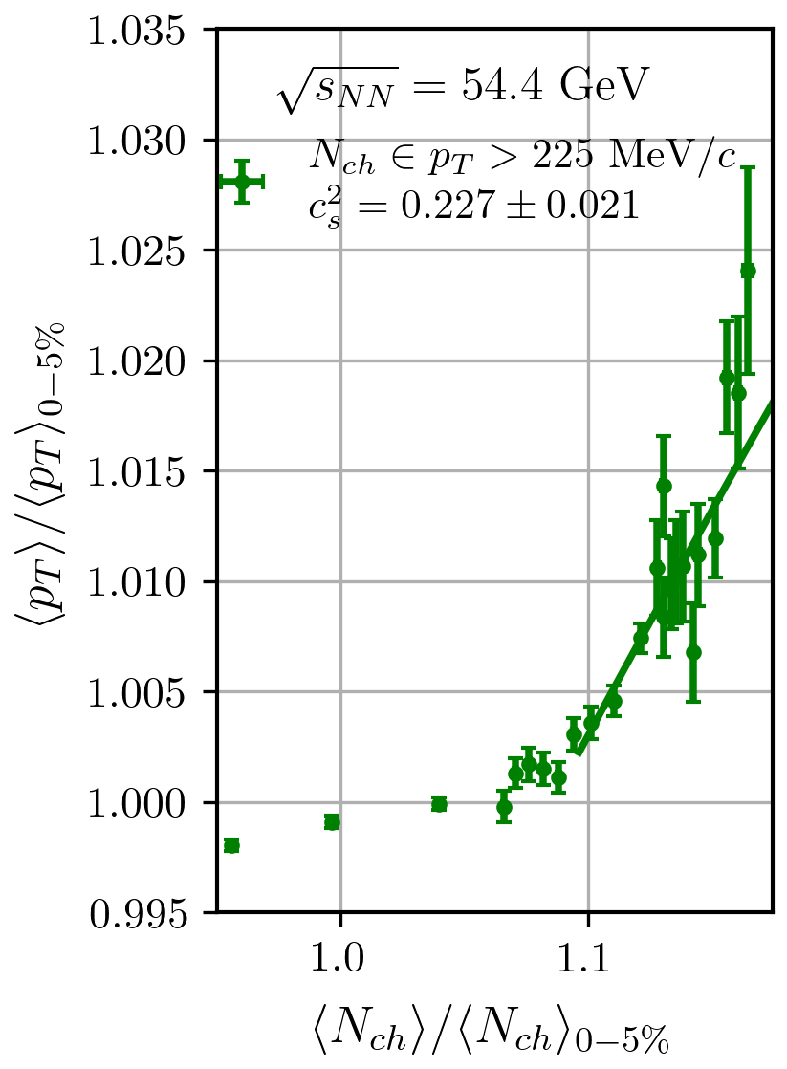
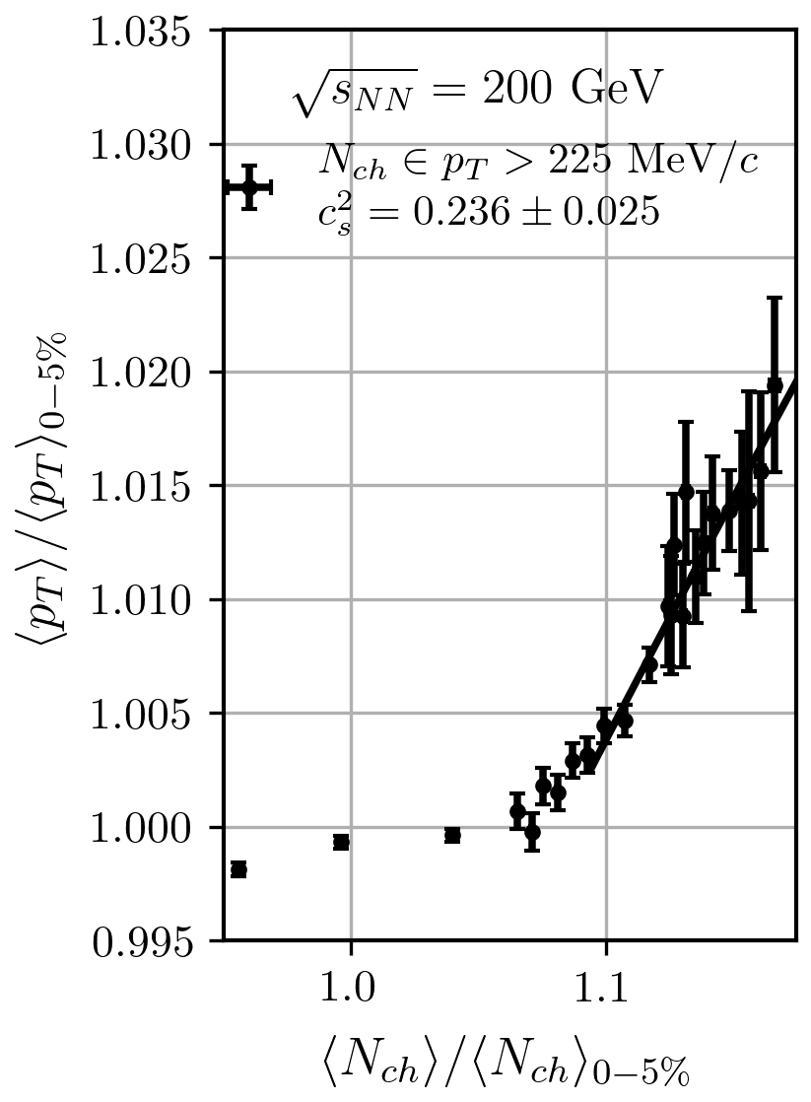
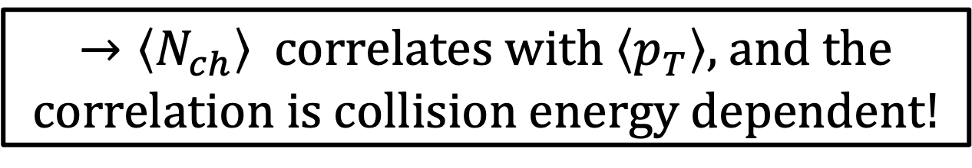
Extracting $c_{s}^{2}$ from model data
$→\left\langle N_{ch}\right\rangle$ correlates with $\left\langle p_{T}\right\rangle ,$and the correlation is collision energy dependent!

Slide 12
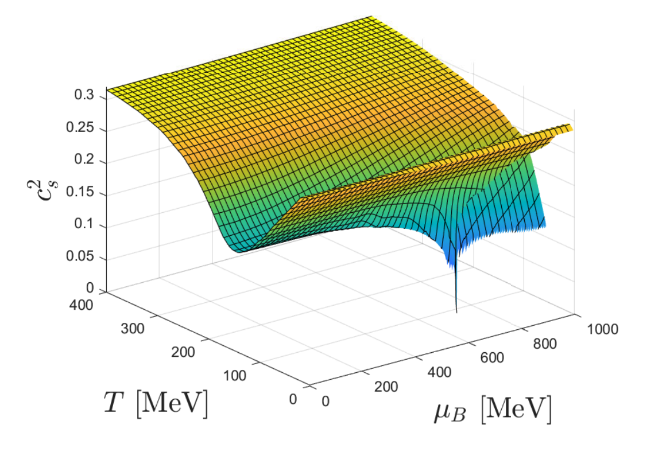
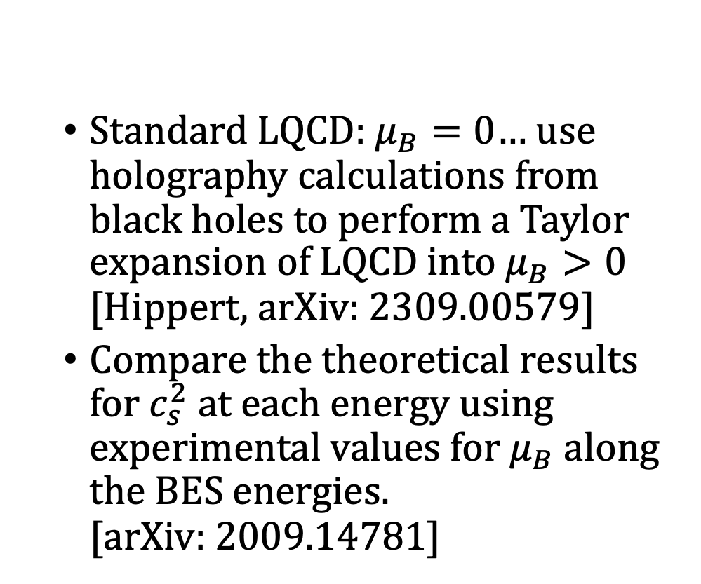

Comparisons to lattice QCD at finite $μ_{B}$
  Standard LQCD: $μ_{B}=0$… use holography calculations from black holes to perform a Taylor expansion of LQCD into $μ_{B}>0$
  $[$Hippert, arXiv: 2309.00579]
  Compare the theoretical results for $c_{s}^{2}$ at each energy using experimental values for $μ_{B}$along the BES energies.
  [arXiv: 2009.14781]
In order to compare our results to theory, we utilize a holography-based expansion of lattice quantum chromodynamics (LQCD).
[Grefa et al., arXiv: 2102.12042]

Slide 13
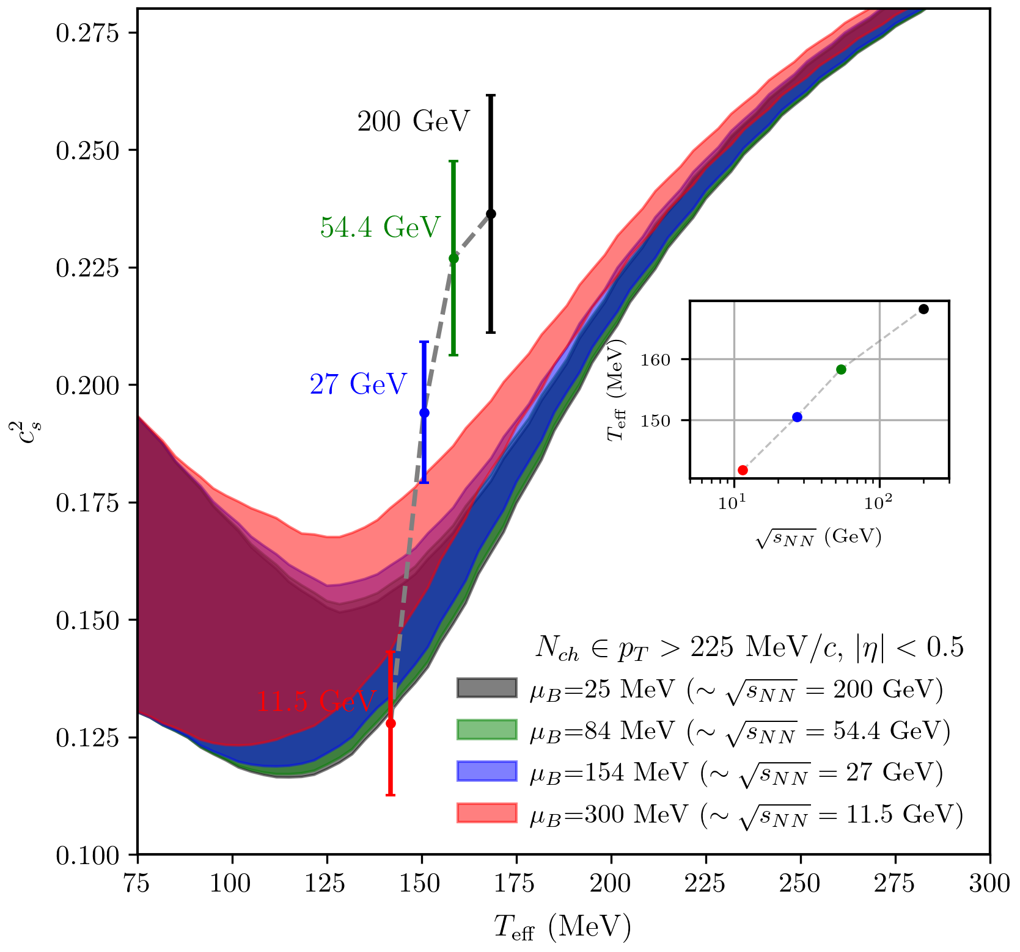
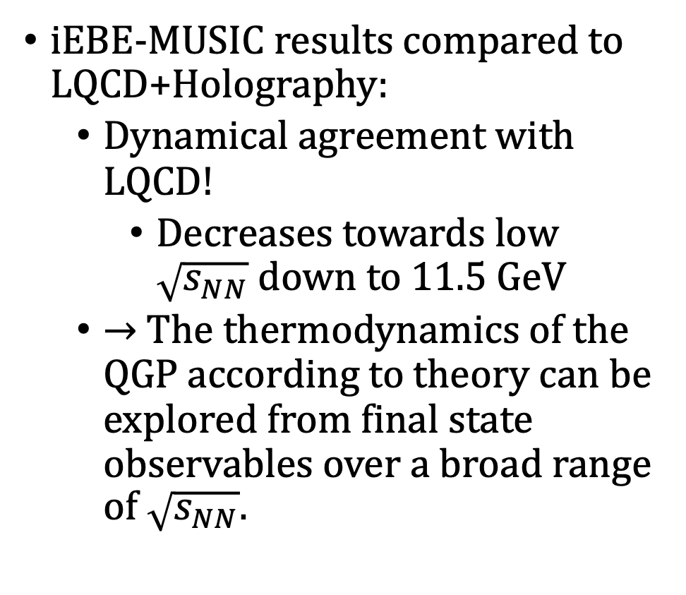
Comparisons to lattice QCD at finite $μ_{B}$
iEBE-MUSIC results compared to LQCD+Holography:
  Dynamical agreement with LQCD!
    Decreases towards low $\sqrt{s_{NN}}$ down to 11.5 GeV
  → The thermodynamics of the QGP according to theory can be explored from final state observables over a broad range of $\sqrt{s_{NN}}$.

Slide 14
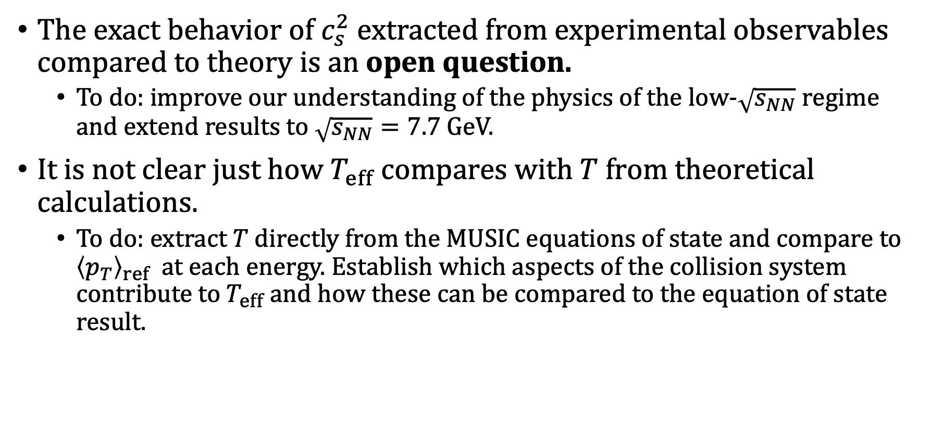
Final Comments
The exact behavior of $c_{s}^{2}$ extracted from experimental observables compared to theory is an open question.
  To do: improve our understanding of the physics of the low-$\sqrt{s_{NN}}$ regime and extend results to $\sqrt{s_{NN}}=7.7$ GeV.
It is not clear just how $T_{eff}$ compares with $T$ from theoretical calculations.
  To do: extract $T$ directly from the MUSIC equations of state and compare to ${\left\langle p_{T}\right\rangle }_{ref}$ at each energy. Establish which aspects of the collision system contribute to $T_{eff}$ and how these can be compared to the equation of state result.

Slide 15
THANK YOU!

