Slide 1
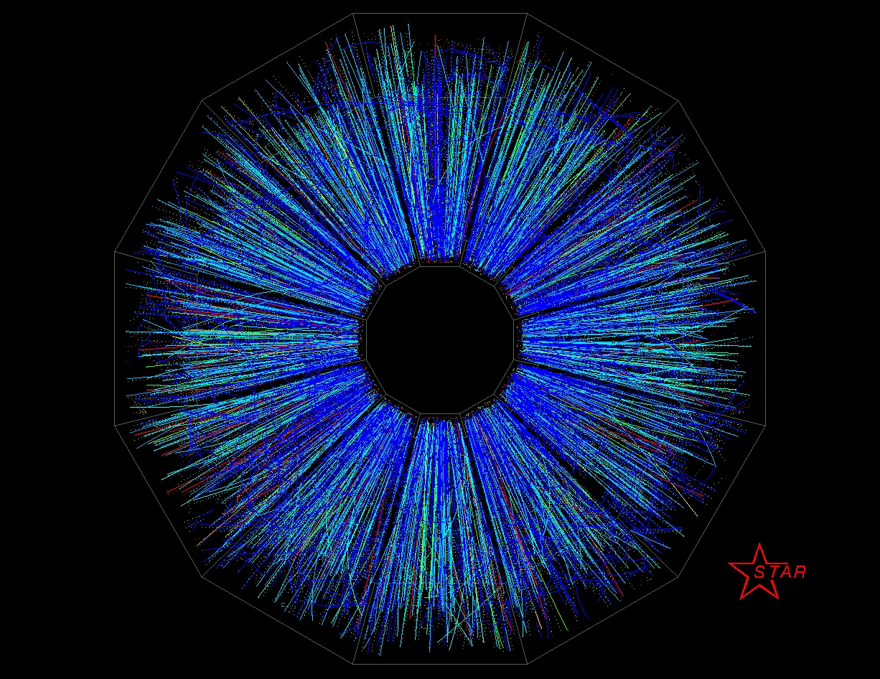
Extracting Observables from Trajectum, a Heavy-Ion Collision Model
By Christian Schmidt
Advisor: Dr. Rene Bellwied
University of Houston Dept. of Physics
Lamar University EXPO 2025 – April 23rd, 2025

Slide 2

Outline
What is Trajectum?
Trajectum dependencies
Speed of sound squared $c_{s}^{2}$
Effective temperature $T_{eff}$
Results

Slide 3
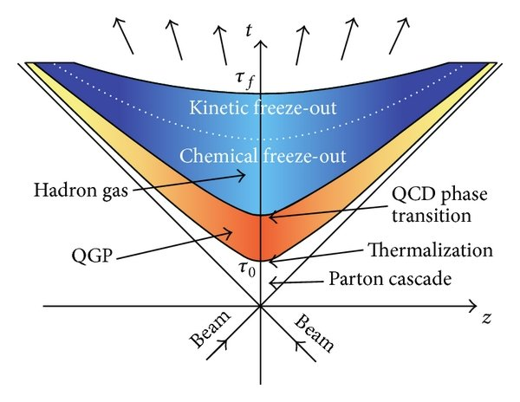

What is Trajectum?
(3)
Trajectum is a set of programs to simulate nuclear collisions.
It is a hydrodynamic modeling code.
Models the evolution of a collision:
(1) Pre-hydrodynamic phase (parton cascade)
(2) Hydrodynamic phase (QGP + hadron gas phase)
(3) Final state particles (after freeze out)
Provides data about final state observables.
Information about the equation of state (EOS) of strongly-interacting matter at high $\sqrt{s_{NN}}$.
(2)
(1)
Shown: a space-time diagram of a heavy-ion collision evolution.
arXiv:2010.15134v2 [nucl-th]

Slide 4
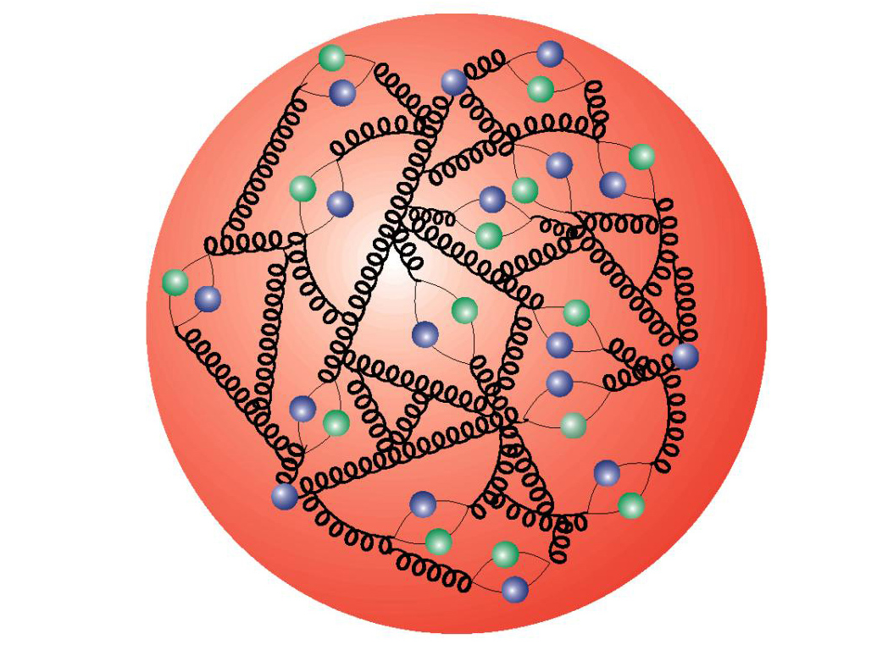
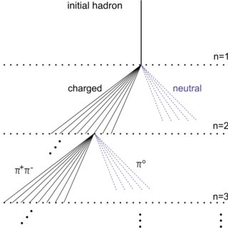
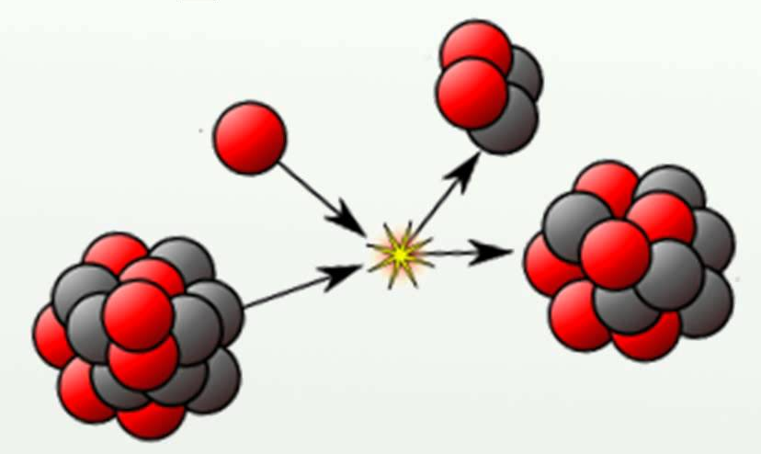
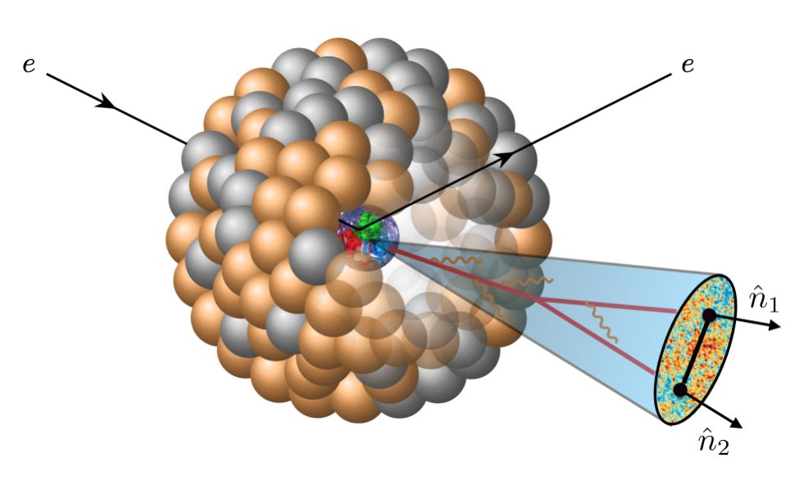
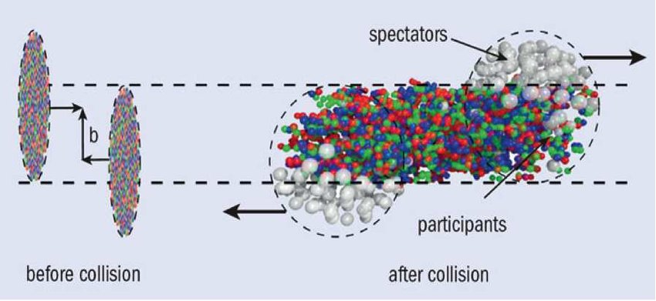
Trajectum dependencies
(Partonic)
(Hadronic)
LHAPDF6
FastJet3
PYTHIA8
GEMINI++
SMASH
Trajectum hydro code
Notes:
Info about each in this slide - concise

Slide 5
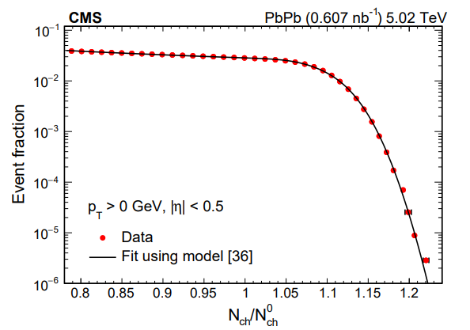
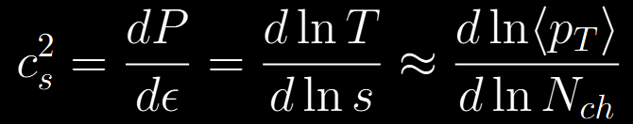







Speed of sound squared $c_{s}^{2}$
Common
5%
10%
0.1%
What is $c_{s}^{2}$?
The equation
What is centrality?
A percentage of total events.
What is impact parameter $b$?
The ultra-central argument
Rare!!!
Centrality:
50%
5%
0.1%
$$b$$
$$b$$
$$b$$
$$b$$
$$b$$
arXiv:2401.06896 [nucl-ex]
Peripheral.
Volume not constant
Central.
Ultra-central.
Volume nearly constant
Nat Phys. 16 (2020) 615

Slide 6
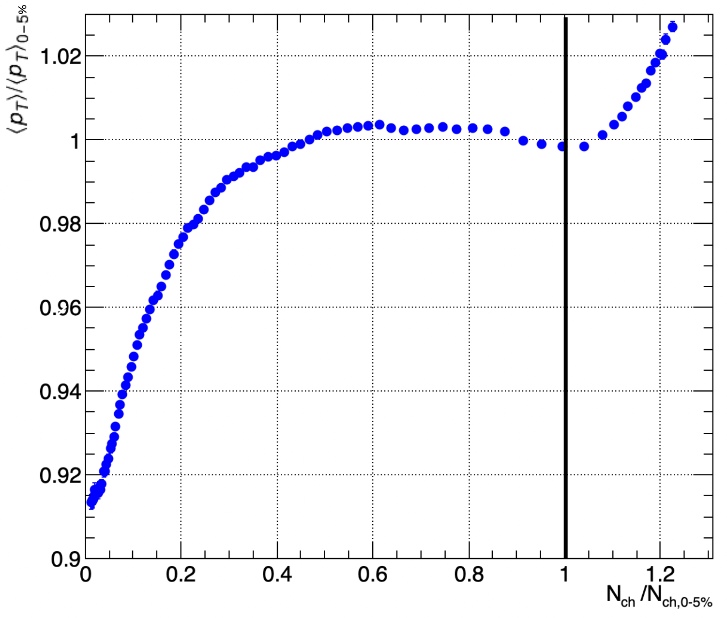
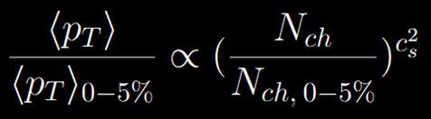



Speed of sound squared $c_{s}^{2}$
Peripheral (direct $b$ dependence)
Central
Ultra-central (no $b$ dependence)
0.1%
Power law fit for ultra-central region with slope parameter $c_{s}^{2}$.
5%
80%
50%
Notes:
RATIO. Above unity all behavior is ultracentral.

Slide 7
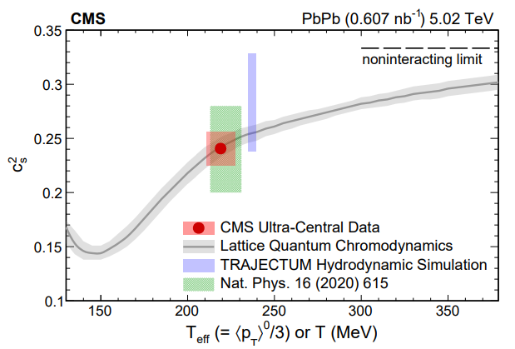
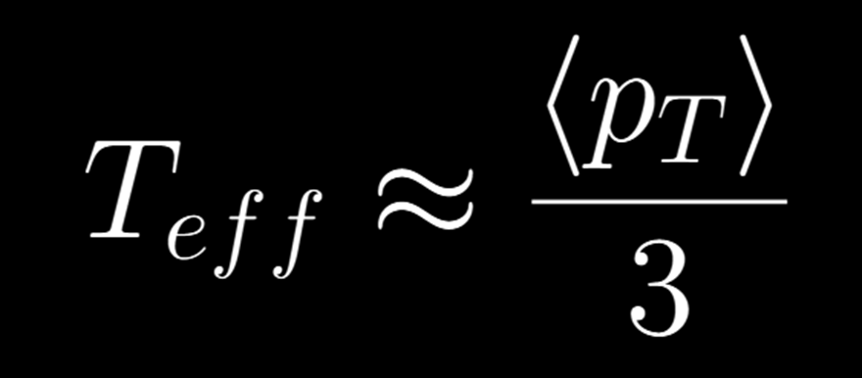


Effective temperature $T_{eff}$
What is $T_{eff}$, and what can it tell us?
s
QGP Phase
Hadronic Phase
Nat. Phys. 16 (2020) 615
arXiv:2401.06896 [nucl-ex]

Slide 8
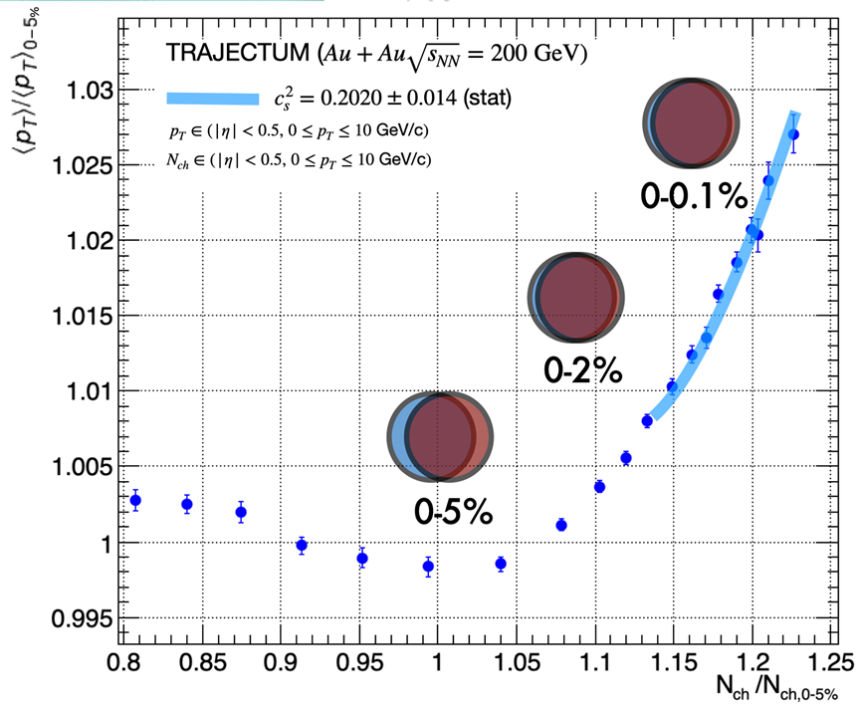
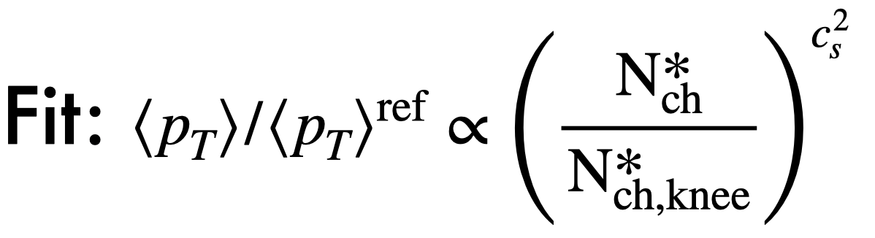
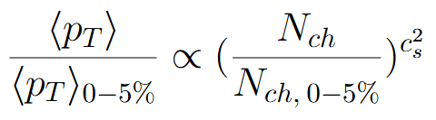
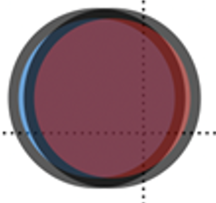
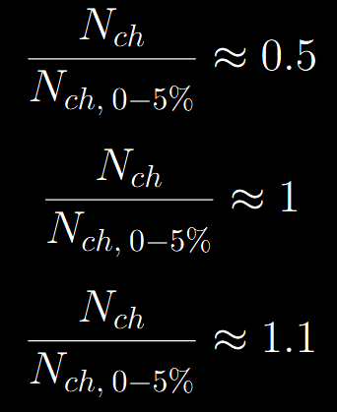
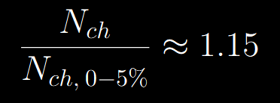
Results
50%
5%
0.1%
0-10%
Notes:
Knee expected at unity … inflection pt on log scale evt fraction curve.
After unity, can be described by the power law, with Nknee and cs^2 as free parameters.
Power law accounts for impact parameter contribution, where as eq on last slide does not.

Slide 9
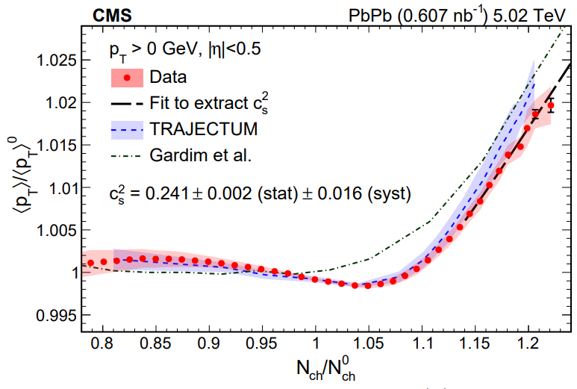

Results
Centrality definition: $N_{ch}∈\left(\left|η\right|<0.5, p_{T}>0\right)$
$$c_{s}^{2}∈\left(0.188, 0.216\right)$$
$$c_{s}^{2}∈\left(0.238, 0.32\right)$$
$$c_{s}^{2}∈\left(0.200, 0.280\right)$$
(Our result) TRAJECTUM at 200 GeV: $c_{s}^{2}∈\left(0.188, 0.216\right)$
arXiv:2401.06896 [nucl-ex]
Notes:
Knee expected at unity … inflection pt on log scale evt fraction curve.
After unity, can be described by the power law, with Nknee and cs^2 as free parameters.
Power law accounts for impact parameter contribution, where as eq on last slide does not.

Slide 10



Results
CMS plot with our results
(Our results shown in purple for $Au+Au \sqrt{s_{NN}}=200 GeV$).
$T_{eff}=200±2.50 MeV$
Within errors of the lattice QCD trend given by Bazavov, et al. (arXiv:1407.6387), Borsanyi et al. (arXiv:1309.5258).
$$Pb+Pb$$
$$\sqrt{s_{NN}}=5.02 TeV$$
$$Au+Au$$
$$\sqrt{s_{NN}}=200 GeV$$
arXiv:2401.06896 [nucl-ex]

Slide 11

Conclusion
Trajectum is used to simulate heavy ion collision events.
It provides data on final state observables for analysis.
We use Trajectum to calculate $c_{s}^{2}$ and $T_{eff}$.
$c_{s}^{2}$ quantifies the compressibility of the EOS of the medium produced by heavy ion collisions.
Trajectum at 5.02 TeV: $c_{s}^{2}∈\left(0.238, 0.328\right)$
Our result – Trajectum at 200 GeV: $c_{s}^{2}=0.2020±0.014 \left(0.188, 0.216\right)$
$T_{eff}$ decreases from LHC energy to RHIC energy.
$c_{s}^{2}$ shows expected decrease within plasma phase.
Next step: Measurement at lower collision energies at RHIC (hadronic phase)

Slide 12
Thank you!

Slide 13
References
1: arXiv:2010.15134v2 [nucl-th]
2: https://www.researchgate.net/figure/The-space-time-evolution-of-heavy-ion-collision-The-figure-is-taken-from-28_fig1_267567608
3: https://www.gauss-centre.eu/fileadmin/research_projects/2021/EPP/pr74yo_fig01_web.jpg
4: https://physics.yale.edu/event/npa-seminar-wenqing-fan-lbnl-studying-jet-substructure-energy-correlators-colliders
5: https://www.researchgate.net/profile/Barbara-Betz/publication/45879759/figure/fig3/AS:669549171064843@1536644370506/Geometry-of-a-heavy-ion-collision-The-two-nuclei-move-along-the-beam-axis-z-axis-with_Q640.jpg
6: https://i.ytimg.com/vi/PbevKE1UZJM/maxresdefault.jpg
7: https://www.researchgate.net/publication/359110660/figure/fig5/AS:1141680212324352@1649209182249/First-three-steps-of-a-hadronic-cascade-in-the-simplified-Heitler-Matthews-model-image_Q320.jpg
8: 615 PLB 809 (2020)
9: arXiv:2401.06896 [nucl-ex]

Slide 14
Figure References
https://all-about-12.blogspot.com/2011/12/to-5-pointed-star-selections-human-body.html
https://www.researchgate.net/figure/The-space-time-evolution-of-heavy-ion-collision-The-figure-is-taken-from-28_fig1_267567608
https://www.gauss-centre.eu/fileadmin/research_projects/2021/EPP/pr74yo_fig01_web.jpg
https://physics.yale.edu/event/npa-seminar-wenqing-fan-lbnl-studying-jet-substructure-energy-correlators-colliders
https://www.researchgate.net/publication/350542810/figure/fig1/AS:1007626452213761@1617248275473/Schematic-picture-of-a-nucleus-nucleus-collision-with-the-impact-parameter-b.jpg
https://i.ytimg.com/vi/PbevKE1UZJM/maxresdefault.jpg
https://www.researchgate.net/publication/359110660/figure/fig5/AS:1141680212324352@1649209182249/First-three-steps-of-a-hadronic-cascade-in-the-simplified-Heitler-Matthews-model-image_Q320.jpg

