Slide 1
Architecture planning
From concept to BAU

Slide 2
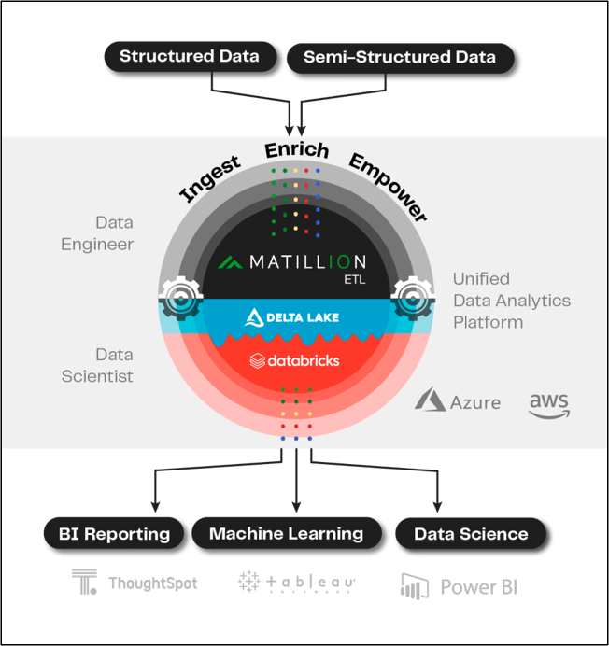

Slide 3
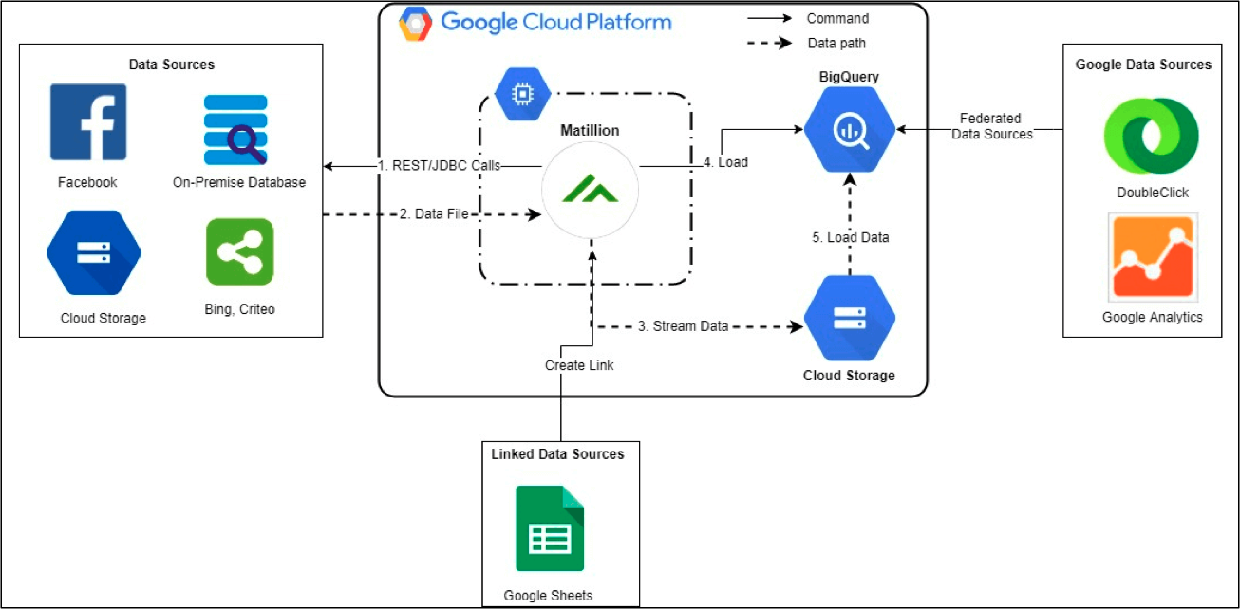

Slide 4
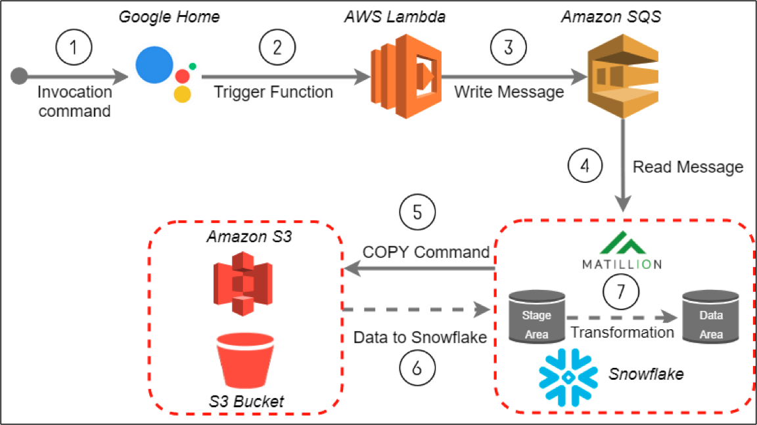

Slide 5
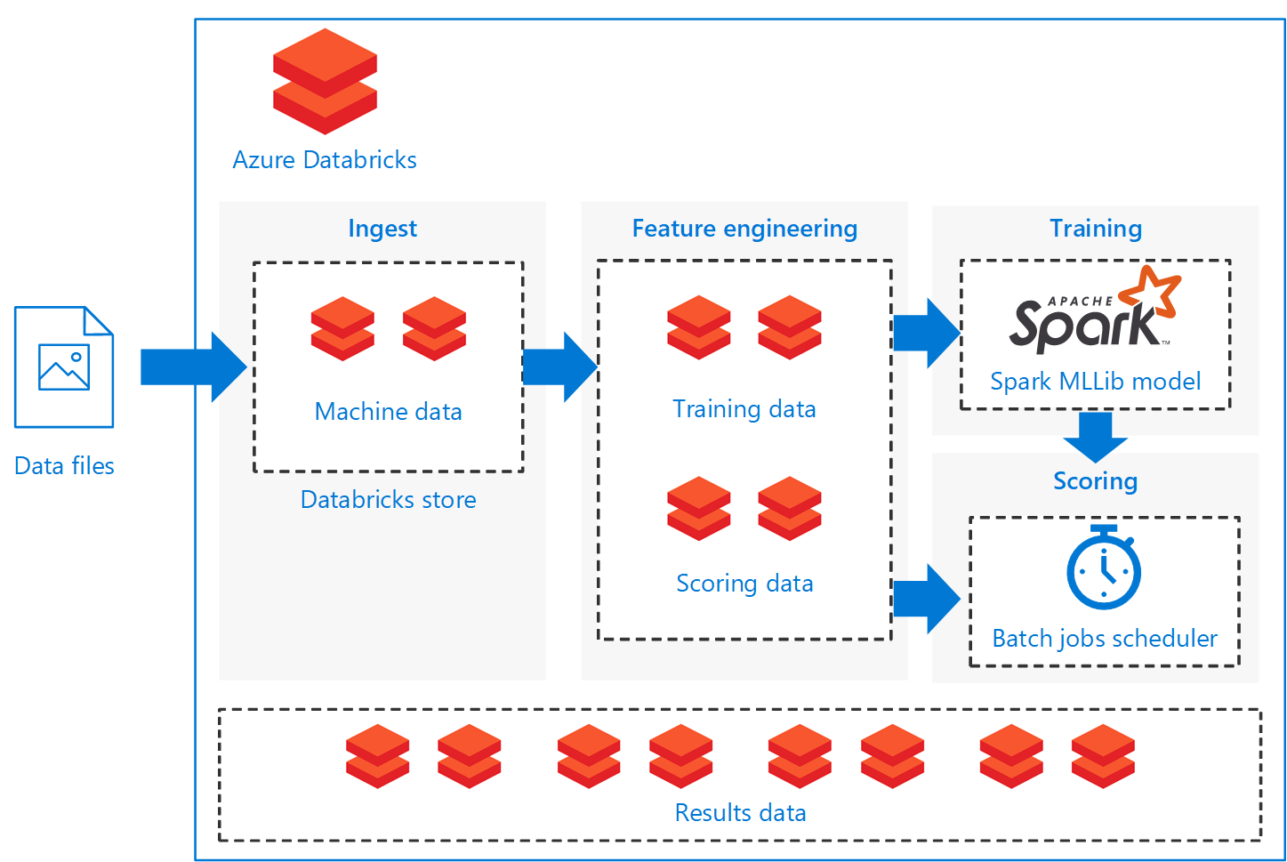

Slide 6
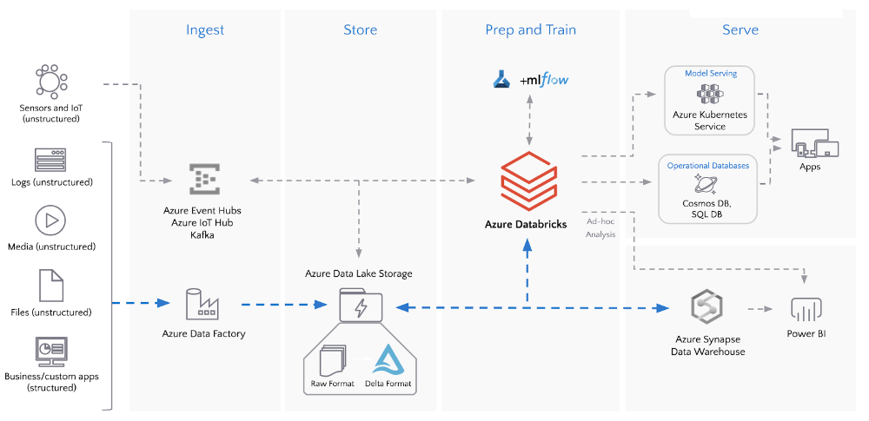

Slide 7
Apache Spark is a data processing framework that can quickly perform processing tasks on very large data sets, and can also distribute data processing tasks across multiple computers, either on its own or in tandem with other distributed computing tools. These two qualities are key to the worlds of big data and machine learning, which require the marshalling of massive computing power to crunch through large data stores. Spark also takes some of the programming burdens of these tasks off the shoulders of developers with an easy-to-use API that abstracts away much of the grunt work of distributed computing and big data processing.
From its humble beginnings in the AMPLab at U.C. Berkeley in 2009, Apache Spark has become one of the key big data distributed processing frameworks in the world. Spark can be deployed in a variety of ways, provides native bindings for the Java, Scala, Python, and R programming languages, and supports SQL, streaming data, machine learning, and graph processing. You’ll find it used by banks, telecommunications companies, games companies, governments, and all of the major tech giants such as Apple, Facebook, IBM, and Microsoft.

Slide 8
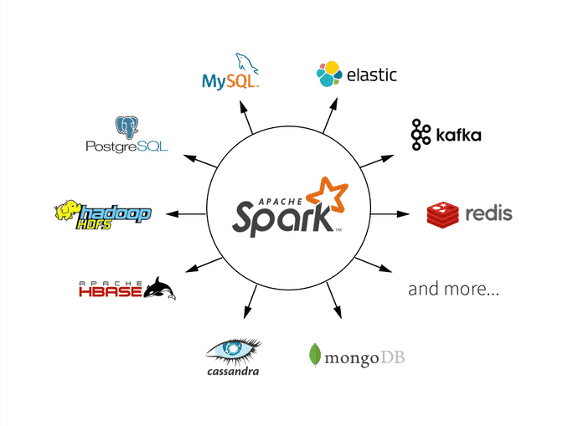

Slide 9
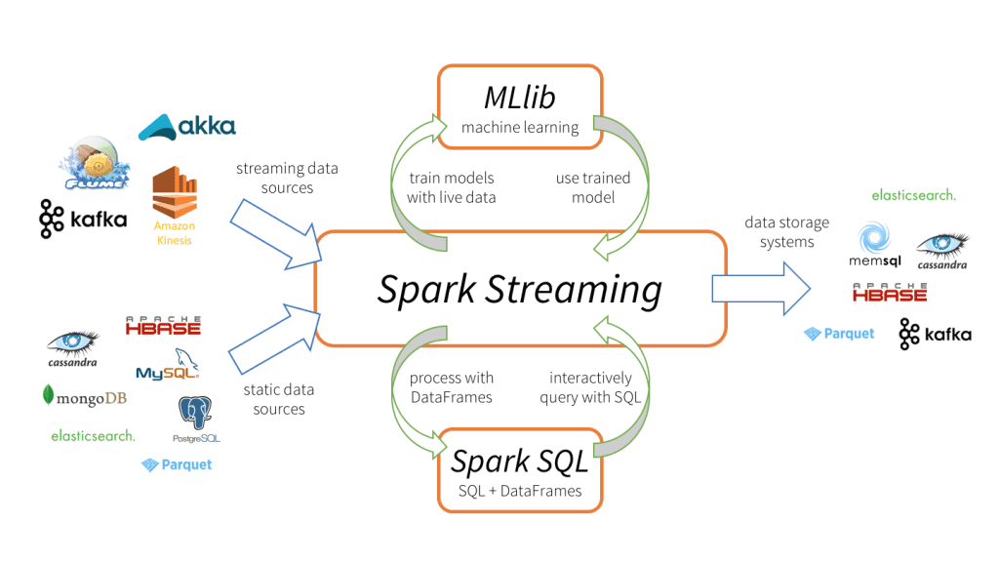

Slide 10
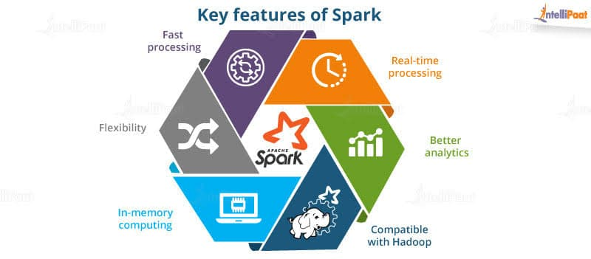

Slide 11
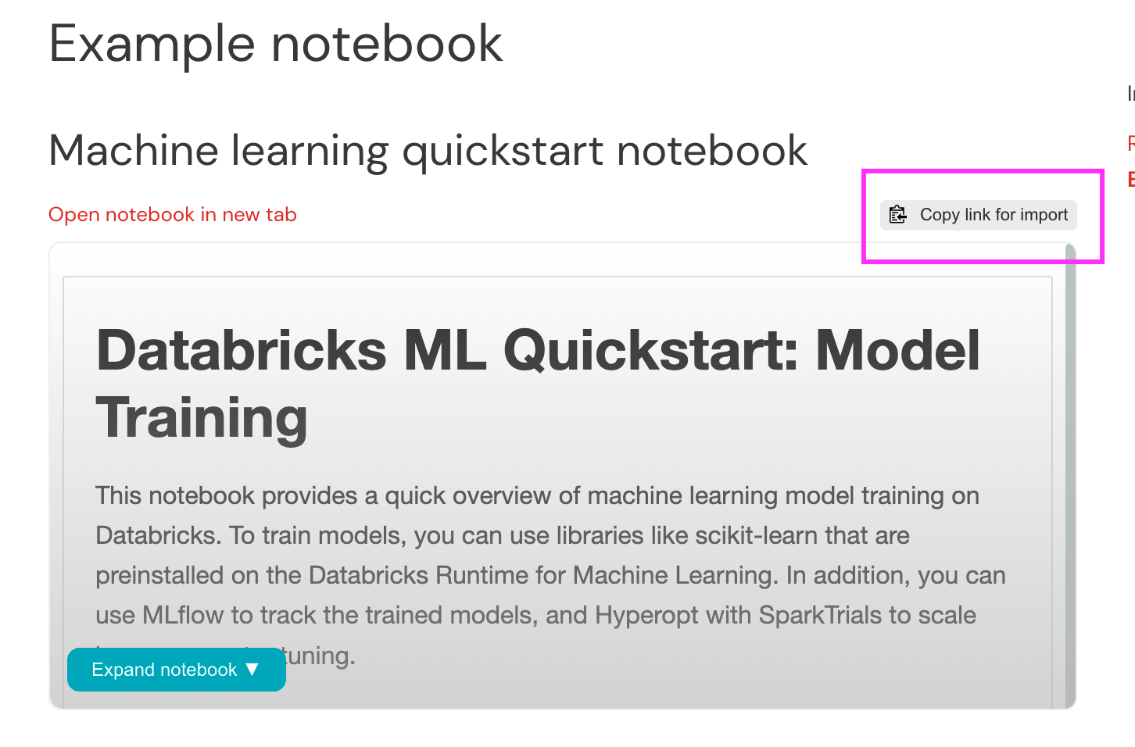

Slide 12
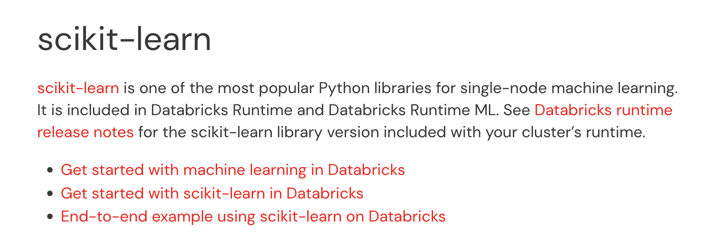

Slide 13
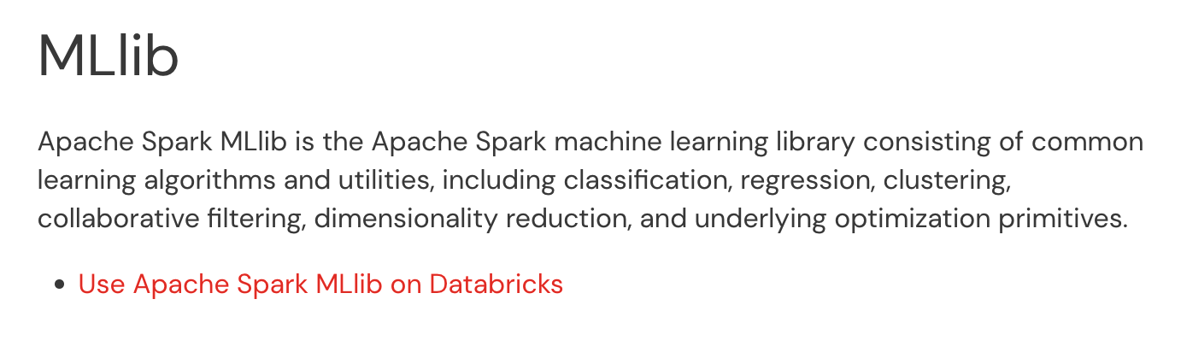

Slide 14
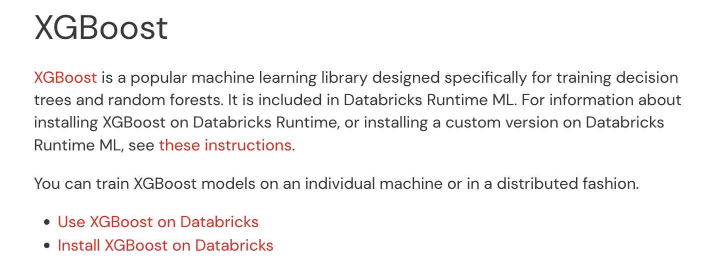

Slide 15
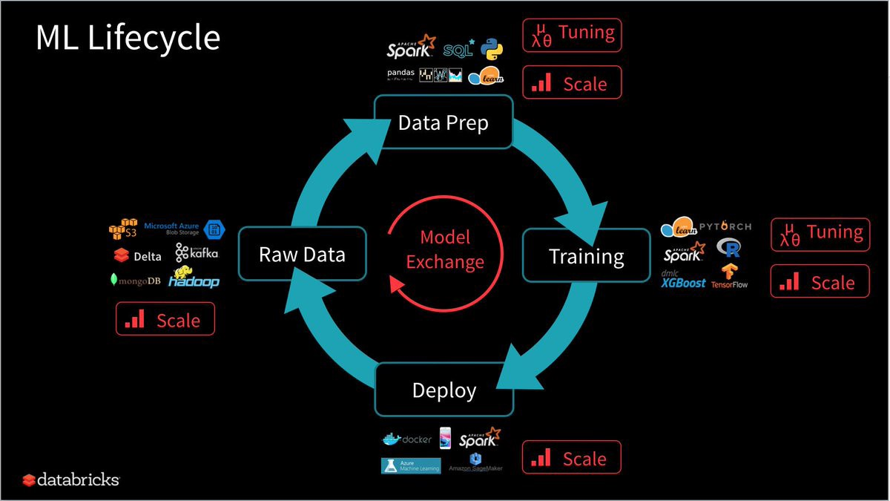

Slide 16
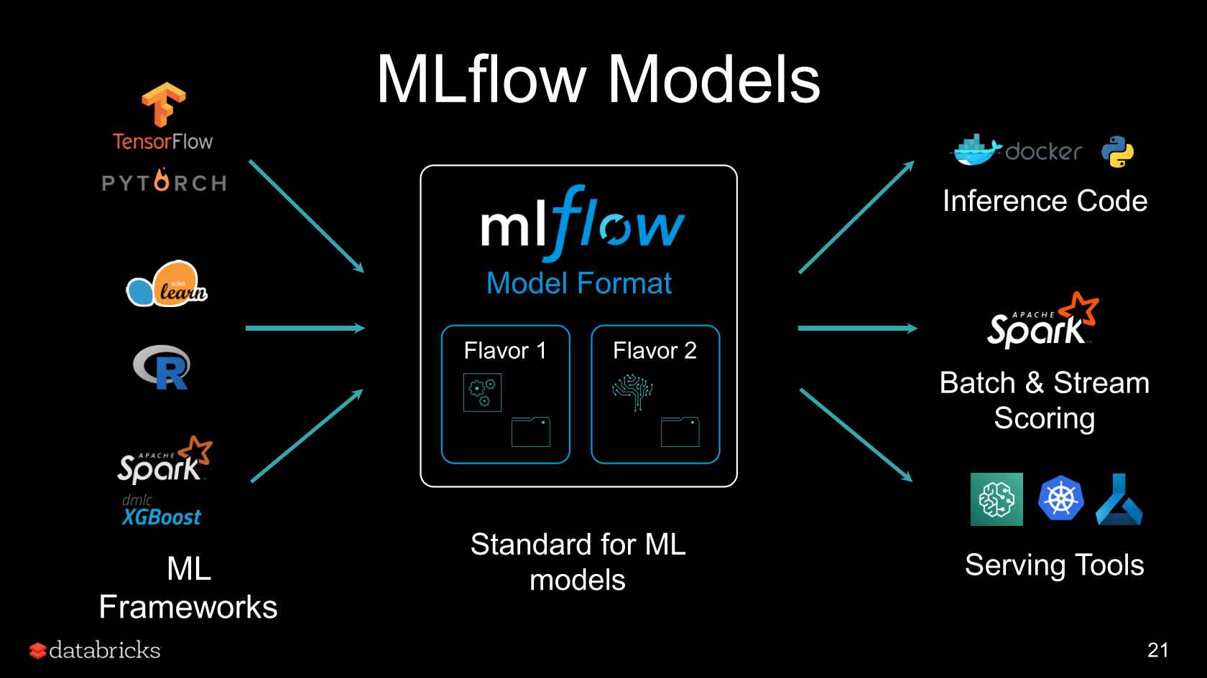

Slide 17
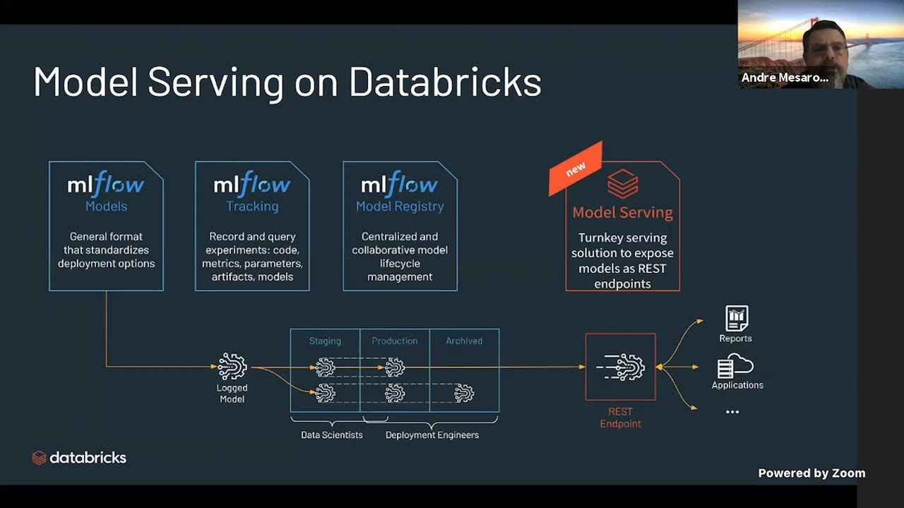

Slide 18
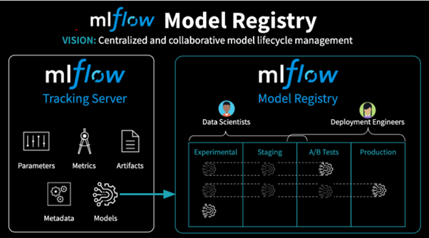

Slide 19
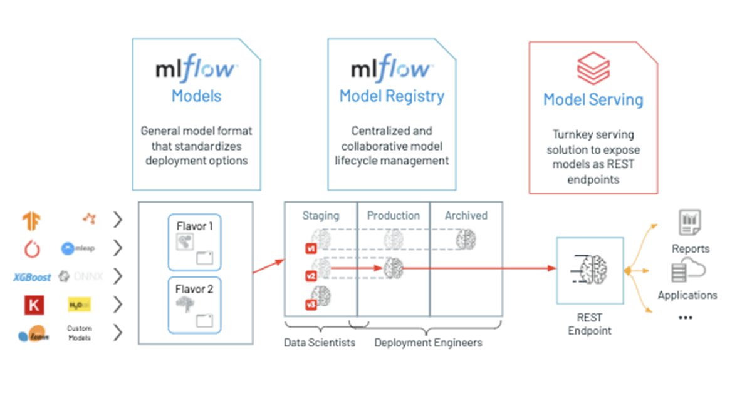

Slide 20
