Slide 1
Northrop Grumman Mission Systems 2023 Intern Showcase
Division:
Org: Location:
[Date]

Slide 2
Agenda
Introduction – 2 min
Intern Presentation – 6 min per person
Q&A – 2 min
Leadership Comments – 3 min

Slide 3
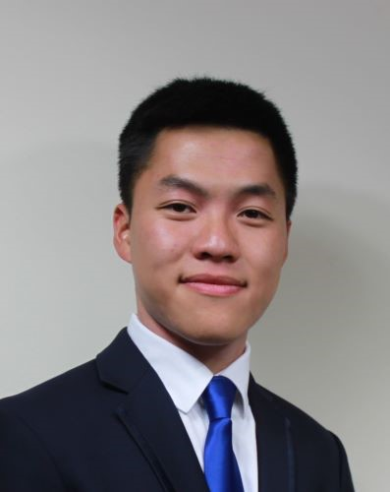

Jeremy Wei- Profile Summary
About Me Name: Jeremy Wei Hometown: Gaithersburg, MD Hobbies: Running, Baking Bread and Pastries, Cooking Favorites: TV/Movies: Legends of Korah Books: The Old Man and the Sea Music: The Strokes or Foster The People Food: Braised pork belly with rice or sushi | Education School: University of Maryland, College Park Degree: Bachelors of Science Major: Electrical Engineering Grad Date: May 2025 What I’ve enjoyed most about my classes/projects: Acquiring new skills and tools for problem solving and interacting with my school’s community of engineers.
Position with NG Position: Software Engineering Intern Organization: FPNT DT/SW Work Location: Woodland Hills, CA Program/Project: PGM | Notable Moments Memorable Activity: Making my first pull request on GitHub Ah-ha Moment: Development of a modular Markdown Parser in python with OOP techniques learned in a class I almost forgot about. Favorite Professional Development Activity: AI in action seminar by Amanda Muller and Hasan Ghadialy Toughest Acronym to Learn: SEARGANT

Slide 4
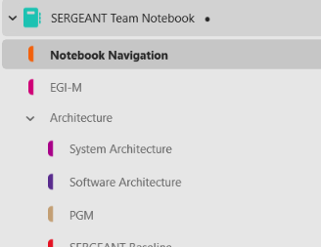
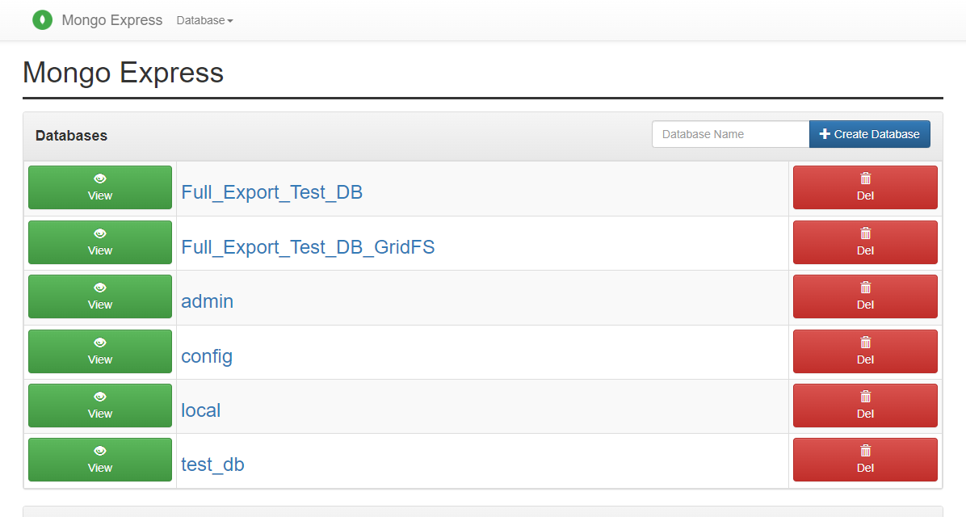
Database Tools - Overview
Jeremy Wei
Why do we need DB Tools?
Consolidate
Organize
Standardize
Tasking
Parsing Markdown documents into document blocks
Interfacing with MongoDB’s API to store and organize data
Interfacing with Confluence’s REST API to sync information from MongoDB to Confluence.
Tox and pytest unittesting
Git and Github development
OOP concepts, typing, etc.
The main challenge has been getting up to speed with the project and learning a completely new programing language.
Furthermore, I have never done large scale development so Github was also new
Give an overview of the project(s) you worked on. Include:
Name of your project
What Challenge were you trying to solve? / What was the scope?
What approach did you take? What was your tasking (What did you do)?
What did you learn? (technical and/or soft-skills)
Keep any technical discussion at high-level, and include the bigger context of the technical application
Feel free to include any relevant diagrams/charts
SEARGANT Team One Note notebook consisting of ~800 files spread across ~200 folders
Mongo and Mongo Express instance running in a local Docker container.

Slide 5
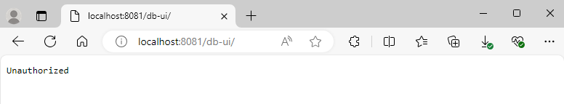
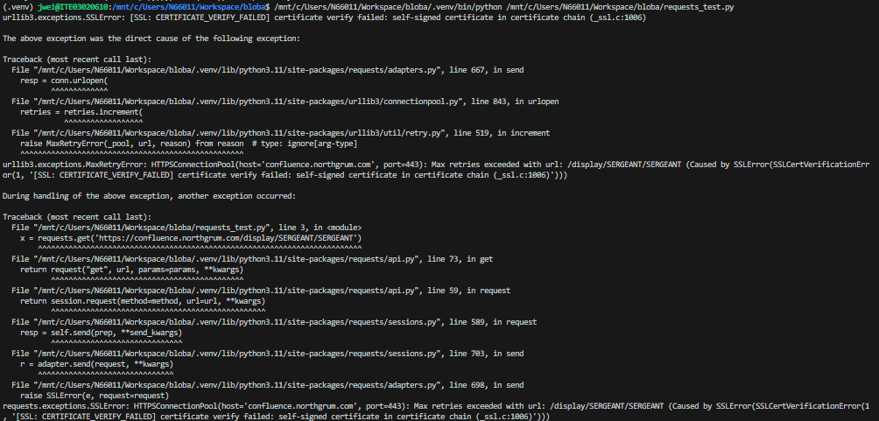
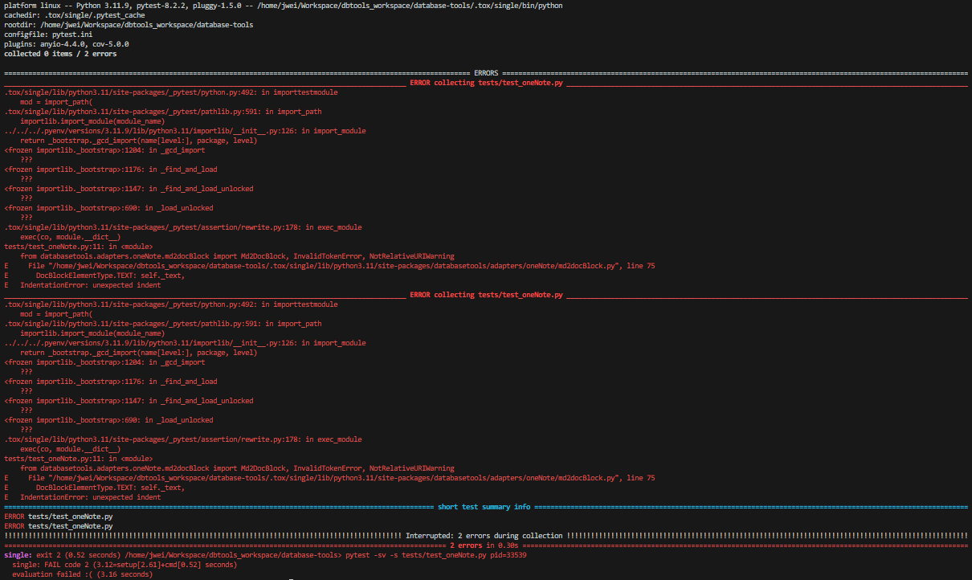
Database Tools - Overview con’t.
Jeremy Wei
Challenges
Local Environment setup
SSL Certificate issues
HTTP and HTTPS Proxy environment variables
MongoDB and Mongo Express
Mongo Express blocking access due to restrictions on usage of basicAuth in our Microsoft Edge browsers.
We love SSL Certificate Errors (we actually don’t)
So many tox errors, all in red…

Slide 6
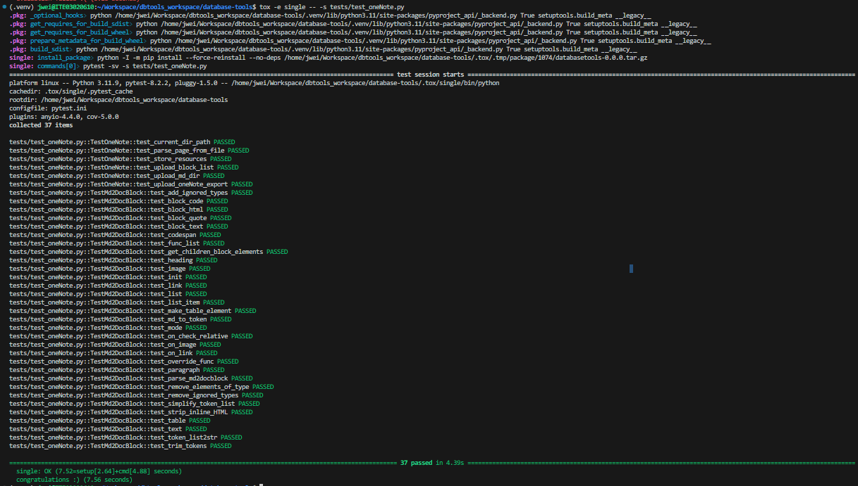
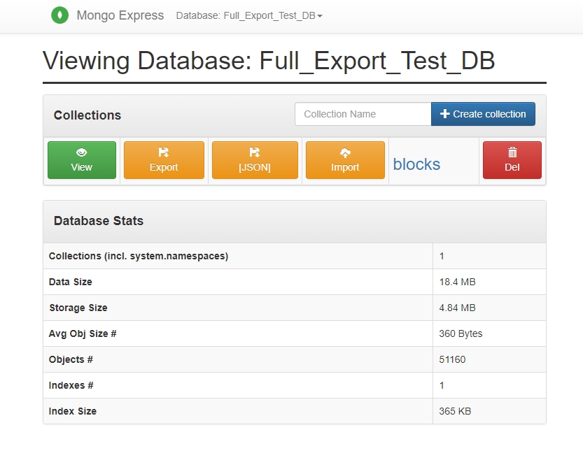
Database Tools - Overview con’t.
Jeremy Wei
Accomplishments
Markdown to Mongo Document Block Parser
One Note Export uploader
Finally getting that clean pytest run on all my unit tests
51160 document parsed and uploaded to MongoDB.

Slide 7





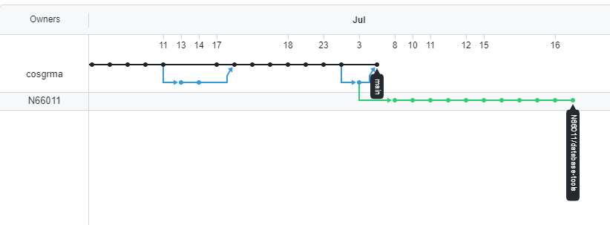









Database Tools - Overview con’t.
Jeremy Wei
My takeaways (Where can I improve/grow)?
Proper use of Object-Oriented Programing Concepts.
The importance of drafting and system engineering.
Basic principles on how to write robust code.
Pytest, Pydantic, and tox
Large scale software development workflow.
Database Tools GitHub network graph. The green branch are my commits!

Slide 8
Questions?
Recognition
Mathew Cosgrove, and my fellow interns

