Slide 1
Northrop Grumman Mission Systems 2023 Intern Showcase
Division:
Org: Location:
[Date]

Slide 2


Jeremy Wei- Profile Summary
About Me Name: Jeremy Wei Hometown: Gaithersburg, MD Hobbies: Running, Baking Bread and Pastries, Cooking Favorites: TV/Movies: Legends of Korah Books: The Old Man and the Sea Music: The Strokes or Foster The People Food: Braised pork belly with rice or sushi | Education School: University of Maryland, College Park Degree: Bachelors of Science Major: Electrical Engineering Grad Date: May 2025 What I’ve enjoyed most about my classes/projects: Acquiring new skills and tools for problem solving and interacting with my school’s community of engineers.
Position with NG Position: Software Engineering Intern Organization: FPNT DT/SW Work Location: Woodland Hills, CA Program/Project: PGM | Notable Moments Memorable Activity: Making my first pull request on GitHub Ah-ha Moment: Development of a modular Markdown Parser in python with OOP techniques learned in a class I almost forgot about. Favorite Professional Development Activity: AI in action seminar by Amanda Muller and Hasan Ghadialy Toughest Acronym to Learn: SERGANT

Slide 3














Database Tools - Overview
Jeremy Wei
What is the big idea of Database Tools?
Improve Efficiency and Save Time
Automated Synchronization
Consistency between documentation
Improve Collaboration
Increase Accessibility
Enhance Information Management
Allows for Scalability
Quality Control
Improves Error Reduction
Increases Standardization
Notes:
So, what is the goal of Database tools? The final goal is to centralize our knowledge bases to one place. Doing this will improve efficiency and save time by making automated synchronizations and making our documentation always consistent and up to date. Furthermore, By centralizing our data, we can increase collaboration by making data more accessible since engineers will only need to refer to one place to find all the data they need. By centralizing all our data, it also allows us to use semantic search algorithms which will help us find the info we need faster. Doing this will also make data management easier since we can make user classes which have certain permissions to certain parts of the knowledge base. And, by deploying on MongoDB we can increase scalability easily due to Mongo’s simplistic but powerful API. Lastly, this tool should help with quality control specifically regarding error reduction and standardization since it is simple to make controls to filter and vet uploaded data.

Slide 4
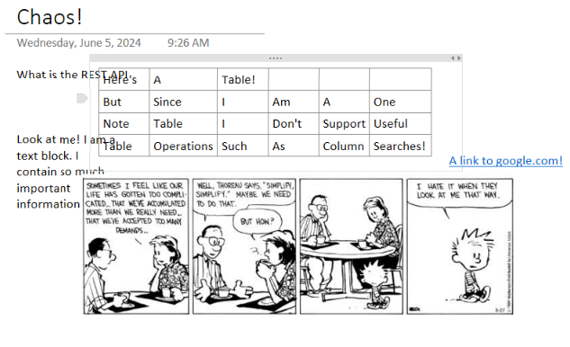

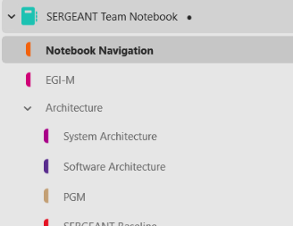

Database Tools – Current Configuration
Jeremy Wei
Cons of One Note:
Allows for chaotic structuring
Poor discoverability amongst workspaces
Terrible API support
No enforcement of structure to pages and order allows for chaos amongst documents leading to many issues such as difficulty when exporting pages, searching for specific information, linking blocks or other notebooks, etc.
SERGANT Team One Note notebook consisting of ~800 files spread across ~200 folders
Notes:
Currently, I’ve been told that many of our teams work on One Note. However, One Note has many downsides such as allowing for chaotic structuring, poor discoverability amongst workspaces (e.g. can’t easily search between notebooks), and terrible API support limiting integration with custom software or applications. Because of these reasons, many inefficiencies arise.

Slide 5
Database Tools – Current Configuration
Jeremy Wei
One Note Notebook 2
One Note Notebook 3
One Note Notebook 1
Step 3:
Open Notebook 3.
Step 2:
Open notebook 2 to find the datasheet.
One Note Notebook 4
Realization:
Found the documentation, but I am unable to export it easily into any format I want.
Realization:
Can’t find the documentation using the One Note search bar. Maybe it’s in notebook 3?
Step 1:
Open notebook 1 to add a new design.
Step 4:
Potentially rinse and repeat with other notebooks.
Realization:
We need to reference a specific documentation page in another notebook!
Realization:
Maybe there is a better way to do this...
Engineers
Notes:
For example, if an engineer wants to add a design to one team’s notebook, they might notice that they need some documentation from another notebook. However, after opening said notebook, they might realize that one note can’t find the specific information they want. So, they might open another notebook and find the documentation, but then realize that it is difficult to export this data into a universal format.

Slide 6
Database Tools – The Idea
Jeremy Wei
Use MongoDB to store our own platform specific data-model.
MongoDB
Use an adapter to transform our data-models into confluence data-models.
Export One Note notebooks to MongoDB, preserving the intentional structure and order made by the engineers
Confluence
One Note
Queries
Prospective integrations
Confluence Pros:
Nice API to interact with.
Beta features
Automatic page summaries
Virtual agent for making SQL, JQL queries
Structured formatting
Notion
Near seamless transition to confluence, allowing engineers to use Confluence’s tools.
Engineers
Github
Jira
= Under development
= Planned integrations
Notes:
To alleviate this problem, we plan to take our One Note notebooks, export and parse them into our MongoDB data-model, then upload these block data-models into confluence. By doing this, we have access to all the data allowing us make features such as semantic searches, mass formatting, etc. During this upload process, we hope to preserve all One Note formats and ordering that the engineers originally intended. This will help with making a seamless transition to confluence since engineers can just pick up where they left off but just on a different platform. We chose upload to confluence enterprise since it has a nice API to interact with, has structured formatting, and has many beta features that are coming to enterprise soon such as automatic page summaries, and a virtual agent to help with making SQL or JQL queries. We are also planning to develop integrations with Notion, Github and Jira to allow for more accessibility.

Slide 7
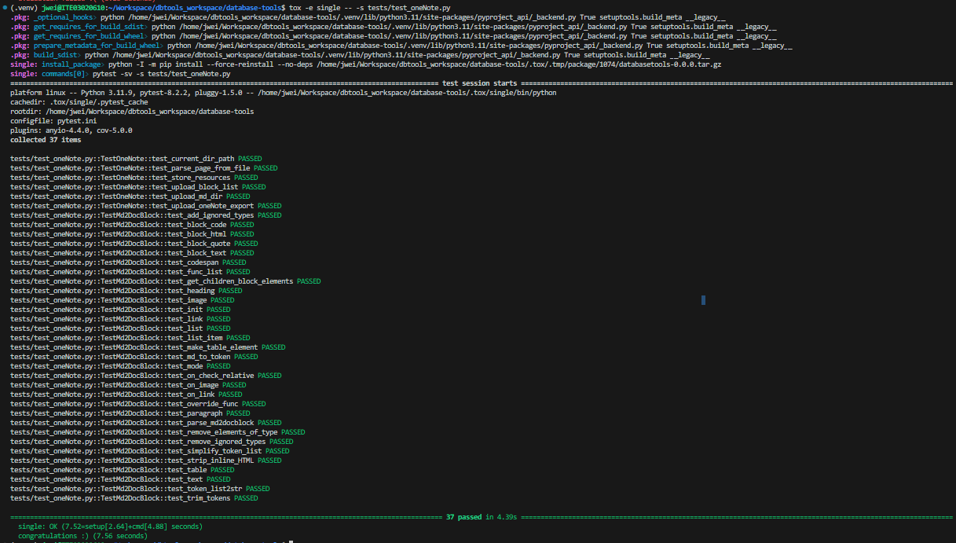
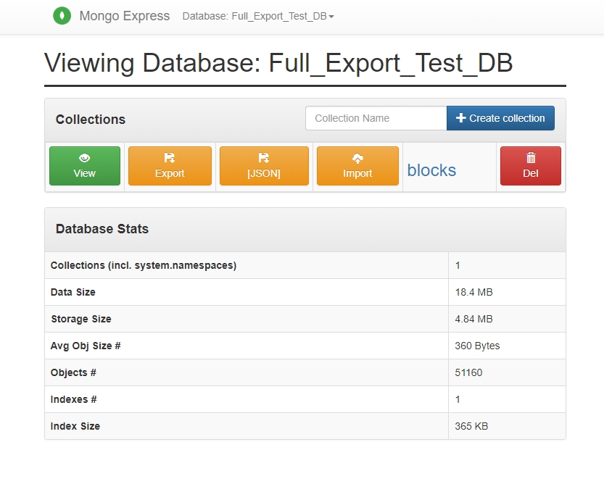
Database Tools - Progress
Jeremy Wei
Markdown to Mongo Document Block Parser
One Note Export uploader
Finally getting that clean pytest run on all my unit tests
51160 document parsed and uploaded to MongoDB.

Slide 8
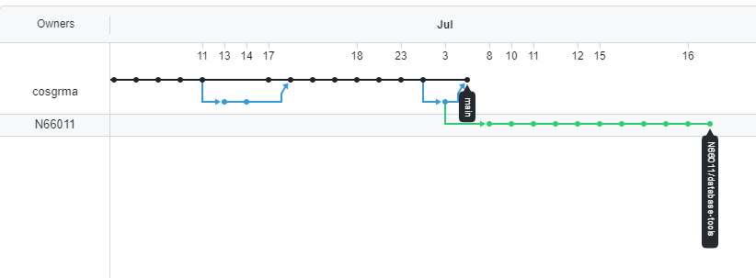
Database Tools - Overview con’t.
Jeremy Wei
My takeaways?
The importance of drafting and system engineering.
Basic principles on how to write robust code.
Pytest, Pydantic, and tox
Large scale software development workflow.
Database Tools GitHub network graph. The green branch are my commits!

Slide 9
Questions?
Recognition
Mathew Cosgrove, and my fellow interns

