Slide 1
Northrop Grumman Mission Systems 2023 Intern Showcase
Division:
Org: Location:
[Date]

Slide 2


Jeremy Wei- Profile Summary
About Me Name: Jeremy Wei Hometown: Gaithersburg, MD Hobbies: Running, Baking Bread and Pastries, Cooking Favorites: TV/Movies: Legends of Korah Books: The Old Man and the Sea Music: The Strokes or Foster The People Food: Braised pork belly with rice or sushi | Education School: University of Maryland, College Park Degree: Bachelors of Science Major: Electrical Engineering Grad Date: May 2025 What I’ve enjoyed most about my classes/projects: Acquiring new skills and tools for problem solving and interacting with my school’s community of engineers.
Position with NG Position: Software Engineering Intern Organization: FPNT DT/SW Work Location: Woodland Hills, CA Program/Project: PGM | Notable Moments Memorable Activity: Making my first pull request on GitHub Ah-ha Moment: Development of a modular Markdown Parser in python with OOP techniques learned in a class I almost forgot about. Favorite Professional Development Activity: AI in action seminar by Amanda Muller and Hasan Ghadialy Toughest Acronym to Learn: SERGEANT

Slide 3














Database Tools - Overview
Jeremy Wei
What is the big idea of Database Tools?
Improve Efficiency and Save Time
Automated Synchronization
Consistency between documentation
Improve Collaboration
Increase Accessibility
Enhance Information Management
Allows for Scalability
Quality Control
Improves Error Reduction
Increases Standardization
Notes:
So, what is the goal of Database tools? The final goal is to centralize our knowledge bases to one place. Doing this will improve efficiency and save time by making automated synchronizations and making our documentation always consistent and up to date. Furthermore, By centralizing our data, we can increase collaboration by making data more accessible since engineers will only need to refer to one place to find all the data they need. By centralizing all our data, it also allows us to use semantic search algorithms which will help us find the info we need faster. Doing this will also make data management easier since we can make user classes which have certain permissions to certain parts of the knowledge base. And, by deploying on MongoDB we can increase scalability easily due to Mongo’s simplistic but powerful API. Lastly, this tool should help with quality control specifically regarding error reduction and standardization since it is simple to make controls to filter and vet uploaded data.

Slide 4
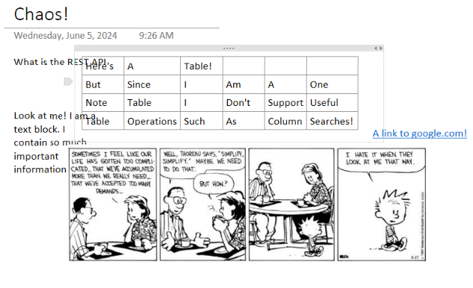
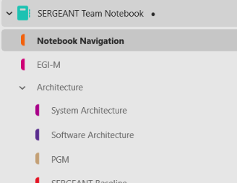

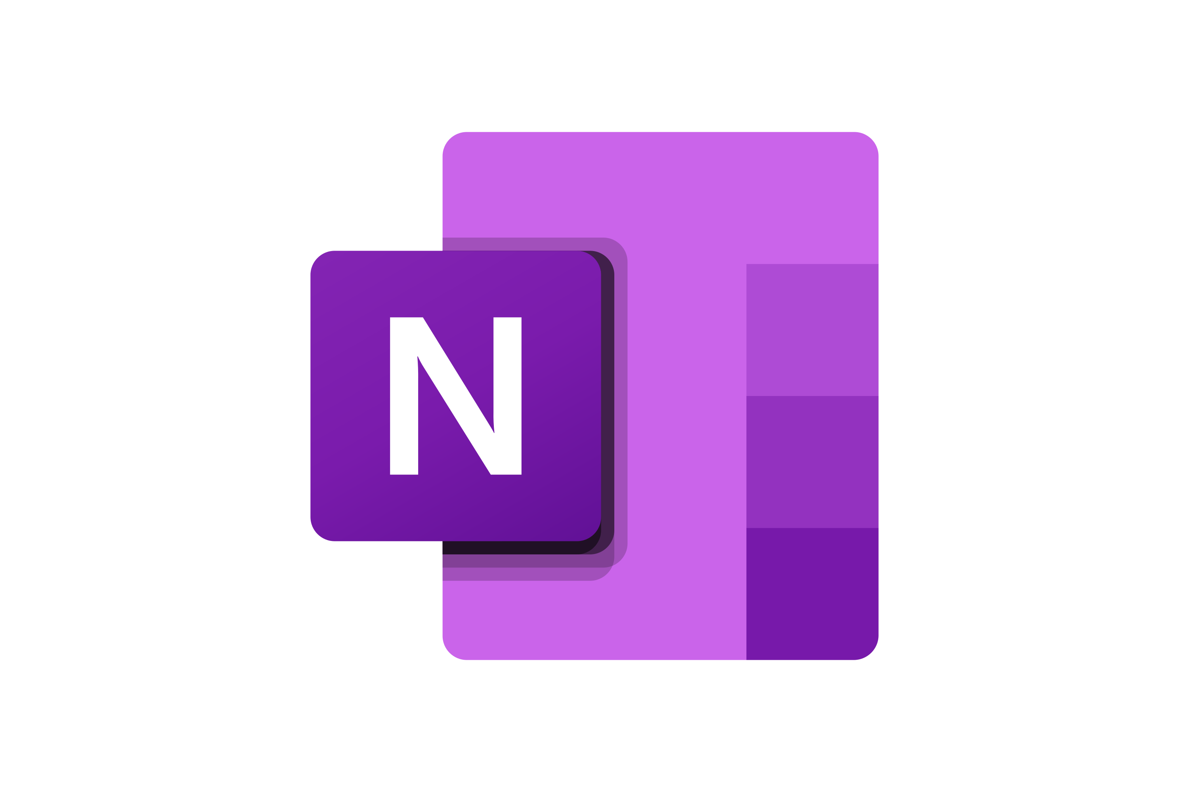
Database Tools – Current Configuration
Jeremy Wei
Cons of One Note:
Allows for chaotic structuring
Poor discoverability amongst workspaces
As notebooks grow, they take up more and more disk space. Side effect of user-side data caching
Inaccessible API in our enterprise setting
No enforcement of structure to pages and order allows for chaos amongst documents leading to many issues such as difficulty when exporting pages, searching for specific information, linking blocks or other notebooks, etc.
SERGANT Team One Note notebook consisting of ~800 files spread across ~200 folders
Notes:
Currently, I’ve been told that many of our teams work on One Note. However, One Note has many downsides such as allowing for chaotic structuring, poor discoverability amongst workspaces (e.g. can’t easily search between notebooks), and terrible API support limiting integration with custom software or applications. Because of these reasons, many inefficiencies arise.

Slide 5





Database Tools – The Idea
Jeremy Wei
Engineers
SERGEANT
Notebook
Uses One Note
Makes documentation in GitHub Pages
GitHub Pages
PGM Notebook
Use Confluence
Confluence
Spaces
T1TL Notebook
Currently the exporter we use does not support some markdown formats. Furthermore, the application struggles with large Notebooks.
Pulls markdown files from the local file system that were generated with the One Note exporter and parses them into DocBlocks to be stored in the MongoDB. Metadata and Page relations are preserved.
Uploads using Confluence data format
Uploads DocBlocks into Confluence and continuously syncs data from MongoDB to Confluence and Back.
Accesses One Note and pulls data to convert to markdown.
= Not in the scope of this project
= Completed
One Note Adapter
Confluence Adapter
GitHub Pages Adapter
= In progress
Uploads DocBlocks to MongoDB
= Data Flow
One Note Exporter
= Interacts with
Exports One Note Notebooks as Markdown Files and stores on a local drive.
Pulls DocBlocks from MongoDB
= Database
Grabs markdown from local file system
= DocBlock Data Model
Docker container runs the MongoDB and Mongo express Instances. During tests, we were able to implement this system and get results uploading DocBlocks to Mongo.
= Markdown File Format
Local File System
MongoDB
= One Note Data Format
Semantic Search, Vectorization, etc. To come...
= Confluence Data Format
Notes:
To alleviate this problem, we plan to take our One Note notebooks, export and parse them into our MongoDB data-model, then upload these block data-models into confluence. By doing this, we have access to all the data allowing us make features such as semantic searches, mass formatting, etc. During this upload process, we hope to preserve all One Note formats and ordering that the engineers originally intended. This will help with making a seamless transition to confluence since engineers can just pick up where they left off but just on a different platform. We chose upload to confluence enterprise since it has a nice API to interact with, has structured formatting, and has many beta features that are coming to enterprise soon such as automatic page summaries, and a virtual agent to help with making SQL or JQL queries. We are also planning to develop integrations with Notion, Github and Jira to allow for more accessibility.

Slide 6


Database Tools – Confluence
Jeremy Wei
So why Confluence?
It has a nice REST API allowing for us to make custom integrations.
Structured formatting
Has most of the features of One Note and more.
Databases, Semantic searches, Built-in Jira integrations, etc.
We already have it! North Grum has made investments into Confluence.
Many employees love it and would vouch for it.
Confluence was built with collaboration in mind.

Slide 7
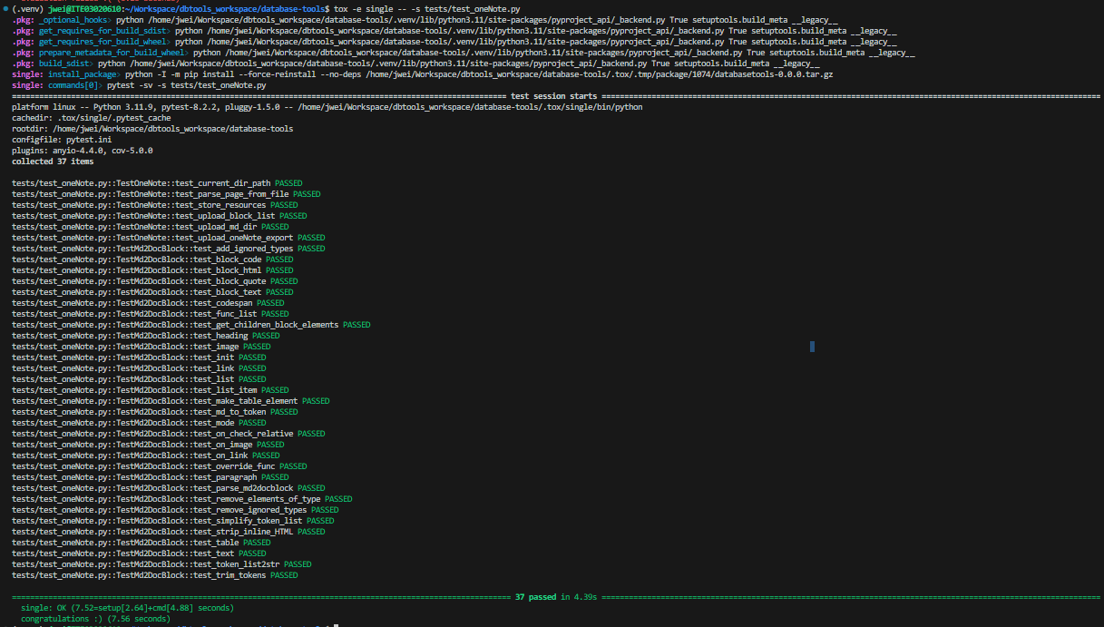
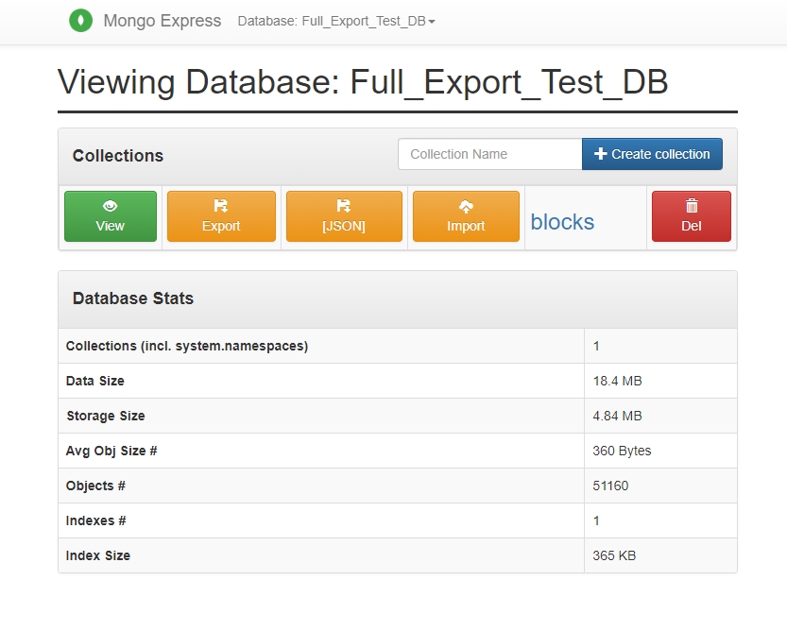
Database Tools - Progress
Jeremy Wei
Markdown to Mongo Document Block Parser
Mongo and Mongo Express running in docker
One Note Export uploader
Successful One Note export into MongoDB using DocBlocks during tests.
51160 document parsed and uploaded to MongoDB.
Finally getting that clean pytest run on all my unit tests

Slide 8
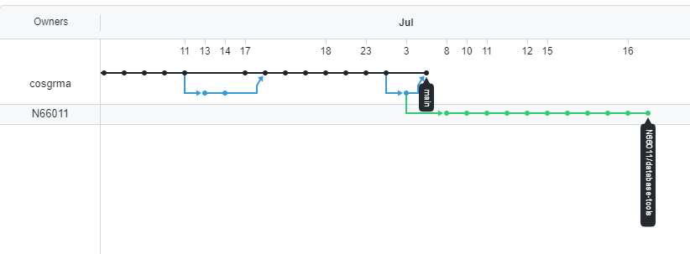
Database Tools - Takeaways
Jeremy Wei
The importance of drafting and system engineering.
Basic principles on how to write robust code.
Pytest, Pydantic, and tox
Large scale software development workflow.
Database Tools GitHub network graph. The green branch are my commits!

Slide 9
Questions?
Recognition
Mathew Cosgrove, and my fellow interns

