Slide 1
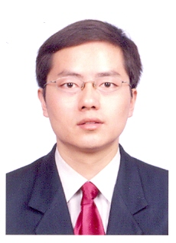
Basic Information
Introduc- tion | Since 2007, Department of Communication Science and Engineering, Fudan University, Associate Professor 2005-2006, Monash University, Australia Academic Researcher 2003-2005, Bell Lab, Nokia Sh-Bell, Research Scientist 2000-2003, Department of Electronic Engineering, Shanghai Jiaotong University，PhD.
Research Fields | Quantum Communications Photon-Counting Communications for Deep-Space The Fifth Generation Mobile Communication (5G) Systems AI Technology for Wireless Communications Multi-Input Multi-Output Orthogonal Frequency-Division Multiplexing (MIMO-OFDM) Broadband Mobile Communication Systems

Slide 2
Research Experience
Projects | 1. National Natural Science Foundation of China (No.60802011、No.61571135、No. 6271137) project leader 2. Major Project of Chinese National Science and Technology “A new generation of wireless mobile communication networks” TD-LTE(No.2009ZX03002-003) /TD-LTE-Advanced (No.2012ZX03001013-004), project leader 3. 863 State High-Tech Development Plan (No. 2011AA100701) 4. Research of the forth generation (4G) mobile communication system Source: France's communications co., LTD My role: Take part in architecture design of the next-generation mobile communication network, the physical link level simulation, and the research of 4G system demonstration media access layer. 5. Research of a new generation (beyond-3G) mobile communication system Source: National ‘863’ program (No.2001AA121031) My role: Participate as a core member on the research of key technology of beyond-3G and 4G like the orthogonal frequency-division multiplexing (OFDM), space-time coding.

