Slide 1
US Accidents (2016-2023)
Group Project for Big Data Management and Governance - A.A. 2023-2024
Ferrari Sara – Pavone Cosimo – Pederzoli Sara

Slide 2
US Accidents (2016-2023) - Dataset Description
This dataset includes nationwide traffic crash information for all 49 US states. The dataset has been continously assembled since February 2016, using data from multiple sources, including several APIs that stream traffic incident data. These APIs capture traffic incidents reported by various entities, such as US and state departments of transportation, law enforcement agencies, traffic cameras and road network sensors. The dataset currently contains over 7 milion records.
Size (GB) | 3.06
Num. Columns | 46
Num. Rows (x10^6) | 7.7
String Columns | 17
Numeric Columns | 13
Bool Columns | 13
Date Columns | 3
Percentage of Nulls | 3.6%

Slide 3
Size Breakdown - How the libraries scale?
Pandas | It has problems running with the entire dataset
Polars | It has problems running with the entire dataset
Data Table | It has problems running with the entire dataset
Spark | It has problems running with the entire dataset
Vaex | It has problems running with the entire dataset
Modin(ray, dask) | It has problems running with the entire dataset
Pyspark_pandas | It has problems running with the entire dataset

Slide 4
Size Breakdown - How the libraries scale?
Our current data processing pipeline encounters challenges when handling a substantial volume of data. To assess the pipeline's performance, we conducted tests using a smaller, sampled version of the dataset.
The original dataset consists of 7.7 million rows.
Our testing utilized a representative sample of 500,000 rows.
In specific frameworks (Spark, Pyspark_pandas), we further refined our testing by using a subset of 10,000 rows for more granular insights.

Slide 5
Pipeline Preparators
EDA
get_stats
get_columns
query
Is_unique
Locate_null_values
Sample_rows
sort
Data Transformation
Change_date_time_format
Delete_columns
Split
Calc_column
Data Cleaning
Replace
Fill_nan
Delete_empty_rows

Slide 6
Pipeline Preparators Implemented
EDA
Perc_null_values
Check_missing_values
Look_for_cases
Plot_geo
Data Transformation
Simple_imputer
Pca
Data Cleaning

Slide 7
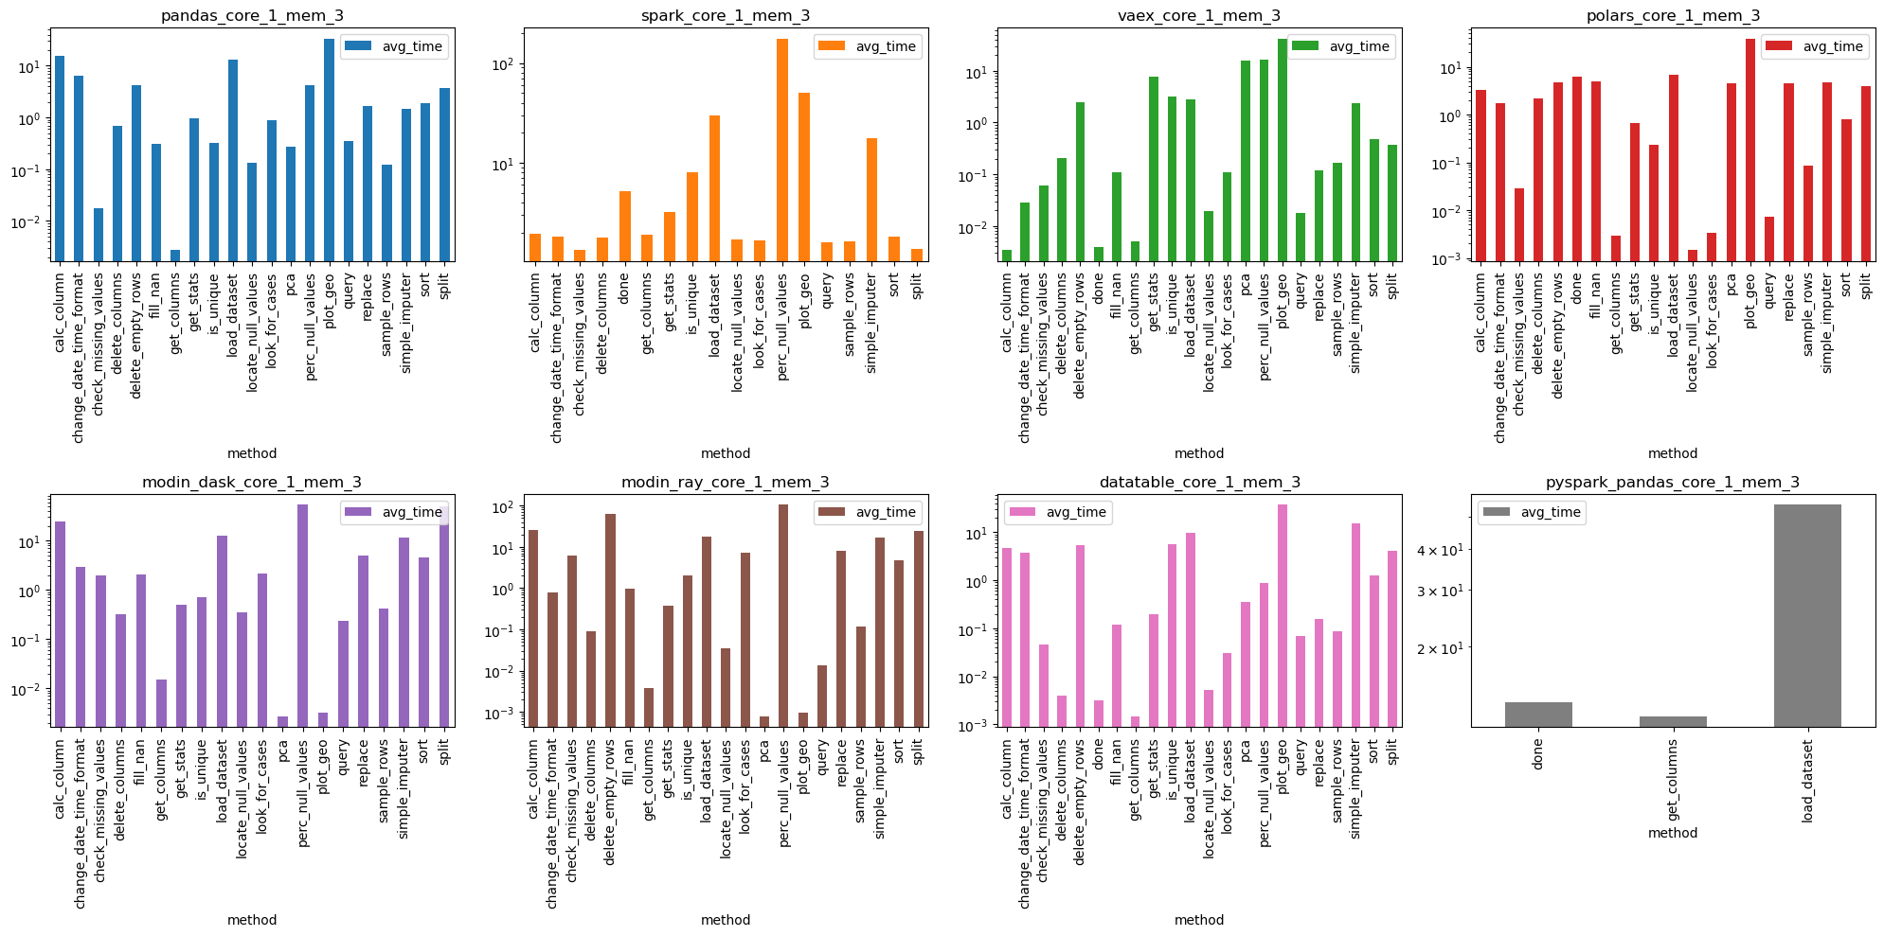
Description of results on Core Preparators

Slide 8
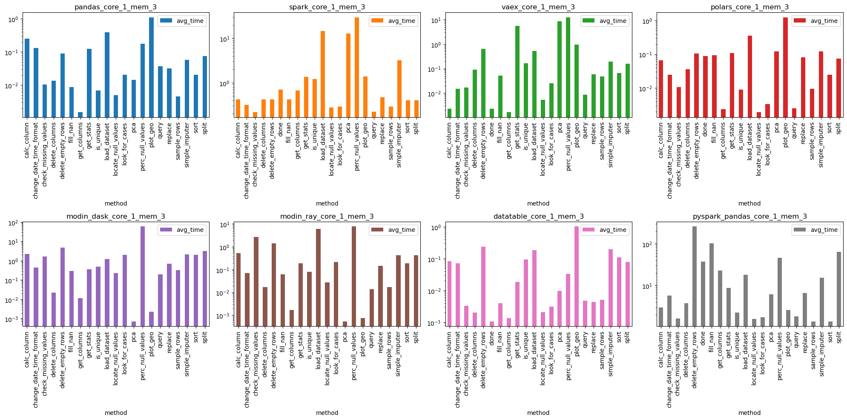
Description of results on Core Preparators (all)

Slide 9
Description of results on Core Preparators (all)

Slide 10
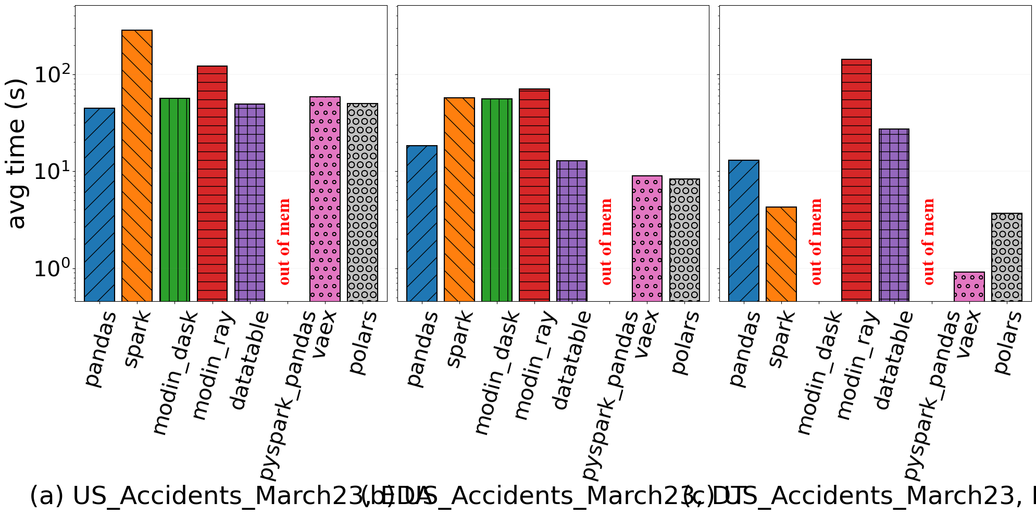
Description of results on Pipeline-Step
EDA
DT
DC

Slide 11
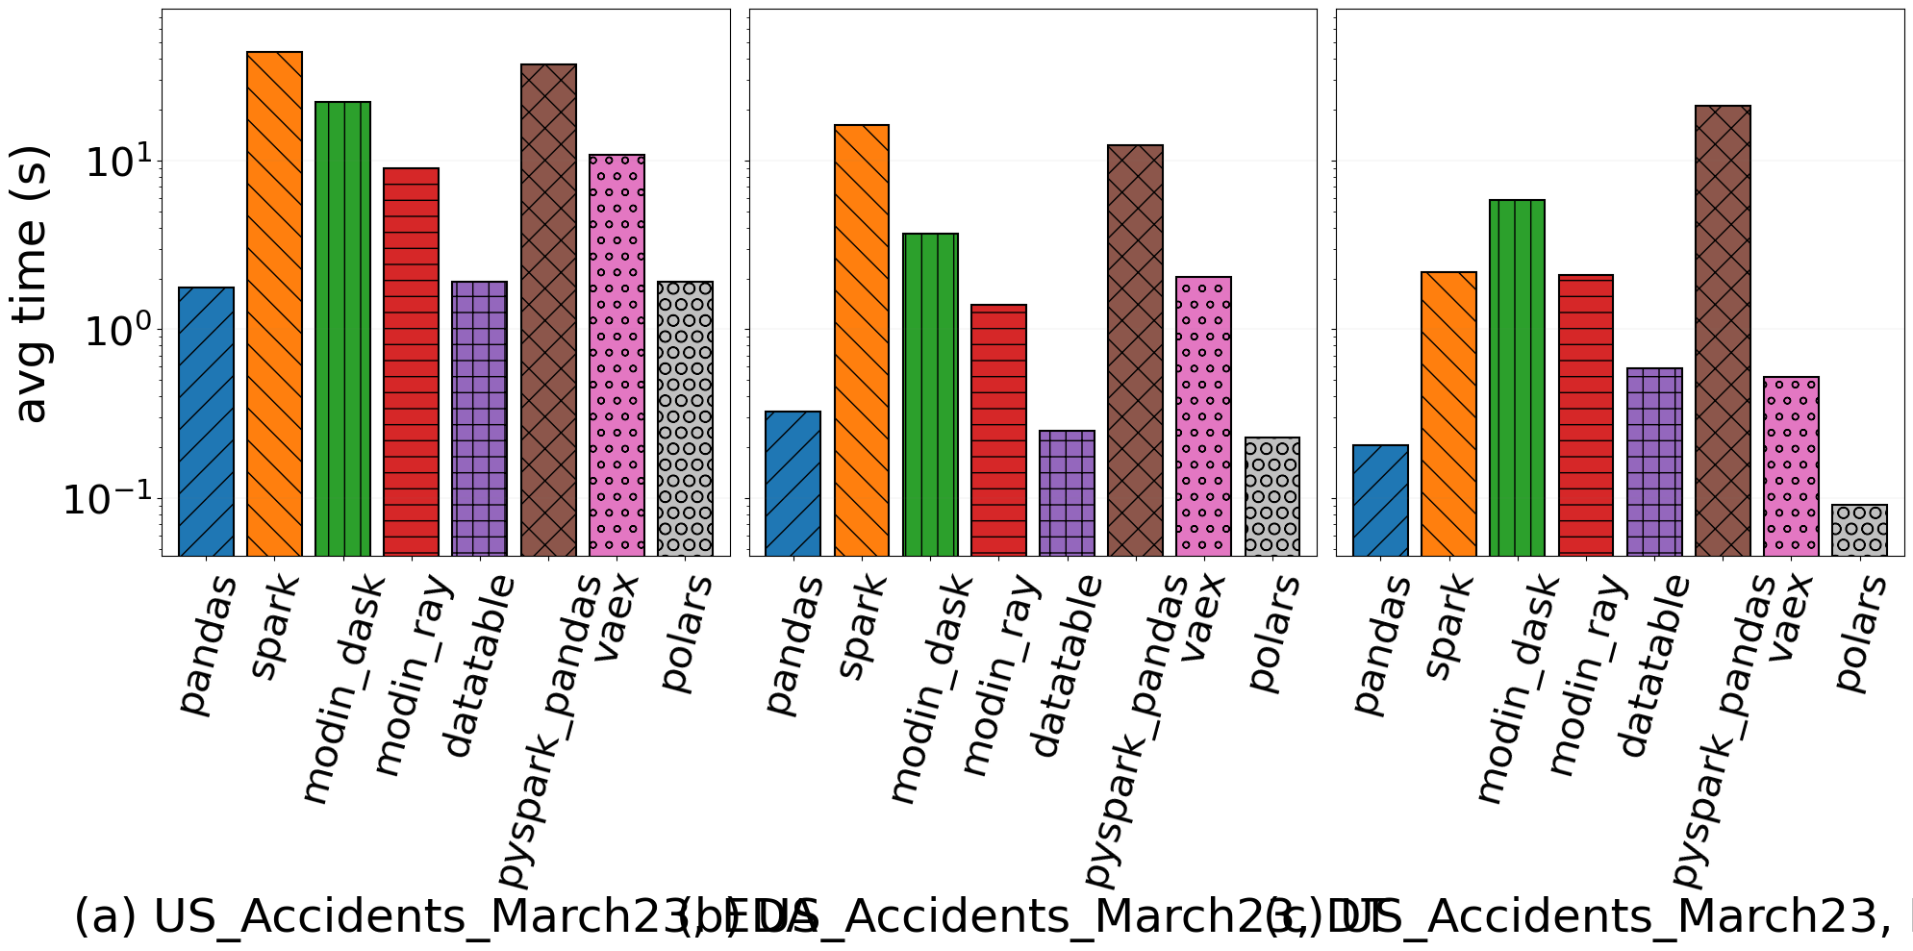
Description of results on Pipeline-Step (all)
EDA
DT
DC

Slide 12
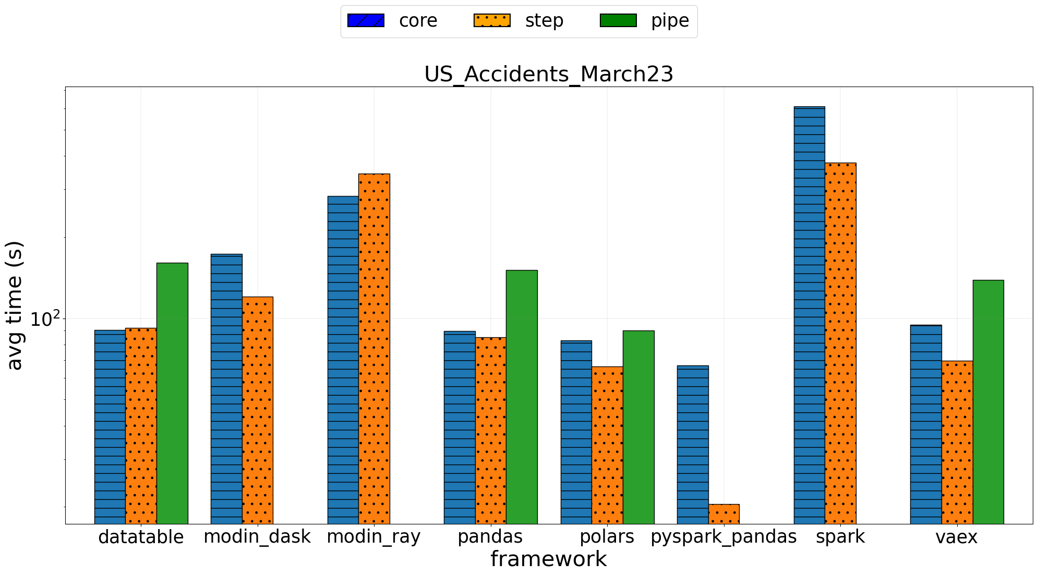
Description of results comparison between Core/Step/Pipe

Slide 13
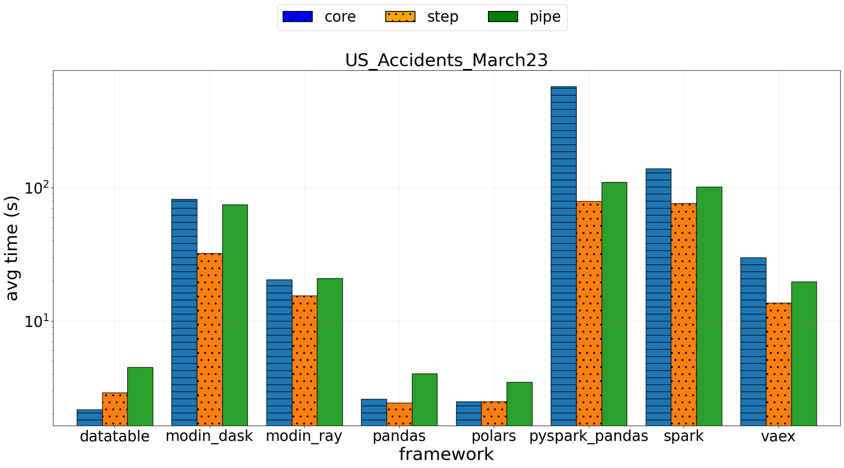
Description of results comparison between Core/Step/Pipe (all)

Slide 14
Conclusion
Determine the ideal dataset dimensionality for effective analysis.
Some frameworks has limitations in terms of memory usage, processing speed and scalability.
Problems encountered on the project

Slide 15
Conclusion
Vaex:
Strengths: Efficient for out-of-core computation and large datasets; support for lazy evaluation; fast and memory efficient.
Limitations: Limited support for complex operations; may not cover all Pandas functionality; single machine solution.
Which libraries is the best? Why not other?

Slide 16
Conclusion
Datatable:
Strengths: High-performance, scalable, and suitable for large datasets
Limitations: Limited support for complex operations; may not be suitable for all use cases (limited third party library support); single machine solution.
Which libraries is the best? Why not other?

Slide 17
Conclusion
Polars:
Strengths: allow parallel execution and compared with Pandas has a 30x of speedup.
Limitations: it is a very new library, so it has a good chance of further improving performance.
Which libraries is the best? Why not other?

Slide 18
THANKS FOR YOUR ATTENTION!
BDMG-vehicle-accidents-github

