Slide 1
PIM Results

Slide 2
Content
SPICE Model
Results and Verification
Problem
Unit Cell Simulation
Parameters
Writing
Reading
Basic Array
Test
1 Kernal
8 Kernal
Simulation Framework
Future Work

Slide 3
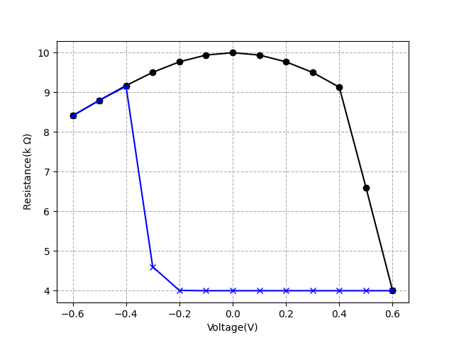
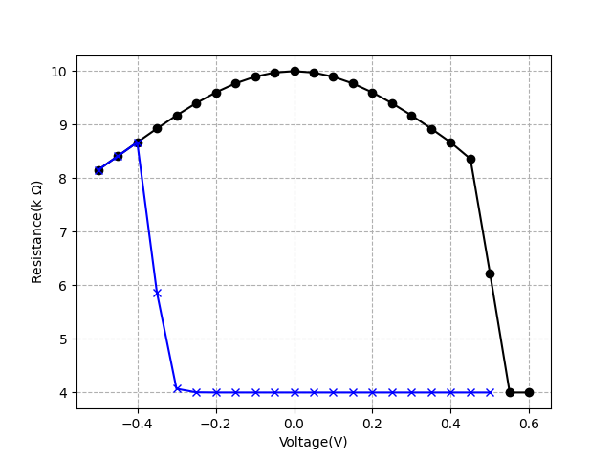
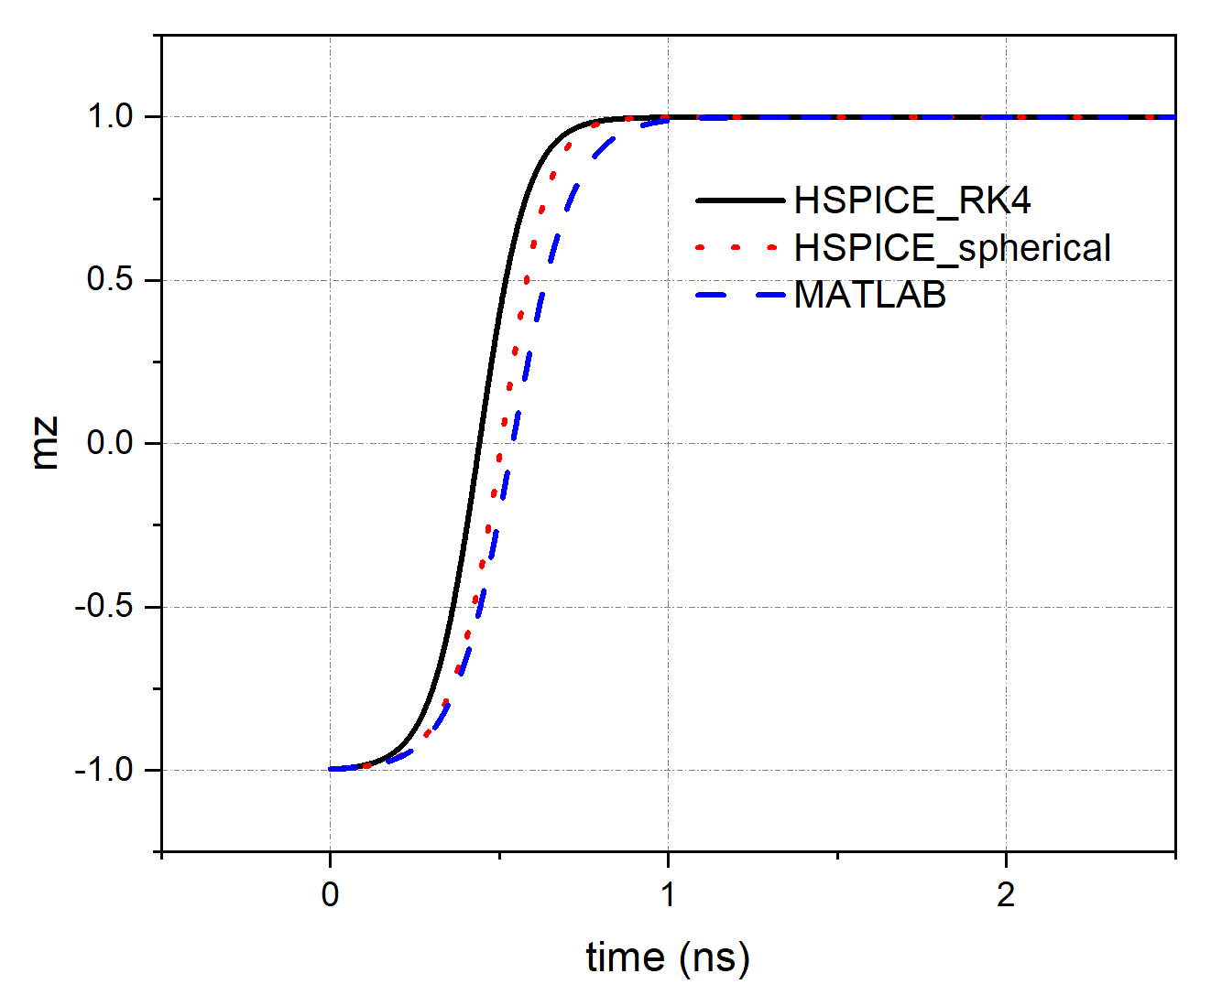
I. SPICE Model
1. Results and Verification
DC
SPICE
MATLAB
Write the MTJ model using Verilog-A (have talked before)
Hybrid simulation by HSPICE

Slide 4
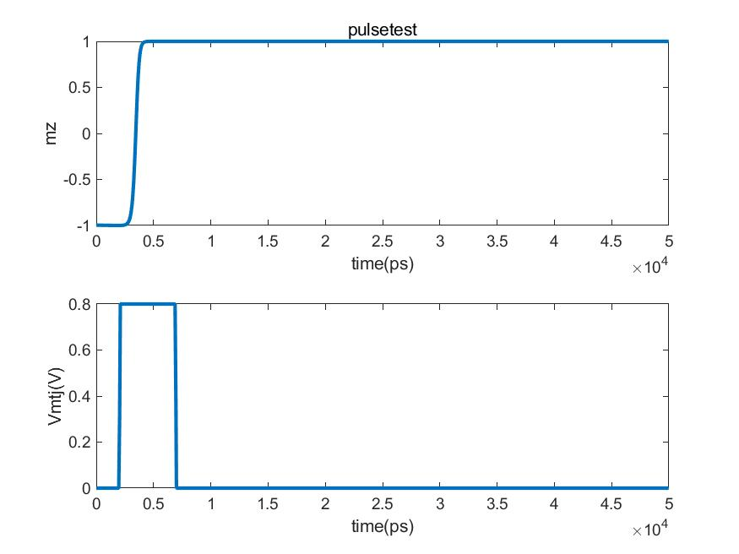
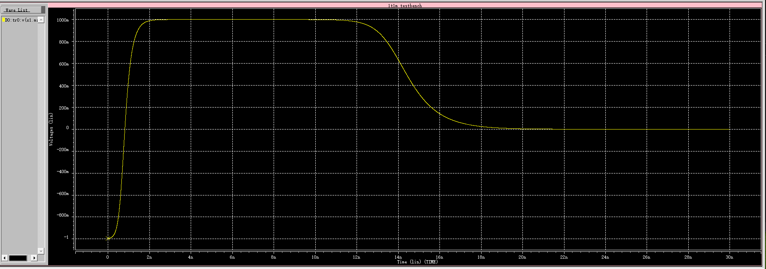
I. SPICE Model
2. Problem
MATLAB:
Expected result
SPICE:
Cannot perform a well nonvolatile characteristic
5 ns pulse

Slide 5
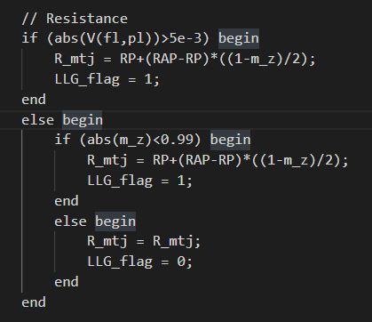
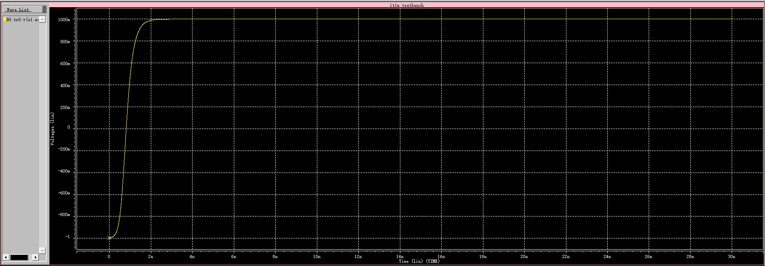
I. SPICE Model
2. Problem
Temporary Solution
It is not reasonable in other experiment, but it is acceptable in this project.
Need to solve in the future.

Slide 6
Content
SPICE Model
Results and Verification
Problem
Unit Cell Simulation
Parameters
Writing
Reading
Basic Array
Test
1 Kernal
8 Kernal
Simulation Framework
Future Work

Slide 7
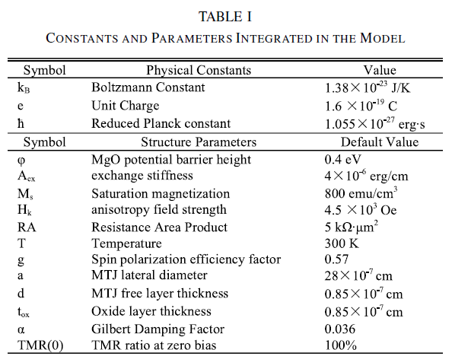



II. Unit Cell Simulation
1. Parameters
V_{dd} = 1.2 V
V_{G} = V_{dd}
MOSFET: NCSU Free PDK 45 nm
(https://eda.ncsu.edu/freepdk/freepdk45/)
Reference: Compact Model of Subvolume MTJ and Its Design Application at Nanoscale Technology Nodes (TED)

Slide 8
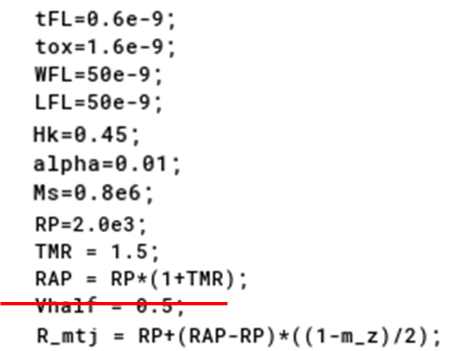
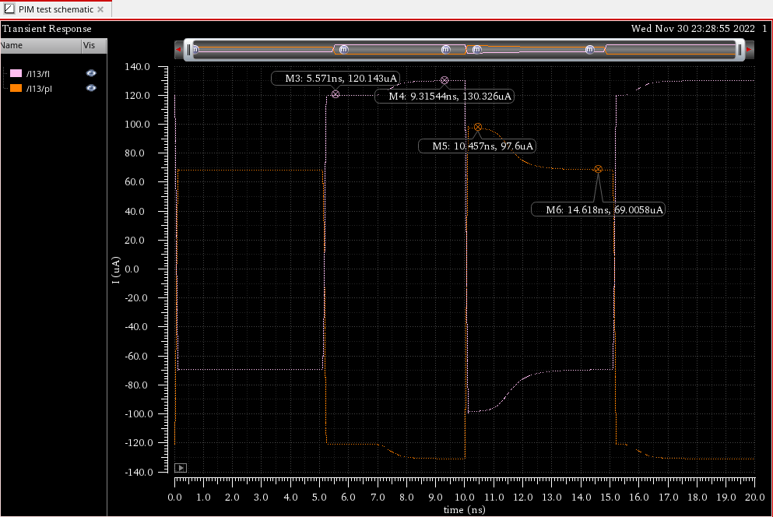
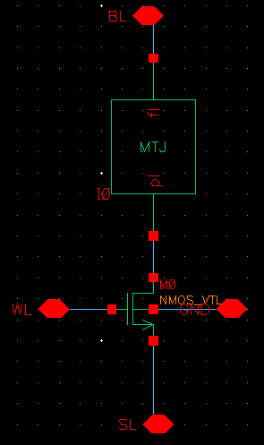
# parallel represents “0,” antiparallel represents “1”
II. Unit Cell Simulation
AP-P : write 0
I_{AP} = 120 uA
I_{P} = 130 uA
P-AP: write 1
I_{AP} = 69 uA
I_{P} = 98 uA
2. Writing 0 & 1

Slide 9
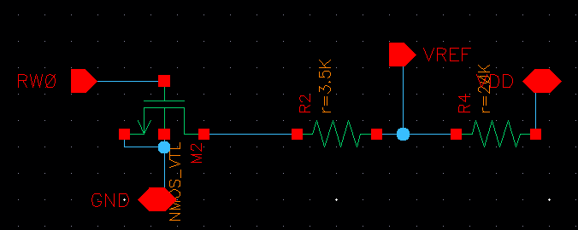
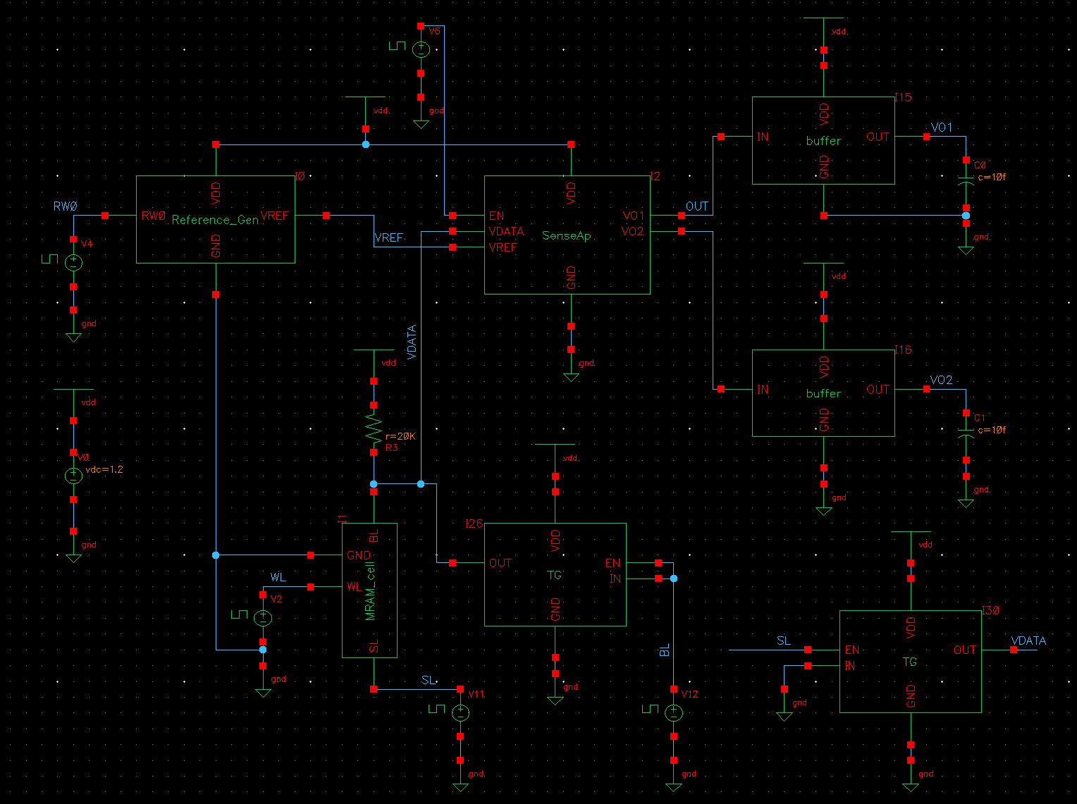
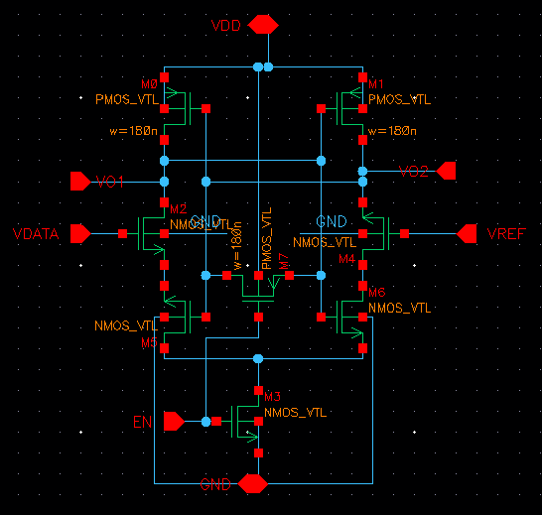
Reference Generator:
II. Unit Cell Simulation
R_{LOAD} should be large to make sure I_{READ} < I_{c}
3. Reading 0 & 1
R_{Ref} < (R_{P} + R_{AP})/2 = 3.5K
Sense Amplifier:

Slide 10
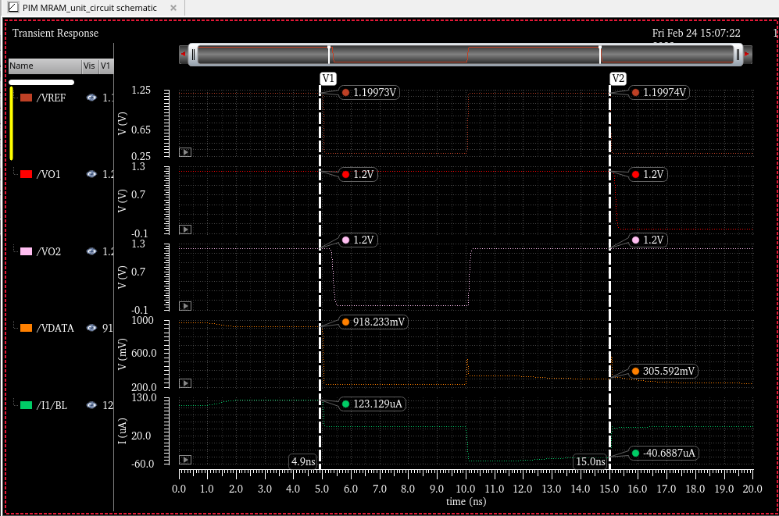
II. Unit Cell Simulation
3. Reading 0 & 1
“0”
“1”
write
read
write
read
Problems:
Asymmetric
Low resolution when reading
Result

Slide 11
Content
SPICE Model
Results and Verification
Problem
Unit Cell Simulation
Parameters
Writing
Reading
Basic Array
Test
1 Kernal
8 Kernal
Simulation Framework
Future Work

Slide 12
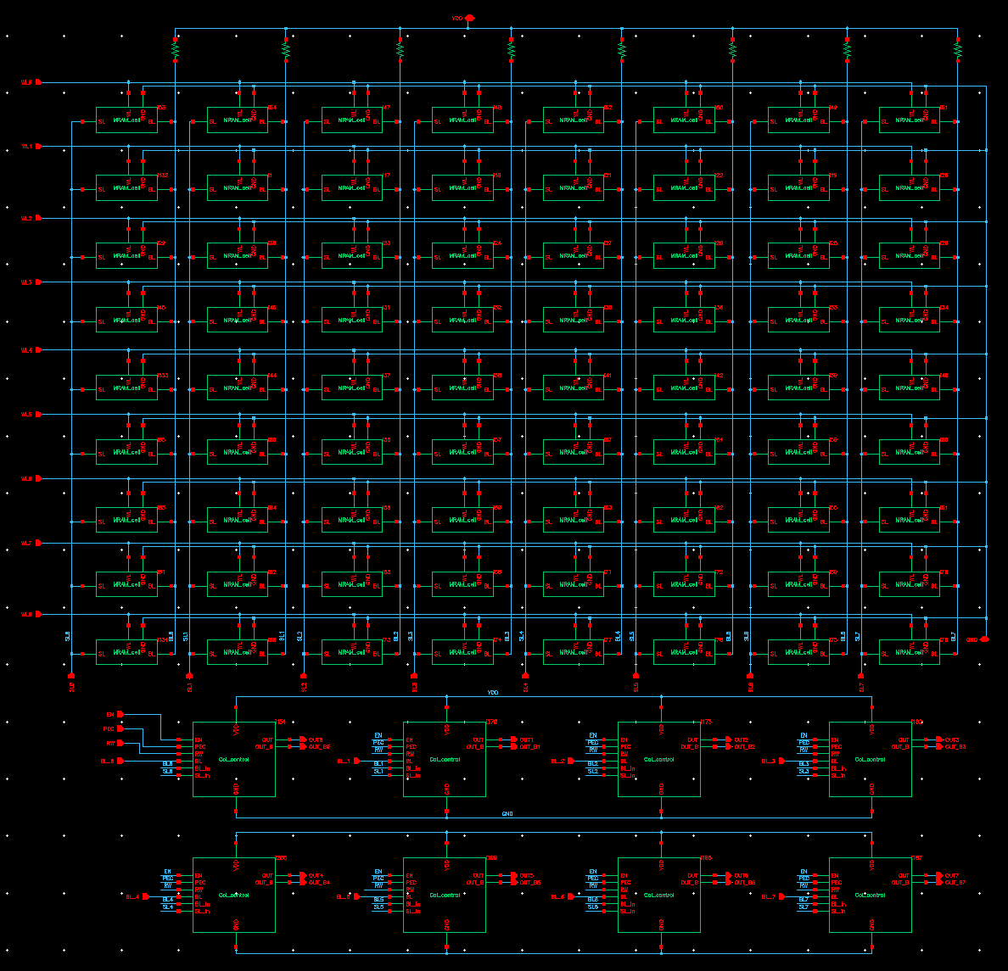
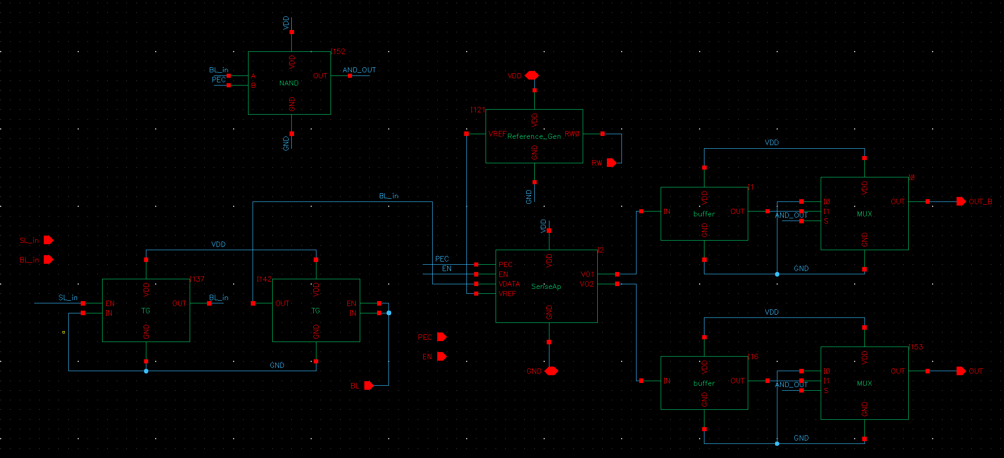
III. Basic Array
Truth Table
V | R=0 (P) | R=1 (AP)
0 | 0 | 0
1 | 0 | 1
Test one kernel
Vdd
VL
VH
need to be filtered

Slide 13
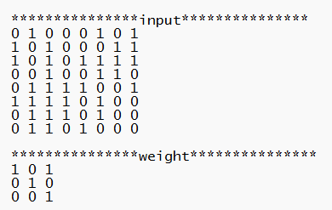
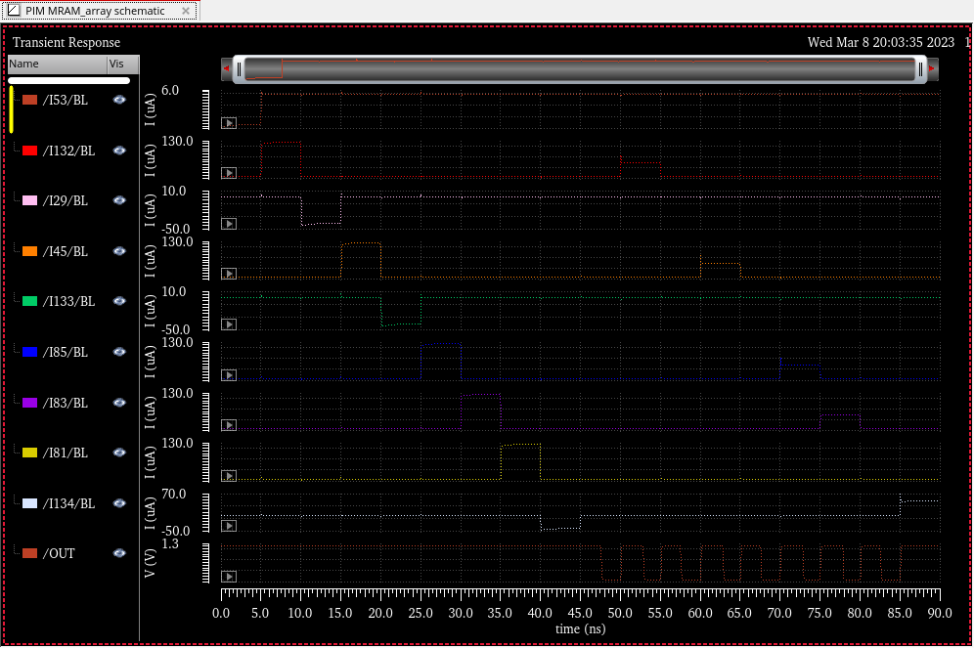
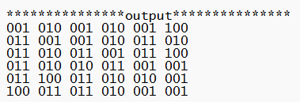
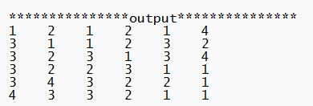
III. Basic Array
1-bit Test Cases
Truth Table
V | R=0 (P) | R=1 (AP)
0 | 0 | 0
1 | 0 | 1
0-45ns: initial the weights
45-90ns: read
“1”

Slide 14
Content
SPICE Model
Results and Verification
Problem
Unit Cell Simulation
Parameters
Writing
Reading
Basic Array
Test
1 Kernal
8 Kernal
Simulation Framework
Future Work

Slide 15
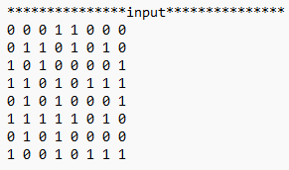
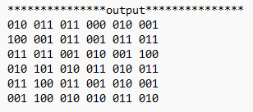
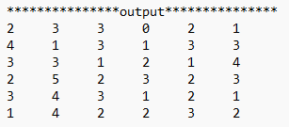

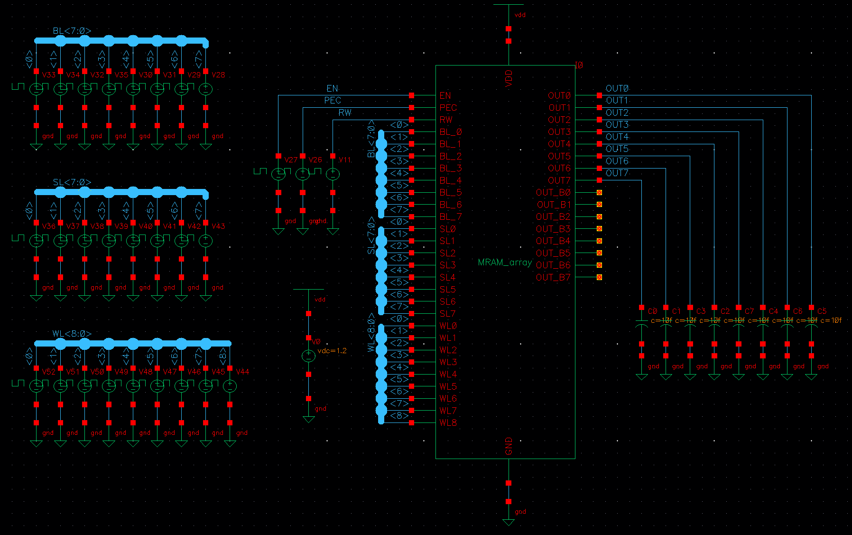
IV. Test
Easy to check

Slide 16
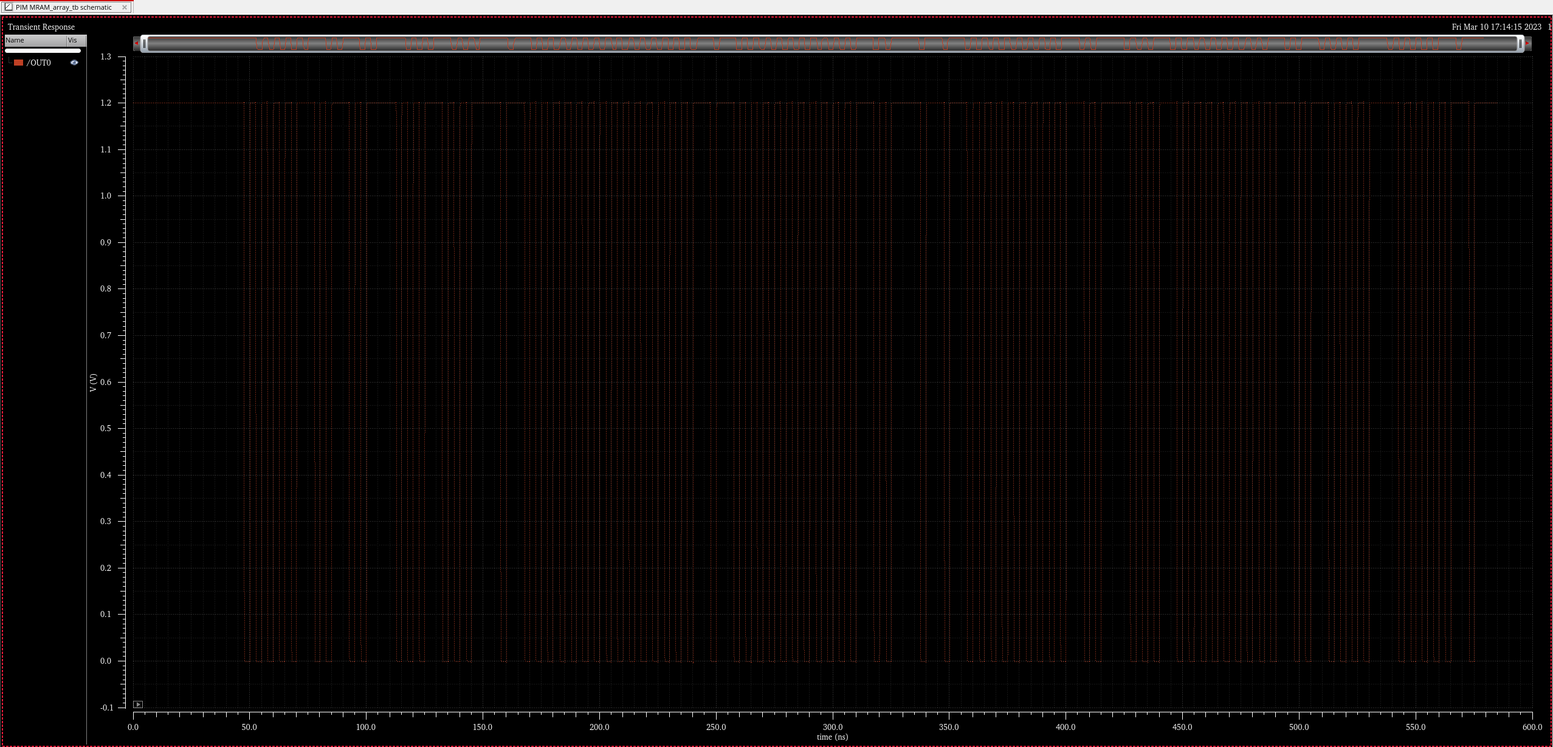
IV. Test
1. 1 Kernal
2
3
3
0
2
1
4
1
3
1
3
3

Slide 17
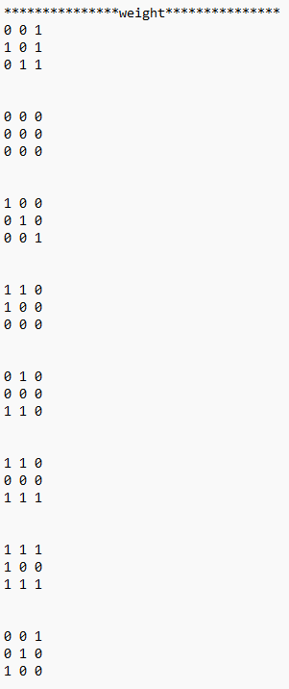
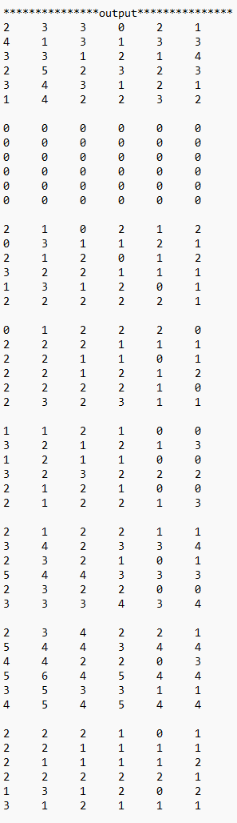
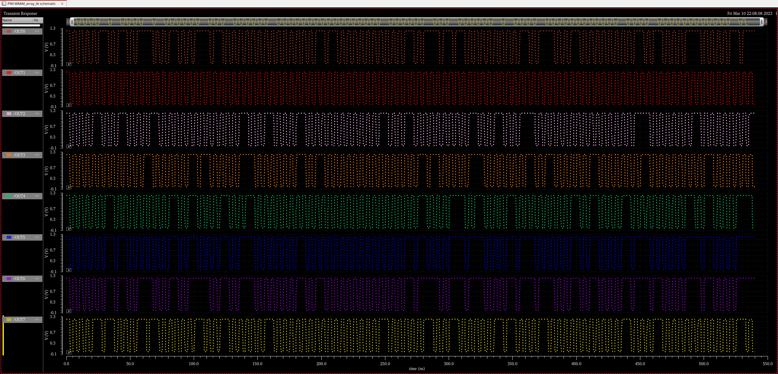
IV. Test
1. 8 Kernal
2
3
3
0
2
1
4
1
3
1
3
3
0
0
0
0
0
0
0
0
0
0
0
0
2
1
0
2
1
2
0
3
1
1
2
1
0
1
2
2
2
0
2
2
2
1
1
1
1
1
2
1
0
0
3
2
1
2
1
3
2
1
2
2
1
1
3
4
2
3
3
4
2
3
4
2
2
1
5
4
4
3
4
4
2
2
2
1
0
1
2
2
1
1
1
1

Slide 18
Content
SPICE Model
Results and Verification
Problem
Unit Cell Simulation
Parameters
Writing
Reading
Basic Array
Test
1 Kernal
8 Kernal
Simulation Framework
Future Work

Slide 19
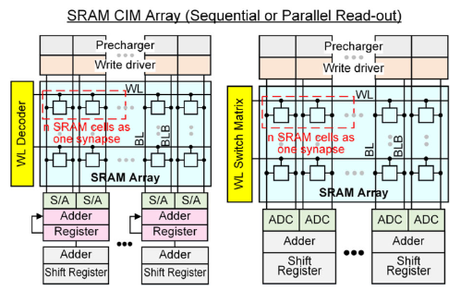
V. Simulation Framework
Image
remapping (im2col)
MTJ
verilog-A
Analog Circuit
HSPICE
Digital Circuit
verilog
result
Details are in the attachment (README.md)

Slide 20
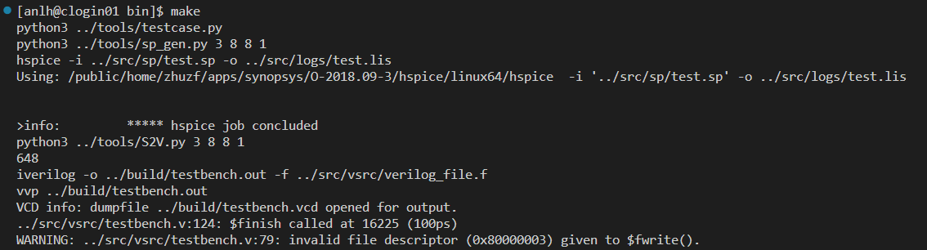
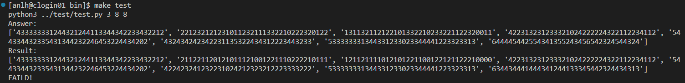

V. Simulation Framework
make (automatically generate testcases and run the process)
make test
If the results are wrong, it will show the answer and results.
If the results are correct, it will show “PASSED!”.

Slide 21
Content
SPICE Model
Results and Verification
Problem
Unit Cell Simulation
Parameters
Writing
Reading
Basic Array
Test
1 Kernal
8 Kernal
Simulation Framework
Future Work

Slide 22
VI. Future Work
Having Done
Impossible to use in my design.
May have better solutions using spintronics based devices.

