Slide 1
Process In-Memory (PIM)

Slide 2
Content
Part 1: Device Level
Part 3: System Level
SPICE Model
Related Work
Results and Verification
Unit Cell Simulation
Parameters
Writing
Reading
Basic Array
Test
Simulation Framework
Future Work
Part 2: Circuit Level

Slide 3
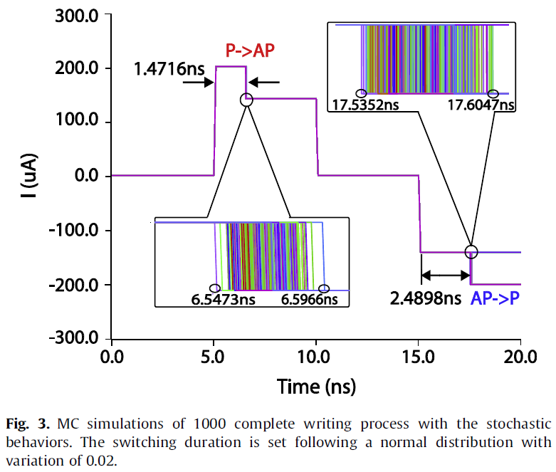
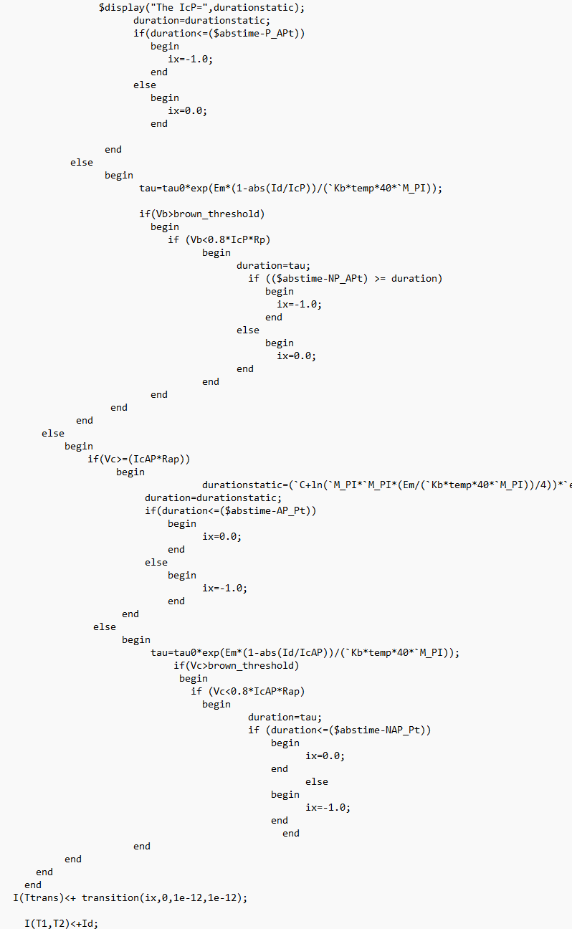
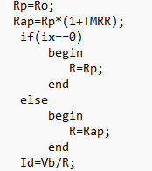
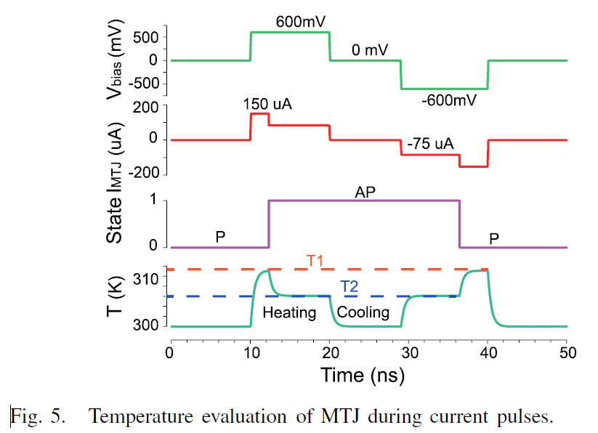
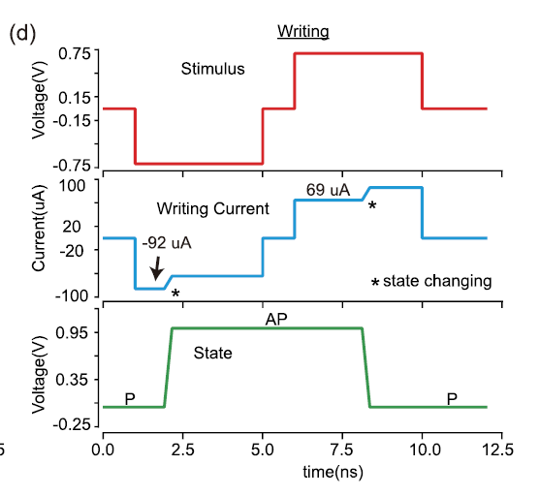
I. SPICE Model
1. Related Work [http://www.spinlib.com/index.html]
Reference: Compact model of magnetic tunnel junction with stochastic spin transfer torque switching for reliability analyses
Reference: Compact Model of Dielectric Breakdown in Spin-Transfer Torque Magnetic Tunnel Junction (TED)
Decide the states by cases instead of solving LLG
Set transition time manually
Reference: Compact Model of Subvolume MTJ and Its Design Application at Nanoscale Technology Nodes (TED)
Do not have the switching process
Do not show the switching process of MRAM or MTJ unit

Slide 4
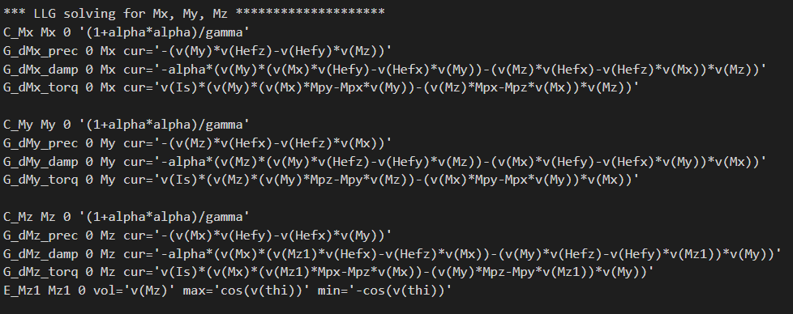
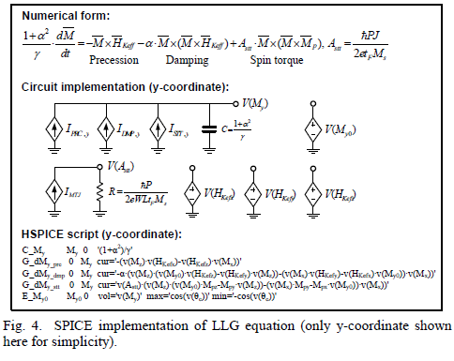

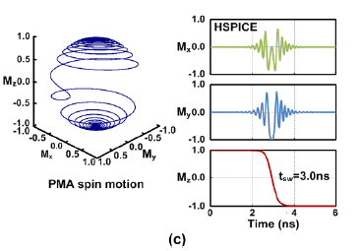
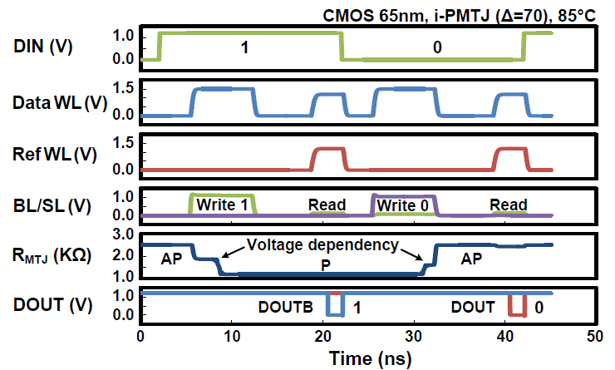
I. SPICE Model
Reference: A technology-agnostic MTJ SPICE model with user-defined dimensions for STT-MRAM scalability studies (CICC)
1. Related Work [http://mtj.umn.edu/index.html]
The differential behavior of m can be captured by solving RC circuit: I=C∙dV/dt
Three current sources represent the precession, damping, and spin torque terms in the LLG equation.
Separate circuits for x, y, and z coordinates are implemented in the same way.

Slide 5
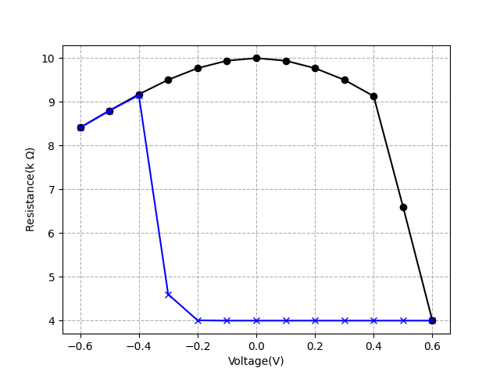
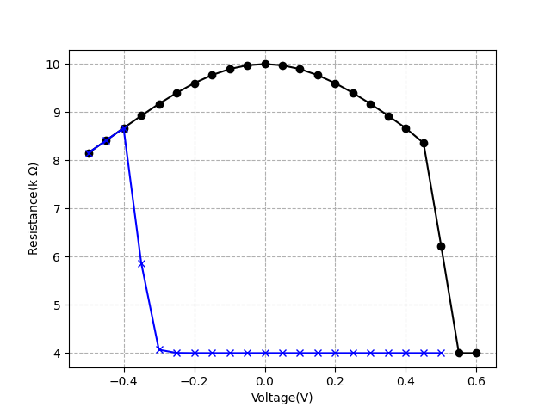
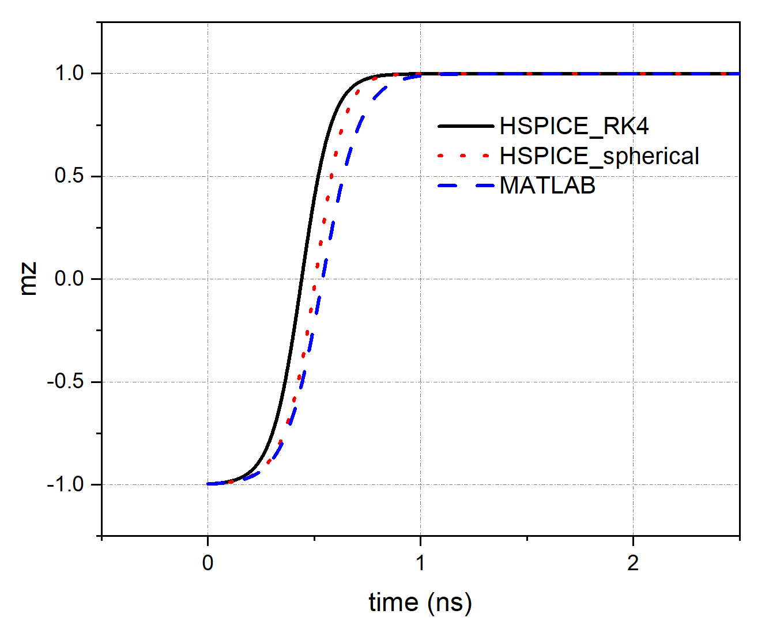
I. SPICE Model
2. Results and Verification
DC
SPICE
MATLAB
Write the MTJ model using Verilog-A
Solving LLG using RK4 numerically
Hybrid simulation by HSPICE
J ≈ 100uA / (50 nm x 50 nm) = 40e9 A/m2
Switching time is ns level

Slide 6
Content
Part 1: Device Level
Part 3: System Level
SPICE Model
Related Work
Results and Verification
Unit Cell Simulation
Parameters
Writing
Reading
Basic Array
Test
Simulation Framework
Future Work
Part 2: Circuit Level

Slide 7
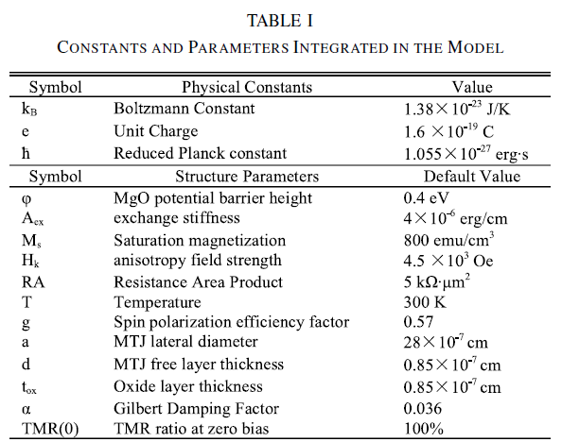



II. Unit Cell Simulation
1. Parameters
V_{dd} = 1.2 V
V_{G} = V_{dd}
MOSFET: NCSU Free PDK 45 nm
(https://eda.ncsu.edu/freepdk/freepdk45/)
Reference: Compact Model of Subvolume MTJ and Its Design Application at Nanoscale Technology Nodes (TED)

Slide 8
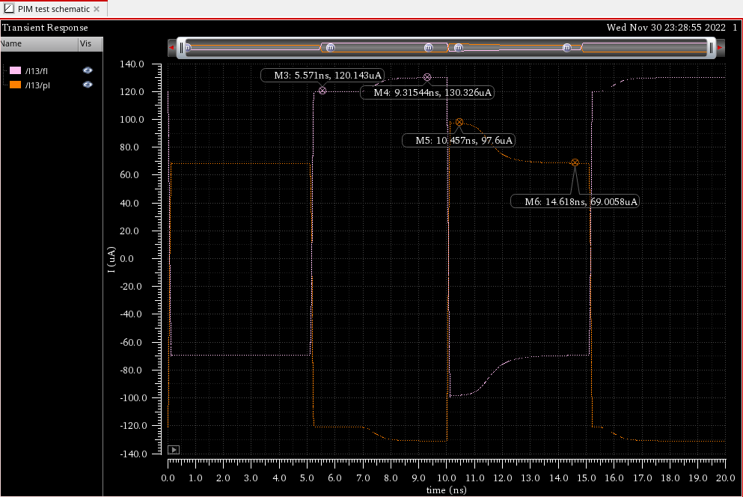
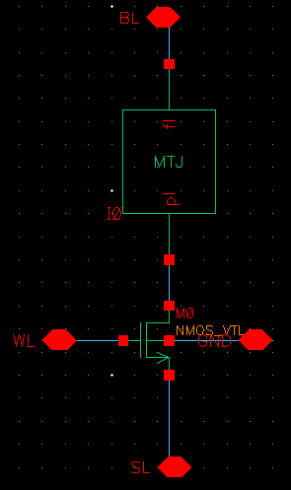
II. Unit Cell Simulation
# parallel represents “0,” antiparallel represents “1”
2. Writing 0 & 1
AP-P : write 0
I_{AP} = 120 uA
I_{P} = 130 uA
P-AP: write 1
I_{AP} = 69 uA
I_{P} = 98 uA

Slide 9
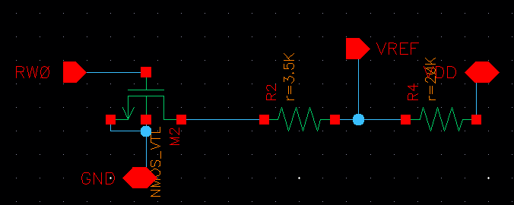
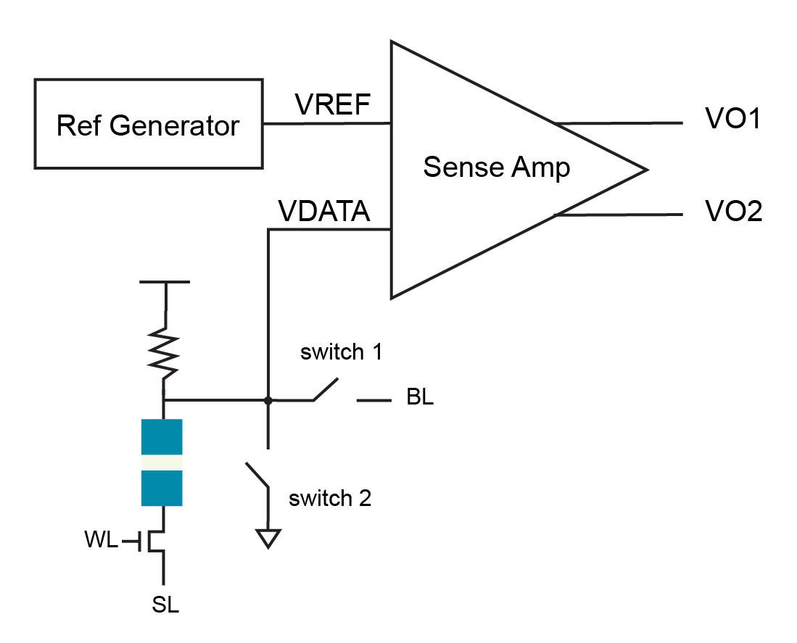
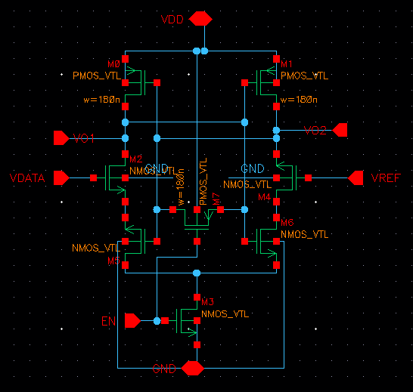
Reference Generator:
II. Unit Cell Simulation
R_{LOAD} should be large to make sure I_{READ} < I_{c}
3. Reading 0 & 1
R_{Ref} < (R_{P} + R_{AP})/2 = 3.5K
Sense Amplifier:
switch 1: controlled by BL, used for write 0
switch 2: controlled by SL, used for write 1

Slide 10
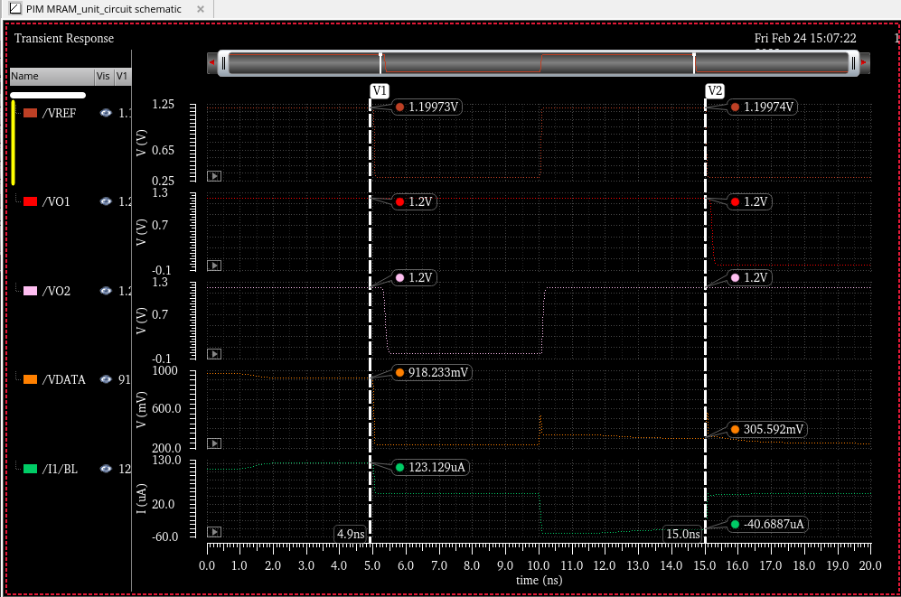
II. Unit Cell Simulation
3. Reading 0 & 1
“0”
“1”
write
read
write
read
Problems:
Asymmetric
Low resolution when reading
Result

Slide 11
Content
Part 1: Device Level
Part 3: System Level
SPICE Model
Related Work
Results and Verification
Unit Cell Simulation
Parameters
Writing
Reading
Basic Array
Test
Simulation Framework
Future Work
Part 2: Circuit Level

Slide 12
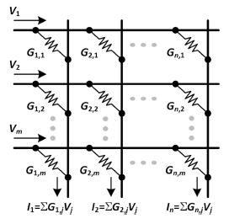
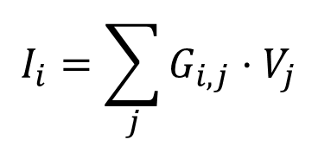
III. Basic Array
Example: convolution
$$I_{i}=\sum_{j}{G_{i,j}}⋅V_{j}$$
input
weight
Advantage:
Less latency
Highly parallel

Slide 13
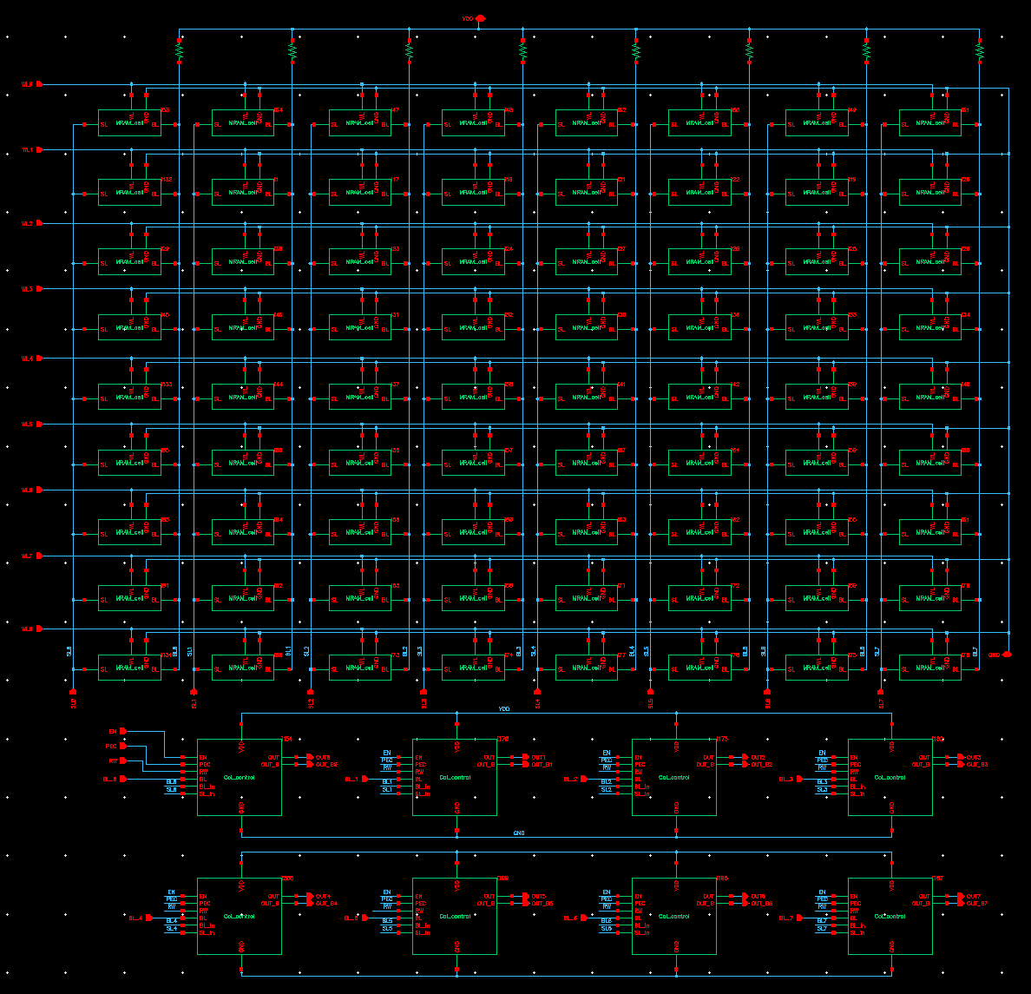
III. Basic Array
Truth Table
V | R=0 (P) | R=1 (AP)
0 | 0 | 0
1 | 0 | 1
Example: 9 (3x3 kernal) x 8 (channel)
test one channel for example
when WL is off, Vdata is Vdd
V | R=0 (P) | R=1 (AP)
0 | Vdd | Vdd
1 | VL | VH
need to be filtered out
output
filter circuit

Slide 14
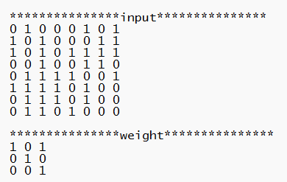
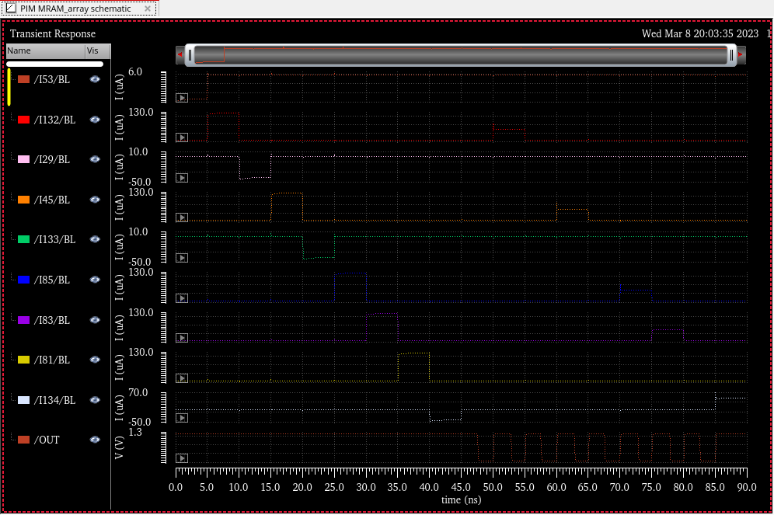
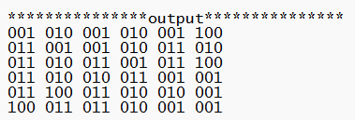
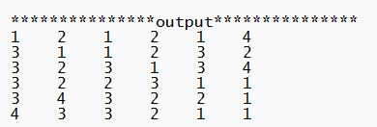
III. Basic Array
1-bit Test Cases
Truth Table
V | R=0 (P) | R=1 (AP)
0 | 0 | 0
1 | 0 | 1
0-45ns: initial the weights
45-90ns: read
“1”

Slide 15
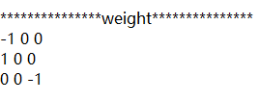
III. Basic Array
For more general cases, weight should have minus values.
Here we use three values (-1, 0, 1)
Use two columns:
one for positive weight
one for negative weight

Slide 16
Content
Part 1: Device Level
Part 3: System Level
SPICE Model
Related Work
Results and Verification
Unit Cell Simulation
Parameters
Writing
Reading
Basic Array
Test
Simulation Framework
Future Work
Part 2: Circuit Level

Slide 17
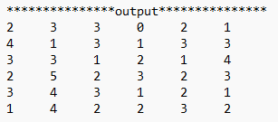
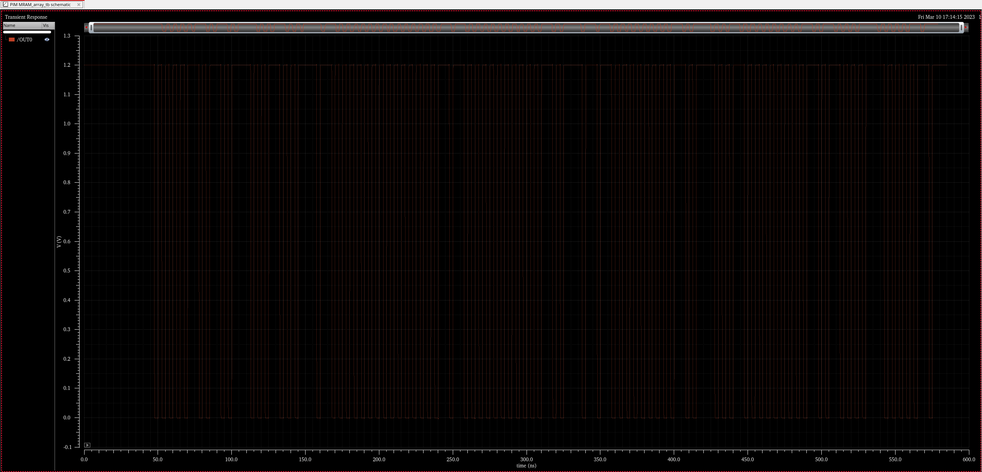
IV. Test
1 Kernal
2
3
3
0
2
1
4
1
3
1
3
3

Slide 18
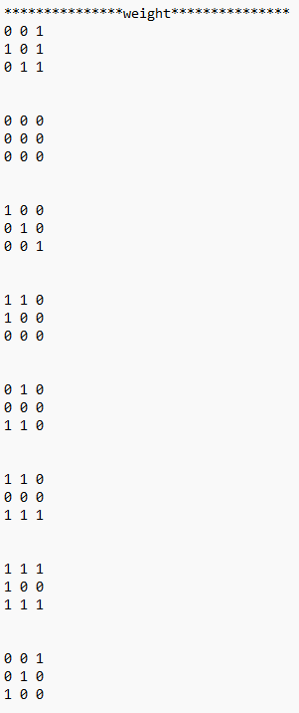
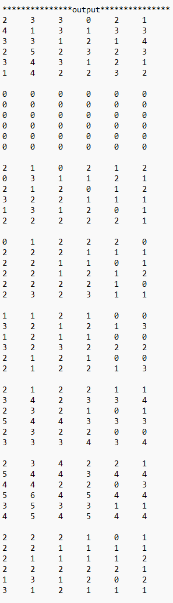
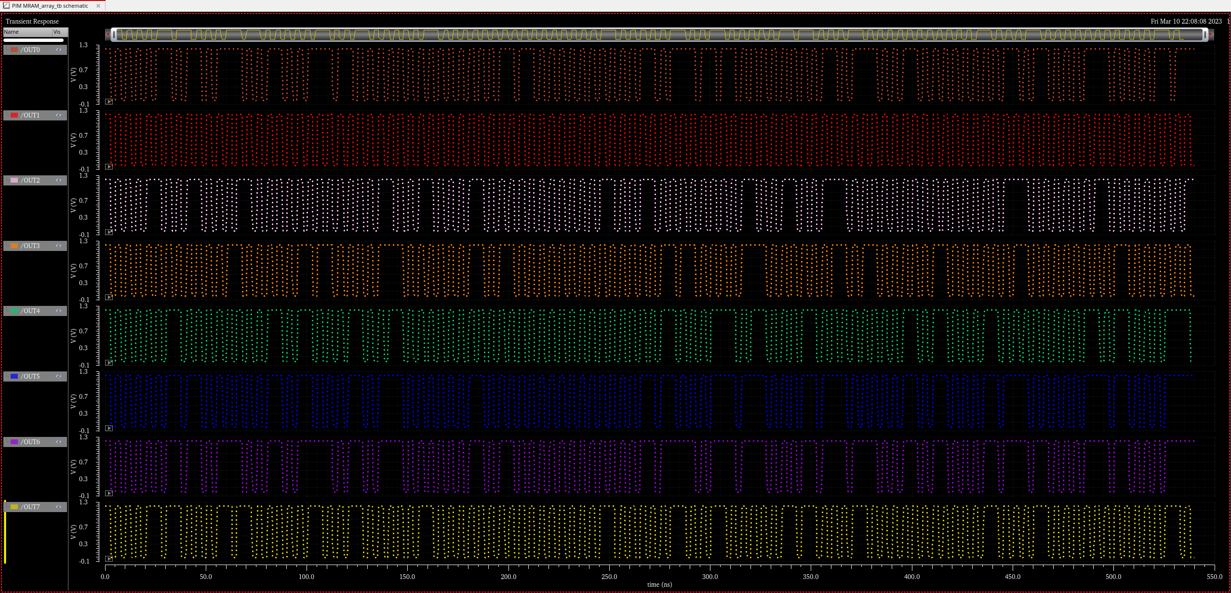
IV. Test
8 Kernal
2
3
3
0
2
1
4
1
3
1
3
3
0
0
0
0
0
0
0
0
0
0
0
0
2
1
0
2
1
2
0
3
1
1
2
1
0
1
2
2
2
0
2
2
2
1
1
1
1
1
2
1
0
0
3
2
1
2
1
3
2
1
2
2
1
1
3
4
2
3
3
4
2
3
4
2
2
1
5
4
4
3
4
4
2
2
2
1
0
1
2
2
1
1
1
1

Slide 19
Content
Part 1: Device Level
Part 3: System Level
SPICE Model
Related Work
Results and Verification
Unit Cell Simulation
Parameters
Writing
Reading
Basic Array
Test
Simulation Framework
Future Work
Part 2: Circuit Level

Slide 20
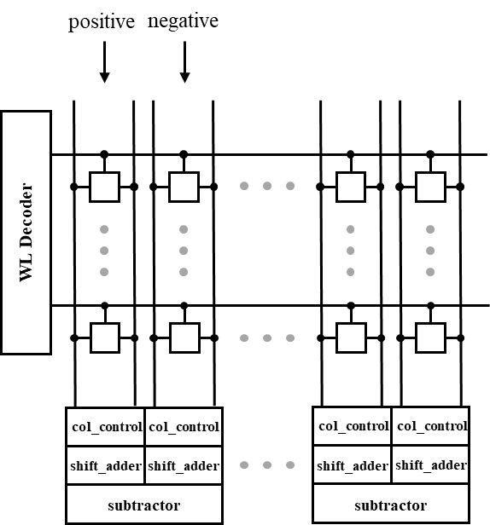
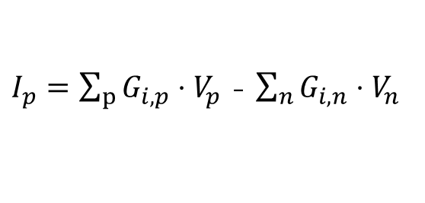
V. Simulation Framework
Image
remapping (im2col)
MTJ
verilog-A
Analog Circuit
HSPICE
Digital Circuit
verilog
relu
relu
result
$I_{p}=\sum_{p}{G_{i,p}}⋅V_{p}$ - $\sum_{n}{G_{i,n}}⋅V_{n}$

Slide 21
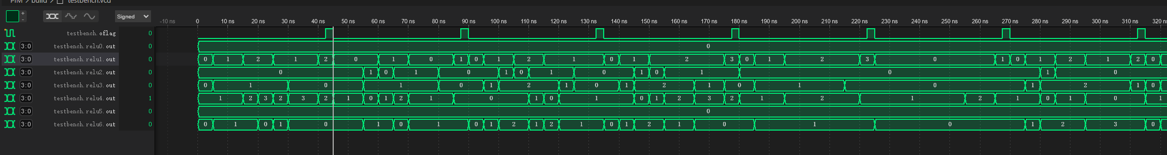

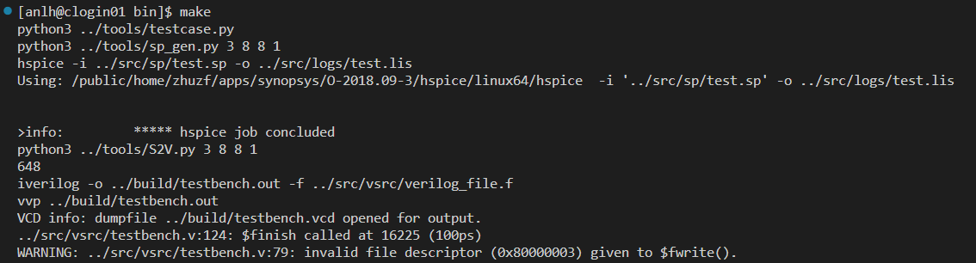
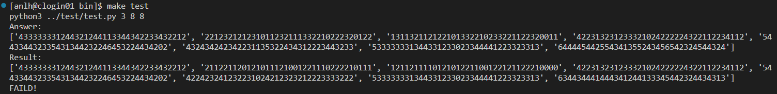

V. Simulation Framework
make (automatically generate testcases and run the process)
make test
If the results are wrong, it will show the answer and results.
If the results are correct, it will show “PASSED!”.

Slide 22
Content
Part 1: Device Level
Part 3: System Level
SPICE Model
Related Work
Results and Verification
Unit Cell Simulation
Parameters
Writing
Reading
Basic Array
Test
Simulation Framework
Future Work
Part 2: Circuit Level

Slide 23
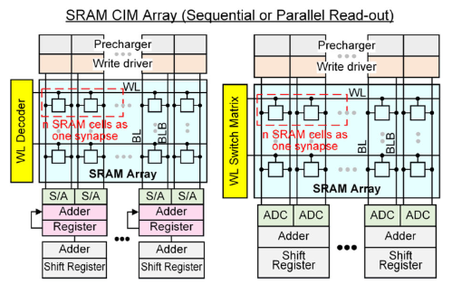
VI. Future Work
Having Done
Impossible to use in my design.
May have better solutions using spintronics based devices.
P. -Y. Chen, X. Peng and S. Yu, "NeuroSim: A Circuit-Level Macro Model for Benchmarking Neuro-Inspired Architectures in Online Learning," in IEEE Transactions on Computer-Aided Design of Integrated Circuits and Systems, vol. 37, no. 12, pp. 3067-3080, Dec. 2018, doi: 10.1109/TCAD.2018.2789723.

