Slide 1
Process In-Memory (PIM)

Slide 2
Content
Part 1: Device Level
Part 3: System Level
SPICE Model
Related Work
Results and Verification
Unit Cell Simulation
Parameters
Writing
Reading
Basic Array
Test
Simulation Framework
Future Work
Part 2: Circuit Level

Slide 3
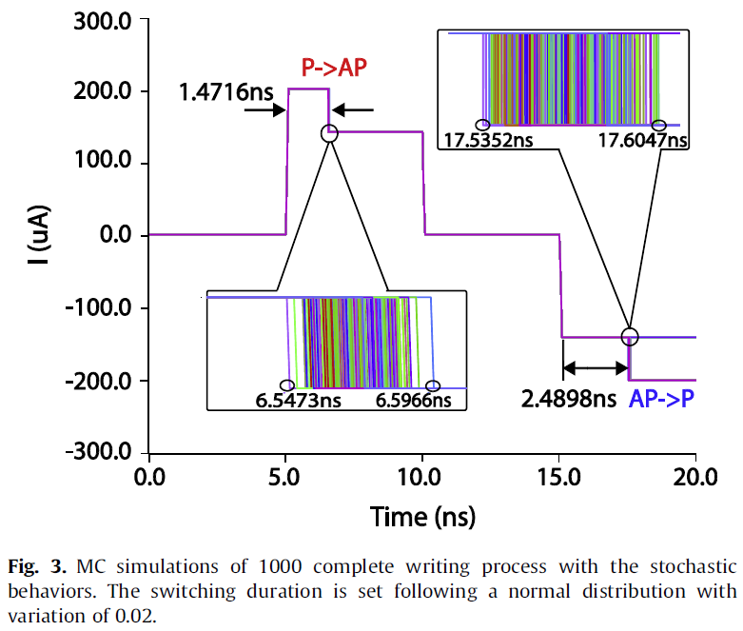
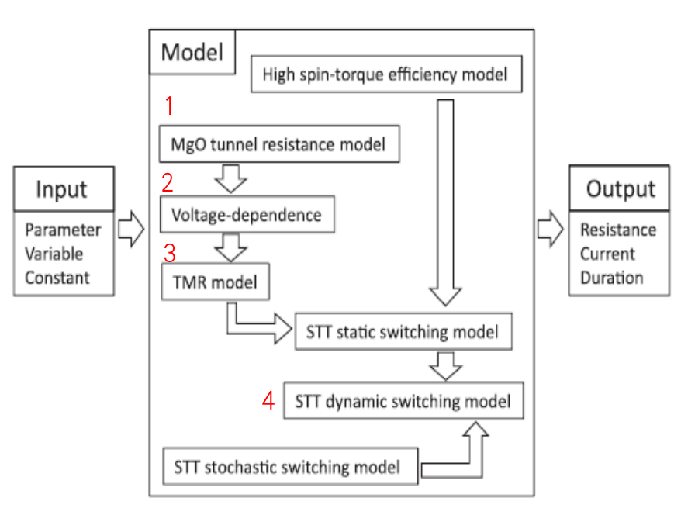
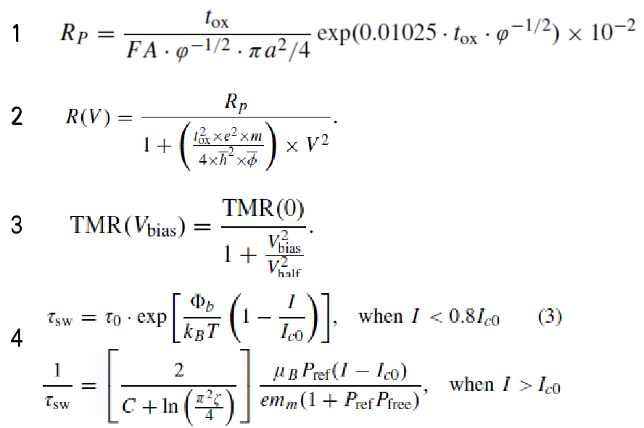
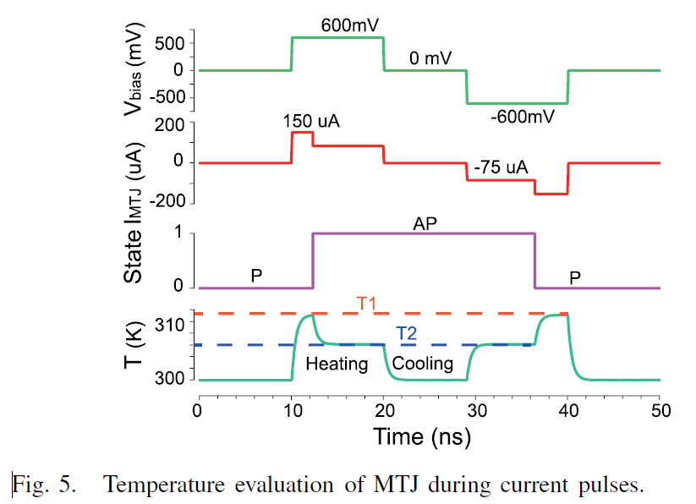
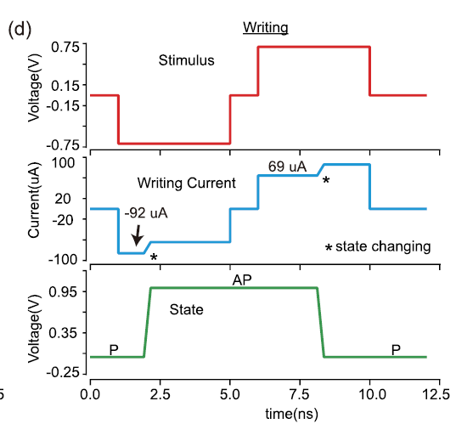
I. SPICE Model
1. Related Work [http://www.spinlib.com/index.html]
Reference: Compact model of magnetic tunnel junction with stochastic spin transfer torque switching for reliability analyses
Reference: Compact Model of Dielectric Breakdown in Spin-Transfer Torque Magnetic Tunnel Junction (TED)
Reference: Compact Model of Subvolume MTJ and Its Design Application at Nanoscale Technology Nodes (TED)
Do not have the switching process
Do not show the switching process of MRAM or MTJ unit

Slide 4
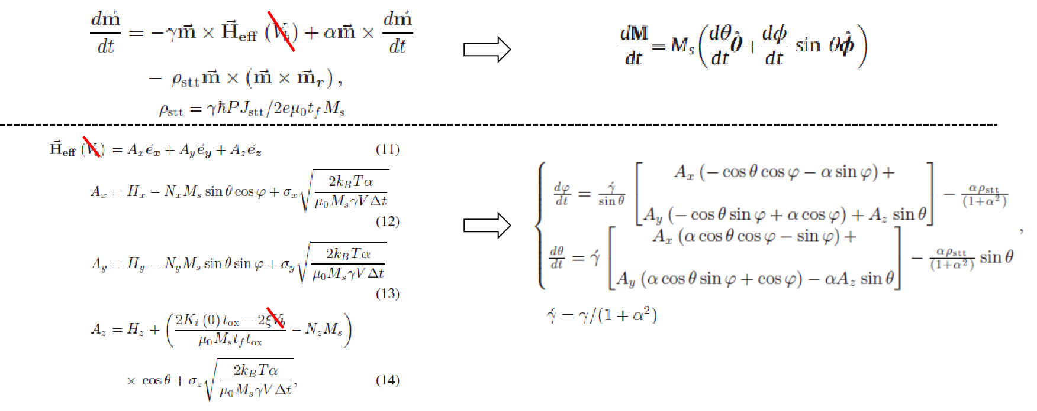
I. SPICE Model
1. Related Work [http://www.spinlib.com/index.html]

Slide 5
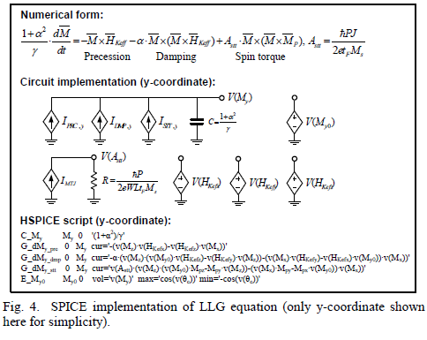
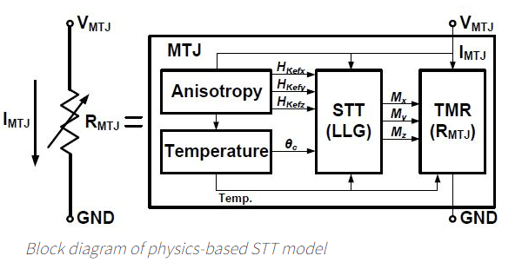
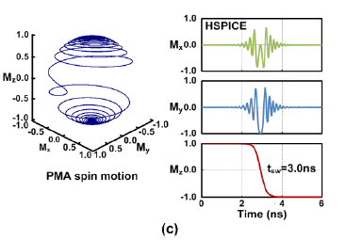
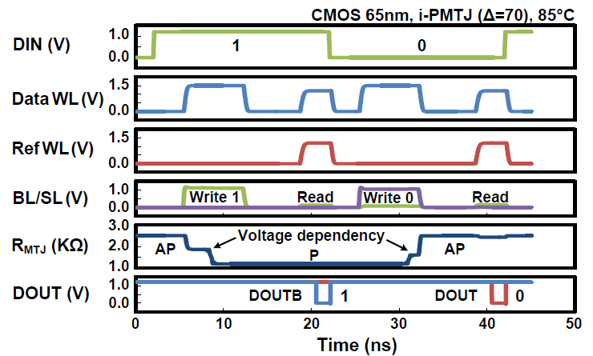
I. SPICE Model
Reference: A technology-agnostic MTJ SPICE model with user-defined dimensions for STT-MRAM scalability studies (CICC)
1. Related Work [http://mtj.umn.edu/index.html]
The differential behavior of m can be captured by solving RC circuit: I=C∙dV/dt
Three current sources represent the precession, damping, and spin torque terms in the LLG equation.
Separate circuits for x, y, and z coordinates are implemented in the same way.

Slide 6
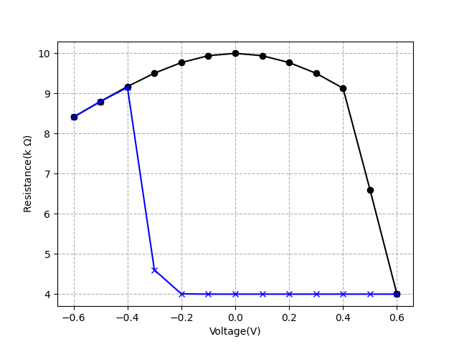
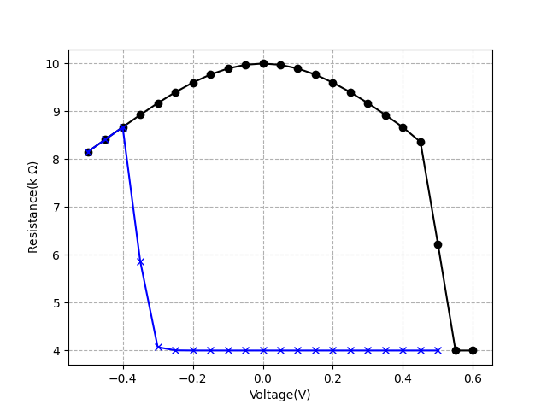
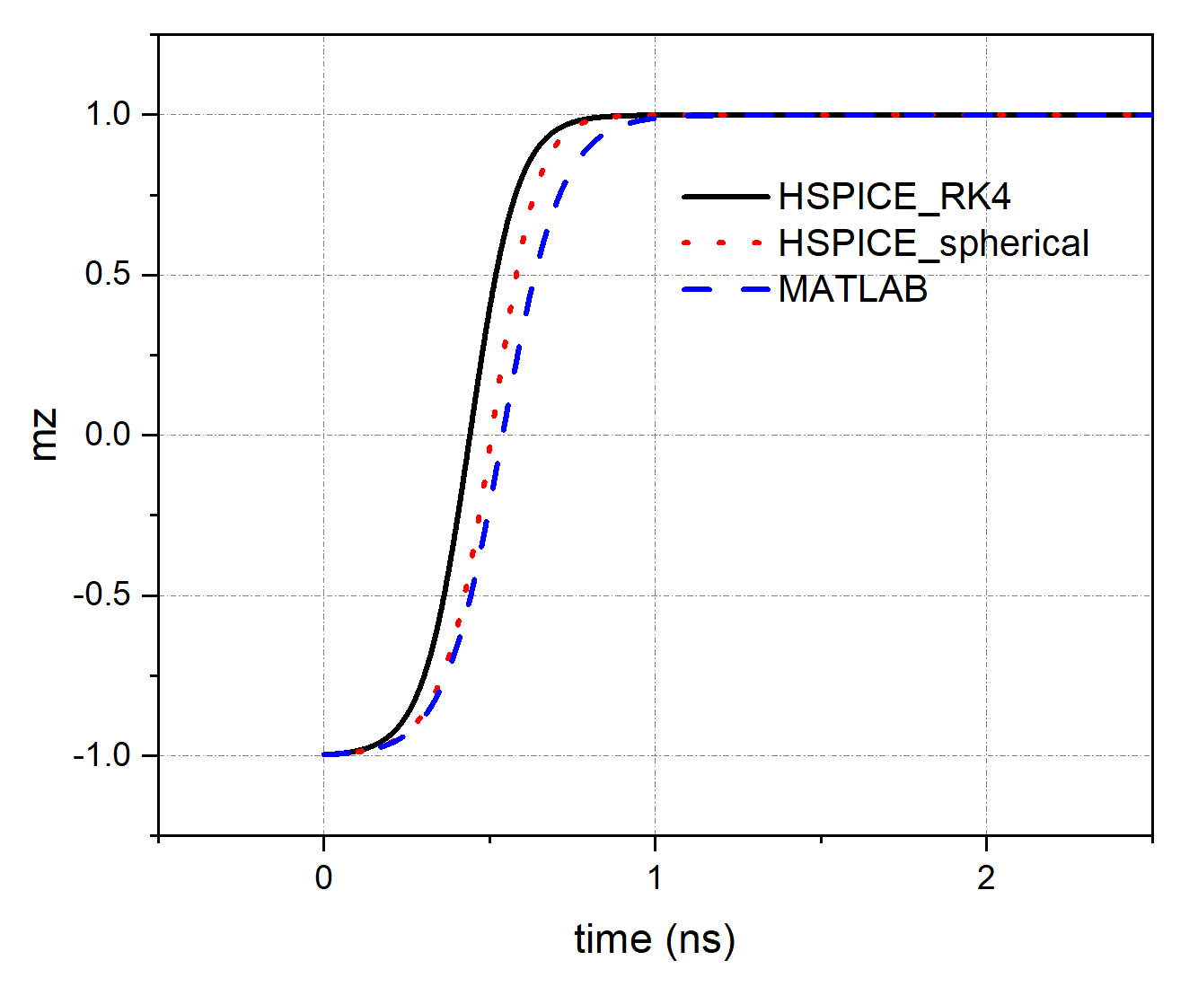
I. SPICE Model
2. Results and Verification
DC
SPICE
MATLAB
Write the MTJ model using Verilog-A
Solving LLG using RK4 numerically
Hybrid simulation by HSPICE
J ≈ 100uA / (50 nm x 50 nm) = 40e9 A/m2
Switching time is ns level

Slide 7
I. SPICE Model
3. Summary
What are the differences or advantages of our model compared to others.
Other physical properties or devices.
SOT
SHE
VCMA
...

Slide 8
Content
Part 1: Device Level
Part 3: System Level
SPICE Model
Related Work
Results and Verification
Unit Cell Simulation
Parameters
Writing
Reading
Basic Array
Test
Simulation Framework
Future Work
Part 2: Circuit Level

Slide 9
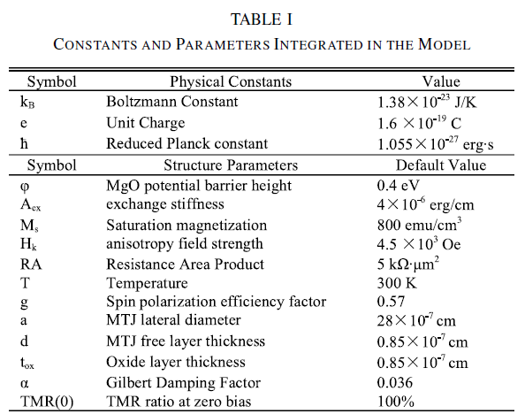



II. Unit Cell Simulation
1. Parameters
V_{dd} = 1.2 V
V_{G} = V_{dd}
MOSFET: NCSU Free PDK 45 nm
(https://eda.ncsu.edu/freepdk/freepdk45/)
Reference: Compact Model of Subvolume MTJ and Its Design Application at Nanoscale Technology Nodes (TED)

Slide 10
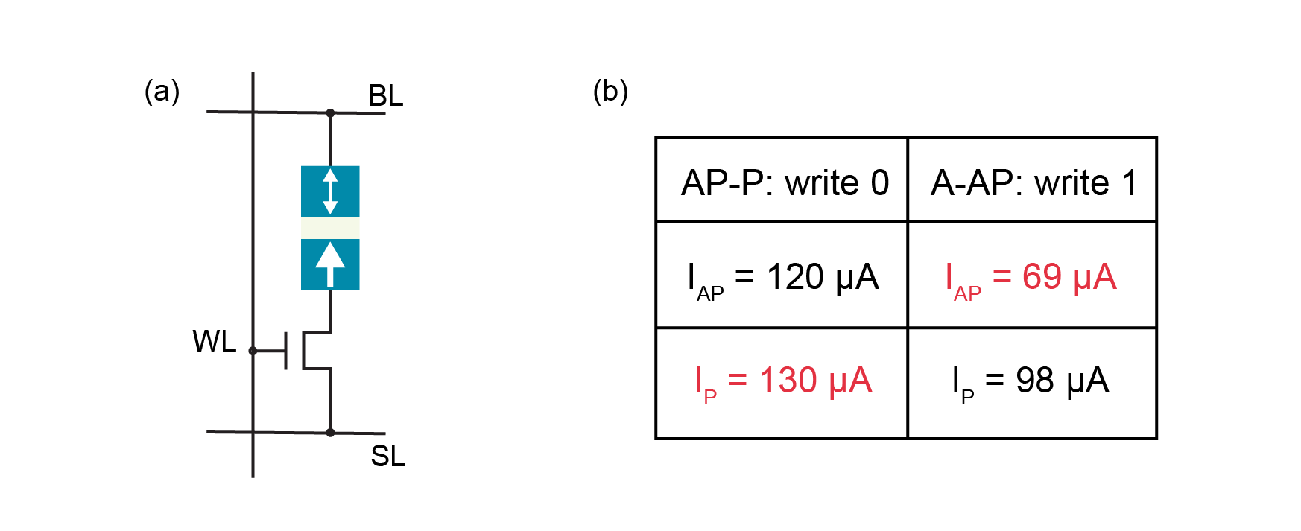
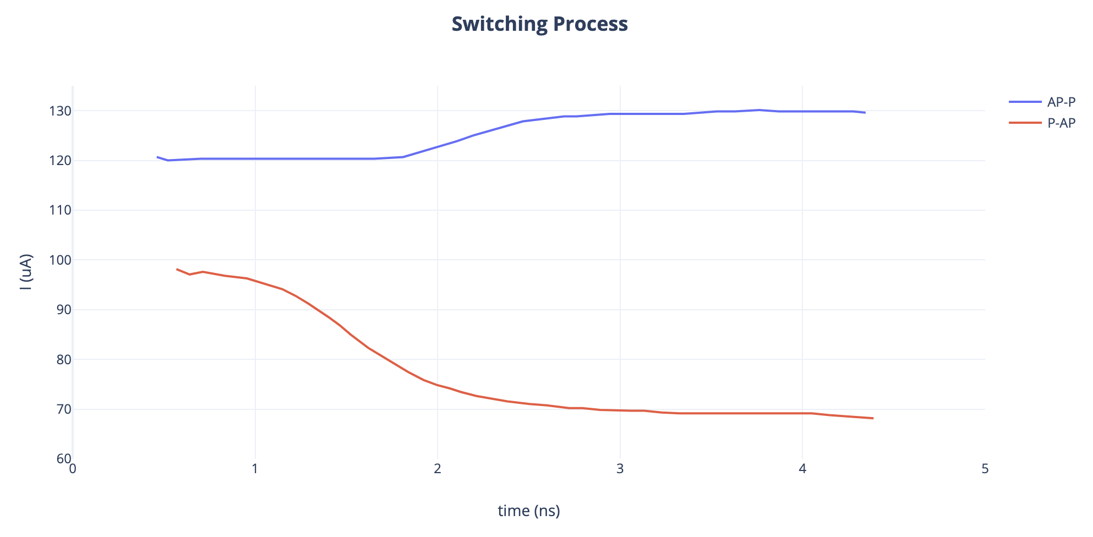
II. Unit Cell Simulation
# parallel represents “0,” antiparallel represents “1”
2. Writing 0 & 1

Slide 11
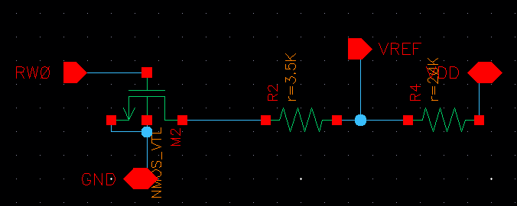
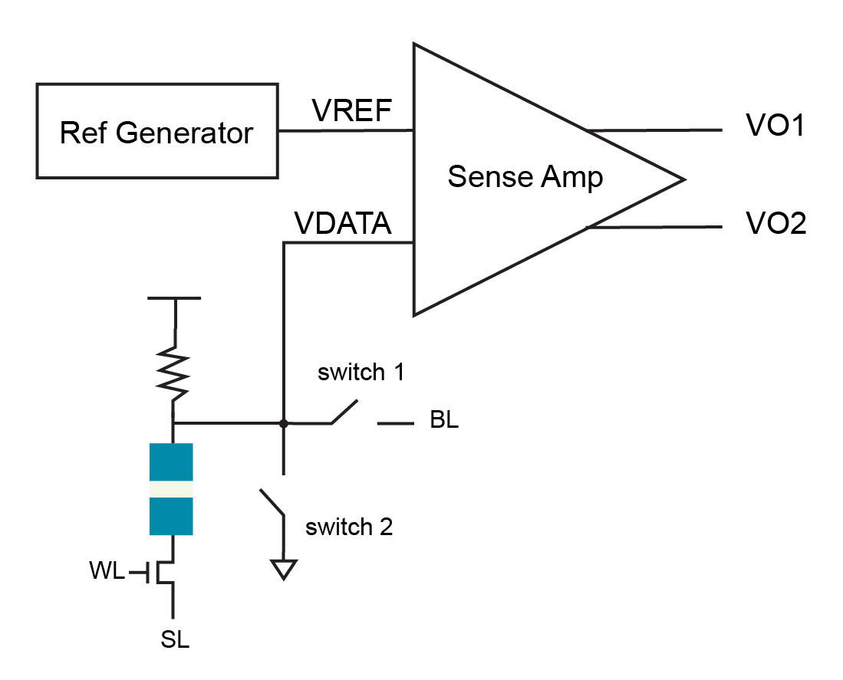
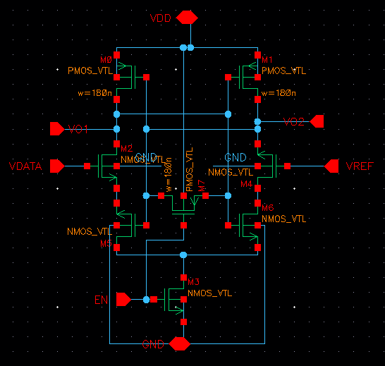
Reference Generator:
II. Unit Cell Simulation
R_{LOAD} should be large to make sure I_{READ} < I_{c}
3. Reading 0 & 1
R_{Ref} < (R_{P} + R_{AP})/2 = 3.5K
Sense Amplifier:
switch 1: controlled by BL, used for write 0
switch 2: controlled by SL, used for write 1

Slide 12
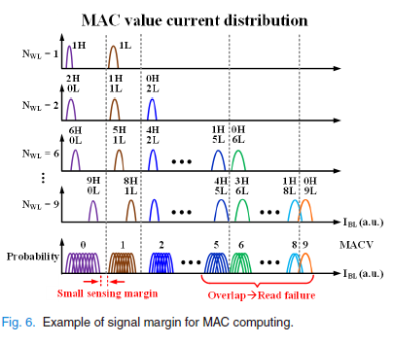
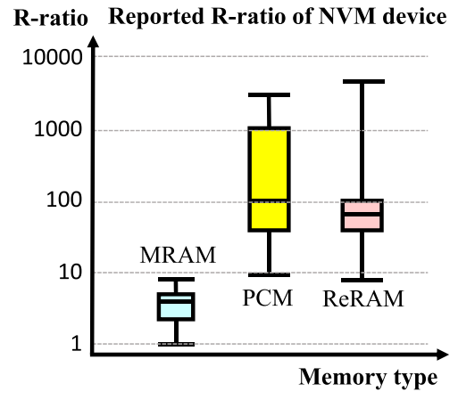
II. Unit Cell Simulation
4. Summary
Asymmetric of writing current.
Low resolution since the sense amplifier (SA) is not sensitive enough.
Due to the small signal margin between neighboring computing states, it is hard to use ADC.
Reference: Challenges and Trends inDeveloping Nonvolatile Memory-Enabled Computing Chips for Intelligent Edge Devices (TED)

Slide 13
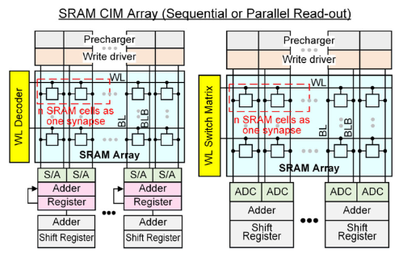
II. Unit Cell Simulation
4. Summary
P. -Y. Chen, X. Peng and S. Yu, "NeuroSim: A Circuit-Level Macro Model for Benchmarking Neuro-Inspired Architectures in Online Learning," (TCAD)

Slide 14
Content
Part 1: Device Level
Part 3: System Level
SPICE Model
Related Work
Results and Verification
Unit Cell Simulation
Parameters
Writing
Reading
Basic Array
Test
Simulation Framework
Future Work
Part 2: Circuit Level

Slide 15
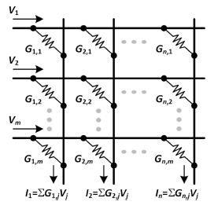
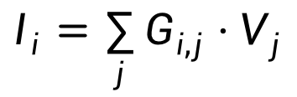
III. Basic Array
Example: MAC
$$I_{i}=\sum_{j}{G_{i,j}}⋅V_{j}$$
input
weight
Advantage:
Less latency
Highly parallel

Slide 16
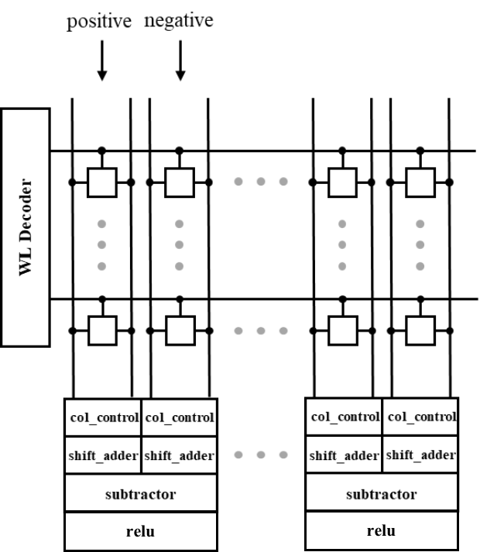
III. Basic Array
Truth Table
V | R=0 (P) | R=1 (AP)
0 | 0 | 0
1 | 0 | 1
Example: 9 (3x3 kernal) x 8 (channel)
test one channel for example
when WL is off, Vdata is Vdd
V | R=0 (P) | R=1 (AP)
0 | Vdd | Vdd
1 | VL | VH
need to be filtered out
output
filter

Slide 17
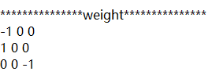
III. Basic Array
For more general cases, weight should have minus values.
Here we use three values (-1, 0, 1)
Use two columns:
one for positive weight
one for negative weight

Slide 18
Content
Part 1: Device Level
Part 3: System Level
SPICE Model
Related Work
Results and Verification
Unit Cell Simulation
Parameters
Writing
Reading
Basic Array
Test
Simulation Framework
Future Work
Part 2: Circuit Level

Slide 19
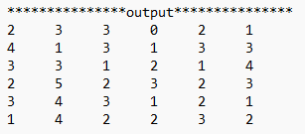
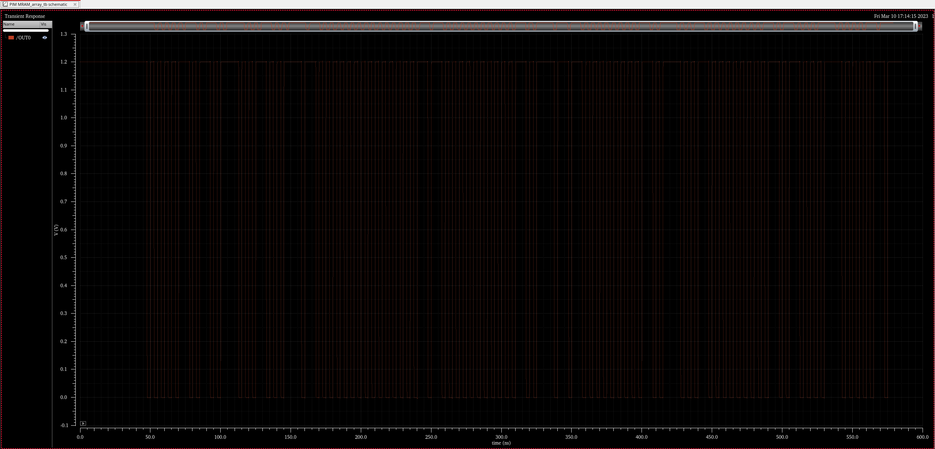
IV. Test
1 Kernal
2
3
3
0
2
1
4
1
3
1
3
3

Slide 20
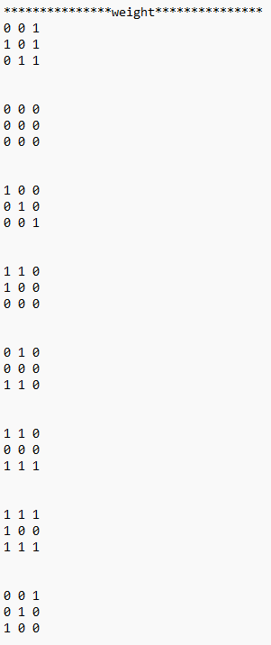
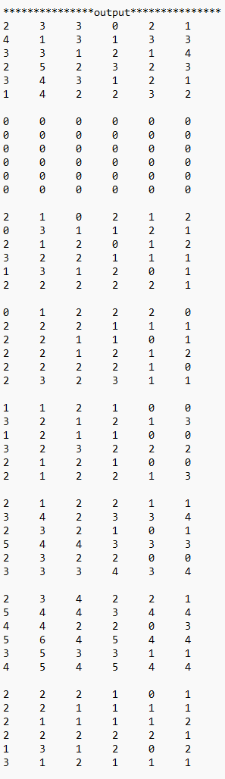
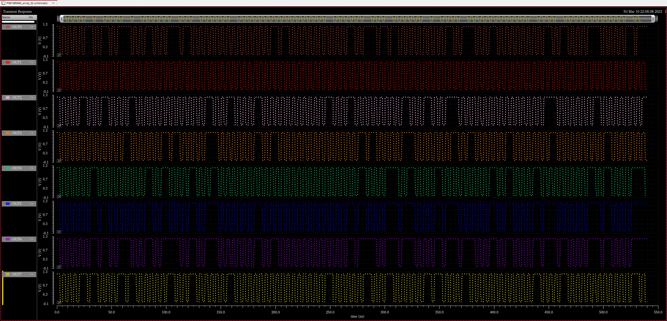
IV. Test
8 Kernal
2
3
3
0
2
1
4
1
3
1
3
3
0
0
0
0
0
0
0
0
0
0
0
0
2
1
0
2
1
2
0
3
1
1
2
1
0
1
2
2
2
0
2
2
2
1
1
1
1
1
2
1
0
0
3
2
1
2
1
3
2
1
2
2
1
1
3
4
2
3
3
4
2
3
4
2
2
1
5
4
4
3
4
4
2
2
2
1
0
1
2
2
1
1
1
1

Slide 21
Content
Part 1: Device Level
Part 3: System Level
SPICE Model
Related Work
Results and Verification
Unit Cell Simulation
Parameters
Writing
Reading
Basic Array
Test
Simulation Framework
Future Work
Part 2: Circuit Level

Slide 22
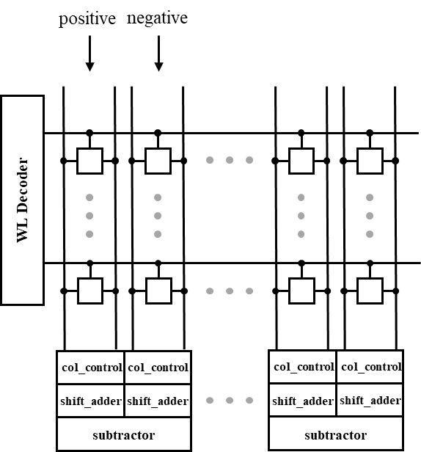

V. Simulation Framework
Input
remapping (im2col)
MTJ
verilog-A
Analog Circuit
HSPICE
Digital Circuit
verilog
relu
relu
output
$I_{p}=\sum_{p}{G_{i,p}}⋅V_{p}$ - $\sum_{n}{G_{i,n}}⋅V_{n}$

Slide 23
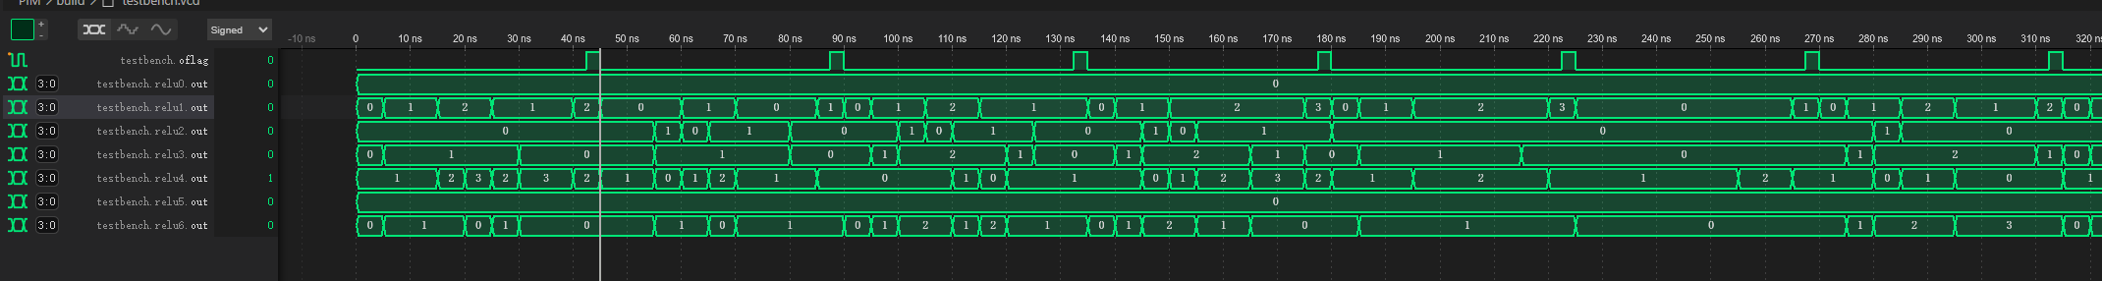

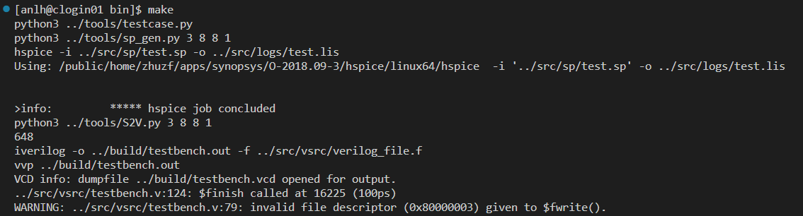
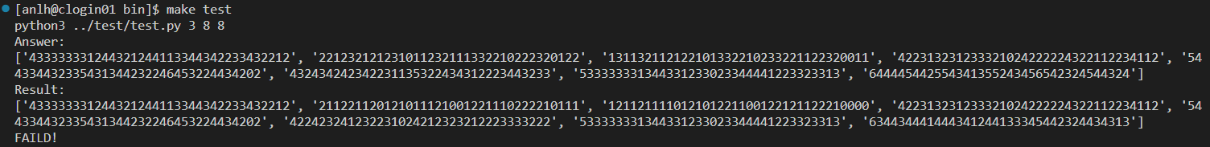

V. Simulation Framework
Automatically generate testcases and run the process
Check results
If the results are wrong, it will show the answers and results.
If the results are correct, it will show “PASSED!”.

Slide 24
V. Simulation Framework
3. Summary
Is the above design and simulation reasonable?
Hspice takes too much time
hard to evaluate energy and area

Slide 25
Content
Part 1: Device Level
Part 3: System Level
SPICE Model
Related Work
Results and Verification
Unit Cell Simulation
Parameters
Writing
Reading
Basic Array
Test
Simulation Framework
Future Work
Part 2: Circuit Level

Slide 26
VI. Future Work
Having Done
Impossible to use in my design.
May have better solutions using spintronics based devices.
P. -Y. Chen, X. Peng and S. Yu, "NeuroSim: A Circuit-Level Macro Model for Benchmarking Neuro-Inspired Architectures in Online Learning," (TCAD)

Slide 27
VI. Future Work
Applications (faster? less energy? higher accuracy?)
CNN
AES encription/decription
image processing
...
Modularize the system
Mapping/Algorithm?

