Slide 1
TECH MAHINDRA
Solution Proposal
Prepared for: DiagTest
April 2026
CONFIDENTIAL | www.techmahindra.com

Slide 2
Agenda
1. Tech Mahindra – Solution Proposal 2. Executive Summary 3. Architecture 4. Commercials

Slide 3
Executive Summary
• This is a test proposal.

Slide 4
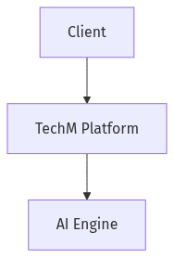
Architecture

Slide 5
Commercials
Role | Rate
Architect | $120/hr

Slide 6
Thank You
Tech Mahindra – Run Different
www.techmahindra.com | Confidential

