Slide 1



Prediction Models for Real Estate Exposure
Through Linear Regression Recommend Variables which Increase Value of Residence
Notes:
Salutations, Thank you Kingland Systems and Iowa Association of Realtors for sponsoring me to share my research upon prediction models for residential prices. I, Charles Sinkus, have been invited to present a data analytical approach to our esteemed colleagues within the IAR Iowa Housing Stats System department in order to reveal an informative methodology for predictions of residential housing prices for our realtors. Additionally recommendations to owners upon how to increase ones residential value based upon specific evidential factors. Shall we dive into the data?

Slide 2
Problem Statement
Using a regression model, this project aims to answer the following questions:
Which features increase or decrease the value of a residence?
Which features should owners acquire to increase this value?
Given a set of features, what is the expected sales-price of a residence?
Given a budget, which type of residence would one be able to afford?
Data source: Kaggle

Slide 3
Exploratory Data Analysis (EDA)
During EDA, the main issues explored were:
Null values
Correlations and collinear features
Features with possible linear relationship with sales-price

Slide 4
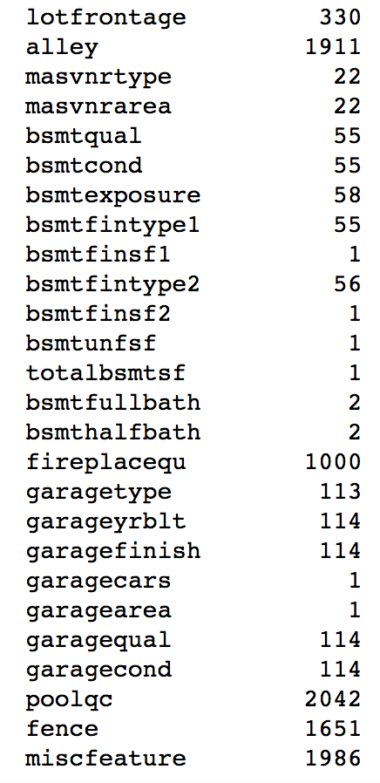
Various columns which contained null values =>
Feature name null count
Notes:
Most of the null values correspond to houses without a certain feature, e.g. pool, alley, basement

Slide 5
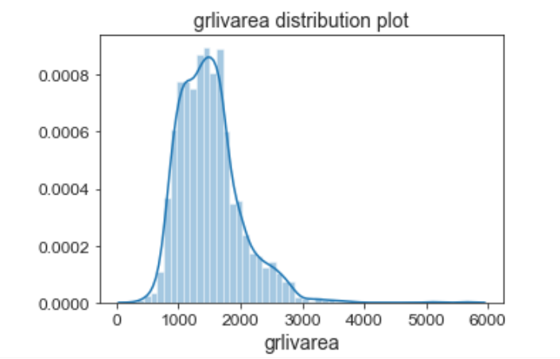
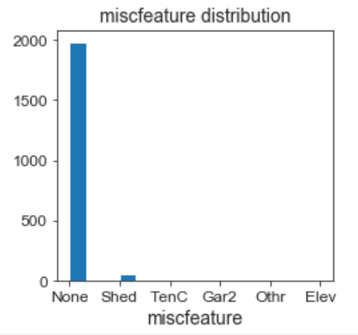
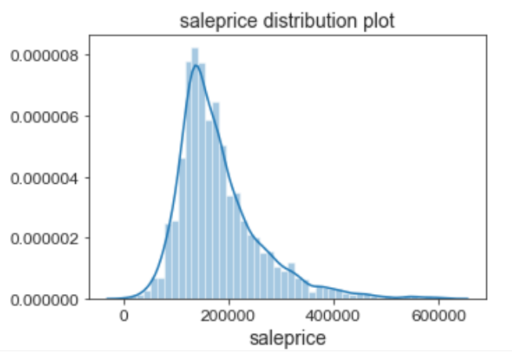
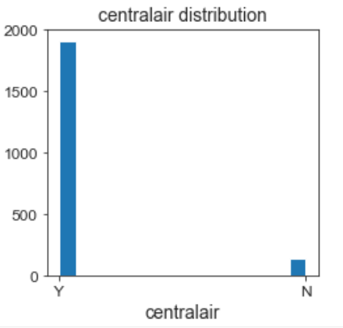
Below are columns which are heavily skewed towards a singular value.
Notes:
These are examples of distribution plots of numerical features, and histograms of categorical features. They show the frequency of each value and each category so one can get a sense of the distribution.
Above grade living area (grlivarea) and saleprice are right skewed and have some houses that were bigger and more expensive than others. Most houses had no miscellaneous features, and almost all houses had centralair.

Slide 6
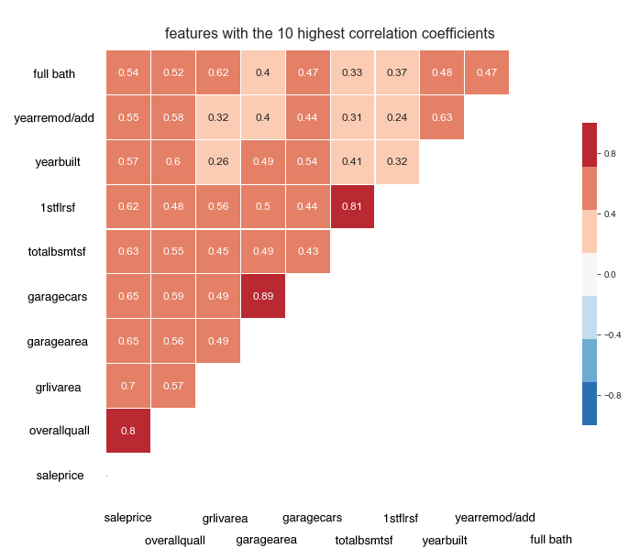
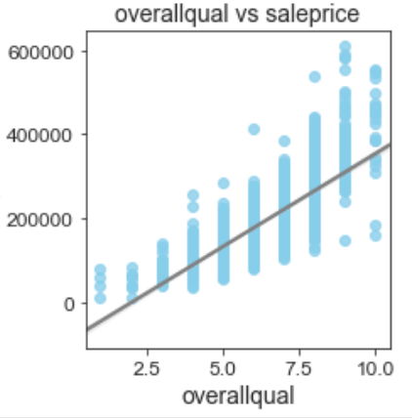
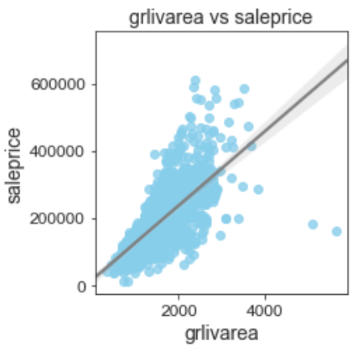
Multicollinearity & Correlation Representation within Variables
Notes:
This is a correlation heatmap of the 10 features that have the highest correlations with sales-price indicating a positively correlation with sales-price.
Overall Quality (OverallQual) presents the highest correlation with saleprice.
Through observation levels of collinearity we find between garagecars and garagearea, and 1stflrsf and totalbsmtsf are the prominent within all factors.
Looking at the top 2 features specifically, there is quite an obvious linear relationship with saleprice
There are also some collinear features.
The pairplots of these 10 features further show their relationship with saleprice, as well as the presence of collinearity (e.g. between 1stflrsf and grlivarea).

Slide 7
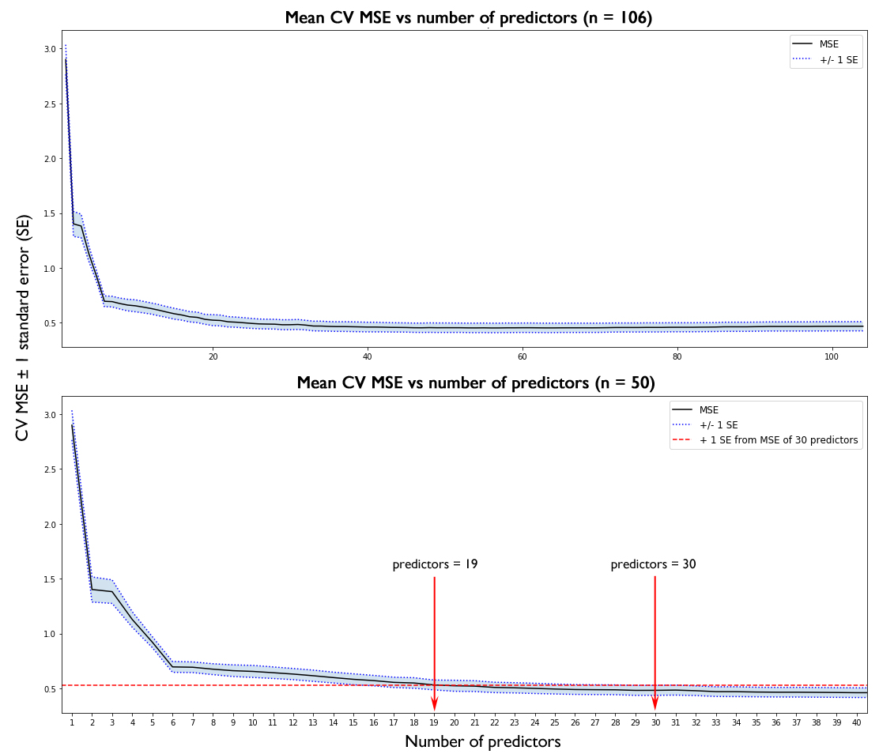
Feature selection
Notes:
These graphs plot the MSE against number of predictors. The top graph shows all 106 non-zero predictors, and the bottom graph zooms into the top 50 predictors to better visualise the trend. You can see that as the number of predictors in the model increases, MSE decreases.
MSE stops decreasing from about 30 predictors onwards
Going up one standard error from that point, we reach 19 predictors.

Slide 8
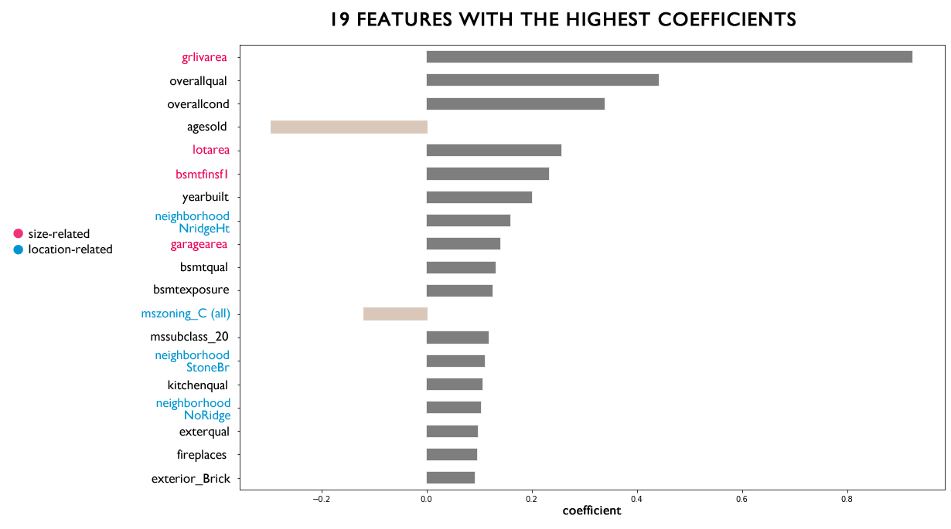
Notes:
Additionally these are the 19 top predictors, in decreasing order of importance
Observe there are two features with negative coefficients –age of the house and mszoning C (commercial) being negatively correlated with sale price. As age increases, sale price deteriorates. Residences in the commercial zone are less-expensive than others within the surrounding area.
Furthermore there are a number of size-related features (pictorially displayed in pink), and location-related features (pictorially displayed in blue). Primarily the factors which are affecting residence price was found to be size and location.
Reduction of the coefficients even further in order to allow further understanding from model one could arguably utilize the top 6 predictors. Being there is a discontinuity or “elbow” within the previous graph at 6, where the factor of MSE decreasing ceases.

Slide 9
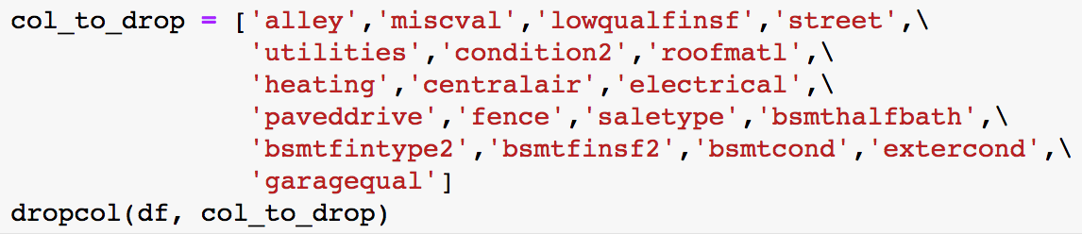
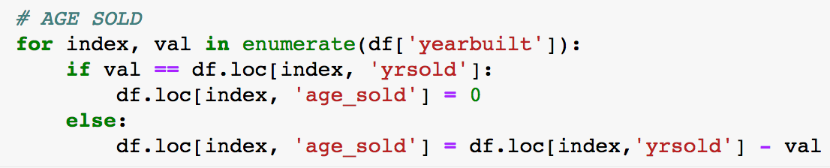
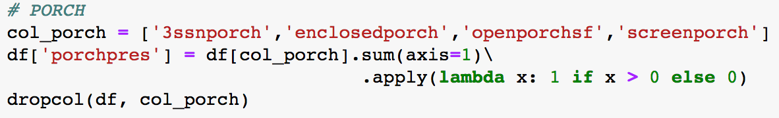
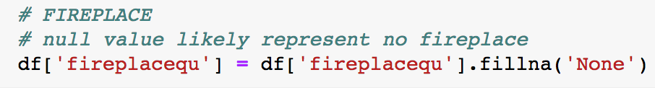
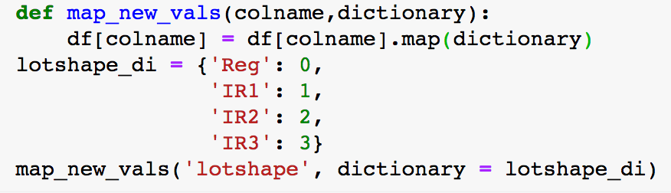
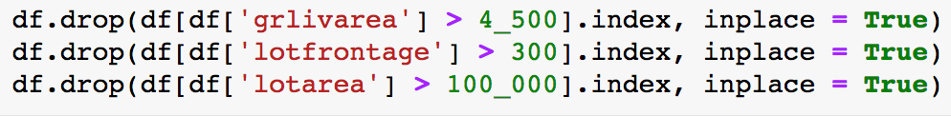
Pre-processing for Model Construction
1 | Drop columns with >80% zero or a single value | 4 | Add new columns
2 | Create ‘presence-absence’ columns | 5 | Impute missing values
3 | Convert ordinal to numerical | 6 | Remove outliers
Notes:
These are my main preprocessing steps.
1. create a dictionary to drop columns with less than 80% zero or singular values
2. establish a imaginary column called presence-absence
3. convert ordinal columns into numerical columns
4. Add new columns focusing upon the variables (YearBuilt, upon the Age-sold or Year sold)
5. imputation of any missing values
6. Exclusion of any outliers.

Slide 10
Recommendations
Important Determinant Factors of Sales-Price
Locations for Investment
Real Estate Market Fluctuations
Suggestions for Increase in Value of Residence
Notes:
1. Square-footage, condition, age, and the location of the residence within my research appeared to have the highest factor of importance for determining the sales-price.
2. Residence Investors should research Northridge Heights, Stone Brook, and Northridge locations for optimal return values.
3. Place residence for sale earlier in order to attract potential procurement clients rather than wait for any market changes to occur.
4. In order to substantially and sustainably increase the value of a residence one would recommend:
-Repaint or remodel the interior and exterior finishes.
Renovate the kitchen with modern appliances for promos, though renovation of entire design.
Include any personal amenities(open fire-place, appliances, etc) in order to increase aesthetic-based environment.
Renovation or repair of the garage, depend upon its condition; install EV-charging stations to accommodate for future innovations.
Review entire residence and renovate any other specific area which the owner would specify any required upgrades.

Slide 11
Sources:
http://jse.amstat.org/v19n3/decock.pdf
https://www.kaggle.com/c/home-data-for-ml-course
https://www.kaggle.com/c/dsir-420-project-2-regression-challenge/rules
https://www.iowarealtors.com/members/technology
https://www.kingland.com/
*Incomplete Research*
Queries or Commentary? (FAQ)
Notes:
Unfortunately during the model construction process our department encountered a massive server error which was due to a black hat infiltration This result caused our data to become completely corrupted

Slide 12
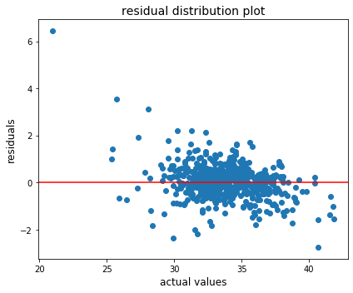
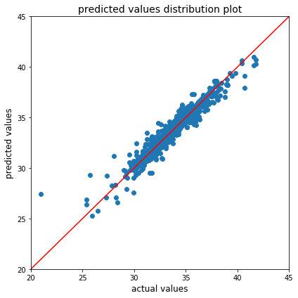
Model Performance Residual plots
Notes:
Different feature engineering approaches
Using the best model from above (elastic net), it was then used to evaluate the test data with different methods for preprocessing and feature engineering (specifically different scaling and transformation methods).
Due to how 𝑦y was transformed for each model, the RMSE of the different models tested were not directly comparable. Therefore, R² was used to select the best method for preprocessing.
Six different methods were tested, using different ways to engineer feature as listed below. Method three performed the best with the highest R² score, and had very little difference between train and test results. In general, methods where y was transformed performed better (model one and three). Method six performed the worst, when saleprice was scaled.
Method One
saleprice was log transformed
transformation of skewed features: log transform for positively skewed features, square transform for negatively skewed features
StandardScaler used on 𝑥x features
Method Two
saleprice was not transformed
transformation of skewed features: log transform for positively skewed features, square transform for negatively skewed features
StandardScaler used on 𝑥x features
Method Three
saleprice was Box-Cox transformed
transformation of skewed features: Box-Cox for all
StandardScaler used on 𝑥x features
Method Four
saleprice was not transformed
transformation of skewed features: Box-Cox for all
StandardScaler used on 𝑥x features
Method Five
same transformations as model 3
RobustScaler used on 𝑥x features instead of StandardScaler
Method Six
same transformations as model 3
StandardScaler used on 𝑥x features and saleprice
The results are summarised below:
Further examination of the residual plot using the elastic net model along with method 3 shows generally equal distribution of variance, with the exception of a few points. The plot of predicted y against true y is also genreally linear with a 1:1 relationship, except for a few outliers.

Slide 13
Test Performance
 | R² | RMSE
Baseline | -0.003 | 2.52
Simple linear regression | -1.103 | 26471299993
Ridge regression | 0.918 | 0.723
Lasso regression | 0.918 | 0.720
Elastic net regression | 0.919 | 0.719
Notes:
Regularised regressions acquire more accurate results than the simple linear regression (which performed worse than the baseline, yet predicted the mean of the training data).
Through experiments with Lasso, Ridge, and Elastic Net Regression Models; I found initially, the elastic net model performed well over the other models, with the highest R2 and the lowest RMSE. Yet with finer tuning and reduction of scope within the variables. may find other results,

