Slide 1



Trade-off between Accuracy and Computational Cost with Neural Architecture Search: a Novel Strategy for Tactile Sensing Design
Authors: Christian Gianoglio, Edoardo Ragusa, Paolo Gastaldo, Maurizio Valle

Slide 2
Introduction
Sensors Array
Raw Data

Slide 3
Introduction
Embedded Electronics
Sensors Array
Acquisition
Raw Data
Digitized Data

Slide 4
Introduction
Embedded Electronics
Elaboration System
Sensors Array
Acquisition
Raw Data
Digit. Data

Slide 5
Introduction
Embedded Electronics
Elaboration System
Signal
Processing
ML model
Sensors Array
Acquisition
Raw Data
Digit. Data

Slide 6
Introduction
Embedded Electronics
Elaboration System
Signal
Processing
ML model
Sensors Array
Acquisition
Elaborated Information
Raw Data
Digit. Data

Slide 7
Introduction
01
Limited Power Budget
Limited Storing Capacity
02
Embedded Electronics
Elaboration System
Signal
Processing
ML model

Slide 8
Introduction
01
Limited Power Budget
Limited Storing Capacity
02
Embedded Electronics
Elaboration System
Signal
Processing
ML model
Heavily Affect

Slide 9
Introduction
01
Limited Power Budget
Limited Storing Capacity
02
Embedded Electronics
Elaboration System
Signal
Processing
ML model
Heavily Affect
OUR GOAL: optimize the elaboration system balancing the effectiveness and computational cost

Slide 10
Proposed Strategy
Based on Evolutionary Neural Architecture Search

Slide 11
Proposed Strategy
Step 1
Define model hyperparameters
Define signal processing techniques

Slide 12
Proposed Strategy
Step 1
Step 2
Define model hyperparameters
Pick a signal processing technique
Define signal processing techniques
Generate a parent model

Slide 13
Proposed Strategy
Step 1
Step 2
Step 3
Define model hyperparameters
Pick a signal processing technique
Train the parent model
Define signal processing techniques
Generate a parent model
Evaluate a custom loss function^{[1]}

Slide 14
Proposed Strategy
Step 1
Step 2
Step 3
Define model hyperparameters
Pick a signal processing technique
Train the parent model
Define signal processing techniques
Generate a parent model
Evaluate a custom loss function^{[1]}
$$score=Effectiveness−θ∗Computational_Cost$$

Slide 15
Proposed Strategy
Step 1
Step 2
Step 3
Step 4
Define model hyperparameters
Pick a signal processing technique
Train the parent model
Modify the parent model
Define signal processing techniques
Generate a parent model
Evaluate a custom loss function
Pick a signal processing technique

Slide 16
Proposed Strategy
Step 1
Step 2
Step 3
Step 4
Step 5
Define model hyperparameters
Pick a signal processing technique
Train the parent model
Modify the parent model
Train the modified model
Define signal processing techniques
Generate a parent model
Evaluate a custom loss function
Pick a signal processing technique
Evaluate the loss function

Slide 17
Proposed Strategy
Repeat until a stop criterion is met
Step 1
Step 2
Step 3
Step 4
Step 5
Define model hyperparameters
Pick a signal processing technique
Train the parent model
Modify the parent model
Train the modified model
Define signal processing techniques
Generate a parent model
Evaluate a custom loss function
Pick a signal processing technique
Evaluate the loss function

Slide 18
Proposed Strategy
Repeat until a stop criterion is met
Step 1
Step 2
Step 3
Step 4
Step 5
Step 6
Define model hyperparameters
Pick a signal processing technique
Train the parent model
Modify the parent model
Train the modified model
Optimized model
Define signal processing techniques
Generate a parent model
Evaluate a custom loss function
Pick a signal processing technique
Evaluate the loss function
Best signal processing technique

Slide 19
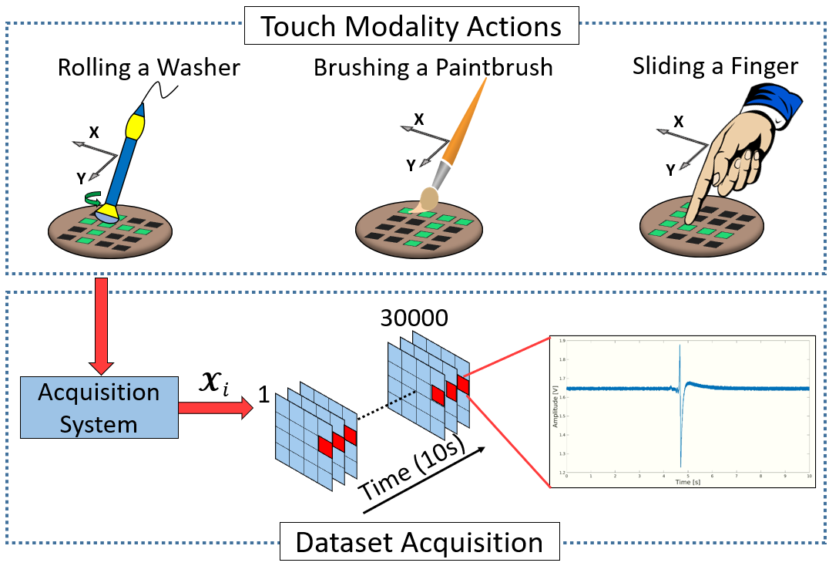
Case Study: Touch Modalities Classification
Action performed on a 4x4 sensing patch
280 data per class

Slide 20
ML Models and Signal Processing Techniques
Step 1
Three 1-D Convolutional Neural Networks:
Standard
Binary weights
Binary weights and activations
Define model hyperparameters

Slide 21
ML Models and Signal Processing Techniques
Step 1
Three 1-D Convolutional Neural Networks:
Standard
Binary weights
Binary weights and activations
Filtering techniques + Moving average with 50% overlap^{[1]}:
No filtering
Low-pass filter
Gaussian window
Decimation technique
Define model hyperparameters
Define signal processing techniques

Slide 22
Parent Model
Step 2
First parent model has 4 convolutional blocks
Signal processing technique randomly chosen
Pick a signal processing technique
Generate a parent model

Slide 23
Parent Model
Step 2
First parent model has 4 convolutional blocks
Signal processing technique randomly chosen
Pick a signal processing technique
Generate a parent model
Step 3
Train the parent model

Slide 24
Evaluation Criterion
Step 3
Evaluate a custom loss function
Number of floating-point operations (FLOPs)
Measured for both signal processing and classification stages
Memory occupation (MO)
Number of elements that must be loaded in the RAM during the inference
largest MO is the biggest tensor processed by the system

Slide 25
Iterative Procedure
Repeat until a stop criterion is met
Step 4
Step 5
Modify the parent model
Train the modified model
At each iteration two mutations are applied:
Add or remove a convolutional block
Random mutation to a convolutional layer
Stop criteria:
Maximum number of iterations
Early-stop criterion on number of times no children achieved a better score than parent model
Pick a signal processing technique
Evaluate the loss function

Slide 26
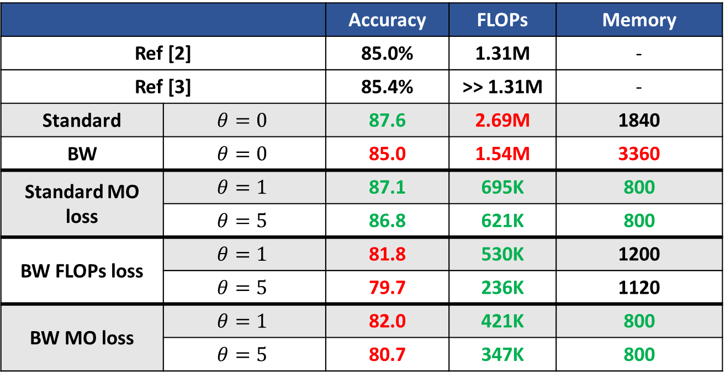
Results
 |  | Accuracy | FLOPs | Memory
Ref [2] |  | 85.0% | 1.31M | -
Ref [3] |  | 85.4% | >> 1.31M | -
Standard | $$θ=0$$ | 87.6 | 2.69M | 1840
BW | $$θ=0$$ | 85.0 | 1.54M | 3360
Standard MO loss | $$θ=1$$ | 87.1 | 695K | 800
 | $$θ=5$$ | 86.8 | 621K | 800
BW FLOPs loss | $$θ=1$$ | 81.8 | 530K | 1200
 | $$θ=5$$ | 79.7 | 236K | 1120
BW MO loss | $$θ=1$$ | 82.0 | 421K | 800
 | $$θ=5$$ | 80.7 | 347K | 800

Slide 27
Results
 |  | Accuracy | FLOPs | Memory
Ref [2] |  | 85.0% | 1.31M | -
Ref [3] |  | 85.4% | >> 1.31M | -
Standard | $$θ=0$$ | 87.6 | 2.69M | 1840
BW | $$θ=0$$ | 85.0 | 1.54M | 3360
Standard MO loss | $$θ=1$$ | 87.1 | 695K | 800
 | $$θ=5$$ | 86.8 | 621K | 800
BW FLOPs loss | $$θ=1$$ | 81.8 | 530K | 1200
 | $$θ=5$$ | 79.7 | 236K | 1120
BW MO loss | $$θ=1$$ | 82.0 | 421K | 800
 | $$θ=5$$ | 80.7 | 347K | 800
Only accuracy matters

Slide 28
Results
 |  | Accuracy | FLOPs | Memory
Ref [2] |  | 85.0% | 1.31M | -
Ref [3] |  | 85.4% | >> 1.31M | -
Standard | $$θ=0$$ | 87.6 | 2.69M | 1840
BW | $$θ=0$$ | 85.0 | 1.54M | 3360
Standard MO loss | $$θ=1$$ | 87.1 | 695K | 800
 | $$θ=5$$ | 86.8 | 621K | 800
BW FLOPs loss | $$θ=1$$ | 81.8 | 530K | 1200
 | $$θ=5$$ | 79.7 | 236K | 1120
BW MO loss | $$θ=1$$ | 82.0 | 421K | 800
 | $$θ=5$$ | 80.7 | 347K | 800
Good compromises between accuracy and cost

Slide 29
Results
 |  | Accuracy | FLOPs | Memory
Ref [2] |  | 85.0% | 1.31M | -
Ref [3] |  | 85.4% | >> 1.31M | -
Standard | $$θ=0$$ | 87.6 | 2.69M | 1840
BW | $$θ=0$$ | 85.0 | 1.54M | 3360
Standard MO loss | $$θ=1$$ | 87.1 | 695K | 800
 | $$θ=5$$ | 86.8 | 621K | 800
BW FLOPs loss | $$θ=1$$ | 81.8 | 530K | 1200
 | $$θ=5$$ | 79.7 | 236K | 1120
BW MO loss | $$θ=1$$ | 82.0 | 421K | 800
 | $$θ=5$$ | 80.7 | 347K | 800
If cost matters more than accuracy

Slide 30
Conclusion
Optimization of tactile elaboration system by an ENAS
Evaluation of a custom loss function
Standard CNNs achieved best accuracy and outperformed SoA
Binary weights CNNs presented a better computational cost with a drop in accuracy

Slide 31
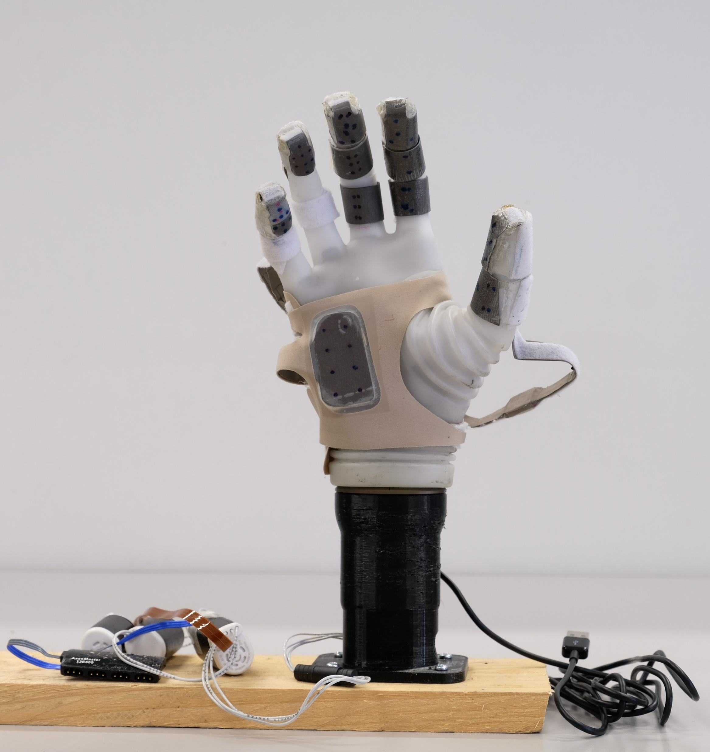
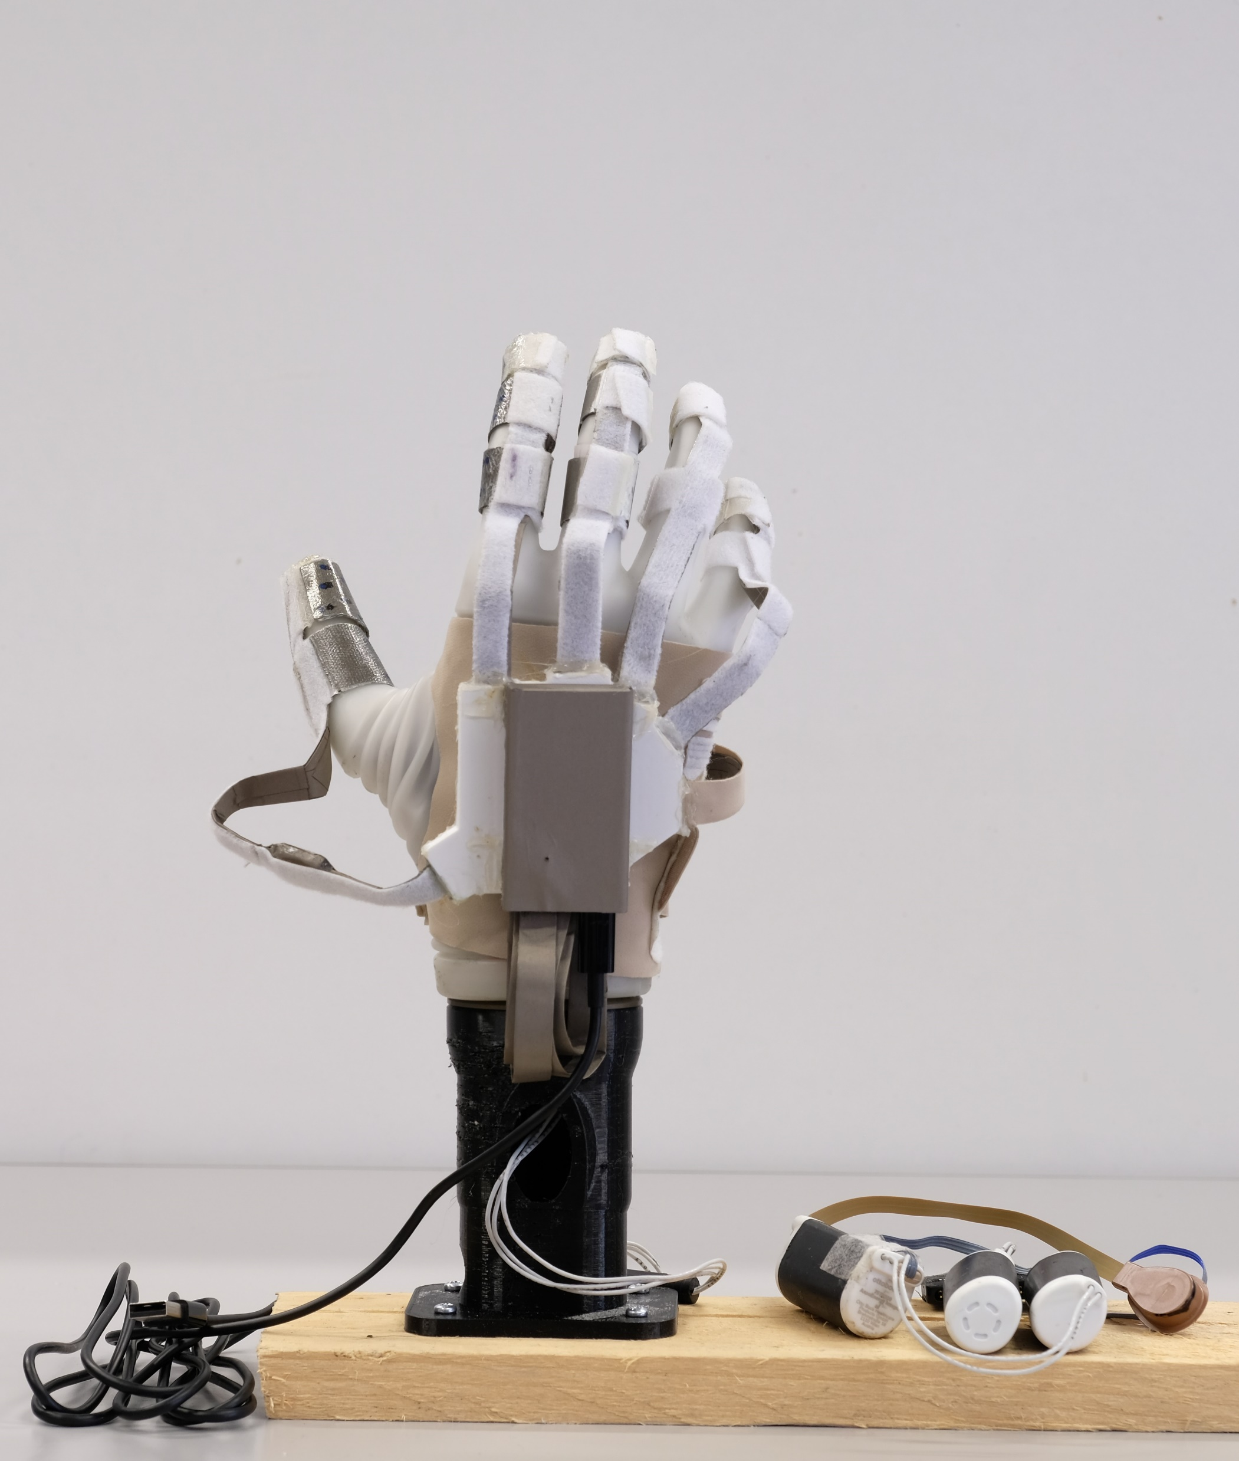
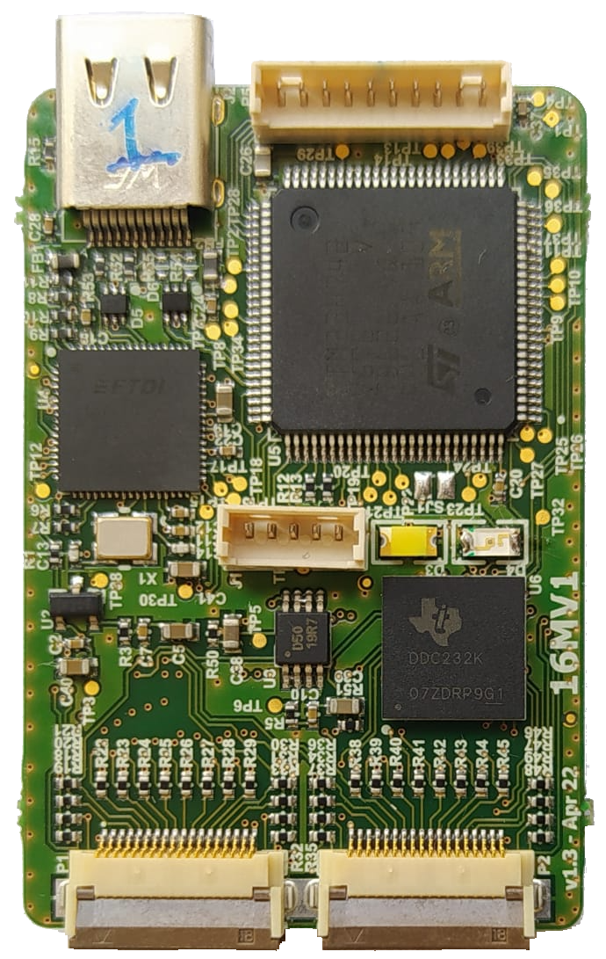
Future Works

Slide 32
Thank you for your attention!

Slide 33

Appendix: Custom Loss Function
Custom loss function^{[1]}
$i^{∗}= \underset{i}{argmin}{\hat{L_{m}}(f_{n,i}^{∗}})+θR_{H}(f_{n,i}^{∗}$)
with
$$f_{n,i}^{∗}= \underset{f∈ℱ_{i}}{argmin}{\hat{L_{n}}\left(f\right)+λR\left(f\right)}$$

Slide 34
Appendix: Custom Loss Function
Custom loss function^{[1]}
$i^{∗}= \underset{i}{argmin}{\hat{L_{m}}(f_{n,i}^{∗}})+θR_{H}(f_{n,i}^{∗}$)
with
$$f_{n,i}^{∗}= \underset{f∈ℱ_{i}}{argmin}{\hat{L_{n}}\left(f\right)+λR\left(f\right)}$$
Trained algorithms,
indexed by different values of hyperparameters
Regularization term
Empirical risk on the training set

Slide 35
Appendix: Custom Loss Function
Custom loss function^{[1]}
$i^{∗}= \underset{i}{argmin}{\hat{L_{m}}(f_{n,i}^{∗}})+θR_{H}(f_{n,i}^{∗}$)
with
$$f_{n,i}^{∗}= \underset{f∈ℱ_{i}}{argmin}{\hat{L_{n}}\left(f\right)+λR\left(f\right)}$$
Best hyperparameters configuration
Regularization term on the computational cost
Empirical risk on the validation set

