Slide 1
Predictive Maintenance of Industrial Machinery
CAPSTONE PROJECT
Presented By:
Rahul Paul
-Department of Computer Science and Engineering
- Tezpur University.

Slide 2
OUTLINE
Problem Statement
Proposed System/Solution
System Development Approach
Algorithm & Deployment
Result
Conclusion
Future Scope
References

Slide 3
Problem Statement
Develop a predictive maintenance model for a fleet of industrial machines to anticipate failures before they occur. This project will involve analyzing sensor data from machinery to identify patterns that precede a failure. The goal is to create a classification model that can predict the type of failure (e.g., tool wear, heat dissipation, power failure) based on real-time operational data. This will enable proactive maintenance, reducing downtime and operational costs.

Slide 4
Proposed Solution
The proposed system will utilize IBM's AutoAI on the watsonx.ai platform to build a high-accuracy predictive maintenance model. AutoAI automates the end-to-end process of machine learning model development, allowing for the rapid creation and deployment of a solution.
The solution will consist of the following components:
Data Collection:
The project will use the "Machine Predictive Maintenance Classification" dataset from Kaggle. This dataset contains historical operational data and failure records for industrial machinery.
Data Preprocessing (Automated by AutoAI):
The AutoAI tool will automatically handle essential data preparation steps, including cleaning the data, handling any missing values, and encoding features for optimal model performance
Automated Model Building (AutoAI):
AutoAI will streamline the model creation process through:
Algorithm Selection: It will test and evaluate multiple classification algorithms to find the most suitable one for predicting machine failures.
Feature Engineering: It will automatically create new, insightful features from the raw sensor data to improve the model's predictive power.
Hyperparameter Optimization: It will fine-tune the selected algorithms to achieve the highest possible accuracy.

Slide 5
Proposed Solution
Deployment:
The best-performing model pipeline discovered by AutoAI will be deployed as a web service on IBM Cloud. This creates a scalable and reliable API endpoint for making real-time failure predictions.
Evaluation:
The model's ability to predict failures will be rigorously evaluated using key classification metrics:
Accuracy: The overall percentage of correct predictions.
Precision and Recall: To measure the model's performance for specific failure types.
F1-Score: The harmonic mean of precision and recall, providing a single score for model quality.
Confusion Matrix: To visualize the model's accuracy across different failure classes.

Slide 6
System Approach
SYSTEM APPROACH
The development strategy for the predictive maintenance system is centered around the integrated and automated environment of IBM's cloud services.
System Requirements:
An active IBM Cloud Lite account.
Provisioned instances of the following core services:
watsonx.ai Studio
Watson Machine Learning
Libraries and Frameworks Utilized by AutoAI:
While AutoAI provides a no-code interface, it leverages a powerful stack of open-source machine learning libraries in the background, including:
Scikit-learn: For a comprehensive suite of data preprocessing tools and classification models.
XGBoost & LightGBM: For state-of-the-art gradient boosting algorithms known for their high performance.

Slide 7
Algorithm & Deployment
Algorithm Selection (Automated by AutoAI):
AutoAI will run a competition among various classification algorithms such as Logistic Regression, Decision Trees, Random Forests, and Gradient Boosting Machines. It will automatically select and present the top-performing algorithms based on their predictive accuracy on the dataset.
Data Input:
The model will be trained on the Kaggle "Machine Predictive Maintenance Classification" dataset. The input features include sensor readings like air temperature, process temperature, rotational speed, torque, and tool wear, along with the corresponding failure type.
Training Process (Automated by AutoAI):
The training process is fully automated. AutoAI ingests the dataset, splits it for training and validation, and then systematically applies a wide range of data transformations, feature engineering techniques, and model training routines. It performs hyperparameter optimization to ensure the final model is highly tuned for this specific task.
Prediction Process:
Once deployed, the model will function via an API. A system can send a set of current sensor readings from a machine to this API. The model will then return a prediction, indicating whether the machine is operating normally or is likely to experience a specific type of failure soon.
Deployment:
The final, optimized model pipeline from AutoAI will be promoted to a deployment space within the Watson Machine Learning service. An online (real-time) deployment will be created, which provides a REST API endpoint for integration with other applications.

Slide 8
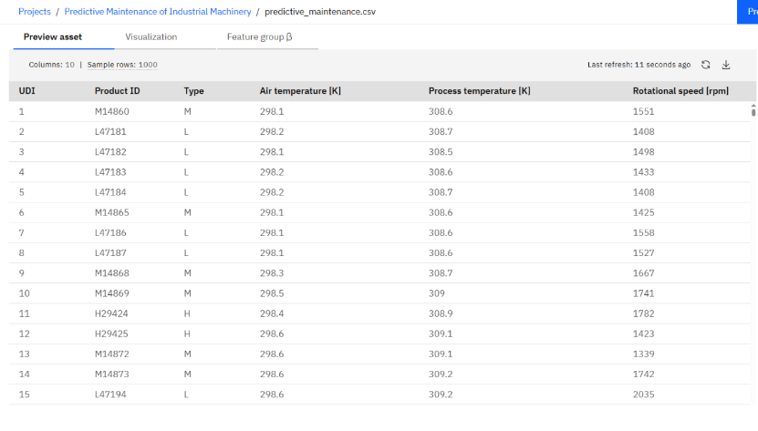
Result
DataSet:

Slide 9
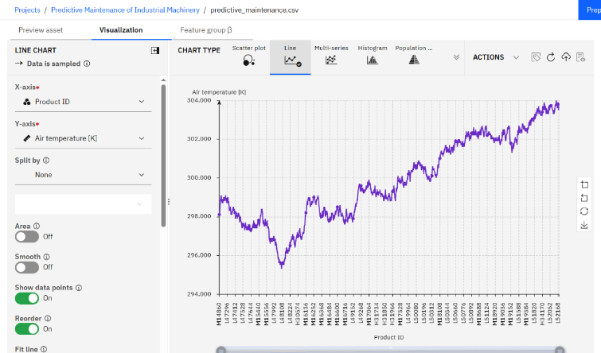
Result
DATASET ANALYSIS:

Slide 10
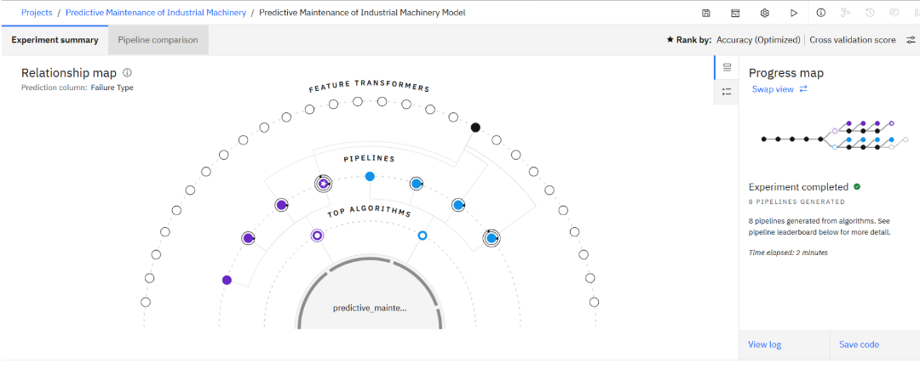
Result

Slide 11
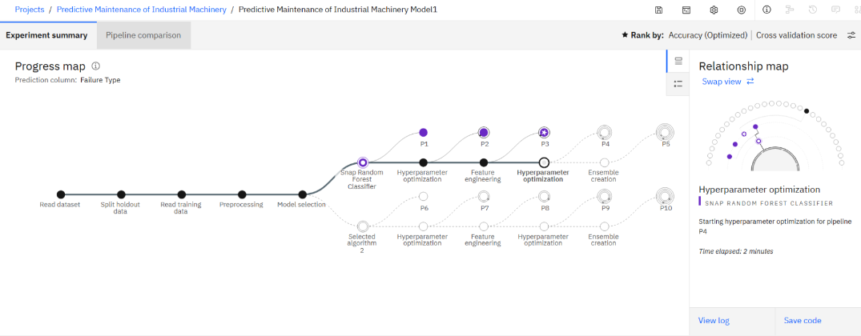
Result

Slide 12
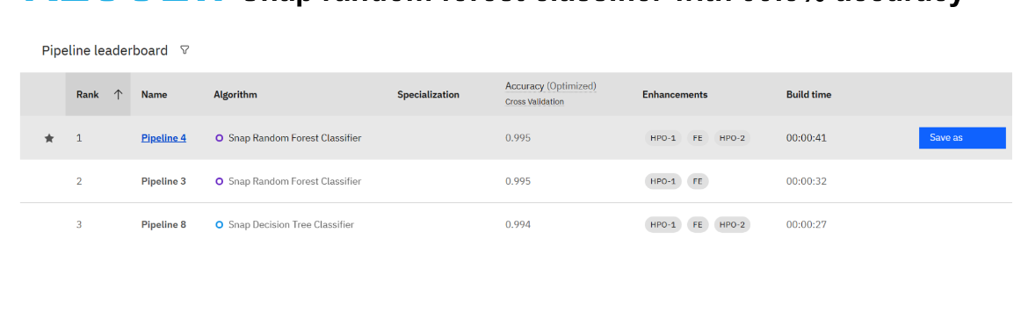
Result

Slide 13
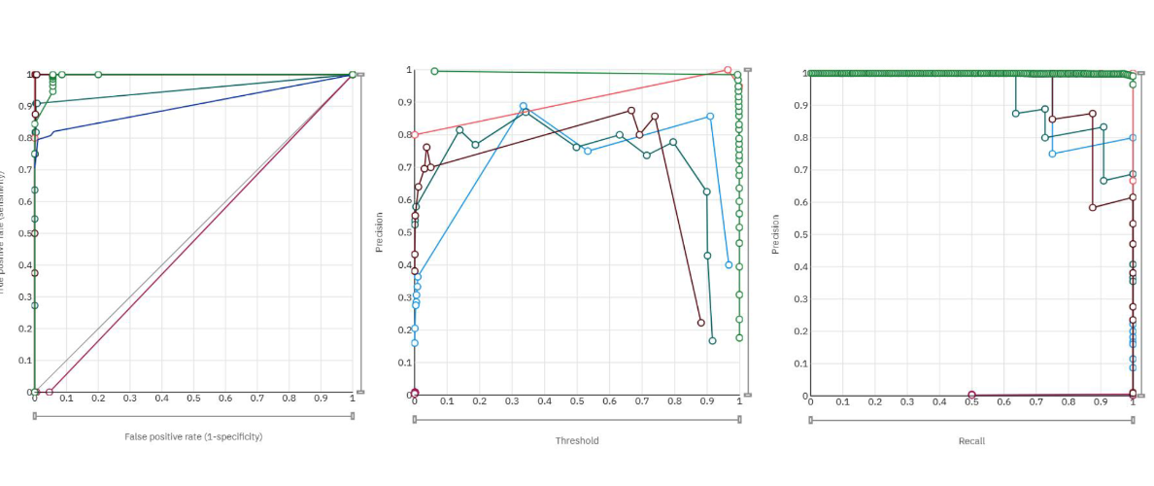
Result

Slide 14
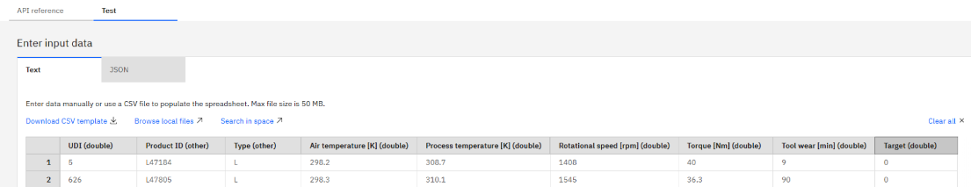
Result
TESTING:

Slide 15
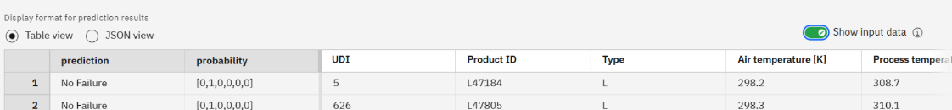
Result
Final Results

Slide 16
Conclusion
This project successfully demonstrates the development of a predictive maintenance system using IBM's AutoAI on watsonx.ai. The use of an automated platform like AutoAI proves to be highly effective in tackling complex industrial challenges, drastically reducing the time and expertise required to build and deploy a high-performance machine learning model. The resulting solution provides a clear pathway for businesses to minimize operational downtime, reduce maintenance costs, and improve overall industrial efficiency.

Slide 17
Future scope
The current system provides a strong foundation that can be expanded upon in several ways:
Real-time Data Streaming: Integrate the deployed model with live data streams from IoT sensors on actual factory floor machinery for immediate, real-time failure prediction.
Remaining Useful Life (RUL) Prediction: Develop a regression model to predict the remaining time before a component is expected to fail, allowing for even more precise maintenance scheduling.
Root Cause Analysis Integration: Enhance the system to not only predict a failure but also to suggest the most likely contributing factors based on sensor data patterns.
Edge Deployment: Deploy the trained model onto edge computing devices located near the machinery. This would reduce latency and allow for predictions even without a constant internet connection.

Slide 18
References
REFERENCES
B, S. (2020). Predictive Maintenance Dataset. Kaggle. Retrieved from https://www.kaggle.com/datasets/shivamb/machine-predictive-maintenance-classification
IBM. (n.d.). AutoAI. IBM. Retrieved from https://www.ibm.com/watson/ai-and-data/autoai
IBM. (n.d.). Watson Machine Learning. IBM. Retrieved from https://www.ibm.com/cloud/watson-machine-learning
GeeksforGeeks. (2024). Predictive Maintenance using Machine Learning.
Towards Data Science. (2020). A practical guide for Predictive Maintenance.

Slide 19
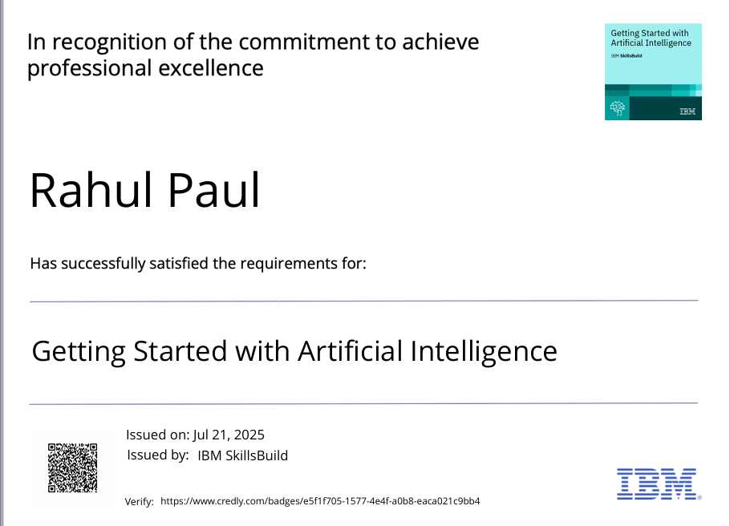
IBM Certifications

Slide 20
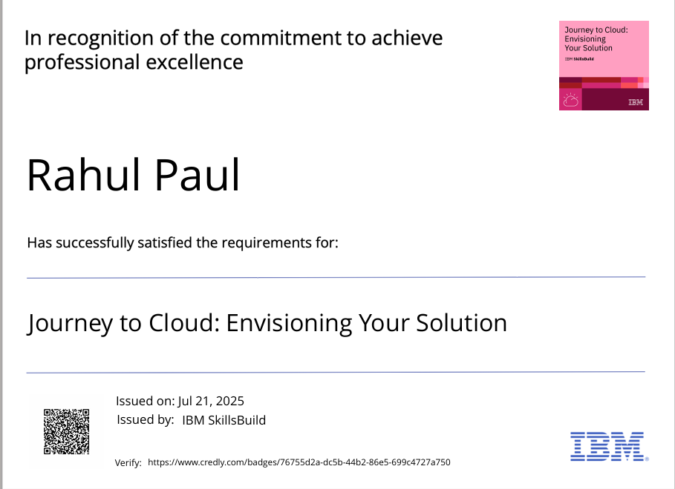
IBM Certifications

Slide 21
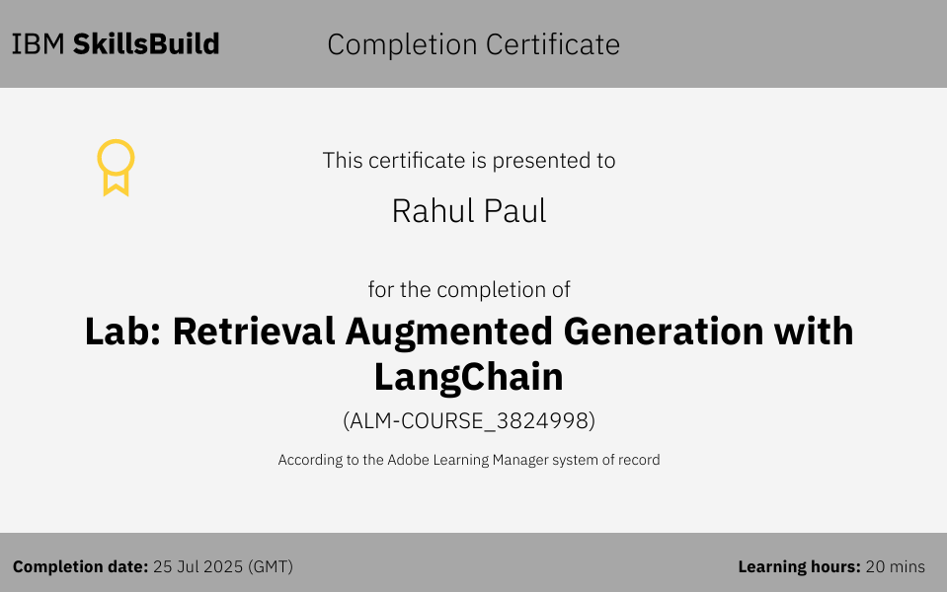
IBM Certifications

Slide 22
THANK YOU

