Slide 1
Understanding how casual riders differ from members
July 2022
Suvradri Maitra

Slide 2
Goals for our discussion today
Analyse trends in the ridership data over the past 12 months - we will cover last 12 months of ridership data from Cyclistic and analyse the trends the data shows us
Analyse the differences in ridership habits of the Members and Riders - we will find out how the casual riders differ from the members in their usage of service provided by Cyclistic
Share recommendations for the company to increase its profits in the long run

Slide 3
Analysing historical data

Slide 4
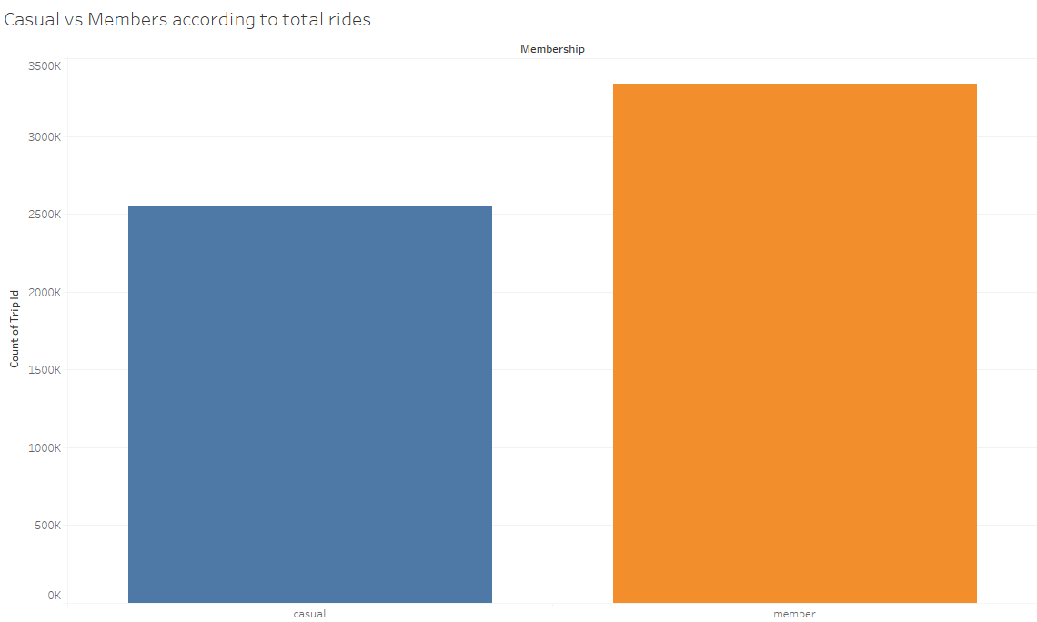
Annual members surpass casual riders in total trips
Notes:
Annual members make more rides in the last 12 months than casual riders - to get a detailed insight we will be analysing ridership data according to the day of the week, next

Slide 5
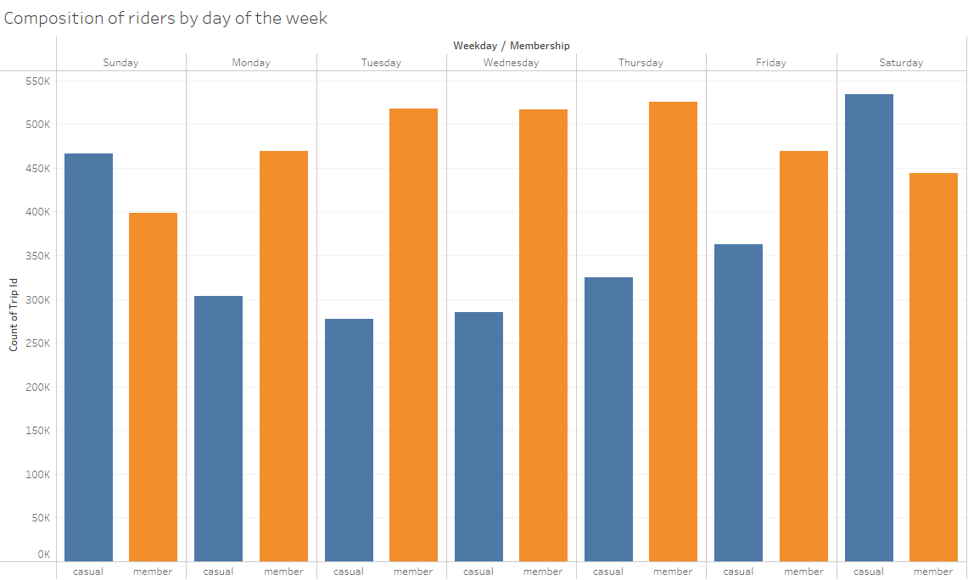
Casual riders avail more rides during the weekends
Notes:
- Weekends see more riders than weekdays
- Members avail more rides during the midweek than the weekends
- Casual riders avail more rides during the weekends, surpassing the member riders in those two days
Next, we will look at the ridership data by months

Slide 6
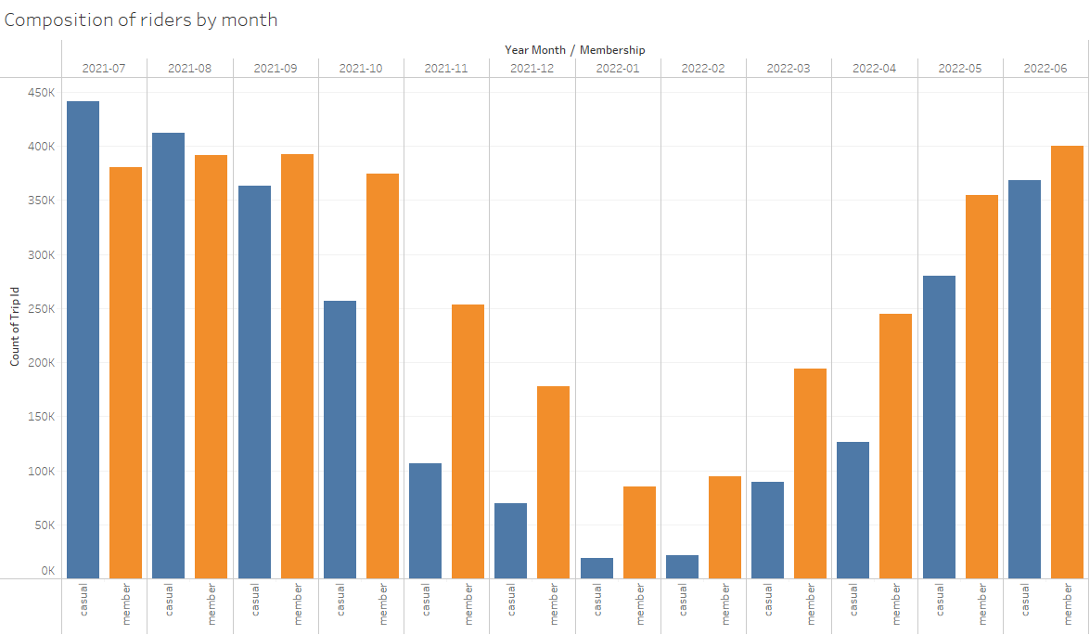
Casual riders are more in warm months than in colder months
Notes:
- Warm months have more riders than cold months
- Total ridership peaks in mid year
- Ridership varies greatly among casual riders in the warm and cold months
- Significant portion of the riders in cold months are members
- Mid-year ridership of casuals and members are comparable
Next we will look at the preference of bike/ride types according to the memberships

Slide 7
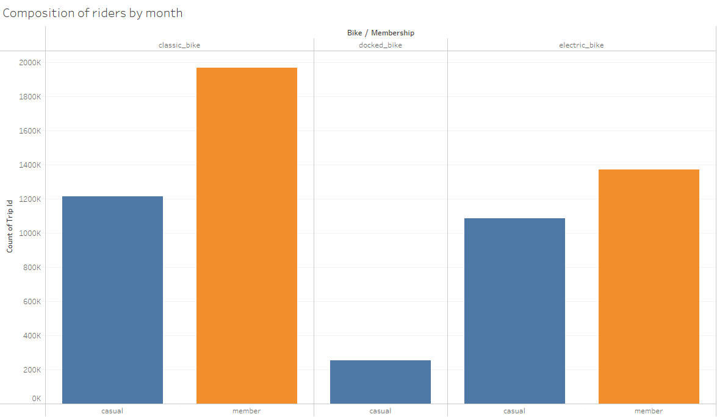
Casual riders use docked bikes while members don’t
Notes:
- People using docked bikes are very small compared to other ride types
- Preference for classic bikes and electric bikes is close for casual riders
- Members prefer classic bikes than electric bikes

Slide 8
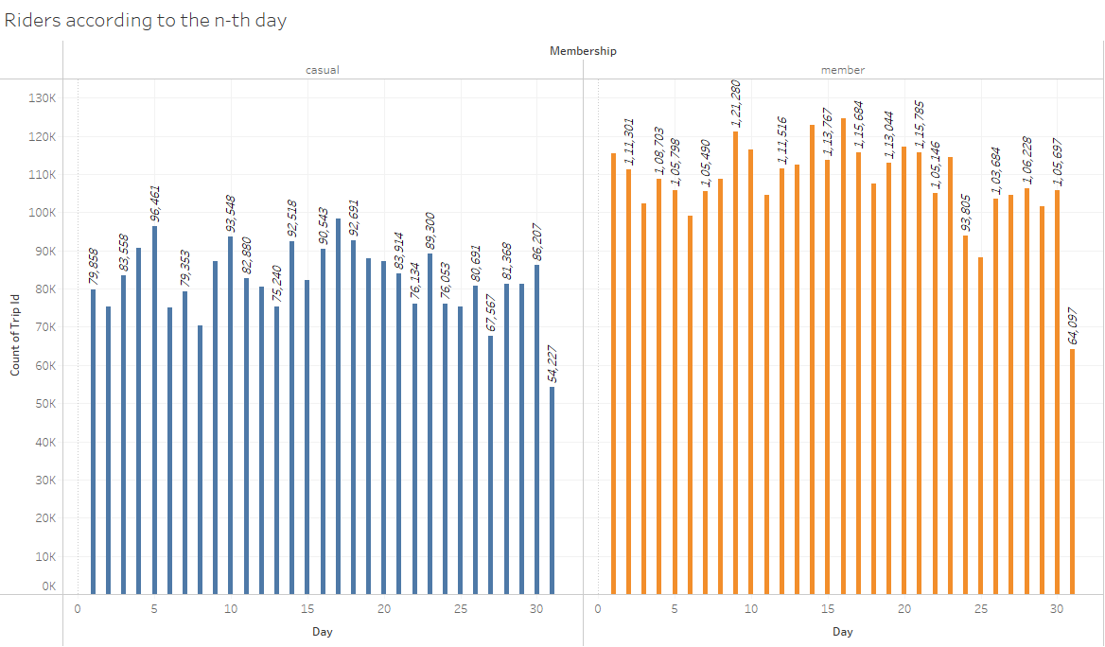
Casual riders vs members according to the n^{th} day
Notes:
- 31st has the minimum value for both casual and member riders since only few months have 31st day
- Ridership for members peak at the middle of the month
- First half of the month sees more members than the second half
- Ridership for casuals increases till the middle of the first week and drops significantly at the end of the week, rising to a 'local' peak at the 10th of the month and again drops at the end of the week, followed by a rise on 17th and drops gradually for the rest of the month except for a sudden rise at the end of the month
- Fluctuation in ridership is more in the first half than in the second half
Next we will look at the riding time of the different membership classes and wrap up

Slide 9
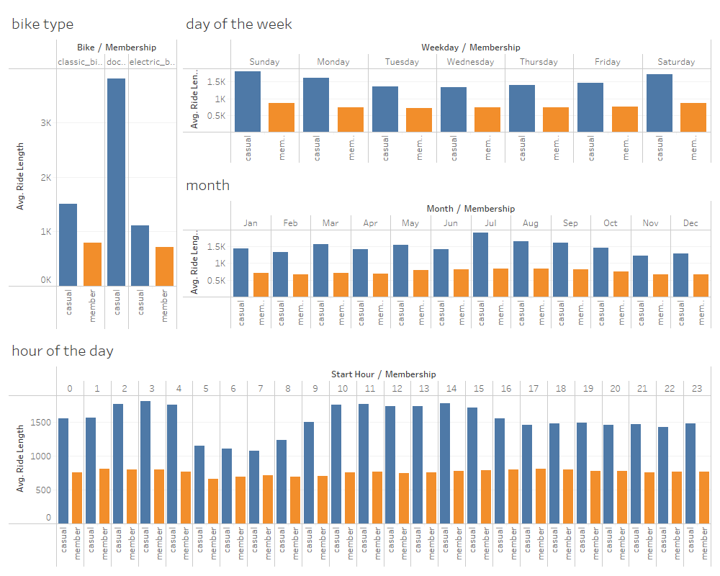
Casual riders
spend more
time in riding
than members
Notes:
- casuals spend more times in the weekends
- casuals spend least time in mid-week
- members' riding time remain comparable throughout
- riding time of members remain comparable throughout the day
- riding time of casuals peak at noon and valleys in the morning
- casuals spend more time on classic bike than electric bike
- members spend almost equal time on classic bike and electric bike

Slide 10
Recommendations
Weekend membership plan
Since we have seen that the casual riders travel more in weekends, this type of membership will attract at least those casual riders who avail Cyclistic services every weekend.
Bi-annual membership plan
Since we see that casual riders avail the services more in the warm months, this type of membership will attract casual riders into becoming a member for half a year.
Discounted membership plan
This would also attract casual riders since we have seen that casual riders travel for a longer duration than members.

Slide 11
Thank you

