Slide 1
VCL Task
Sampath Koti

Slide 2
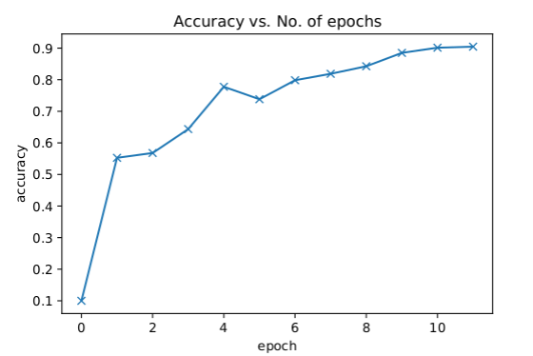
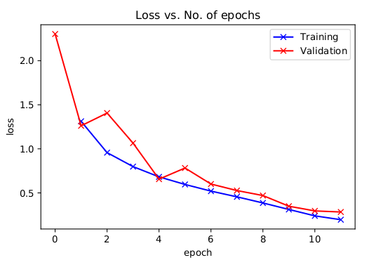
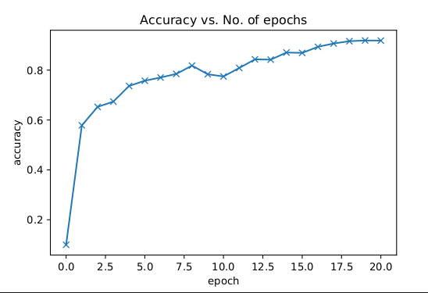
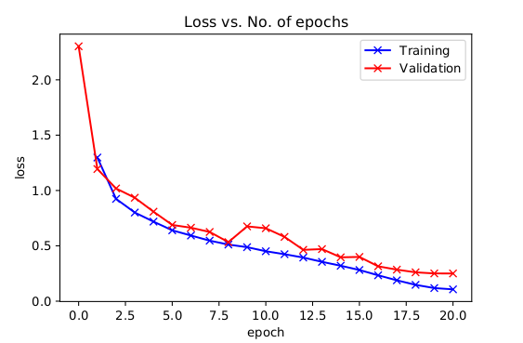
Task 1
Trained a CNN model on CIFAR-10 ,the following are the results for 10 epochs training and 20 epoch training.
The accuracy for the 10 epoch was 90.46% and the accuracy for the 20 epoch run was 91.88%

Slide 3
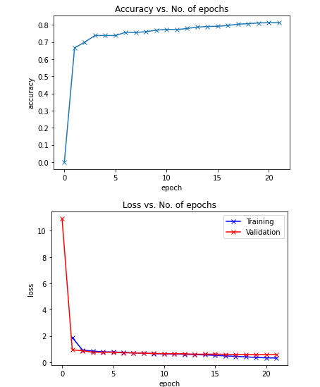
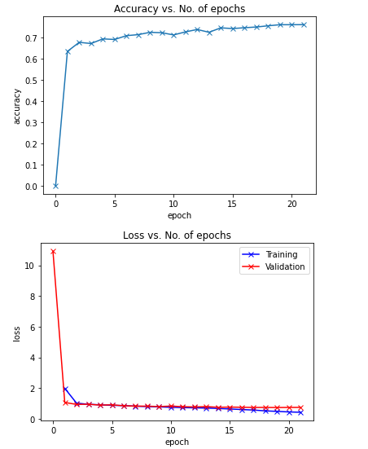
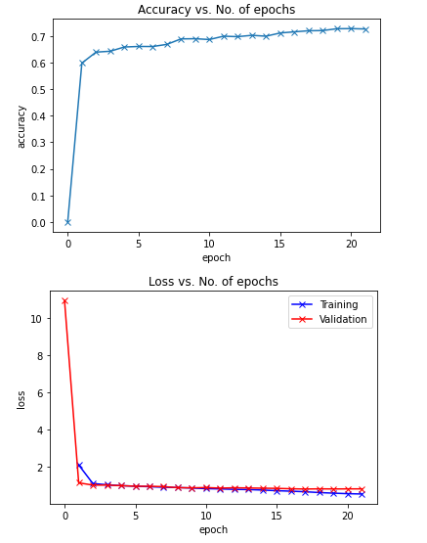
Task 2(transfer learning)
Trained a pre-trained ResNet18 on CIFAR-10 , got an accuracy of 81.2% on 10% freezing,75.97 on 20% freezing and 72.6 on 30% freezing. The following are the graphs of the same, there is a clear trend of decrease in accuracy as the freezing percentage increases.
10% freezing
20% freezing
30% freezing

Slide 4
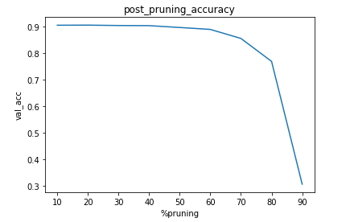
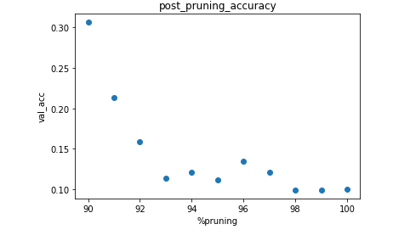
Task 3(Model Pruning)
Following are the graphs depicting accuracies of pruning effect on M1 model.
10%-90% pruning
90%-99% pruning
Observations:
-Accuracy drops to 30.65% on 90% pruning and goes below 30.65% on further pruning
-The model is able to maintain an accuracy upwards of 90% up to 40% pruning
-This shows most of the parameters in the model are useless and can be pruned saving memory and reducing forward computation time.

Slide 5
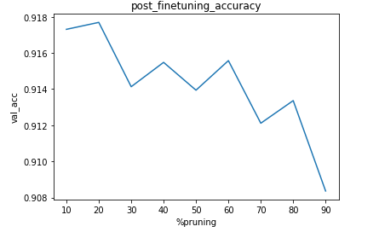
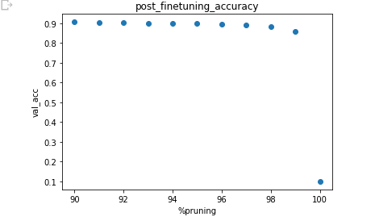
Task 4(Model Pruning and finetuning)
Following are the graphs depicting accuracies of pruning effect on M1 model.
10%-90% pruning
90%-99% pruning
Observations:
-The model is able to maintain an accuracy upwards of 90% up to 90% pruning post fine tuning but cannot reach an accuracy of 91.88%(original accuracy ) on pruning and finetuning.
-The model is able to maintain accuracy near 90% up to a pruning of 96% and above 88% accuracy up to 98% pruning and the accuracy drops to 85.8% on 99% pruning.

Slide 6
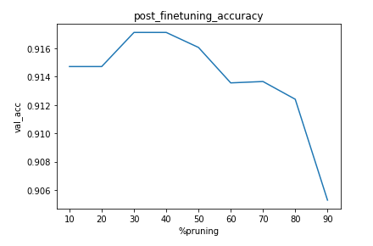
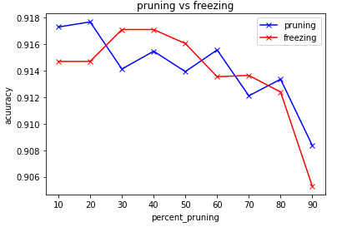
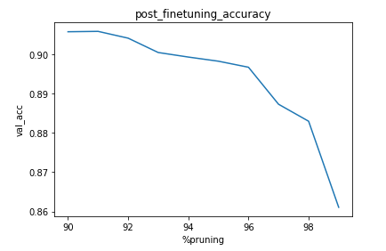
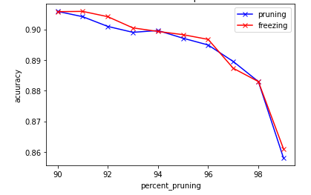
Task 5(Model Freezing and finetuning)
Following are the graphs depicting effects of freezing the weight that were pruned on M1 model.
10%-90% pruning
90%-99% pruning
Observations:
-The model is able to maintain an accuracy upwards of 90% up to 90% pruning post fine tuning but cannot achieve an accuracy of 91.88%(original accuracy) on freezing and finetuning.
-In an overall trend pruning and finetuning give better accuracy in comparison with freezing and fine tuning up to 90% pruning
,whereas freezing give better accuracy in comparison with pruning and finetuning from 90-99% pruning

Slide 7
THANK YOU

