Slide 1
Angular 2+

Slide 2
1. What is Angular?
Angular is a JavaScript framework and therefor it runs in the browser.
“Single page application” only one page is shipped from the server
after the page was loaded, angular changes only parts of the DOM which needs to be updated
so it allow us to change the content of the page after it has been loaded.
https://www.w3schools.com/js/js_htmldom.asp

Slide 3
2. AngularJs vs Angular
AngularJs 1.0 was released in 2012 and has dominated the world of open-source JavaScript frameworks and was heavily used in both enterprises and individual projects.
As a result, Angular evolved from AngularJs 1.x to Angular 2.0+, the latest released version is Angular 9.

Slide 4
2.1. AngularJS
it uses pure javascript.
The architecture is based on MVC and also uses HTML as a template language by extending HTML attributes with Directives and binding data to HTML with expressions.
AngularJs creates an environment that is readable, and quick to develop.

Slide 5
2.2. Angular 2+
it uses Typescript, which is a language created by Microsoft
Typescript doesn’t run in the browser but it can be compiled to javascript.
Typescript, unlike Javascript, is strongly typed and if we assign a wrong type to a typed attribute, we get a warning;
the benefits of ES6 like iterator and lambdas.

Slide 6
3. Let’s get started
Because in Angular 2+ we use typescript, we will have a more complex workflow. We can’t just import the Angular framework as a <script> file in the HTML page as it is in AngularJs 1.x.
we need a different setup: a project in which we can write typescript code and in the end we compile to JavaScript.
setting up such a workflow can be relative complex because the Angular framework itself is not a trivial framework, there is an essential tool that can be used, Angular CLI

Slide 7
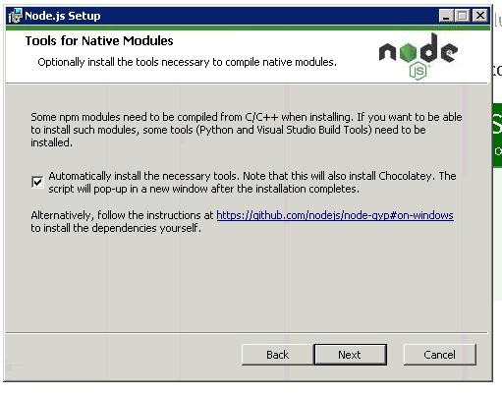
3.2. NodeJs and npm
Download and install nodeJs: https://nodejs.org/en/download/
Check the option to install chocolatey:
(The installation will take a while,
Don’t panic! )
Run node –version
Run the commands from previous slide
for AngularCLI (Because we installed
AngularCLI, we also have access to “ng”
command)

Slide 8
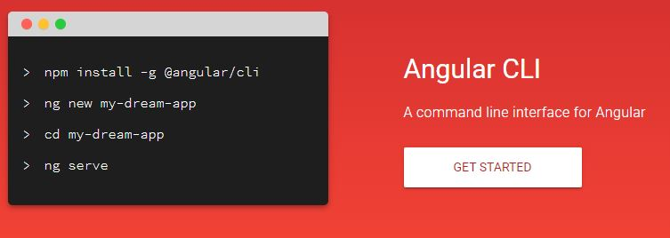
3.1. Angular CLI
a tool provided by the angular team to make it easy to get started with creating Angular applications;
https://cli.angular.io/ - can find the installation instructions and how we can open the default application it comes with;

Slide 9
Instructions from Angular CLI (for copy paste ☺ )
open a command line
npm install –g @angular/cli
ng new my-dream-app
cd my-dream-app
ng serve
We can see the “npm” command which comes from “node package manager” and we need to install nodeJs to be able to use the npm command.
npm install @angular/flex-layout@latest --save

Slide 10

4. Create our first angular application
Go to the folder where you want to create your application and open command line
ng new end-to-end-app - creates the project and install all the dependencies it needs
select to add routing and CSS!
(the installation will take a while, don’t panic!)

Slide 11

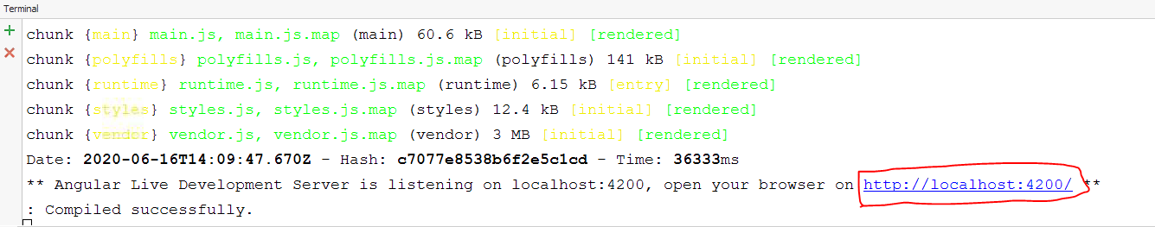
navigate to the project folder
run ng serve - will spin up the development server which hosts your Angular application so you can see like it would run on a real server;
it will be server from this link: http://localhost:4200 which is also outputed in the ng serve log

Slide 12
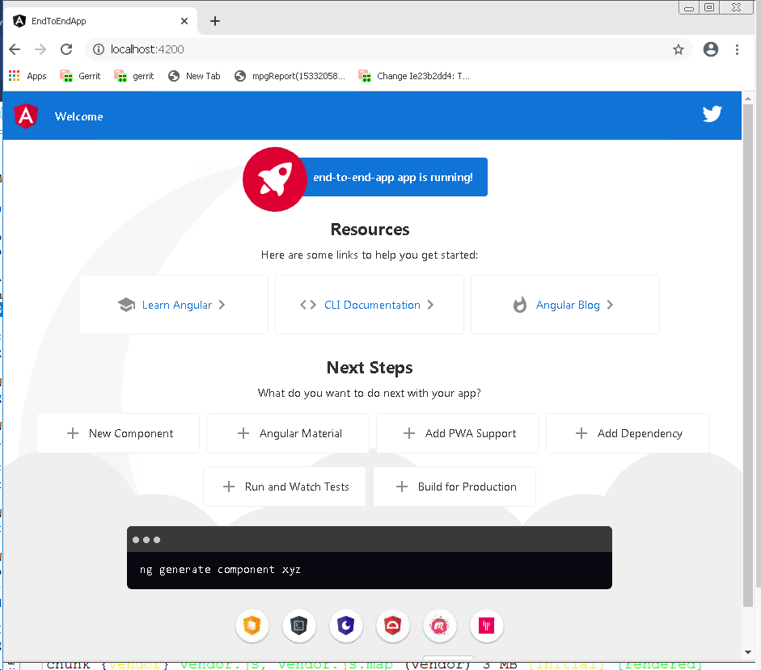
Open browser and navigate to: http://localhost:4200
The default application
created by angular/cli:
ng new end-to-end-app

Slide 13
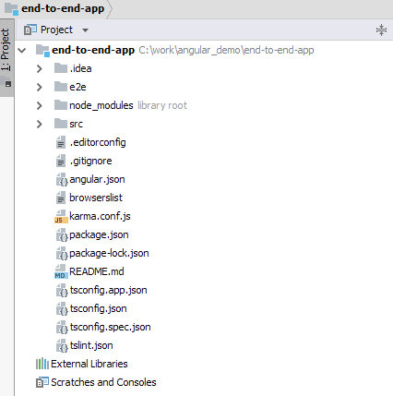
5. Explore the application package
Angular.json - manages some
general configuration settings
for the project;
Karma.config.js - for tests

Slide 14
Package.json - manages all the dependencies used in the application (npm manages all the packages and CLI uses npm under the hood)
Tsconfig.json - configure the typescript compiler
Tslint - to make sure we write clean code and provide warnings;
-------------------------------------------------------------------------------------------------
“node_modules” folder - all the dependences which were installed with npm
“dist” folder – is generated after ng build
- it creates the build of your project , converts all your ".ts files" and other files to the simple js files that browser can understand.
- P.S.: if you open index.html file inside dist folder the whole project will run.
---------------------------------------------------------------------------------------------------

Slide 15
In SRC folder:
“app” package - we use most of the time
“assets” package - were we can store static assets like images
“environments” package - manage diff environment variables: dummy URL in dev, and real URL during production
Index.html
Main.ts - contains angular code, responsible with starting our angular application
Polyfils.ts - to make our app work on older browsers
Style.css - global style

Slide 16
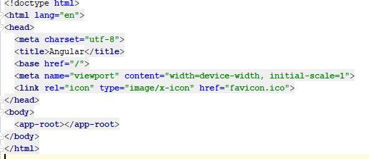
6. How Angular starts
If we go to index.html
<app-root></app-root> -> it’s not a normal html element, also we don’t import any scripts and we don’t write any scripts
-> important in loading our app

Slide 17
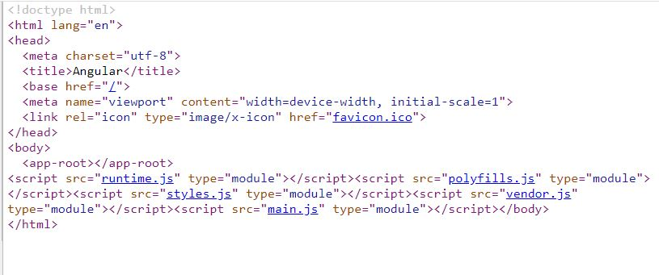
after we run ng serve and we navigate to http://localhost:4200
right click -> view page source
The workflow managed and set up by CLI, after compiling and bundle our code, it takes this “code” and injects the import statements in the index.html at the bottom of the file:

Slide 18
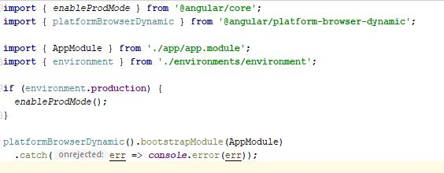
In Main.js which is main.ts:
starts our angular application
importing some objects from angular framework and also importing AppModule;
platformBrowserDynamic -> starts the angular application-> AppModule

Slide 19
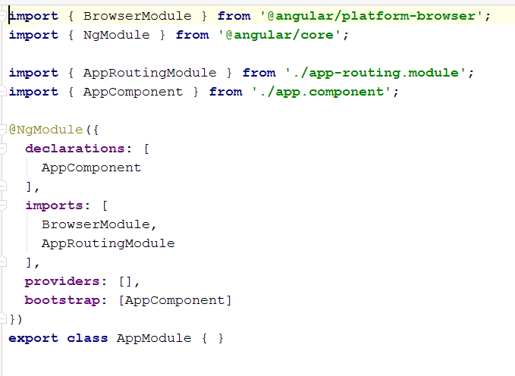
App.module.ts -> tells angular which modules and components this application actually use;

Slide 20
How Angular Application starts?
it scans the index.html where it imports our javascript files
it kick starts our main.ts
it takes a look at which feature our application uses -> app.module.ts
then has a look at these features. Ex: app.component.ts
and then it understands the rest of the index.html and renders the content of out app <app-root></app-root>

Slide 21

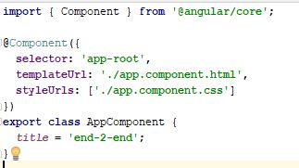
7. Component structure
7.1. AppComponent:
7.1.a. Typescript file: app.component.ts:

Slide 22
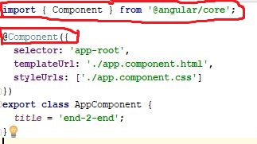
@Component -> another typescript feature, a decorator in typescript
To inform Angular that this is a component we add @Component;
The @Component contains some logic defined from angular framework
The @Component is a typescript feature, but the logic is from angular

Slide 23
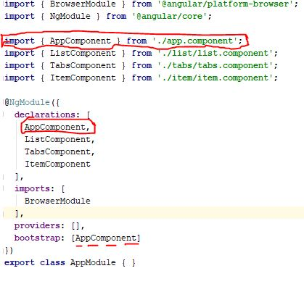
app.module.ts – we declare a component and also we need to
add every new component.
import {AppComponent} from ‘./app.component’
-> the .ts is omitted because it is added
by the build flow;
-> import is a typescript feature, is not angular,
it is required to know where it can find the class;

Slide 24
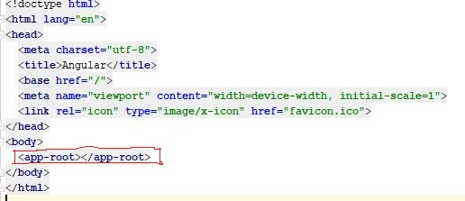
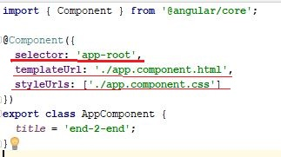
export class AppComponent{} -> what comes after export, it means it can be used in another file.
-> export and class are featured shipped with javascript 6;

Slide 25
The html we write in our component, in app.component.html for example, is the template of the component.
we write the html we want to render when this component is being rendered.
Angular component gets rendered to the screen by angular. Angular will adjust the DOM after the page was loaded.
The code from component html files, will not be loaded as html page, it will be parsed by angular and translate it into javascript and adjust the DOM according when the time comes;

Slide 26

7.1. Create components with Angular CLI
Example: Generate component “user-detail”:
Command:
ng generate component user-detail
Shortcut Command:
ng g c user-detail
Generate component without test file Command:
ng g c user-detail --skipTests=true

Slide 27
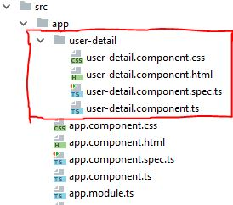
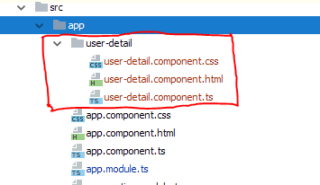
“user-detail” component generated with Angular CLI
ng g c user-detail --skipTests=true

Slide 28
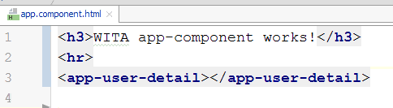
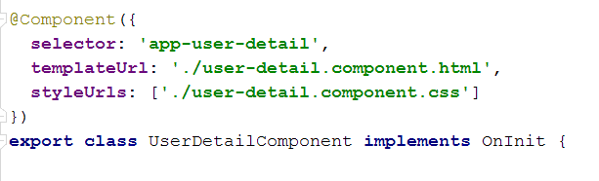
Go to app.component.html and replace the content with:
where <app-user-detail></app-user-detail> is our new user-detail component selector:

Slide 29

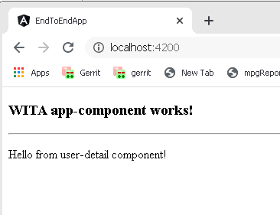
Go to user-detail.component.html and add:
When we save in our IDE (ex: CTRL + S) the code is automatically recompiled and redeployed (except for some structural changes)

Slide 30
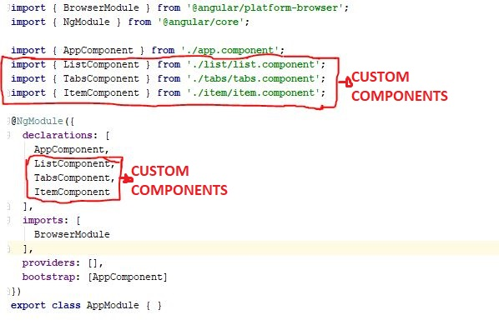
AppModule with multiple new components:

Slide 31
SECOND PART

Slide 32
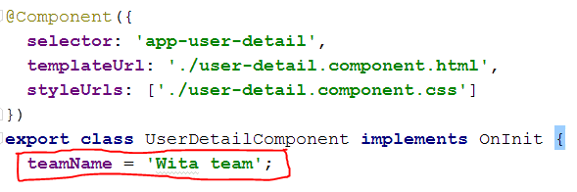

I. Output data via String interpolation
Syntax: {{attributeName}}
The html file contains a template angular will render when the time comes. Because the html is not loaded by the browser we can use elements provided by angular;

Slide 33
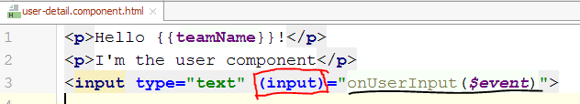
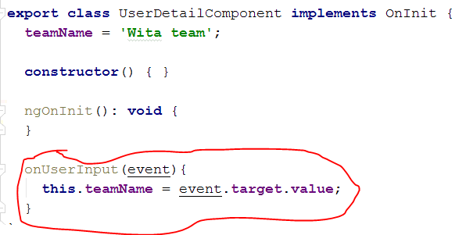
II. Listen to an event: (the name of the event)
Let’s add an input field.
(Events: https://www.w3schools.com/jsref/dom_obj_event.asp )
user-detail.component.ts

Slide 34
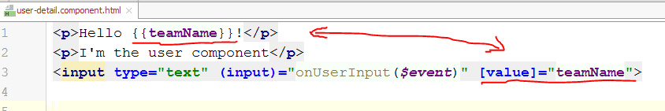
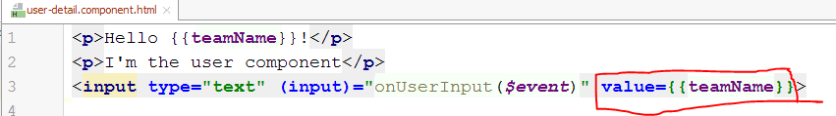
III. Property binding: Binding to DOM/html property
Ex: [value]=”name”
Or:

Slide 35
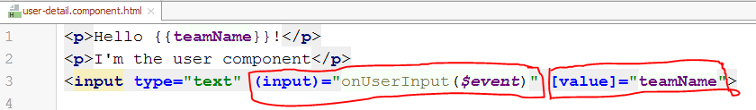
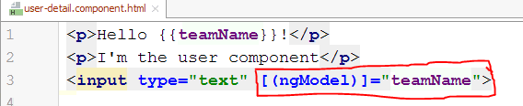
IV. Two way Binding: listen to an event + setting a value
Angular has a Directive for this issue: ngModel
Angular will manage the binding in both directions: it listens to the input event and it binds the value.
It can’t be used on any html element, it needs to have a value property to bind to, and also emit an input event;
Need to import FormsModule to use ngModel

Slide 36
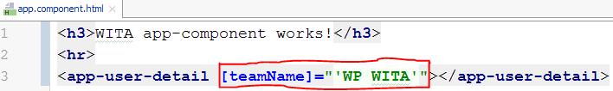
V. Binding Component Properties
Lets use property and event binding on our components;
If we can listen to events to native elements and pass data to the property of native elements, it will be nice if we could pass data to our component, and to listen to events of our own components;
Ex: If we want to pass the initial value for “teamName” from outside of user-detail.component -> from app.component
Bind to “teamName” from outside of the component:

Slide 37
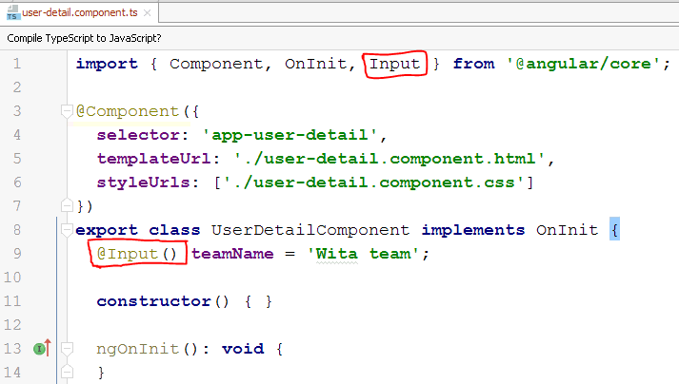
Decorators can be added to a property:
@Input() teamName -> makes “teamName” bindable with @Input()

Slide 38
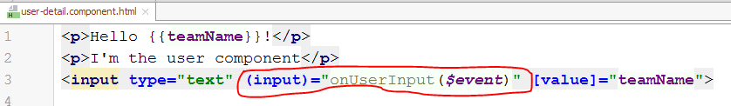
VI. Listen to Custom events. Events of our own components
If we pass a value from outside our component, and we also change that value (provided from the outside of the component) from inside our component, the application can get out of sync.
So, it will be better not to change the value from inside the component, but to pass an event to the parent component and to change it from there, and the parent component will then still pass the updated value to our component because we are binded to it.
The code from user-detail.component.html

Slide 39
So, to recapitulate:
a. the parent component html (the example from “v. Binding Component Properties”), app.component.html:
b. the child component html, user-detail.component.html:

Slide 40
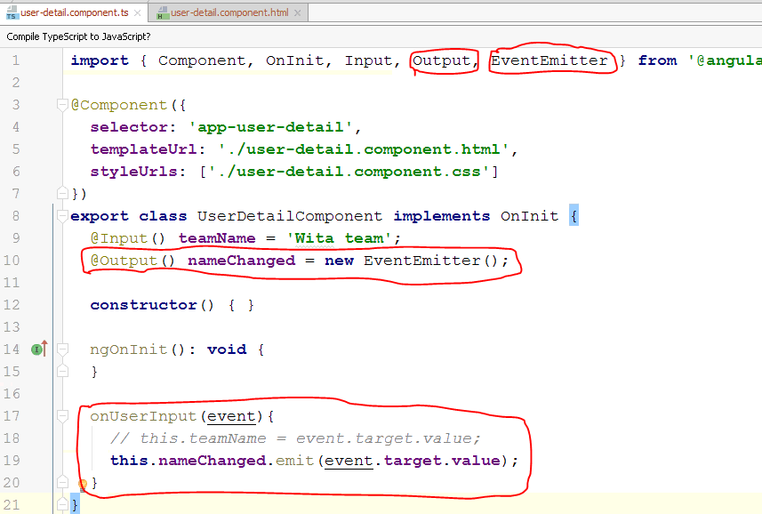
c. the child component .ts, user-detail.component.ts:
I want to emit
an event that I can
listen to from
outside, from my
app.component.html
1.1. @Output()
1.2. our event name
will be nameChanged

Slide 41
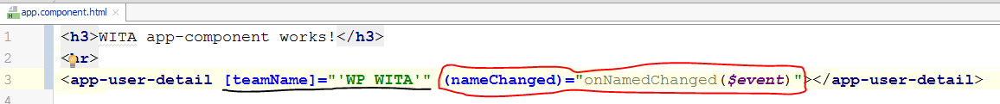
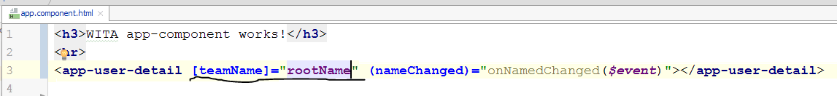
With EventEmitter<string>() we have an object which allows us to emit string events. We will pass a string value and angular will wrap it into an $event object which will be passed on;
Now we want to be able to listen to the event, in our parent component:

Slide 42
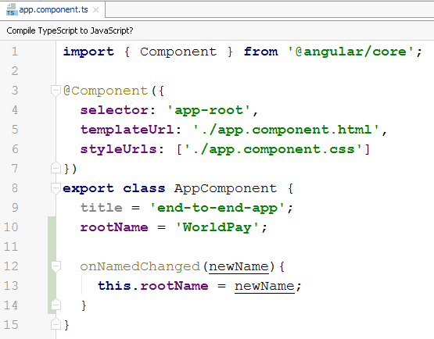
d. In parent .ts, app.component.ts:

Slide 43
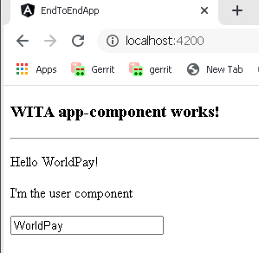
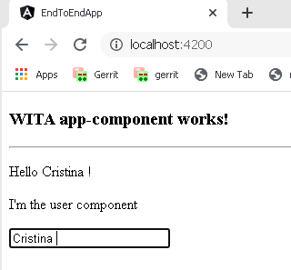
Cc
=> Property and event binding used with our own components in Angular, and allows our components to communicate with each other

Slide 44
Directives
Directives are instructions which you place in your templates;
Components are Directives, and the instructions will be “replace myself with the template from component”
Directives -> allows you to adjust parts of the element it sits on.
Ex [(ngModel)] -> allows you to listen to the input event and to adjust the value;
!!To remind you: in the “”, we write typescript code. Ex: *ngFor="let item of items"

Slide 45
Using CSS Framework with Angular
We will use BOOTSTRAP library (we use ANGULAR MATERIAL, but the installation is the same – when I created the .ppt I was taking into consideration to use Bootstrap)
In the application folder, we open the command line, and we will use npm to install more dependencies:
npm install bootstrap –save
--save it will also add bootstrap as a dependency in our package.json

Slide 46
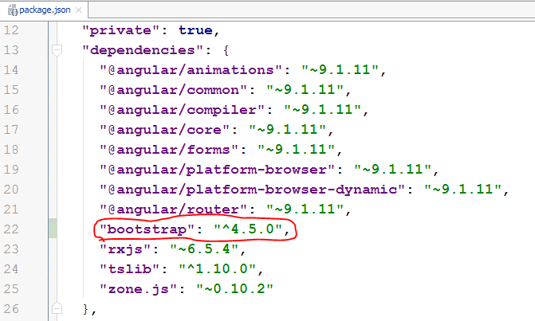
In package.json:

Slide 47
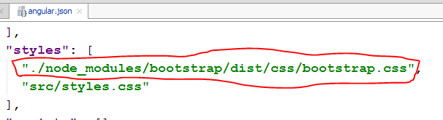
We need to add in angular.json , in styles structure, the path to bootstrap:
See: https://getbootstrap.com/docs/4.5/components/alerts/

