Slide 1
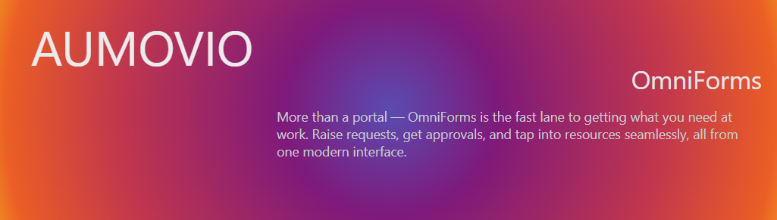
Project Proposition Technical Stack

Slide 2



Project Introduction: OmniForms
Introducing a Lightweight, Secure, and Scalable Platform
Single Sign-On Integration
Seamlessly connects with Azure Active Directory for streamlined authentication and authorization with encrypted communication.
Dynamic Form Builder
Supports multiple question types with rich customization, including conditional visibility and draft-saving capabilities.
Robust Approval Flow
Automated assignment of requests to AD managers, with intuitive approve/reject flows enhancing operational efficiency.

Slide 3
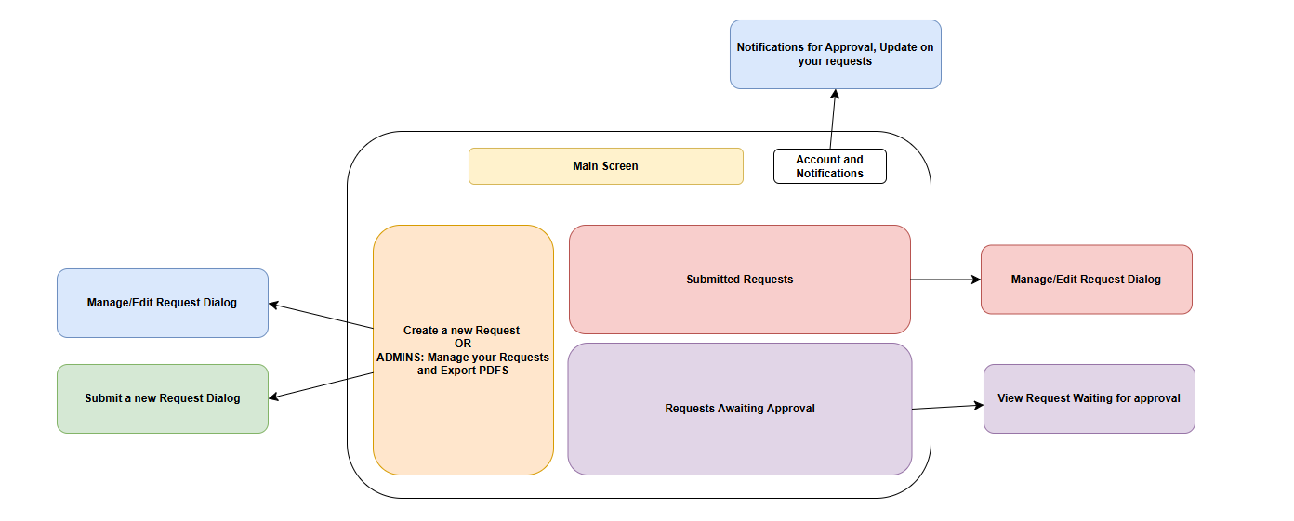
Frontend Schema

Slide 4



OmniForms Technical Architecture
A Modular, Cloud-Native System Design
Cloud-Native Infrastructure
Built on Azure cloud services with Kubernetes orchestration, ensuring high availability, auto-scaling, and resilience. (Code is integrated into Docker images for easy deployment and versioning)
RESTful API Layer
Exposes well-documented endpoints for form submissions, approvals, and reporting; ensures integration flexibility.
Secure Data Storage (Azure CosmosDB)
Implements encrypted NoSQL databases for handling sensitive form data.
Using NoSQL and dynamic fields not only allows us to keep the historical requests as they were, but also reducing document sizes given that fields do not have to be present at all times. Data coherence is done with Reflection at Code level.

Slide 5
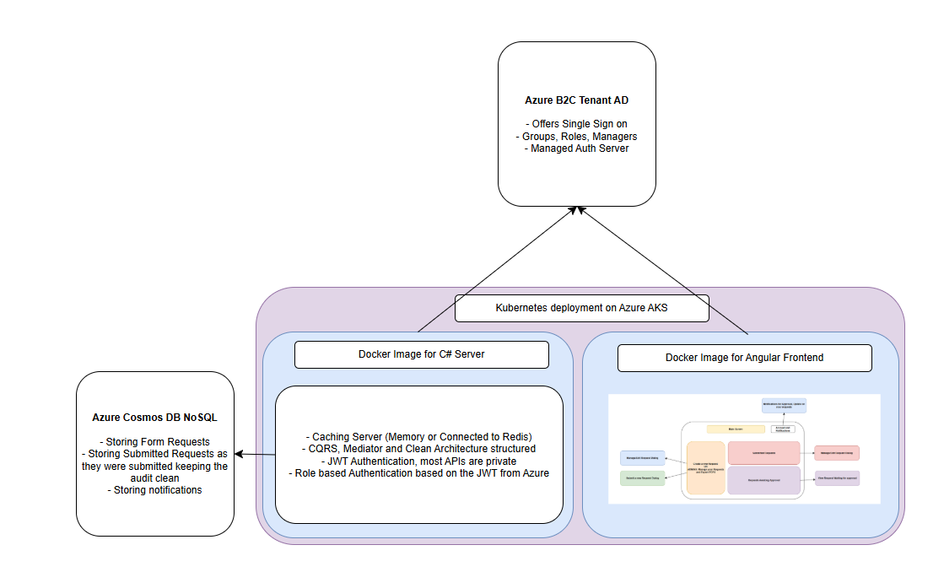
Infrastructure Schema

Slide 6
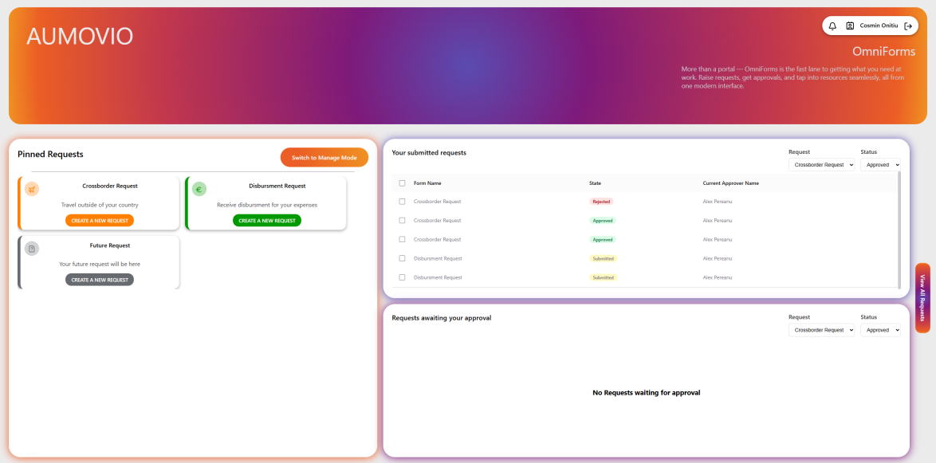
Key Benefits and Value Proposition
Empowering Users and Streamlining Administration
Enhanced User Experience: Intuitive interfaces and real-time feedback ensure high form completion rates and user satisfaction.
Operational Efficiency: Automated workflows and integrated reporting tools drastically reduce manual administrative tasks.
Compliance and Auditability, and Event Systems
Built-in logging and audit trails provide full visibility, supporting compliance with data protection regulations. The application is also equipped with an Event bus (In memory or using the Azure Event bus) that makes easy to keep track of actions, notifications and ramifications.

Slide 7
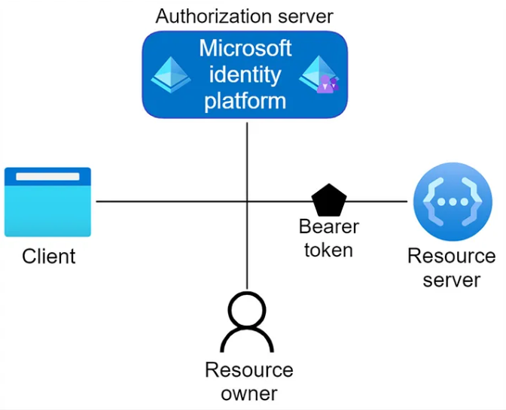
Security Architecture
Enterprise-Grade Security Model
Azure AD Integration: Leverages Azure Active Directory for seamless Single Sign-On (SSO), ensuring enterprise-wide authentication and authorization.
JWT Token Security: Utilizes Azure-issued JWT tokens to authenticate every request, supporting stateless and highly secure communication.
End-to-End Encryption: All data in transit is encrypted using TLS 1.3, ensuring confidentiality and integrity between client and server.
Secure Coding Standards: Implements strict .NET 8 security best practices including input validation, CSRF protection, and role-based access control.

Slide 8
Caching and Performance Optimization
Accelerating OmniForms
Redis or inMemory Caching Layer: Employs Redis or InMemory Cache to reduce database load and deliver ultra-fast response times across high-traffic scenarios.
The cache is divided into 3 layers, each with an invalidation policy.
All Requests
Owned Requests
Id Requests (Which also have Owner as an extra key)
Asynchronous Processing: Implements background event queues for non-blocking operations, enhancing responsiveness during heavy workloads.

Slide 9
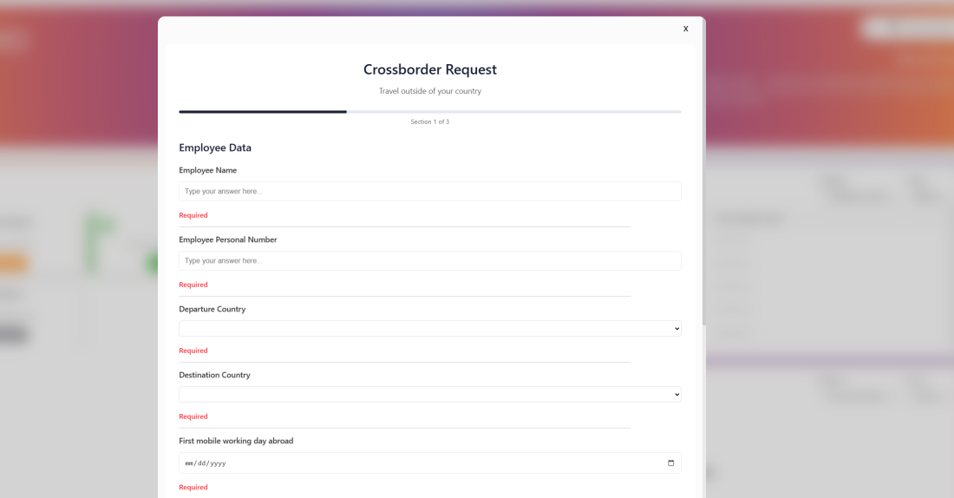
Custom Form Builder Features
Drag-and-Drop Interface: Intuitive UI allowing users to create forms with diverse field types, custom colors and layouts without coding.
(Single Choice, Multi Choice, Text, YesNo, Number, Date and AD (Gives choices from Active Directory)
Advanced Field Logic: Supports conditional visibility, validation rules, and dynamic calculations to adapt forms in real-time.
Draft Logic: Offers option to save requests as draft which can also extend into a template functionality to reuse requests with precompleted fields.
Responsive Design: Forms are mobile-optimized and fully responsive to ensure usability across all devices.

Slide 10

Future Roadmap and Enhancements
Enhanced AD Filtering: Implementation of granular Active Directory filtering to enable targeted user selection and optimized form routing.
Advanced Lookup Capabilities: Dynamic lookups linked to specific organizational datasets, simulating enterprise-grade workflow platforms like K2.
Custom Approval Chains: Flexibility to define multi-tiered approval workflows beyond the default manager model, supporting complex governance.
Cross-Platform Expansion: Plans to extend OmniForms’ accessibility via mobile-first design and deeper integration with Microsoft Teams and Slack.

