Slide 1


Sponsors

Slide 2

Sponsors

Slide 3


Slide 4
Spring Data: Get rid of boilerplate DAOs
„Winners never quit & quitters never win.”
- Vince Lombardi
Cosmin Alexandru SPÎNU
Software Developer @ TSS-Yonder
CodeCamp, apr. 2016

Slide 5
meetAudience();
What brings you here ?
Who heard about Spring Data ?
x code campers
Who worked with Spring Data ?
x code campers

Slide 6
why();
Access Layer implementation with specific APIs
A lot of ways for implementing DAOs
Boilerplate

Slide 7
searchSolution();
Spring Data JPA ofc
Easier way to develop apps using RDB or newer technologies
JPA, MongoDB, Redis, Solr, REST, Cassandra, ElasticSearch and many others

Slide 8
printCurrentWay();
Persistence mechanism from EJB
JDBC API
ORM – Hibernate
JPA

Slide 9
printNextWay();
Spring Framework
Provides sophisticated support for traditional data access techs
Simplified infrastructure setup and exception translation
The transactional mechanism

Slide 10
printNextWay();
Spring Data
First release @ SpringOne 2010
Provides a simple and consistent approach for working with data persistence
Reduces the necessary effort for having the persistence layer in place

Slide 11
getRepository();
The goal of Spring Data repository abstraction is to significantly reduce the amount of boilerplate code required to implement data access layers for various persistence stores.
– This is what Spring officialy says.
The central interface for repository abstraction is ... Repository ☺

Slide 12
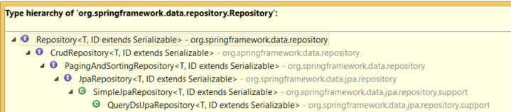
getRepository();

Slide 13

getRepository();
Configuration ?

Slide 14
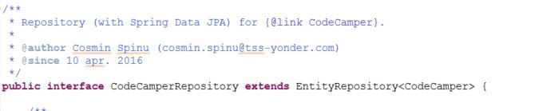
getRepository();

Slide 15
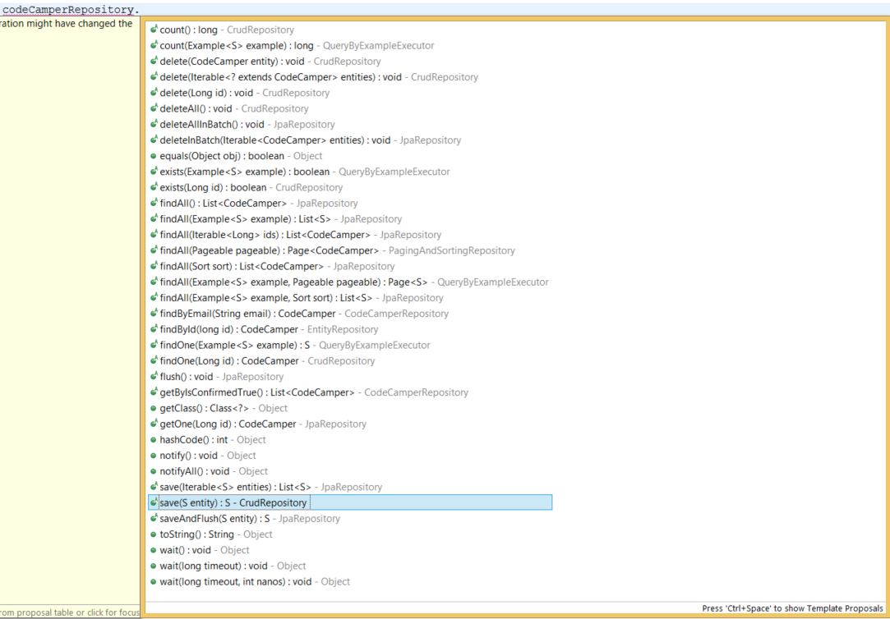
getRepository();

Slide 16
findBySomething();
Query methods
findBy, getBy, queryBy, removeBy, deleteBy, countBy
findDistinctBy, findFirst3, findTop3
findByFirstNameAndLastNameOrderByAgeDesc
findByDocumentDocumentDate, findByDocument_DocumentDate

Slide 17
findBySomething();
Keywords
And, Or, Is, Equals, Between, LessThan, LessThanEqual, After/Before, IsNull, IsNotNull, Like, NotLike, StartingWith, Containing, OrderBy, Not, In, True, False, IgnoreCase, Regex etc.
Return types
Void, Primitives, Wrapper types, T, Iterator<T>, Collection>T>

Slide 18
queryAnnotation();
@Query
Supports both, JPQL and SQL queries
It overrides the query method behaviour
There is no naming convention

Slide 19
namedQuery();
Named Queries
Define them in properties files, annotation (@NamedQuery , @NamedNativeQuery) or orm.xml file
CodeCamper.findByEmailNamed=„...” in a property file
<named-query> or <named-native-query> in orm.xml
There is no naming convention

Slide 20
sortAndPage();
Keyword: OrderBy
For @Query you can use ORDER BY in the query string
Sort Class
Extend PagingAndSortingRepository

Slide 21
customRepo();
Create an interface CustomRepository
Implement the interface needed methods in CustomRepositoryImpl and annotate it with @Repository
In your main repository extend the CustomRepository

Slide 22
advanced();
Supports also Criteria API in Custom repos
Dynamic queries (Criteria API - the standard way in JPA)
Supports advanced quering with QueryDSL
ofc instead of Criteria API ☺
Caching is configurable as in any other Spring/Hibernate project

Slide 23
audit();
@CreatedBy , @LastModifiedBy – who ?
@CreatedDate, @LastModifiedDate – when ?
Spring Security integration

Slide 24
demo();
https://github.com/cosminspn/cc-apr-2016/
https://github.com/cosminspn/cc-apr-2016/tree/master/source/spring-data-example

Slide 25
removeFromTheProject();
When Spring Data does not bring value ?
A lot of JOIN queries
DB which do not use FKs
When even the CRUD methods should be overriden
May be other situations ...

Slide 26
hopeForTheBest();
Who heard about Spring Data ?
x code campers
Who worked with Spring Data ?
x code campers

Slide 27
thankYou();
THANK YOU !
QUESTIONS ?

Slide 28


Slide 29

Please fill the online evaluation form after event

